Slide 1

LPC10
2.4kbps federal standard in speech coding
ECE 8873 Data Compression & Modeling
03/17/2004
Soo Hyun Bae
School of Electrical & Computer Engineering
Georgia Institute of Technology
<soohyun@ece.gatech.edu>

Slide 2
Agenda
Taxonomy of Speech Coders
LPC10 Properties
Voicing Classification
Levinson-Durbin Recursion
Pitch Detection
Synthesize Speech
Speech Coder Comparision

Slide 3
Linear Prediction
Speech Coder Standard
FS1015-LPC10 | Coefficient 10
FS1016-CELP | Code Excitation
MELP | Mixed Excitation
IS-54 VCELP | Vector Sum Excited
IS-96 QCELP | QualComm Code Excited
LD-CELP G.728 | Low-Delay Code-Excited
G.729 CS-ACELP | Conjugate-structure Algebraic-Code-Excited
LP
LP
LP
LP
LP
LP
LP

Slide 4
Where is LPC10?
Taxonomy of Speech Coders
Speech Coders
Waveform Coders
Vocoders
LPC10
Time Domain : PCM. ADPCM
Frequency Domain : Sub-band coders, Adaptive transform coder
Linear Predictive Coder
Formant Coders
Waveform Coders : Preserve the signal waveform not speech
Vocoders : Analyze speech, extract parameters, use parameters to synthesize speech

Slide 5
Properties (1)
So called LPC10 because 10 LP coefficients are used
Bandwidth: 2.4kbps
Samples/frame : 180 samples
Bits/frame: 54 bits
Frame Size: 22.5ms = 44.44 frames/sec
Target stream : 8khz sampling rate, 16bit quantization

Slide 6
Properties (2)
“Buzzy” since noise through parameter updates
Regularly voiced excitation is unnatural, makes some jitter
Voicing error produce significant distortions
Only models speech, doesn’t work if backgound noise. Not suitable to mobile phone application

Slide 7
Encoded stream
 | LP Coefficients |  |  | Pitch&Voicing |  | Energy
0 |  |  | 41 |  | 48 |  | 53
- The remaining 1 bit is for synchronization
LP Coefficients: Levinson-Durbin Recursion
Pitch & Voicing : Causal & Noncausal Prediction Gain
Energy : Low-Band Speech Energy

Slide 8
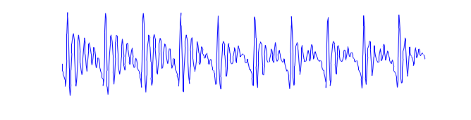
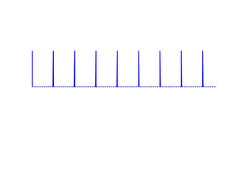


Vocoder
Encoder
Original Speech
Analysis:
Voiced/Unvoiced decision
Pitch Period (voiced only)
Signal power (Gain)
Pitch
Period
Decoder
Signal Power
Pulse Train
V/U
G
Vocal Tract
Model
Synthesized Speech
Random Noise

Slide 9
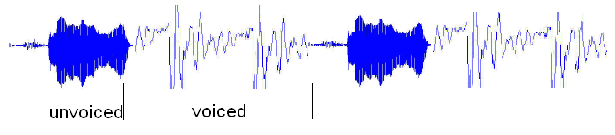

Voicing Classification(1)
Voiced Source
  Generated by vocal cords’ vibrations
  Periodic, spacing is the pitch,
Unvoiced Source
  Generated without vibrations
  Excitation is modeled by a White Gaussian Noise source
  No pitch
How to discriminate?
Fisher’s Method

Slide 10
Voice Classification (2)
Compute R(0)
No
Yes
Compute LPC and Pitch Detection
Silence Period
R(0) > R(0) for noise ?

Slide 11
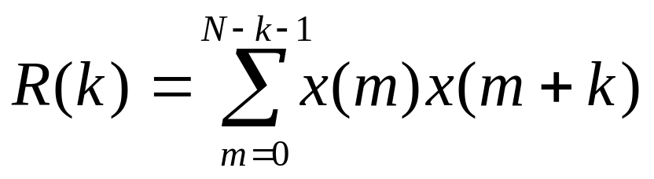
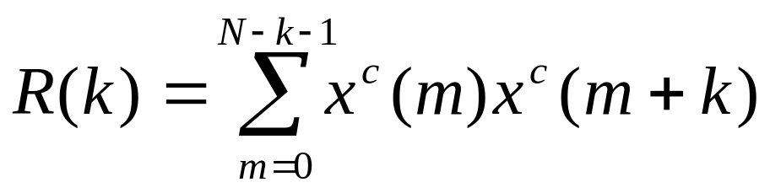
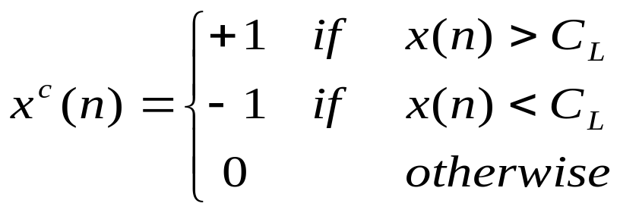
Pitch & Voicing (1)
If x(n) is periodic in N, R(k) is also periodic in N
Hard to compute

Slide 12
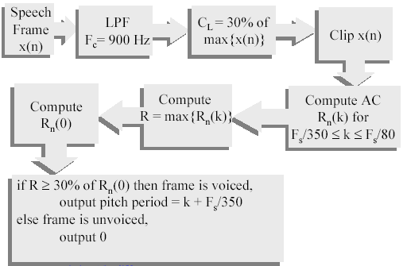
Pitch & Voicing (2)

Slide 13
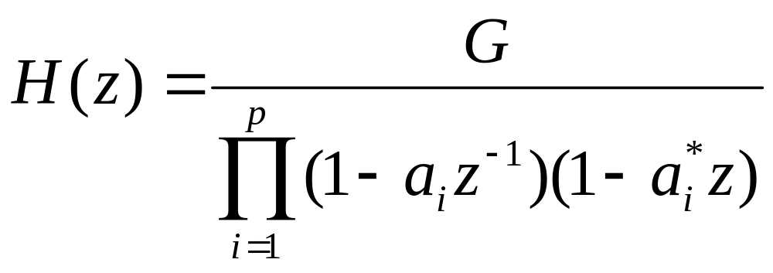
Reflection Coefficient (1)
Human auditory system is more sensitive to poles then to zeros
Where G is the gain, p is the order, a’s are poles

Slide 14
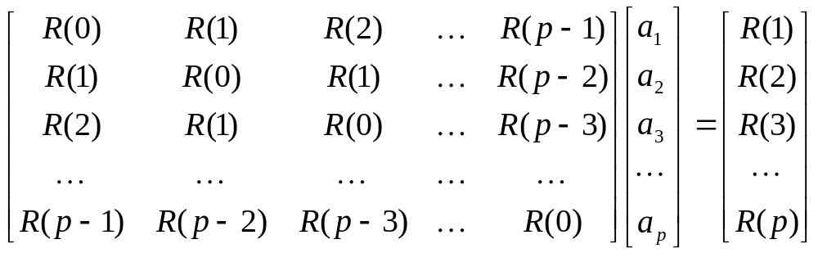
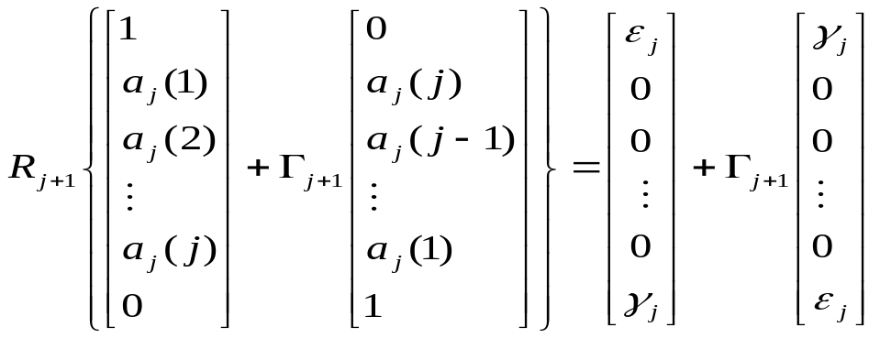
Reflection Coefficient (2)
Levinson-Durbin Recursion for all-pole model
Toeplitz

Slide 15
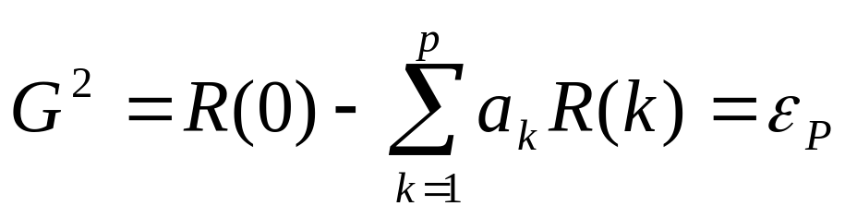

Energy – Gain Coefficient
From autocorrelation matching property, G is calculated from MSE given by Levinson-Durbin Revursion
Transmit the coefficient G
Recall

Slide 16
Synthesize speech
Recall the Encoder/Decoder structure
Pitch
Period
Decoder
Signal Power
Pulse Train
V/U
G
H(z)
Synthesized Speech
Random Noise

Slide 17
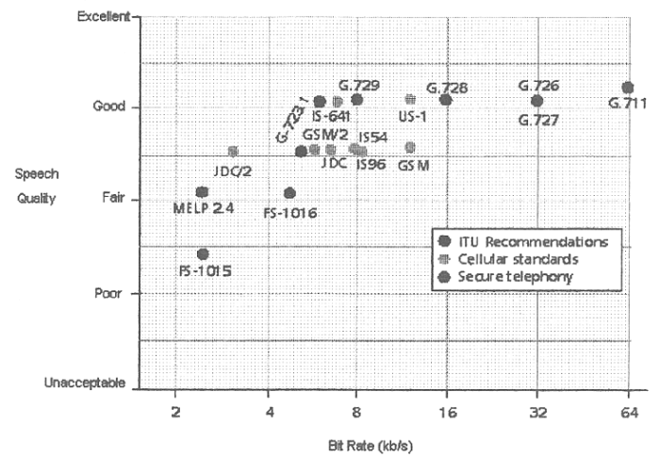
Speech Coder Comparison
Original

Slide 18
References
Welch V.C., Tremain T.E., Campbell J. P. Jr., “A comparison of US Government standard voice coders”, MILCOM’89, Vol. 1, pp269-273, 1989.
Cox R. V., “Three New Speech Coders from the ITU Cover a Range of Applications”, Comm. Magazine of IEEE, Vol. 35, pp40-47, 1997
Campbell J. P. Jr., Tremain T.E., “Voiced/Unvoiced Classification of Speech with Applications to the U.S. Government LPC-10E Algorithm”, ICASSP86, Vol. 11, pp473-476, 1986
http://www.ee.ucla.edu/~ingrid/ee213a/speech/speech.html
http://mia.ece.uic.edu/~papers/WWW/MultimediaStandards/
http://www.ecse.rpi.edu/Homepages/shivkuma/
http://www.eee.strath.ac.uk/r.w.stewart/index2.htm
http://web.syr.edu/~gsriniva/tech/docs/
http://www.speech.cs.cmu.edu/comp.speech/Section3/Software/celp-3.2a.html
http://www.arl.wustl.edu/~jaf/lpc/
http://www.ecsl.cs.sunysb.edu/cse660/speech.html

