Slide 1
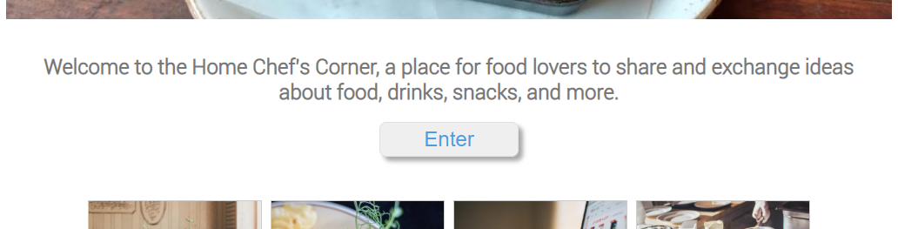
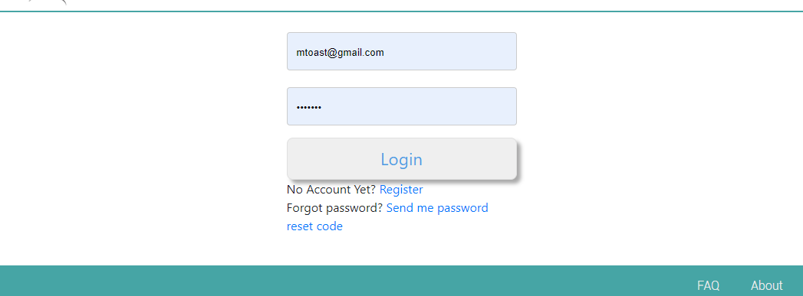
Index.html
hcc-btn-fullCol
login.html
register.html
passwd_reset_req.html
passwd_reset.html
hcc-btn-fullCol

Slide 2
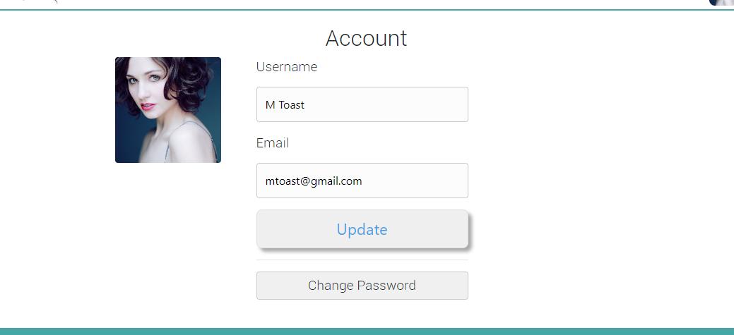

posts.html
hcc-btn-sm
account.html
hcc-btn-fullCol
new_post.html
hcc-btn

Slide 3
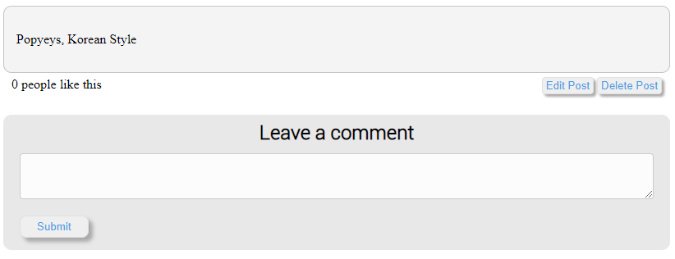
view_post.html
hcc-btn-sm
hcc-btn-lg

