Slide 1


Slide 2

FOLIO ACQUISITIONS
(Order Up, Please)
June 3, 2025

Slide 3
Your Host:
Stephen Strohl, Associate Director, Member Services
steve@mobiusconsortium.org
Everything here is either on or will soon be “ON THE WIKI”
Go to: https://wiki.mobiusconsortium.org/
Select the FOLIO “Book” and go to ACQUISITIONS & SERIALS

Slide 4


We are moving to Ramsons next month
Enhancements will be coming (we’ll get to that)
Some workflows will improve
Sunflower will be coming by the end of 2025 (we believe)
June 3, 2025
Notes:
ECS – ENHANCED CONSORTIAL SUPPORT

Slide 5

Background
There is a lot of background to go over here.
General Orders Settings
PO Number Settings
Settings Related to Inventory Interactions
Notes:
A lot of background and settings that must be setup.
This is kind of obvious really – things like your setup, your vendors, funds, FY, and more.
You need to have that established before you can jump on into Ordering things.
3 main areas we will go over
GENERAL:
PO NUMBER:
INVENTORY INTERACTIONS:

Slide 6
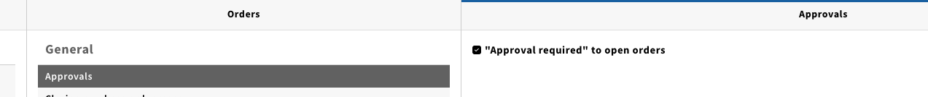
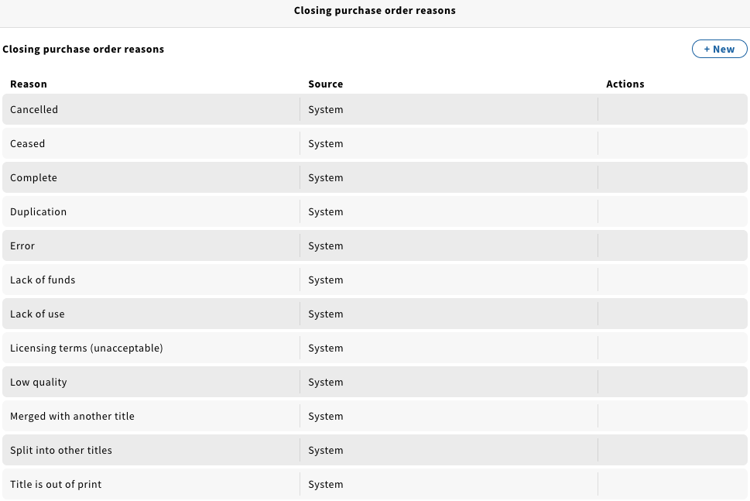
Let’s Go…
To Begin with -> Apps > Settings > Orders
Notes:
Navigate over to APPS > SETTINGS > ORDERS
Top to bottom – APPROVALS (yes)
This is something you do if you want a separate setup before things can be sent off. Typical in larger libraries.
CLOSING PURCHASE ORDER REASONS – some are hard coded, but some can be added with the NEW button.

Slide 7
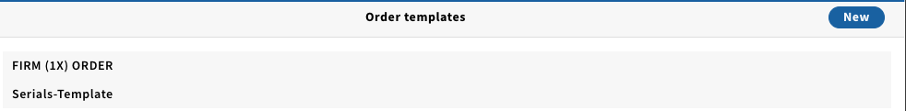
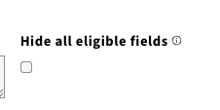
Let’s Go…
To Begin with -> Apps > Settings > Orders
Notes:
Navigate over to APPS > SETTINGS > ORDERS - show FIRM (1X) ORDER and describe.
ORDER TEMPLATES – streamline workflow and defaults.
Create using NEW
HIDE ALL ELIGIBLE FIELDS will mask all non-mandatory fields, can selectively show some fields by unselecting the EYEBALL cross/out slashed eyeball

Slide 8
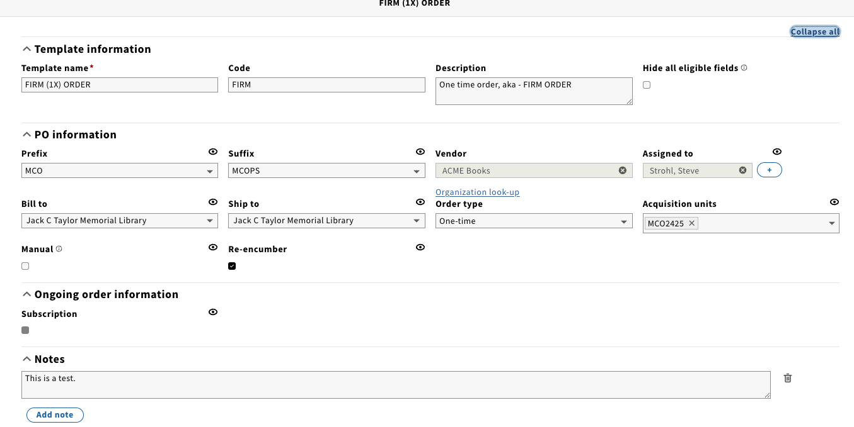
Let’s Go…
To Begin with -> Apps > Settings > Orders
Notes:
Navigate over to APPS > SETTINGS > ORDERS
ORDER TEMPLATES – streamline workflow and defaults.
Can customize template for types of orders / vendors you use, etc. Predictable, common values in question.
Can edit / duplicate / delete

Slide 9
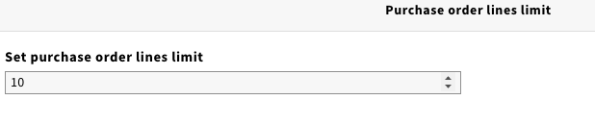
…SETTINGS>ORDERS
To Begin with -> Apps > Settings > Orders
Notes:
Must set a limit – I reduced mine to 10.
Configuring the upper limit on how many items can be on a single PO. PO is the “master record” here.
Limit is from 1-999.

Slide 10
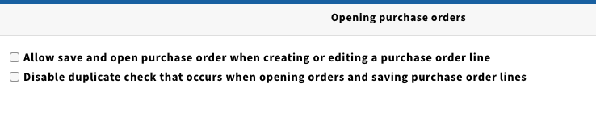
…SETTINGS>ORDERS
To Begin with -> Apps > Settings > Orders
Notes:
First option – you are increasing what you can do when you save a PO. Save and keep or save and keep working with it on individual line items.
This is a workflow / permissions consideration.
Second option – will it look at the existing PO values and warn of a duplicate. Helps to prevent accidental duplicates.

Slide 11
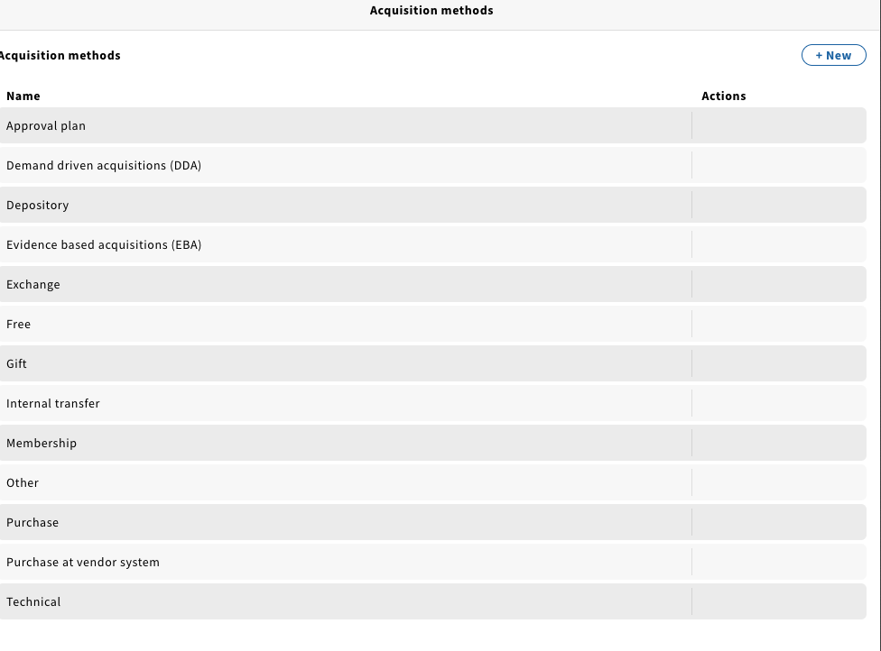
…SETTINGS>ORDERS
To Begin with -> Apps > Settings > Orders
Notes:
Many defaults – can add additional Acquisition Methods

Slide 12
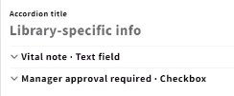
…SETTINGS>ORDERS
To Begin with -> Apps > Settings > Orders
Notes:
Custom Fields can be used in a number of ways – on PO AND on PO LINES. If you want to keep track of something and it isn’t in the UI or it is special to you, this is a good option.
Viewable / Editable / contents of which can be searched.
Use w/Caution - mandatory fields.
Can be re-ordered in a number of ways.
Many options.

Slide 13

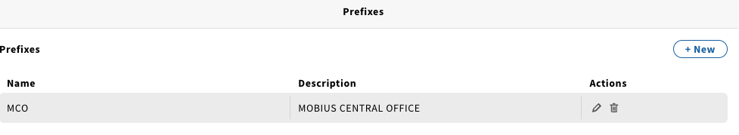
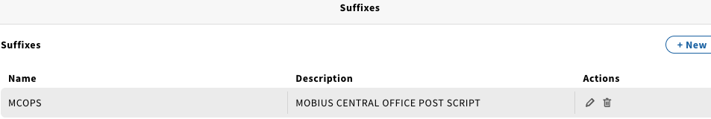
…SETTINGS>ORDERS
To Begin with -> Apps > Settings > Orders
Notes:
Setting w/PO Numbers
System will do it on its own – can specify prefix and suffix to PO’s. Optional values. Great if multiple libraries or departments use ACQ.
There is a 7-character limit for prefixes and suffixes and 22 characters in total.

Slide 14
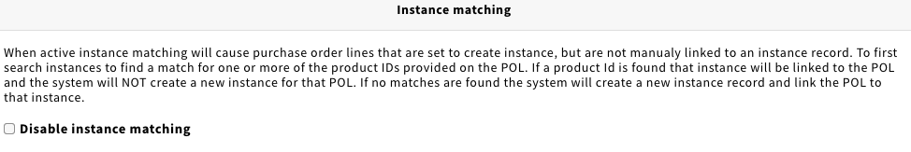
…SETTINGS>ORDERS
To Begin with -> Apps > Settings > Orders
Notes:
For INSTANCES you use – can append add ISBN’s, ISSN’s, etc.
We need to link Orders to Instances – if you DISABLE – you need to tell the system.

Slide 15
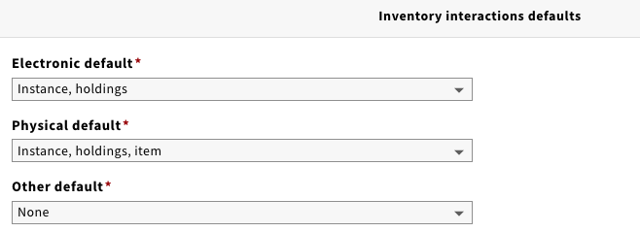
…SETTINGS>ORDERS
To Begin with -> Apps > Settings > Orders
Notes:
Options on what prompts and/or workflows one gets when they are working with various types of material(s).
Can be overridden at the point of contact.

Slide 16
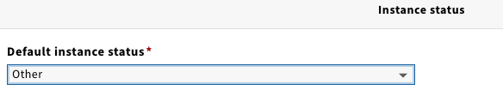
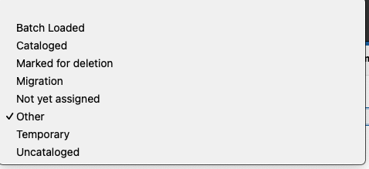
…SETTINGS>ORDERS
To Begin with -> Apps > Settings > Orders
Notes:
Options derived from INVENTORY settings.
Assigned at the point when the order is opened.

Slide 17
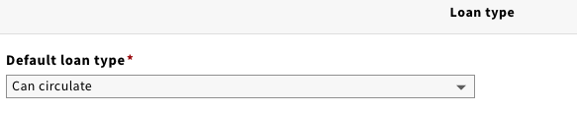
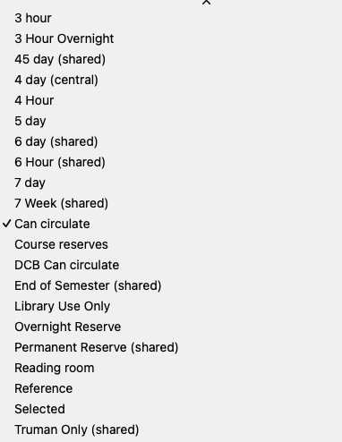
…SETTINGS>ORDERS
To Begin with -> Apps > Settings > Orders
Notes:
Options derived from INVENTORY settings.
Assigned at the point when the order is opened.
Can be updated as needed.
STOP – we now show DATA IMPORT Field Mapping Profiles

Slide 18
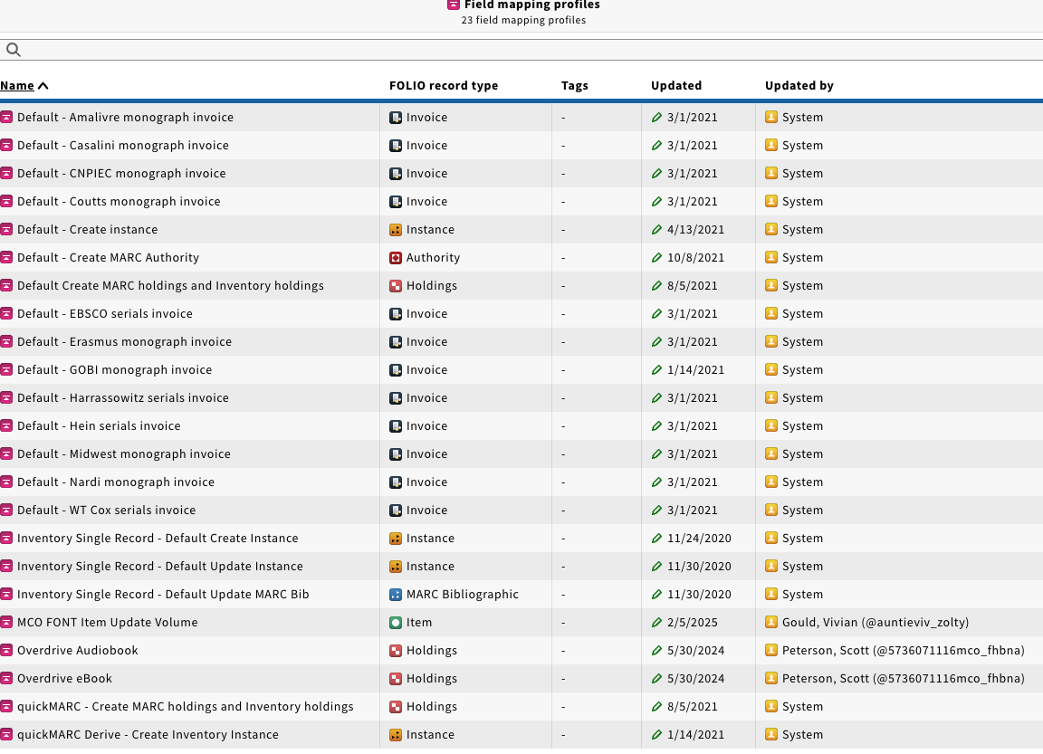
Another Option
To Begin with -> Apps > Settings > Data Import > Field Mapping Profiles
Notes:
OK – so the setup is done.
While we are not going to do this today, here’s one way to start the process.
You can import Orders from MARC.
Navigate over; show these screens – edit the DEFAULT – CREATE INSTANCE
So, if you are importing records and want to extract and create orders, you can do this, and we can help you.

Slide 19
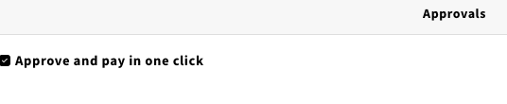
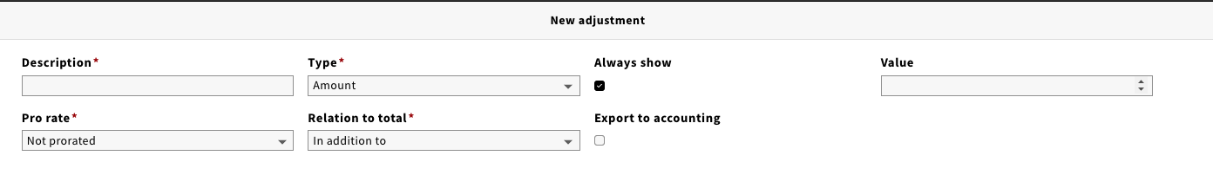
…SETTINGS>INVOICES
To Begin with -> Apps > Settings > Invoices
Notes:
General Settings - APPROVALS
Combine or not – if you do, you still get prompted.
With ADJUSTMENTS
Account for extra costs – taxes, shipping, VAT, etc… – can distribute across lines or pay it separately - can pre-set as a whole.
Do you always show the options or not? Do you do it case by case?
Can export to accounting.

Slide 20
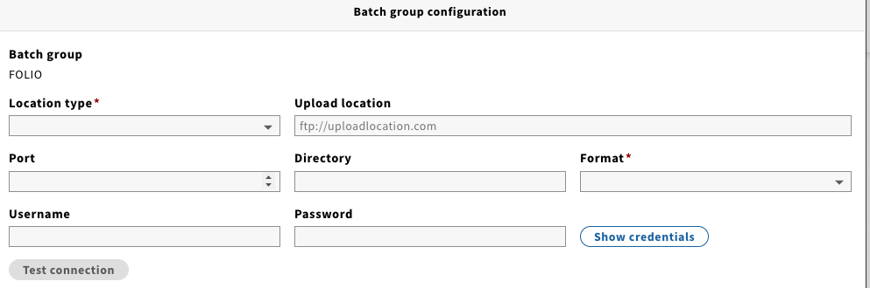
…SETTINGS>INVOICES
To Begin with -> Apps > Settings > Invoices
Notes:
This is for export vouchers - controlling the config and output in various batches.
Must be triggered manually right now.

Slide 21
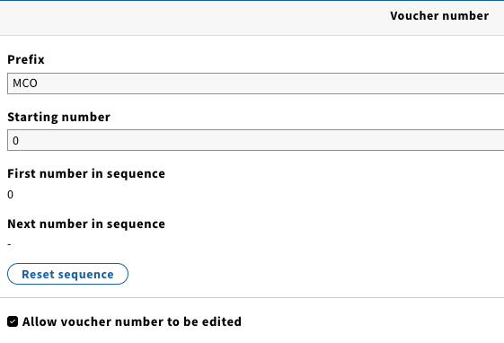
…SETTINGS>INVOICES
To Begin with -> Apps > Settings > Invoices
Notes:
Can affiliate prefix with vouchers

Slide 22
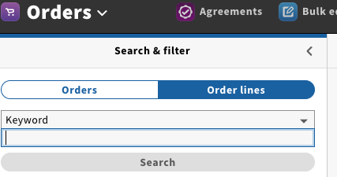
APPS>ORDERS
Notes:
APPS > ORDERS
Search and Filter options
I can find Orders, PO Lines, Related Invoices – I can always click more to see much more information about that part of the transaction

Slide 23
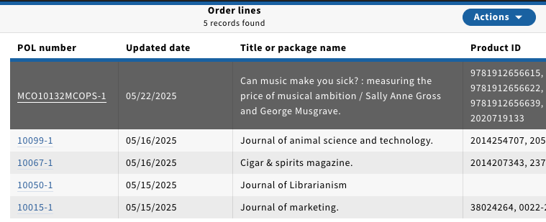
APPS>ORDERS
Notes:
APPS > ORDERS > ORDER LINES
See: ”Can Music Make You Sick?”
Or look for m

Slide 24
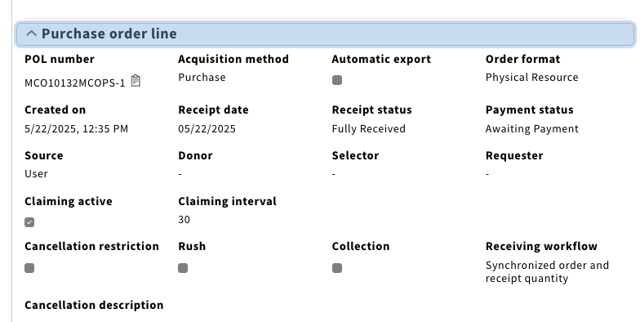
APPS>ORDERS
Notes:
See: ”Can Music Make You Sick?”
Or look for m
======
Please note the PO Line RECEIVING WORKFLOW – Synchronized vs Individual (Serial)

Slide 25
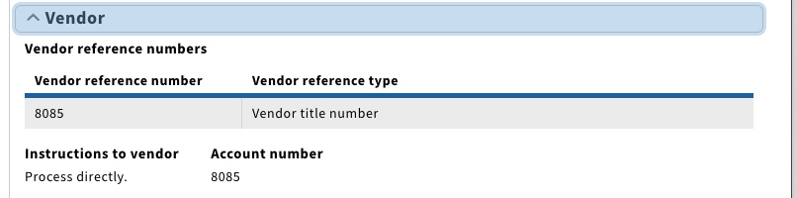
APPS>ORDERS
Notes:
See: ”Can Music Make You Sick?”
Or look for m
======
Please note the PO Line VENDOR – Ref Number that can be assigned w/this vendor.

Slide 26
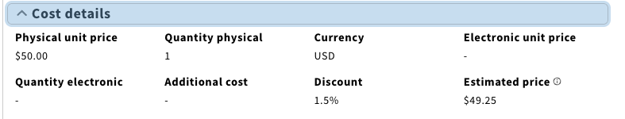
APPS>ORDERS
Notes:
See: ”Can Music Make You Sick?”
Or look for m
======
Please note the PO Line COST DETAILS – Amount, Discounts, and more.

Slide 27
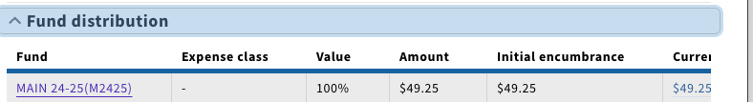
APPS>ORDERS
Notes:
See: ”Can Music Make You Sick?”
Or look for m
======
Please note the PO Line FUND DISTRIBUTION – All on one or split out.

Slide 28

APPS>ORDERS
Notes:
See: ”Can Music Make You Sick?”
Or look for m
======
Please note the PO Line LOCATION affiliated with the order (template)

Slide 29
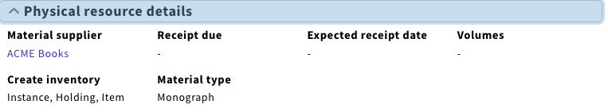
APPS>ORDERS
Notes:
See: ”Can Music Make You Sick?”
Or look for m
======
Please note the PO Line PHYSICAL RESOURCES details – vendor, info and what kind of records will be created.

Slide 30
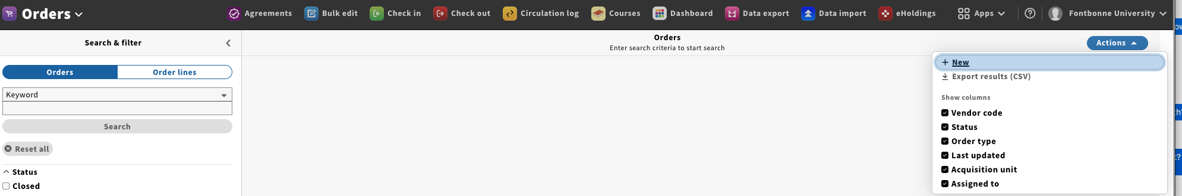
APPS>ORDERS
Notes:
Now, let’s create an ORDER.
ORDERS > ACTIONS > NEW > Template - see fields.
Show different ORDER TYPES – subscriptions, etc…
ONE - TIME ORDER
Once you have the new ORDER you need to link a new PO Line Item to it.
You can link to something already in your collection OR you can key in a brief, new record (or you can go to INVENTORY and Import a record w/a LCCN
EXISTING TITLE - 2020719320 Food riots, food rights and the politics of provisions
IMPORT – 2025938854 Pope Leo XIV : the first American Pope / Grace Hansen.
https://lccn.loc.gov/2025938854
IMPORT – 2020037594 All things Arabia : Arabian identity and material culture
https://www.loc.gov/item/2020037594/

Slide 31
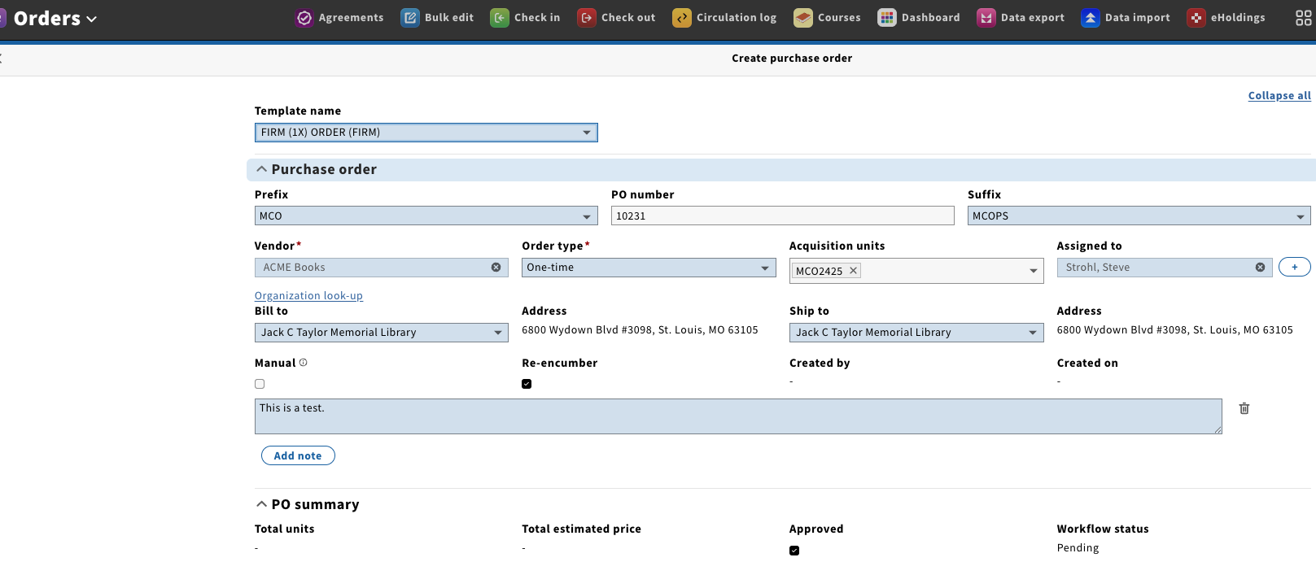
APPS>ORDERS
Notes:
Now, let’s create an ORDER.
FOR SOMETHING THAT ISN’T IN THE CATALOG
ORDERS > ACTIONS > NEW > Template - see fields.
Show different ORDER TYPES – subscriptions, etc…
ONE - TIME ORDER

Slide 32
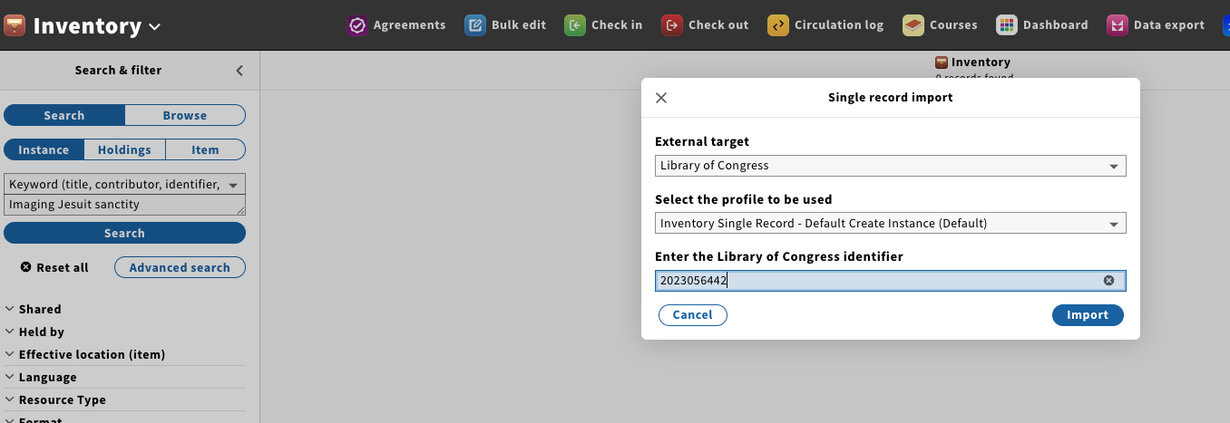
APPS>INVENTORY
Notes:
SEARCH / INSTANCE / KEYWORD
If not there, ACTIONS / IMPORT / LCCN

Slide 33
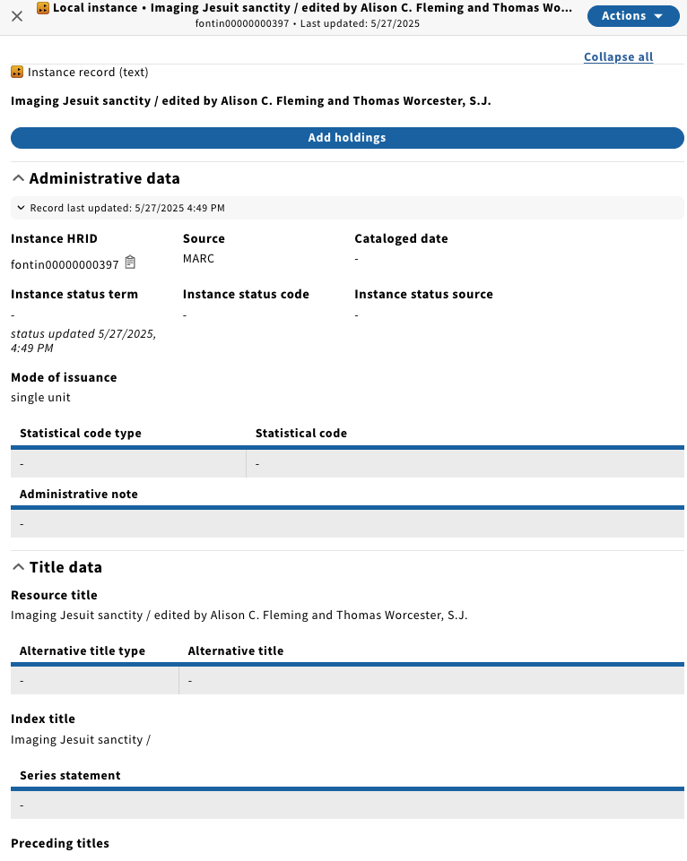
APPS>INVENTORY
Notes:
GO TO INVENTORY
SEARCH / INSTANCE / KEYWORD
If not there, ACTIONS / IMPORT / LCCN
Record created in the system.

Slide 34
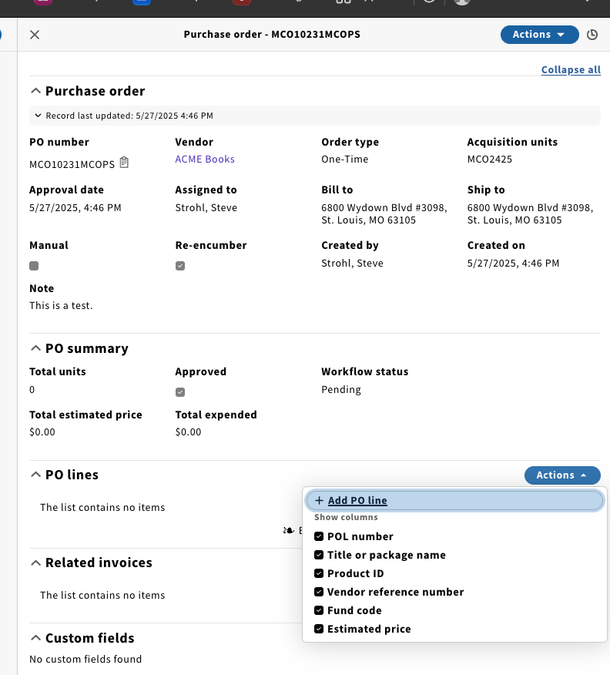
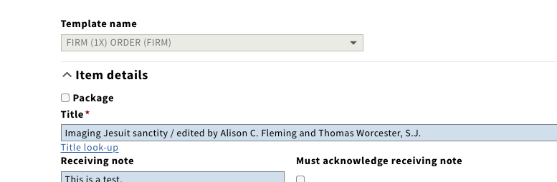

APPS>ORDERS
Notes:
SWITCH BACK TO ORDERS
Scroll back UP and do the TITLE LOOK UP.
See FIELDS. FIELDS WILL TELL YOU WHAT IS MANDATORY.
Get to the end – SAVE & CLOSE or SAVE & OPEN ORDER.

Slide 35
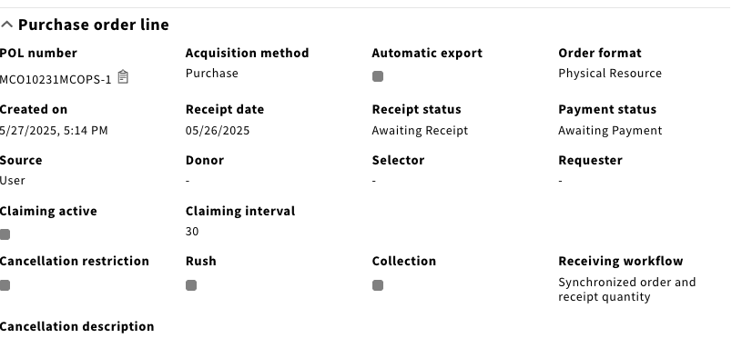
APPS>ORDERS
Notes:
ORDER IS AWAITING RECEIPT / AWAITING PAYMENT
See RECEIVING WORKFLOW

Slide 36
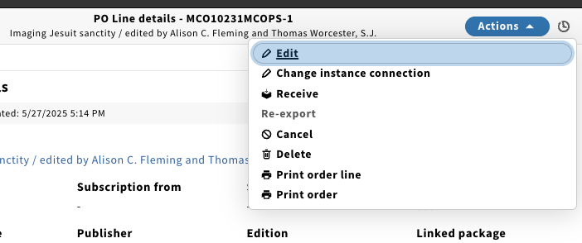
APPS>ORDERS
Notes:
From here – go right to RECEIVE

Slide 37
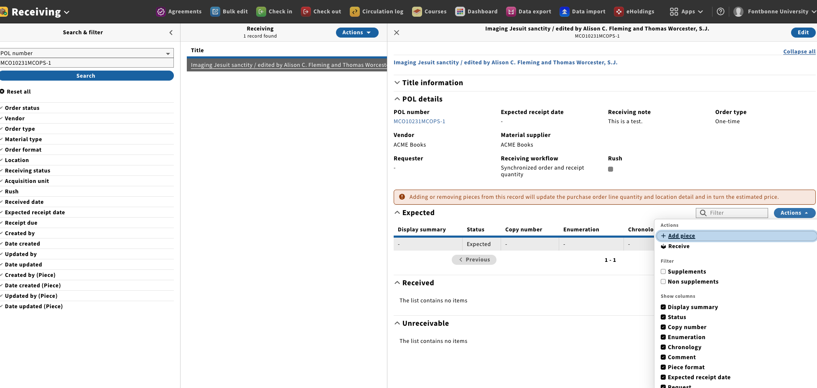
APPS>RECEIVE
Notes:
From here – go right to RECEIVE

Slide 38
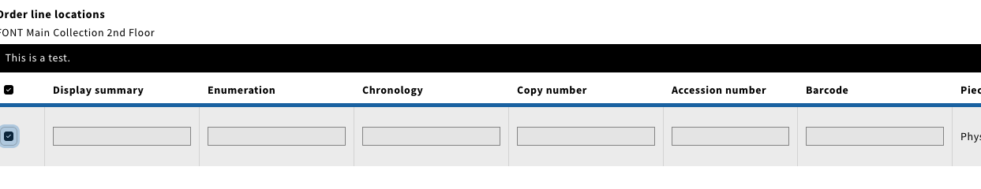
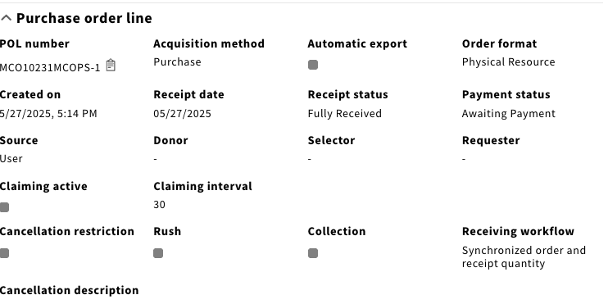
APPS>RECEIVE
Notes:
From here – go right to RECEIVE
Fill in fields.
Once you do that – you go back and see it is FULL RECEIVED.

Slide 39
APPS>RECEIVE
Notes:
From here – go right to RECEIVE
Fill in fields.
Once you do that – you go back and see it is FULL RECEIVED.

Slide 40
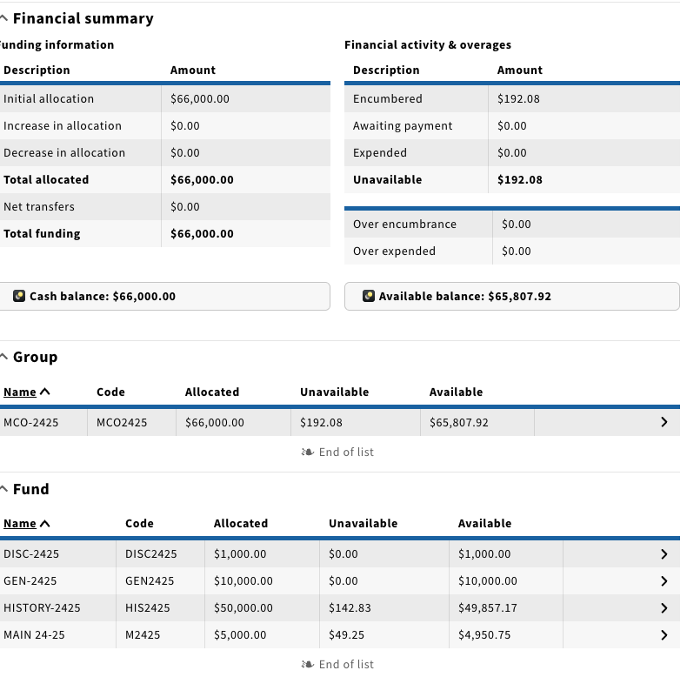
APPS>FINANCE
Check LEDGER “m” – Name is MCO2425
Notes:
See FUNDS, BELOW.

Slide 41
Coming Up…
Ramsons (ACQUISITIONS):
Finance
Display total credited amount separate from total expended amount on budget
Filter by encumbrance status
Display currency on fiscal year and budget records
Notes:
MU: https://libraryguides.missouri.edu/folio/ramsons
https://folio-org.atlassian.net/wiki/spaces/REL/pages/399081833/Sunflower+R1+2025+Notes+on+functionality

Slide 42
Coming Up…
Ramsons (ACQUISITIONS):
Finance
Display total credited amount separate from total expended amount on budget
Filter by encumbrance status
Display currency on fiscal year and budget records
Notes:
MU: https://libraryguides.missouri.edu/folio/ramsons
https://folio-org.atlassian.net/wiki/spaces/REL/pages/399081833/Sunflower+R1+2025+Notes+on+functionality

Slide 43
Coming Up…
Ramsons (ACQUISITIONS):
Invoices
Duplicate invoices
Orders
Custom POL fields available for CSV export
Custom field filter for POLs
Autoscrolling when adding POL fixed
Notes:
MU: https://libraryguides.missouri.edu/folio/ramsons
https://folio-org.atlassian.net/wiki/spaces/REL/pages/399081833/Sunflower+R1+2025+Notes+on+functionality

Slide 44
Coming Up…
Ramsons (ACQUISITIONS):
Receiving
Create a configurable list of users for nonstandard handling of pieces in receiving
Print routing list for physical pieces in receiving
Support binding of serial issues into bound volumes
Notes:
MU: https://libraryguides.missouri.edu/folio/ramsons
https://folio-org.atlassian.net/wiki/spaces/REL/pages/399081833/Sunflower+R1+2025+Notes+on+functionality

Slide 45
Coming Up…
Sunflower (ACQUISITIONS):
Finance
Libraries can now allocate money in batch on a per-ledger basis.
Batch allocation supports both allocations from within the UI and via CSV upload
Allocations must be validated in the UI before they can be committed
Notes:
MU: https://libraryguides.missouri.edu/folio/ramsons
https://folio-org.atlassian.net/wiki/spaces/REL/pages/399081833/Sunflower+R1+2025+Notes+on+functionality

Slide 46
Coming Up…
Sunflower (ACQUISITIONS):
Invoices
Invoices now support full history of edits for invoices and invoice lines
“Save and keep editing” button allows users to save records and continue working on them without having to re-open that record.
Notes:
MU: https://libraryguides.missouri.edu/folio/ramsons
https://folio-org.atlassian.net/wiki/spaces/REL/pages/399081833/Sunflower+R1+2025+Notes+on+functionality

Slide 47
Coming Up…
Sunflower (ACQUISITIONS):
Organizations / Invoicing / Receiving:
Number generators for Code in Organizations and Item barcode, Accession number and Call number in Inventory and Receiving can generate numbers defined by sequences in Settings
Notes:
MU: https://libraryguides.missouri.edu/folio/ramsons
https://folio-org.atlassian.net/wiki/spaces/REL/pages/399081833/Sunflower+R1+2025+Notes+on+functionality

Slide 48
Resources
EBSCO Connect!
FOLIO Guided Tour: Serials Receiving Workflow
Receiving & Claiming Serials
MOBIUS Wiki!
Serials & More
Original Molly Driscoll Training & MOBIUS Training
Notes:
Don’t struggle, learn!
EBSCO Connect - better format now.
Search and browse videos.

Slide 49
THANK YOU!
Notes:
THANK YOU.

