Slide 1


Slide 2

FOLIO SERIALS
(The Days of Wine & Quesnelia)
June 3, 2025

Slide 3
Your Host:
Stephen Strohl, Associate Director, Member Services
steve@mobiusconsortium.org
Everything here is either on or will soon be “ON THE WIKI”
Go to: https://wiki.mobiusconsortium.org/
Select the FOLIO “Book” and go to ACQUISITIONS & SERIALS

Slide 4


We are moving to Ramsons next month
Enhancements will be coming (we’ll get to that)
Some workflows will improve
Sunflower will be coming by the end of 2025 (we believe)
June 3, 2025
Notes:
ECS – EXTRA CAREFUL STUFF

Slide 5

Background
We’re going to gloss over little things like “PERMISSIONS” today.
Permissions will be changing in future releases of FOLIO
You may or may not have all of the permissions you need to do everything (since what we’ll be looking at today crosses many modules and functions).
If you need to do some and/or all of what you see today, we’ll help you out and get things setup for you and/or your colleague(s).

Slide 6
Begin the Beguine…
To Begin with -> In FOLIO, we start In…any guesses?

Slide 7
Begin the Beguine…
To Begin with -> In FOLIO, we start In…any guesses?
Either INVENTORY or ORDERS, but NOT in SERIALS.

Slide 8
INVENTORY…
You will need a record to work with – what is your SERIALS title?
You might have an INVENTORY record to start with.
One could be loaded from an external file
You could do a Fast Add (a brief MARC if you will)
Add a new MARC bibliographic record
Or Import a Z39.50 connection and bring a record into your tenant (you will need to know the LC Identifier Number
You need to start outside of the SERIALS module
Notes:
Yo uwill

Slide 9
INVENTORY…
For this example, we will:
Z39.50 using the Library of Congress Control Number
IMPORT (take defaults), enter the Number
Edit Record & Explain Fields
Suppress from Discovery, Staff Suppress, etc…
Notes:
LCCN =
The name of the journal is
SUPPRESS…
INSTANCE STATUS TERM (OTHER)
Show fields

Slide 10
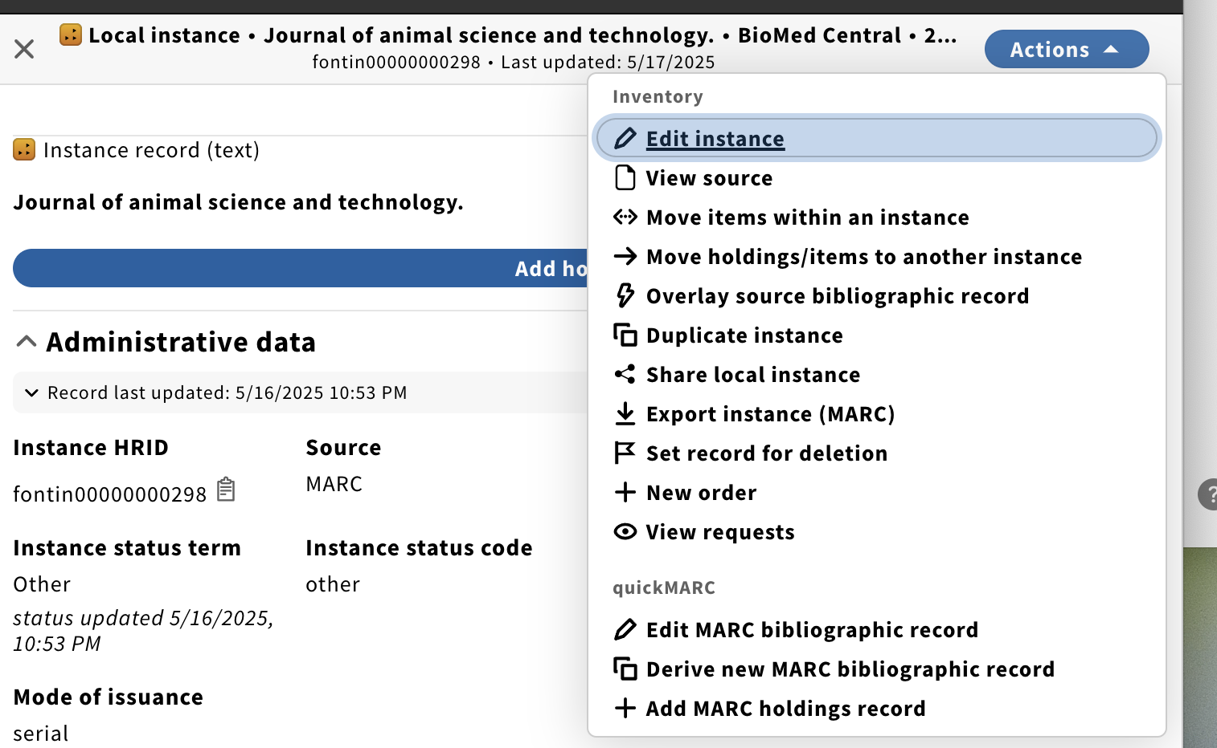
INVENTORY…
From this record, go to ACTIONS > NEW ORDER
Notes:
SUPPRESS…
INSTANCE STATUS TERM (OTHER)
Show fields

Slide 11
ORDERS
You need to create an ORDER record to affiliate and “tie” to your Serial.
You don’t have to use any of the pay functions (you can, of course)
You don’t have to go back to the ORDER to do anything after you create it.
Information from your new Serial record will be tied to the ORDER
Notes:
Once you have your Serial Record that you are going to work with, you need to create an ORDER record.
One publication pattern per title/ORDER so if you have something that is a MONTHLY, WEEKLY, and ANNUAL, you will need 3 records.

Slide 12
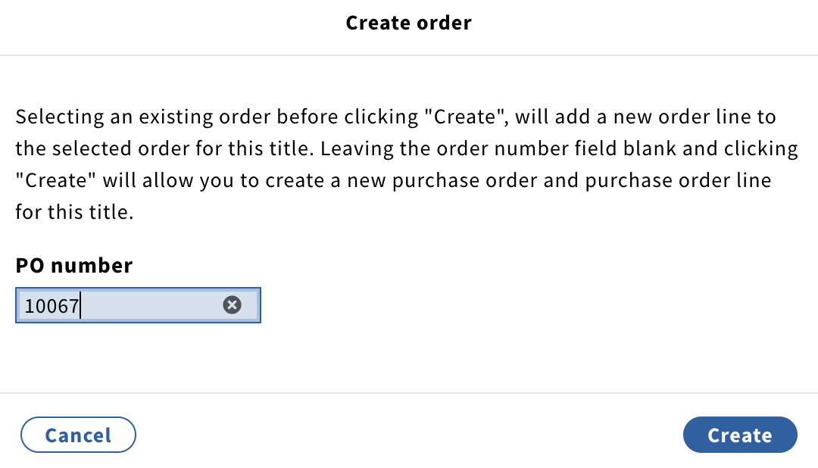
ORDER Details

Slide 13
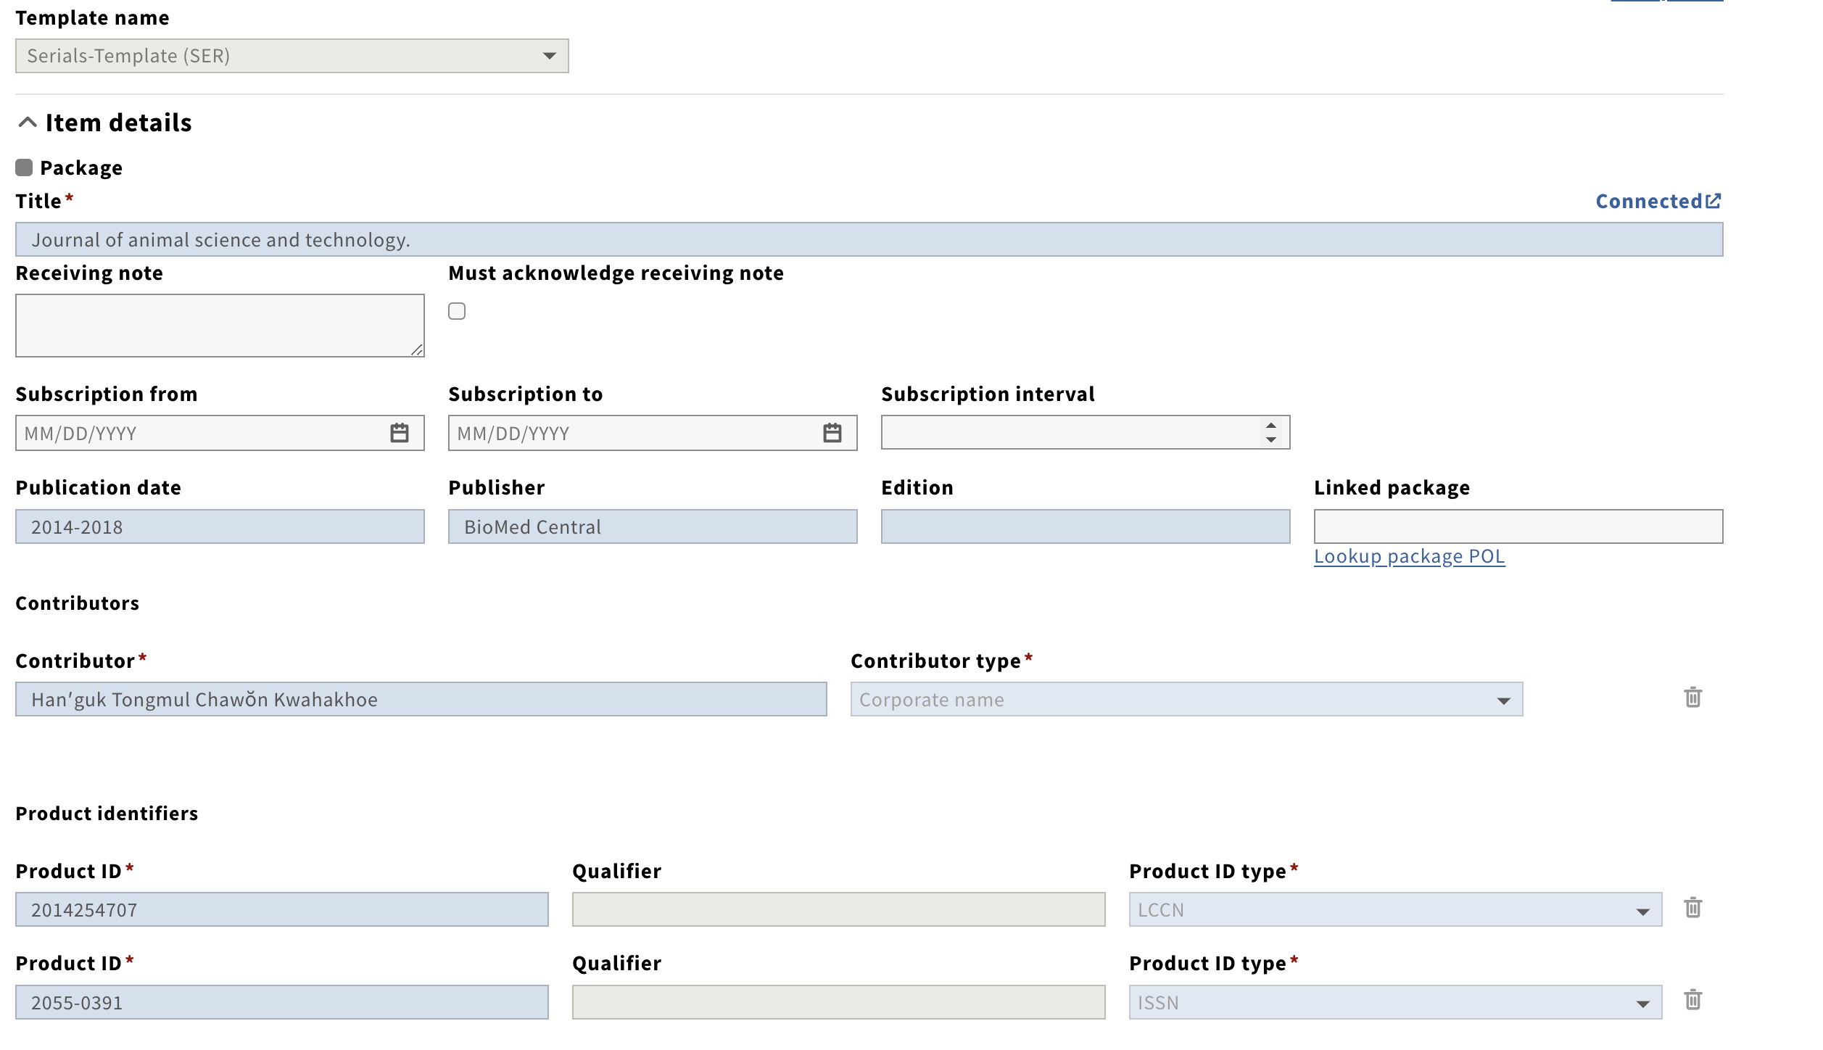
ORDER Details
Notes:
If you have an ORDER, then when you link the INVENTORY record to it, the fields will populate.
Review fields and enter in any data that is relevant.
Check dates and price fields

Slide 14
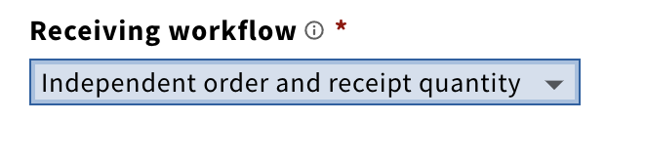
ORDER Details
IMPORTANT:
The Receiving Workflow must be set to: INDEPENDENT ORDER AND RECEIPT QUANTITY
Notes:
This must be set for FOLIO to treat this as a serial.
DO NOT select the default, which is SYNCHRONIZED ORDER AND RECEIPT QUANTITY

Slide 15
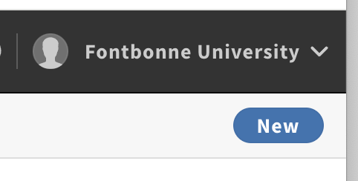
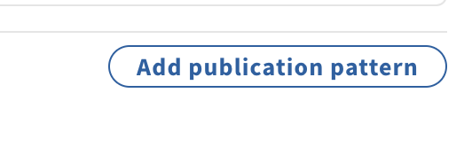
SERIALS
Go to SERIALS:
New
Enter in ORDER Number
Fields Populate and Order is affiliated w/serial
Notes:
GO TO SERIALS / NEW / ENTER IN ORDER NUMBER and the fields will populate.
Click on new title and then proceed to ADD PUBLICATION PATTERN

Slide 16
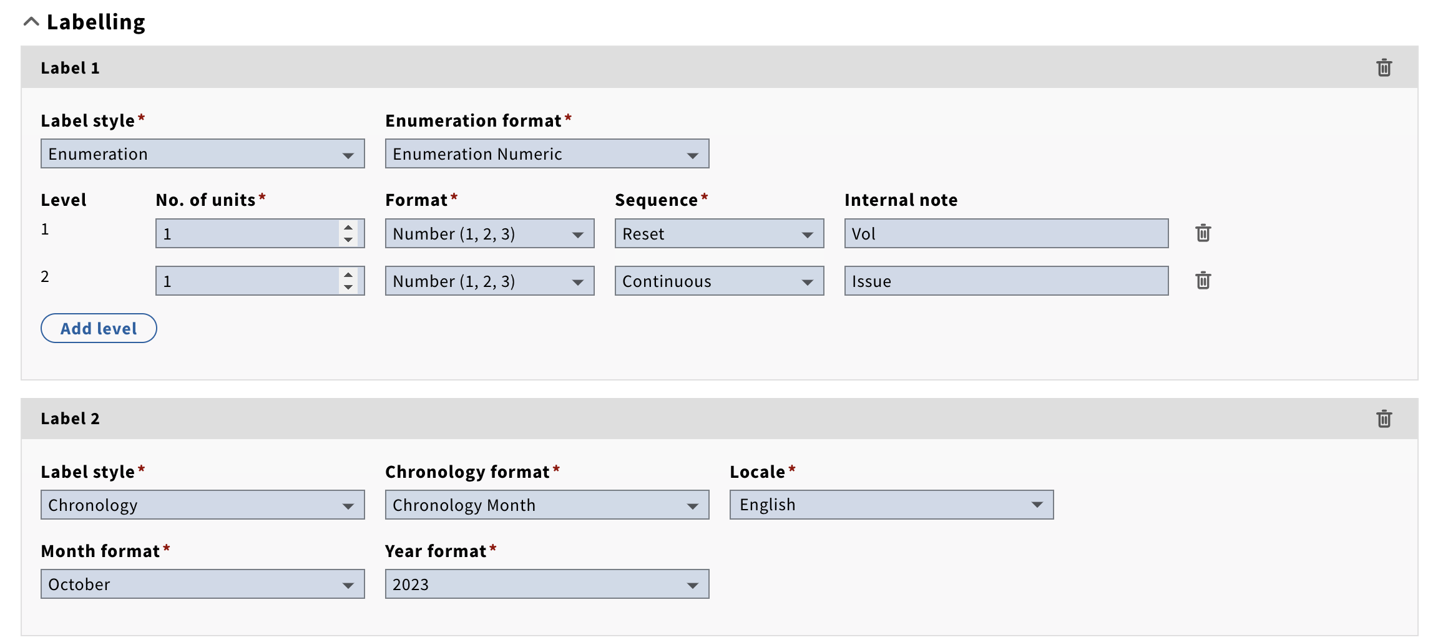
SERIALS
ADDING A PUBLICATION PATTERN:
Publication Cycle & Labelling
Notes:
PUBLICATION CYCLE – MONTHLY, for example
NUMBER OF MONTHS – 1
NUMBER OF ISSUES PER PUBLISHED CYCLE – 1
ISSUE 1 – Day 15 or something – day of the month
Talk about OMISSION and COMBINATION RULES (We have an example of OMISSION)
LEVEL 1 - NUMBER OF UNITS – 1
FORMAT – NUMBER 1,2,3
SEQUECNCE – CONTINUOUS
INTERNAL NOTE – Vol

Slide 17
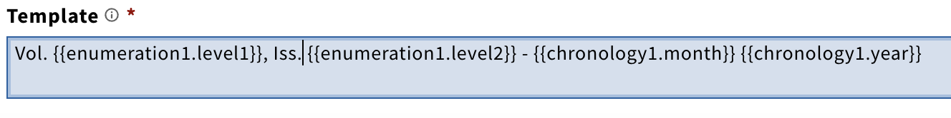
SERIALS Template
This is key: https://docs.folio.org/docs/acquisitions/serials/
Notes:
Link to Template options to follow: https://docs.folio.org/docs/acquisitions/serials/
Copy/Paste and PREVIEW
SAVE AND CLOSE

Slide 18
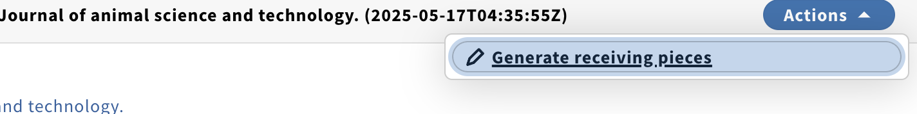
SERIALS - Generating
Now, stay in SERIALS and go to:
ACTIONS > Generate Predicted Pieces
Enter in data; PREVIEW
If OK, then Generate
Now, stay in SERIALS and go to:
ACTIONS > Generate Receiving Pieces
Notes:
Stay in SERIALS – once you create the pattern, generate predicted pieces, you then need to generate the receiving pieces

Slide 19
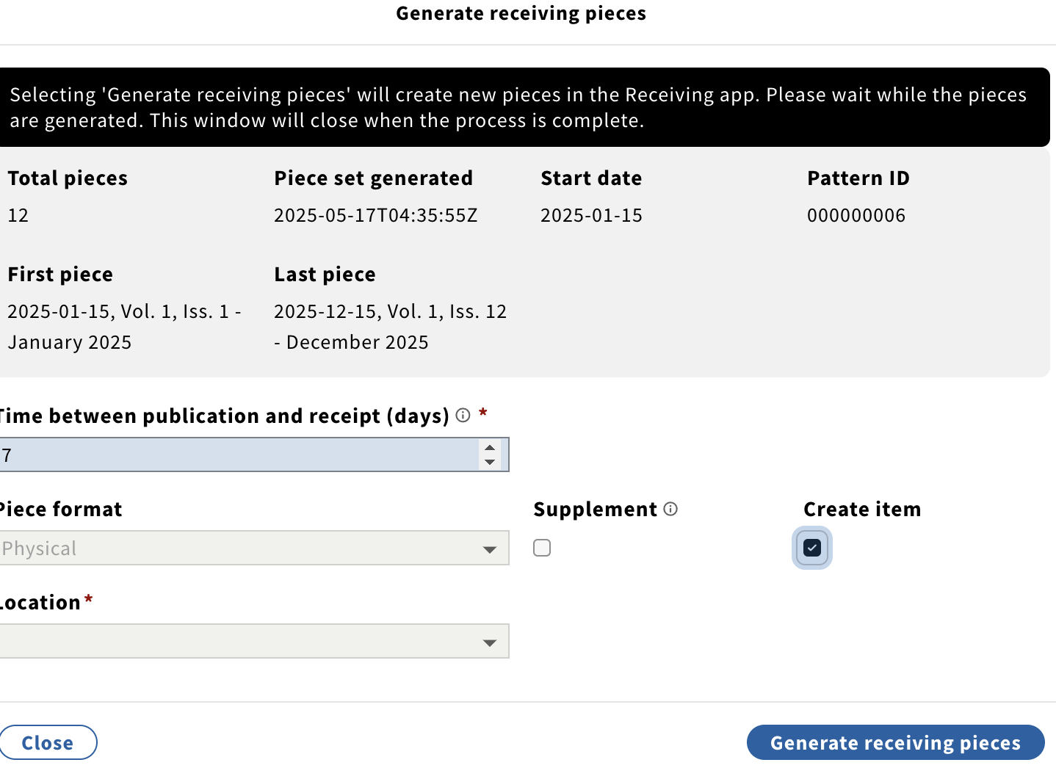
SERIALS - Generating
Notes:
Stay in SERIALS – once you create the pattern, generate predicted pieces, you then need to generate the receiving pieces.
Once you do this, go to the RECEIVING APP

Slide 20
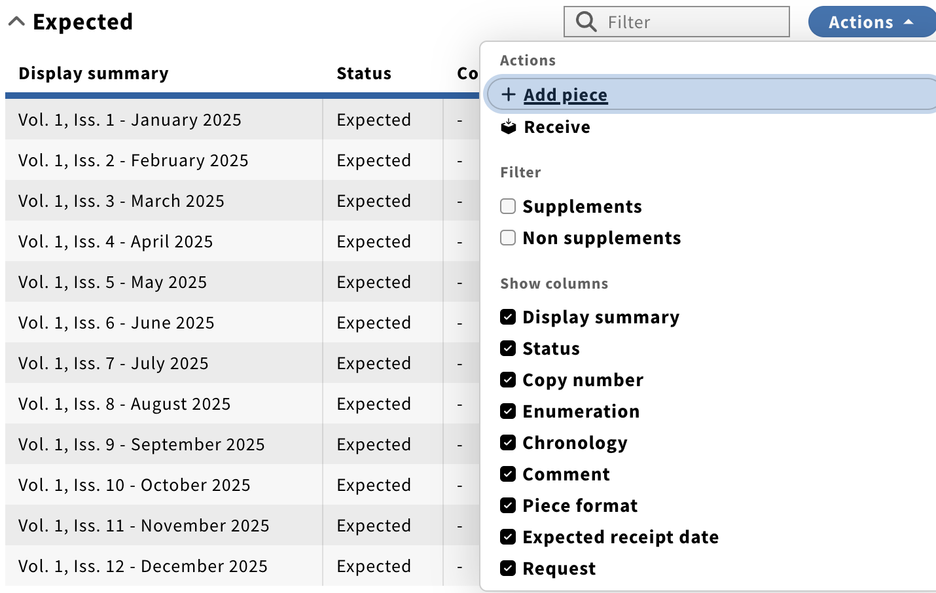
RECEIVING
Notes:
GO to RECEIVING
SEARCH FOR YOUR TITLE
MIDDLE WAY DOWN – ACTIONS BUTTON (on right)
RECEIVE

Slide 21
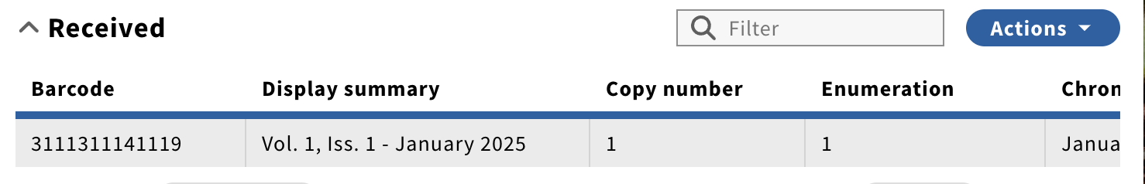
RECEIVING
Notes:
RECEIVE your first issue – then, go back in and fill in more of it including barcode, issue info, etc.
LOCATE as of May/early June 2025 is kind of a mess with issues and dates (to be fixed soon)
https://ramsons.docs.folio.org/docs/acquisitions/serials/

Slide 22
Coming Up…
Ramsons (SERIALS):
Ability to delete predicted pieces
Modify publication patterns (before creating predicted pieces)
Sunflower (SERIALS):
Notes:
MU: https://libraryguides.missouri.edu/folio/ramsons
https://connect.ebsco.com/s/share-video-authenticated?vtui__mediaId=a1hUT000000J77RYAS

Slide 23
Resources
EBSCO Connect!
FOLIO Guided Tour: Serials Receiving Workflow
Receiving & Claiming Serials
MOBIUS Wiki!
Serials & More
Original Molly Driscoll Training & MOBIUS Training
Notes:
Don’t struggle, learn!
EBSCO Connect - better format now.
Search and browse videos.

Slide 24
THANK YOU!
Notes:
THANK YOU.

