Slide 1

Yet Another Movie Recommender (YAMR)
Final Project Slide Deck
Matthew Collins

Slide 2
Project Overview
Developed AI-powered movie recommender system
Neural collaborative filtering approach
AWS cloud deployment (ECS, DynamoDB, Cognito)
React.js frontend integration

Slide 3
Timeline and Milestones
Weeks 1-2: Planning, Data Collection
Weeks 3-5: Model Development and Training
Weeks 6-7: Frontend & Backend Integration
Week 8: Testing, Deployment, and Documentation

Slide 4
Dataset and Preprocessing
MovieLens dataset (Movies, Ratings, Tags)
Clean, high-quality, structured data
Preprocessing: feature engineering, normalization
Migrated to AWS DynamoDB for production use

Slide 5
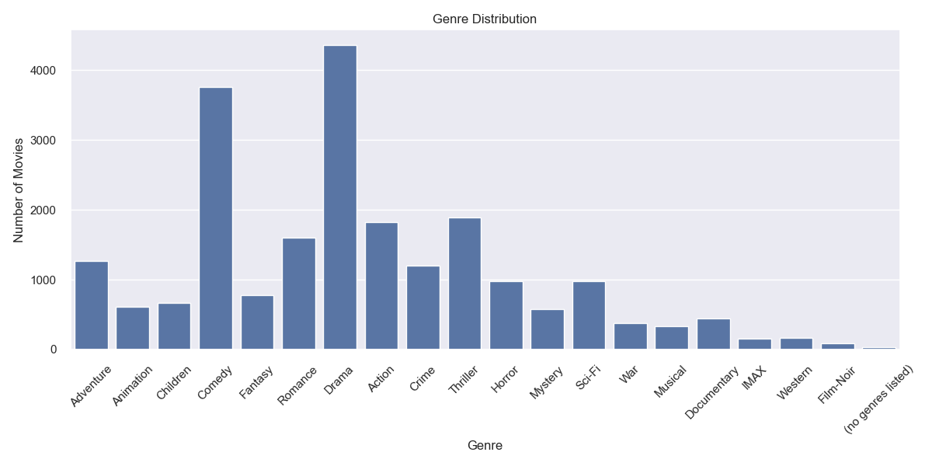
Dataset and Preprocessing

Slide 6
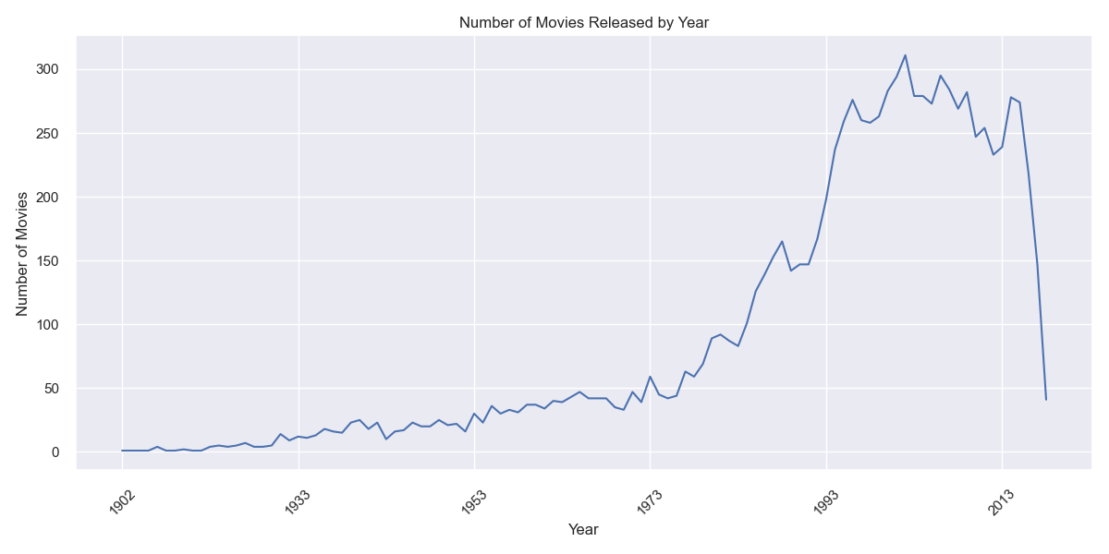
Dataset and Preprocessing

Slide 7
AI Model Architecture
Neural Collaborative Filtering (NCF)
User and Movie Embedding Layers
Deep Neural Network (3 hidden layers)
BatchNorm, Dropout, Sigmoid Output (1-5 scale)

Slide 8
Model Training and Results
80-20 Train-Validation Split
RMSE: 0.938 | MAE: 0.715
Smooth convergence, minimal overfitting
Cold-start handled with hybrid approach

Slide 9
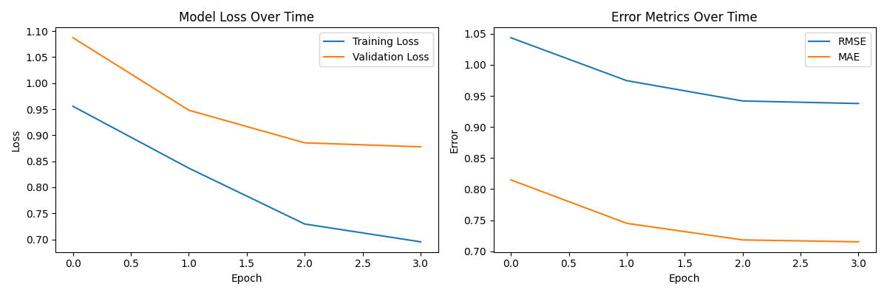
Model Training and Results

Slide 10
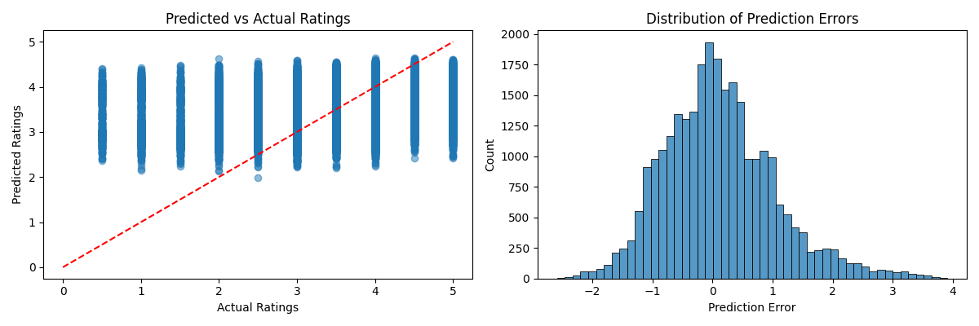
Model Training and Results

Slide 11
User Interface Design
React.js frontend with AWS Amplify
Figma wireframes and prototypes
5-star rating system for movies
Real-time personalized recommendations

Slide 12
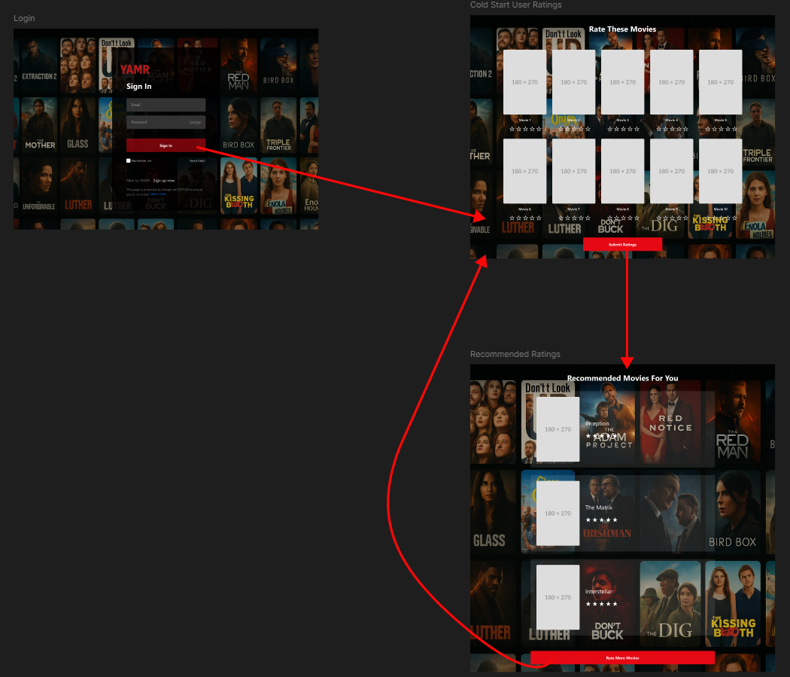
User Interface Design

Slide 13
System Deployment
Backend containerized with Docker
Deployed to AWS ECS with ALB
API Gateway and Flask backend
Integrated with AWS services (DynamoDB, Cognito)

Slide 14
Testing and Optimization
Informal system testing (model, API, UI)
Performance improvements (batching, caching)
Simplified authentication for evaluation
Prepared for production monitoring

Slide 15
Conclusion and Future Work
Robust, scalable recommendation system
Potential future enhancements:
Content-based filtering integration
A/B testing of recommendation strategies
Expanded user profiling

Slide 16
Important Links
Link to Github Repo
Link to Hosted Front End Website
Note Login Page is Disabled for Grading

