Slide 1

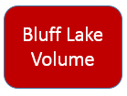
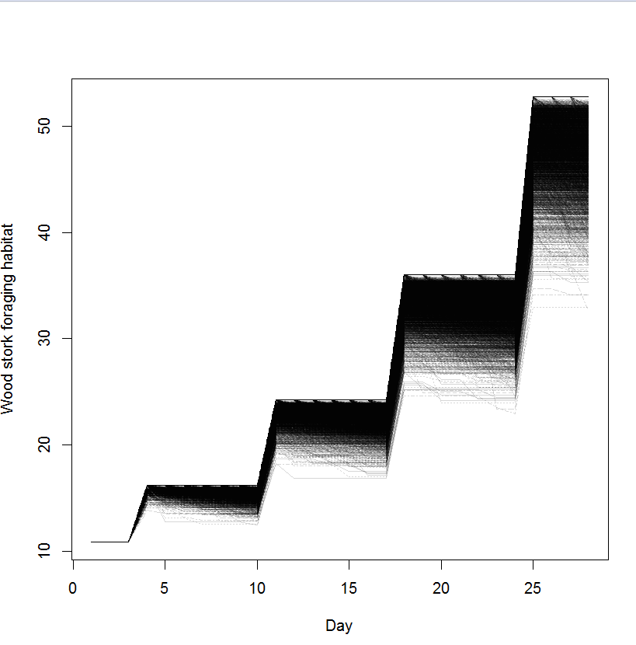
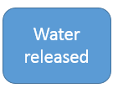
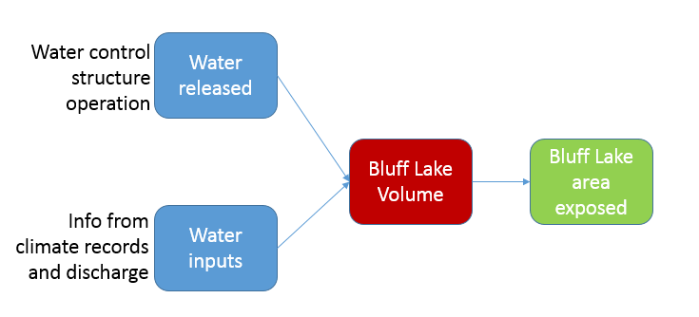
Bluff Lake benefit
Sub-Goal A.2 – Waterbirds
Sub-Goal A.4 - Threatened and Endangered Species
Strategy A.2.3.1: Provide seasonal drawdowns of approximately 600 acres of Bluff Lake to ensure mudflats and shallow water habitats and increase foraging opportunities.
Objective A.7.2: Maintain a balanced native fisheries population in lakes by managing size distribution, ratio of predator to prey, mortality rates, and other key parameters.
Sub-Goal D.2 - Fishing
Objective D.2.1: Open year-round bank fishing on Bluff Lake where and when compatible with other priority uses.
Provide woodstork foraging habitat
Sub-Goal A.7 - Aquatic Biota
Sub-Goal A.1 – Waterfowl
Objective A.1.1: Provide at minimum, 1.1-million DEDs over a 110-day period yearly through the possible combination of managed moist-soil plants, planted agricultural crops, lakes, and or seasonally flooded GTRs.
Objective A.2.3: Increase brood survival of breeding waterbird populations by enhancing refuge habitats.
Metric for Bluff Lake?
Metric?
Maximize Bass catch per hour
Maximize Crappie catch per hour
Maximize Catfish catch per hour
Maximize Anything catch per hour
Objective A.7.3: Support existing populations of paddlefish by manipulating water flow from the lakes during the key spring spawning migration periods of February 15 to May 1.
Strategy A.7.3.1: Weekly release at least an estimated 400 cubic feet per second of water for at least one, 8-hour period
Strategy A.7.2.4: Create deep-water habitats within Bluff Lake and use soil from excavations to create forested islands to serve as possible future rookeries for birds.

Slide 2
Water control structure operation
Water released
Bluff Lake
Volume
Bluff Lake area exposed
Info from climate records and discharge
Water inputs

Slide 3
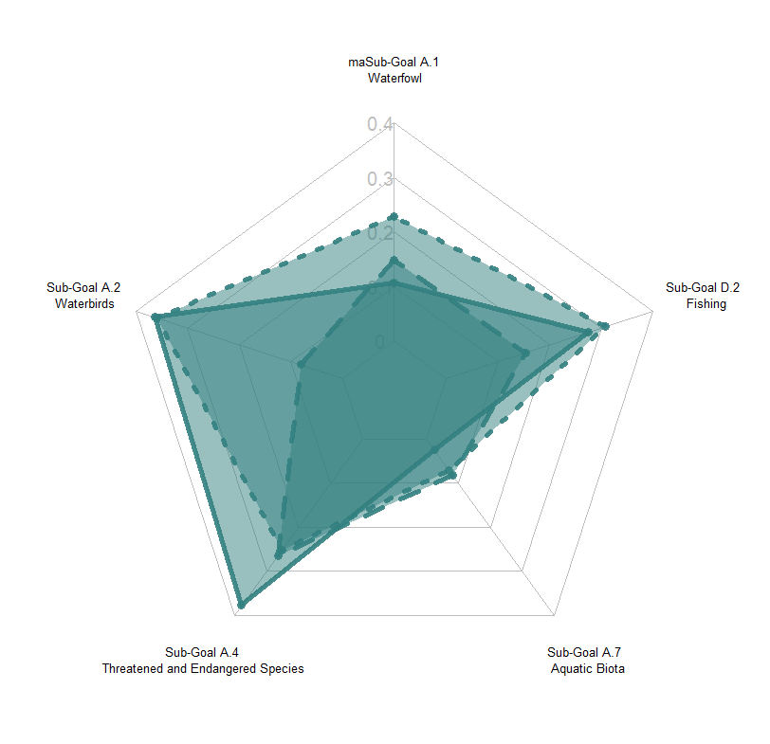

Slide 6
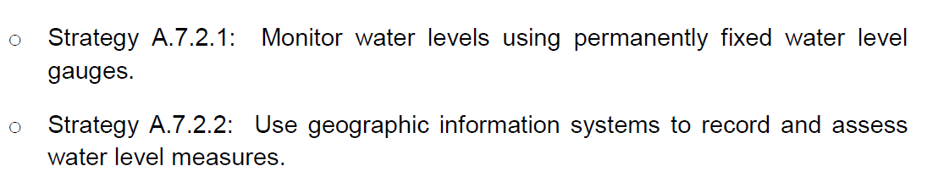

Slide 7
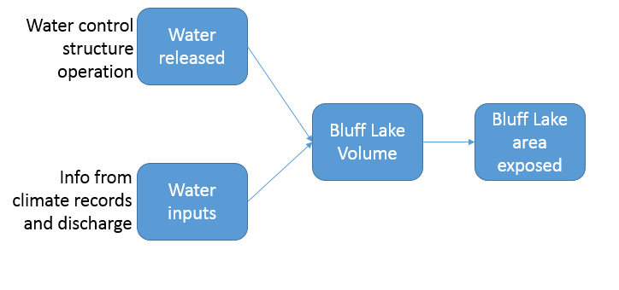
Bluff Lake benefit
Sub-Goal A.2 – Waterbirds
Sub-Goal A.4 - Threatened and Endangered Species
Strategy A.2.3.1: Provide seasonal drawdowns of approximately 600 acres of Bluff Lake to ensure mudflats and shallow water habitats and increase foraging opportunities.
Objective A.7.2: Maintain a balanced native fisheries population in lakes by managing size distribution, ratio of predator to prey, mortality rates, and other key parameters.
Strategy A.7.3.1: Weekly release at least an estimated 400 cubic feet per second of water for at least one, 8-hour period
Sub-Goal D.2 - Fishing
Objective D.2.1: Open year-round bank fishing on Bluff Lake where and when compatible with other priority uses.
Provide woodstork foraging habitat
Objective A.7.3: Support existing populations of paddlefish by manipulating water flow from the lakes during the key spring spawning migration periods of February 15 to May 1.
Sub-Goal A.1 – Waterfowl
Objective A.1.1: Provide at minimum, 1.1-million DEDs over a 110-day period yearly through the possible combination of managed moist-soil plants, planted agricultural crops, lakes, and or seasonally flooded GTRs.
Objective A.2.3: Increase brood survival of breeding waterbird populations by enhancing refuge habitats.
Metric for Bluff Lake?
Metric?
Maximize Bass catch per hour
Maximize Crappie catch per hour
Maximize Catfish catch per hour
Maximize Anything catch per hour

