Slide 1
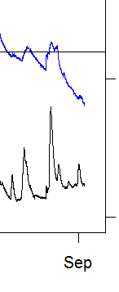
Don’t care about modeling these big events well, more than enough water to meet all uses
This figure is on the next slide
Observed Lake Elevation
Are we missing some outflow here? Did they open the gates?
Intake inflows for the time highlighted by the red circle, do not go down suggesting an unaccounted for loss of water
Modeled lake elevation
This is nice here! This is the area we are interested in modeling well.

Slide 2
Measured lake elevation
Water coming into Bluff Lake, there is a box weir that we used the weir equation to calculate Q in over 30 minutes.
Was expecting lake elevation to not go down, 2 explanations. 1) the refuge opened gates, Victoria is looing into that, or 2) there is evaporation occurring that might be non negligible, get Steve’s thoughts
Refuge opened of the tainter gates

