Slide 1
Ardagh (La Fleche) Mercury PROJECT
Jan. 01, 2018

Slide 2
Project requirements
The following slides represent the new requirements to be delivered to Ardagh – La Fleche in Q1, 2018.
These requirements are based from on-site installation as well as customer observations.
These changes reflect 4 major points:
GUI / Functionality Changes for Sweep / Water to include workflow as well as icon designs.
Added manual register functionality in GUI as well as PLC
CIP3 changes to add ductor setting capability based on coverage.
Add ductor setting to stored forms

Slide 3
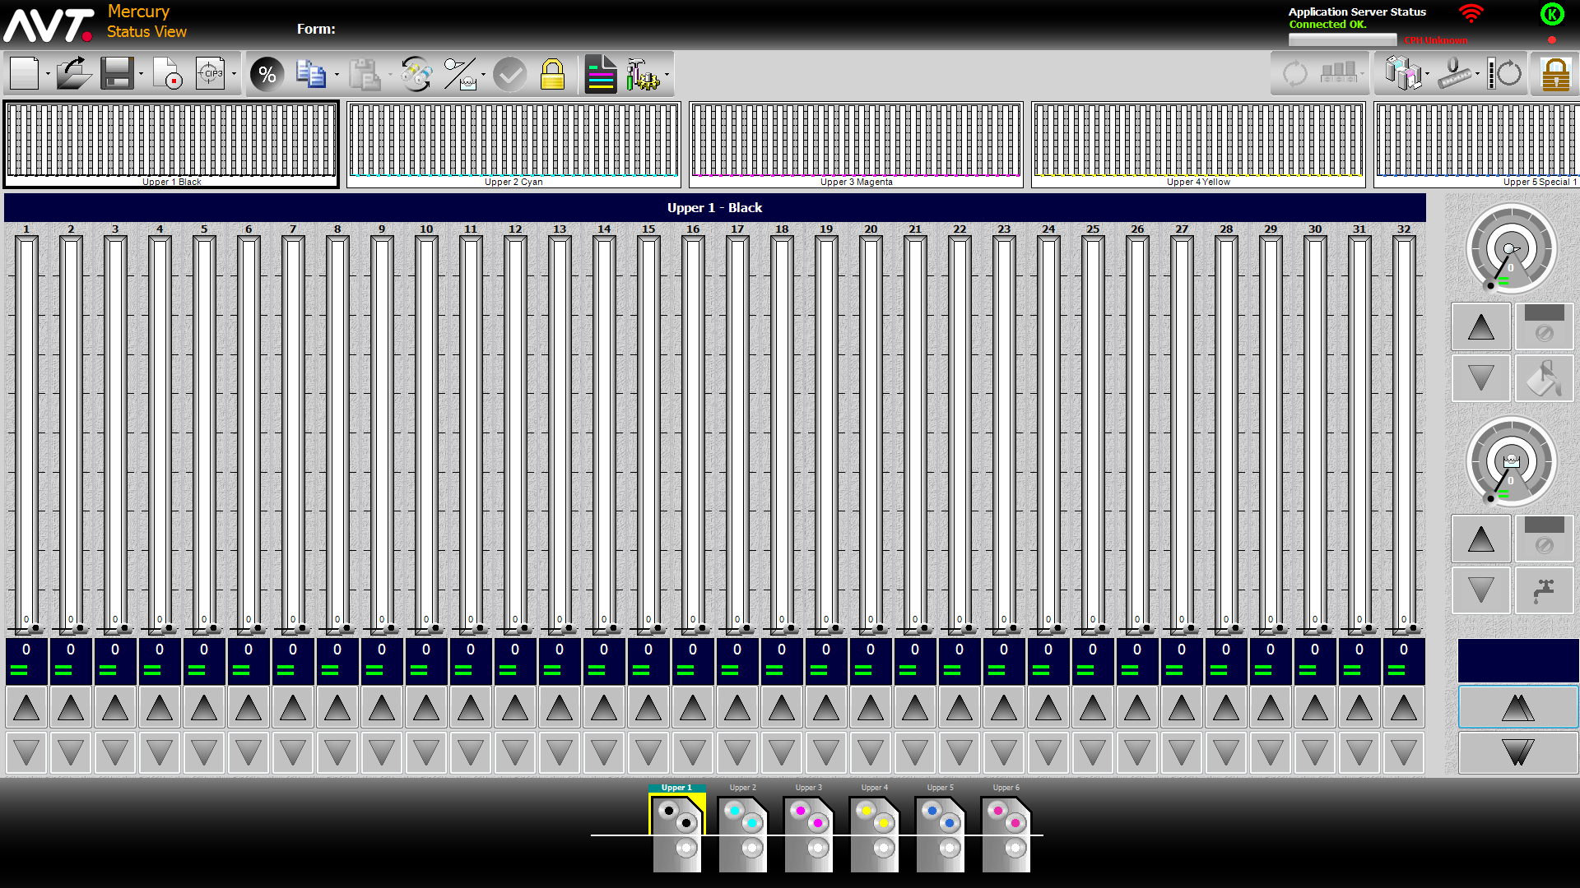
Mercury Status screen
There are essentially no changes to the main Status View screen as far as the GUI is concerned. There are, however, changes to how some functions will work.

Slide 4
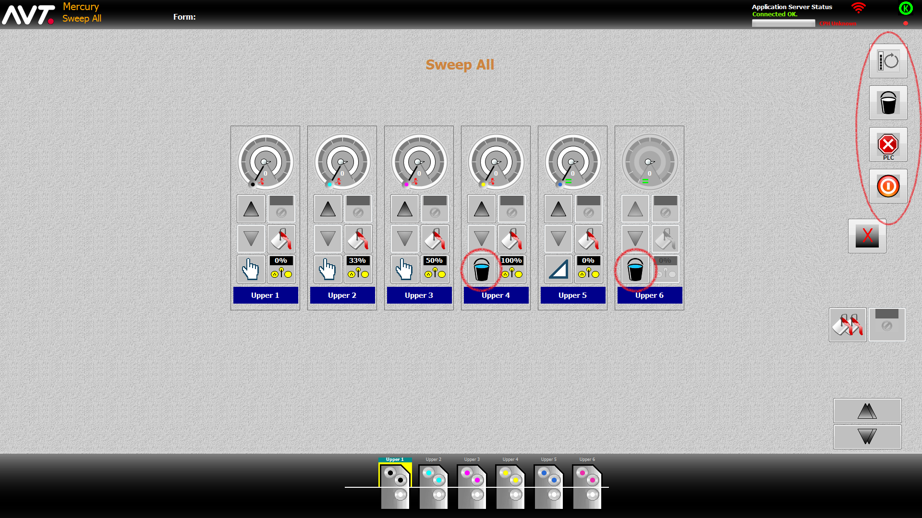
SWEEP all screen
There are several major changes in the Sweep All screen.

Slide 5


Sweep ALL SCREEN (CONT.)
ACTIVATION BUTTONS INCREASE IN SIZE
The buttons for RUN, WASH, PLC STOP, and the new OFF/ON UNIT TOGGLE button are all increased in size to match the cancel, or exit screen, button.
FUNCTION BUTTON TOGGLE CHANGE
The function button for each unit will only have two toggle states…manual (hand) or auto (ramp).
The third state was previously used to disable the sweep function for that unit, but this enable/disable function will move to a new button and workflow.
When changing states, the operator will NO LONGER be required to push the RUN button to toggle the state.
For Ardagh, the function button really will not have much purpose since there is no ramping for sweeps on their press. For other installations WITH sweep ramping, however, the function button would serve a purpose. We will keep the function button as is, regardless of purpose at this site.
WASH BUTTON CHANGE
The WASH button, that was previously a green hand icon below the run button, will get a new, wash bucket, icon.
To activate the wash function on any unit (s), the unit (s) must be selected, then the WASH button must be selected.
When wash is selected for a given unit, the function button for that unit will change to the wash bucket icon (instead of the hand or ramp) and the wash routine should begin without the need for the RUN button.
The WASH feature is available for any unit, regardless of function state or enable/disable state. (i.e. a unit can be disabled, but still have the WASH feature available for use at “most” any time.)
For a unit that is ON, or sweep function is enabled via the toggle button, then the press must be OFF impression for that unit to utilize the WASH feature. This is to ensure that the WASH cannot accidentally be enabled during production.
For a unit that is OFF, or sweep function is disabled via the toggle button, then the unit can begin the wash routine without regard to press speed or impression status. The purpose of this is to allow the operator or operator helper to clean a unit whether the press is in production or not.

Slide 6


Sweep ALL SCREEN (CONT.)
PLC STOP BUTTON ADDED
The PLC STOP button will be added to stop any output from the PLC to the sweep motors (aka “arc” motors) currently in motion. (Or being requested to move)
This is also a new icon being supplied for this button as the one used is not suitable. Further, this new icon matches the same icon currently used in the SnapREG product to halt PLC outputs, so I would like to keep these looking the same. Additionally, we will add the letters “PLC” to the button to clearly indicate this button is used for the PLC.
To use this feature, the unit (s) must be selected, then the PLC STOP button must be selected. This should cease all output for the sweep motors at this point. (No RUN button required) Additionally, the dial (s) should NOT show a green equal sign if the feedback does not equal the set position.
UNIT ENABLE / DISABLE BUTTON ADDED
A new button will be added to toggle the sweep functions on or off for the unit (s) selected.
Previously, the sweep function was turned off with the third state on the function button. This has been moved.
To toggle a unit sweep functions on or off, the unit must be selected and then the on/off button must be selected. Multiple units can be selected at a time.
If the unit is ON, the unit and dial will not be grayed out and all buttons will be active.
If the unit is OFF, the general buttons and dial will be grayed out.

Slide 7
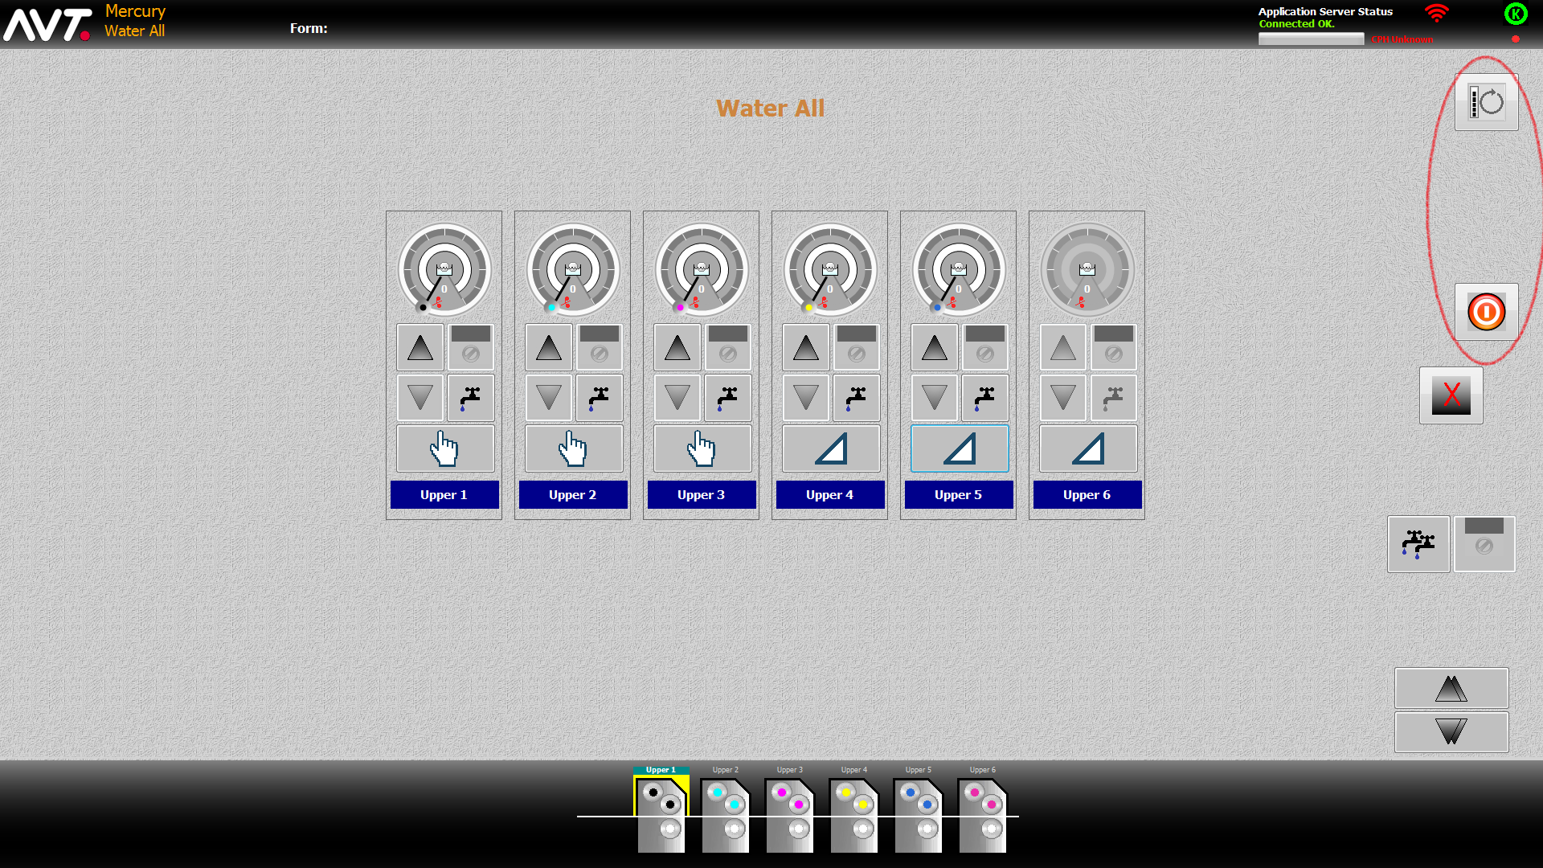
Water all screen

Slide 8
WATER ALL SCREEN (CONT.)
ACTIVATION BUTTONS INCREASE IN SIZE
The buttons for RUN and the new OFF/ON UNIT TOGGLE button are all increased in size to match the cancel, or exit screen, button.
FUNCTION BUTTON TOGGLE CHANGE
The function button for each unit will only have two toggle states…manual (hand) or auto (ramp).
The third state was previously used to disable the sweep function for that unit, but this enable/disable function will move to a new button and workflow.
When changing states, the operator will NO LONGER be required to push the RUN button to toggle the state.
When the button is in manual, the dampener (water) output will be exactly the trim value on the dial without respect to press speed.
When the button is in auto, the dampener (water) output will be variable based on the press speed and using the calculations from the ramping curve for the selected paper type. (curve)
UNIT ENABLE / DISABLE BUTTON ADDED
A new button will be added to toggle the sweep functions on or off for the unit (s) selected.
Previously, the sweep function was turned off with the third state on the function button. This has been moved.
To toggle a unit sweep functions on or off, the unit must be selected and then the on/off button must be selected. Multiple units can be selected at a time.
If the unit is ON, the unit and dial will not be grayed out and all buttons will be active.
If the unit is OFF, the general buttons and dial will be grayed out.

Slide 9

Button definitions / Terminology
Ink Surge
This button shall run the surge output device at 100% for a pre-determined amount of time. (Runtime Option) The button can be pressed multiple times to add to the surge time. So, if the preset time is 3 sec., then the surge will be set for 3 sec. if the button is pressed once. If the button is pressed twice, the total surge time will now be 6 sec.
The RUN button must be used to initiate the Surge.
When the Ink Surge is used, the AVT PLC will output a 24VDC signal to customer supplied relays to run the Ink Washup motors for the selected run time.
THE SWEEP TRIM VALUE SHALL NOT CHANGE AND THE SWEEP MOTOR SHALL NOT MOVE TO ANY OTHER POSITION when a separate surge device is used like what is in place at Ardagh.
The ink surge can be initiated in either MANUAL or AUTO mode.
The press should be in motion. (i.e. FPM, CPH, or MPM > 1)
The impression signal will NOT be required to be active high or low.

Slide 10

Button definitions / Terminology
Flood
This button shall run the water control at 100% for a pre-determined amount of time. The button can be pressed multiple times to add to the flood time.
Ardagh does NOT have a separate device to activate for flood, so the trim values must go to 100% during the flood.
The RUN button must be used to initiate the Flood.
When the Flood button is used, the AVT PLC will output 10VDC (or max output voltage) to the Ardagh PowerFlex AC drives to run the water motors at 100% for the selected run time.
The water flood can be initiated in either MANUAL or AUTO mode.
The press should be in motion.
The impression signal will NOT be required to be active high or low.

Slide 11



Button definitions / Terminology (cont.)
Cancel / Countdown Timer (Ink Surge & Flood)
This button is shown on both the Status screen and the Sweep All / Water All screens. It has two functions. The first function will immediately cancel the Surge or Flood signals when pushed. It will also cancel any time showing if the Surge or Flood button was pressed, but the RUN button was not selected.
The second function of this button is to show the preset time or the time left for the surge or flood after the surge or flood button has been pressed. (This is the nn part of the button) Each time the Ink Surge or Flood button is pressed, this timer will display the cumulative amount of time still left for the surge. Limit to two digits.
Function (Sweep and Water) – These buttons have two states. Each press of the button will toggle the function to the next state. The two states are:
HAND
AUTO
When HAND is selected, the sweep or water shall run at the selected trim value and the output to the sweep or water device will not vary based on press speed. No need to select RUN after this state is selected.
The AUTO setting means that the sweep or water will run at the setting shown on the dial. Also, if ramping is enabled, then the sweep or water will follow the pre-defined ramping curves as the press increases or decreases in speed. No need to select RUN after this state is selected.

Slide 12

Button definitions / Terminology (cont.)
Surge All
This button will set the ink surge time to all fountains. There are prerequisites to what is considered “all fountains”. These are:
The fountain must be part of the same split.
The fountain must be active (enabled).
The RUN button must be used to initiate the Surge.
When the Ink Surge is used, the AVT PLC will output a 24VDC signal to customer supplied relays to run the Ink Washup motors for the selected run time.
THE SWEEP TRIM VALUE SHALL NOT CHANGE AND THE SWEEP MOTOR SHALL NOT MOVE TO ANY OTHER POSITION when a separate surge device is used like what is in place at Ardagh.
The ink surge can be initiated in either MANUAL or AUTO mode.
The press should be in motion. (i.e. FPM, CPH, or MPM > 1)
The impression signal will NOT be required to be active high or low.

Slide 13


Button definitions / Terminology (cont.)
Flood All
This button will send the flood signal to all fountains. There are prerequisites to what is considered “all fountains”. They are:
The fountain must be part of the same split.
The fountain must be active (enabled).
This button shall run the water control at 100% for a pre-determined amount of time. The button can be pressed multiple times to add to the flood time.
Ardagh does NOT have a separate device to activate for flood, so the trim values must go to 100% during the flood.
The RUN button must be used to initiate the Flood.
When the Flood button is used, the AVT PLC will output 10VDC (or max output voltage) to the Ardagh PowerFlex AC drives to run the water motors at 100% for the selected run time.
The water flood can be initiated in either MANUAL or AUTO mode.
The press should be in motion.
The impression signal will NOT be required to be active high or low.
Access Ramping Screens
This button should appear when ramping is enabled and will be present in the system menu. (Along with ELO Calib, Splits, etc…) Selecting this button will open the Ramping Screen.

Slide 14

Button definitions / Terminology (cont.)
Ductor Control
This button will have 4 states. Each press of the button will toggle to the next state. The 4 states are 0, 33%, 50%, and 100%.
After toggling to the desired state, the RUN button must be used.
The top of the button (black area) will display the current value for the ductor setting.
The AVT PLC will output a binary signal to the Ardagh PLC. The binary signal will be as follows:
0% = 11
33% = 10
50% = 01
100% = 00

Slide 15

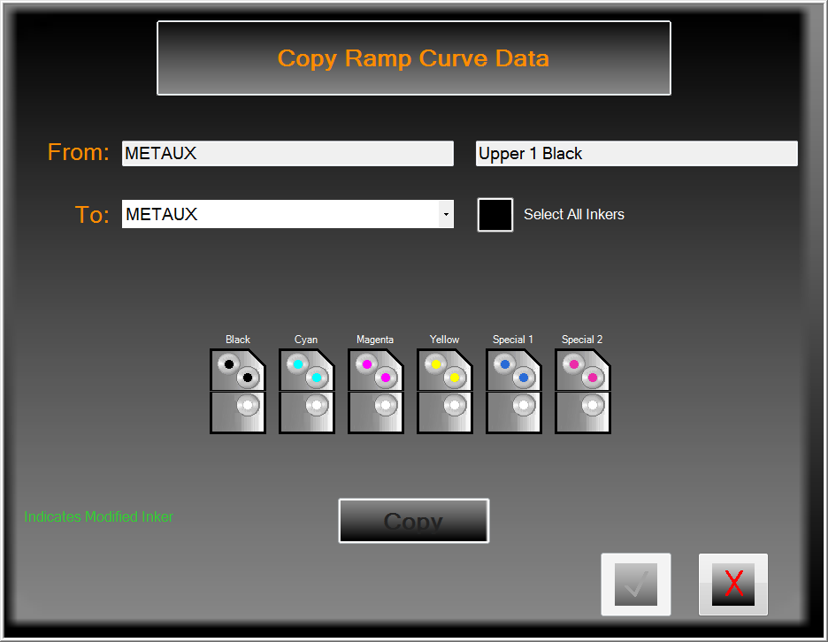
Button definitions / Terminology (cont.)
Copy Ramp Curve Data
This button will initiate a pop up window allowing the operator to copy the current curve data to other inkers and/or other curve preset types.

Slide 16





Button definitions / Terminology (cont.)
Restore Linear
Use of this button will restore a linear curve between Step 1 and Step 20.
Cancel
Functions like the Cancel button in all other Mercury screens. No changes will be saved and the screen will be exited if this button is used.
Accept (Green Check)
Functions like the Accept button in all other Mercury screens. All changes to that point are accepted and the screen will be exited if this button is used.
Help
Use of this button should take the operator to the appropriate entry in the manual. (User, Training, Service, etc.)
Water Ramping
Button has two states, selected or unselected. If in the Ink Ramping screen then this should show as unselected. May be omitted if Water Ramping not enabled on system.

Slide 17
Water / Sweep ramping calculations
Revised Spreadsheet
A revised spreadsheet has been supplied to allow flatter response. This new spreadsheet allows far greater latitude in adjusting the curves than the prior one.
The previous spreadsheet only allowed rather steep climbs in motor output vs the speed input. Ardagh, being a metal decorator, requires minimal (if any) changes based on speed.
The new spreadsheet will require some more option settings in Sitegen.

Slide 18
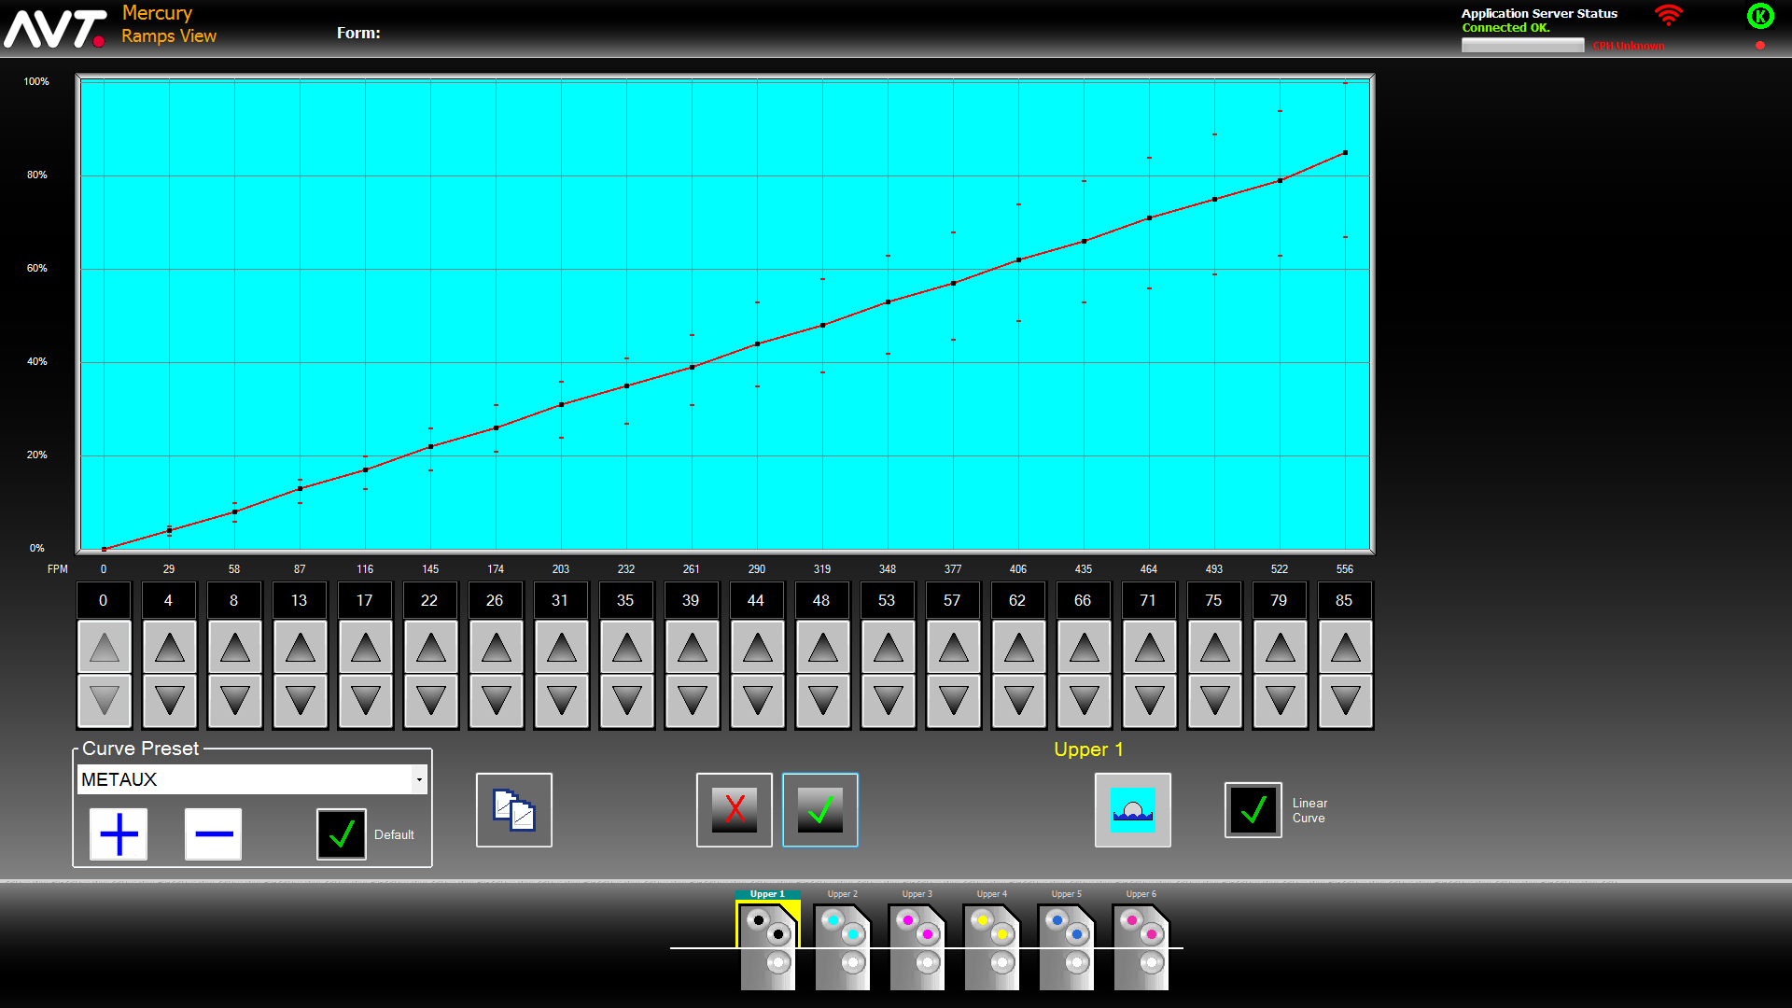
Water ramping
Ramp Graph This graph depicts dampener output (%) based on speed. (FPM, IPH, or MPM) For Ardagh, this will be IPH.
Output This line represents the motor output value.
Percent This axis defines the output.
Min/Max These hash marks define the min/max value allowed for the given step point..
Speed This axis defines the speed.
Digital Value This portion (xx) of the step point shows the digital value of the graph in that step point.
Step Point These buttons allow up/dn adjustment of the output on the curve for that step point.

Slide 19
Water ramping (cont.)
Background Color
R = 0
G = 255
B = 255
Curve Preset This name is defined by the names in the paper corrections. All of the preset curve values will need to be stored for each paper type AND stored with the job. (Form) The Curve Preset Name will apply to ALL units.
Copy Ramp Curve Data This function allows copying the curve settings to a different curve preset and/or inkers.

Slide 20
Water ramping (cont.)
Confirm This function allows all changes made during this session to be saved. No changes are saved to anything without this button being selected. This includes copying unit-to-unit and curve preset to curve preset as well as any other modifications.
Cancel This function allows the operator to discard any changes made.
Restore Linear This should give a straight (flat) line between the min and max step points.

Slide 21
Unit mounted HMI controls
Changes?

Slide 22
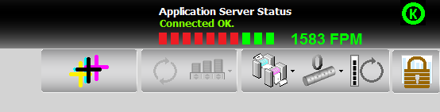
register
Customer wishes to have manual register controls added to the Mercury screen.
A new set of screens has been mocked up. These screens will be accessible using a new icon from the Main Status View Screen.
Selecting the button below will change the GUI view to the new Register screen.

Slide 23
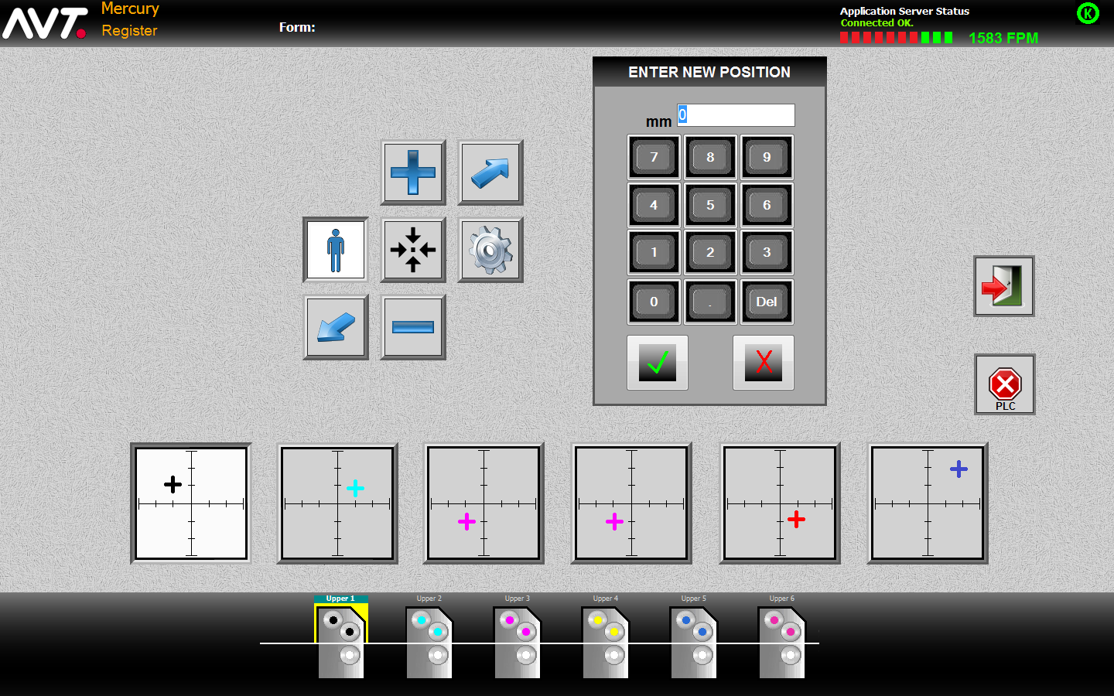
Register (cont.)

Slide 24
Register (cont.)
Register Workflow
Enter the Register Screen
Select the desired Unit(s) to move register on.
You may select multiple units at a time.
Units may be selected / unselected as many times as desired before the direction and distance are applied.
You may select or unselect units using the graphs or the units from the unit display at the bottom of the screen.
Select the direction of movement.
Only one direction may be selected at a time.
To change your mind on direction of movement, simply select a different direction button. That button will become the new selection and the previously selected button will no longer be selected.
Select the distance of the movement using the keypad.
You may enter any valid number on the keypad up to a pre-defined maximum.
To correct any mistake in keying in the number, you may use the Del button to delete one number at a time or you may select the “X” button to delete all numbers entered.
You may correct any mistakes as many times as needed before continuing to the next step.
Once you have the correct units, the motor direction, and the distance value entered correctly, you will select the green check at the bottom of the keypad. This will activate the appropriate outputs on the PLC to move the register motors.
After the moves have been applied using the green check, all unit(s) and direction buttons shall become unselected. (Raised)
If you realize you have made an error AFTER selecting the green check, or for any reason you need to cancel register motors outputs, you may hit the red “X” button to cancel all register motor outputs. This will immediately cancel any current or queued moves from the PLC.

Slide 25
Register (cont.) UNIT SELECTION
Unit Selection When a unit is NOT selected, the graph shall appear as raised (border change) and the background shall appear gray. Additionally, the unit in the lower display shall NOT have a yellow highlight.
Unit Selection There shall be two methods of selecting the unit to apply register motor moves. Either select the graph or the unit from the unit display below. Multiple units may be selected. When selected, the graph shall appear depressed (and a white background) and the unit shall be highlighted in yellow.

Slide 26
Register (cont.) motor direction
Motor Direction After the unit(s) have been selected, a motor direction must be selected. ONLY ONE MOTOR DIRECTION CAN BE SELECTED AT A TIME!
Motor Direction Buttons There are 6 ways in which register on a unit can be moved…Operator, Gear, Advance, Retard, Skew Advance, Skew Retard. There is an additional button for motor centering. (To be explained later)

Slide 27
Register (cont.) Distance
Motor Distance Once the units and direction have been selected, enter a distance value into the keypad. This example shows mm, but inch should also be available as a runtime option.
Del and Cancel Buttons These perform similar, yet different, functionality. If distance values are keyed incorrectly by the operator, selecting the Del button will delete the last digit entry. Selecting the “X” Cancel button will delete the entire numeric entry.

Slide 28
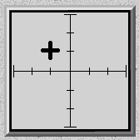
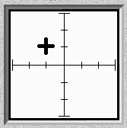
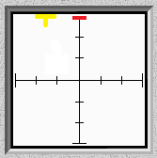
Register - KEY GUI COMPONENTS
Register Positional Graph
These graphs give an approximate position of the register motors in lateral and circumferential axis.
The orientation of these graphs will correlate to orientation of the direction buttons.
For Ardagh, the motors on the register will provide a potentiometer feedback. The full range of each pot will need to scale within the graph below. Note that the pot range may be different for lateral and circumferential so allowances for this must be made in Sitegen / Beckhoff PLC.
The graphs are selectable over their entire area. When NOT selected, the background should be gray and the outline border should make the graph appear as a raised button. When selected, the background should be white and the outline border should make the graph appear as a depressed button.
Additionally, when a limit is reached for any given motor direction, a red line shall indicate that the limit has been reached. The limit status shall display regardless if the unit is selected or not.

Slide 29
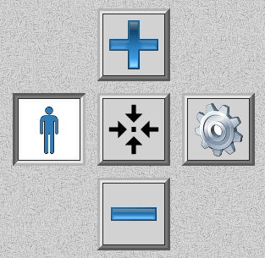
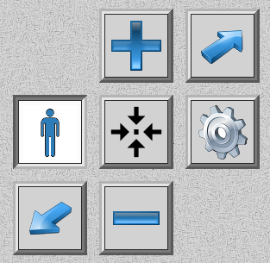
Register - KEY GUI COMPONENTS (cont.)
Register Direction Buttons
These buttons will set the direction for the motors to move for the selected unit or units.
These buttons are larger than normal for Mercury – 64 x 64 pixels
There are 6 directions that register can be moved as well as centering. (More on centering later)
Operator – This will move the lateral motor in the direction of the operator, or button side of the press.
Gear – This will move the lateral motor in the direction of the gear, or drive side of the press.
Advance – This will move the circumferential motor in the direction of the substrate travel.
Retard – This will move the circumferential motor in the opposite direction of the substrate travel.
Skew Advance – This will move the plate skew, or cocking motor in the advance direction. (aka as “diagonal” register)
Skew Retard – This will move the plate skew, or cocking motor in the retard direction. (aka as “diagonal” register)
Not all presses have plate skew capability. (Ardagh – La Fleche does NOT have this, but Ardagh – Hungary DOES have this and is a customer requirement.) Therefore, plate skewing must be an optional feature, selectable in Sitegen. When the skew feature is not enabled, the buttons will not display. With and without skewing versions shown below.

Slide 30
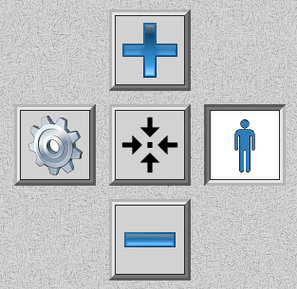
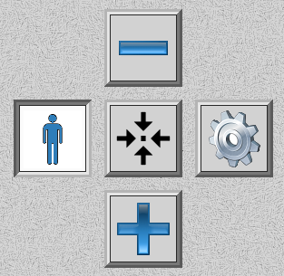
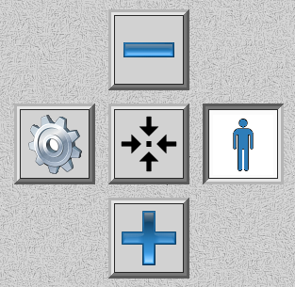
Register - KEY GUI COMPONENTS (cont.)
Register Direction Buttons
The direction button orientation on the GUI must be configurable. The Operator / Gear buttons must be able to be swapped as well as the Advance / Retard buttons AND they must be swappable independent of the other. This gives 4 iterations, as follows:

Slide 31
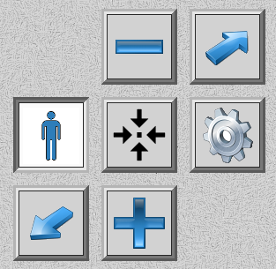
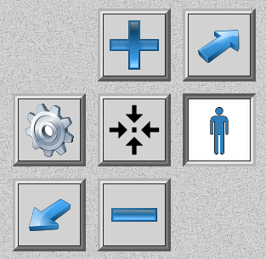
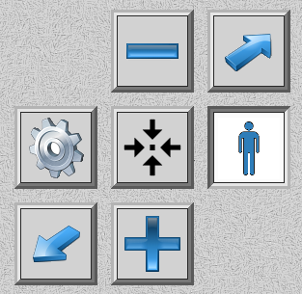
Register - KEY GUI COMPONENTS (cont.)
Register Direction Buttons (with Skewing)
When configuring the button orientation as in the previous slide, it should be noted that there are no changes made to the skewing button locations. However, the “assignment” of the skewing buttons will change based on the orientation of the Advance / Retard buttons.
Skew button assignment does NOT change based on Operator / Gear orientations.
SKEW ADVANCE
SKEW RETARD
SKEW RETARD
SKEW ADVANCE
SKEW ADVANCE
SKEW RETARD
SKEW RETARD
SKEW ADVANCE

Slide 32
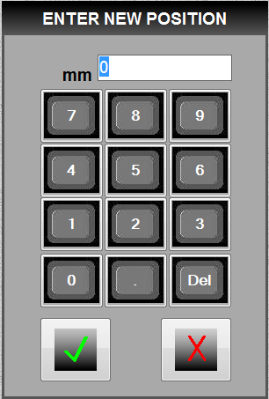
Register - KEY GUI COMPONENTS (cont.)
Numeric Keypad Entry
This shall display in either hundredths of a mm (0.00) or thousands of an inch (0.000) (Sitegen par.)
Decimal will always be implied for numeric entry. For example, if the unit of measure is set to MM and the operator keys in the digits 4 and 5, the resulting value shall be 0.45 mm. If the operator keys in the digits 4 and 5 and 0, then the resulting value will be 4.50 mm. If the operator keys in only the digit 4, then the resulting value shall be 0.04 mm.
The keypad shall always be visible and in the same location on the GUI. (i.e. it is NOT a popup)
“MM” or “INCH”
Not required.
Select button to delete the last keyed digit.
Accept values and apply to selected units / motors.
Select button to clear all keyed in digits.

Slide 33



Register - KEY GUI COMPONENTS (cont.)
Register Exit and Cancel Buttons
The two buttons on the right shall be used as follows:
Exit the Register screen and return to the main Status View Screen.
STOP any current motor movement or register PLC motor output.
Register Centering
This button should only be displayed where pot feedback is available for the register motors.
When using this button, the motors for a unit should move to the center point for both circ and lateral motors.
To determine the center point, the system should use the min and max A/D value, divide in half, and then move the motors to the expected midway point between the min and max A/D value.
When this function is activated, the system should be monitoring the pot feedback for the motors involved. If at any time that pot feedback is not moving as expected (as in a stuck motor, faulty feedback wiring, or broken pot), then the PLC should immediately stop trying to move that motor. Another attempt to move the motor should be made by nudging the motor. If the feedback is unsuccessful after 2 nudge attempts, the system should stop trying. Additionally, the limit indicators on the graph should flash on both ends for the affected motor. To clear the error, the operator should press the STOP PLC button.

Slide 34
Register – PLC ADDITIONS
Beckhoff PLC Components
Additional modules will be used to control the register motors.
The EL1100 will be used to extend the PLC bus to another cabinet. This communicates with the CX5010 via EtherCat.
The EL1808 modules will be used to accept the twin, limit switch inputs from each register motor.
The EL2808 modules will be used to control the register motor directions.
The EL3255 modules will be used to read the potentiometer feedback from each motor.
The EL9011 End Plate is required to cap off the PLC bus.
The 24V PS will be used to supply power to the EL1100 as well as the bus and all PLC 24V outputs.
Component | Description | Quan
055G400877 | ASSY, BECKHOFF EL1100 ENET I/O | 1
055G400883 | ASSY, BECKHOFF EL2808 I/O MOD | 3
055G400882 | ASSY, BECKHOFF EL1808 I/O MOD | 3
055G400501* | ASSY, BECKHOFF EL3255 I/O MOD | 3
055G400881 | ASSY, BECKHOFF EL9011 END PLT | 1
055G400891 | ASSY, PS, PRO ECO 240W 24V 10A | 1

Slide 35
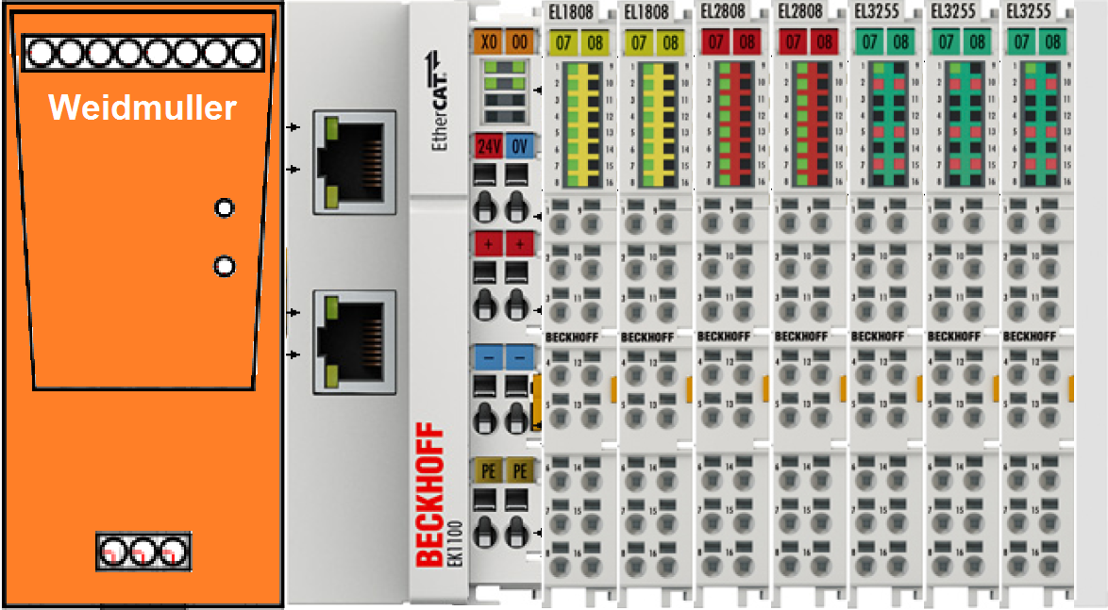
Register – PLC ADDITIONS (cont.)
Beckhoff PLC Components

Slide 36
Register – PLC ADDITIONS (cont.)
Beckhoff Motor Control
The register motors will need to move very precise distances. To that end, each register motor will need to be controlled using slopes. (time = distance)
Each register motor shall have it’s own slope value. These slopes will need to be adjusted on site, as needed, and should be accessible within Sitegen.
The pot feedback from the motors should NOT be used to determine the actual distance moved or to determine when the motor should be shut off. (as is currently the case with sweep motors)
The pot feedback shall only be used to display approximate positioning on the GUI within the total motor travel.
Each pot feedback shall have it’s own A/D min and max values.
Each motor shall have hard limit switches. At least for the initial Ardagh installation at La Fleche, we expect a separate limit input for each direction on each motor. (i.e. two limit switch inputs)
There may be instances where we only have one limit switch input for both directions. (Ardagh-Hungary is unknown as of this writing) Provisions must be made for this within the code. (i.e. with only one limit input, there is not really any way to tell electrically which direction cause the limit switch to activate. Therefore, the software will need to realize that a motor was moving in a certain direction when the limit was activated so that must be the direction that is in limit and the GUI should display as such.)
There may be instances where there are NO hard limit switch inputs. While this is rare, it is not unheard of. Provisions must be made for this condition within the code using the pot feedback A/D min and max values to determine when a limit has been reached.
There may be instances where no pot feedback is available and only hard limit switch inputs are available. This is actually the most common scenario in many presses, but not so for the first two installations at Ardagh as far as we know as of this writing. Again, Ardagh – La Fleche is defined. Ardagh – Hungary is uncertain.

Slide 37
CIP3 Presetting
CIP3 Presetting Based on Substrate and Ductor Settings
CIP3 presets currently have AutoScanCal tables that are based on the following items:
Paper Type
Percent Image Coverage
Constant or Variable Sweep Settings (i.e. Auto Sweep Adjust)
The press at Ardagh prints on metal, so very little correction is typically needed and there really should not be the need for more than one or two “paper types”.
However, the press at Ardagh also uses Ductor control. Since the setting for the ductor control is not only variable, but also can be set at the whim of the operator, this can lead to presets which are less than optimal.
It could be said, for example, that if a good ink key setting is 20% with a ductor setting of 50%, then a ductor setting of 100% would then require that same ink key setting to be 10%. (half of previous setting) Likewise, a ductor setting of 33% would likely require the same ink key setting to be around 24%. (17% more open due to the decreased ducting frequency)
We will need to find a way to automatically “set” the ductor control during a preset operation in order to provide accurate and consistent presets. “How” we can do this will be a topic of another discussion and outside the scope of this document.
Ductor Settings Stored with Form
The customer has asked for the capability to store the ductor settings with the forms. Since each fountain can have it’s own ductor setting, this would need to be stored this way within the forms. Like the above point, the “how” we do this is outside the scope of this document and a separate discussion.

