Slide 1

















$$1.6 ns$$
625 MHz Clock
18-bit Counter
$$0$$
$$1$$
$$2$$
$$3$$
$$4$$
$$5$$
$$T_{i}^{COARSE}$$
$$event[i]$$
$$T_{i}^{FINE}$$
$$T_{j}^{COARSE}$$
$$event[j]$$
$$T_{j}^{FINE}$$
$$0$$
$$T_{i}^{NUTT}$$
$$T_{ij}$$
$$T_{j}^{NUTT}$$
time

Slide 2

$$T_{CLK}$$
Clock
Coarse Counter
$$0$$
$$1$$
$$2$$
$$3$$
$$4$$
$$5$$
$$T_{i}^{COARSE}$$
$$event[i]$$
$$T_{i}^{FINE}$$
$$T_{j}^{COARSE}$$
$$event[j]$$
$$T_{j}^{FINE}$$
$$0$$
$$T_{i}^{NUTT}$$
$$T_{ij}$$
$$T_{j}^{NUTT}$$
time

Slide 3
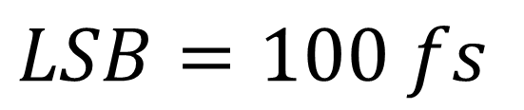







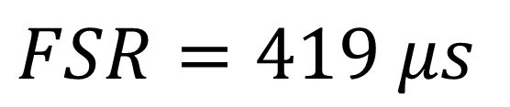

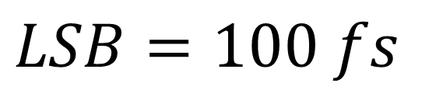

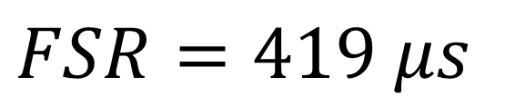

VHDL TDC
VHDL TDC
CH 24
COUNTER
Input
Logic
$$\#1$$
$$\#16$$
COUNTER
Input
Logic
CH 24
$$\#16$$
$$\#1$$
Input
Events
Input
Events
SAMPLING
STOP
STOP
SAMPLING
STOP
STOP
512-taps TDL
512-taps TDL
24
512-taps TDL
512-taps TDL
24
START
START
CH 1
START
START
$$\#1$$
$$\#16$$
CH 1
$$\#16$$
$$\#1$$
Thermometric
512-bit
Thermometric
512-bit
18-bit
Thermometric
512-bit
Thermometric
512-bit
18-bit
SAMPLING
STOP
STOP
SAMPLING
STOP
STOP
512-taps TDL
512-taps TDL
512-taps TDL
512-taps TDL
START
START
Decoder
Decoder
615 MHz
START
START
Decoder
Decoder
615 MHz
Binary
9-bit
Binary
9-bit
Binary
9-bit
Binary
9-bit
Binary
9-bit
Binary
9-bit
Binary
9-bit
Binary
9-bit
Thermometric
512-bit
Thermometric
512-bit
18-bit
Thermometric
512-bit
Thermometric
512-bit
18-bit
Shift
(>> 14)
Shift
(>> 14)
100 MHz
Sub-Interpolator
100 MHz
Sub-Interpolator
Decoder
Decoder
Decoder
Decoder
Binary
14-bit
Binary
14-bit
Binary
9-bit
Binary
9-bit
Binary
9-bit
Binary
9-bit
Binary
9-bit
Binary
9-bit
Binary
9-bit
Binary
9-bit
Calibrator
Calibrator
Shift
(>> 14)
Shift
(>> 14)
$$T_{24}^{COARSE}$$
Sub-Interpolator
14-bit
$$T_{24}^{COARSE}$$
Sub-Interpolator
$$T_{24}^{FINE}$$
14-bit
$$T_{24}^{FINE}$$
Binary
14-bit
+
$$FSR=419 μs$$
Binary
14-bit
-
+
$$FSR=419 μs$$
-
Calibrator
$$T_{24}^{NUTT}$$
Calibrator
32-bit
$$T_{24}^{NUTT}$$
$$T_{1}^{COARSE}$$
32-bit
14-bit
$$T_{1}^{COARSE}$$
$$T_{1}^{FINE}$$
14-bit
$$FSR=419 μs$$
$$T_{1}^{FINE}$$
$$FSR=419 μs$$
$$FSR=419 μs$$
-
+
$$FSR=419 μs$$
-
+
$$LSB=100 fs$$
$$LSB=100 fs$$
$$T_{1}^{NUTT}$$
32-bit
$$T_{1}^{NUTT}$$
32-bit
$$FSR=419 μs$$
$$FSR=419 μs$$
$$LSB=100 fs$$
$$LSB=100 fs$$
CH24
CH1
CH24
CH1

Slide 4
VHDL TDC
CH 24
COUNTER
Input
Logic
$$\#1$$
$$\#16$$
Input
Events
SAMPLING
STOP
STOP
512-taps TDL
512-taps TDL
24
START
START
CH 1
$$\#16$$
$$\#1$$
Thermometric
512-bit
Thermometric
512-bit
18-bit
SAMPLING
STOP
STOP
512-taps TDL
512-taps TDL
START
START
Decoder
Decoder
615 MHz
Binary
9-bit
Binary
9-bit
Binary
9-bit
Binary
9-bit
Thermometric
512-bit
Thermometric
512-bit
18-bit
Shift
(>> 14)
100 MHz
Sub-Interpolator
Decoder
Decoder
Binary
14-bit
Binary
9-bit
Binary
9-bit
Binary
9-bit
Binary
9-bit
Calibrator
Shift
(>> 14)
$$T_{24}^{COARSE}$$
Sub-Interpolator
14-bit
$$T_{24}^{FINE}$$
Binary
14-bit
+
$$FSR=419 μs$$
-
Calibrator
$$T_{24}^{NUTT}$$
32-bit
$$T_{1}^{COARSE}$$
$$T_{1}^{FINE}$$
14-bit
$$FSR=419 μs$$
$$FSR=419 μs$$
-
+
$$LSB=100 fs$$
$$T_{1}^{NUTT}$$
32-bit
$$FSR=419 μs$$
$$LSB=100 fs$$
CH24
CH1

Slide 5
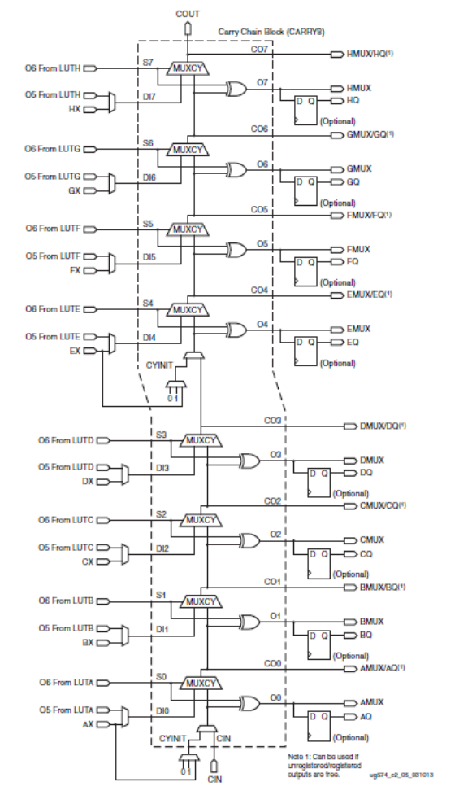
CARRY8
CO(7)
O(7)
CO(6)
O(6)
CO(5)
O(5)
CO(4)
O(4)
CO(3)
O(3)
CO(2)
O(2)
CO(1)
O(1)
CO(0)
O(0)

Slide 6
Ideal Propagation
Bubble Error
... |0000 0000 | 0100 0100 | 0101 0011 | 1111 1111 | …
Thermometric Code
With Bubble Error
512-tap
Real Propagation over TDL
DDL #16
DDL #4
DDL #3
DDL #2
DDL #1
... | 0 | 0 | …
...
... | 0 | 1 | …
... | 1 | 1 | …
... | 0 | 1 | …
... | 0 | 1 | …
16 Thermometric Codes
Without Bubble Error
16×32-tap
Edge Detector
Edge Detector
Edge Detector
Edge Detector
Edge Detector
5-bit
5-bit
5-bit
5-bit
5-bit
16 Binary Codes
Merging
Decoder
14-bit
1 Binary Code

Slide 7
Ideal Propagation
Bubble Error
... |0000 0000 | 0100 0100 | 0101 0011 | 1111 1111 | …
Thermometric Code
With Bubble Error
512-tap
Real Propagation over TDL
DDL #16
DDL #4
DDL #3
DDL #2
DDL #1
... | 0 | 0 | …
...
... | 0 | 1 | …
... | 1 | 1 | …
... | 0 | 1 | …
... | 0 | 1 | …
16 Thermometric Codes
Without Bubble Error
16×32-tap
Edge Detector
Edge Detector
Edge Detector
Edge Detector
Edge Detector
5-bit
5-bit
5-bit
5-bit
5-bit
16 Binary Codes
Merging
Decoder
9-bit
1 Binary Code

Slide 8
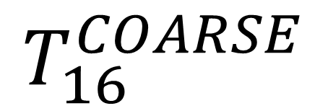
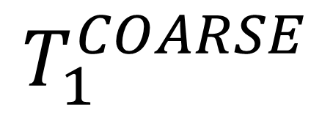
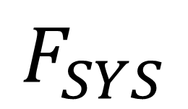
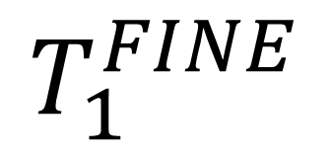
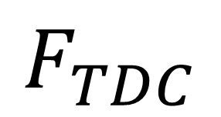


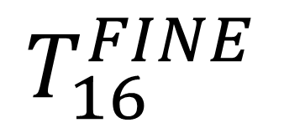
VHDL IP-CORE TDC
$$\#1$$
$$\#4$$
Input events
COARSE
COUNTER
Input
Logic
C-TDC
STOP
STOP
$$\#1$$
WUA-TDL-TDC
$$\#4$$
WUA-TDL-TDC
16
START
START
C-TDC
STOP
STOP
Thermometric
Thermometric
WUA-TDL-TDC
WUA-TDL-TDC
START
START
Decoder
Decoder
Thermometric
Thermometric
$$F_{TDC}$$
Sub-interpolator
417MHz
Decoder
Decoder
Calibrator
CH 16
$$F_{SYS}$$
Sub-interpolator
100MHz
Calibrator
CH 1
16 bit
16 bit
16 bit
16 bit
$$T_{1}^{FINE}$$
$$T_{16}^{FINE}$$
$$T_{1}^{COARSE}$$
$$T_{16}^{COARSE}$$

Slide 9
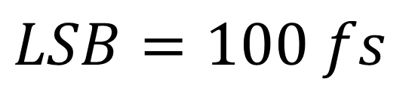


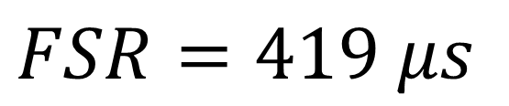
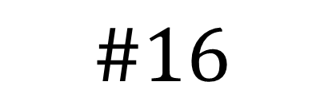

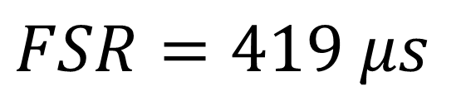
CH 1
$$\#16$$
$$\#1$$
$$\#1$$
SAMPLING
STOP
STOP
STOP
512-taps TDL
512-taps TDL
512-taps TDL
START
START
START
Thermometric
512-bit
Thermometric
512-bit
18-bit
Thermometric
512-bit
Decoder
Decoder
Decoder
Binary
9-bit
Binary
9-bit
Binary
9-bit
Binary
9-bit
Binary
9-bit
Binary
9-bit
Shift
(>> 14)
Sub-Interpolator
Binary
14-bit
Calibrator
$$T_{1}^{COARSE}$$
$$T_{1}^{FINE}$$
14-bit
-
$$FSR=419 μs$$
+
32-bit
$$T_{1}^{NUTT}$$
$$FSR=419 μs$$
$$LSB=100 fs$$

Slide 10

START
Condition
CH1
CH2
CH3
….
CHx
….
STOP
Condition
CH15
CH16
$$0$$
t
Max. Window
Max. Window
Max. Window

Slide 11

START
Condition
CH1
CH2
CH3
Valid = 1
Valid = 1
Valid = 0
….
CHx
….
STOP
Condition
CH15
CH16
t
$$0$$

Slide 12
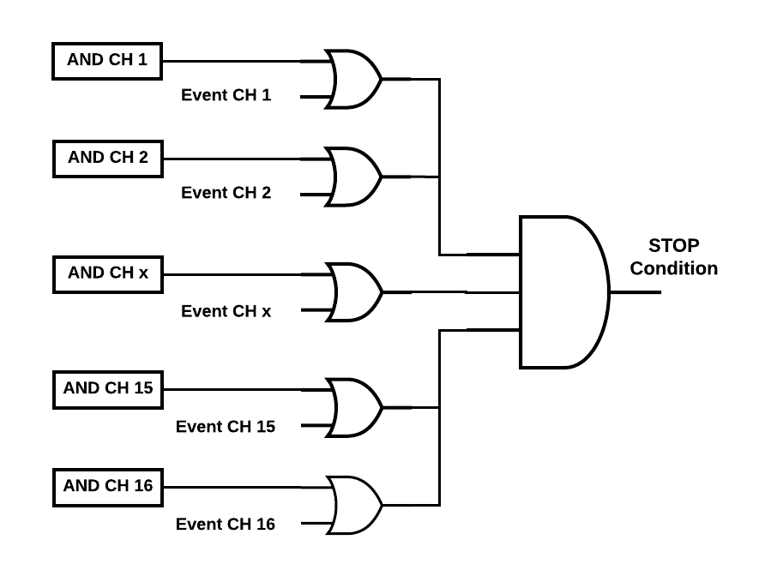
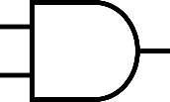
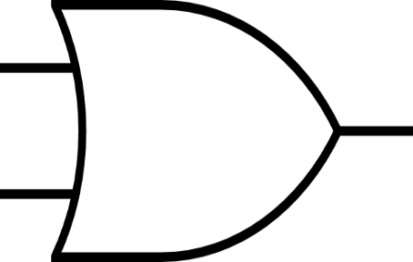
OR CH 1
Event_CH1
OR CH 2
Event_CH2
OR CH x
Event_CHx
OR CH 15
Event_CH15
OR CH 16
Event_CH16

Slide 13
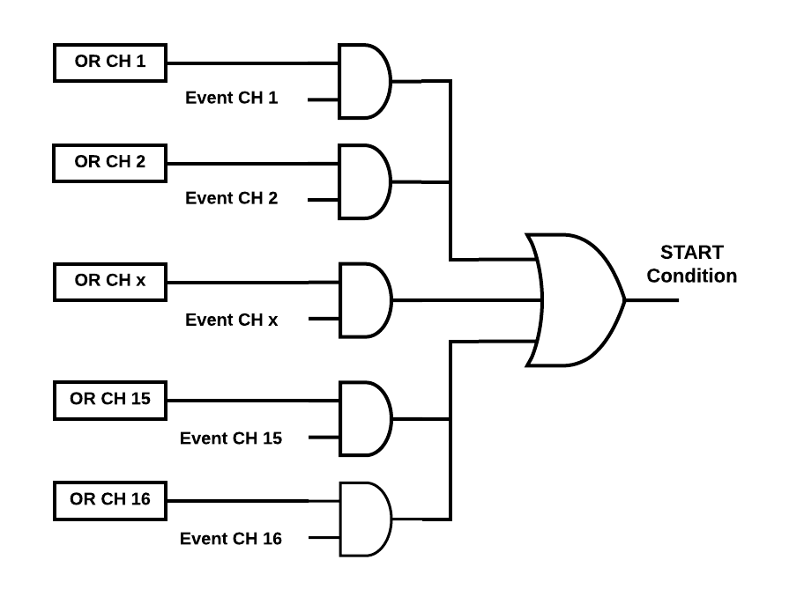
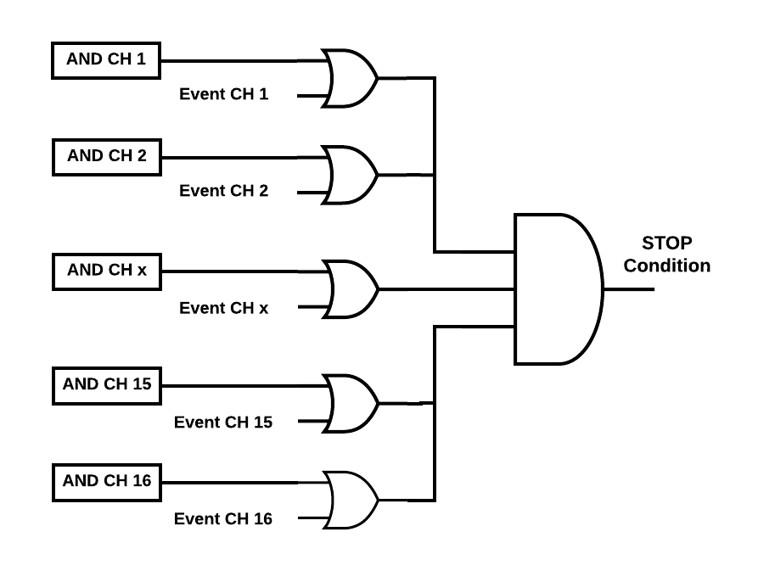

Slide 14

























$$T_{SYNC}∙D$$
$$TAG$$
ON
$$N_{TTM}$$
$$0$$
$$1$$
$$2$$
$$3$$
$$T_{CLK}$$
$$N^{COARSE}$$
$$0$$
$$1$$
$$2$$
$$3$$
$$4$$
$$5$$
$$5$$
$$7$$
$$8$$
$$9$$
$$10$$
$$11$$
$$12$$
$$13$$
$$14$$
$$event[i]$$
START fine i
$$T_{TAG}^{COARSE}$$
$$T_{i}^{COARSE}$$
STOP fine TAG
STOP fine i
$$T_{TAG}^{FINE}$$
$$T_{i}^{FINE}$$
$$N_{TTM}∙T_{SYNC}∙D$$
$$T_{i}^{COARSE}−T_{TAG}^{COARSE}$$
$$T_{i,TTM}$$

Slide 15






Acquisition Window $<T_{FSR}$
ON
$$TRIGGER$$
$$T_{CLK}$$
$$N^{COARSE}$$
$$0$$
$$1$$
$$2$$
$$3$$
$$4$$
$$5$$
$$5$$
$$7$$
$$8$$
$$9$$
$$10$$
$$11$$
$$12$$
$$13$$
$$14$$
$$event[i]$$
$$T_{TRIGGER}^{COARSE}$$
START fine i
$$T_{i}^{COARSE}$$
STOP fine SYNC
STOP fine i
$$T_{TRIGGER}^{FINE}$$
$$T_{i}^{FINE}$$
$$T_{i}^{COARSE}−T_{TRIGGER}^{COARSE}$$
$$T_{MHA,i}$$

Slide 16
16 Decimated Delay-Line |  |  |  |  |  |  |  |  |  |  |  |  |  |  |  | 16 Decimated Delay-Line
CARRY8 #N+3 |  |  |  |  |  |  |  | CARRY8 #N+2 |  |  |  |  |  |  |  | CARRY8 #N+1 |  |  |  |  |  |  |  | CARRY8 #N
CO(7) | CO(6) | CO(5) | CO(4) | CO(3) | CO(2) | CO(1) | CO(0) | CO(7) | CO(6) | CO(5) | CO(4) | CO(3) | CO(2) | CO(1) | CO(0) | CO(7) | CO(6) | CO(5) | CO(4) | CO(3) | CO(2) | CO(1) | CO(0) | CO(7) | CO(6) | CO(5) | CO(4) | CO(3) | CO(2) | CO(1) | CO(0)
1 | 1 | 1 | 1 | 1 | 1 | 1 | 1 | 1 | 1 | 1 | 1 | 1 | 1 | 1 | 1 | 1 | 1 | 1 | 1 | 1 | 1 | 1 | 1 | 1 | 1 | 1 | 1 | 1 | 1 | 1 | 1
1 | 0 | 1 | 1 | 1 | 1 | 1 | 1 | 1 | 1 | 1 | 1 | 1 | 1 | 1 | 1 | 1 | 1 | 1 | 1 | 1 | 1 | 1 | 1 | 1 | 1 | 1 | 1 | 1 | 1 | 1 | 1
1 | 0 | 1 | 0 | 1 | 1 | 1 | 1 | 1 | 1 | 1 | 1 | 1 | 1 | 1 | 1 | 1 | 1 | 1 | 1 | 1 | 1 | 1 | 1 | 1 | 1 | 1 | 1 | 1 | 1 | 1 | 1
1 | 0 | 1 | 0 | 1 | 1 | 1 | 1 | 1 | 1 | 1 | 1 | 1 | 1 | 1 | 1 | 1 | 1 | 1 | 1 | 1 | 1 | 1 | 1 | 1 | 1 | 1 | 1 | 1 | 1 | 1 | 1
1 | 0 | 0 | 0 | 1 | 1 | 1 | 1 | 1 | 1 | 1 | 1 | 1 | 1 | 1 | 1 | 1 | 1 | 1 | 1 | 1 | 1 | 1 | 1 | 1 | 1 | 1 | 1 | 1 | 1 | 1 | 1
1 | 0 | 0 | 0 | 1 | 1 | 1 | 0 | 1 | 1 | 1 | 1 | 1 | 1 | 1 | 1 | 1 | 1 | 1 | 1 | 1 | 1 | 1 | 1 | 1 | 1 | 1 | 1 | 1 | 1 | 1 | 1
1 | 0 | 0 | 0 | 1 | 0 | 1 | 0 | 1 | 1 | 1 | 1 | 1 | 1 | 1 | 1 | 1 | 1 | 1 | 1 | 1 | 1 | 1 | 1 | 1 | 1 | 1 | 1 | 1 | 1 | 1 | 1
0 | 0 | 0 | 0 | 1 | 1 | 1 | 0 | 1 | 1 | 1 | 1 | 1 | 1 | 1 | 1 | 1 | 1 | 1 | 1 | 1 | 1 | 1 | 1 | 1 | 1 | 1 | 1 | 1 | 1 | 1 | 1
0 | 0 | 0 | 0 | 1 | 0 | 1 | 0 | 1 | 1 | 1 | 1 | 1 | 1 | 1 | 1 | 1 | 1 | 1 | 1 | 1 | 1 | 1 | 1 | 1 | 1 | 1 | 1 | 1 | 1 | 1 | 1
0 | 0 | 0 | 0 | 0 | 0 | 1 | 0 | 1 | 1 | 1 | 1 | 1 | 1 | 1 | 1 | 1 | 1 | 1 | 1 | 1 | 1 | 1 | 1 | 1 | 1 | 1 | 1 | 1 | 1 | 1 | 1
0 | 0 | 0 | 0 | 0 | 0 | 1 | 0 | 1 | 1 | 1 | 1 | 1 | 1 | 1 | 1 | 1 | 1 | 1 | 1 | 1 | 1 | 1 | 1 | 1 | 1 | 1 | 1 | 1 | 1 | 1 | 1
0 | 0 | 0 | 0 | 0 | 0 | 1 | 0 | 1 | 0 | 1 | 1 | 1 | 1 | 1 | 1 | 1 | 1 | 1 | 1 | 1 | 1 | 1 | 1 | 1 | 1 | 1 | 1 | 1 | 1 | 1 | 1
0 | 0 | 0 | 0 | 0 | 0 | 1 | 0 | 1 | 0 | 1 | 1 | 1 | 1 | 1 | 1 | 1 | 1 | 1 | 1 | 1 | 1 | 1 | 1 | 1 | 1 | 1 | 1 | 1 | 1 | 1 | 1
0 | 0 | 0 | 0 | 0 | 0 | 1 | 0 | 1 | 0 | 1 | 0 | 1 | 1 | 1 | 1 | 1 | 1 | 1 | 1 | 1 | 1 | 1 | 1 | 1 | 1 | 1 | 1 | 1 | 1 | 1 | 1
0 | 0 | 0 | 0 | 0 | 0 | 0 | 0 | 1 | 0 | 1 | 1 | 1 | 1 | 1 | 1 | 1 | 1 | 1 | 1 | 1 | 1 | 1 | 1 | 1 | 1 | 1 | 1 | 1 | 1 | 1 | 1
0 | 0 | 0 | 0 | 0 | 0 | 0 | 0 | 1 | 0 | 1 | 0 | 1 | 1 | 1 | 1 | 1 | 1 | 1 | 1 | 1 | 1 | 1 | 1 | 1 | 1 | 1 | 1 | 1 | 1 | 1 | 1
0 | 0 | 0 | 0 | 0 | 0 | 0 | 0 | 1 | 0 | 0 | 0 | 1 | 1 | 1 | 1 | 1 | 1 | 1 | 1 | 1 | 1 | 1 | 1 | 1 | 1 | 1 | 1 | 1 | 1 | 1 | 1
0 | 0 | 0 | 0 | 0 | 0 | 0 | 0 | 1 | 0 | 0 | 0 | 1 | 0 | 1 | 1 | 1 | 1 | 1 | 1 | 1 | 1 | 1 | 1 | 1 | 1 | 1 | 1 | 1 | 1 | 1 | 1
0 | 0 | 0 | 0 | 0 | 0 | 0 | 0 | 0 | 0 | 0 | 0 | 1 | 0 | 1 | 1 | 1 | 1 | 1 | 1 | 1 | 1 | 1 | 1 | 1 | 1 | 1 | 1 | 1 | 1 | 1 | 1
0 | 0 | 0 | 0 | 0 | 0 | 0 | 0 | 0 | 0 | 0 | 0 | 1 | 0 | 1 | 1 | 1 | 1 | 1 | 1 | 1 | 1 | 1 | 1 | 1 | 1 | 1 | 1 | 1 | 1 | 1 | 1
0 | 0 | 0 | 0 | 0 | 0 | 0 | 0 | 0 | 0 | 0 | 0 | 1 | 0 | 1 | 0 | 1 | 1 | 1 | 1 | 1 | 1 | 1 | 1 | 1 | 1 | 1 | 1 | 1 | 1 | 1 | 1
0 | 0 | 0 | 0 | 0 | 0 | 0 | 0 | 0 | 0 | 0 | 0 | 1 | 0 | 1 | 0 | 1 | 1 | 1 | 1 | 1 | 1 | 1 | 1 | 1 | 1 | 1 | 1 | 1 | 1 | 1 | 1
0 | 0 | 0 | 0 | 0 | 0 | 0 | 0 | 0 | 0 | 0 | 0 | 0 | 0 | 1 | 0 | 1 | 1 | 1 | 1 | 1 | 1 | 1 | 1 | 1 | 1 | 1 | 1 | 1 | 1 | 1 | 1
0 | 0 | 0 | 0 | 0 | 0 | 0 | 0 | 0 | 0 | 0 | 0 | 0 | 0 | 1 | 0 | 1 | 1 | 1 | 1 | 1 | 1 | 1 | 1 | 1 | 1 | 1 | 1 | 1 | 1 | 1 | 1
0 | 0 | 0 | 0 | 0 | 0 | 0 | 0 | 0 | 0 | 0 | 0 | 0 | 0 | 1 | 0 | 1 | 0 | 1 | 1 | 1 | 1 | 1 | 1 | 1 | 1 | 1 | 1 | 1 | 1 | 1 | 1
0 | 0 | 0 | 0 | 0 | 0 | 0 | 0 | 0 | 0 | 0 | 0 | 0 | 0 | 0 | 0 | 1 | 0 | 1 | 1 | 1 | 1 | 1 | 1 | 1 | 1 | 1 | 1 | 1 | 1 | 1 | 1
0 | 0 | 0 | 0 | 0 | 0 | 0 | 0 | 0 | 0 | 0 | 0 | 0 | 0 | 0 | 0 | 1 | 0 | 1 | 0 | 1 | 1 | 1 | 1 | 1 | 1 | 1 | 1 | 1 | 1 | 1 | 1
0 | 0 | 0 | 0 | 0 | 0 | 0 | 0 | 0 | 0 | 0 | 0 | 0 | 0 | 0 | 0 | 1 | 0 | 1 | 0 | 1 | 1 | 1 | 1 | 1 | 0 | 1 | 0 | 1 | 1 | 1 | 1
0 | 0 | 0 | 0 | 0 | 0 | 0 | 0 | 0 | 0 | 0 | 0 | 0 | 0 | 0 | 0 | 1 | 0 | 0 | 0 | 1 | 1 | 1 | 1 | 1 | 0 | 1 | 0 | 1 | 1 | 1 | 1
0 | 0 | 0 | 0 | 0 | 0 | 0 | 0 | 0 | 0 | 0 | 0 | 0 | 0 | 0 | 0 | 1 | 0 | 0 | 0 | 0 | 1 | 1 | 1 | 1 | 0 | 1 | 0 | 1 | 1 | 1 | 1
0 | 0 | 0 | 0 | 0 | 0 | 0 | 0 | 0 | 0 | 0 | 0 | 0 | 0 | 0 | 0 | 0 | 0 | 0 | 0 | 1 | 1 | 1 | 1 | 1 | 0 | 1 | 0 | 1 | 1 | 1 | 1
0 | 0 | 0 | 0 | 0 | 0 | 0 | 0 | 0 | 0 | 0 | 0 | 0 | 0 | 0 | 0 | 0 | 0 | 0 | 0 | 1 | 0 | 1 | 1 | 1 | 0 | 1 | 0 | 1 | 1 | 1 | 1
0 | 0 | 0 | 0 | 0 | 0 | 0 | 0 | 0 | 0 | 0 | 0 | 0 | 0 | 0 | 0 | 0 | 0 | 0 | 0 | 0 | 1 | 1 | 1 | 1 | 0 | 1 | 0 | 1 | 1 | 1 | 1
0 | 0 | 0 | 0 | 0 | 0 | 0 | 0 | 0 | 0 | 0 | 0 | 0 | 0 | 0 | 0 | 0 | 0 | 0 | 0 | 0 | 0 | 1 | 1 | 1 | 0 | 1 | 0 | 1 | 1 | 1 | 1
0 | 0 | 0 | 0 | 0 | 0 | 0 | 0 | 0 | 0 | 0 | 0 | 0 | 0 | 0 | 0 | 0 | 0 | 0 | 0 | 0 | 0 | 1 | 1 | 1 | 0 | 0 | 0 | 1 | 1 | 1 | 1
0 | 0 | 0 | 0 | 0 | 0 | 0 | 0 | 0 | 0 | 0 | 0 | 0 | 0 | 0 | 0 | 0 | 0 | 0 | 0 | 0 | 0 | 1 | 0 | 1 | 0 | 1 | 0 | 1 | 1 | 1 | 1
0 | 0 | 0 | 0 | 0 | 0 | 0 | 0 | 0 | 0 | 0 | 0 | 0 | 0 | 0 | 0 | 0 | 0 | 0 | 0 | 0 | 0 | 1 | 0 | 1 | 0 | 0 | 0 | 1 | 1 | 1 | 1
0 | 0 | 0 | 0 | 0 | 0 | 0 | 0 | 0 | 0 | 0 | 0 | 0 | 0 | 0 | 0 | 0 | 0 | 0 | 0 | 0 | 0 | 1 | 0 | 0 | 0 | 0 | 0 | 1 | 1 | 1 | 1
0 | 0 | 0 | 0 | 0 | 0 | 0 | 0 | 0 | 0 | 0 | 0 | 0 | 0 | 0 | 0 | 0 | 0 | 0 | 0 | 0 | 0 | 1 | 0 | 0 | 0 | 0 | 0 | 1 | 1 | 1 | 0
0 | 0 | 0 | 0 | 0 | 0 | 0 | 0 | 0 | 0 | 0 | 0 | 0 | 0 | 0 | 0 | 0 | 0 | 0 | 0 | 0 | 0 | 1 | 0 | 0 | 0 | 0 | 0 | 0 | 1 | 1 | 0
0 | 0 | 0 | 0 | 0 | 0 | 0 | 0 | 0 | 0 | 0 | 0 | 0 | 0 | 0 | 0 | 0 | 0 | 0 | 0 | 0 | 0 | 1 | 0 | 0 | 0 | 0 | 0 | 0 | 0 | 1 | 0
0 | 0 | 0 | 0 | 0 | 0 | 0 | 0 | 0 | 0 | 0 | 0 | 0 | 0 | 0 | 0 | 0 | 0 | 0 | 0 | 0 | 0 | 0 | 0 | 0 | 0 | 0 | 0 | 0 | 1 | 1 | 0
0 | 0 | 0 | 0 | 0 | 0 | 0 | 0 | 0 | 0 | 0 | 0 | 0 | 0 | 0 | 0 | 0 | 0 | 0 | 0 | 0 | 0 | 0 | 0 | 0 | 0 | 0 | 0 | 0 | 0 | 1 | 0

Slide 17
16 Decimated Delay-Line |  |  |  |  |  |  |  |  |  |  |  |  |  |  |  | 16 Decimated Delay-Line
CARRY8 #N+3 |  |  |  |  |  |  |  | CARRY8 #N+2 |  |  |  |  |  |  |  | CARRY8 #N+1 |  |  |  |  |  |  |  | CARRY8 #N
1 | 1 | 1 | 1 | 1 | 1 | 1 | 1 | 1 | 1 | 1 | 1 | 1 | 1 | 1 | 1 | 1 | 1 | 1 | 1 | 1 | 1 | 1 | 1 | 1 | 1 | 1 | 1 | 1 | 1 | 1 | 1
1 | 0 | 1 | 1 | 1 | 1 | 1 | 1 | 1 | 1 | 1 | 1 | 1 | 1 | 1 | 1 | 1 | 1 | 1 | 1 | 1 | 1 | 1 | 1 | 1 | 1 | 1 | 1 | 1 | 1 | 1 | 1
1 | 0 | 1 | 0 | 1 | 1 | 1 | 1 | 1 | 1 | 1 | 1 | 1 | 1 | 1 | 1 | 1 | 1 | 1 | 1 | 1 | 1 | 1 | 1 | 1 | 1 | 1 | 1 | 1 | 1 | 1 | 1
1 | 0 | 1 | 0 | 1 | 1 | 1 | 1 | 1 | 1 | 1 | 1 | 1 | 1 | 1 | 1 | 1 | 1 | 1 | 1 | 1 | 1 | 1 | 1 | 1 | 1 | 1 | 1 | 1 | 1 | 1 | 1
1 | 0 | 0 | 0 | 1 | 1 | 1 | 1 | 1 | 1 | 1 | 1 | 1 | 1 | 1 | 1 | 1 | 1 | 1 | 1 | 1 | 1 | 1 | 1 | 1 | 1 | 1 | 1 | 1 | 1 | 1 | 1
1 | 0 | 0 | 0 | 1 | 1 | 1 | 0 | 1 | 1 | 1 | 1 | 1 | 1 | 1 | 1 | 1 | 1 | 1 | 1 | 1 | 1 | 1 | 1 | 1 | 1 | 1 | 1 | 1 | 1 | 1 | 1
1 | 0 | 0 | 0 | 1 | 0 | 1 | 0 | 1 | 1 | 1 | 1 | 1 | 1 | 1 | 1 | 1 | 1 | 1 | 1 | 1 | 1 | 1 | 1 | 1 | 1 | 1 | 1 | 1 | 1 | 1 | 1
0 | 0 | 0 | 0 | 1 | 1 | 1 | 0 | 1 | 1 | 1 | 1 | 1 | 1 | 1 | 1 | 1 | 1 | 1 | 1 | 1 | 1 | 1 | 1 | 1 | 1 | 1 | 1 | 1 | 1 | 1 | 1
0 | 0 | 0 | 0 | 1 | 0 | 1 | 0 | 1 | 1 | 1 | 1 | 1 | 1 | 1 | 1 | 1 | 1 | 1 | 1 | 1 | 1 | 1 | 1 | 1 | 1 | 1 | 1 | 1 | 1 | 1 | 1
0 | 0 | 0 | 0 | 0 | 0 | 1 | 0 | 1 | 1 | 1 | 1 | 1 | 1 | 1 | 1 | 1 | 1 | 1 | 1 | 1 | 1 | 1 | 1 | 1 | 1 | 1 | 1 | 1 | 1 | 1 | 1
0 | 0 | 0 | 0 | 0 | 0 | 1 | 0 | 1 | 1 | 1 | 1 | 1 | 1 | 1 | 1 | 1 | 1 | 1 | 1 | 1 | 1 | 1 | 1 | 1 | 1 | 1 | 1 | 1 | 1 | 1 | 1
0 | 0 | 0 | 0 | 0 | 0 | 1 | 0 | 1 | 0 | 1 | 1 | 1 | 1 | 1 | 1 | 1 | 1 | 1 | 1 | 1 | 1 | 1 | 1 | 1 | 1 | 1 | 1 | 1 | 1 | 1 | 1
0 | 0 | 0 | 0 | 0 | 0 | 1 | 0 | 1 | 0 | 1 | 1 | 1 | 1 | 1 | 1 | 1 | 1 | 1 | 1 | 1 | 1 | 1 | 1 | 1 | 1 | 1 | 1 | 1 | 1 | 1 | 1
0 | 0 | 0 | 0 | 0 | 0 | 1 | 0 | 1 | 0 | 1 | 0 | 1 | 1 | 1 | 1 | 1 | 1 | 1 | 1 | 1 | 1 | 1 | 1 | 1 | 1 | 1 | 1 | 1 | 1 | 1 | 1
0 | 0 | 0 | 0 | 0 | 0 | 0 | 0 | 1 | 0 | 1 | 1 | 1 | 1 | 1 | 1 | 1 | 1 | 1 | 1 | 1 | 1 | 1 | 1 | 1 | 1 | 1 | 1 | 1 | 1 | 1 | 1
0 | 0 | 0 | 0 | 0 | 0 | 0 | 0 | 1 | 0 | 1 | 0 | 1 | 1 | 1 | 1 | 1 | 1 | 1 | 1 | 1 | 1 | 1 | 1 | 1 | 1 | 1 | 1 | 1 | 1 | 1 | 1
0 | 0 | 0 | 0 | 0 | 0 | 0 | 0 | 1 | 0 | 0 | 0 | 1 | 1 | 1 | 1 | 1 | 1 | 1 | 1 | 1 | 1 | 1 | 1 | 1 | 1 | 1 | 1 | 1 | 1 | 1 | 1
0 | 0 | 0 | 0 | 0 | 0 | 0 | 0 | 1 | 0 | 0 | 0 | 1 | 0 | 1 | 1 | 1 | 1 | 1 | 1 | 1 | 1 | 1 | 1 | 1 | 1 | 1 | 1 | 1 | 1 | 1 | 1
0 | 0 | 0 | 0 | 0 | 0 | 0 | 0 | 0 | 0 | 0 | 0 | 1 | 0 | 1 | 1 | 1 | 1 | 1 | 1 | 1 | 1 | 1 | 1 | 1 | 1 | 1 | 1 | 1 | 1 | 1 | 1
0 | 0 | 0 | 0 | 0 | 0 | 0 | 0 | 0 | 0 | 0 | 0 | 1 | 0 | 1 | 1 | 1 | 1 | 1 | 1 | 1 | 1 | 1 | 1 | 1 | 1 | 1 | 1 | 1 | 1 | 1 | 1
0 | 0 | 0 | 0 | 0 | 0 | 0 | 0 | 0 | 0 | 0 | 0 | 1 | 0 | 1 | 0 | 1 | 1 | 1 | 1 | 1 | 1 | 1 | 1 | 1 | 1 | 1 | 1 | 1 | 1 | 1 | 1
0 | 0 | 0 | 0 | 0 | 0 | 0 | 0 | 0 | 0 | 0 | 0 | 1 | 0 | 1 | 0 | 1 | 1 | 1 | 1 | 1 | 1 | 1 | 1 | 1 | 1 | 1 | 1 | 1 | 1 | 1 | 1
0 | 0 | 0 | 0 | 0 | 0 | 0 | 0 | 0 | 0 | 0 | 0 | 0 | 0 | 1 | 0 | 1 | 1 | 1 | 1 | 1 | 1 | 1 | 1 | 1 | 1 | 1 | 1 | 1 | 1 | 1 | 1
0 | 0 | 0 | 0 | 0 | 0 | 0 | 0 | 0 | 0 | 0 | 0 | 0 | 0 | 1 | 0 | 1 | 1 | 1 | 1 | 1 | 1 | 1 | 1 | 1 | 1 | 1 | 1 | 1 | 1 | 1 | 1
0 | 0 | 0 | 0 | 0 | 0 | 0 | 0 | 0 | 0 | 0 | 0 | 0 | 0 | 1 | 0 | 1 | 0 | 1 | 1 | 1 | 1 | 1 | 1 | 1 | 1 | 1 | 1 | 1 | 1 | 1 | 1
0 | 0 | 0 | 0 | 0 | 0 | 0 | 0 | 0 | 0 | 0 | 0 | 0 | 0 | 0 | 0 | 1 | 0 | 1 | 1 | 1 | 1 | 1 | 1 | 1 | 1 | 1 | 1 | 1 | 1 | 1 | 1
0 | 0 | 0 | 0 | 0 | 0 | 0 | 0 | 0 | 0 | 0 | 0 | 0 | 0 | 0 | 0 | 1 | 0 | 1 | 0 | 1 | 1 | 1 | 1 | 1 | 1 | 1 | 1 | 1 | 1 | 1 | 1
0 | 0 | 0 | 0 | 0 | 0 | 0 | 0 | 0 | 0 | 0 | 0 | 0 | 0 | 0 | 0 | 1 | 0 | 1 | 0 | 1 | 1 | 1 | 1 | 1 | 0 | 1 | 0 | 1 | 1 | 1 | 1
0 | 0 | 0 | 0 | 0 | 0 | 0 | 0 | 0 | 0 | 0 | 0 | 0 | 0 | 0 | 0 | 1 | 0 | 0 | 0 | 1 | 1 | 1 | 1 | 1 | 0 | 1 | 0 | 1 | 1 | 1 | 1
0 | 0 | 0 | 0 | 0 | 0 | 0 | 0 | 0 | 0 | 0 | 0 | 0 | 0 | 0 | 0 | 1 | 0 | 0 | 0 | 0 | 1 | 1 | 1 | 1 | 0 | 1 | 0 | 1 | 1 | 1 | 1
0 | 0 | 0 | 0 | 0 | 0 | 0 | 0 | 0 | 0 | 0 | 0 | 0 | 0 | 0 | 0 | 0 | 0 | 0 | 0 | 1 | 1 | 1 | 1 | 1 | 0 | 1 | 0 | 1 | 1 | 1 | 1
0 | 0 | 0 | 0 | 0 | 0 | 0 | 0 | 0 | 0 | 0 | 0 | 0 | 0 | 0 | 0 | 0 | 0 | 0 | 0 | 1 | 0 | 1 | 1 | 1 | 0 | 1 | 0 | 1 | 1 | 1 | 1
0 | 0 | 0 | 0 | 0 | 0 | 0 | 0 | 0 | 0 | 0 | 0 | 0 | 0 | 0 | 0 | 0 | 0 | 0 | 0 | 0 | 1 | 1 | 1 | 1 | 0 | 1 | 0 | 1 | 1 | 1 | 1
0 | 0 | 0 | 0 | 0 | 0 | 0 | 0 | 0 | 0 | 0 | 0 | 0 | 0 | 0 | 0 | 0 | 0 | 0 | 0 | 0 | 0 | 1 | 1 | 1 | 0 | 1 | 0 | 1 | 1 | 1 | 1
0 | 0 | 0 | 0 | 0 | 0 | 0 | 0 | 0 | 0 | 0 | 0 | 0 | 0 | 0 | 0 | 0 | 0 | 0 | 0 | 0 | 0 | 1 | 1 | 1 | 0 | 0 | 0 | 1 | 1 | 1 | 1
0 | 0 | 0 | 0 | 0 | 0 | 0 | 0 | 0 | 0 | 0 | 0 | 0 | 0 | 0 | 0 | 0 | 0 | 0 | 0 | 0 | 0 | 1 | 0 | 1 | 0 | 1 | 0 | 1 | 1 | 1 | 1
0 | 0 | 0 | 0 | 0 | 0 | 0 | 0 | 0 | 0 | 0 | 0 | 0 | 0 | 0 | 0 | 0 | 0 | 0 | 0 | 0 | 0 | 1 | 0 | 1 | 0 | 0 | 0 | 1 | 1 | 1 | 1
0 | 0 | 0 | 0 | 0 | 0 | 0 | 0 | 0 | 0 | 0 | 0 | 0 | 0 | 0 | 0 | 0 | 0 | 0 | 0 | 0 | 0 | 1 | 0 | 0 | 0 | 0 | 0 | 1 | 1 | 1 | 1
0 | 0 | 0 | 0 | 0 | 0 | 0 | 0 | 0 | 0 | 0 | 0 | 0 | 0 | 0 | 0 | 0 | 0 | 0 | 0 | 0 | 0 | 1 | 0 | 0 | 0 | 0 | 0 | 1 | 1 | 1 | 0
0 | 0 | 0 | 0 | 0 | 0 | 0 | 0 | 0 | 0 | 0 | 0 | 0 | 0 | 0 | 0 | 0 | 0 | 0 | 0 | 0 | 0 | 1 | 0 | 0 | 0 | 0 | 0 | 0 | 1 | 1 | 0
0 | 0 | 0 | 0 | 0 | 0 | 0 | 0 | 0 | 0 | 0 | 0 | 0 | 0 | 0 | 0 | 0 | 0 | 0 | 0 | 0 | 0 | 1 | 0 | 0 | 0 | 0 | 0 | 0 | 0 | 1 | 0
0 | 0 | 0 | 0 | 0 | 0 | 0 | 0 | 0 | 0 | 0 | 0 | 0 | 0 | 0 | 0 | 0 | 0 | 0 | 0 | 0 | 0 | 0 | 0 | 0 | 0 | 0 | 0 | 0 | 1 | 1 | 0
0 | 0 | 0 | 0 | 0 | 0 | 0 | 0 | 0 | 0 | 0 | 0 | 0 | 0 | 0 | 0 | 0 | 0 | 0 | 0 | 0 | 0 | 0 | 0 | 0 | 0 | 0 | 0 | 0 | 0 | 1 | 0

Slide 18

$$2.5 ns$$
400 MHz Clock
12-bit Counter
$$0$$
$$1$$
$$2$$
$$3$$
$$4$$
$$5$$
$$T_{i}^{COARSE}$$
$$event[i]$$
$$T_{i}^{FINE}$$
$$T_{j}^{COARSE}$$
$$event[j]$$
$$T_{j}^{FINE}$$
$$0$$
$$T_{i}^{NUTT}$$
$$T_{ij}$$
$$T_{j}^{NUTT}$$
time

Slide 19
VHDL TDC
CH 24
COUNTER
Input
Logic
$$\#1$$
$$\#16$$
Input
Events
SAMPLING
STOP
STOP
512-taps TDL
512-taps TDL
24
START
START
CH 1
$$\#16$$
$$\#1$$
Thermometric
512-bit
Thermometric
512-bit
12-bit
SAMPLING
STOP
STOP
512-taps TDL
512-taps TDL
START
START
Decoder
Decoder
615 MHz
Binary
9-bit
Binary
9-bit
Binary
9-bit
Binary
9-bit
Thermometric
512-bit
Thermometric
512-bit
12-bit
Shift @ CLK TDC
(>> 13)
100 MHz
Sub-Interpolator
Decoder
Decoder
Binary
14-bit
Binary
9-bit
Binary
9-bit
Binary
9-bit
Binary
9-bit
Calibrator
Shift
(>> 13)
$$T_{24}^{COARSE}$$
Sub-Interpolator
14-bit
$$T_{24}^{FINE}$$
Binary
14-bit
+
$$FSR=419 μs$$
-
Calibrator
$$T_{24}^{NUTT}$$
32-bit
$$T_{1}^{COARSE}$$
$$T_{1}^{FINE}$$
14-bit
$$FSR=419 μs$$
$$FSR=419 μs$$
-
+
$$LSB=100 fs$$
$$T_{1}^{NUTT}$$
32-bit
$$FSR=419 μs$$
$$LSB=100 fs$$
CH24
CH1

Slide 20
CH 1
$$\#16$$
$$\#1$$
SAMPLING
STOP
STOP
512-taps TDL
512-taps TDL
START
START
Thermometric
512-bit
Thermometric
512-bit
12-bit
Decoder
Decoder
Binary
9-bit
Binary
9-bit
Binary
9-bit
Binary
9-bit
Shift
(>> 13)
Sub-Interpolator
Binary
14-bit
Calibrator
$$T_{1}^{COARSE}$$
$$T_{1}^{FINE}$$
14-bit
$$FSR=419 μs$$
STOP
64 CARRY8
(TDL 512-tap)
-
+
START
$$T_{1}^{NUTT}$$
32-bit
CO Thermometric
512-bit
CO Thermometric
512-bit
$$FSR=419 μs$$
$$LSB=100 fs$$
Decoder
Binary
9-bit
Binary
9-bit

Slide 21





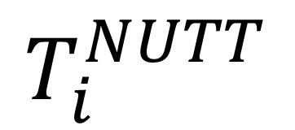
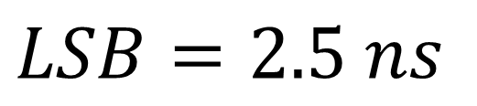
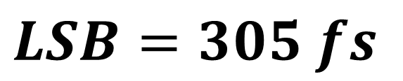
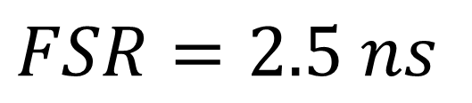

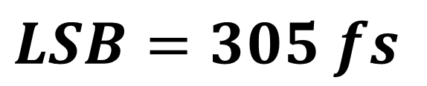
x64
CO(7)
O(7)
CO(6)
O(6)
CO(5)
O(5)
CO(4)
O(4)
CH i-th
CO(3)
Event i-th
O(3)
INPUT
LOGIC
COARSE
SAMPLER
STOP
64 CARRY8
(TDL 512-tap)
STOP
64 CARRY8
(TDL 512-tap)
CO(2)
$$\#1$$
O(2)
$$\#4$$
START
START
CO(1)
CO #1 Thermometric
512-bit
O #2 Thermometric
512-bit
CO #7 Thermometric
512-bit
O #8 Thermometric
512-bit
O(1)
CO(0)
O(0)
Decoder
Decoder
Decoder
Decoder
Shift
(>> 13)
Binary
9-bit
Binary
9-bit
Binary
9-bit
Binary
9-bit
Binary
9-bit
Binary
9-bit
Binary
9-bit
Binary
9-bit
400 MHz
Sub-Interpolator
13-bit
12-bit
FIFO
DUAL PORT
FIFO
DUAL PORT
$$FSR=2.5 ns$$
$$FSR=10.24 μs$$
200 MHz
$$LSB=305 fs$$
Calibrator
$$LSB=2.5 ns$$
Shift
(>> 3)
13-bit
$$T_{i}^{COARSE}$$
$$T_{i}^{FINE}$$
-
+
25-bit
$$T_{i}^{NUTT}$$
$$FSR=10.24 μs$$
$$LSB=305 fs$$

Slide 22
CH 1
$$\#16$$
$$\#1$$
SAMPLING
STOP
STOP
512-taps TDL
512-taps TDL
START
START
Thermometric
512-bit
Thermometric
512-bit
12-bit
Decoder
Decoder
Binary
9-bit
Binary
9-bit
Binary
9-bit
Binary
9-bit
Shift
(>> 13)
Sub-Interpolator
Binary
14-bit
Calibrator
$$T_{1}^{COARSE}$$
$$T_{1}^{FINE}$$
14-bit
$$FSR=419 μs$$
-
+
$$T_{1}^{NUTT}$$
32-bit
$$FSR=419 μs$$
$$LSB=100 fs$$

Slide 23
Ideal Propagation
Bubble Error
... |0000 0000 | 0100 0100 | 0101 0011 | 1111 1111 | …
Thermometric Code
With Bubble Error
512-tap
Real Propagation over TDL
DDL #16
DDL #4
DDL #3
DDL #2
DDL #1
... | 0 | 0 | …
...
... | 0 | 1 | …
... | 1 | 1 | …
... | 0 | 1 | …
... | 0 | 1 | …
16 Thermometric Codes
Without Bubble Error
16×32-tap
Edge Detector
Edge Detector
Edge Detector
Edge Detector
Edge Detector
5-bit
5-bit
5-bit
5-bit
5-bit
16 Binary Codes
Merging (e.g. Sum or Sort)
Decoder
9-bit
1 Binary Code

Slide 24
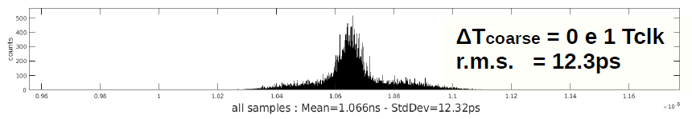
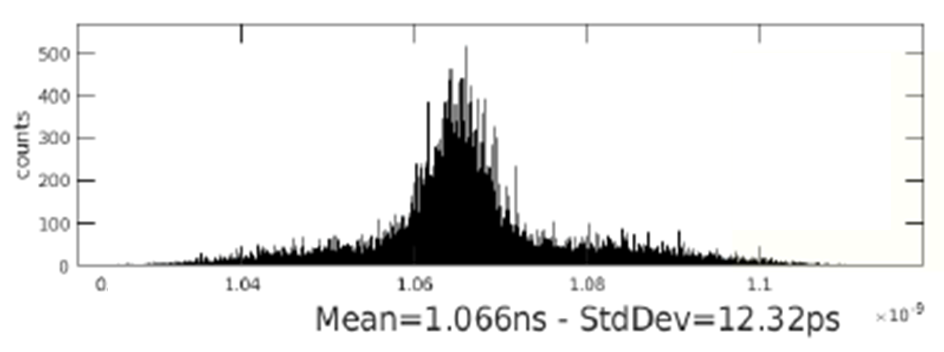

Slide 25
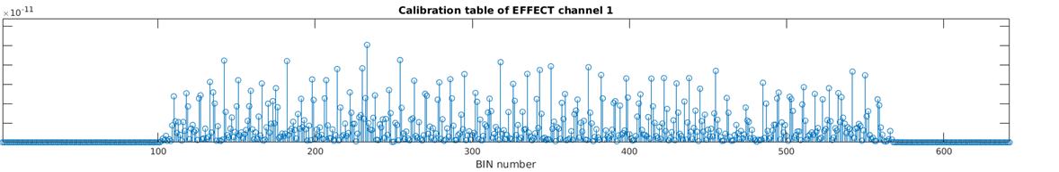
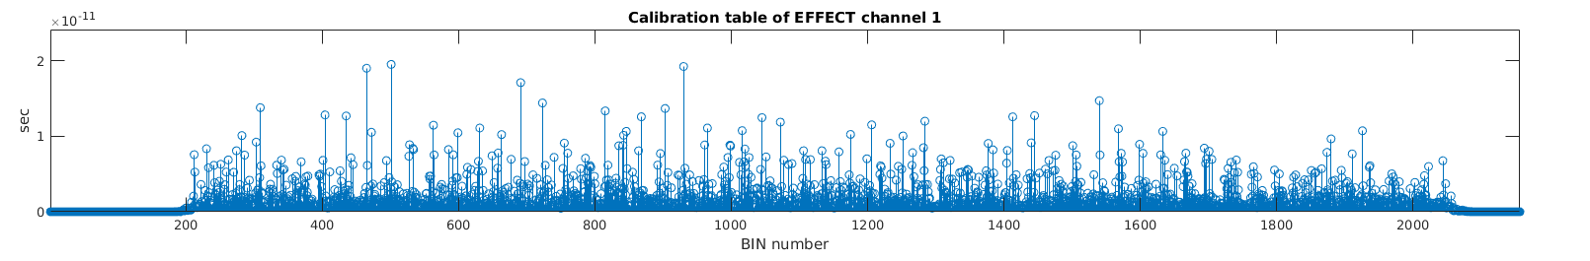
TDL Calibration Table
60
50
40
30
20
10
0
No Sub-Interpolation
Propagation Delay [ps]
100
V-TDL Calibration Table
16th Sub-Interpolation Order

Slide 26


$$2.5 ns$$
Clock
Coarse
Counter
$$0$$
$$1$$
$$2$$
$$3$$
$$4$$
$$T_{i}$$
$$T_{i}^{COARSE}$$
$$event[i]$$
$$T_{i}^{FINE}$$

