Slide 1
Homework Time!
Preview of Unit 5 Homework

Slide 2
Objectives
Utilize Pandas to perform data analysis
Visualize data using Matplotlib & Pandas

Slide 3
Full Instructions & Data Set
Found in 05-Matplotlib > Homework > Instructions > README.md
Data contained in Pymaceuticals > data

Slide 4
Background
Matplotlib is popular, comprehensive library used to create a range of visualizations in Python
Data analysts regularly use visualizations to convey the meaning of data
What good is data without a good “plot” to tell the story?
In this assignment, you’ll pretend you’re a senior data analyst at a pharmaceutical company, Pymaceuticals, that is currently testing the performance of a new cancer drug
You will use Pandas and Matplotlib to analyze and visualize data to produce meaningful insights on the drugs performance against other treatment options

Slide 5
Before You Begin
Create a new repository in GitHub called “matplotlib-challenge”
Clone repository to your computer
Inside your local repository (computer):
Create a data directory
Store the csv files you will use for this assignment in here
Create an analysis directory
Store the plot images created throughout this assignment in here (should be automatically stored here when code is run)
Move the starter Jupyter Notebook provided into your repository
Make sure your Jupyter Notebook also shows the plots and calculations requested

Slide 6
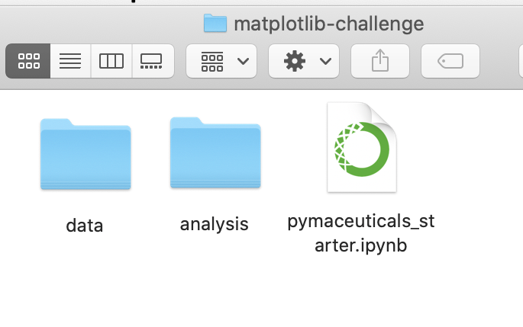
File Structure Example

Slide 7
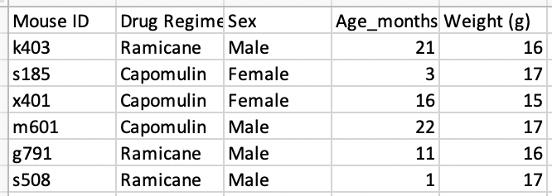
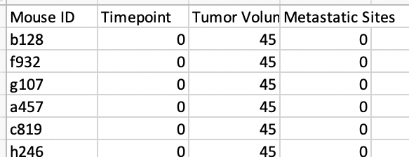
Data & Instructions Preview
Using the data to the left, use Pandas & Matplotlib to do the following:
Clean the data
Generate a summary statistics table
Create a bar graph, pie chart, box & whisker plot, and scatter plot
Calculate correlation coefficient and linear regression model
… more information on deliverables can be found in the instructions!

Slide 8
Pymaceuticals Reminders
You must use Pandas and Matplotlib
You must use Jupyter Notebook
Some instructions require you to create two identical graphs – one for Pandas, one for Matplotlib
Easy to miss these specifics!
Download and submit your Jupyter Notebook as an .ipynb file with the plots and calculations shown
Include a written description of at least three observations and/or inferences that can be made from the data
Include these at the top of the notebook
You must use proper labeling of your plots
Plot titles, axis labels, legend labels, x-axis and y-axis limits, etc.
... Please use the Pymaceuticals_starter.ipynb file contained in the Pymaceuticals folder as a reference on the expected format

Slide 9
Considerations Cont...
These tasks are challenging, be patient with yourself
You have been provided a starter notebook – use the comments as a reminder of the steps to follow as you complete the assignment
Don’t get bogged down in small details – if you can’t figure something out, switch tasks or take a break and then come back to it
Break down the objectives into achievable tasks
Start early!
Sit with the discomfort and unknowing
Get comfortable with Google, Stack Overflow, and reading documentation

Slide 10
Submission
Commit and push changes to your GitHub repository
Example of how to do this:
Open up terminal or GitBash
Cd foldername
Git add .
// Adds all changes so you’re ready for commit
Git commit –m “message”
// Commits changes - use a meaningful message
Git push
You’re done!

Slide 11

Questions?

