Slide 1
AdventureWorks
Full-Stack Sales Pipeline
Portfolio Project
Tools: MySQL · SQL · Power BI · Data Modeling · Business Intelligence

Slide 2
Project Overview
What I Built
MySQL + Workbench
Analyzed 4,000 reseller sales orders across 632 unique resellers and 17 salespersons in 10 global territories.
Goal: Identify which territories are underperforming and whether the gap is driven by reseller coverage, salesperson quality, or product-category fit.
Scope: Accessories, Bikes, Clothing, and Components across 2017–2020.
Database hosting, cleaning queries, view creation
SQL
Data inspection, transformation, view architecture
Power BI
Live connection, DAX measures, 3-page dashboard
CSV → MySQL → SQL View → Power BI Dashboard

Slide 3
Data Cleaning
& Preparation
Building a trustworthy foundation before any analysis

Slide 4
Data Cleaning — What I Checked & Why It Matters
✓
Row Count & Null Checks
0 nulls across all key columns in sales, product, reseller tables
Action:
No action needed
✓
Duplicate Order Numbers
Multiple rows per order number — investigated as multi-line orders
Action:
Retained — legitimate one order, multiple products
⚠
OrderDate Format
Stored as full text — "Friday, August 25, 2017"
Action:
Parsed to DATE using STR_TO_DATE with %W, %M %d, %Y
✓
Whitespace — All Tables
Potential leading/trailing spaces in product, reseller, salesperson
Action:
TRIM applied to all text columns across 3 tables
⚠
Currency Formatting
StandardCost stored with $ and , characters
Action:
Stripped using REPLACE before numeric use
⚠
Character Encoding
José Saraiva stored as JosÃ© Saraiva in salesperson table
Action:
Fixed with targeted UPDATE using LIKE pattern match

Slide 5
Territory Analysis
& Key Findings
Mapping sales performance to find underperforming markets

Slide 6
Dataset at a Glance — Key Metrics
4,000
632
17
10
Total Orders
Unique Resellers
Salespersons
Territories
Orders by Territory
212.7
Southwest
717
Canada
658
Orders per Salesperson
Northwest
513
Team average — but distribution
is highly uneven across territories
Southeast
455
Central
363
Northeast
331
France
179
United Kingdom
174
Germany
118
Australia
108

Slide 7
Territory Performance — Coverage Drives Volume
Orders by Category Across All Territories
< 230
Bikes
33.2% · 3,009 orders
combined orders
Australia + Germany
Components
vs. 717 for Southwest alone
27.6% · 2,505 orders
Clothing
Concentration risk — 2 territories
underserved vs. peer markets
25.4% · 2,299 orders
Accessories
13.8% · 1,249 orders

Slide 8
Monthly Order Trend — Consistent Growth 2017–2020
+260%
order growth
2017 → 2020
~50/month
mid-2017 starting point
~185/month
by late 2020 peak
Consistent
upward trend — no plateau

Slide 9
Salesperson Performance & Reseller Coverage Analysis
Top Salespersons by Orders
Reseller Coverage vs. Orders — By Territory
Tsvi Reiter
430
Linda Mitchell
310
Jae Pak
295
Jillian Carson
220
Michael Blythe
180
Garrett Vargas
175
Tete Mensa-Annan
120
Key finding: Reseller count correlates directly with order volume — underperformance is a coverage gap, not a headcount problem.

Slide 10
Business
Recommendations
Turning findings into actionable next steps

Slide 11
Three Data-Backed Recommendations
Expand the Reseller Network in Australia & Germany
01
Australia and Germany combined for fewer than 230 orders — against 717 for Southwest. The data shows coverage drives volume, not rep count. Recruiting 20–30 new reseller partners in each territory is the highest-ROI action before adding any salesperson headcount.
Investigate France & United Kingdom Engagement
02
Both markets have adequate reseller coverage but disproportionately low order volumes compared to peer territories. The gap points to a product-fit or sales engagement issue — conduct a Bikes-focused sales review in both markets before any structural changes.
Replicate Tsvi Reiter's Engagement Model Team-Wide
03
At 400+ orders, Tsvi Reiter operates at nearly double the team average. Documenting and sharing his reseller engagement approach across the wider team could meaningfully lift performance in mid-tier territories without additional headcount investment.

Slide 12
Project Deliverables & Power BI Dashboard
Power BI Dashboard — 3 Pages
SQL File — fullstack_project.sql
KPI Cards
Phase 1 — Inspection
Total orders, resellers, salespersons, orders/salesperson
7 queries: row counts, null checks, duplicates, date format audit
Territory Bar Chart
All 10 territories ranked by order volume
Phase 2 — Cleaning
Monthly Trend
Date parsing, TRIM, REPLACE, encoding fix
Order growth from 2017 to 2020
Scatter Plot
Phase 3 — View Creation
Salesperson efficiency — resellers vs. orders
vw_sales_analysis joining all 5 tables
Region × Category Matrix
Order counts by territory and product category
Phase 4 — Business Queries
Salesperson Bar Chart
6 queries answering territory, category, salesperson, and trend questions
All 17 salespersons ranked with region color coding
Product Charts
Top 10 products, donut by category, subcategory column
Slicers (×3)
Year, SalesGroup, Category — cross-filter all visuals

Slide 13
Skills Demonstrated in This Project
SQL Data Inspection
SQL Data Cleaning
Null checks, duplicate detection, referential integrity, date format audit, character encoding fix
STR_TO_DATE parsing, TRIM across 3 tables, REPLACE for currency symbols, targeted UPDATE fix
SQL View Architecture
Power BI & DAX
Single analytical view joining 5 tables — Power BI reads one clean object, not raw tables
Live MySQL connection, DISTINCTCOUNT and DIVIDE measures, 3-page dashboard, tile slicers, cross-filtering
Business Insight
Documentation
Translated territory data into 3 actionable recommendations tied to reseller coverage and engagement
GitHub README in narrative style, SQL file with inline comments, pipeline architecture diagram

Slide 14
Thank You
AdventureWorks Full-Stack Sales Pipeline
4,000
632
10
3
Orders Analyzed
Resellers
Territories
Recommendations
Tools: MySQL · SQL · Power BI · Data Modeling · Business Intelligence

Slide 15
Power BI
Dashboard Preview
3 pages — Executive Summary · Territory Deep Dive · Product Performance

Slide 16
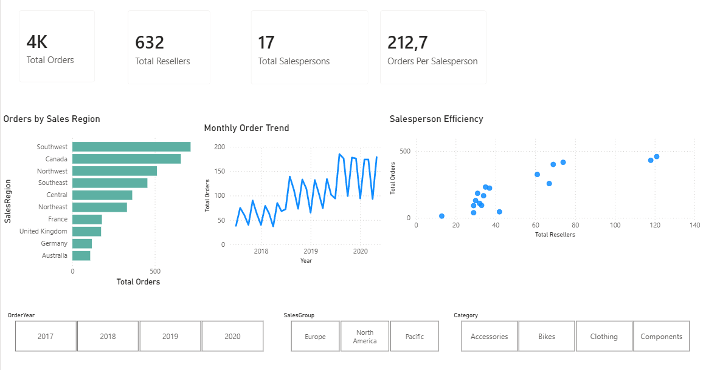
Executive Summary
KPI Cards · Territory Bar Chart · Monthly Trend · Salesperson Scatter · 3 Slicers
Australia & Germany - lowest territory volume

Slide 17
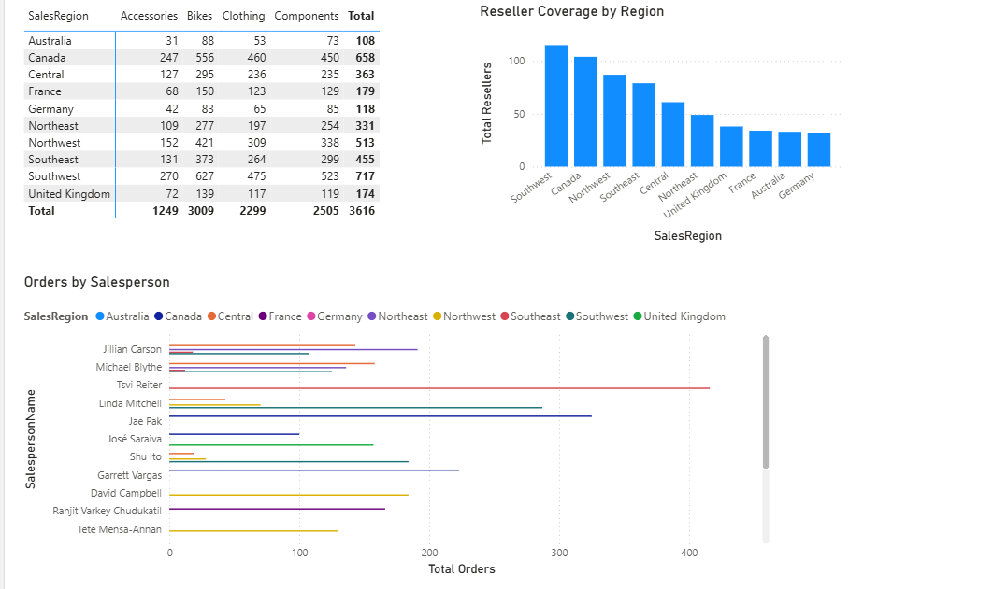
Territory Deep Dive
Region × Category Matrix · Reseller Coverage Chart · Orders by Salesperson
Tsvi Reiter at 400+ orders - nearly double the team average - top of the bar chart

Slide 18
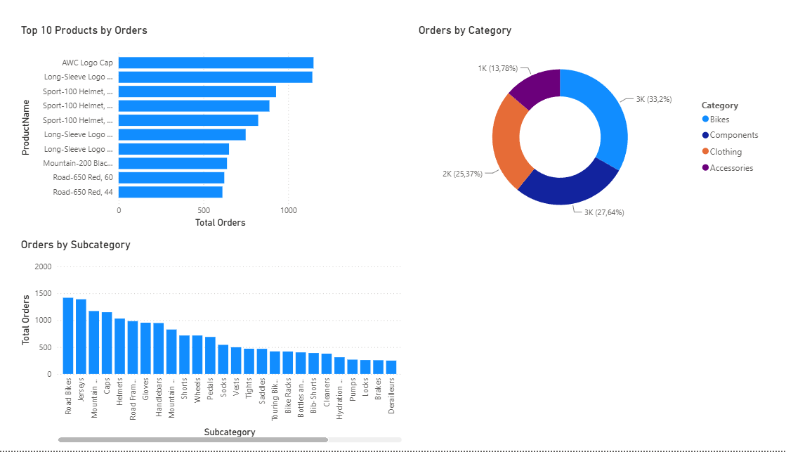
Product Performance
Top 10 Products · Orders by Category (Donut) · Orders by Subcategory
Bikes = 33.2% of all orders · AWC Logo Cap & Long-Sleeve Logo are top products

