Slide 1
ARM 7 architecture
By
Anuja Gote

Slide 2
INTRODUCTION
Developed at Acorn Computers Limited
Between 1983 and 1985
First RISC microprocessor
1990 ARM Limited was established
ARM Ltd does not fabricate ICs, it develops and sells architecture

Slide 3
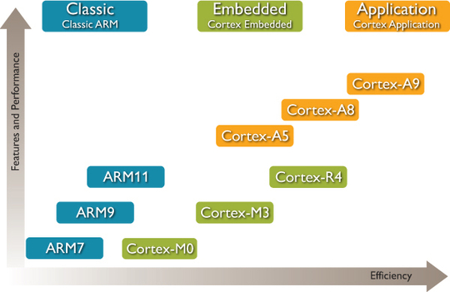
ARM Development

Slide 4
FEATURES OF ARM PROCESSORS
Based on RISC architectures
Small Implementation size
Very low power consumption
Performance
Large uniform register file
Load/store architecture
data-processing operations only operate on register contents
Simple addressing modes
5 types of instructions
Auto-increment and auto-decrement addressing modes

Slide 5
Features
Control over both the Arithmetic Logic Unit (ALU) and shifter
In most data-processing instructions
Maximize the use of an ALU and a shifter
Load and store multiple instructions
Maximize data throughput
Conditional execution of almost all instructions
Maximize execution throughput
3 address instructions
2 source and 1 destination

Slide 6
Features
Three basic instruction sets
A 32- bit ARM instruction set
A 16 –bit thumb instruction set and
The 8-bit java byte code used in jazelle state
7 operating modes
1 unprivileged and 6 privileged
Arm7
Von Neumann architecture
3 stage pipelining
Fetch – decode – Execute

Slide 7
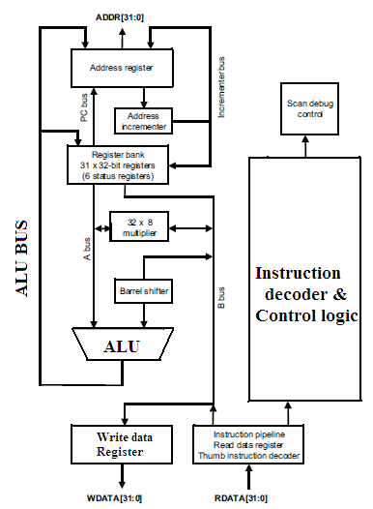
ARCHITECTURE

Slide 8
ARCHITECTURE
Von Neumann model
Single bus for both data and instructions
The decrease in performance – overcome by pipelining
Advanced microcontroller bus architecture (AMBA) bus architecture
AMBA high-speed bus (AHB) or the advanced system bus (ASB)
Advanced peripheral Bus (APB).

Slide 9
ARCHITECTURE
ARM Processor consists of
Arithmetic logic unit (32-bit)
One booth multiplier(32-bit)
One barrel shifter
One control unit
Register file of 37 registers each of 32 bits
Program status register of 32 bits
Instruction register,
Memory data read and write register and memory address register

Slide 10
ARCHITECTURE
One priority encoder
Multiple load and store instruction
To indicate which register in the register file to be used.
Data items are placed in register file
Instructions typically use two source registers.
A Barrel shifter on the data path can preprocess data before it enters ALU
Increment/decrement logic can update register content for sequential access independent of ALU

Slide 11
Processor Modes
Seven processor modes
Six privileged modes and one non-privileged mode called user mode.
Privileged modes
Abort,
Fast interrupt request (FIQ),
Interrupt request (IRQ),
Supervisor (SVC),
System,
And undefined

Slide 12
Processor Modes
Privileged mode
Full read write access of status register
Unprivileged mode
Full read but partial or nil write access of status register
5 least significant bits (LSB)
of status register represent
the processor mode
10000 | User
10001 | FIQ
10010 | IRQ
10011 | SVC
10111 | ABORT
11011 | UND

Slide 13
Unprivileged
USER
User mode is used for programs and applications
Most applications run in this mode
when normal execution is under process
It has its own 16 GPR and CPSR
User : 10000

Slide 14
Privileged
FIQ
IRQ
This mode is used to handle interrupt requiring FAST response with low latency
It uses R0 – R7 registers of USER mode.
E.g.:
DMA transfer
FIQ : 10001
This mode used to handle general interrupt
It uses R0 – R12 registers of USER mode
E.g.:
Interrupting peripherals
IRQ : 10010

Slide 15
Privileged
ABORT
UNDEFINED
The processor enters abort mode when there is a failed attempt to access memory.
It uses R0 – R12 registers of USER mode
ABORT : 10111
Undefined mode is used when the processor encounters
an instruction that is undefined
or not supported by the implementation.
It uses R0 – R12 registers of USER mode
UND : 11011

Slide 16
Privileged
SUPERVISOR
SYSTEM
Supervisor mode is the mode that the processor is in after reset
It is generally the mode that an operating system kernel operates in.
Used for protected mode operation
It uses R0 – R12 registers of USER mode
SVC : 10011
System mode is a special version of user mode
It allows full read-write access to the CPSR.
User can alter the Status Register
It uses the same register set as USER mode.
SYSTEM : 11111

Slide 17
ARM Register Organization
ARM has a total of 37 registers
31 are general-purpose registers (GPRs) of 32-bits,
6 status registers (SR)
ARM follows BANKED REGISTER concept
At any time, only 16 GPRs are available to the user with one SR
Remaining 15 GPRs are used to speed up exception processing
There are two program status registers:
CPSR : current program status register
SPSR : saved program status register

Slide 18
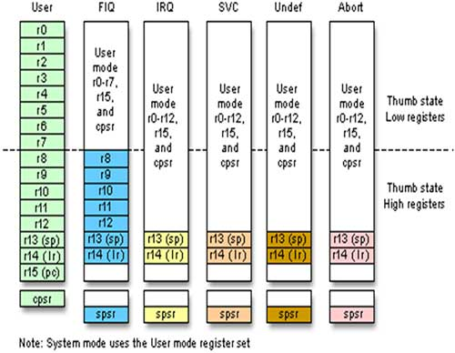
Register Organization/ Programmer’s Model

Slide 19
Banked Registers
The Banked registers are available only when the processor is in a particular mode.
Banked registers of a particular mode are denoted by an underline character post-fixed to the mode mnemonic or _mode
E.g.: abort mode has banked registers r13_abt, r14_abt and spsr_abt
Every mode uses the common PC and CPSR and Registers R0 – R12
EXCEPT FIQ (Only R0 – R7 are used)

Slide 20
Banked Register
Registers R0 to R13 are orthogonal
any instruction on R0, can be equally applied to any of the other registers.
R13 acts as a stack pointer register (SP)
R14 acts as a link register (LR)
R15 acts as a program counter register (PC)

Slide 21
Special Registers
Stack Pointer (SP) (R13)
Store the address of the stack top
R13 is used by the PUSH and POP instructions in T variants,
And by the SRS and RFE instructions from ARMv6.
Link register (LR) (R14)
Holds the address of the next instruction after a branch and link (BL or BLX) instruction
Used to return from a subroutine call
Also used for return address information on entry to exception modes

Slide 22
Special Registers
Program Counter (PC) (R15)
Pointer to the instruction which is two instructions after the instruction being executed
3 stage pipelining
Used commonly by all operating modes
Status Registers
CPSR and SPSR
CPSR register is used to monitor and control internal operations

Slide 23
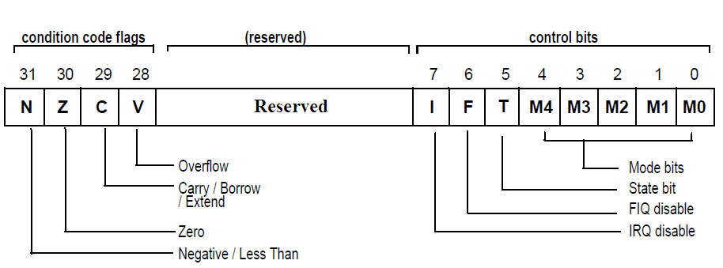
CPSR
Dedicated 32-bit register and resides in the register file
Divided into four fields, each of 8 bits wide:
Flags, status, extension, and control
Extension and status fields are reserved for future use
The control field contains
The processor mode, state, and interrupt mask bits.
The flags field contains the condition flags

Slide 24
CPSR ( Current Program Status Register )
31 | 30 | 29 | 28 |  | 24 23 |  | 7 | 6 | 5 | 4 | 3 | 2 | 1 | 0
N | Z | C | V | …… | I | …… | I | F | T | M4 | M3 | M2 | M1 | M0
Overflow
1: Thumb
0: ARM
Carry
1: Jazelle state
1: FIQ disabled
Zero
1: IRQ disabled
Modes
10000 | User
10001 | FIQ
10010 | IRQ
10011 | SVC
10111 | ABORT
11011 | UND
Negative /
Less than

Slide 25
CPSR
T bit = 1 : Processor is in Thumb state.
To change states the core executes a specialized branch instruction (BLX)
T bit = 0 : Processor is in ARM state and executes ARM instructions.
V, C, Z, N are the Condition flags.
V (Overflow) : Set if the result causes a signed overflow
C (Carry) : Is set when the result causes an unsigned carry
Z (Zero) : This bit is set when the result after an arithmetic operation is zero, frequently used to indicate equality
N (Negative) : This bit is set when the bit 31 of the result is a binary 1.

Slide 26
ARM Memory Organization
BIG ENDIAN
LITTLE ENDIAN
31 0
31 0
0A 0B 0C 0D
0A 0B 0C 0D
a
a+1
a+2
a+3
0A
0B
0C
0D
a
a+1
a+2
a+3
0D
0C
0B
0A

Slide 27
Exceptions, Interrupts, and the Vector Table
Exceptions are generated by internal and external sources
E.g.: externally generated interrupt
Or an attempt to execute an undefined instruction
The processor state just before handling the exception is preserved
So that the original program can be resumed after the completion of the exception routine

Slide 28
ARM Exceptions
ARM exceptions may be considered in three group
Exceptions generated as the direct effect of executing an instruction.
Software interrupts,
undefined instructions (including coprocessor instructions where the requested coprocessor is absent)
and prefetch aborts (instructions that are invalid due to a memory fault occurring during fetch)
Exceptions generated as a side-effect of an instruction.
Data aborts (a memory fault during a load or store data access)
Exceptions generated externally, unrelated to the instruction flow.
Reset, IRQ and FIQ are in this group

Slide 29
ARM Exceptions
The ARM architecture supports 7 types of exceptions.
Reset
Undefined Instruction
Software Interrupt(SWI)
Pre-fetch abort(Instruction Fetch memory fault)
Data abort (Data access memory fault)
IRQ(normal Interrupt)
FIQ (Fast Interrupt request)

Slide 30
RESET:
First instruction executed by the processor when power is applied.
This instruction branches to the initialization code.
UNDEFINED:
Used when the processor cannot decode an instruction.
SOFTWARE:
Software interrupt vector is called to handle a SWI instruction.
The SWI instruction is frequently used as the mechanism to invoke an operating system routine.

Slide 31
PREFETCH ABORT:
If the processor attempts to fetch an instruction from an address without the correct access permissions.
The actual abort occurs in the decode stage.
DATA ABORT:
It is raised when an instruction attempts to access data memory without the correct access permissions.
IRQ and FIQ:
Interrupt request vector is used by external hardware to interrupt the normal execution flow of the processor.
It can only be raised if IRQs are not masked in the CPSR.

Slide 32
When Interrupted, processor..
Changes to the operating mode corresponding to the particular exception.
Saves the address of the instruction following the exception entry instruction in r14 (LR_new mode)
Saves the old value of the CPSR in the SPSR_new mode.
Disables interrupts
IRQ by setting bit 7 of the CPSR
FIQ by setting bit 6 of the CPSR.
Forces the PC to begin executing at the relevant vector address

Slide 33
Interrupt Priorities and vector add
Exception / Interrupt | Name | Operating Mode | Address | Priority
Reset | RESET | SVC | 0X00000000 | 1
Undefined Instruction | UNDEF | UND | 0X00000004 | 6
Software Interrupt | SWI | SVC | 0X00000008 | 6
Pre-fetch Abort | PABT | ABORT | 0X0000000C | 5
Data Abort | DABT | ABORT | 0X00000010 | 2
Interrupt Request | IRQ | IRQ | 0X00000018 | 4
Fast Interrupt Request | FIQ | FIQ | 0X0000001C | 3

Slide 34
IVT
The exception Vector table
gives the address of the subroutine program to be executed when the exception or interrupt occurs.
Each vector table entry contains a form of branch instruction pointing to the start of a specific routine.

Slide 35
Return from Exception
Once exception has been handled, user task has to be normally resumed
Any modified user registers must be restored from handler’s stack
CPSR restored from appropriate SPSR_handler
PC must be changed back to relevant instruction address from LR

Slide 36
Loading PC from LR
To return from SWI or Undefined
MOVS pc,r14
‘s’ indicates destination is PC, so special instruction.
To return from FIQ,IRQ or prefetch abort
SUBS pc, r14, #4
IRQ,FIQ must return one instruction early to execute the instruction that was usurped
Prefetch abort must return 1 instruction early to execute instruction that caused memory fault at first.

Slide 37
Loading PC from LR
To return from data abort
SUBS pc, r14,#8
Data abort must come 2 instructions early to retry the data transfer instruction,
i.e. before the instruction which was usurped.

Slide 38
Return from Exception
PC = Executing + 8 → LR
SWI, undefined
Executing and decoding instruction are executed then goes to serve exception.
Therefore when returning should return to the instruction being fetched. (LR → PC)
IRQ,FIQ and pre fetch Abort
Decoding instruction is usurped
Therefore while returning, decode state instruction should be taken in.
LR-4 → PC

Slide 39
Return from Exception
Incase of data abort
The instruction being decoded is usurped.
But retry is attempted for data fetch. Therefore while returning, the instruction being executed has to be fetched again.
LR – 8 → PC

Slide 40
Pipelining
Mechanism used by the RISC processor to execute instructions at an increased speed
Fetches the next instruction while other instructions are being decoded and executed.
Arm7 processor has a 3 stage pipelining architecture
Fetch : loads an instruction from memory
Decode : identifies the instruction to be executed
Execute : executes the instruction and writes the result back to a register

Slide 41
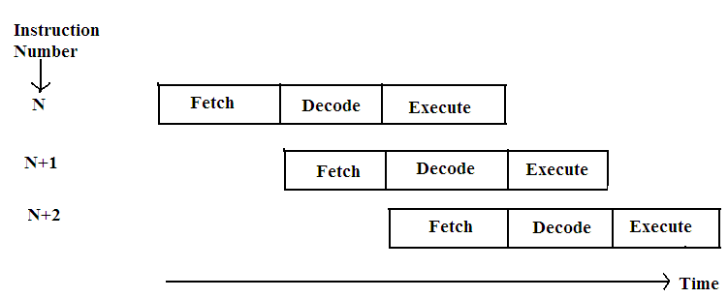
3 stage Pipelining

Slide 42
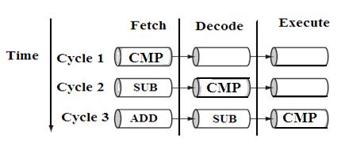
The ARM7 processor
Fetches the first instruction ‘CMP’ in the first cycle
During the second cycle
It decodes the CMP instruction
And fetches the SUB instruction.
During the third cycle
It executes the CMP instruction,
Decodes the SUB instruction
And fetches the third instruction ADD.

Slide 43
7 Addressing Modes of ARM
Scaled
Addressing
Post
Indexing
Immediate
Addressing
Pre-Indexing
with
write back
Addressing
Multiple
Register
Transfer
Addressing
Register
Addressing
Register
Indirect
Addressing
IA
IB
DA
DB

Slide 44
1. Register Addressing
All 3 operands in the instruction are registers
ADD r0,r1,r2 ; r0←r1+r2
Different instructions supported:
Arithmetic operations
SUB r0,r1,r2 ; r0 ← r1 - r2
RSB ro,r1,r2 ; r0 ← r2 - r1
Bit-wise operations
AND ro,r1,r2; r0 ← r1 and r2

Slide 45
1. Register Addressing
Register Movements
MOV ro,r2; r0 ← r2
MVN r0,r2; r0 ← NOT r2
Comparison operations
CMP r1,r2 ; set CC on r1 – r2

Slide 46
2. Immediate Addressing
One of the source operand can be an immediate data i.e. constant value
The data has to be preceded by # symbol
ADD r3,r3,#1; r3 = r3 +1
To provide data in hexadecimal base, ‘&’ has to be written after the # symbol
ADD r8,r7,#&ff

Slide 47
3. Scaled or Shifted register operands
Similar to register addressing but the second source operand can be scaled or shifted before operating
ADD r3,r2,r1,LSL #3
r3 = r2 + 8 × r1
LSL : Logical Shift Left (0 to 31 places)
LSR : Logical Shift Right
ASL : Arithmetic Shift Left (same as LSL)
ASR : Arithmetic Shift Right (MSB bit is copied)

Slide 48
4. Register Indirect Addressing
The base register is used as pointer to point to memory location.
Either loads the destination register from memory location
or stores the value into memory location from register
[] brackets are used to indicate pointer
LDR r0,[r1]; r0 ← mem[r1]
STR r0,[r1]; mem[r1] ← r0

Slide 49
5. Base plus offset addressing
Pre- indexed addressing
The base register is scaled to point up to 4K locations.
LDR r0,[r1, #4] ; r0 ← mem[r1 + 4]
The base register is not modified after the operation.
It also supports Auto indexing (write back feature)
LDR r0, [r1, #4]! ; r0 ← mem[r1 + 4]
and r1 = r1 + 4

Slide 50
6. Base plus offset
Post Indexed addressing
The base register is altered after operation
LDR r0, [r1] , #4 ; r0 ← mem[r1]
and r1 = r1 + 4

Slide 51

7. Multiple Register Transfer / Stack
Allows several registers to be transferred at once.
Any subset or all 16 registers within single instruction.
LDMIA r1, {r0 , r2, r5 }
; r0 ← mem[r1]
; r2 ← mem[r1 + 4]
; r5 ← mem[r1 + 8]
The order in which registers are mentioned does not matter.
Lower Register will interact with Lower address

Slide 52
STMIA r1, {r2 – r4}
; mem[r1] ← r2
mem[r1 + 4] ← r3
mem[r1 + 8] ← r4
BUT r1 is unchanged
IF STMIA r1! , {r2 – r4}
Then in the end r1_new = r1_old +8
‘!’ indicates auto operation

Slide 53
STACK Operations
Stack is classified into two types depending upon address increment/decrement
Ascending stack (growing up) (Increment)
Descending stack (growing down) (Decrement)
Depending upon whether the SP points to a valid location or blank location
Full stack (Valid Data) (Before)
Empty stack (Blank Location) (After)

Slide 54
Types of stack
FULL Ascending
Grows up and base register points to address having valid data
EMPTY Ascending
Grows up but base register points to blank location
FULL Descending
Grows down and base register points to address having valid data
EMPTY Descending
Grows down but base register points to blank location

Slide 55
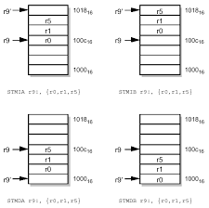

Slide 56
Stack Operations
PUSH
Ascending – Increment Descending – Decrement
Full – Before Empty – After
Full Ascending | STMIB | STMFA
Empty Ascending | STMIA | STMEA
Full Descending | STMDB | STMFD
Empty Descending | STMDA | STMED

Slide 57
Equivalent PUSH and POP
PUSH Increment → POP Decrement
PUSH Before → POP After
STACK | PUSH |  | POP
Full Ascending | STMIB | STMFA | LDMDA | LDMFA
Empty Ascending | STMIA | STMEA | LDMDB | LDMEA
Full Descending | STMDB | STMFD | LDMIA | LDMFD
Empty Descending | STMDA | STMED | LDMIB | LDMED

Slide 58
Instruction Set
ARM instructions are classified into 6 types
Data processing instructions
Branch instructions
Load-store instructions
Software interrupt instruction
Program status register instructions
Co processor instructions
Most instructions can have conditional Execution
ARM effectively has more number of instructions.

Slide 59
Conditional Evaluation
All instructions contain a condition field which determines whether the CPU will execute them.
Non-executed instructions soak up 1 cycle.
Still have to complete cycle so as to allow fetching and decoding of next instructions.
This removes the need for many branches, which stall the pipeline (3 cycles to refill).
Allows very dense in-line code, without branches.
The Time penalty of not executing several conditional instructions is frequently less than overhead of the branch or subroutine call that would otherwise be needed.

Slide 60
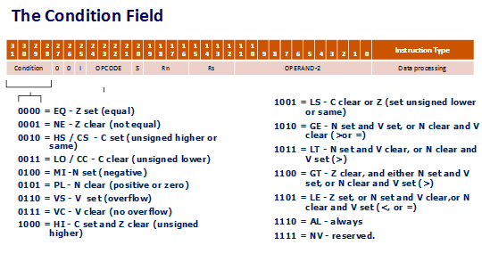

Slide 61
AL Always
NV Never
EQ Equal
NE Not equal
VS Overflow set
VC Overflow clear
MI Minus
PL Plus
CS Carry set
CC Carry clear
HI Higher
GE Greater than or equal
LT Less than
GT Greater than
LE Less than or equal

Slide 62
Using Conditional Fields
To execute an instruction conditionally, simply postfix it with the appropriate condition:
E.g.: Add instruction takes the form:
ADD r0,r1,r2 ; r0 = r1 + r2 (ADDAL)
To execute this only if the zero flag is set:
ADDEQ r0,r1,r2 ; If zero flag set then r0 = r1 + r2

Slide 63
Updating Conditional Fields
Data processing operations do not affect the condition flags
Except the comparison instructions
To affect the condition flags,
‘S’ bit is appended at the end
For example to add two numbers and set the condition flags:
ADDS r0,r1,r2 ; r0 = r1 + r2 and set flags

Slide 64
Instruction Set Classification of ARM7
Data
Processing
Branch
Instruction
Load
Store Inst
S/W
Interrupt
Program
Status
Reg Inst
Co-Processor
Inst
These are
3 addr inst
Conditional execution
Shift, ALU operations in single inst
The suffix ‘S’ for data processing inst will update CPSR, PC
These are
Uncondi-
tional branch
Conditional branch
Conditional Execution
Branch & link instructions
Subroutine & Return inst
Transfers data between memory and registers
It causes a mechanism for application s/w to call OS routine
MRS: Transfer CPSR or SPSR to Register
MSR: Transfer Register to CPSR or SPSR
CP Data processing
CP register movement
CP memory transfer
SWI {<cond>}
{SWI no}
Single
Register
transfer
Multiple
Register
transfer
SWAP

Slide 65
Instruction Set Classification of ARM7
Abbreviation used in the inst set
Branch
Instruction
Load Store Instr.
S/W
Interrupt
inst
Program
Status
Reg Inst
Co-Processor
Inst
Data
Processing
These are
Unconditional branch:
B
Conditional branch: B<COND>
Branch & link instructions: BL
Subroutine Return inst
MOV PC,lr
LDR
STR
LDRB
STRB
ADR
LDM
STM
SWAP
MRS: Transfer CPSR or SPSR to Register
MSR: Transfer Register to CPSR or SPSR
MOV
MVN
ADD
ADC
SUB/RSB
SBC/RSC
MUL/MULL
MLA/MLAL
ORR/EOR
AND/BIC
TST/TEQ
CMP/CMN
LSL/ASL
LSR/ASR
ROR/RRX
It causes a mechanism for application s/w to call OS routine
SWI
Co-Processor
Data Operation
Instruction
CDP
Co-Processor
Data Transfer
LDC,
STC
Co-Processor
Register Transfer
Instruction
MRC,
MCR

Slide 66
Data processing instructions
Manipulate data within registers.
Register move instructions
Arithmetic instructions
Logical instructions
Comparison instructions
Multiply instructions and shift
Can process one of their operands using the barrel shifter.
EXCEPT MUL (multiply), CLZ (count leading zeros), and QADD (signed saturated 32-bit add) instructions

Slide 67
Register Movement Operations
MOVE Destination Register, Source Register
MOV Rd , Rs
Rd ← Rs
MVN Rd , Rs
Rd ← NOT Rs

Slide 68
Arithmetic Operations
ADD r0, r1, r2 ; r0 = r1 + r2
ADC r0, r1, r2 ; r0 = r1 + r2 + C
SUB r0, r1, r2 ; r0 = r1 – r2
SBC r0, r1, r2 ; r0 = r1 – r2 - C
RSB r0, r1, r2 ; r0 = r2 – r1
RSC r0, r1, r2 ; r0 = r2 – r1 – C

Slide 69
Logical Operations
AND r0, r1, r2 ; r0 = r1 and r2
ORR r0, r1, r2 ; r0 = r1 or r2
EOR r0, r1, r2 ; r0 = r1 xor r2
BIC r0, r1, r2 ; r0 = r1 and NOT r2
LSL,LSR,ASL,ASR : shift operations
ROR : rotate right by 0:31 places
RRX: rotate right extended i.e. through carry

Slide 70
Comparison Operations
There is no Destination operand.
ONLY affect Conditional Code bits in CPSR (N, Z, C and V)
CMP r1, r2 ; set CC on r1 – r2
CMN r1, r2 ; set CC on r1 + r2
TST r1, r2 ; set CC on r1 and r2
TEQ r1, r2 ; set CC on r1 xor r2

Slide 71
Multiply Operations
Second operand cannot be an immediate data
Destination and Source1 cannot be same
Of the max 64 bit product,
least significant 32 bits preserved in Destination register
rest are ignored
MUL r4, r3, r2 ; r4 = (r3 X r2)_{[31 : 0]}
MLA r4, r3, r2, r1 ;r4 = (r3 X r2 + r1)_{[31 : 0]}

Slide 72
Multiply – 64 bit results
UNSIGNED Numbers
UMULL RdHi, RdLo, Rm, Rs
RdHi:RdLo ← Rm X Rs
UMLAL RdHi, RdLo, Rm, Rs
RdHi:RdLo ← RdHi:RdLo + Rm X Rs
SIGNED Numbers
SMULL RdHi, RdLo, Rm, Rs
RdHi:RdLo ← Rm X Rs
SMLAL RdHi, RdLo, Rm, Rs
RdHi:RdLo ← RdHi:RdLo + Rm X Rs

Slide 73
Branch Instructions
Changes the normal flow of execution OR
Call a subroutine
Subroutines, if-then-else structures, and loops
UNCONDITIONAL
B label ; jumps to label unconditionally
BL subroutine ; jumps to subroutine and overrides LR with PC
To return from sub routine [MOV PC, r14]

Slide 74
BX and BLX
Branch exchanges
Use an absolute address stored in register Rm
Primarily used to branch to and from thumb code
Branch Exchange (BX)
The T bit in the CPSR is updated by the least significant bit of the branch register
Branch exchange with link (BLX)
Updates the T bit of the CPSR with the least significant bit of branch register
Sets the link register with the return address

Slide 75
Conditional Branching
B<Condition> Label
AL Always
EQ Equal
NE Not equal
VS Overflow set
VC Overflow clear
CS/HS Carry set/Higher or same
CC/LO Carry clear/ Lower
HI Higher
LS Lower or same
GT Greater than
GE Greater than or equal
LT Less than
LE Less than or equal
MI Minus
PL Plus

Slide 76
Load Store Instructions
Load : Memory → Register
Store : Register → Memory
LDR/STR : load/store register
LDB/STB : load/ store byte
LDM/STM : load/store multiple
ADR : load address in to register
ADR r0 , my_array ; address of my_array → r0
SWAP r0,[r1] ; ro← mem[r1] and mem[r1] ← r0

Slide 77
Software Interrupt
SWI is a user-defined instruction.
It causes an exception trap to the SWI hardware vector
Causing a change to supervisor mode
Causing the SWI exception handler to be called.
The handler then examines the comment field of the instruction to decide what operation has been requested.
Using SWI , an OS can implement a set of privileged operations which applications running in user mode can request.
E.g. : SWI &0 ; o/p the character in r0 register
SWI &11 ; terminate

Slide 78
PSR instructions
MRS and MSR
CPSR/SPSR to/from a general purpose register.
All of status register, or just the flags, can be transferred.
MRS{<cond>} Rd,<psr> ; Rd = <psr>
MSR{<cond>} <psr>,Rm ; <psr> = Rm
<psr> = CPSR, CPSR_all, SPSR or SPSR_all

Slide 79
Affecting a single flag in SR
MSR{<cond>} <psrf>,Rm ; <psrf> = Rm
<psrf> = CPSR_flg or SPSR_flg
Also an immediate form
MSR{<cond>} <psrf>,#Immediate
This immediate must be a 32-bit immediate, of which the 4 most significant bits are written to the flag bits.

Slide 80
Co-Processor Instructions
The ARM architecture supports 16 coprocessors
Each coprocessor instruction set occupies part of the ARM instruction set.
There are three types of coprocessor instruction
Coprocessor data processing
Coprocessor (to/from ARM) register transfers
Coprocessor memory transfers (load and store to/from memory)

Slide 81
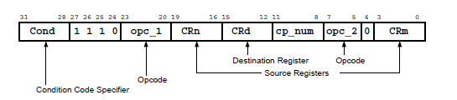
Coprocessor Data Processing
This instruction initiates a coprocessor operation
The operation is performed only on internal coprocessor state
E.g.: Multiply the contents of two registers and store the result in a third register
CDP{<cond>} <cp_num>, <opc_1>, CRd, CRn, CRm, {<opc_2>}

Slide 82
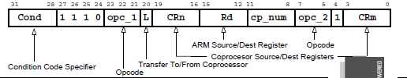
Coprocessor Register Transfers
These two instructions move data between ARM registers and coprocessor registers
MRC : Move to Register from Coprocessor
MCR : Move to Coprocessor from Register
<MRC|MCR>{<cond>} <cp_num>, <opc_1>, Rd, CRn, CRm, <opc_2>

Slide 83
Coprocessor Memory Transfers
Load from memory to coprocessor registers
LDC <cp_num>,CRd,<address>
Store to memory from coprocessor registers.
STC <cp_num>,CRd,<address>

Slide 84
ARM processor Family
ARM Family | Year of Release | Architecture | Pipeline | Operational Frequency | Multiplier | MIPS
ARM7 | 1995 | Von Neumann | 3 stage | 80 MHz | 8x32 | 0.97
ARM9 | 1997 | Harvard | 5 stage | 150 MHz | 8x32 | 1.1
ARM10 | 1999 | Harvard | 6 stage | 260 MHz | 16x32 | 1.3
ARM11 | 2003 | Harvard | 8 stage | 335 MHz | 16x32 | 1.2

Slide 85
Thumb instruction set
Subset of the 32-bit ARM instructions forming a 16-bit instruction set space
Used for memory-constrained systems.
Thumb has higher code density
Exceptions generated during Thumb execution switch to ARM execution before executing the exception handler
Only the low registers r0 to r7 can be accessed
The higher registers r8 to r12 are only accessible with MOV, ADD, or CMP instructions

Slide 86
Thumb
CMP and all the data processing instructions operating on low registers update the condition flags in the CPSR
Sr. No | Registers | Access
1 | r0 – r7 | Fully accessible
2 | r8 – r12 | Only accessible by MOV ,ADD &CMP
3 | r13SP | Limited accessibility
4 | r14 lr | Limited accessibility
5 | r15 PC | Limited accessibility
6 | CPSR | Only indirect access
7 | SPSR | No access

Slide 87
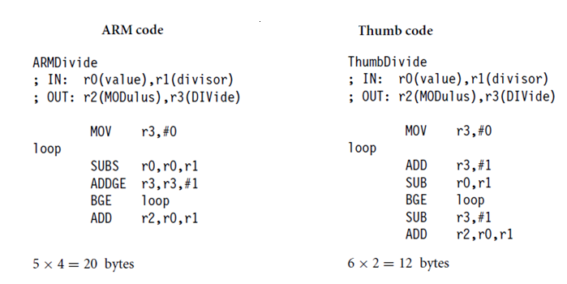
Code density comparison

Slide 88
Comparison
Parameter | ARM Instruction set | THUMB Instruction set
CPSR’s T bit | T = 0 | T= 1
Instruction size | 32 bit | 16 bit
Core instructions | 58 | 30
Conditional execution | For most of the instructions | For branch instructions only
Program status register | Read-write in privilleged mode | No direct access
Register access | All 15 GPR’s + PC | 8 GPR’s +PC+7 high register
Exception handling inst. | Supported | Not supported
Program length | Less | More than ARM instruction

Slide 89
ARM development tools
ARM C compiler or ARM assembler
Linker
ARM Sd(symbolic debugger)
ARM emulator or ARM development board
The ARM C compiler converts C source file into .aof (arm object file)
.aof file is given to linker to link all branches & function calls to generate .aif file
.aif file is given to ARMsd (symbolic debugger) to load , run & debug the program on ARM emulator or system development board.

Slide 90
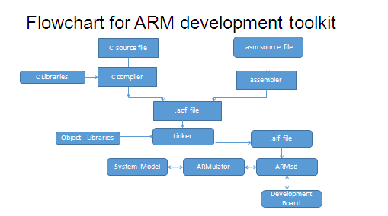

Slide 91
Thank You

