Slide 1
What is Bayesian SSVS?

Slide 2
Bayesian SSVS for Hunger modelling

Slide 3
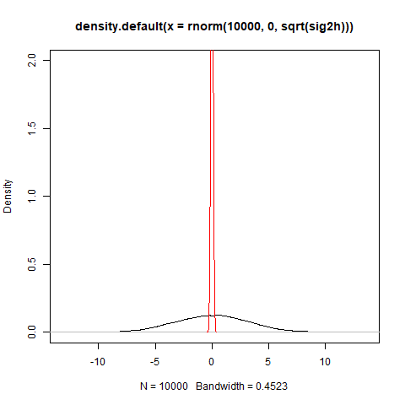
Spike and slab prior

Slide 4
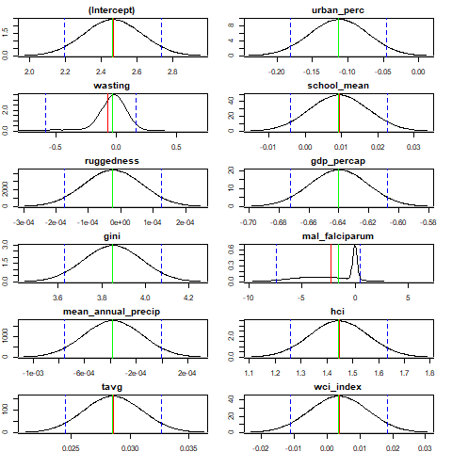
Posterior distributions
mean
median
credible interval: 0.05/0.95

Slide 5
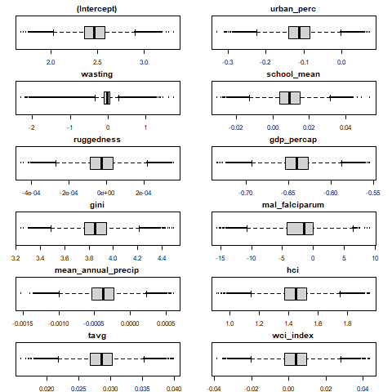
Posterior boxplots

Slide 6
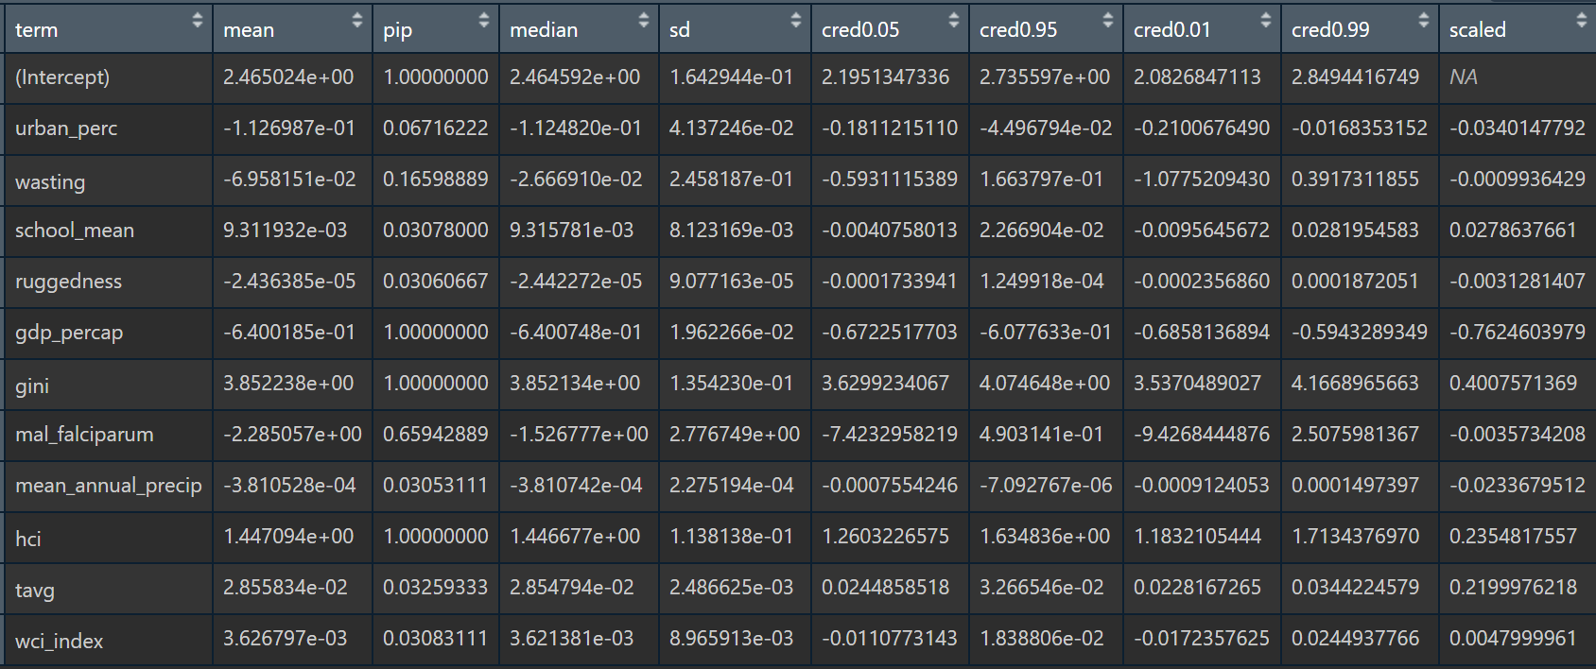
Posterior dataframe

Slide 7
Results compared to LASSO

Slide 8
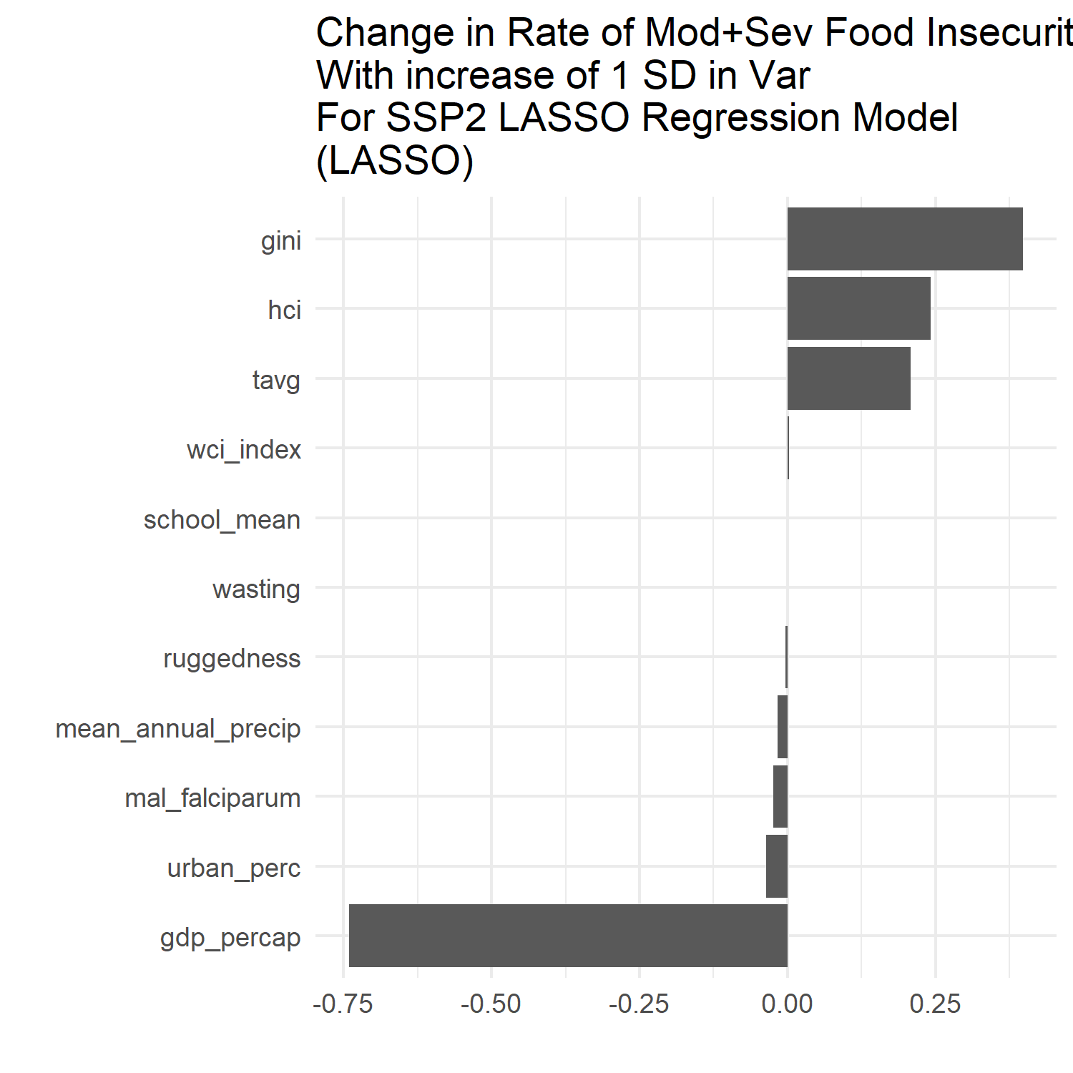


Slide 9
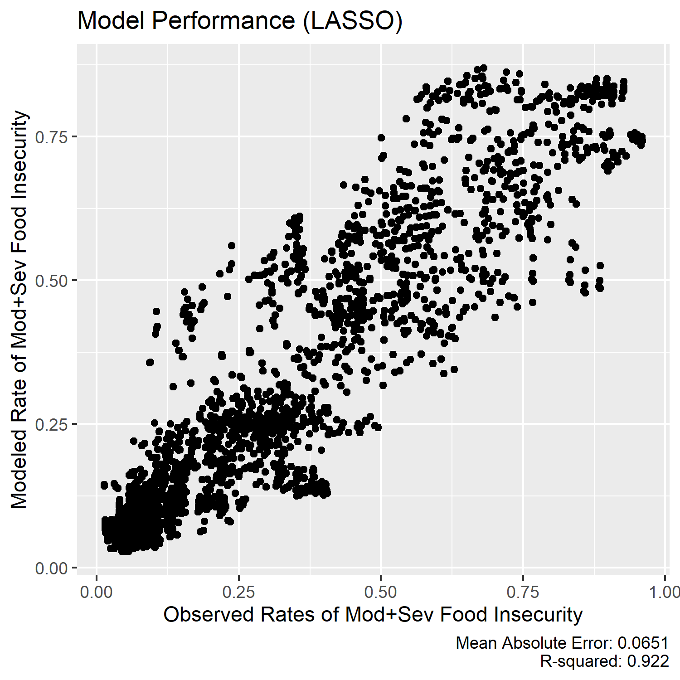


Slide 10
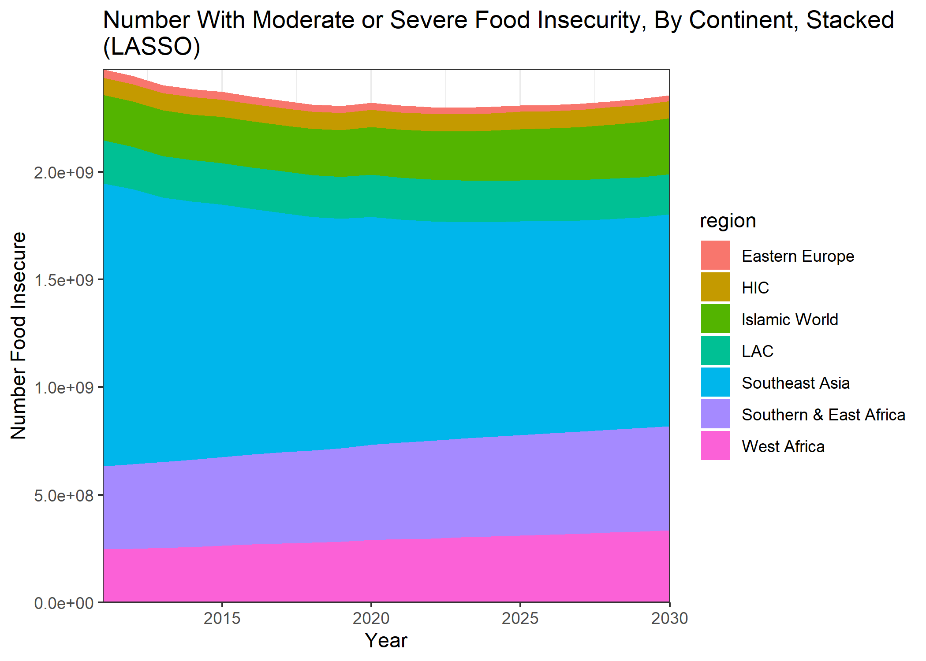
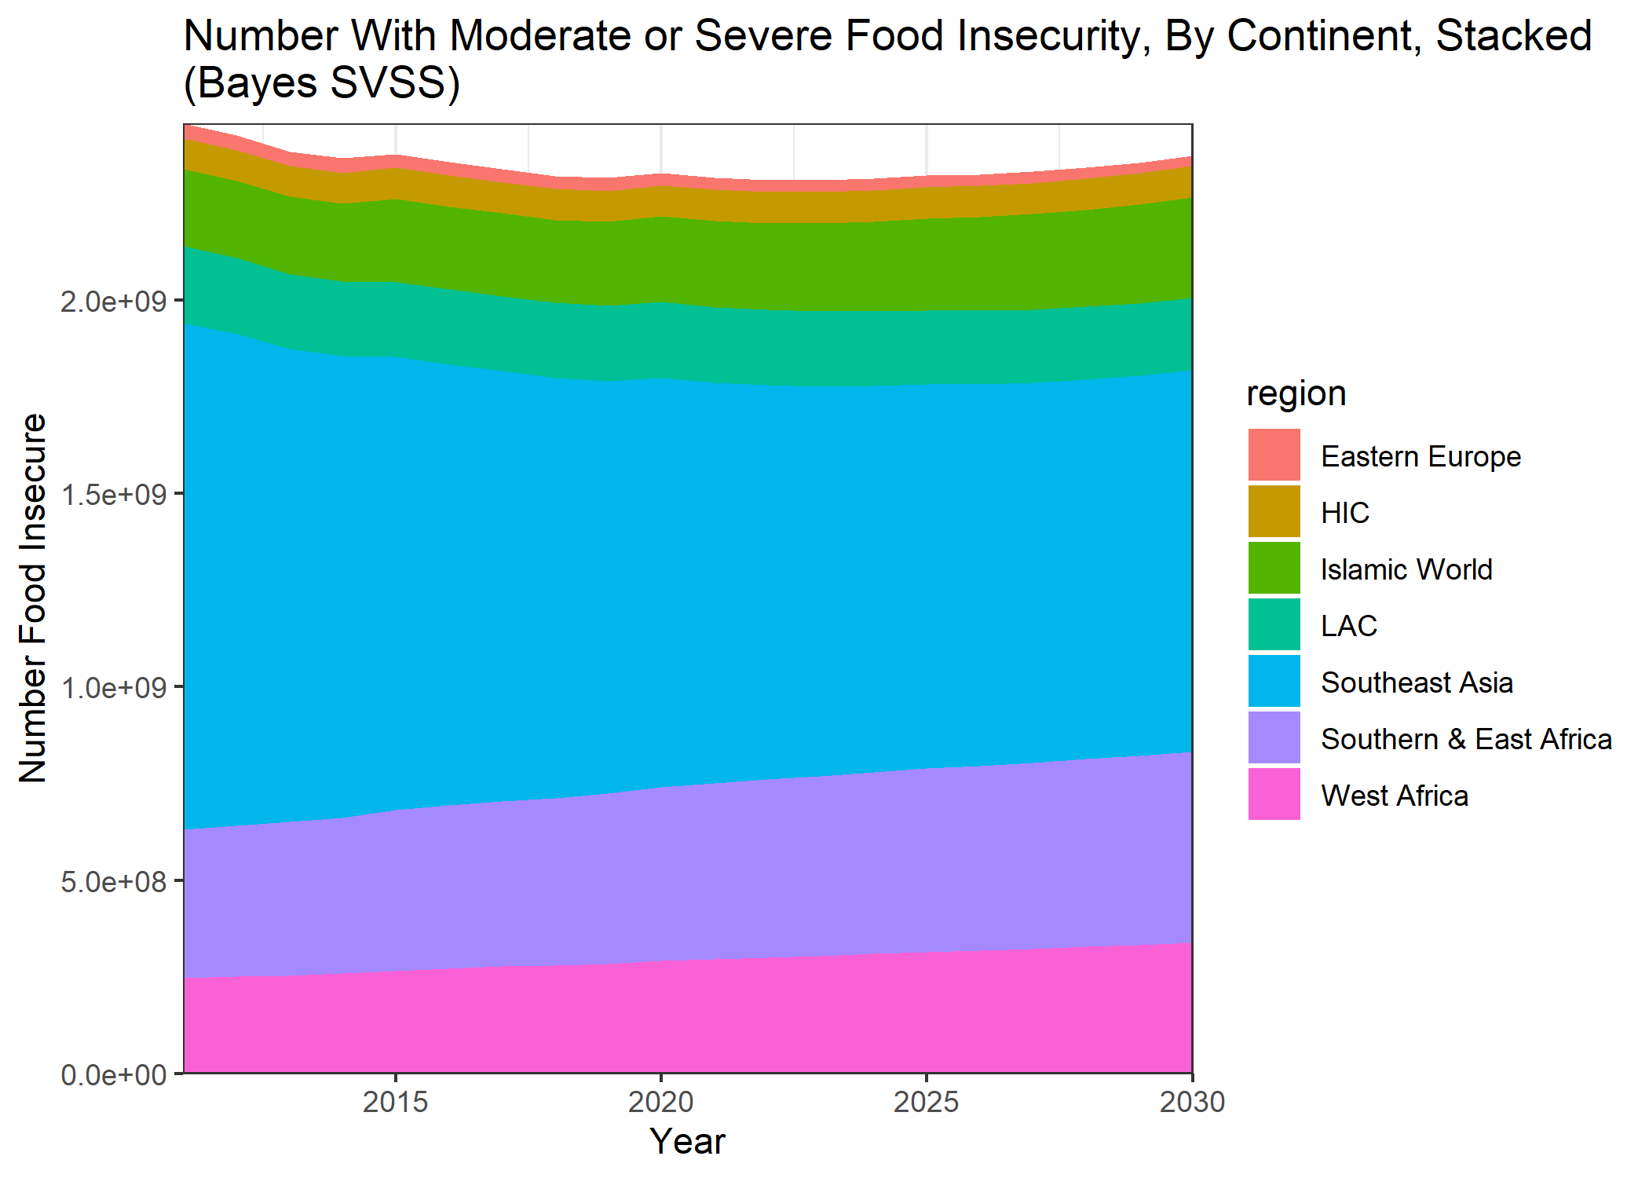

Slide 11
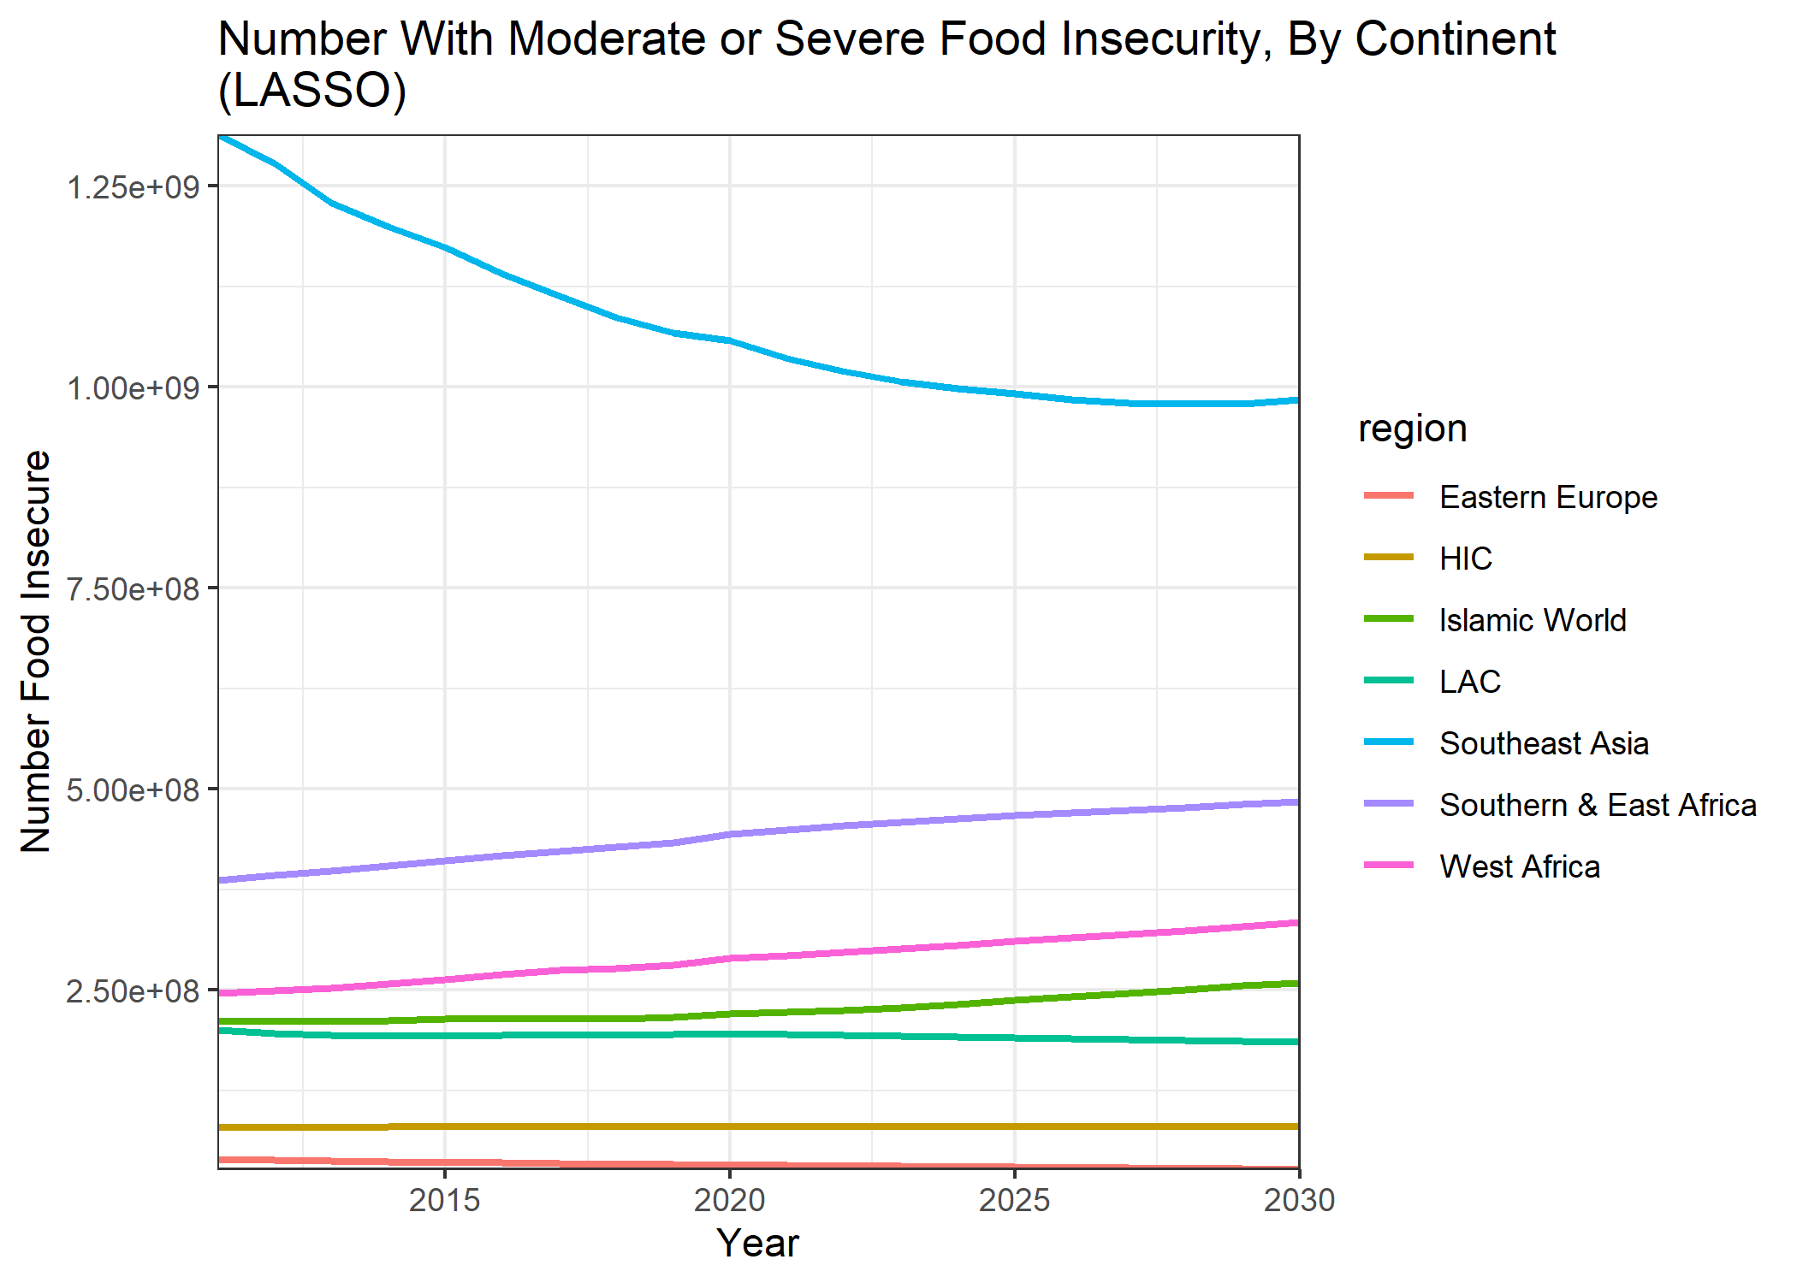
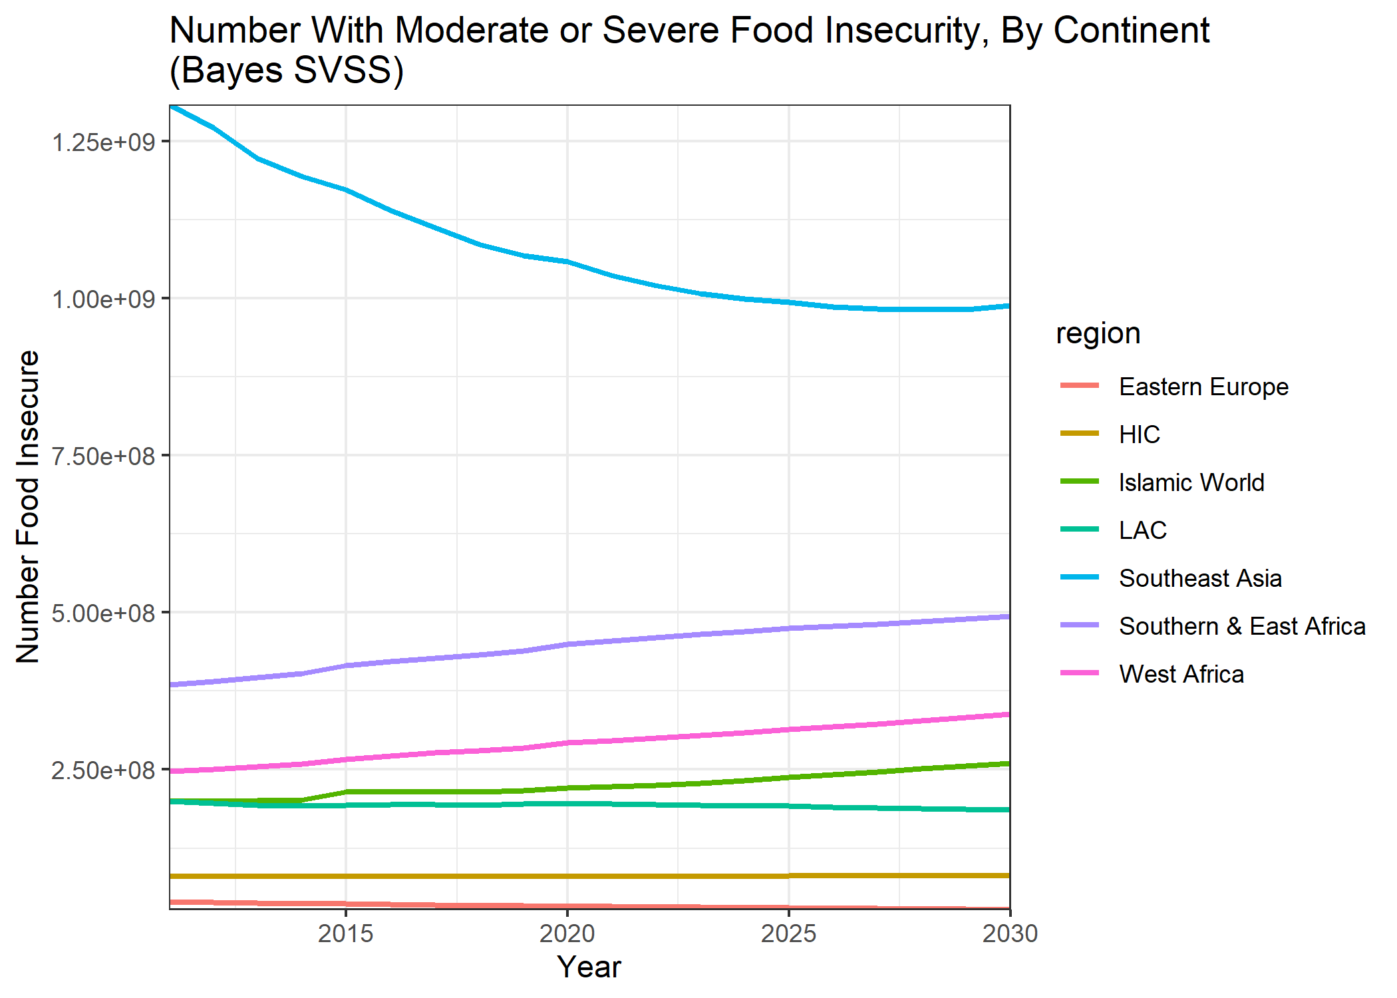

Slide 12
