Slide 1
NYC Rodent Problem

Slide 2
311 Data is Non-Conclusive
We are working with 311 data:
Calls are based on more than just data
Awareness, trust and access are other contributors
Our classification for confirmed calls from descriptions:
An inspector “found violations” or “minor violations”
An inspector “took action”
Owners are fixing the issues found
Additional Data:
Land Use Reports
Restaurant Inspections

Slide 3
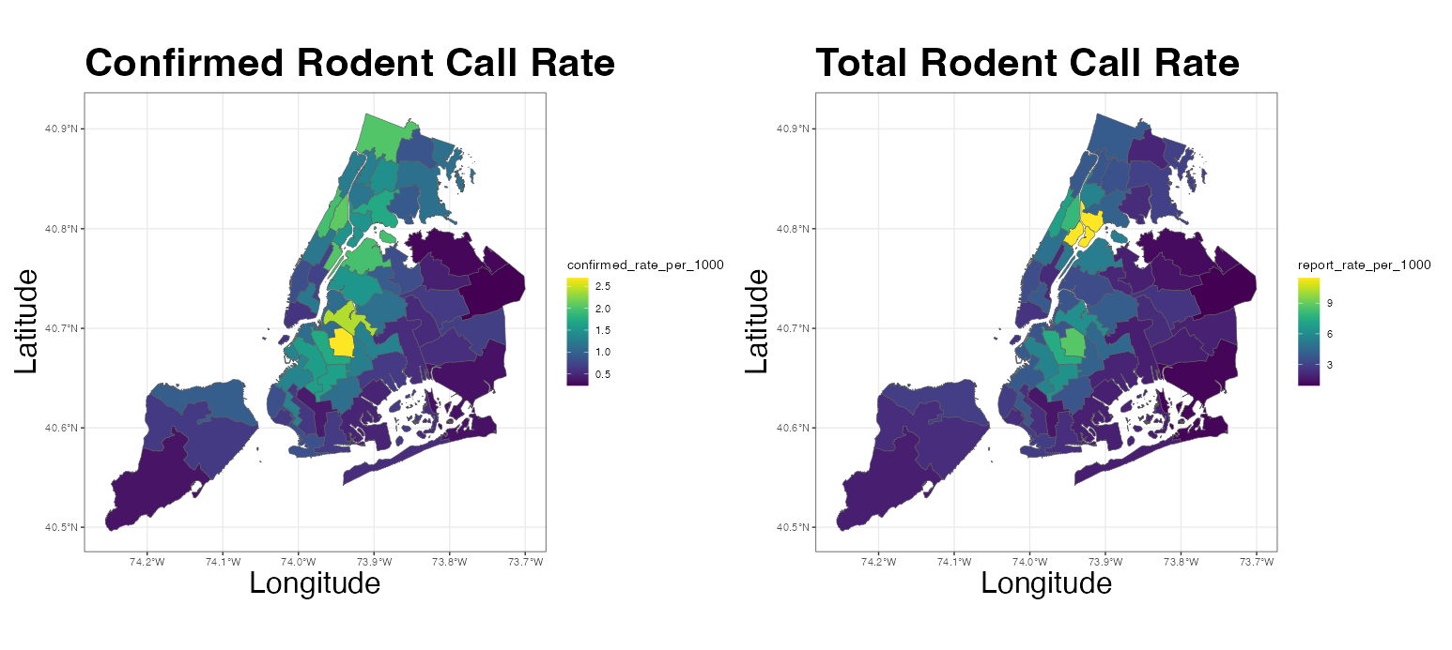
Where Reporting and Confirmed Cases Concentrate
Plots about confirmed cases vs actual rates

Slide 4
What factors correspond to rodent reports?
Conditional Autoregressive model
Factors that correspond to an INCREASE in confirmed call rate:
Proximity to other rodent-related issues
Higher median home value
Older buildings
Factors that correspond to a DECREASE in confirmed call rate
More people per housing unit
High percentage of vacant housing units

Slide 5
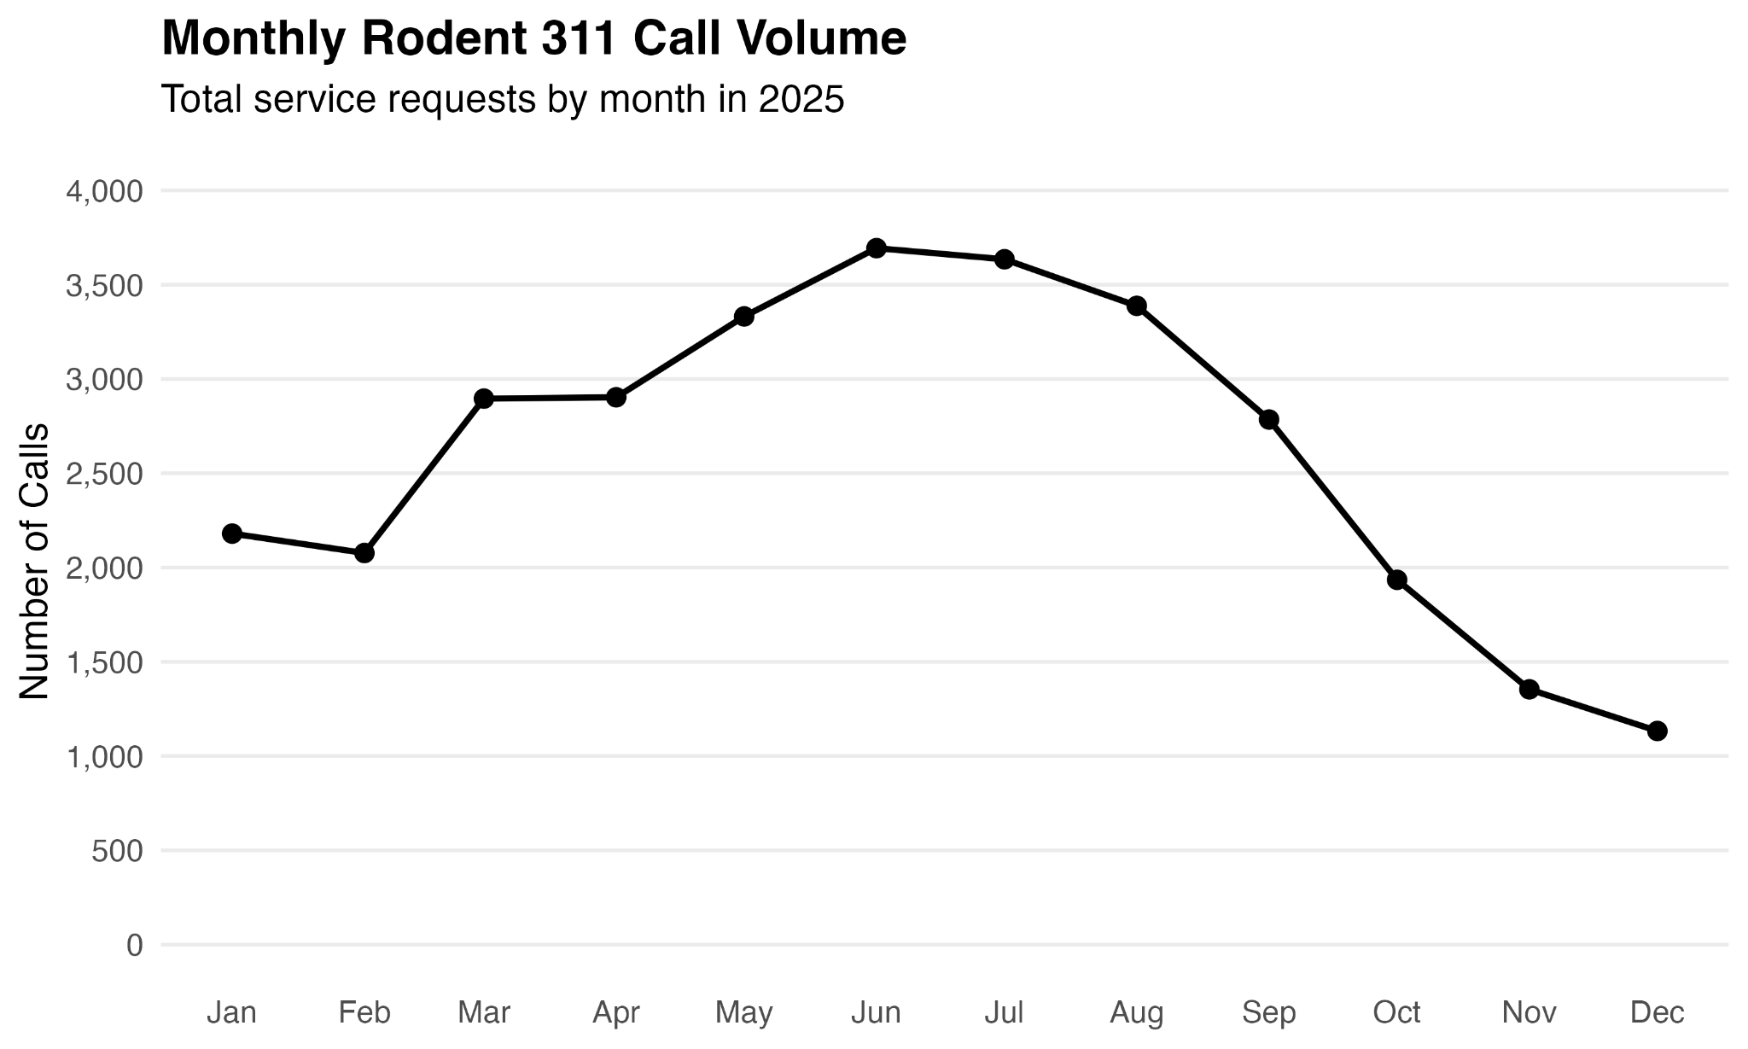
Rodent-related Calls Spike in the Summer

Slide 6
What should we do about it?
Action Items
Model Based: Focus efforts on areas with high confirmed rates
Time Based: Shift resource allocation to reflect higher call volume in summer months
Inference Based: Increased community outreach in underrepresented districts
** 311 complaints are not a direct measure of rodent activity **

Slide 7
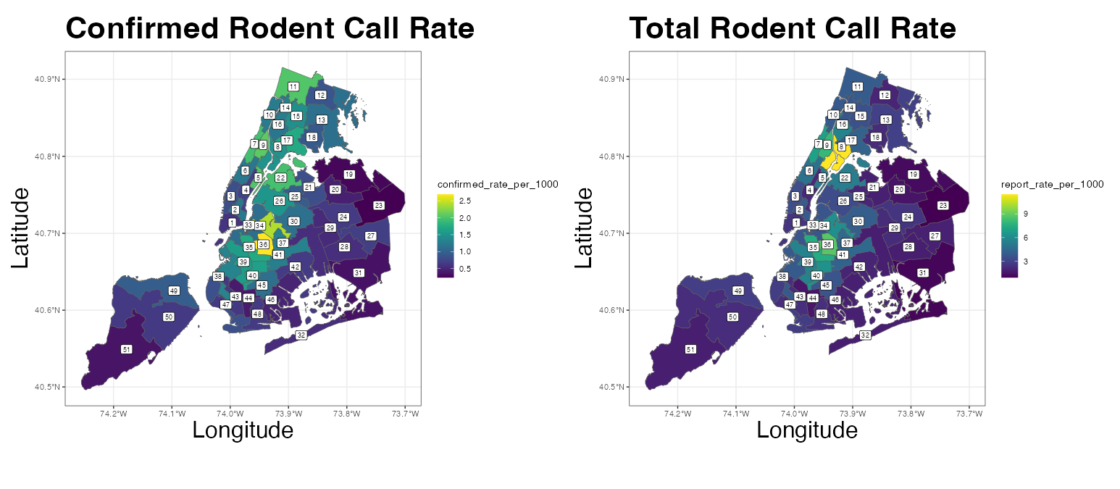
Appendix:

Slide 8
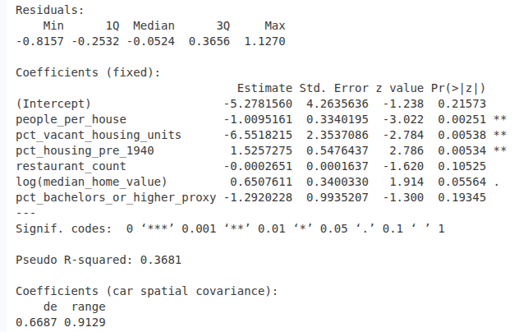
Model Summary- Confirmed Call Rate

Slide 9
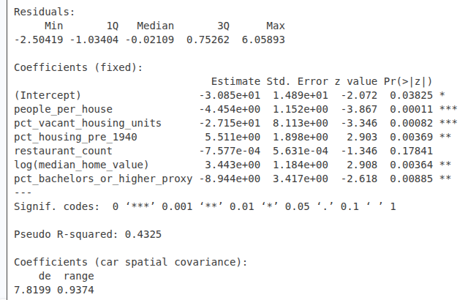
Model Summary- Total Call Rate

