Slide 1
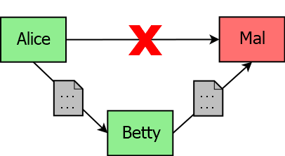
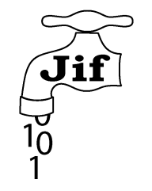


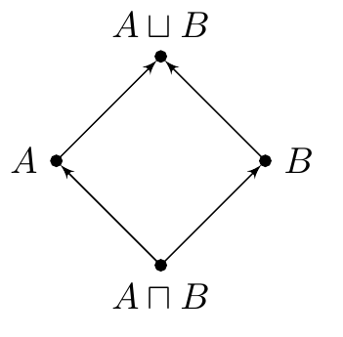
THE APPLICABILITY OF INFORMATION FLOW TO SECURE JAVA DEVELOPMENT
Joseph Spearritt || Supervisors: Dr. Larissa Meinicke & Prof. Ian Hayes
WHAT IS INFORMATION FLOW?
Access Control
Confidentiality is controlled by performing access checks at runtime.
Circumventing Access Control
Alice gives Betty access… who then gives Mal access. We want a policy on the propagation. The Bell-Lapadula Lattice Model
Extends Mandatory Access Control. Uses a lattice of confidentiality states.
Arrows show direction of allowed flow. Enforcing Information Flow
A non-interfering program contains no invalid information flows. A program can be verified as being non-interfering statically via type checking.
CAN THIS BE APPLIED?
Yes! Security typed languages build Information Flow into their type system.
Two mature Java-based candidates:
PROJECT GOAL
Compare and evaluate JIF and Paragon:
Are they viable to use?
If not, what do they lack?
Is one more feasible than the other?
PROJECT PROCESS
Design case studies showcasing differing policy properties
Implement each in JIF and Paragon
Compare the implementations
Can the compiler enforce the policy?
What burden is put on the programmer?
THE LANGUAGES
JIF
Policies defined by interacting principals. ‘Decentralised Label Model’ does not require one central source of truth.
int{Alice->Bob} x;
Paragon
Policies defined in predicate logic. ‘Flow Locks’ allow for stateful policies. ?{alice:} int x; ?{Object x: isAllowed(x)} int x;
CASE STUDIES
Battleships
Requires declassification of board coordinates via special query method. Both Paragon & JIF can represent this.
Conference Management
Requires time-variant policy.
Paragon encodes this easily. JIF does not.
Calendar Scheduler
Requires policy dependent on a runtime list of attendees. Neither JIF nor Paragon can encode this.
CHALLENGES
Research languages
Little documentation
Non-existent toolchain
Compiler bugs
Conceptual Difficulty
Requires solid understanding of Information Flow theory
Lots of literature but very disparate
Code is not ‘policy agnostic’, causing cognitive burden
CONCLUSIONS
Information Flow and security typing have many potential applications
Neither JIF nor Paragon are mature enough to be viable implementations
JIF’s policy model is more complex and places more burden on the programmer
Paragon’s logic-based policies are both simpler to understand and more powerful in terms of policy expression
Paragon

