Slide 1
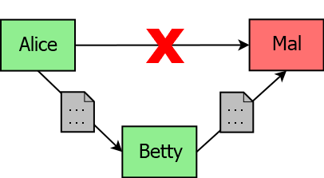
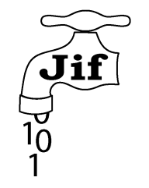

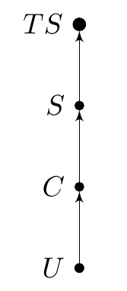
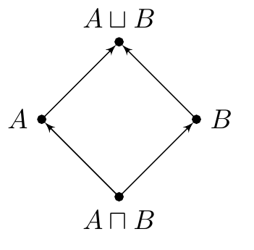
THE APPLICABILITY OF INFORMATION FLOW TO SECURE JAVA DEVELOPMENT
MAIN HEADINGS – BODONI MT 18PT ALL CAPS
Subheadings – Helvetica Neue Bold 14pt
Body Text – Helvetica Neue 14pt (min 12pt)
Don’t have the above fonts installed?
Substitutes for Bodoni MT:
Didot on Apple
or Times New Roman (Apple & Windows)
Substitutes for Helvetica Neue:
Helvetica (Apple)
or Arial (Apple & Windows)
Joseph Spearritt || Supervisors: Dr. Larissa Meinicke & Prof. Ian Hayes
WHAT IS INFORMATION FLOW?
Access Control
Confidentiality is controlled by performing access checks.
Circumventing Access Control
Alice gives Betty access… who then gives Mal access. We want a policy on the propagation. The Bell-Lapadula Lattice Model
Extends Mandatory Access Control. Uses a lattice of confidentiality states.
Arrows show direction of allowed flow. Enforcing Information Flow
A non-interfering program contains no invalid information flows. A program can be verified as being non-interfering statically via type checking.
CAN THIS BE APPLIED?
Yes! Security typed languages build Information Flow into their type system.
Two mature Java-based candidates:
PROJECT GOAL
Compare and evaluate JIF and Paragon:
Are they viable to use?
If not, what do they lack?
Is one more feasible than the other?
PROJECT PROCESS
Design case studies showcasing differing policy properties
Implement each in JIF and Paragon
Compare the implementations
Can the compiler enforce the policy?
What burden is put on the programmer?
THE LANGUAGES
JIF
Policies defined by interacting principals. ‘Decentralised Label Model’ does not require one central source of truth.
int{Alice->Bob} x;
Paragon
Policies defined in predicate logic. ‘Flow Locks’ allow for stateful policies. ?{alice:} int x; ?{Object x: isAllowed(x)} int x;
CASE STUDIES
Battleships
Requires declassification of board coordinates via special query method. Both Paragon & JIF can represent this.
Conference Management
Requires time-variant policy.
Paragon encodes this easily. JIF does not.
Calendar Scheduler
Requires policy dependent on a runtime list of attendees. Neither JIF nor Paragon can encode this.
CHALLENGES
Research languages
Little documentation
Non-existent toolchain
Compiler bugs
Conceptual Difficulty
Requires solid understanding of Information Flow theory
Lots of literature but very disparate
Code is not ‘policy agnostic’, causing cognitive burden
CONCLUSIONS
Information Flow has potential in any context where verifying its correctness with respect to security is relevant. Neither JIF nor Paragon are mature implementations, but Paragon’s ease and expressivity for dynamic policies make it more practical for real world development.
FURTHER WORK
Some other approaches:
LIFTy: Haskell dialect which synthesises runtime checks based on refinement types
JRIF: extension of JIF to allow for dynamic policy using state automata
General Hints & Tips
Do not change the colour/size/logos/positioning of the Slide Master.
This is a standard format across all Innovation Expo posters.
Do not add other corporate logos. This is an infringement of copyright, unless you have express permission to do so.
Do use this space as creatively as you wish.
Avoid using large background colours – doesn’t print well.
Stick to the basic fonts & sizes (left) – these read clearly. If you need to reduce the text size, you are trying to put too much on your poster.
As a check, print “scaled to fit” onto A4 and read at arms length.
Save your poster as you work on it.
You shouldn’t need to change the sizing of this file, it should already be landscape format with width: 41cm and height: 28.7 cm (A3 with 5 mm borders all around).
The title may look to close to the top edge – don’t be tempted to change it. It allows for the extra 5mm from the printing.
Paragon
A passive attacker should be unable to distinguish between program executions which differ only in their high confidentiality inputs

