Slide 1
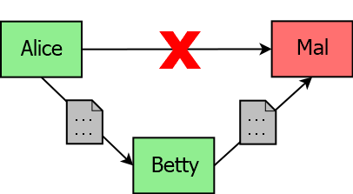
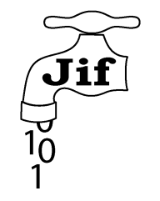

THE APPLICABILITY OF INFORMATION FLOW TO SECURE JAVA DEVELOPMENT
Joseph Spearritt || Supervised by Dr Larissa Meinicke & Prof Ian Hayes
What Is Information Flow?
Confidentiality is generally controlled through access control checked at runtime.
Alice gives Betty access… who then gives Mal access. We want a policy on the propagation.
A Solution: Security Typing
Programming languages that enforce controls on information propagation through the type system. Programs that can potentially leak information will not compile! Two mature Java-based candidates:
Project: Compare Languages Through Developing Case Studies
Each case study showcases different security properties.
Battleships
Declassification of queries
Conference Management
Timed release policy
Calendar Scheduler
Quantification over event attendees
JIF struggles with dynamic policies like timed release, which Paragon handles easily. However, both fail to encode the Calendar Scheduler policy.
Conclusions
Security Typed Information Flow has many potential applications.
Neither JIF nor Paragon are mature enough to be viable implementations.
JIF’s policy model is more complex, and places more burden on the programmer.
Paragon’s logic-based policies are both simpler to understand and more powerful in terms of policy expression.
Things to Include:
The purpose of this poster is to explain your project. After your heading, be sure to provide a brief overview and explanation of your project.
You can be as creative as you wish, but consider readability and how it will look when printed.
You can use photos, images, graphs or diagrams.
Guidelines
All text must be Arial, size 20
Poster must remain in A3 and portrait orientation
Do not include corporate logos unless you can provide evidence of your permission to use it.
Submission
Return your completed poster to Georgia.Baker@uq.edu.au by Friday 27th October 2017 12pm (Midday).
Paragon
UQ Innovation Showcase 2017
School of Information Technology & Electrical Engineering

