Slide 1
Integration
Bidirectional data integration process
SFMC -> IS IS -> SFMC

Slide 2
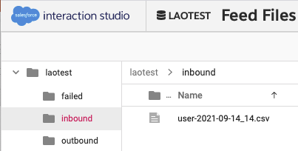
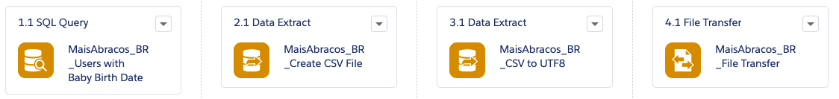
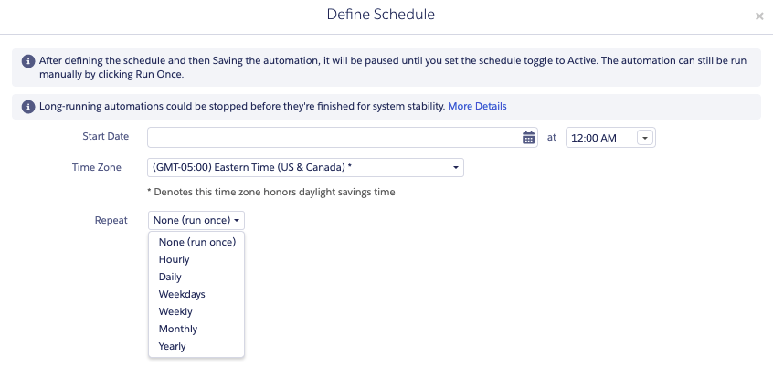
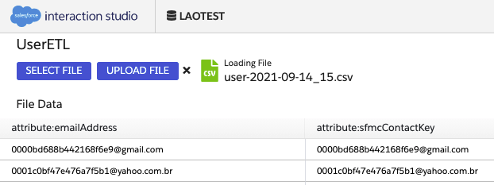
SFMC
Automation Studio
IS FTP

Slide 3

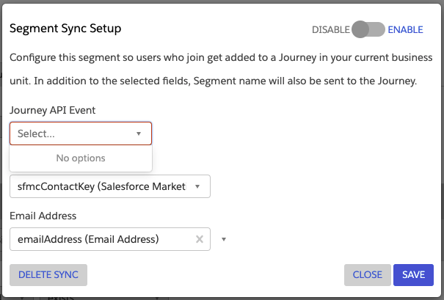
IS
SFMC
User Segment

