Slide 1



PROJECT | BUSINESS CASE
Automated Customer Reviews
Classification, Clustering & Generative AI Summarization
Sentiment
Classification
Product
Clustering
Generative AI
Summarization
Team: Lydia · Marcelo · Don
Ironhack AI Engineering Bootcamp — 2026
Notes:
Boa tarde. Este projeto trabalha reviews de clientes da Amazon e resolve tres problemas: classificar o sentimento de cada review, agrupar produtos em categorias maiores, e gerar automaticamente um artigo resumo por categoria. Equipa: Lydia, Marcelo e Don. (~25-30s)

Slide 2


00 · BUSINESS PROBLEM
Too Many Reviews, Too Little Signal
Online reviews are too numerous and too noisy for consumers or sellers to interpret manually at scale — the signal that matters is buried in thousands of unstructured, repetitive comments.
Goal: build an NLP system that classifies sentiment, groups product categories, and turns review patterns into actionable insight — automatically, at scale.
Consumers
Sellers
Decide whether a product or category is worth buying, based on real sentiment patterns — not a wall of unread reviews.
Identify weak spots, top-performing products, and recurring complaints, without reading every review by hand.
Automated Customer Reviews
2
Notes:
O problema de negocio: ha demasiadas reviews, demasiado ruidosas, para consumidores e vendedores lerem manualmente. O objetivo e um sistema de NLP que classifica sentimento, agrupa categorias, e transforma padroes de reviews em insight acionavel -- para dois tipos de utilizador: consumidor e vendedor. (~35s)

Slide 3




00 · BUSINESS PROBLEM
System Architecture: From Raw Data to Product
›
›
›
›
›
›
Raw datasets
Clean + label
Balanced set
Fine-tuned
DistilBERT
Embeddings
+ KMeans
BART
summaries
Gradio app
Kaggle + UCSD
rating → sentiment
129K reviews
sentiment model
5 meta-categories
offline articles
serves artifacts
Heavy computation (training, clustering, generation) happens once, offline, in the notebook. The app only loads pre-exported artifacts — it never re-trains or re-clusters at runtime.
Automated Customer Reviews
3
Notes:
Do lado tecnico: dados em bruto, limpeza e labeling, dataset balanceado, DistilBERT afinado, embeddings de categoria e KMeans, resumos BART offline, artefactos exportados, e a app Gradio a servir tudo isso sem recalcular nada em tempo real. (~35s)

Slide 4
01 · DATA ACQUISITION
Two Datasets, One Unified Schema
The project needed both real product-category structure and a large, balanced volume of labeled sentiment — so two independent sources were combined.
Primary Dataset
Larger Dataset
Kaggle / Datafiniti — Amazon Consumer Reviews
UCSD Amazon Reviews 2023 (via Hugging Face)
67,992
reviews
317,201
reviews, all categories sampled
Real product categories & product names
Requires Kaggle authentication to download
Used later as the source for Clustering (Section 10)
Adds volume and category diversity
6 columns: text, rating, sentiment, product, category, source
Used to enrich sentiment balance before training
Automated Customer Reviews
4
Notes:
Combinamos duas fontes: Kaggle/Datafiniti com quase 68 mil reviews e categorias de produto reais, e o dataset UCSD via Hugging Face, com 317 mil reviews de todas as categorias. Unificamos as duas num schema comum antes de qualquer analise. (~40s)

Slide 5
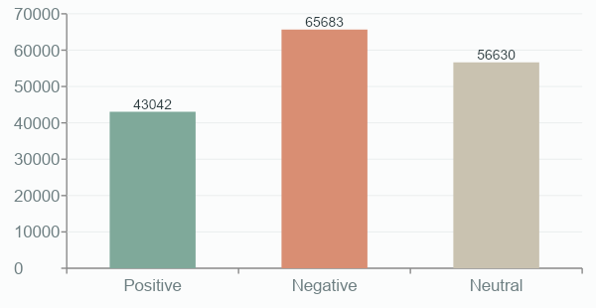
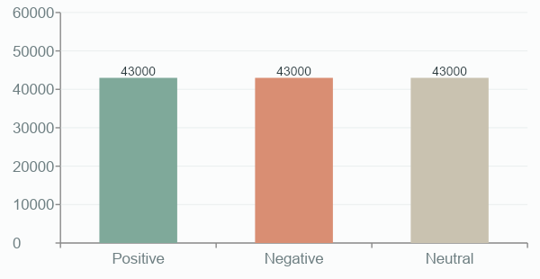
01 · DATA ACQUISITION
Merging & Balancing the Sentiment Classes
Star ratings were mapped to sentiment (1–2★ negative, 3★ neutral, 4–5★ positive). The natural merge was heavily skewed toward positive reviews — extra negative/neutral samples were added in two augmentation steps (Amazon Reviews 2023, then a Hugging Face corpus), then the dataset was balanced.
Before balancing (after merge + augmentation)
After balancing (final training set)
26.0% pos · 39.7% neg · 34.3% neutral — 165,355 reviews total (post-dedup, pre-cap)
43,000 reviews per class — 129,000 total (103,200 train / 25,800 test)
Automated Customer Reviews
5
Notes:
Depois de somar as duas fontes de aumento, o dataset ficou desequilibrado na direcao oposta: negative passou a ser a classe maior (39.7%), e positive ficou a mais pequena (26%) porque o dataset primary tinha muitos duplicados internos que so foram removidos nesta fase. Por isso balanceamos para exatamente 43 mil por classe -- o teto real imposto pelo positive ja deduplicado. (~45s)

Slide 6
02 · EDA & PREPARATION
From Raw Reviews to a Model-Ready Split
›
›
›
Clean
Label
Balance
Split
Deduplicate, strip HTML/newlines, drop empty or malformed reviews
Map star rating → sentiment (1–2★ neg, 3★ neutral, 4–5★ pos)
Augment with Hugging Face reviews, cap at 43,000 / class
80 / 20 stratified train-test split, fixed random seed
Final training corpus
129,000
103,200
25,800
3 classes
total balanced reviews
train (80%)
test (20%)
negative · neutral · positive
Automated Customer Reviews
6
Notes:
O pipeline de preparacao teve quatro passos: limpar o texto, mapear rating de 1 a 5 estrelas para sentimento, balancear as classes, e um split 80/20 estratificado para treino e teste. (~40s)

Slide 7
03 · SENTIMENT MODEL — BASELINE
DistilBERT: Why Fine-Tuning Is Required
Off-the-shelf sentiment models on Hugging Face are almost always binary (positive / negative). Testing one directly on our 3-class data exposes the problem.
Zero-shot baseline (no fine-tuning)
Fine-tuning setup
distilbert-base-uncased-finetuned-sst-2-english
Base model
distilbert-base-uncased (66M params)
61%
0.49
0%
Task
3-class classification head (replaces 2-class)
accuracy
macro F1
neutral recall
Train / test
103,200 / 25,800 reviews
Epochs
2
A binary model structurally cannot predict a class it never saw in training — neutral recall is not low, it is impossible. This is the concrete justification for fine-tuning.
Batch size
8
Learning rate
2e-5
Max sequence length
256 tokens
Training time (Colab T4)
~50 minutes
Automated Customer Reviews
8
Notes:
Antes de treinar, testamos um modelo binario ja pronto, sem fine-tuning: 61% de accuracy e 0% de recall na classe neutral, porque um modelo binario nunca pode prever uma classe que nao existe na sua arquitetura. Isso justificou o fine-tuning do DistilBERT nas nossas 3 classes, com 103 mil reviews de treino. (~55s)

Slide 8

03 · SENTIMENT MODEL — BASELINE
DistilBERT Fine-Tuned: Results
82.88%
0.8285
0.8285
66M
accuracy
macro F1
weighted F1
parameters
Fine-tuning closes the gap dramatically
Macro F1 jumped from 0.49 (zero-shot) to 0.8285 after fine-tuning on the balanced 3-class dataset.
Neutral-class recall — the hardest class, since it requires distinguishing genuinely mixed sentiment — rose from a structural 0% to roughly 75%.
This baseline becomes the model to beat with a larger architecture: RoBERTa.
Automated Customer Reviews
9
Notes:
Depois do fine-tuning, o DistilBERT subiu para quase 83% de accuracy, e o recall da classe neutral passou de zero para cerca de 75%. Este e o baseline a bater. (~40s)

Slide 9
04 · SENTIMENT MODEL — COMPARISON
RoBERTa: Three Training Iterations
roberta-base (125M params, ~2x DistilBERT) was fine-tuned on the same data, iterating on hyperparameters to test whether a larger model meaningfully improves results.
Version | Epochs | Batch | LR | Warmup / fp16 | Macro F1 | Note
v1 | 2 | 8 | 2e-5 | — | 0.8387 | Baseline RoBERTa configuration
v2 | 3 | 16 | 1e-5 | — | 0.8404 | Best overall — larger batch, lower LR
v3 | 3 | 16 | 1e-5 | 0.1 + fp16 | 0.8324 | Underperformed v2 — added complexity
v1 → v2 (+0.0017 F1): small gain — larger batch and lower LR helped modestly.
v2 → v3 (−0.0080 F1): v3 underperformed v2. Warmup and fp16 were introduced together, so the exact cause cannot be isolated without an ablation test — but stacking optimizations without tuning them jointly is a known risk.
Automated Customer Reviews
10
Notes:
Testamos o RoBERTa em tres configuracoes. A v2 teve o melhor resultado, com um ganho modesto sobre a v1. A v3, mais complexa, com warmup e precisao reduzida, teve pior resultado que a v2 -- como mudamos duas coisas ao mesmo tempo, nao isolamos qual foi a causa exata sem um teste de ablation. (~55s)

Slide 10

04 · SENTIMENT MODEL — COMPARISON
RoBERTa v2: Best Accuracy, at a Cost
84.07%
0.8404
125M
+1.19pp
accuracy (v2)
macro F1 (v2)
parameters
F1 vs DistilBERT
Is the gain worth the cost?
RoBERTa v2 is the highest-accuracy model overall, but needs 2× the parameters, ~2.5× the training time, and roughly double the memory of DistilBERT.
A +1.19 percentage-point Macro F1 gain is barely perceptible to end users of a review-aggregation product.
Conclusion carried into the Evaluation section: this cost/benefit trade-off directly drives the production model choice.
Automated Customer Reviews
11
Notes:
O RoBERTa v2 tem a melhor accuracy no geral, mas precisa do dobro dos parametros e quase o dobro do tempo de treino, para um ganho de menos de 1 ponto percentual de F1. (~40s)

Slide 11
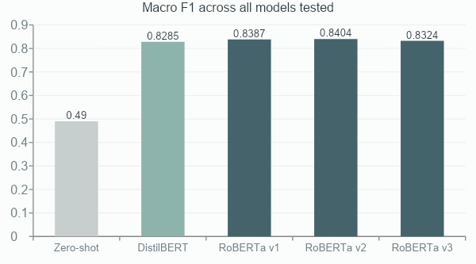
05 · EVALUATION
Production Decision: DistilBERT Fine-Tuned
DistilBERT vs. RoBERTa v2 (best)
Criterion | DistilBERT | RoBERTa v2
Macro F1 | 0.8285 | 0.8404
Parameters | 66M | 125M
Training time | ~50 min | ~1h 40
Inference speed | ~2.5× faster | baseline
Memory footprint | ~250 MB | ~500 MB
A +1.19pp gain does not justify doubling infrastructure cost for real-time review processing. Selected for deployment: DistilBERT fine-tuned — powers the app's live sentiment classifier.
Ceiling around ~84%: label noise from mapping star ratings to sentiment (a 3-star “great product, terrible shipping” review is genuinely ambiguous, even for a human annotator).
Automated Customer Reviews
12
Notes:
Aqui esta a decisao mais importante do projeto: escolhemos o DistilBERT para producao, nao o modelo com melhor numero. A diferenca de qualidade e impercetivel para o utilizador final, mas o DistilBERT e 2.5x mais rapido a inferir e usa metade da memoria -- numa plataforma que processa reviews em tempo real, isso pesa mais do que 1% de F1. (~70s -- slide mais importante, nao apressar)

Slide 12
06 · CLUSTERING
Grouping 41 Categories into 5 Meta-Categories
Categories (not individual reviews) are embedded with all-MiniLM-L6-v2 using chunked mean-pooling, then grouped with KMeans. K was selected by silhouette score within the allowed range.
41
K = 5
0.233
product categories
silhouette = 0.233
silhouette score, chosen k
# | Meta-category | Categories | Reviews
0 | Fire TV, Refurbished & Promotional Electronics | 3 | 5,076
1 | Chargers, Cables & Device Accessories | 6 | 573
2 | Kindle, Tablets, Batteries & Office Products | 15 | 53,284
3 | Small Accessories, Cases, Stands & Pet Supplies | 11 | 102
4 | Echo, Alexa & Home Entertainment | 6 | 8,924
Cluster 3 is treated as a low-confidence cluster due to low review support (102 reviews across 11 categories) — flagged explicitly, not hidden.
Automated Customer Reviews
13
Notes:
Para agrupar produtos, clusterizamos as 41 categorias -- nao as reviews individuais -- com embeddings semanticos e KMeans. O K ideal, testado estatisticamente, foi 5. Um dos clusters ficou muito mais pequeno que os outros; sinalizamos isso como possivel ruido, nao escondemos. (~50s)

Slide 13
07 · GENERATIVE AI
Transformer-Based Review Summarization
facebook/bart-large-cnn summarizes ranked review evidence per sentiment (value / mixed / concerns), mapped to a 17-theme business taxonomy, then checked by a semantic quality audit — offline, in the notebook.
1
Rank products, select evidence
2
BART summarizes each sentiment
3
Map to business taxonomy
4
Semantic + tone audit
Example — Cluster: Kindle, Tablets, Batteries & Office Products
50,723
91.1%
“Customers consistently praise value for money, battery life, and ease of use and setup — while recurring complaints focus on charging speed and reliability and battery life.”
reviews
positive
Product flagged for attention: AmazonBasics AAA Performance Alkaline Batteries (36 Count) — filtered by minimum review count and excludes raw ASIN / “Unknown” placeholders.
These validated summaries export to generated_articles.csv and are loaded directly by the app's Category intelligence tab (next slide) — a taxonomy fallback applies only to individual fields lacking sufficient evidence.
Automated Customer Reviews
14
Notes:
Para cada meta-categoria geramos, offline, tres resumos com o BART -- valor, feedback misto, e queixas -- mapeados a uma taxonomia de 17 temas de negocio e validados por uma auditoria semantica. No cluster de Kindle e Tablets, por exemplo, os clientes valorizam o custo-beneficio e a duracao da bateria, mas tambem reclamam da bateria e da velocidade de carregamento. Estes resumos validados sao os que a app carrega diretamente -- nao ha resumos "mais leves" a substitui-los. (~50s)

Slide 14
08 · DEPLOYMENT
The App: A Gradio Demo for Two Audiences
Consumer view
Seller view
Pick from 8 plain-language product groups — a separate, simpler taxonomy than the 5 ML meta-clusters
One click (“Analyse”) returns sentiment, average rating, strengths and concerns
Strengths & concerns extracted live via the same theme taxonomy — no BART or file dependency
Overview — portfolio sentiment, weakest & strongest meta-category
Category intelligence — 3D cluster view + the quality-audited BART summary
Product performance — top & worst products by sentiment and volume
Review analyzer — live DistilBERT classifier for a pasted review
Built with Gradio, deployed with a public share link from Colab. Serves pre-exported artifacts — including audited BART summaries — and the fine-tuned DistilBERT; nothing trains or generates live.
Automated Customer Reviews
15
Notes:
Tudo isto esta numa app interativa em Gradio, com duas vistas: consumidor, que escolhe um grupo de produto em linguagem simples e ve sentimento, rating e temas extraidos ao vivo pela taxonomia -- sem depender do BART -- e vendedor, com quatro separadores: overview, inteligencia de categoria (onde aparecem os resumos validados do BART), performance de produtos, e um classificador ao vivo com o DistilBERT afinado. (~35s)

