Slide 1
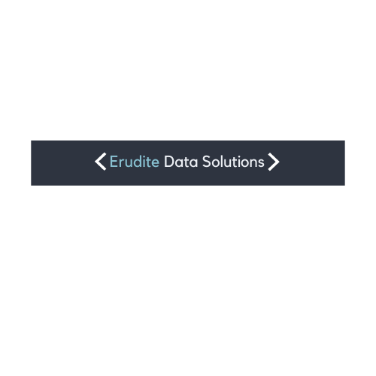
Erudite Data Solutions

