Slide 1
How to Build Android 5.0 on Zedboard
Noritsuna Imamura

Slide 2
Agenda
Build FSBL(First Boot Loader) & U-boot
Build Kernel
Make device tree file
Build Android 5.0.2
Setup Zedboard
Notes:
という形で進める

Slide 3
Link List
Android Source Code
https://github.com/noritsuna/zedroid_manifests.git
Kernel Source Code
https://github.com/noritsuna/zedroid_device_xilinx_zedboard-kernel.git
boot loader & kernel & Android binaries
https://github.com/noritsuna/zedroid_device_xilinx_zedboard-images.git
If you don’t need to build this from source code, please go to “Setup Zedboard” section after these binaries.

Slide 4
Build FSBL(First Boot Loader) & U-boot

Slide 5
Download Board Design Files
ANALOG DEVICES
ADV7511 XILINX EVALUATION BOARDS REFERENCE DESIGN
http://wiki.analog.com/resources/fpga/xilinx/kc705/adv7511
File
http://wiki.analog.com/_media/resources/fpga/xilinx/kc705/cf_adv7511_zed_edk_14_4_2013_02_05.tar.gz
Why need?
ADV7511 is Video Chip for HDMI on Zedboard. Android requires visual output.
Android supports virtual display since 4.4. If you don’t need use HDMI display, please skip this section.

Slide 6
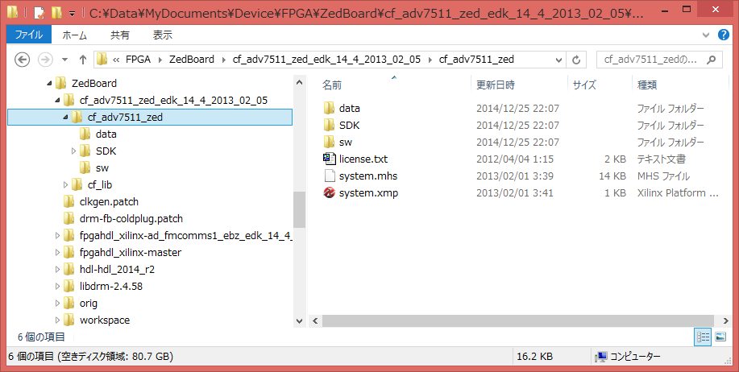
Unpack the downloaded file
Go to “cf_adv7511_zed” dir
Start “system.xmp” file by XPS

Slide 7
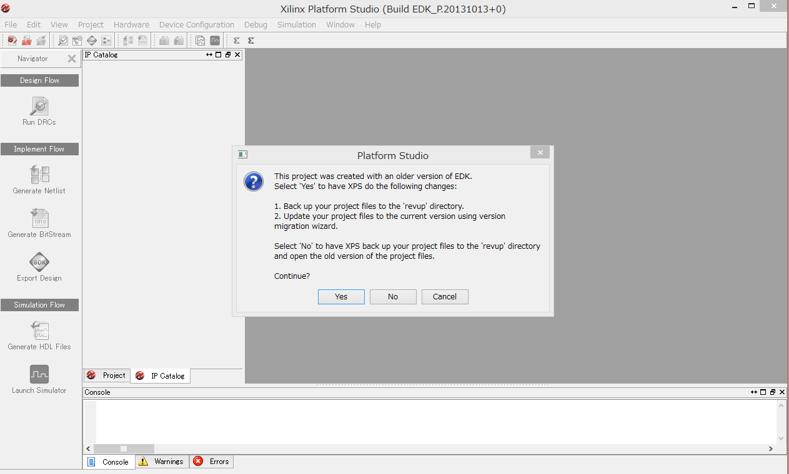
Convert version
Click & Answer “Yes” After Questions

Slide 8
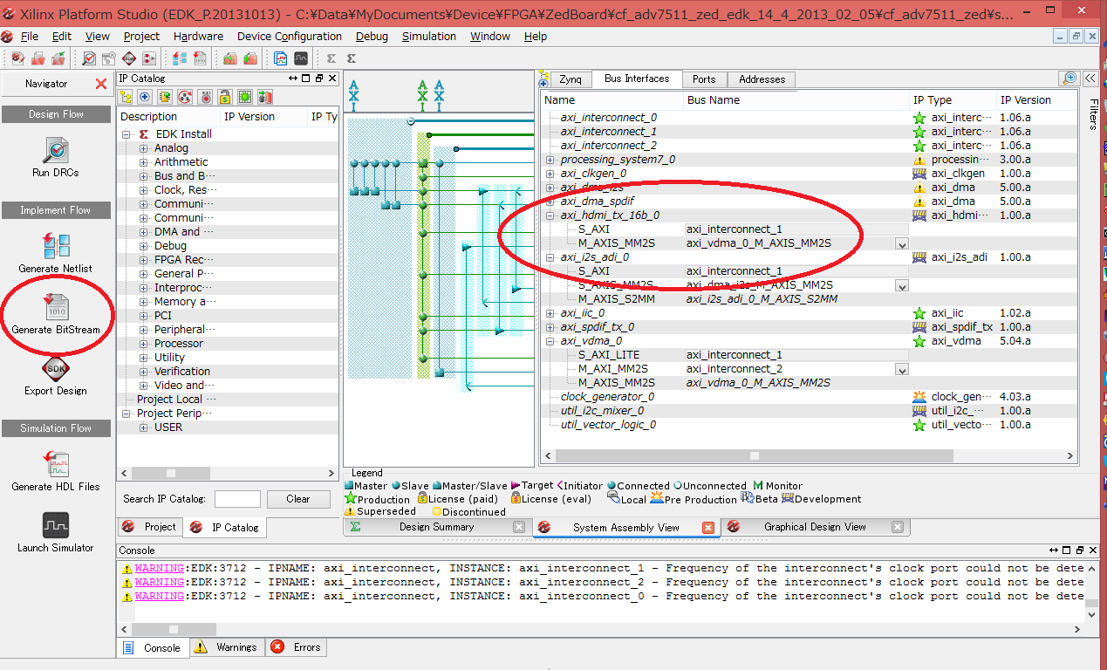
Check HDMI & Generate Flow Design
Click “Generate BitStream”

Slide 9
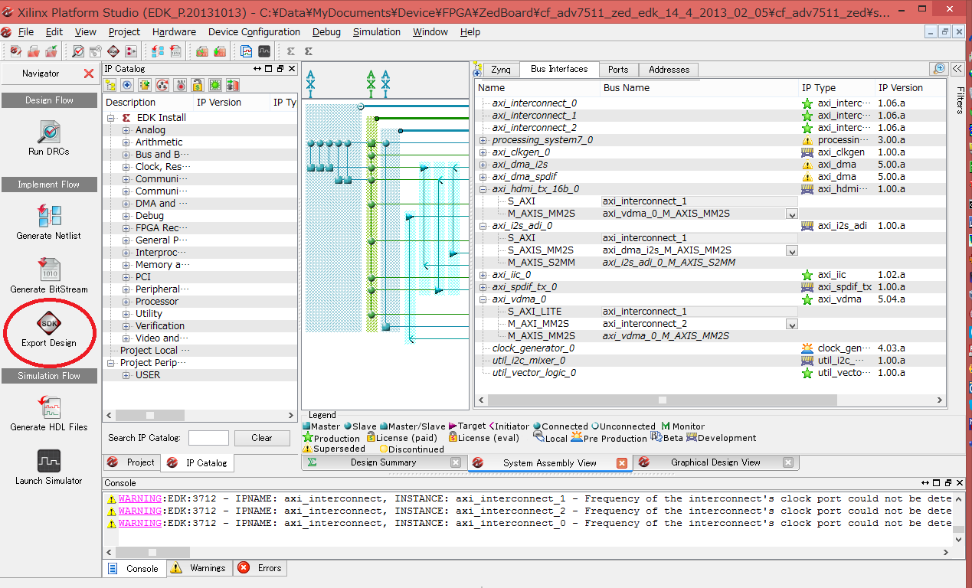
Export Hardware Design to “SDK”
Click “Export SDK”

Slide 10
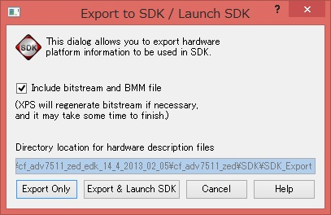
Lunch SDK
Click “Export & Lunch SDK”

Slide 11
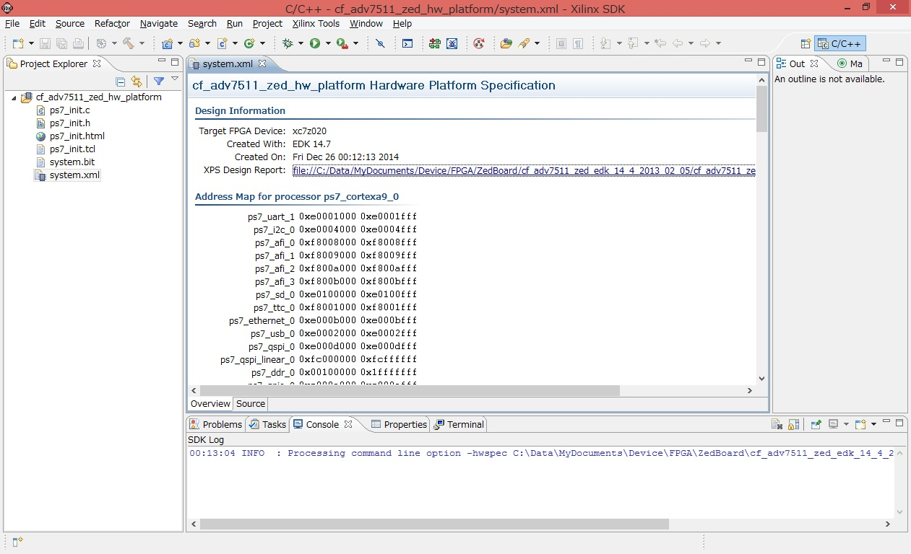
Finish to lunch SDK

Slide 12
Next: Compile U-boot

Slide 13
Prepare Compiler for u-boot
Download XILINX Compiler(Android NDK is OK)
PetaLinux with compiler
http://www.xilinx.com/support/download/index.html/content/xilinx/en/downloadNav/petalinux.html
Set Environments
export PETALINUX=[path to petaLinux compiler]
export CCOMPILER=arm-xilinx-eabi-gcc
export ARCH=arm
export CROSS_COMPILE=arm-xilinx-eabi-
export PATH=$PATH:${PETALINUX}/tools/linux-i386/arm-xilinx-gnueabi/bin

Slide 14
Download & Compile u-boot
Download & Compile
git clone https://github.com/Xilinx/u-boot-xlnx.git
cd u-boot-xlnx/
git checkout -b xilinx-v14.4 xilinx-v14.4
make zynq_zed_config
make
After finish to compile u-boot, top directory has “u-boot” file.
This is u-boot image without hardware info.

Slide 15
Next: Back to SDK for building boot image

Slide 16
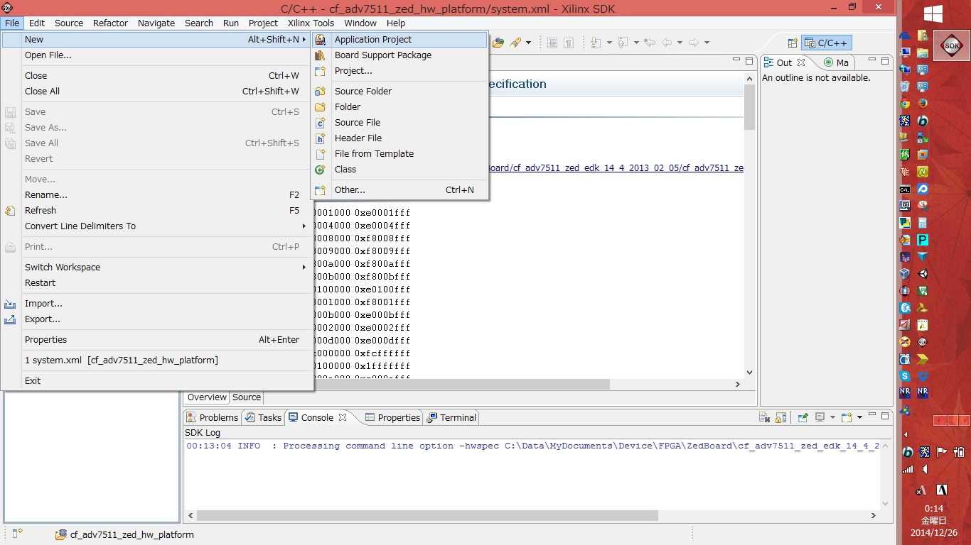
Create Application Project
Select File -> New -> Application Project

Slide 17
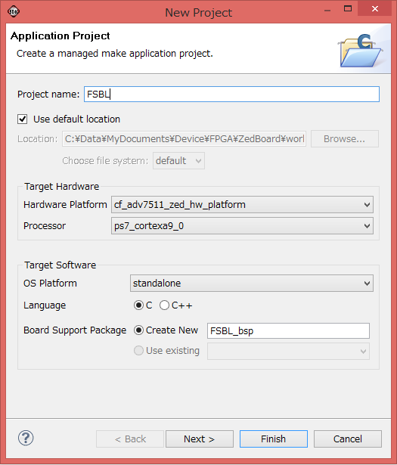
App Wizard 1/2:
Project Name: FSBL
Target Hardware:
Hardware Platform: cf_adv7511_zed_hw_platform
Processor: ps7_cortexa9_0
Click “Next>”

Slide 18
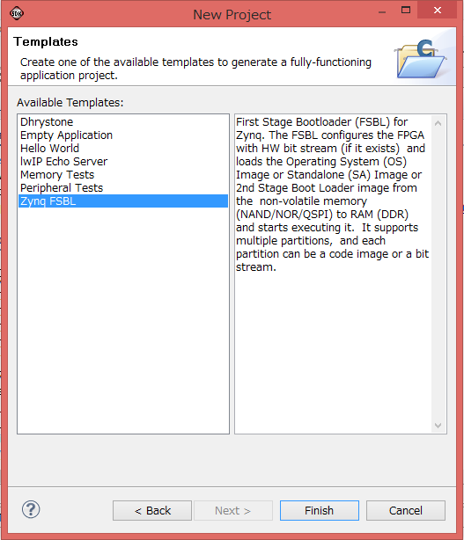
App Wizard 2/2:
Select “Zynq FSBL”
Click “Finish”

Slide 19
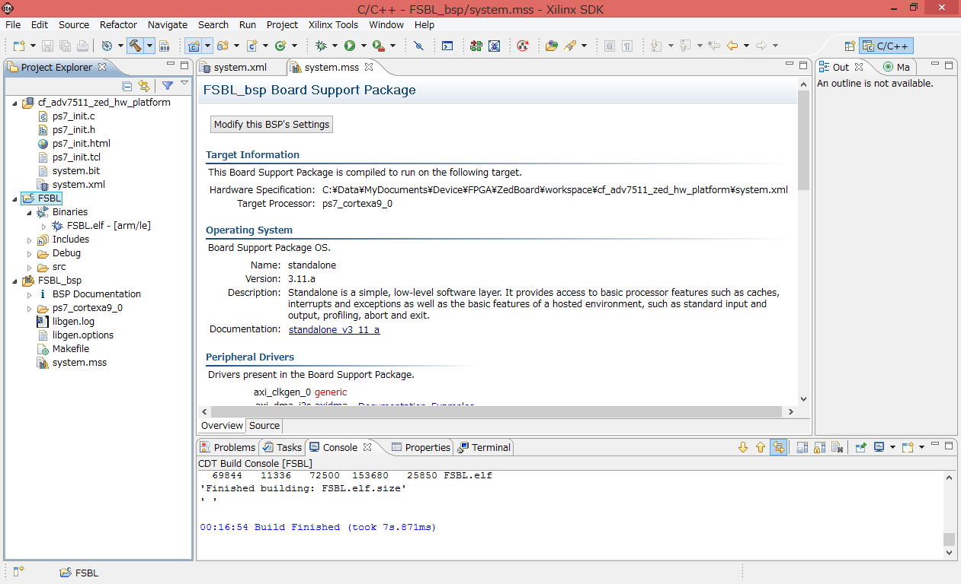
Created FSBL project

Slide 20
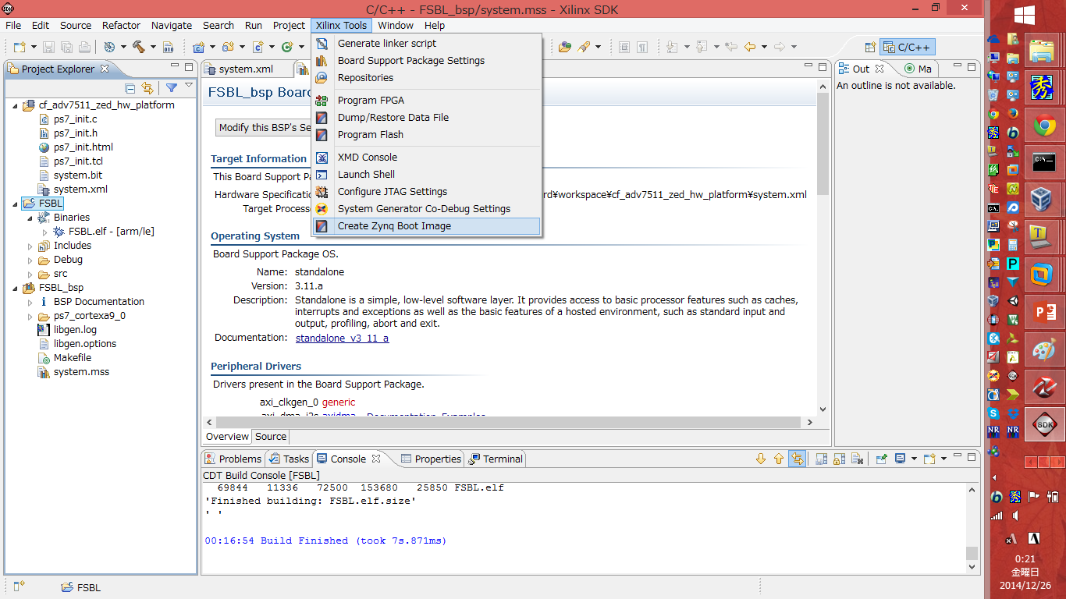
Create Boot Image 1/4
Select Xilinx Tools -> Create Zynq Boot Image

Slide 21
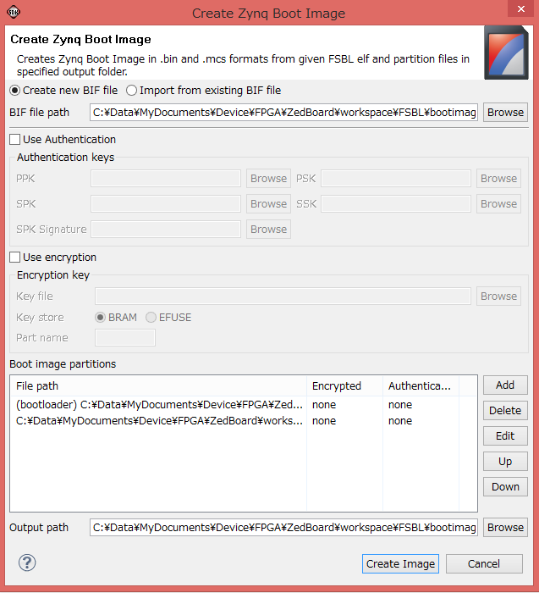
Create Boot Image 2/4
Lunch Wizard
Click “Add”

Slide 22
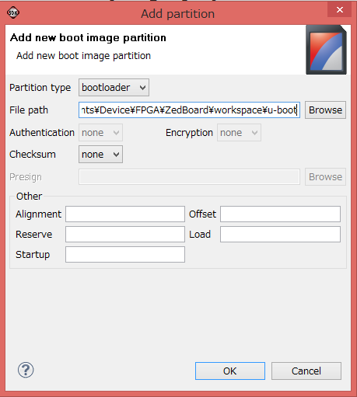
Create Boot Image 3/4
Lunch Sub-Window
Select:
Partition type: bootloader
Input:
File path: [U-boot file]
Click “OK”

Slide 23
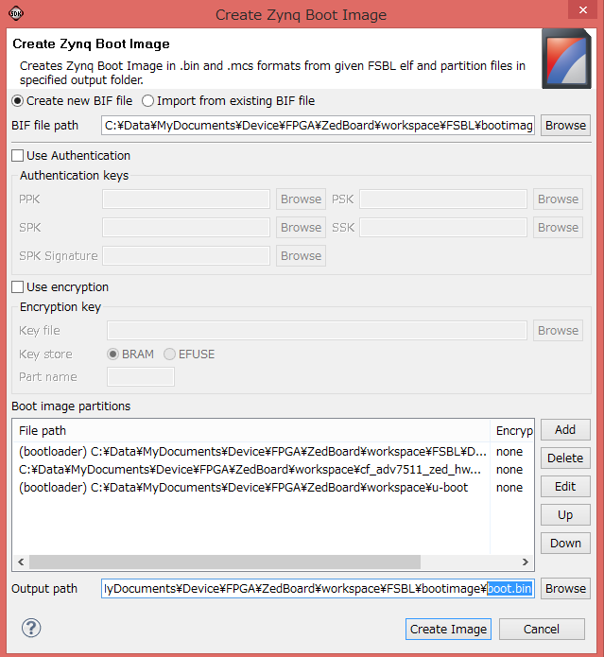
Create Boot Image 4/4
Added your “u-boot” in “Boot image partitions”
Change “Output path”:
output.bin -> boot.bin
Click “Create Image”

Slide 24
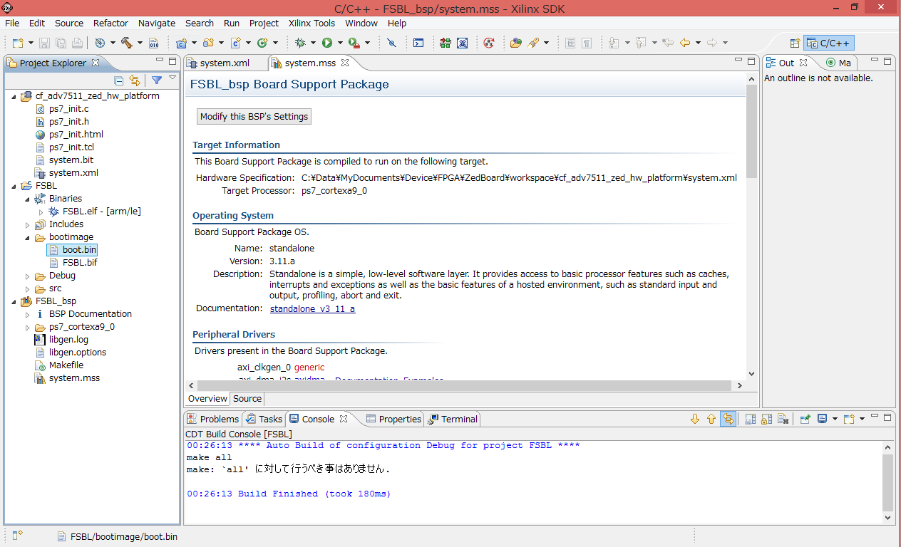
Created Boot Image
Start compiling automatically
After finish, You get boot image for Zedboard as boot.bin

Slide 25
Build Kernel

Slide 26
Prepare Compiler
Download XILINX Compiler(Android NDK is OK)
PetaLinux with compiler
http://www.xilinx.com/support/download/index.html/content/xilinx/en/downloadNav/petalinux.html
Set Environments
export PETALINUX=[path to petaLinux compiler]
export CCOMPILER=arm-xilinx-eabi-gcc
export ARCH=arm
export CROSS_COMPILE=arm-xilinx-eabi-
export PATH=$PATH:${PETALINUX}/tools/linux-i386/arm-xilinx-gnueabi/bin

Slide 27
Download & Compile Kernel
Download & Compile Kernel
git clone https://github.com/noritsuna/zedroid_device_xilinx_zedboard-kernel.git
cd zedroid_device_xilinx_zedboard-kernel
git checkout zedroid-5.0.2_r1
make zynq_zed_android_defconfig
make uImage LOADADDR=8000
You can get “uImage” in “arch/arm/boot/”

Slide 28
Make device tree file

Slide 29
Build device tree file
Build device tree file
cd [kernel dir]
make zynq-zed-adv7511.dtb
You can get “zynq-zed-adv7511.dtb” in “arch/arm/boot/dts/”
Rename “zynq-zed-adv7511.dtb” to “devicetree.dtb”

Slide 30
Build Android 5.0.2

Slide 31
Download source code & build
Install build tools following Google Android Site
https://source.android.com/source/downloading.html
Download source code & build
repo init -u https://github.com/noritsuna/zedroid_manifests -b zedroid-5.0.2_r1
repo sync
source ./build/envsetup.sh
lunch zedboard-userdebug
make

Slide 32
Appendix: OpenGL/ES support
If you use “lunch zedboard-userdebug”, this Android is for OpenGL/ES 2.0.
Zedboard doesn’t have GPU. My Android uses software renderer. It’s soooooooo slow.
If you use OpenGL/ES 1.2, it’s better to use.
Android’s OpenGL/ES current version is “2.0”. Some applications require “2.0”.
Special Options
OpenGL/ES 1.2 version
lunch zedboard_GLES12-userdebug
OpenGL/ES 2.0 version
lunch zedboard_GLES20-userdebug

Slide 33
Mark up ARM RAM image info
Android’s RAM image is NOT for u-boot.
sudo apt-get install u-boot-tools
mkimage -A arm -O linux -T ramdisk -a 0x2000000 -n "Zedboard ramdisk" -d [Android output dir]/ramdisk.img uramdisk.image.gz
“uramdisk.image.gz” file is RAM image for u-boot.

Slide 34
Setup Zedboard

Slide 35
Prepare Hardwares: SD Card 1/2
4GB SD Card
Partition:
1st primary: VFAT(FAT32) over 1GB with boot flag
2nd primary: ext4 over 1GB
3rd primary: ext4 over 500MB
4th primary: Linux Swap over 500MB
Copy Files
[Xilinx SDK dir]/boot.bin
[kernel dir]/arch/arm/boot/uImage
[kernel dir]/arch/arm/boot/dts/devicetree.dtb
[Android dir]/uramdisk.image.gz
To 1st partition

Slide 36
Prepare Hardwares: SD Card 2/2
4GB SD Card
Copy Files
[Android output dir]/system/* files with permission info
To 2nd partition
[Android output dir]/userdata/* files with permission info
To 3rd partition

Slide 37
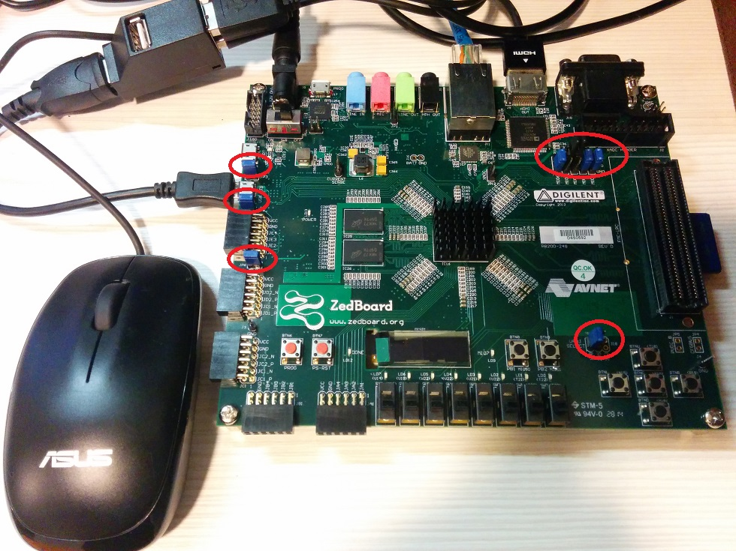
Prepare Hardwares: Zedboard DIPs
JP2, JP3, JP6: “Short”
JP18: “1V8” is “Short”
MI02, MI03, MI06: “3V3” is “Short”
MI04, MI05: “GND” is “Short”

Slide 38

Prepare Hardwares: LAN, HDMI, OTG
Required LAN, HDMI
If you don’t connect them, it doesn’t boot up.
Required 2 more ports: USB Hub
USB port is OTG only. Other USB port is NOT USB.

Slide 39
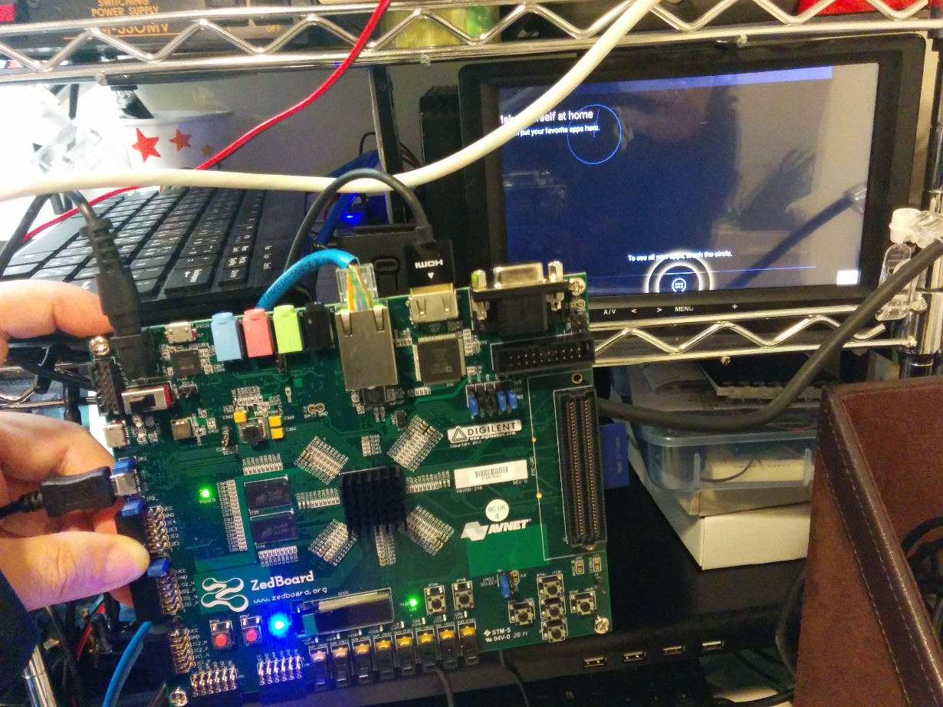
Power ON!
Insert SD Card
Connect AC Adapter and Turn on Power Switch!
Please wait 5-10 mins. Because when 1st boot, ART compile all applications to native binary.
Enjoy!

