Slide 1
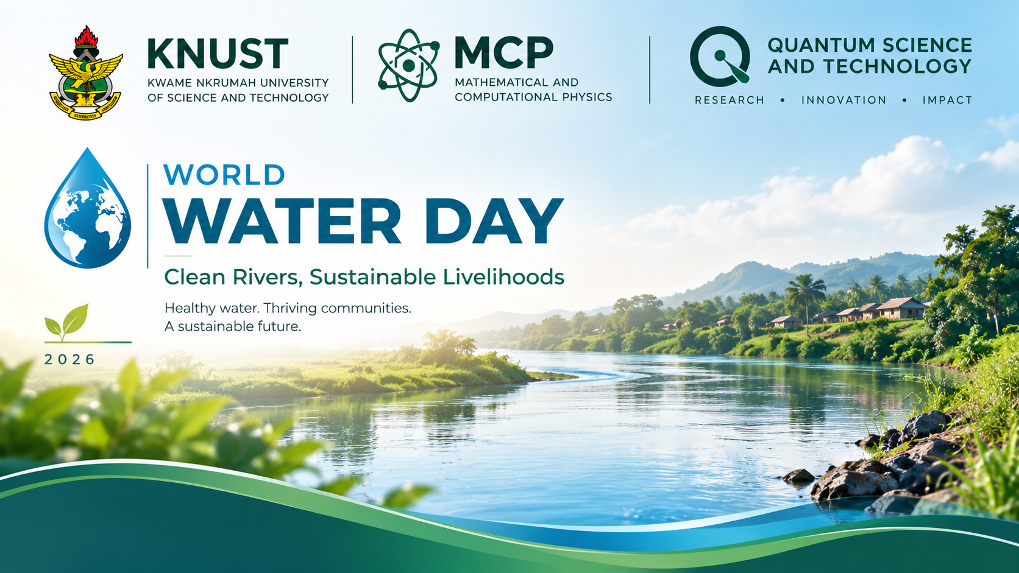
WORLD WATER DAY 2026
Clean Rivers,
Sustainable Livelihoods
Water • Science • Sustainable Solutions
KNUST | Mathematical and Computational Physics
CLEAN RIVERS • SUSTAINABLE FUTURES

Slide 2
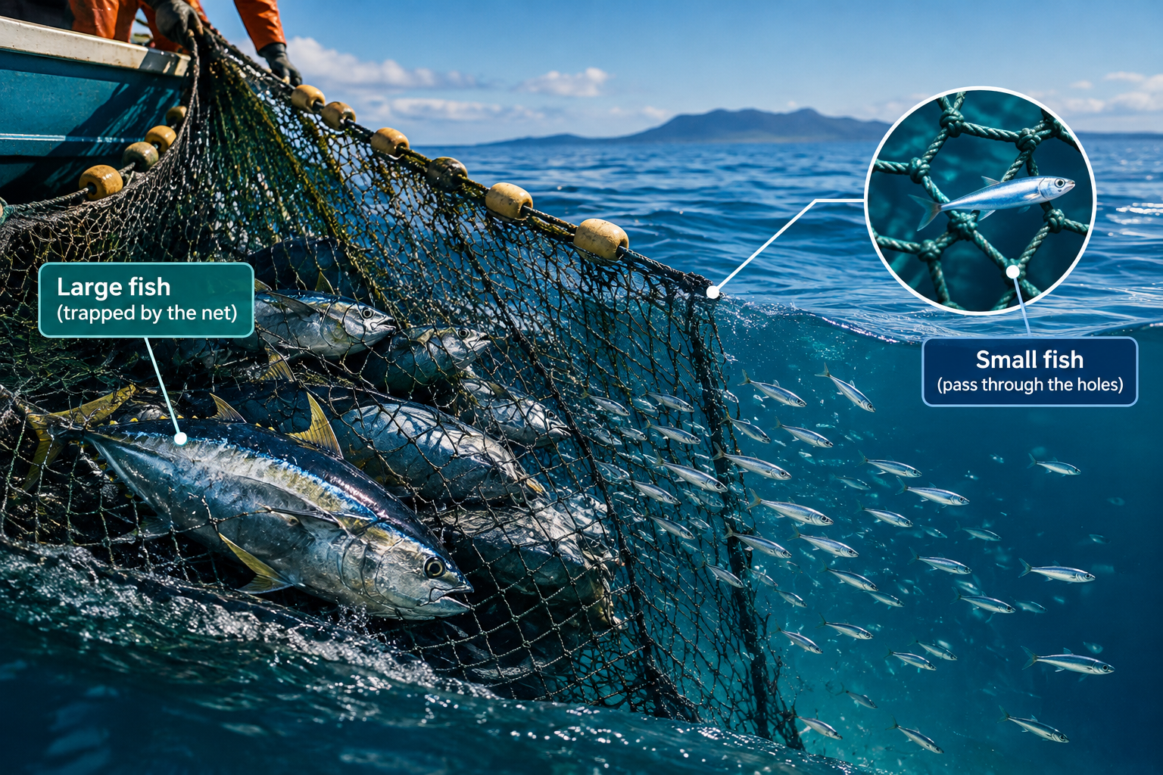
WORLD RIVERS DAY 2026
CAN A NET CATCH EVERYTHING?
also put a title for slide 4

Slide 3
WORLD RIVERS DAY 2026
Three Key Points
01
02
03
A NET HAS WHAT IT CATCHES
A SMALLER FISH CAN PASS THROUGH
THIS IS WHAT TRADITIONAL FILTER USING SAND, GRAVEL, ACTIVATED CHARCOAL DOES

Slide 4
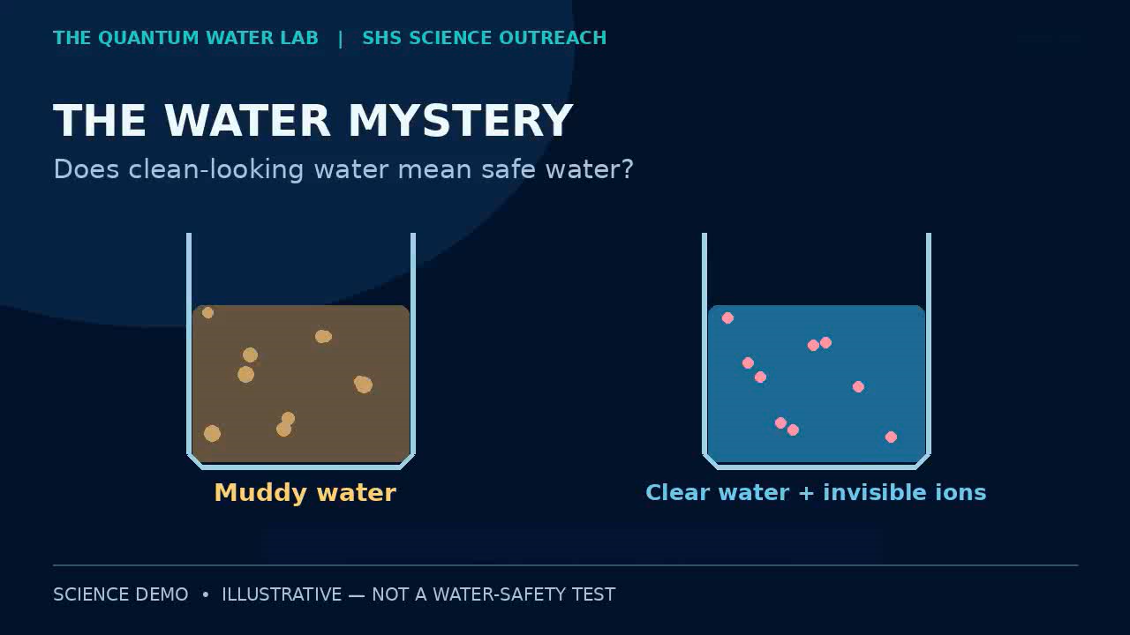
WORLD RIVERS DAY 2026
Title
A short subtitle or guiding question

Slide 5
WORLD RIVERS DAY 2026
DISSOLVED CONTAMINANTS ARE MISSED
Category | Scale / Size | Traditional Filter | Result | Mechanism / Solution
Macroscopic Debris (Leaves, twigs, gravel) | >1 mm (1,000,000 nm) | Gravel & Coarse Sand | TRAPPED ✅ | Physical straining between gravel
Fine Mud & Silt | 10–100 µm (10,000–100,000 nm) | Fine Sand | TRAPPED ✅ | Blocked in tight gaps between sand grains
Dissolved Heavy Metals (Pb2+, Hg2+) | 0.1–0.5 nm | Sand, Gravel, Charcoal | MISSED ❌ | Capture needs suitable sorbent chemistry
Dissolved Salts (Na+, Cl-) | 0.3–0.4 nm | Sand, Gravel, Charcoal | MISSED ❌ | Capture needs suitable sorbent chemistry
For comparisons, paired explanations, or text alongside a visual
LEFT COLUMN
RIGHT COLUMN
Add text, image, chart, or diagram
Add text, image, chart, or diagram

Slide 6
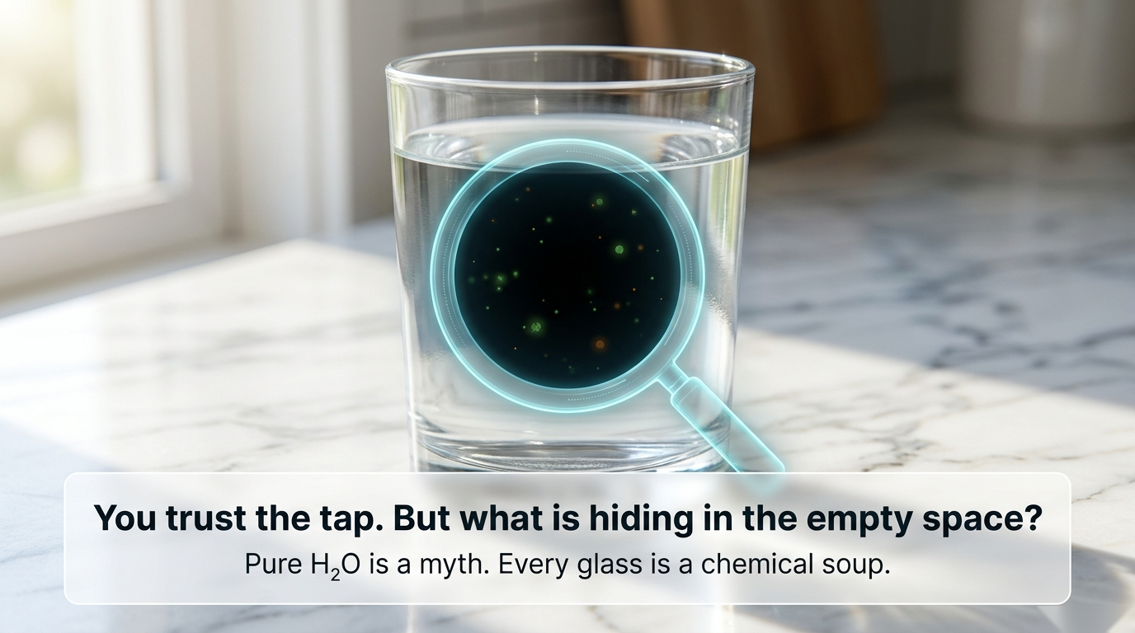
WORLD RIVERS DAY 2026
CLEAR WATER IS NOT PURE WATER
Contaminants like mercury ions pollute at the atomic level, dissolving in the water
These filters are blind to it so even the water may look clean after filtering.
Water purification materials need to be engineered at the quantum scale
Key observation / explanation

Slide 7
WORLD RIVERS DAY 2026
In our research at the MCP, we use materials like metal organic frameworks (MOF) for water purification.
These are very tiny nets/cubes with metal vertices and edges made of organic materials called linker.
Inside these cages, we anchor sulfur-containing sites..

Slide 8
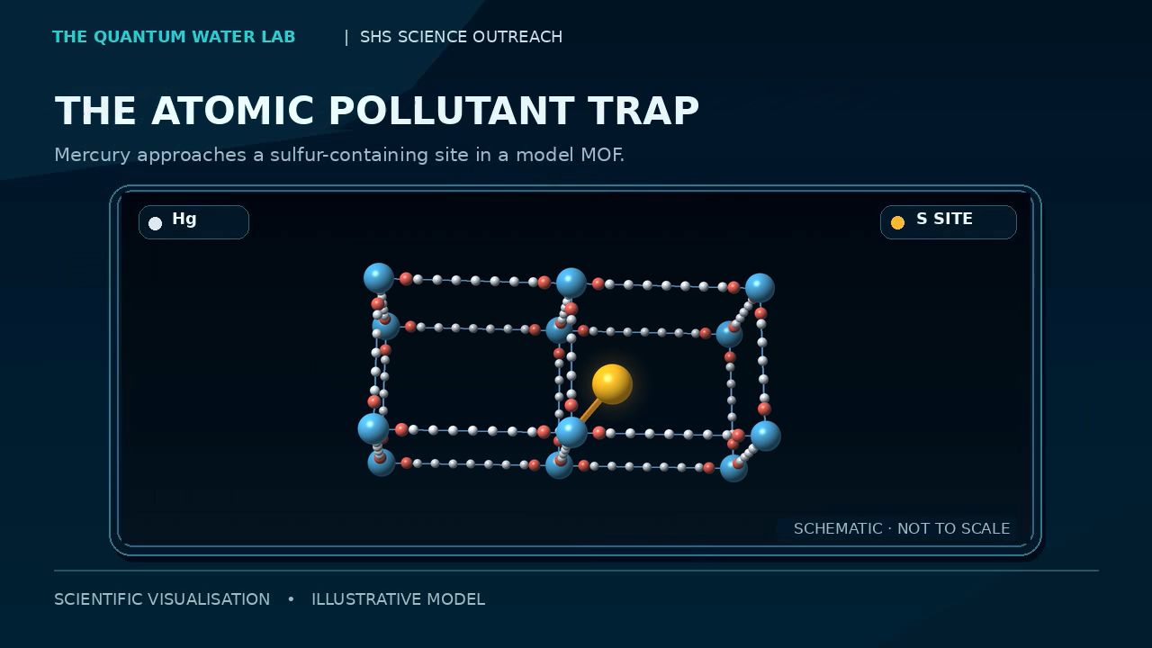
WORLD RIVERS DAY 2026

Slide 9
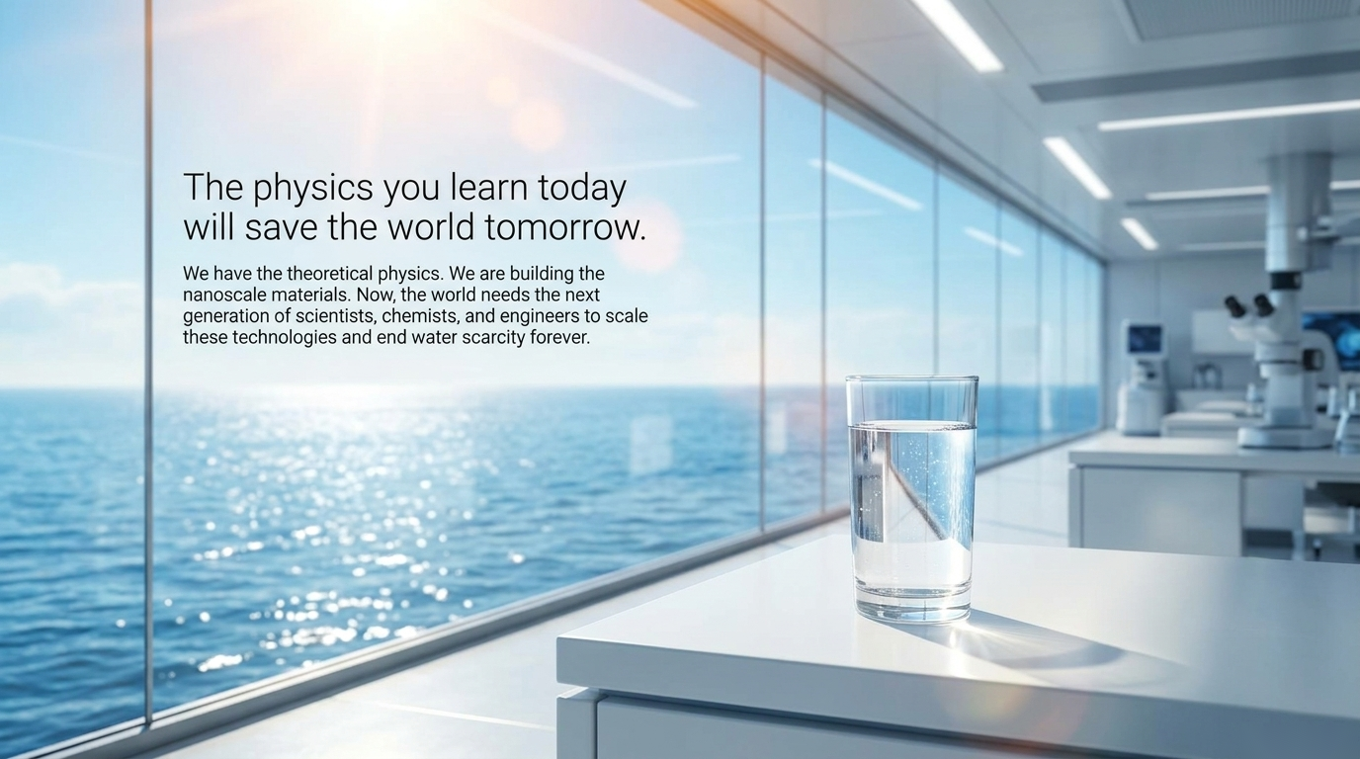
WORLD WATER DAY 2026
In our research at the MCP, we use materials like metal organic frameworks (MOF) for water purification.
These are very tiny nets/cubes with metal vertices and edges made of organic materials called linker.
Inside these cages, we anchor sulfur-containing sites.
Mercury acts as a quantum 'soft acid' and binds tightly to the sulfur 'soft base', creating an unbreakable chemical lock that permanently traps the mercury.

Slide 10
WORLD WATER DAY 2026
Thank You
Clean Rivers • Sustainable Livelihoods
Questions and Discussion

