Slide 1



深度學習 Deep Learning
Recurrent Neural Networks
(RNN)
Instructor: 林英嘉 (Ying-Jia Lin)
2025/03/31
Course GitHub
Slido # DL_0331

Slide 2
Outline
Training tips [30 min]
Recurrent Neural Networks (RNN) [50 min]
Homework 2 [50 min]
Quiz [20 min]

Slide 3
Natural Language Processing
電腦是如何學習自然語言呢？

Slide 4
Word Representations
like
🖥️
?
apple
Basic Approach
apple
[1, 0, 0, 0, 0, 0, 0, 0]
One hot encodings with each vector size equal to the vocab size (8 in this case)
Corpus
eat
[0, 1, 0, 0, 0, 0, 0, 0]
I like to eat apple
I
[0, 0, 1, 0, 0, 0, 0, 0]
Vocabulary
Pros: handy, training-free
Cons: sparse matrix which occupies much memory
You like to watch TV
like
[0, 0, 0, 1, 0, 0, 0, 0]
watch
[0, 0, 0, 0, 1, 0, 0, 0]
to
[0, 0, 0, 0, 0, 1, 0, 0]
...

Slide 5

Word Embeddings (Word2Vec)
Input
Word2Vec model
Prediction
[1] Mikolov et al. "Distributed representations of words and phrases and their compositionality." NeurIPS 2013.
Steve
Jobs
CBOW ^{[1]}
(Continuous Bag-of-Words)
[MASK]
founded
Apple
Large Corpora
(E.g., Wikipedia)
Inc.
[MASK]
Steve
[MASK]
Jobs
Skip-gram ^{[1]}
founded
[MASK]
Apple
[MASK]
Inc.

Slide 6
After Training Word Embeddings
The outputs are dense vectors with a fixed dimension size:
Dimension size (e.g., 300)
apple -0.110960 0.016115 -0.004809 0.033589 0.121455 …
banana -0.027713 -0.015676 0.003314 0.077602 0.159718 …
…
…
…
Vocabulary size
(e.g., 30,000)

Slide 7
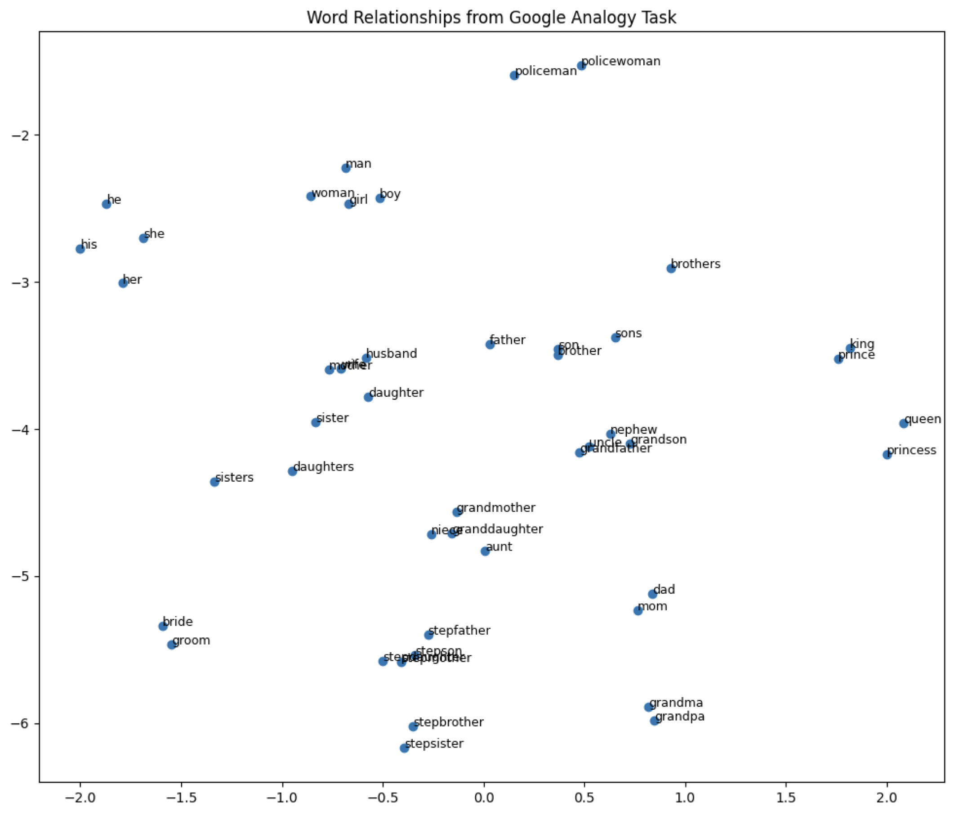
Word Embeddings 視覺化
Word embedding model: glove-wiki-gigaword-100
Dimension reduction: t-SNE
Dataset: Mikolov et al., 2013

Slide 8
Recurrent Neural Networks
RNN

Slide 9
Short comings of FFN
Lack of Sequence Modeling:
In NLP tasks, understanding the sequence of words and their dependencies is crucial for accurate predictions.
Fixed Input Size:
FFNs require fixed-size inputs, which can be problematic for NLP tasks where input sequences vary in length.
Limited Contextual Information:
Many NLP tasks benefit from capturing long-range dependencies and understanding the broader context of a text, which is better addressed by models capable of modeling sequential data effectively.

Slide 10
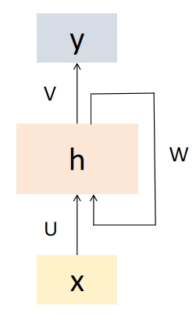
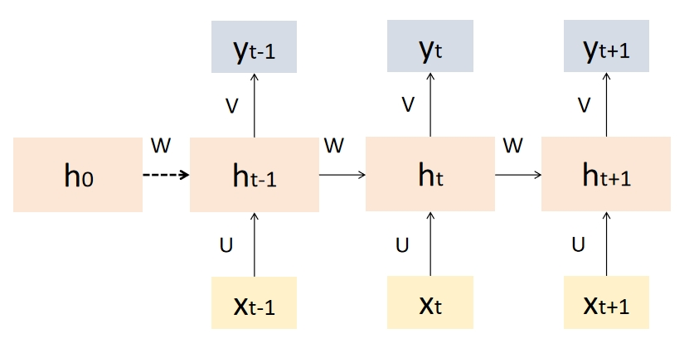
Recurrent Neural Networks (RNN)
Recurrent Neural Networks (RNNs) are a type of artificial neural network designed to handle sequential data by capturing temporal dependencies.
RNN 的“遞迴”是指它在每一個時間步中重複使用相同的參數（同一組權重），並把先前的隱藏狀態傳到下一個時間步

Slide 11
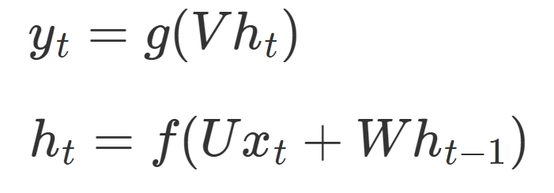









RNN
$$y_{t}$$
The equation on step t is:
, where f and g are activation functions.
$$V$$
$$U$$
$$f=Wx_{t}+Uh_{t−1}$$
$$h_{t}$$
+
$$U$$
$$W$$
$$h_{t−1}$$
$$x_{t}$$

Slide 12
Properties of RNNs
Sequential Processing:
RNNs handle sequences, allowing them to model temporal dependencies in data.
Recurrent Connections:
RNNs maintain internal memory, facilitating the capture of long-term dependencies.
Parameter Sharing:
RNNs share parameters across time steps, enhancing efficiency in learning sequential data.
Vanishing Gradient Problem:
Traditional RNNs may face vanishing gradient issues, hindering learning of long-term dependencies.

Slide 13
Text Generation with RNN
Hidden size: 100
Vocab
Prob
a
...
apple
...
b
...
banana
...
elephant
...
eraser
...
...
zoo
0.0001
...
0.600
...
0.0001
...
0.0003
...
0.300
...
0.05
...
...
0.0001
$$h$$
Classification Layer
Hidden size: Vocab_size
RNN
RNN
RNN
$$h′$$
Vocab
size
I
love
an

Slide 14

RNNs for Sequence Classification
This movie was awful. The ending was absolutely horrible.
Classifier
Positive
Negative
FFN
h_{n}
h₀
RNN
RNN
RNN
RNN
x₁
x₂
x₃
x_{n}

Slide 15



Stacked RNNs
Stacked RNNs consist of multiple networks where the output of one layer serves as the input to a subsequent layer
h₁
h₂
h₃
h_{n}
$$h_{0}^{3}$$
RNN
RNN
RNN
RNN
RNN layer3
$$h_{0}^{2}$$
RNN
RNN
RNN
RNN
RNN layer2
$$h_{0}^{1}$$
RNN
RNN
RNN
RNN
RNN layer1
x₁
x₂
x₃
x_{n}

Slide 16
Bidirectional RNNs
y₁
y₂
y₃
y_{n}
Concatenation
RNN
RNN
RNN
RNN
RNN2
RNN1
RNN
RNN
RNN
RNN
x₁
x₂
x₃
x_{n}

Slide 17
Bidirectional RNNs for Sequence Classification
The final hidden units from the forward and backward passes are combined to represent the entire sequence.
This combined representation serves as input to the subsequent classifier.
FFN
Concatenation
RNN
RNN
RNN
RNN
RNN2
RNN1
RNN
RNN
RNN
RNN
x₁
x₂
x₃
x_{n}

Slide 18
Shortage of standard RNNs
Gradient vanishing (梯度消失) problem
Long-term dependencies cannot be handled.
RNNs can only remember local relationships.
This is result from back-propagation through-time (BPTT) during training.

Slide 19



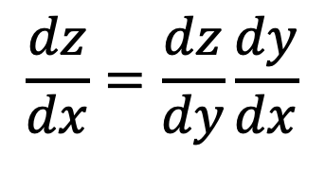



(Calculus) Chain Rule - 1
$$Δx$$
$$Δz$$
$$x$$
$$y$$
$$z$$
$$\frac{dz}{dx}=\frac{dz}{dy}\frac{dy}{dx}$$
$\frac{dz}{dx}$ 代表 $x$ 對 $z$ 的影響，但 $x$ 的變化會影響到 $y$，接著 $y$ 影響到 $z$

Slide 20

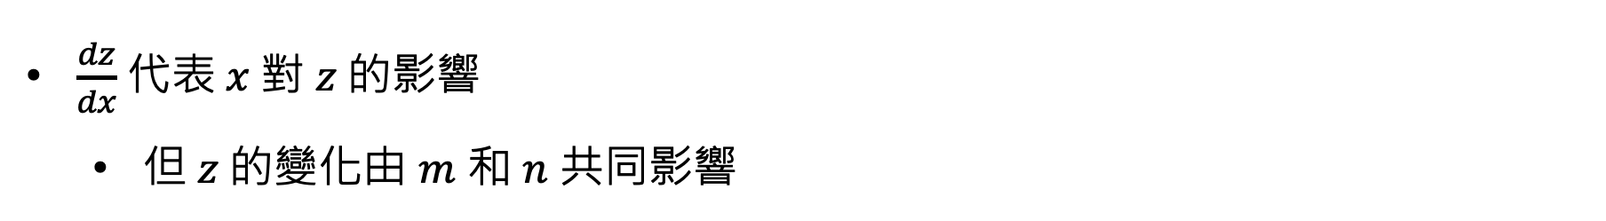
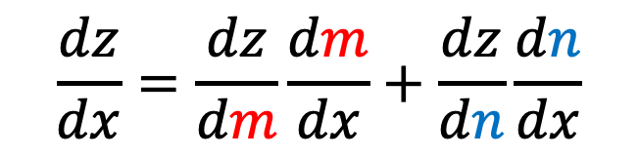

(Calculus) Chain Rule - 2
$$m$$
$$x$$
$$z$$
$$n$$
$$\frac{dz}{dx}=\frac{dz}{dm}\frac{dm}{dx}+\frac{dz}{dn}\frac{dn}{dx}$$
$\frac{dz}{dx}$ 代表 $x$ 對 $z$ 的影響
但 $z$ 的變化由 $m$ 和 $n$ 共同影響

Slide 21





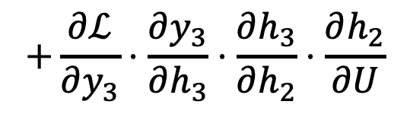






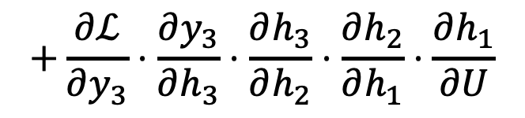






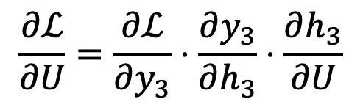




Back-propagation through-time (BPTT)
$$y_{t}$$
$$y_{1}$$
$$y_{2}$$
$$y_{3}$$
$$V$$
$$V$$
$$V$$
$$V$$
$$h_{t}$$
$$U$$
$$U$$
$$U$$
+
$$h_{1}$$
$$h_{2}$$
$$h_{3}$$
$$U$$
$$W$$
$$W$$
$$W$$
$$W$$
$$h_{t−1}$$
$$x_{t}$$
$$x_{1}$$
$$x_{2}$$
$$x_{3}$$
$$\frac{∂ℒ}{∂U}=\frac{∂ℒ}{∂y_{3}}⋅\frac{∂y_{3}}{∂h_{3}}⋅\frac{∂h_{3}}{∂U}$$
$$+\frac{∂ℒ}{∂y_{3}}⋅\frac{∂y_{3}}{∂h_{3}}⋅\frac{∂h_{3}}{∂h_{2}}⋅\frac{∂h_{2}}{∂U}$$
$$+\frac{∂ℒ}{∂y_{3}}⋅\frac{∂y_{3}}{∂h_{3}}⋅\frac{∂h_{3}}{∂h_{2}}⋅\frac{∂h_{2}}{∂h_{1}}⋅\frac{∂h_{1}}{∂U}$$
(small)

Slide 22

















LSTM (Long Short-Term Memory)
Hochreiter, Sepp, and Jürgen Schmidhuber. "Long short-term memory." Neural computation 9.8 (1997): 1735-1780.
$$c_{t}=c_{t}×f_{t}+n_{t}$$
LSTM uses 4 times of weights as a standard RNN.
+
$$c_{t−1}$$
$$×$$
$$f_{t}$$
$$n_{t}$$
$$c_{t}$$
Multiplication
Sigmoid
Sigmoid
tanh
+
+
+
$$UF$$
$$WF$$
$$UI$$
$$WI$$
$$U$$
$$W$$
$$h_{t−1}$$
$$x_{t}$$
$$h_{t−1}$$
$$x_{t}$$
$$h_{t−1}$$
$$x_{t}$$
Forget Gate
Input Gate
RNN Cell

Slide 23




LSTM (Long Short-Term Memory)
Hochreiter, Sepp, and Jürgen Schmidhuber. "Long short-term memory." Neural computation 9.8 (1997): 1735-1780.
$$c_{t}=c_{t}×f_{t}+n_{t}$$
LSTM uses 4 times of weights as a standard RNN.
+
$$c_{t−1}$$
$$×$$
$$f_{t}$$
$$n_{t}$$
$$c_{t}$$
tanh
Sigmoid
Multiplication
$$o_{t}$$
$$h_{t}$$
+
$$UO$$
$$WO$$
$$h_{t−1}$$
$$x_{t}$$
Output Gate

Slide 24
RNN vs. LSTM
 | Memory Mechanism | Handles Long Dependencies? | Gradient Vanishing?
RNN | Hidden state h_{t} | Worse | Yes
LSTM | Memory state c_{t} + Hidden state h_{t} | Better | Much less than a standard RNN

Slide 25
Activation functions (啟動函數)
 | 值的範圍 | 使用情境
softmax | [0, 1] (sum up to 1) | 需要讓多個值產生相加為一的機率值的時候，常用於建立分類任務模型時計算 cross-entropy loss
sigmoid | [0, 1] | 需要讓單一值產生機率值的時候，常用於建立二元分類任務模型時計算 binary cross-entropy loss
tanh | [-1, 1] | 常用於LSTM等RNN模型中，主要為引入非線性轉換。tanh的值是對稱的，以零為中心，在有些訓練條件下和sigmoid相比較不會梯度消失
ReLU | [0, 正值] | 常用於CNN或MLP等模型中，主要為引入非線性轉換。計算簡單，在許多任務收斂快

Slide 26
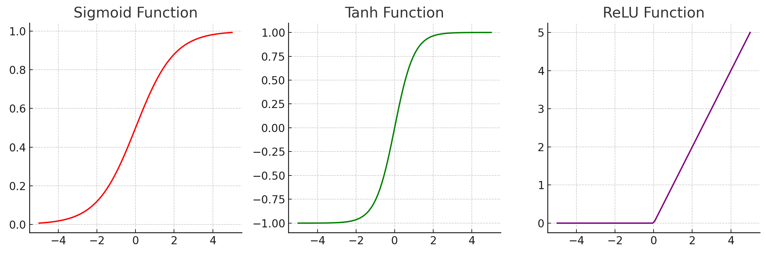
Activation functions
Softmax: https://datascience.stackexchange.com/questions/57005/why-there-is-no-exact-picture-of-softmax-activation-function

Slide 27
Thank you!
Instructor: 林英嘉
✉️ yjlin@cgu.edu.tw
TA: 林君襄
✉️ becky890926@gmail.com

