Slide 1



深度學習 Deep Learning
Backpropagation
Instructor: 林英嘉 (Ying-Jia Lin)
2025/03/03
Course GitHub
Slido # DLBP

Slide 2
Syllabus
Week | Topic | Note
1 | 深度學習介紹以及本課程綱要 (Introduction to Deep Learning / Syllabus)
2 | PyTorch教學 / 梯度下降 (I) | (最佳化)
3 | 梯度下降 (II)
4 | 神經網路與反向傳播法 | HW1
5 | 手把手實作深度學習框架細節探索
6 | 卷積神經網路 (with LAB)
7 | 循環神經網路 (with LAB) | HW2
8 | 自注意力模型 (with LAB)
9 | 期中考
10 | 自監督式模型方法 | HW3
11 | 強化學習 (Reinforcement Learning)
12 | 模型壓縮 (Model Compression)
13 | 大模型時代如何有效率訓練模型？ | HW4
14 | 可解釋性人工智慧
15 | 小組實作成果報告 (1)
16 | 小組實作成果報告 (2)
(0217 version)

Slide 3
Syllabus
Week | Topic | Note
1 | 深度學習介紹以及本課程綱要 (Introduction to Deep Learning / Syllabus)
2 | PyTorch教學 / 梯度下降 (I) | (最佳化)
3 | 神經網路與反向傳播法 | HW1
4 | 梯度下降 (II)
5 | 手把手實作深度學習框架細節探索
6 | 卷積神經網路 (with LAB)
7 | 循環神經網路 (with LAB) | HW2
8 | 自注意力模型 (with LAB)
9 | 期中考
10 | 自監督式模型方法 | HW3
11 | 強化學習 (Reinforcement Learning)
12 | 模型壓縮 (Model Compression)
13 | 大模型時代如何有效率訓練模型？ | HW4
14 | 可解釋性人工智慧
15 | 小組實作成果報告 (1)
16 | 小組實作成果報告 (2)
LAB*
Exam
Report
*LAB代表包含程式碼實作教學

Slide 4
Outline
Gradient Descent Recap [20 min]
Backpropagation [60 min]
PyTorch [35 min]
作業說明 [15 min]
Quiz [20 min]

Slide 5
Deep Learning 學習路徑
[Deep Learning Fundamentals]
PyTorch (W2, W3)
Gradient Descent (W2, W4)
W4: Stochastic Gradient Descent (SGD), Momentum
Neural Networks and Back-propagation (W3)
More about PyTorch (W5)

Slide 6


[Recap] Univariate gradients
First-order derivative (s)
Univariate function: a scaler
Multivariate function: a vector
Univariate Example:
Original function:
$$f\left(x\right)=x^{2}$$
First-order derivative:
$$f^{′}\left(x\right)=2x=∇_{x}f$$

Slide 7
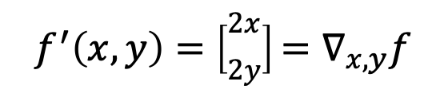
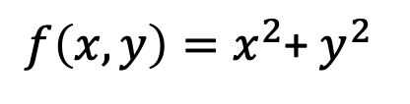
[Recap] Multivariate gradients
First-order derivative (s)
Univariate function: a scaler
Multivariate function: a vector
Multivariate Example:
Original function:
$f\left(x, y\right)=x^{2}$+ $y^{2}$
$$f^{′}\left(x,y\right)=\left[\begin{matrix}2x \\ 2y\end{matrix}\right]=∇_{x,y}f$$
First-order derivatives:

Slide 8
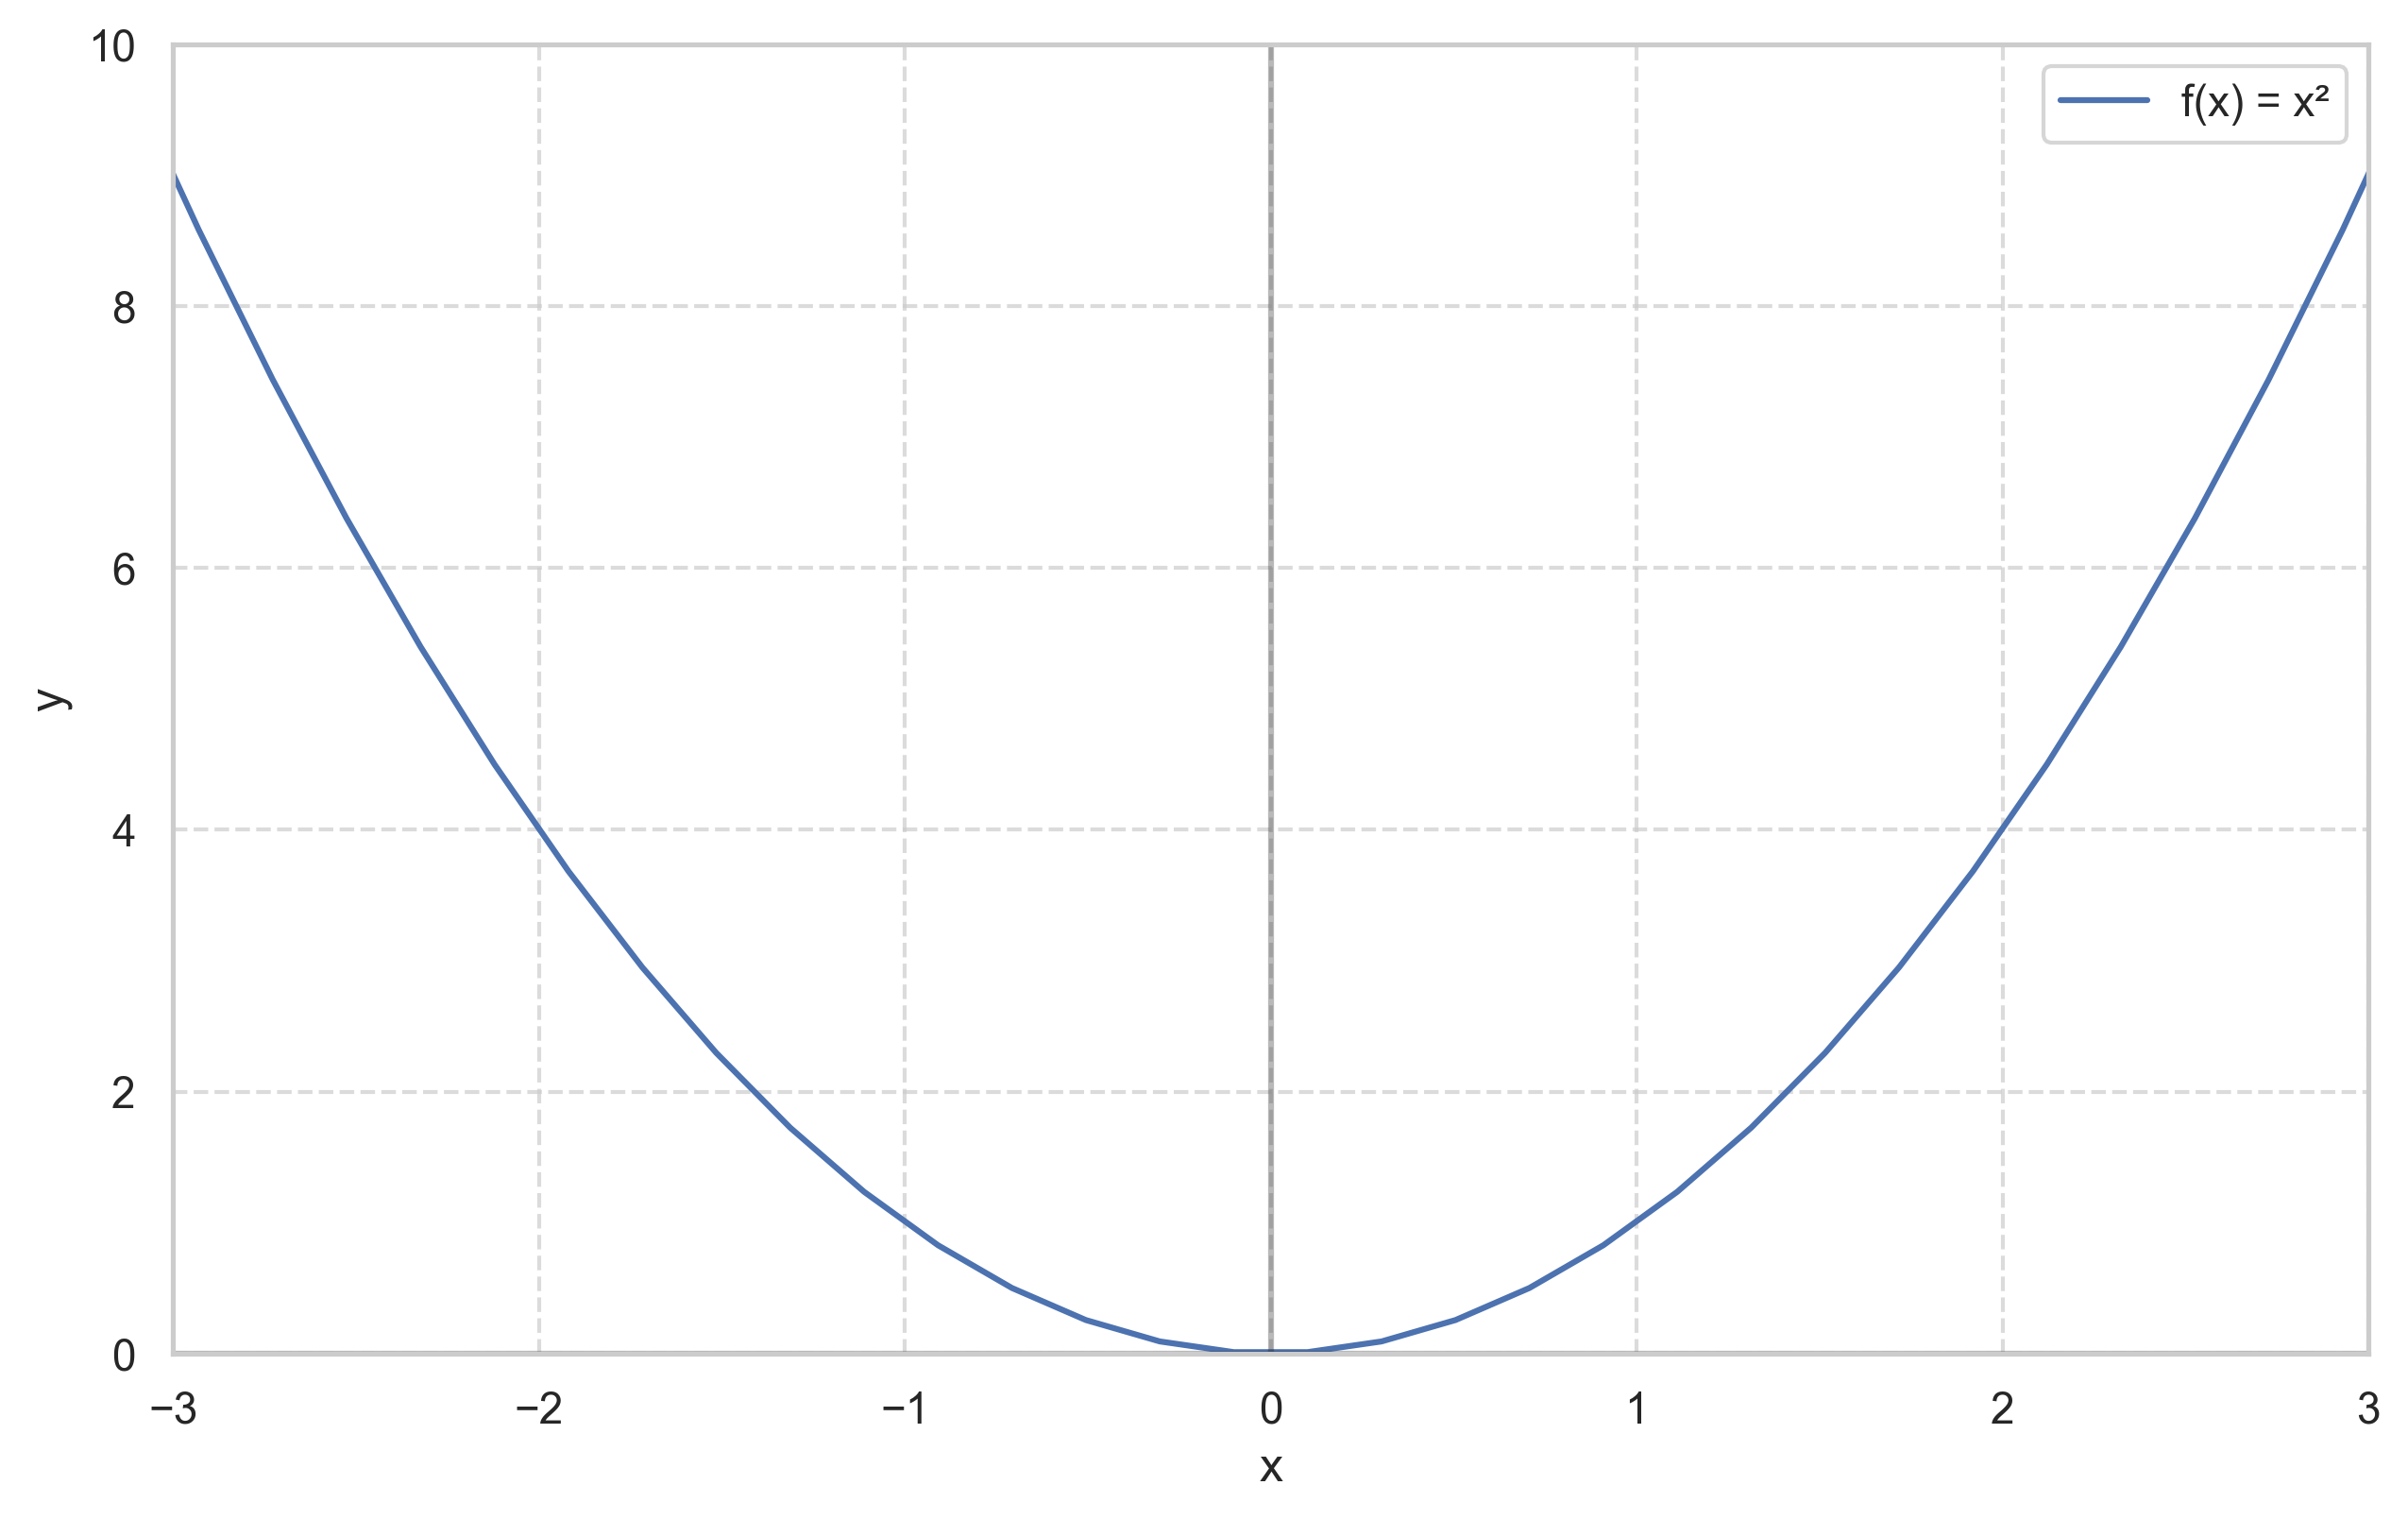


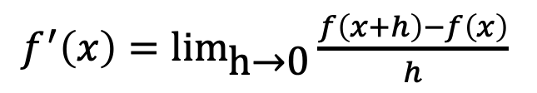


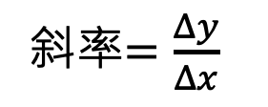
[Recap] What are gradients? (數學意義)
斜率$=\frac{Δy}{Δx}$
$$f\left(x\right)=x^{2}$$
一次導函數：
$f^{′}\left(x\right)=\text{li}{\text{m}}_{\text{h}\text{→}\text{0}}\frac{f\left(x+h\right)−f\left(x\right)}{h}$
$$Δy$$
$$=2x$$
$$Δx=h$$
梯度等於一次導函數的值，也就是斜率

Slide 9
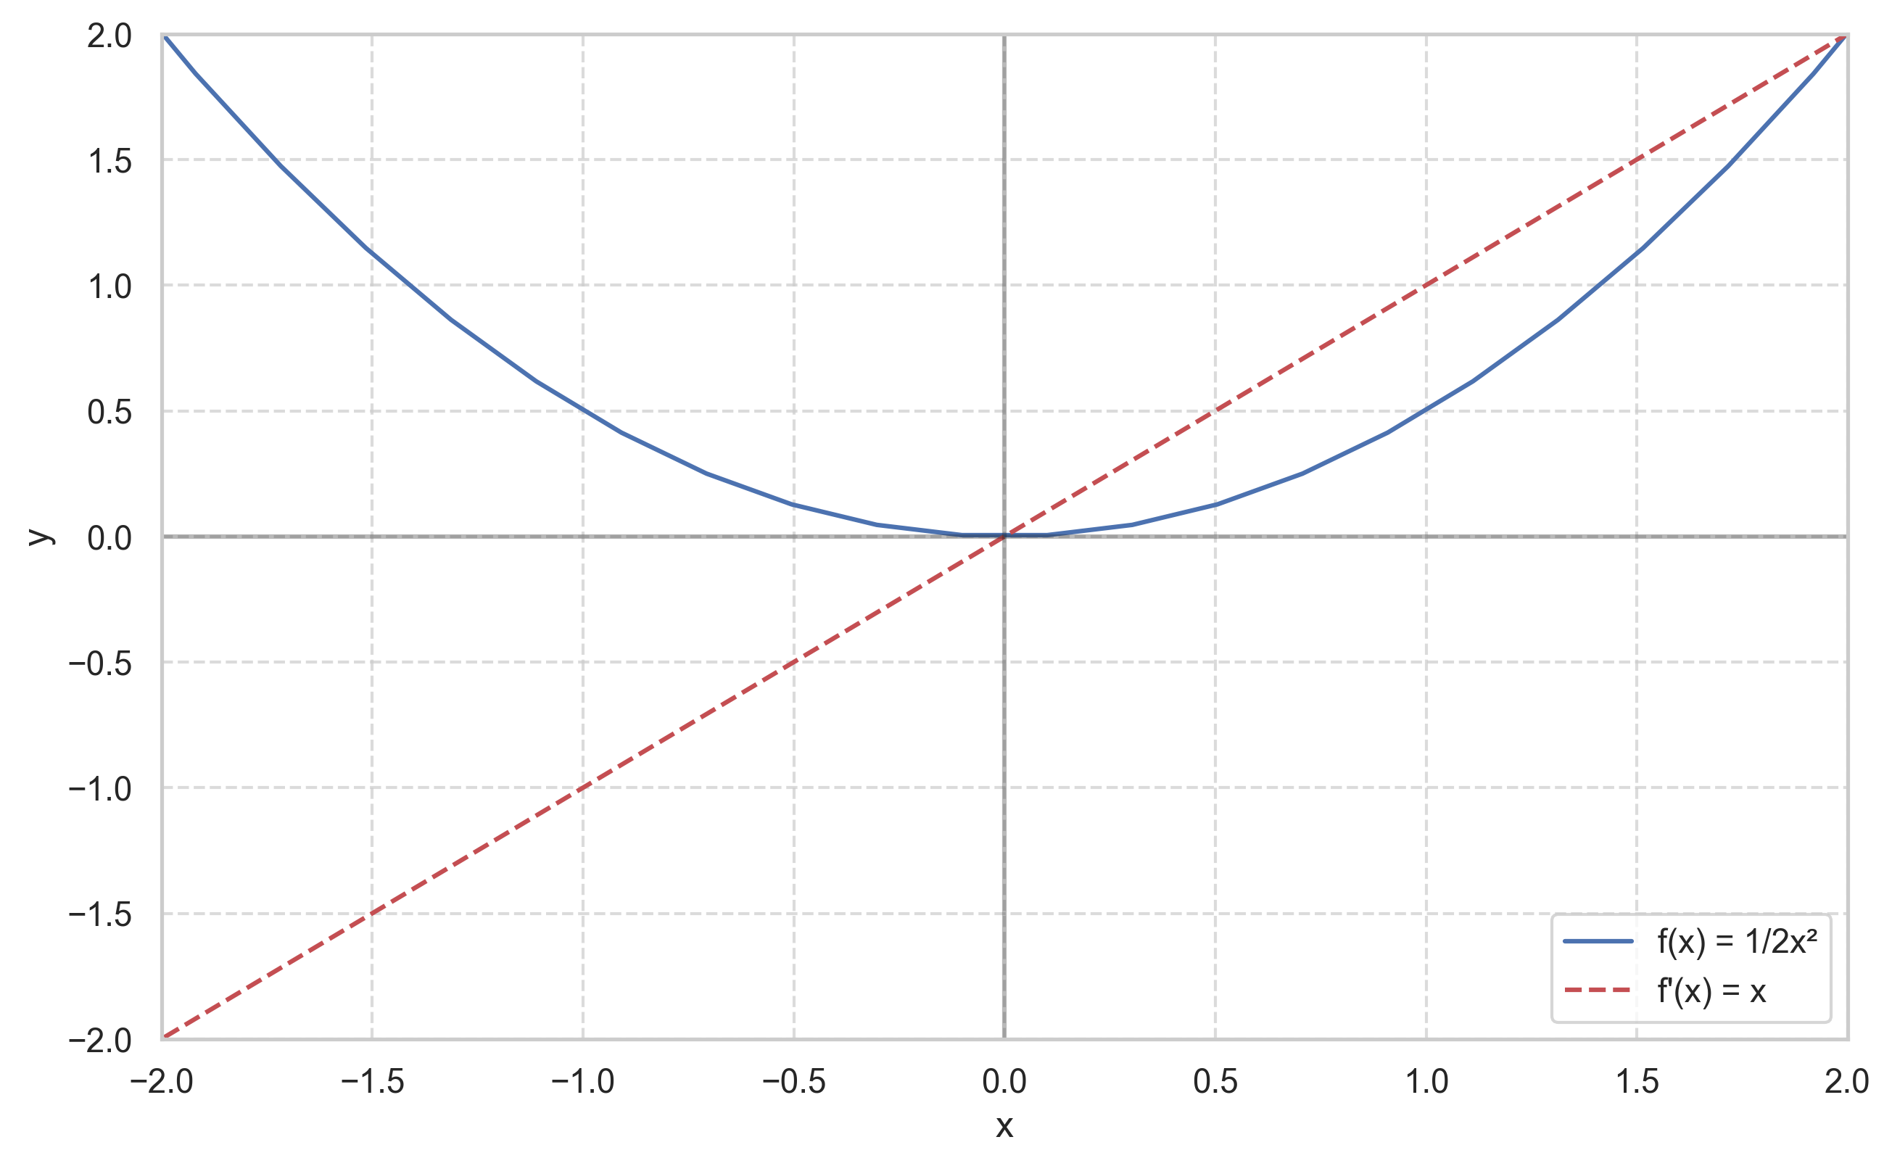
[Recap] Gradient Descent
一次導數為零達到最佳解

Slide 10
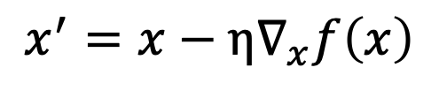
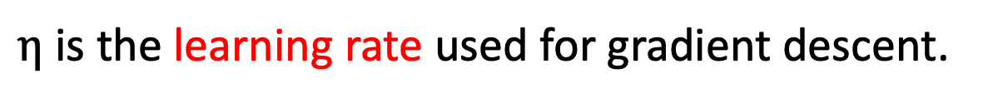
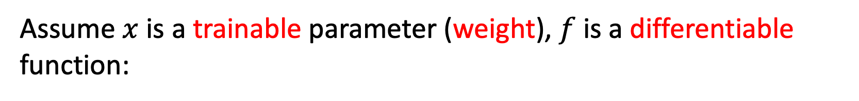
[Recap] Gradient Descent (梯度下降法)
Assume $x$ is a trainable parameter (weight), $f$is a differentiable function:
Gradient descent:
$$x^{′}=x−η∇_{x}f\left(x\right)$$
$η$ is the learning rate used for gradient descent.

Slide 11
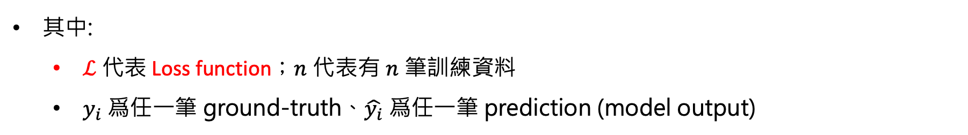
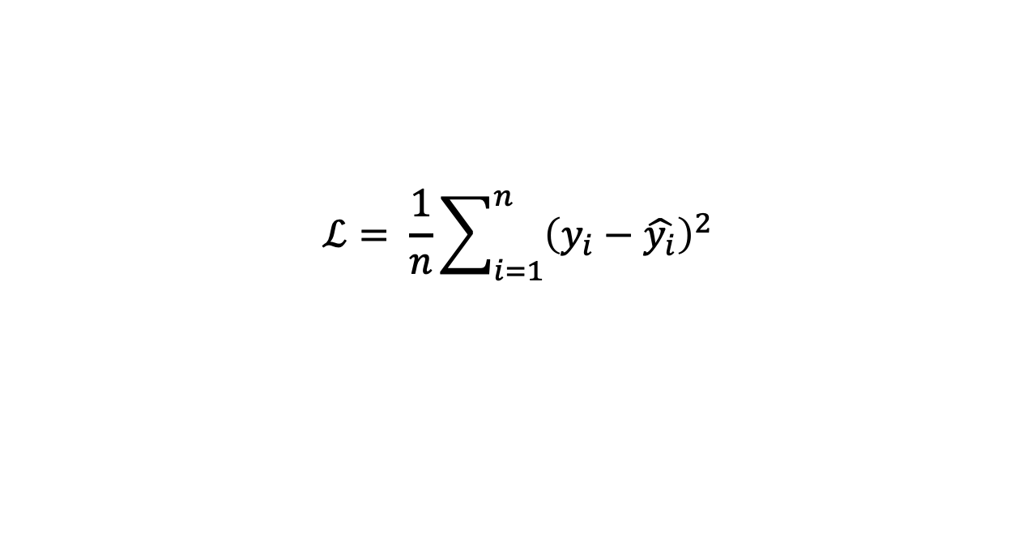
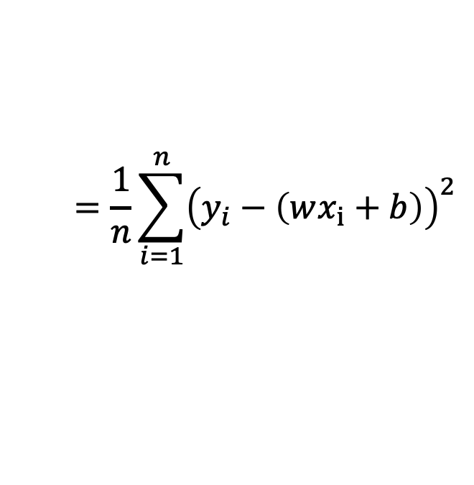
[Recap] Minimize a Regression Model
以均方誤差 (Mean Squared Error) 為例：
$$ℒ= \frac{1}{n}\sum_{i=1}^{n}{{\left(y_{i}−\hat{y_{i}}\right)}^{2}}$$
$$=\frac{1}{n}\sum_{i=1}^{n}{{\left(y_{i}−\left(wx_{i}+b\right)\right)}^{2}}$$
其中:
$ℒ$ 代表 Loss function；$n$ 代表有 $n$ 筆訓練資料
$y_{i}$ 爲任一筆 ground-truth、$\hat{y_{i}}$ 爲任一筆 prediction (model output)

Slide 12
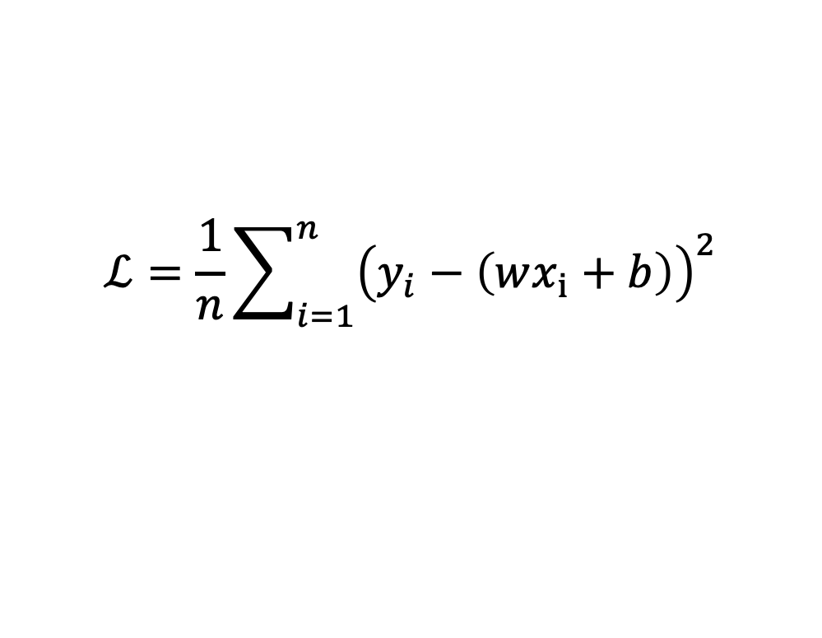
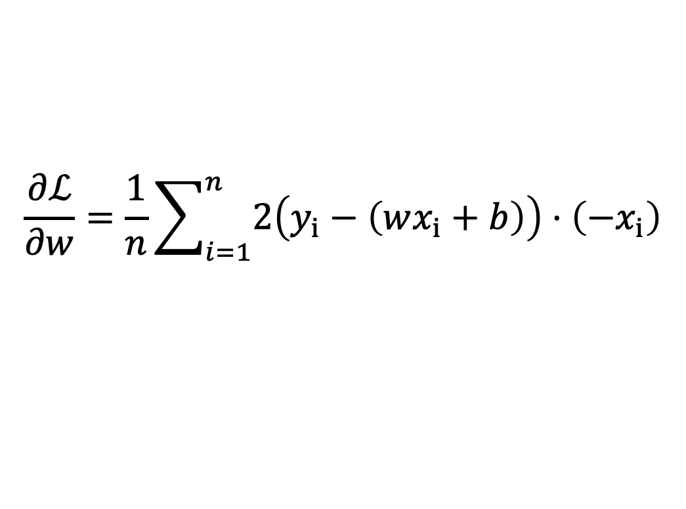
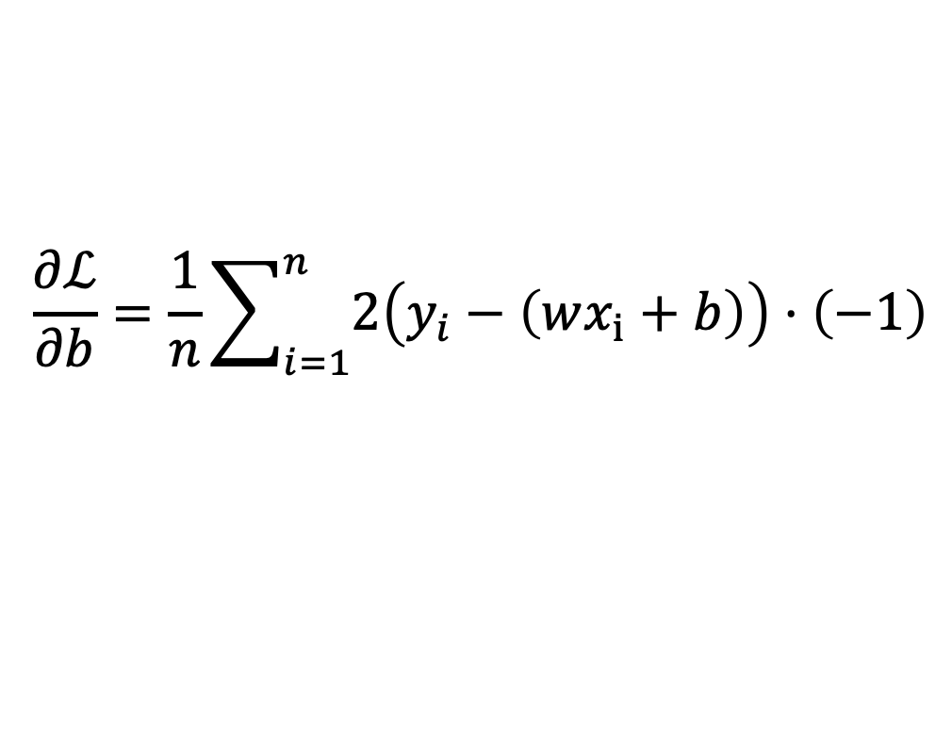
[Recap] Minimize a Regression Model
$$ℒ=\frac{1}{n}\sum_{i=1}^{n}{{\left(y_{i}−\left(wx_{i}+b\right)\right)}^{2}}$$
$$\frac{∂ℒ}{∂w}=\frac{1}{n}\sum_{i=1}^{n}{2\left(y_{i}−\left(wx_{i}+b\right)\right)}⋅\left(−x_{i}\right)$$
對w進行偏微分
$$\frac{∂ℒ}{∂b}=\frac{1}{n}\sum_{i=1}^{n}{2\left(y_{i}−\left(wx_{i}+b\right)\right)}⋅\left(−1\right)$$
對b進行偏微分

Slide 13
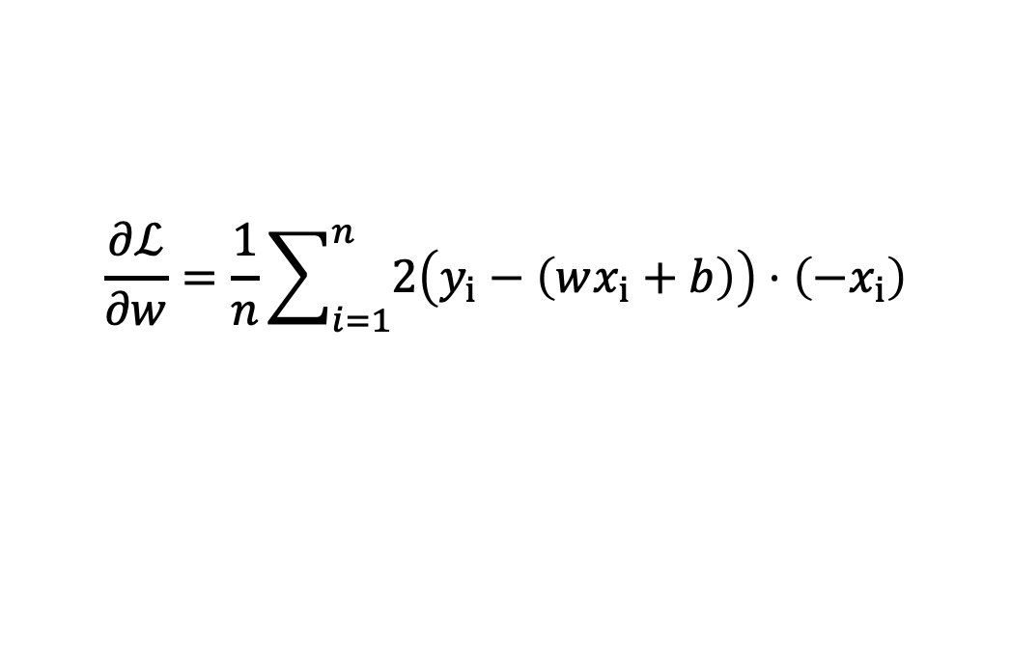
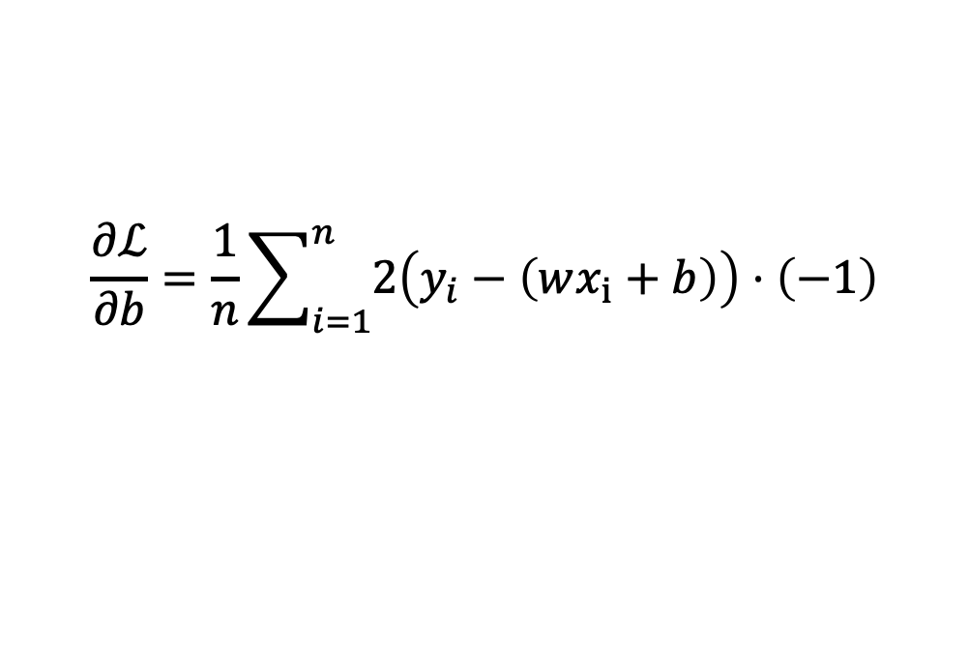
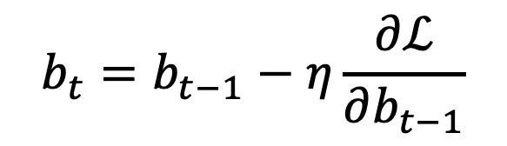
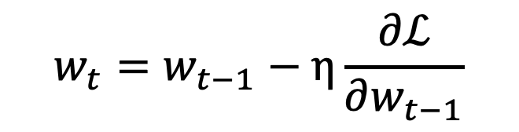
[Recap] Minimize a Regression Model
$$\frac{∂ℒ}{∂w}=\frac{1}{n}\sum_{i=1}^{n}{2\left(y_{i}−\left(wx_{i}+b\right)\right)}⋅\left(−x_{i}\right)$$
$$\frac{∂ℒ}{∂b}=\frac{1}{n}\sum_{i=1}^{n}{2\left(y_{i}−\left(wx_{i}+b\right)\right)}⋅\left(−1\right)$$
更新w：
更新b：
$$w_{t}=w_{t−1}−η\frac{∂ℒ}{∂w_{t−1}}$$
$$b_{t}=b_{t−1}−η\frac{∂ℒ}{∂b_{t−1}}$$
$η$ 代表 learning rate，扮演梯度下降過程的重要角色

Slide 14
Backpropagation

Slide 15
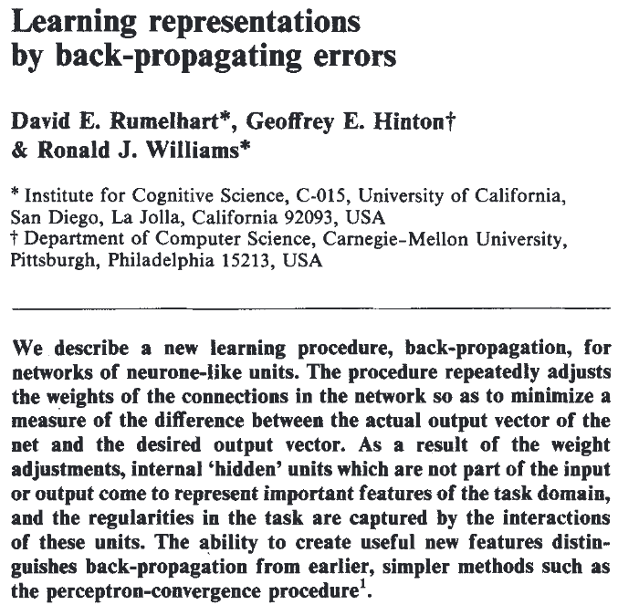
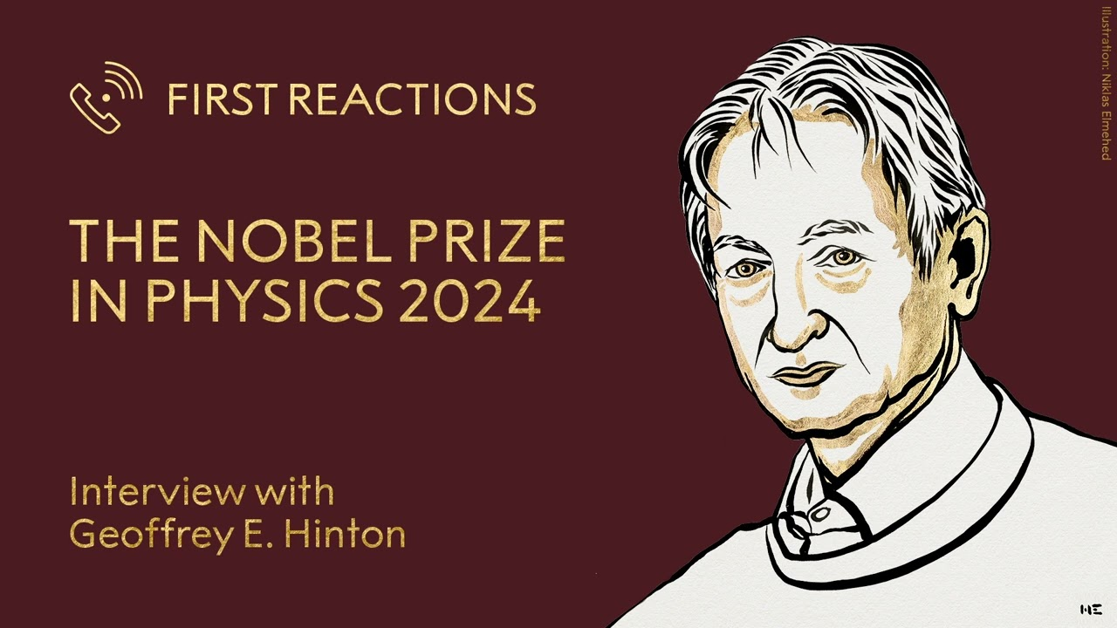
What is Backpropagation? (BP)
Backpropagation is the application of the chain rule from calculus for computing the gradient.
https://www.youtube.com/watch?v=-icD_KmvnnM
Rumelhart, David E., Geoffrey E. Hinton, and Ronald J. Williams. "Learning representations by back-propagating errors." nature 323.6088 (1986): 533-536.

Slide 16

Training Process of a Deep Learning Model
深度學習模型被訓練的流程
Update weights (the learning part)
Model
Back-Propagation
Gradient Descent
Training Data
Calculate gradients

Slide 17
Backpropagation 推導

Slide 18



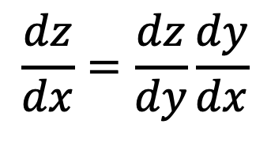



(Calculus) Chain Rule - 1
$$Δx$$
$$Δz$$
$$x$$
$$y$$
$$z$$
$$\frac{dz}{dx}=\frac{dz}{dy}\frac{dy}{dx}$$
$\frac{dz}{dx}$ 代表 $x$ 對 $z$ 的影響，但 $x$ 的變化會影響到 $y$，接著 $y$ 影響到 $z$

Slide 19

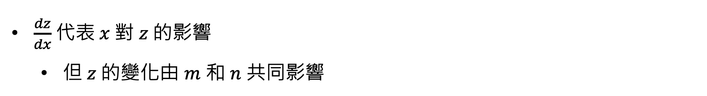
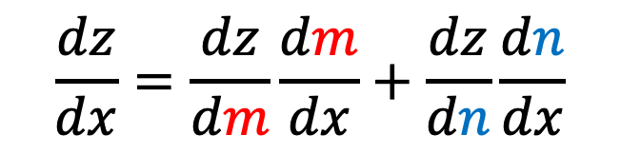

(Calculus) Chain Rule - 2
$$m$$
$$x$$
$$z$$
$$n$$
$$\frac{dz}{dx}=\frac{dz}{dm}\frac{dm}{dx}+\frac{dz}{dn}\frac{dn}{dx}$$
$\frac{dz}{dx}$ 代表 $x$ 對 $z$ 的影響
但 $z$ 的變化由 $m$ 和 $n$ 共同影響

Slide 20
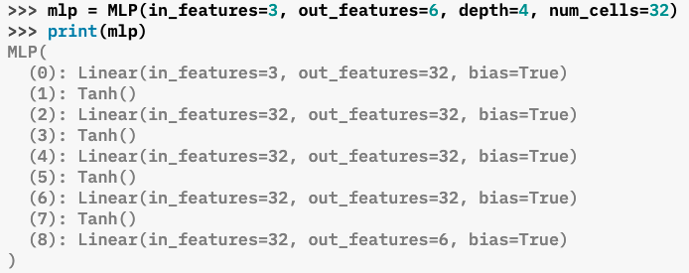











MLP 多層感知機 (今天的範例模型)
⬇️ A two-layer MLP (multi-layer perceptron)
$$w_{1,1}$$
$$x_{1}$$
$$z_{1}$$
$$w_{3,1}$$
$$w_{1,2}$$
$$\hat{y}$$
$$w_{2,1}$$
$$x_{2}$$
$$z_{2}$$
$$w_{3,2}$$
$$w_{2,2}$$
輸入層
(1st 層)
隱藏層
(2nd 層)
輸出層
(3rd 層)
Figure source (關於層數): https://pytorch.org/rl/0.6/reference/generated/torchrl.modules.MLP.html

Slide 21
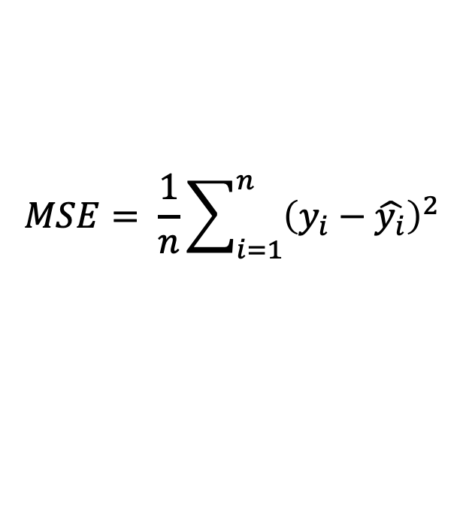

MLP 多層感知機 (今天的範例模型)
⬇️ A two-layer MLP (multi-layer perceptron)
$$MSE= \frac{1}{n}\sum_{i=1}^{n}{{\left(y_{i}−\hat{y_{i}}\right)}^{2}}$$
$$w_{1,1}$$
$$x_{1}$$
$$z_{1}$$
$$w_{3,1}$$
$$w_{1,2}$$
$$ℒ = \frac{1}{2}{\left(y−\hat{y}\right)}^{2}$$
$$\hat{y}$$
$$w_{2,1}$$
$$x_{2}$$
$$z_{2}$$
$$w_{3,2}$$
現在只探討單一樣本，所以沒有1/n 跟總和的部分
為了簡潔，這邊先乘上 1/2
$$w_{2,2}$$
輸入層
(1st 層)
隱藏層
(2nd 層)
輸出層
(3rd 層)

Slide 22

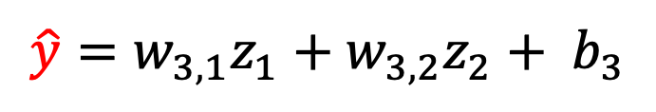
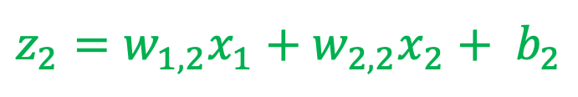
Forward Pass (由輸入層到輸出層進行 )
⬇️ A two-layer MLP (multi-layer perceptron)
$z_{1}=w_{1,1}x_{1}+w_{2,1}x_{2}+$ $b_{1}$
$$w_{1,1}$$
$$x_{1}$$
$$z_{1}$$
$$w_{3,1}$$
$$w_{1,2}$$
$$z_{2}=w_{1,2}x_{1}+w_{2,2}x_{2}+ b_{2}$$
$$\hat{y}$$
$$w_{2,1}$$
$$x_{2}$$
$$z_{2}$$
$$w_{3,2}$$
$$\hat{y}=w_{3,1}z_{1}+w_{3,2}z_{2}+ b_{3}$$
$$w_{2,2}$$
輸入層
(1st 層)
隱藏層
(2nd 層)
輸出層
(3rd 層)

Slide 23
Training Process of a Deep Learning Model
深度學習模型被訓練的流程
Update weights (the learning part)
Model
Back-Propagation
Gradient Descent
Training Data
Calculate gradients
計算參數的梯度 (w和b)

Slide 24
[Recap] Univariate gradients
First-order derivative (s)
Univariate function: a scaler
Multivariate function: a vector
Multivariate Example:
Original function:
$f\left(x, y\right)=x^{2}$+ $y^{2}$
$$f^{′}\left(x,y\right)=\left[\begin{matrix}2x \\ 2y\end{matrix}\right]=∇_{x,y}f$$
First-order derivatives:

Slide 25






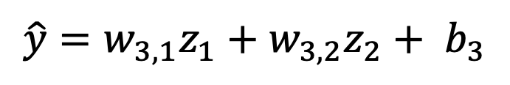



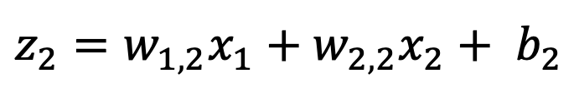




計算參數的梯度 (w和b)
$$w_{1,1}$$
$z_{1}=w_{1,1}x_{1}+w_{2,1}x_{2}+$ $b_{1}$
$$x_{1}$$
$$z_{1}$$
$$w_{3,1}$$
$$w_{1,2}$$
$$z_{2}=w_{1,2}x_{1}+w_{2,2}x_{2}+ b_{2}$$
$$\hat{y}$$
$$w_{2,1}$$
$$x_{2}$$
$$z_{2}$$
$$w_{3,2}$$
$$\hat{y}=w_{3,1}z_{1}+w_{3,2}z_{2}+ b_{3}$$
$$w_{2,2}$$
$$ℒ^{′}\left(w,b\right)=\left[\begin{matrix} \\ \begin{aligned}\frac{∂ℒ}{∂w_{1,1}} \\ \frac{∂ℒ}{∂w_{1,2}} \\ ⋮ \\ ⋮ \\ \frac{∂ℒ}{∂b_{3}}\end{aligned}\end{matrix}\right]=∇_{w,b}ℒ$$
為了簡化計算流程，後面的推導只會涵蓋 w 的部分

Slide 26

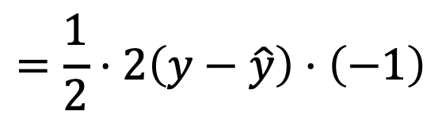

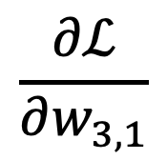

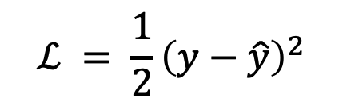


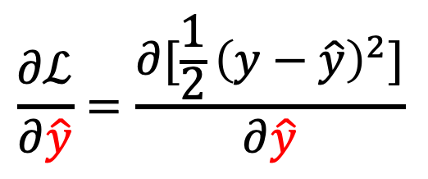
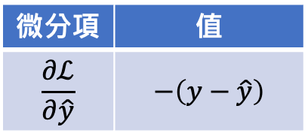





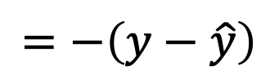
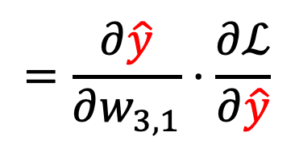


Backpropagation (Layer: 2, $w_{3,1}$)
grad_table
$$w_{1,1}$$
微分項 | 值
$$\frac{∂ℒ}{∂\hat{y}}$$ | $$−\left(y−\hat{y}\right)$$
$$\frac{∂ℒ}{∂w_{3,1}}$$
$$=\frac{∂\hat{y}}{∂w_{3,1}}⋅\frac{∂ℒ}{∂\hat{y}}$$
$$x_{1}$$
$$z_{1}$$
$$w_{3,1}$$
$$w_{1,2}$$
$$\hat{y}$$
$$y$$
$$w_{2,1}$$
$$x_{2}$$
$$z_{2}$$
$$w_{3,2}$$
$$\frac{∂ℒ}{∂\hat{y}}=\frac{∂[\frac{1}{2}{\left(y−\hat{y}\right)}^{2}]}{∂\hat{y}}$$
$$w_{2,2}$$
$$ℒ = \frac{1}{2}{\left(y−\hat{y}\right)}^{2}$$
$ℒ$ 帶入
$$=\frac{1}{2}⋅2\left(y−\hat{y}\right)⋅\left(−1\right)$$
$$w_{3,1}$$
$$\hat{y}$$
$$ℒ$$
$$=−\left(y−\hat{y}\right)$$

Slide 27


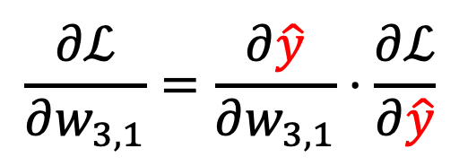
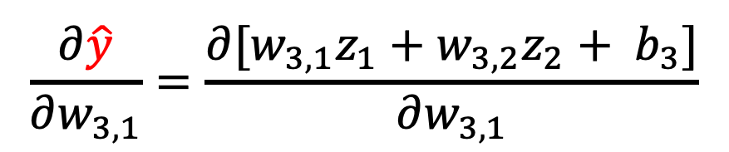


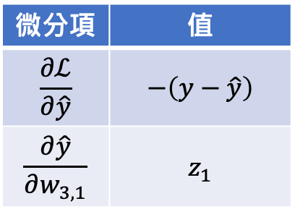

Backpropagation (Layer: 2, $w_{3,1}$)
grad_table
$$w_{1,1}$$
微分項 | 值
$$\frac{∂ℒ}{∂\hat{y}}$$ | $$−\left(y−\hat{y}\right)$$
$$\frac{∂\hat{y}}{∂w_{3,1}}$$ | $$z_{1}$$
$$\frac{∂ℒ}{∂w_{3,1}}=\frac{∂\hat{y}}{∂w_{3,1}}⋅\frac{∂ℒ}{∂\hat{y}}$$
$$x_{1}$$
$$z_{1}$$
$$w_{3,1}$$
$$w_{1,2}$$
$$\hat{y}$$
$$y$$
$$w_{2,1}$$
$$x_{2}$$
$$z_{2}$$
$$w_{3,2}$$
$$w_{2,2}$$
$$\frac{∂\hat{y}}{∂w_{3,1}}=\frac{∂[w_{3,1}z_{1}+w_{3,2}z_{2}+ b_{3}]}{∂w_{3,1}}$$
$\hat{y}$ 帶入
$$\hat{y}=w_{3,1}z_{1}+w_{3,2}z_{2}+ b_{3}$$
$=$ $z_{1}$

Slide 28
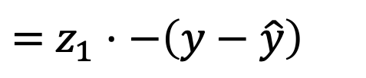
Backpropagation (Layer: 2, $w_{3,1}$)
grad_table
$$w_{1,1}$$
微分項 | 值
$$\frac{∂ℒ}{∂\hat{y}}$$ | $$−\left(y−\hat{y}\right)$$
$$\frac{∂\hat{y}}{∂w_{3,1}}$$ | $$z_{1}$$
$$\frac{∂ℒ}{∂w_{3,1}}=\frac{∂\hat{y}}{∂w_{3,1}}⋅\frac{∂ℒ}{∂\hat{y}}$$
$$x_{1}$$
$$z_{1}$$
$$w_{3,1}$$
$$w_{1,2}$$
$$\hat{y}$$
$$y$$
$$w_{2,1}$$
$$x_{2}$$
$$z_{2}$$
$$w_{3,2}$$
$$w_{2,2}$$
$=$ $z_{1}⋅−\left(y−\hat{y}\right)$

Slide 29
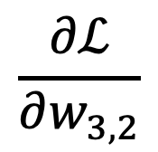
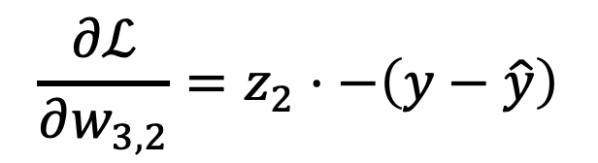

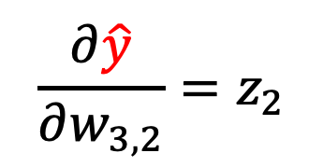



Backpropagation (Layer: 2, $w_{3,2}$)
grad_table
$$w_{1,1}$$
微分項 | 值
$$\frac{∂ℒ}{∂\hat{y}}$$ | $$−\left(y−\hat{y}\right)$$
$$\frac{∂\hat{y}}{∂w_{3,1}}$$ | $$z_{1}$$
$$\frac{∂ℒ}{∂w_{3,2}}$$
$$=\frac{∂\hat{y}}{∂w_{3,2}}⋅\frac{∂ℒ}{∂\hat{y}}$$
$$x_{1}$$
$$z_{1}$$
$$w_{3,1}$$
$$w_{1,2}$$
$$\hat{y}$$
$$y$$
$$w_{2,1}$$
$$x_{2}$$
$$z_{2}$$
$$w_{3,2}$$
$$w_{2,2}$$
因為
$$\hat{y}=w_{3,1}z_{1}+w_{3,2}z_{2}+ b_{3}$$
$$ℒ = \frac{1}{2}{\left(y−\hat{y}\right)}^{2}$$
$$\frac{∂\hat{y}}{∂w_{3,2}}=z_{2}$$
所以
$$w_{3,2}$$
$$\hat{y}$$
$$ℒ$$
$$\frac{∂ℒ}{∂w_{3,2}}=z_{2}⋅−\left(y−\hat{y}\right)$$
因此

Slide 30


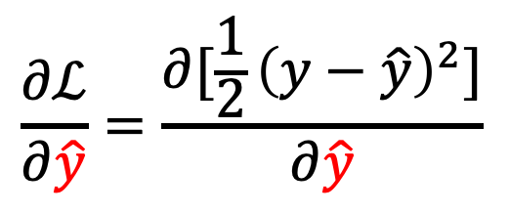

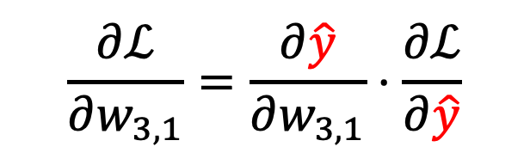



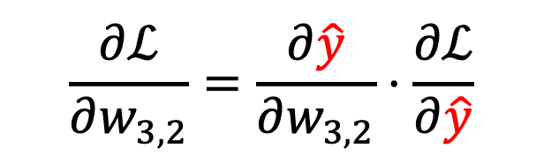

反向傳播法觀察 (1)
Backward Pass
grad_table
微分項 | 值
$$\frac{∂ℒ}{∂\hat{y}}$$ | $$−\left(y−\hat{y}\right)$$
$$\frac{∂\hat{y}}{∂w_{3,1}}$$ | $$z_{1}$$
$$w_{1,1}$$
$$\frac{∂ℒ}{∂w_{3,1}}=\frac{∂\hat{y}}{∂w_{3,1}}⋅\frac{∂ℒ}{∂\hat{y}}$$
$$x_{1}$$
$$z_{1}$$
$$w_{3,1}$$
$$w_{1,2}$$
$$\hat{y}$$
$$y$$
$$w_{2,1}$$
$$w_{3,2}$$
$$\frac{∂ℒ}{∂w_{3,2}}=\frac{∂\hat{y}}{∂w_{3,2}}⋅\frac{∂ℒ}{∂\hat{y}}$$
$$x_{2}$$
$$z_{2}$$
$$w_{2,2}$$
Forward Pass
$$\frac{∂ℒ}{∂\hat{y}}=\frac{∂[\frac{1}{2}{\left(y−\hat{y}\right)}^{2}]}{∂\hat{y}}$$
$$\hat{y}=w_{3,1}z_{1}+w_{3,2}z_{2}+ b_{3}$$
💡反向傳播法是在算loss對參數的梯度
= Forward Pass 結果的偏微分 x Backward Pass 結果的偏微分

Slide 31
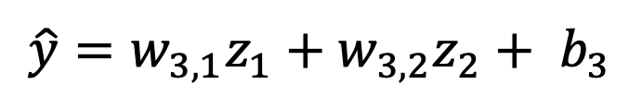
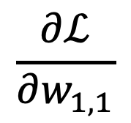










Backpropagation (Layer: 1, $w_{1,1}$)
grad_table
微分項 | 值
$$\frac{∂ℒ}{∂\hat{y}}$$ | $$−\left(y−\hat{y}\right)$$
$$\frac{∂\hat{y}}{∂w_{3,1}}$$ | $$z_{1}$$
$$w_{1,1}$$
微分項 | 值
$$\frac{∂ℒ}{∂\hat{y}}$$ | $$−\left(y−\hat{y}\right)$$
$$\frac{∂\hat{y}}{∂w_{3,1}}$$ | $$z_{1}$$
$$\frac{∂\hat{y}}{∂z_{1}}$$ | $$w_{3,1}$$
$$\frac{∂ℒ}{∂w_{1,1}}$$
$$=\frac{∂z_{1}}{∂w_{1,1}}⋅\frac{∂ℒ}{∂z_{1}}$$
$$x_{1}$$
$$z_{1}$$
$$w_{3,1}$$
$$w_{1,2}$$
$$\hat{y}$$
$$y$$
$$w_{2,1}$$
$$x_{2}$$
$$z_{2}$$
$$w_{3,2}$$
$$=\frac{∂z_{1}}{∂w_{1,1}}⋅\frac{∂\hat{y}}{∂z_{1}}⋅\frac{∂ℒ}{∂\hat{y}}$$
$$w_{2,2}$$
$$\hat{y}=w_{3,1}z_{1}+w_{3,2}z_{2}+ b_{3}$$
$$\frac{∂\hat{y}}{∂z_{1}}=\frac{∂[w_{3,1}z_{1}+w_{3,2}z_{2}+ b_{3}]}{∂z_{1}}$$
$$w_{1,1}$$
$$z_{1}$$
$$\hat{y}$$
$$ℒ$$
$$=w_{3,1}$$

Slide 32

Backpropagation (Layer: 1, $w_{1,1}$)
grad_table
$$w_{1,1}$$
微分項 | 值
$$\frac{∂ℒ}{∂\hat{y}}$$ | $$−\left(y−\hat{y}\right)$$
$$\frac{∂\hat{y}}{∂w_{3,1}}$$ | $$z_{1}$$
$$\frac{∂\hat{y}}{∂z_{1}}$$ | $$w_{3,1}$$
$$\frac{∂ℒ}{∂w_{1,1}}=\frac{∂z_{1}}{∂w_{1,1}}⋅\frac{∂ℒ}{∂z_{1}}$$
$$x_{1}$$
$$z_{1}$$
$$w_{3,1}$$
$$w_{1,2}$$
$$\hat{y}$$
$$y$$
$$w_{2,1}$$
$$x_{2}$$
$$z_{2}$$
$$w_{3,2}$$
$$=\frac{∂z_{1}}{∂w_{1,1}}⋅\frac{∂\hat{y}}{∂z_{1}}⋅\frac{∂ℒ}{∂\hat{y}}$$
$$w_{2,2}$$
已經算過了，直接取記錄過的值就可以了！

Slide 33





Backpropagation (Layer: 1, $w_{1,1}$)
grad_table
微分項 | 值
$$\frac{∂ℒ}{∂\hat{y}}$$ | $$−\left(y−\hat{y}\right)$$
$$\frac{∂\hat{y}}{∂w_{3,1}}$$ | $$z_{1}$$
$$\frac{∂\hat{y}}{∂z_{1}}$$ | $$w_{3,1}$$
$$\frac{∂z_{1}}{∂w_{1,1}}$$ | $$x_{1}$$
$$w_{1,1}$$
微分項 | 值
$$\frac{∂ℒ}{∂\hat{y}}$$ | $$−\left(y−\hat{y}\right)$$
$$\frac{∂\hat{y}}{∂w_{3,1}}$$ | $$z_{1}$$
$$\frac{∂\hat{y}}{∂z_{1}}$$ | $$w_{3,1}$$
$$\frac{∂ℒ}{∂w_{1,1}}=\frac{∂z_{1}}{∂w_{1,1}}⋅\frac{∂ℒ}{∂z_{1}}$$
$$x_{1}$$
$$z_{1}$$
$$w_{3,1}$$
$$w_{1,2}$$
$$\hat{y}$$
$$y$$
$$w_{2,1}$$
$$x_{2}$$
$$z_{2}$$
$$w_{3,2}$$
$$=\frac{∂z_{1}}{∂w_{1,1}}⋅\frac{∂\hat{y}}{∂z_{1}}⋅\frac{∂ℒ}{∂\hat{y}}$$
$$w_{2,2}$$
$z_{1}=w_{1,1}x_{1}+w_{2,1}x_{2}+$ $b_{1}$
因此
$$\frac{∂z_{1}}{∂w_{1,1}}=\frac{∂(w_{1,1}x_{1}+w_{2,1}x_{2}+ b_{1})}{∂w_{1,1}}$$
$$\frac{∂ℒ}{∂w_{1,1}}=x_{1}⋅−\left(y−\hat{y}\right)⋅w_{3,1}$$
$$=x_{1}$$

Slide 34



反向傳播法觀察 (2): Forward Pass
$$w_{1,1}$$
微分項 | 值
$$\frac{∂ℒ}{∂\hat{y}}$$ | $$−\left(y−\hat{y}\right)$$
$$\frac{∂\hat{y}}{∂w_{3,1}}$$ | $$z_{1}$$
$$\frac{∂\hat{y}}{∂z_{1}}$$ | $$w_{3,1}$$
$$\frac{∂z_{1}}{∂w_{1,1}}$$ | $$x_{1}$$
$$x_{1}$$
$$z_{1}$$
$$w_{3,1}$$
$$w_{1,2}$$
$$\hat{y}$$
$$y$$
$$w_{2,1}$$
$$x_{2}$$
$$z_{2}$$
$$w_{3,2}$$
$$w_{2,2}$$
$$\hat{y}=w_{3,1}z_{1}+w_{3,2}z_{2}+ b_{3}$$
💡Forward Pass 結果的偏微分等於輸入的值
$z_{1}=w_{1,1}x_{1}+w_{2,1}x_{2}+$ $b_{1}$
$$z_{2}=w_{1,2}x_{1}+w_{2,2}x_{2}+ b_{2}$$

Slide 35












還有哪些參數還沒算到 Gradients
$$w_{1,1}$$
$$x_{1}$$
$$z_{1}$$
$$w_{3,1}$$
$$w_{1,2}$$
$$\hat{y}$$
$$w_{2,1}$$
$$x_{2}$$
$$z_{2}$$
$$w_{3,2}$$
$$w_{2,2}$$
$$ℒ^{′}\left(w,b\right)=\left[\begin{matrix} \\ \begin{aligned}\frac{∂ℒ}{∂w_{1,1}} \\ \frac{∂ℒ}{∂w_{1,2}} \\ ⋮ \\ ⋮ \\ \frac{∂ℒ}{∂b_{3}}\end{aligned}\end{matrix}\right]=∇_{w,b}ℒ$$
剩下的 w 和 b 的算法其實大同小異

Slide 36
Gradient Descent vs. Back-propagation
 | Gradient Descent | Back-propagation
功能 | 根據梯度更新權重值 (weights) | 計算神經網路中的梯度，以供梯度下降使用
最終目標 | 透過梯度找出 function 最佳解 (最小化目標函數) | 計算梯度，以便使用梯度下降找到最佳解

Slide 37
Summary for Backpropagation
我們使用 Backpropagation + Gradient Descent，透過更新大量的模型參數來訓練深度學習模型
Forward Pass: 算出每個節點的values
Backward Pass: error signal
核心精神是 Cache 機制
Backward Pass
Output
Gold Ans
0.5
1.0
Forward Pass

Slide 38
Can we train deep NN without BP?
Calculating partial derivatives for the parameters by hands is time-consuming.
Alternatives of BP:
https://stackoverflow.com/questions/55287004/are-there-alternatives-to-backpropagation

Slide 39
Thank you!
Instructor: 林英嘉
✉️ yjlin@cgu.edu.tw
TA: 林君襄
✉️ becky890926@gmail.com

