Slide 1



深度學習 Deep Learning
Training Tips (BN, Dropout)
Instructor: 林英嘉 (Ying-Jia Lin)
2025/03/31
Course GitHub
Slido # DL_0331

Slide 2
Outline
Training tips
Batch Normalization
Dropout

Slide 3






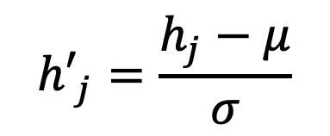

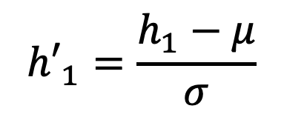
Batch Normalization (BN) During Training
計算：$μ$ (平均數) & $σ$ (標準差)
$${h′}_{1}=\frac{h_{1}−μ}{σ}$$
$$x_{1}$$
$$h_{1}$$
$${h′}_{1}$$
...
...
...
$${h′}_{j}=\frac{h_{j}−μ}{σ}$$
$$x_{n}$$
$$h_{j}$$
$${h′}_{j}$$
Ioffe, Sergey, and Christian Szegedy. "Batch normalization: Accelerating deep network training by reducing internal covariate shift." International conference on machine learning. 2015.

Slide 4
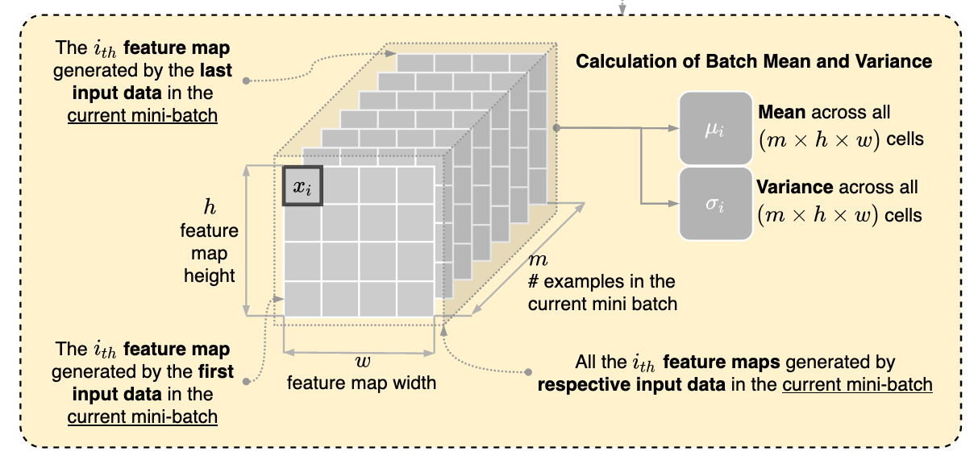
BN During Training
Figure source: https://stackoverflow.com/questions/65613694/calculation-of-mean-and-variance-in-batch-normalization-in-convolutional-neural

Slide 5
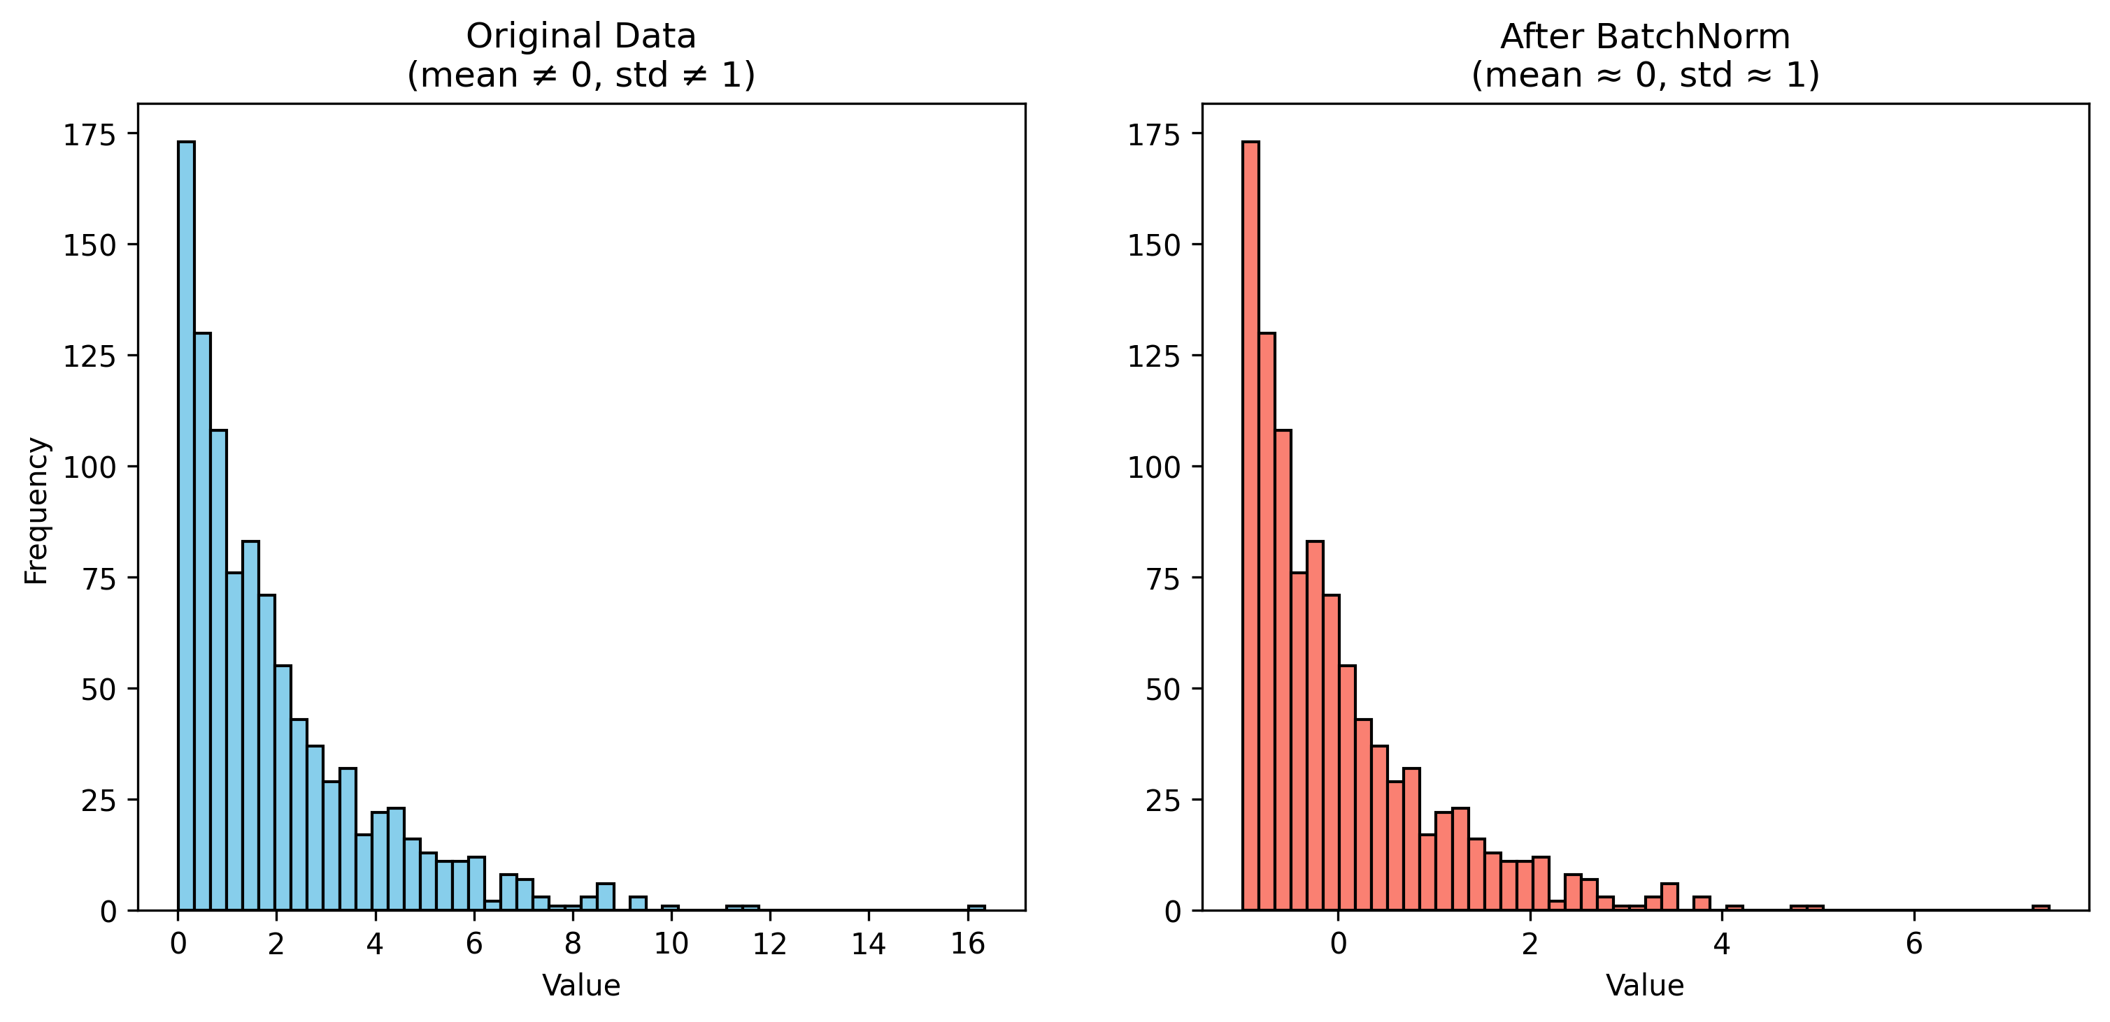
Value comparison example with BN

Slide 6


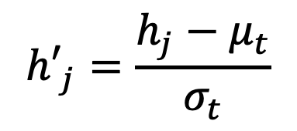



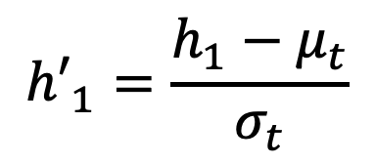










BN During Test (Inference)
https://pytorch.org/docs/stable/generated/torch.nn.BatchNorm2d.html
Training
計算：$μ$ (平均數) & $σ$ (標準差)
$$x_{1}$$
$$h_{1}$$
$${h′}_{1}$$
Moving average
$$μ_{t}=αμ_{t}+\left(1−α\right)μ_{t−1}$$
...
...
...
$$x_{n}$$
$$h_{j}$$
$${h′}_{j}$$
$$σ_{t}=ασ_{t}+\left(1−α\right)σ_{t−1}$$
Inference
$${h′}_{1}=\frac{h_{1}−μ_{t}}{σ_{t}}$$
$$x_{1}$$
$$h_{1}$$
$${h′}_{1}$$
假設只有1張影像
...
...
...
$${h′}_{j}=\frac{h_{j}−μ_{t}}{σ_{t}}$$
$$x_{n}$$
$$h_{j}$$
$${h′}_{j}$$

Slide 7
BN Summary
BN 對數值進行轉換，使得轉換後的數值的平均值為零、標準差為1，類似於統計上的 Z-score standardization
BN 可以：
減少不同特徵尺度帶來的偏差
提高模型訓練時的穩定性

Slide 8
Dropout
訓練的時候把神經網路每一層的輸入值部份以 p 的機率隨機替換成 0
p 是超參數
可防止模型過擬合 (over-fitting)，增強模型的泛化能力 (generalization)
x
x
(Output)
Srivastava, Nitish, et al. "Dropout: a simple way to prevent neural networks from overfitting." The journal of machine learning research 15.1 (2014): 1929-1958.

Slide 9
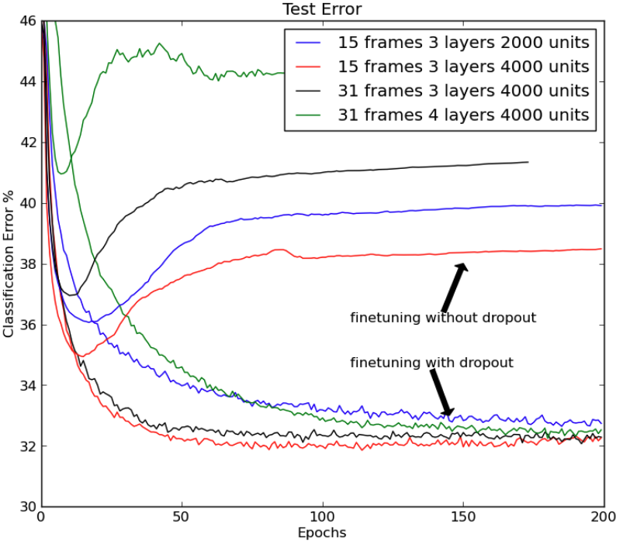
Dropout may improve generalization
Srivastava, Nitish, et al. "Dropout: a simple way to prevent neural networks from overfitting." The journal of machine learning research 15.1 (2014): 1929-1958.

Slide 10
Dropout Implementation
https://pytorch.org/docs/stable/generated/torch.nn.Dropout.html
實務上採用 Inverted Dropout: output 要除以 (1 - p)
假設 p = 0.2:
值下跌 20%
接著除以 80% 來弭平失去的值
x
(Output)

Slide 11
model.eval()
使用 training 時取得的平均值跟標準差來算 batch normalization
關閉 dropout (保留所有的神經元)

Slide 12
Thank you!
Instructor: 林英嘉
✉️ yjlin@cgu.edu.tw
TA: 林君襄
✉️ becky890926@gmail.com

