Slide 1



深度學習 Deep Learning
Recurrent Neural Networks
(RNN)
Instructor: 林英嘉 (Ying-Jia Lin)
2025/03/31
Course GitHub
Slido # DL_0331

Slide 2
Outline
Recurrent Neural Networks (RNN) [50 min]
Homework 2
Projects
Quiz [20 min]

Slide 3
Activation functions
The core idea of using activation functions is to introduce nonlinearity into neural networks.
Neural network models aim to avoid the final processing stage being merely a linear transformation of the inputs, so that the model is able to have good performance on complex problems.
Commonly used activation functions including Sigmoid, ReLU, tanh, GeLU...

Slide 4
Activation functions
 | Range | Applications
softmax | [0, 1] (sum up to 1) | It is commonly used in multi-class classification tasks where the model needs to predict the probability distribution over classes.
sigmoid | [0, 1] | It often used in binary classification tasks where a threshold is needed to predict probabilities of belonging to one of the two classes.
tanh | [-1, 1] | It is often preferred over sigmoid for hidden layers as it produces zero-centered output
ReLU | [0, +inf] | It introduce nonlinearity and avoid gradient vanishing

Slide 5
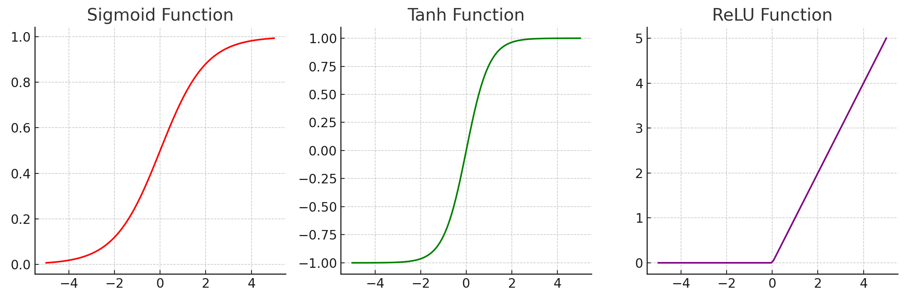
Activation functions
Softmax: https://datascience.stackexchange.com/questions/57005/why-there-is-no-exact-picture-of-softmax-activation-function

Slide 6
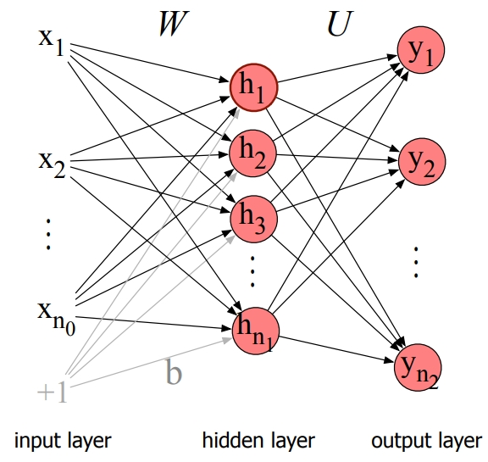
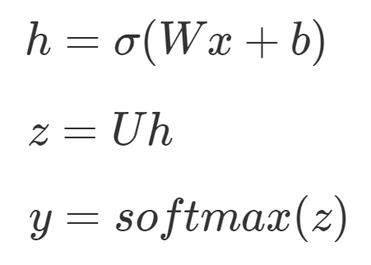
Feedforward network
Feedforward network (FFN) is a multilayer feedforward network in which the units are connected with no cycles.

Slide 7
Short comings of FFN
Lack of Sequence Modeling:
In NLP tasks, understanding the sequence of words and their dependencies is crucial for accurate predictions.
Fixed Input Size:
FFNs require fixed-size inputs, which can be problematic for NLP tasks where input sequences vary in length.
Limited Contextual Information:
Many NLP tasks benefit from capturing long-range dependencies and understanding the broader context of a text, which is better addressed by models capable of modeling sequential data effectively.

Slide 8
Natural Language Processing
電腦是如何學習自然語言呢？

Slide 9
Word Representations
like
🖥️
?
apple
Basic Approach
apple
[1, 0, 0, 0, 0, 0, 0, 0]
One hot encodings with each vector size equal to the vocab size (8 in this case)
Corpus
eat
[0, 1, 0, 0, 0, 0, 0, 0]
I like to eat apple
I
[0, 0, 1, 0, 0, 0, 0, 0]
Vocabulary
Pros: handy, training-free
Cons: sparse matrix which occupies much memory
You like to watch TV
like
[0, 0, 0, 1, 0, 0, 0, 0]
watch
[0, 0, 0, 0, 1, 0, 0, 0]
to
[0, 0, 0, 0, 0, 1, 0, 0]
...

Slide 10

Word Embeddings (Word2Vec)
Input
Word2Vec model
Prediction
[1] Mikolov et al. "Distributed representations of words and phrases and their compositionality." NeurIPS 2013.
Steve
Jobs
CBOW ^{[1]}
(Continuous Bag-of-Words)
[MASK]
founded
Apple
Large Corpora
(E.g., Wikipedia)
Inc.
[MASK]
Steve
[MASK]
Jobs
Skip-gram ^{[1]}
founded
[MASK]
Apple
[MASK]
Inc.

Slide 11
After Training Word Embeddings
The outputs are dense vectors with a fixed dimension size:
Dimension size (e.g., 300)
apple -0.110960 0.016115 -0.004809 0.033589 0.121455 …
banana -0.027713 -0.015676 0.003314 0.077602 0.159718 …
…
…
…
Vocabulary size
(e.g., 30,000)

Slide 12
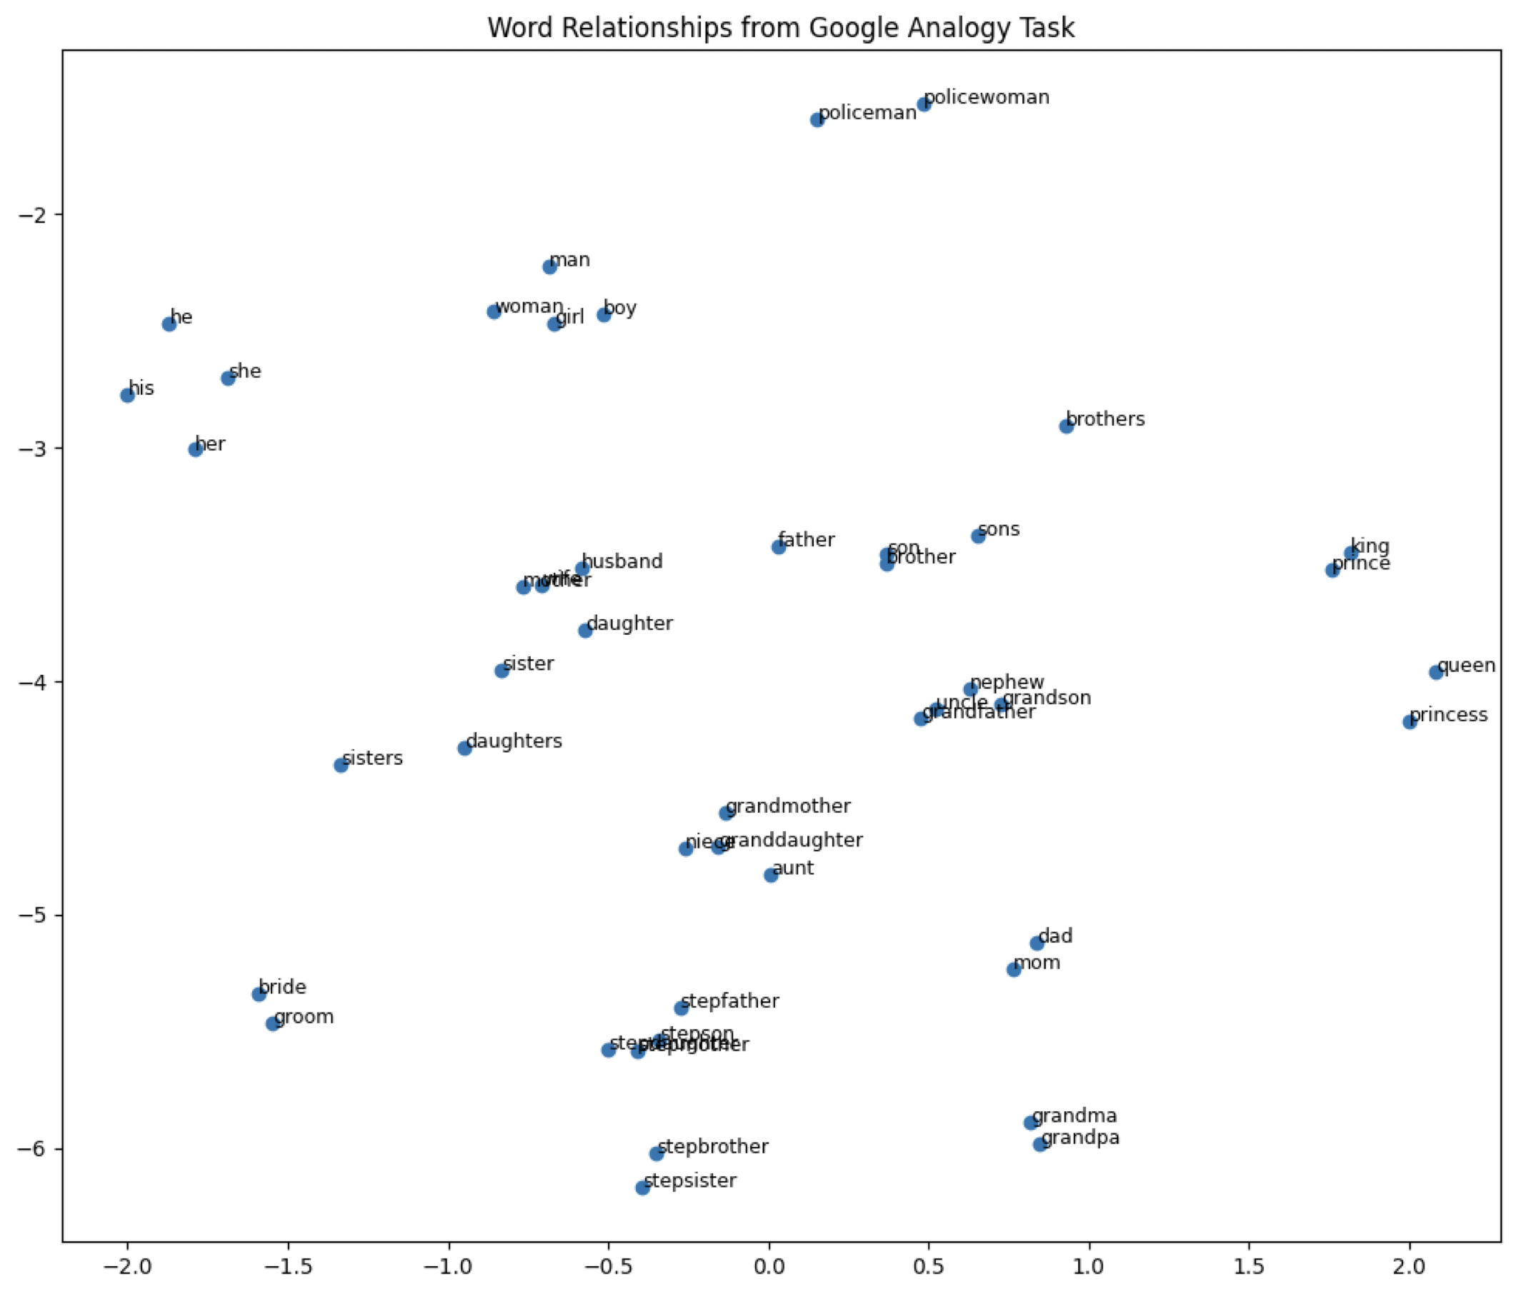
Word Embeddings 視覺化
Word embedding model: glove-wiki-gigaword-100
Dimension reduction: t-SNE
Dataset: Mikolov et al., 2013

Slide 13
Recurrent Neural Networks
RNN

Slide 14
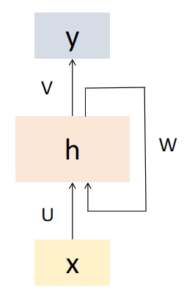
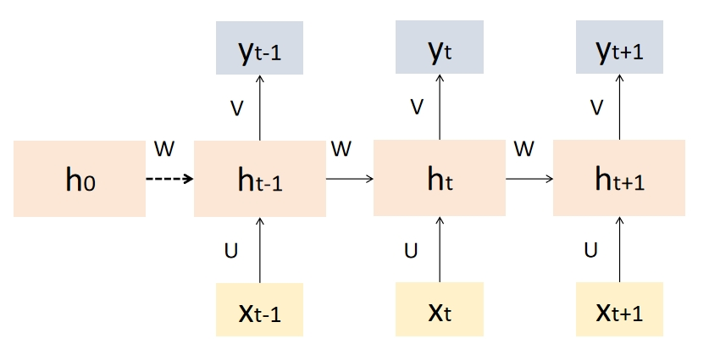
RNN
Recurrent Neural Networks (RNNs) are a type of artificial neural network designed to handle sequential data by capturing temporal dependencies.
The same set of weights and biases are used across all time steps

Slide 15
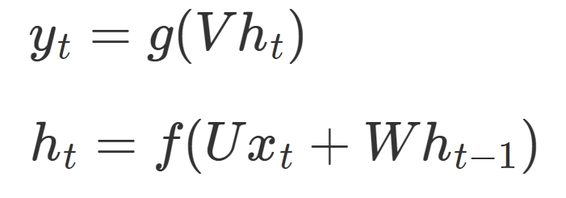







RNN
$$y_{t}$$
The equation on step t is:
, where f and g are activation functions.
$$V$$
$$h_{t}$$
+
$$W$$
$$U$$
$$h_{t−1}$$
$$x_{t}$$

Slide 16
Properties of RNNs
Sequential Processing:
RNNs handle sequences, allowing them to model temporal dependencies in data.
Recurrent Connections:
RNNs maintain internal memory, facilitating the capture of long-term dependencies.
Parameter Sharing:
RNNs share parameters across time steps, enhancing efficiency in learning sequential data.
Vanishing Gradient Problem:
Traditional RNNs may face vanishing gradient issues, hindering learning of long-term dependencies.

Slide 17
Name Entity Recognition
Name Entity Recognition (NER) is a fundamental task in NLP.
The model needs to identify named entities within the sequence, such as countries, organizations, and individuals.
LOC
TIME
 | Meaning
B | Beginning
I | Inside
O | Outside
E | End
S | Single
My flight to New York is at 5pm
Strategy: BIO
B-LOC
I-LOC
B-TIME
Strategy: BIOES
B-LOC
E-LOC
S-TIME

Slide 18
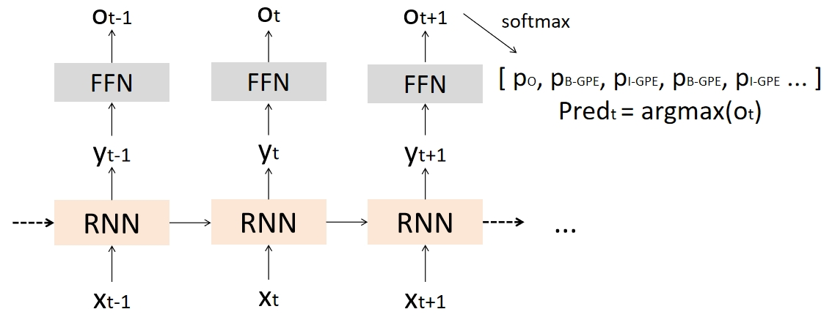
RNNs for NER
In token classification task, every output should be mapped to a one-hot vector.
A feed forward network is added to the RNN model.
 | Meaning
B | Beginning
I | Inside
O | Outside
E | End
S | Single
(Nx5) matrix
(取最大值)

Slide 19
RNNs for Sequence Classification
RNNs classify the entire sequences rather than the tokens within them.
Take the hidden layer for the last token of the text.
FFN
h_{n}
RNN
RNN
RNN
RNN
x₁
x₂
x₃
x_{n}

Slide 20
Stacked RNNs
Stacked RNNs consist of multiple networks where the output of one layer serves as the input to a subsequent layer
y₁
y₂
y₃
y_{n}
RNN layer3
RNN
RNN
RNN
RNN
RNN layer2
RNN
RNN
RNN
RNN
RNN layer1
RNN
RNN
RNN
RNN
x₁
x₂
x₃
x_{n}

Slide 21
Stacked RNNs
Stacked RNNs generally outperform single-layer networks.
The network induces representations at differing levels of abstraction across layers
The initial layers of stacked networks induce representations that serve as useful abstractions for further layers
However, as the number of stacks is increased the training costs rise quickly.

Slide 22
Bidirectional RNNs
In many applications, RNNs have to access to the entire input sequence.
Bidirectional RNN was introduced.
It combines two independent bidirectional RNNs, one where the input is processed from the start to the end, and the other from the end to the start
y₁
y₂
y₃
y_{n}
Concatenation
RNN
RNN
RNN
RNN
RNN2
RNN1
RNN
RNN
RNN
RNN
x₁
x₂
x₃
x_{n}

Slide 23
Bidirectional RNNs for Sequence Classification
The final hidden units from the forward and backward passes are combined to represent the entire sequence.
This combined representation serves as input to the subsequent classifier.
FFN
Concatenation
RNN
RNN
RNN
RNN
RNN2
RNN1
RNN
RNN
RNN
RNN
x₁
x₂
x₃
x_{n}

Slide 24
Shortage of standard RNNs
Gradient vanishing (梯度消失) problem
Long-term dependencies cannot be handled.
RNNs can only remember local relationships.
This is result from back-propagation through-time (BPTT) during training.

Slide 25



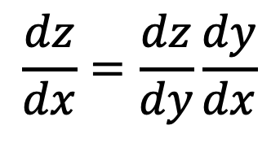



(Calculus) Chain Rule - 1
$$Δx$$
$$Δz$$
$$x$$
$$y$$
$$z$$
$$\frac{dz}{dx}=\frac{dz}{dy}\frac{dy}{dx}$$
$\frac{dz}{dx}$ 代表 $x$ 對 $z$ 的影響，但 $x$ 的變化會影響到 $y$，接著 $y$ 影響到 $z$

Slide 26

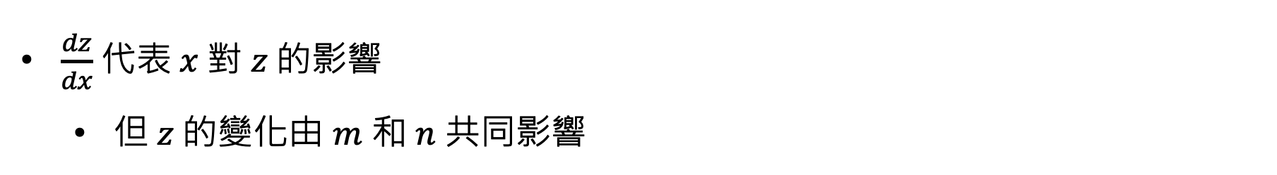
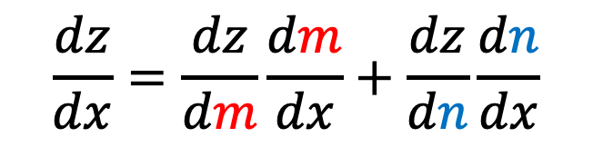

(Calculus) Chain Rule - 2
$$m$$
$$x$$
$$z$$
$$n$$
$$\frac{dz}{dx}=\frac{dz}{dm}\frac{dm}{dx}+\frac{dz}{dn}\frac{dn}{dx}$$
$\frac{dz}{dx}$ 代表 $x$ 對 $z$ 的影響
但 $z$ 的變化由 $m$ 和 $n$ 共同影響

Slide 27




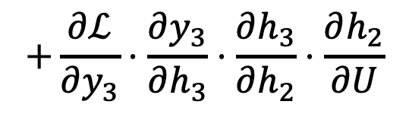





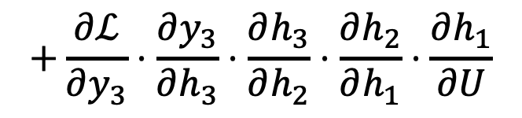





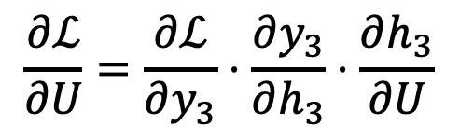




Back-propagation through-time (BPTT)
$$y_{1}$$
$$y_{2}$$
$$y_{3}$$
$$V$$
$$V$$
$$V$$
$$U$$
$$U$$
$$U$$
$$h_{1}$$
$$h_{2}$$
$$h_{3}$$
$$W$$
$$W$$
$$W$$
$$x_{1}$$
$$x_{2}$$
$$x_{3}$$
$$\frac{∂ℒ}{∂U}=\frac{∂ℒ}{∂y_{3}}⋅\frac{∂y_{3}}{∂h_{3}}⋅\frac{∂h_{3}}{∂U}$$
$$+\frac{∂ℒ}{∂y_{3}}⋅\frac{∂y_{3}}{∂h_{3}}⋅\frac{∂h_{3}}{∂h_{2}}⋅\frac{∂h_{2}}{∂U}$$
$$+\frac{∂ℒ}{∂y_{3}}⋅\frac{∂y_{3}}{∂h_{3}}⋅\frac{∂h_{3}}{∂h_{2}}⋅\frac{∂h_{2}}{∂h_{1}}⋅\frac{∂h_{1}}{∂U}$$
(small)

Slide 28
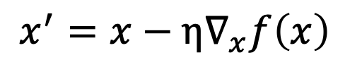
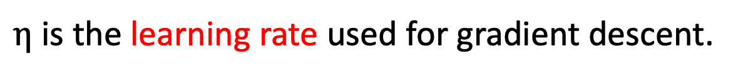
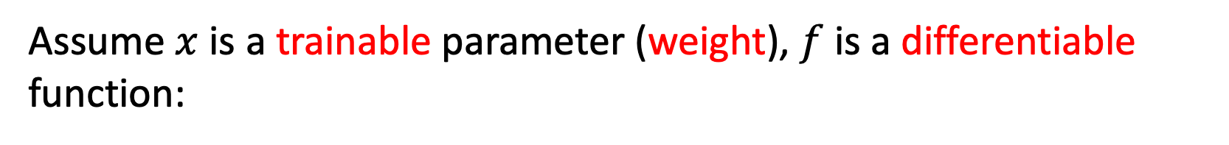
Gradient Descent (梯度下降法)
Assume $x$ is a trainable parameter (weight), $f$is a differentiable function:
Gradient descent:
$$x^{′}=x−η∇_{x}f\left(x\right)$$
$η$ is the learning rate used for gradient descent.

Slide 29

















LSTM (Long Short-Term Memory)
Hochreiter, Sepp, and Jürgen Schmidhuber. "Long short-term memory." Neural computation 9.8 (1997): 1735-1780.
$$c_{t}=c_{t}×f_{t}+n_{t}$$
LSTM uses 4 times of weights as a standard RNN.
+
$$c_{t−1}$$
$$×$$
$$f_{t}$$
$$n_{t}$$
$$c_{t}$$
Multiplication
Sigmoid
Sigmoid
tanh
+
+
+
$$UF$$
$$WF$$
$$UI$$
$$WI$$
$$U$$
$$W$$
$$h_{t−1}$$
$$x_{t}$$
$$h_{t−1}$$
$$x_{t}$$
$$h_{t−1}$$
$$x_{t}$$
Forget Gate
Input Gate
RNN Cell

Slide 30




LSTM (Long Short-Term Memory)
Hochreiter, Sepp, and Jürgen Schmidhuber. "Long short-term memory." Neural computation 9.8 (1997): 1735-1780.
$$c_{t}=c_{t}×f_{t}+n_{t}$$
LSTM uses 4 times of weights as a standard RNN.
+
$$c_{t−1}$$
$$×$$
$$f_{t}$$
$$n_{t}$$
$$c_{t}$$
tanh
Sigmoid
Multiplication
$$o_{t}$$
$$h_{t}$$
+
$$UO$$
$$WO$$
$$h_{t−1}$$
$$x_{t}$$
Output Gate

Slide 31
RNN vs. LSTM
 | Memory Mechanism | Handles Long Dependencies? | Gradient Vanishing?
RNN | Hidden state h_{t} | Worse | Yes
LSTM | Memory state c_{t} + Hidden state h_{t} | Better | Much less than a standard RNN

Slide 32
Thank you!
Instructor: 林英嘉
✉️ yjlin@cgu.edu.tw
TA: 林君襄
✉️ becky890926@gmail.com

