Slide 1



深度學習 Deep Learning
PyTorch Modeling
Instructor: 林英嘉 (Ying-Jia Lin)
2025/03/17
Course GitHub
Slido # DL0317

Slide 2
Steps for building your first PyTorch program
Step 1 (Data):
Prepare the dataset
Overwrite PyTorch Dataset
Define DataLoader
Step 2 (Model):
Construct the model
Define the loss function
Define the optimizer
Step 3 (Training):
Write the training process
Step 4 (Evaluation):
Write the evaluation process

Slide 3
Step 1: Prepare the dataset
Step 1 (Data)
From torchvision (image data) or torchtext (text data)
You may skip Step 1-2.
User-defined dataset
Download from the Internet
Your own dataset

Slide 4
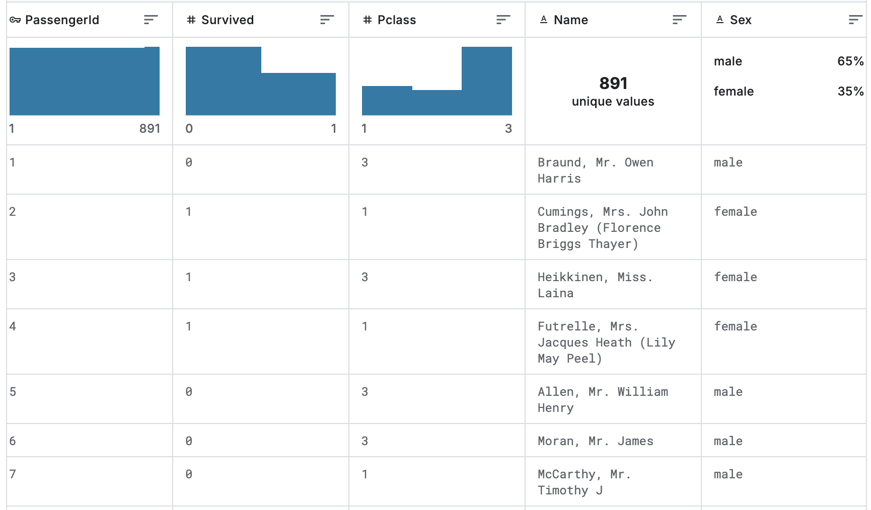
What is a dataset?
data / instance /example
dataset
https://www.kaggle.com/competitions/titanic/data?select=train.csv

Slide 5
Step 1-2: Overwrite PyTorch Dataset
為了符合我們載入資料的需求
例如：適合我們資料的前處理過程
簡潔且容易維護的資料存取介面：
img, label = dataset[0] # `dataset` 是透過 PyTorch Dataset 所建立的
index

Slide 6
Step 1-2: Overwrite PyTorch Dataset
Step 1 (Data)
我們需要繼承 torch.utils.data.Dataset，並改寫三個項目 (__init__, __getitem__, __len__)：
import torch
class CustomDataset(torch.utils.data.Dataset):
def __init__(self, parameter_1, parameter_2, ...):
# Prepare some things
# that you are going to use in `__getitem__` and `__len__`
def __getitem__(self, index):
# do_something
return data, label
def __len__(self):
return len(data_variable)
__init__：初始化 class 中的變數
__getitem__：讓 PyTorch Dataset 可以透過 index 來取得任一筆資料
__len__ ：取得資料集的總數

Slide 7
Step 1-2: Overwrite PyTorch Dataset
Step 1 (Data)
import torch
class HandWrite(torch.utils.data.Dataset):
def __init__(self, files: list, word_to_id: dict, transform=None):
self.files = files # 全部的資料
self.transform = transform # 影像資料前處理的流程
def __getitem__(self, index):
fname = self.files[index]
image = Image.open(fname)
if self.transform is not None:
image = self.transform(image)
label = fname.split('/')[-1].split('_')[0]
return image, torch.tensor(word_to_id[label])
def __len__(self):
return len(self.files)

Slide 8
Step 1-3: Define DataLoader
Step 1 (Data)
batch
batch
batch
batch
Dataset
打亂
batch
batch
batch
batch
...
(Shuffle)
batch
batch
batch
batch
在batch size = k時，每個batch有k筆資料
# We should split the dataset into train / validation / test sets first.
train_loader = torch.utils.data.DataLoader(trainset, batch_size=TRAIN_BS, shuffle=True)
val_loader = torch.utils.data.DataLoader(valset, batch_size=VAL_BS, shuffle=False)
test_loader = torch.utils.data.DataLoader(testset, batch_size=TEST_BS, shuffle=False)

Slide 9
Advantages of batching
Training:
mini-batch gradient descent 有機會避免模型陷入局部最小值
Inference (validation or test):
省記憶體
不需要累積梯度，所以 inference 時期的 batch size (bs) 通常可以比 training 時期的 bs 還大

Slide 10
Step 2-1: Construct the model
Step 2 (Model)
我們需要：
繼承 torch.nn.Module，
初始化 torch.nn.Module 原本定義的內容
改寫兩個項目 (__init__, forward)
class MyModel(torch.nn.Module):
def __init__(self):
super().__init__() # 初始化 torch.nn.Module 原本定義的內容
# Define our new variables
# Define our model layers
def forward(self, x):
# Do something (forward pass)
return output
https://pytorch.org/tutorials/beginner/basics/buildmodel_tutorial.html

Slide 11
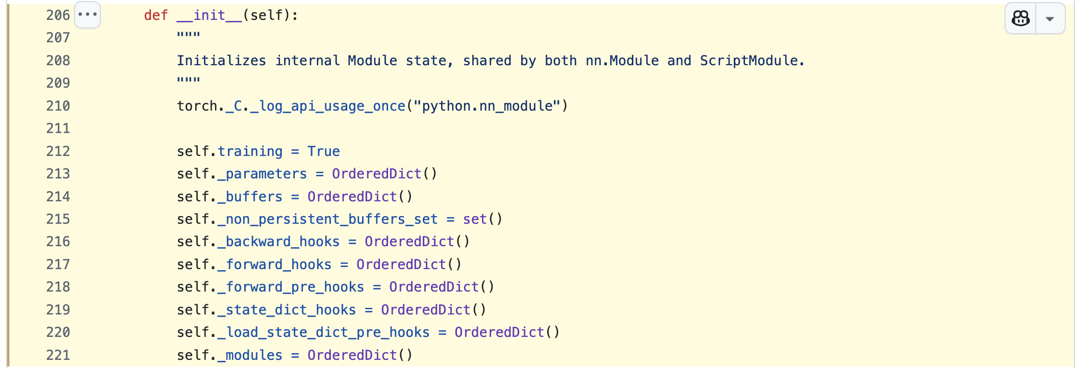
為什麼需要 super().__init__() ?
模型需要繼承 torch.nn.Module，並且透過 super().__init__() 初始化原本在 nn.Module 中被定義好的內容，如下圖所示：
https://github.com/pytorch/pytorch/blob/266657182a4040937f6f27011d7ddf77716db83d/torch/nn/modules/module.py#L206-L221

Slide 12
Step 2-2: Define the loss function
Step 2 (Model)
Loss functions | Usage
torch.nn.CrossEntropyLoss | Classification
torch.nn.MSELoss | Regression
torch.nn.BCELoss | Binary classification
loss_function = torch.nn.CrossEntropyLoss()

Slide 13


模型輸出的後處理
Cross-entropy: $ℒi=−logP\left(Y=y_{i} | X=x_{i}\right)$
Unnormalized log-probabilities / logits | Unnormalized probabilities | Probabilities
0.5 | 1.6487 | 0.225
0.7 | 2.0138 | 0.275
1.3 | 3.6693 | 0.500
Cat
Model
Dog
Apple
Model output
Exponential
Softmax

Slide 14

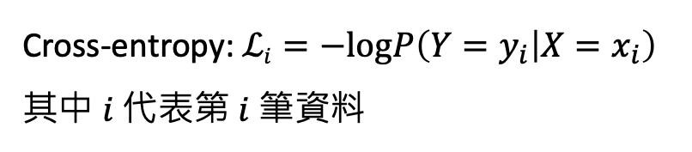
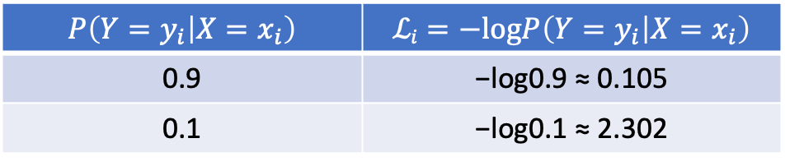
Cross-entropy (交叉熵)
Cross-entropy: $ℒi=−logP\left(Y=y_{i} | X=x_{i}\right)$
其中 $i$ 代表第 $i$ 筆資料
交叉」(Cross) 代表的是 兩個機率分布之間的關係，特別是用一個分布來衡量 與另一個分布的相似程度
量測模型輸出的負對數機率，代表模型預測該類別的信心程度
模型預測該類別的信心程度越大時， $ℒi$ 就會越小
模型預測該類別的信心程度越小時， $ℒi$ 就會越大
$$P\left(Y=y_{i} | X=x_{i}\right)$$ | $$ℒi=−logP\left(Y=y_{i} | X=x_{i}\right)$$
0.9 | −log0.9 ≈ 0.105
0.1 | −log0.1 ≈ 2.302

Slide 15
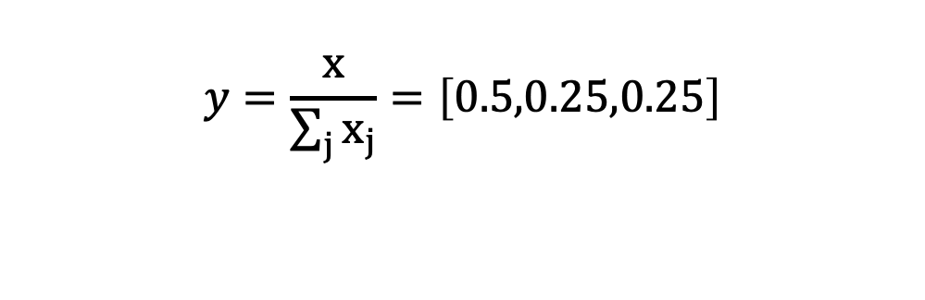
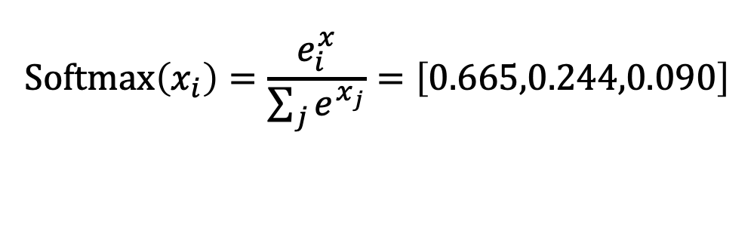
Softmax (Non-linear Transformation)
採用 exponential -> 大的數值更大，小的數值更小
有助於梯度下降
$$y=\frac{x}{\sum_{j}{x_{j}}}=\left[0.5,0.25,0.25\right]$$
$$\text{Softmax}\left(x_{i}\right)=\frac{e_{i}^{x}}{\sum_{j}{e^{x_{j}}}}=\left[0.665,0.244,0.090\right]$$

Slide 16
Step 2-3: Define the optimizer
Step 2 (Model)
Loss functions | Meaning
torch.optim.SGD | Stochastic gradient descent (with momentum)
torch.optim.RMSprop | RMSProp (Root Mean Square Propagation)
torch.optim.Adam | Adam (Adaptive Moment Estimation)
torch.optim.AdamW | AdamW (Adam with decoupled weight decay)
learning_rate = 1e-3 # 代表 0.001
optimizer = optim.Adam(model.parameters(), lr=learning_rate)

Slide 17
Step 3: Write the training process
Step 3 (Training)
Clear gradients
Input data to the model
Computer loss
Computer gradients
Update model parameters
(Repeat 1. to 5. until the end of training)
optimizer.zero_grad()
output = model(**batch)
loss = loss_function(gold, output)
loss.backward()
optimizer.step()

Slide 18
** in Python
**dict 可以展開字典，轉換成關鍵字參數傳遞給函式
def greet(age, name):
print(f"My name is {name} and I am {age} years old.")
person_info = {"name": "Alex", "age": 25}
greet(**person_info) # 等同於 greet(name="Alex", age=25)

Slide 19
Step 3: Write the training process
Step 3 (Training)
Clear gradients
Input data to the model
Computer loss
Computer gradients
Update model parameters
(Repeat 1. to 5. until the end of training)
optimizer.zero_grad()
output = model(**batch)
loss = loss_function(gold, output)
loss.backward()
optimizer.step()

Slide 20
Step 3: Write the training process
Step 3 (Training)
for batch in train_loader:
output = model(**batch)
...
output = model(**batch)
# Get x, y from your dataloader
for batch_x, batch_y in train_loader:
output = model(batch_x)
loss = criterion(output, target)
...

Slide 21
Step 4: Write the evaluation process
Step 4 (Evaluation)
from sklearn.metrics import accuracy_score
with torch.no_grad():
for batch in val_loader: # or test_loader
output = model(**batch)
pred = outputs.argmax(dim=1)
...
predictions.append(pred)
accuracy_score(test_labels, predictions)

Slide 22
Thank you!
Instructor: 林英嘉
✉️ yjlin@cgu.edu.tw
TA: 林君襄
✉️ becky890926@gmail.com

