Slide 1



深度學習 Deep Learning
Transformers
自注意力機制模型
Instructor: 林英嘉 (Ying-Jia Lin)
2025/11/05
Course GitHub
Slido # DL1105

Slide 2
Outline
Weakness of RNNs and CNNs [10 min]
Transformers [90 min]
Announcement about Term Project [10 min]
Homework 3 [25 min]
Quiz [15 min]

Slide 3
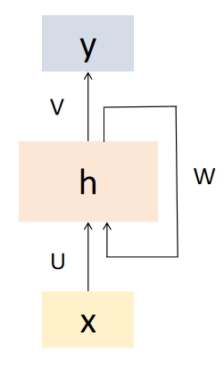
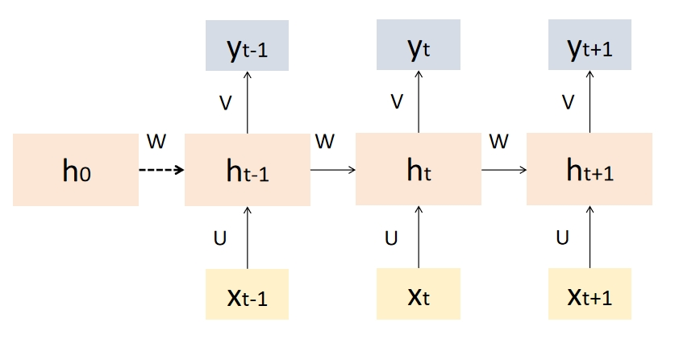
[Recap] Recurrent Neural Networks (RNN)
Recurrent Neural Networks (RNNs) are a type of artificial neural network designed to handle sequential data by capturing temporal dependencies.
RNN 的“遞迴”是指它在每一個時間步中重複使用相同的參數（同一組權重），並把先前的隱藏狀態傳到下一個時間步

Slide 4
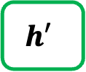
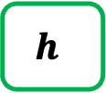
[Recap] Text Generation with RNN
Hidden size: 100
Vocab
Prob
a
...
apple
...
b
...
banana
...
elephant
...
eraser
...
...
zoo
0.0001
...
0.600
...
0.0001
...
0.0003
...
0.300
...
0.05
...
...
0.0001
$$h$$
Classification Layer
(Hidden size Vocab_size)
RNN
RNN
RNN
$$h′$$
Vocab
size
I
love
an

Slide 5
[Recap] RNN 的記憶力意義
得知第一個字為「庭」
已經包含了「庭院深」的資訊
已經包含了「庭院深深深幾許」的資訊
h₀
h₁
h₂
h₃
...
h₆
h₇
...
庭
院
深
幾
許

Slide 6
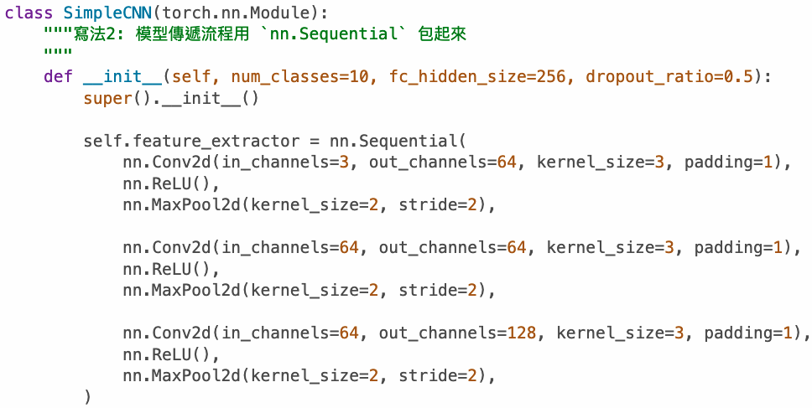
序列模型 (Sequential Model)
Conv2d
一層一層執行
(Recap)
ReLU
MaxPool
...
h₀
h₁
h₂
h₃
...
h₆
h₇
序列模型：
一步一步執行，有時間點關係
...
庭
院
深
幾
許

Slide 7
為什麼我們需要序列模型?
Contextual Embedding
(具備上下文知識的表達)
RNN
RNN
RNN
RNN
RNN
RNN
RNN
RNN
open
a
bank
account
on
the
river
bank
Same word embedding

Slide 8
深度學習常見模型架構
CNN
(著重局部資訊)
RNN
(著重記憶力)
Transformer
(著重全局資訊與記憶力)
i
love
deep
learning
i
love
deep
learning

Slide 9
RNN 與 CNN 作為序列模型的問題
問題：RNN 難以平行化
問題：CNN 著重局部資訊
RNN
RNN
RNN
RNN
Pooling
CNN
CNN
CNN
open
a
bank
account
open
a
bank
account

Slide 10















Encoder and Decoder
輸出是 hidden states
輸出是 sequence (文字)
$${\hat{y}}_{1}$$
$${\hat{y}}_{2}$$
……
$${\hat{y}}_{t−1}$$
$${\hat{y}}_{t}$$
$$h_{0}$$
$$h_{1}$$
……
$$h_{n−2}$$
$$C$$
FFN (linear layer(s))
Encoder
Decoder
$$h_{init}$$
……
_
$${\hat{y}}_{1}$$
……
$${\hat{y}}_{t−2}$$
$${\hat{y}}_{t−1}$$
_
$$x1$$
$$x_{n−2}$$
$$x_{n−1}$$
(Start)
(Start)
Input sequence
(Encoder 的輸出有很多種被Decoder運用的方式)

Slide 11

Transformer

Slide 12
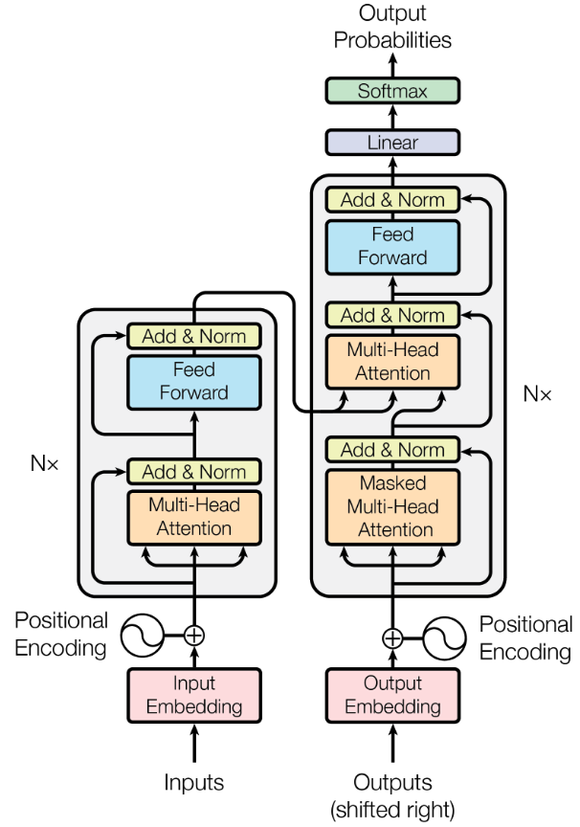
Overview of Transformer
Vaswani, Ashish, et al. "Attention is all you need." NeurIPS (2017).
Decoder
Encoder

Slide 13
Outline of Transformer
Vaswani, Ashish, et al. "Attention is all you need." NeurIPS (2017).

Slide 14
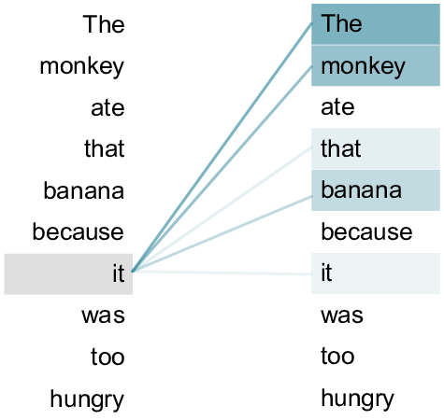
Transformer
Source: An example of the self-attention mechanism following long-distance... | Download Scientific Diagram (researchgate.net)
Transformer 來自論文：Attention Is All You Need (Vaswani et al., 2017)
Transformer 內部的主要機制為 Self-attention
Self-attention: 句子內的每個 token 自己跟自己做 attention
attention 進行的過程需要主動與被動
Self-attention
open
a
bank
account

Slide 15
Query (Q), Key (K), and Value (V)
t = 1
h₁
Weighted sum
a₁
a₂
a₃
a₄
q₁
k₁
v₁
q₂
k₂
v₂
q₃
k₃
v₃
q₄
k₄
v₄
🎯
e₁
I
e₂
print
e₃
Hello
e₄
world

Slide 16
Query (Q), Key (K), and Value (V)
t = 2
h₁
h₂
Weighted sum
a₁
a₂
a₃
a₄
q₁
k₁
v₁
q₂
k₂
v₂
q₃
k₃
v₃
q₄
k₄
v₄
🎯
e₁
I
e₂
print
e₃
Hello
e₄
world

Slide 17

QKV 的比喻
Vaswani, Ashish, et al. "Attention is all you need." NeurIPS (2017).
Query
Key
Value
Query: (主動) 查詢的關鍵字；Key: (被動) 查詢的對象
Value: 值，關鍵字與對象的匹配程度
Notes:
https://stats.stackexchange.com/questions/421935/what-exactly-are-keys-queries-and-values-in-attention-mechanisms

Slide 18
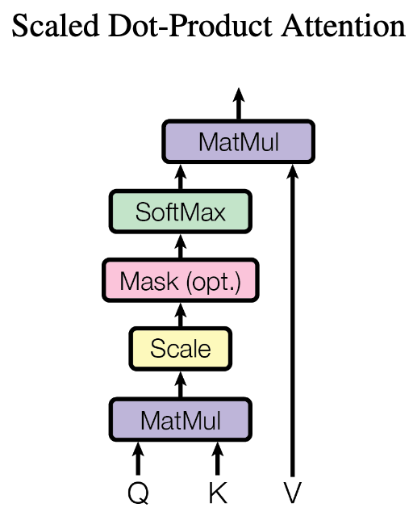
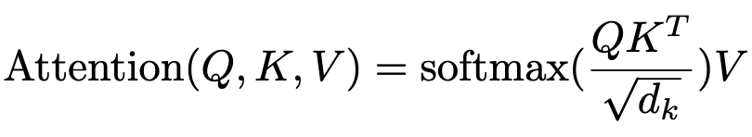



為什麼 Transformers 可以平行化？
d_{q} = d_{k} = d_{v}
(自注意力機制可以利用矩陣乘積來進行平行化計算)
$$Q$$
$$KT$$
$$V$$
q₁
v₁
k₁
k₂
k₃
q₂
v₂
q₃
v₃
N x d_{q}
d_{k} x N
N x d_{v}
q₁
k₁
v₁
q₂
k₂
v₂
q₃
k₃
v₃
e₁
I
e₂
printed
e₃
Hello

Slide 19

Transformers 的權重值 (1/2)
Q: N x d_{q}
K: N x d_{k}
V: N x d_{v}
(
)
$$T$$
e₁
e₁
e₁
e₂
W^{Q}
e₂
W^{K}
e₂
W^{V}
e₃
e₃
e₃
N x d_{model}
d_{model} x d_{q}
N x d_{model}
d_{model} x d_{k}
N x d_{model}
d_{model} x d_{v}
e₁
e₁
e₁
e₂
e₂
e₂
e₃
e₃
e₃
d_{model} : Embedding 的維度大小
I
printed
Hello

Slide 20




Transformers 的權重值 (2/2)
$$Q$$
$$KT$$
(
)
$$T$$
q₁
e₁
e₁
k₁
k₂
k₃
=
W^{Q}
=
q₂
e₂
e₂
W^{K}
q₃
e₃
e₃
N x d_{q}
N x d_{model}
d_{model} x d_{q}
d_{k} x N
N x d_{model}
d_{model} x d_{k}
$$V$$
v₁
e₁
v₂
=
e₂
W^{V}
v₃
e₃
N x d_{v}
N x d_{model}
d_{model} x d_{v}

Slide 21
Self-attention 的公式與縮放項

Slide 22
Query (Q), Key (K), and Value (V)
t = 1
h₁
Weighted sum
a₁
a₂
a₃
a₄
q₁
k₁
v₁
q₂
k₂
v₂
q₃
k₃
v₃
q₄
k₄
v₄
🎯
e₁
I
e₂
print
e₃
Hello
e₄
world

Slide 23
Query (Q), Key (K), and Value (V)
t = 2
h₁
h₂
Weighted sum
a₁
a₂
a₃
a₄
q₁
k₁
v₁
q₂
k₂
v₂
q₃
k₃
v₃
q₄
k₄
v₄
🎯
e₁
I
e₂
print
e₃
Hello
e₄
world

Slide 24
Self-attention 動畫
Figure source: https://research.google/blog/transformer-a-novel-neural-network-architecture-for-language-understanding/

Slide 25
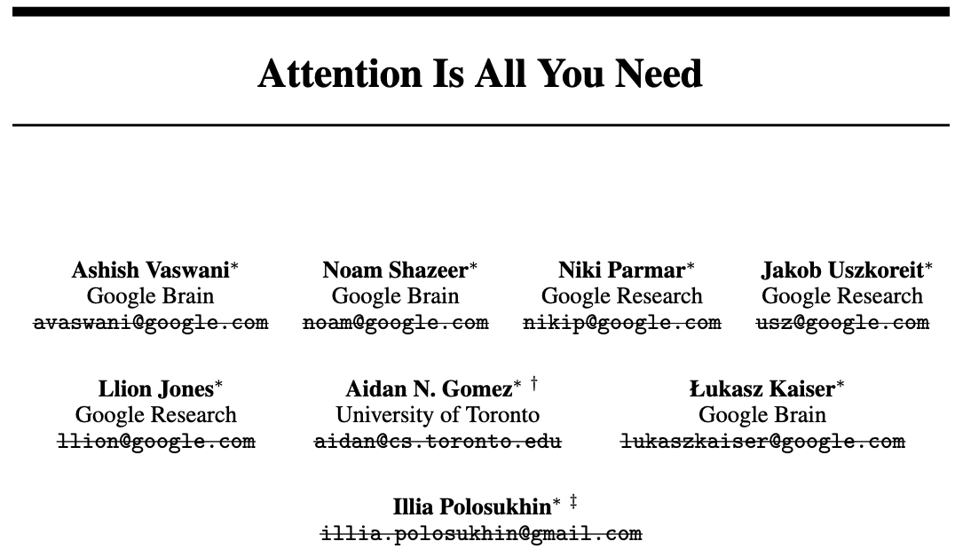
Essential AI
Anthropic
Inceptive
Cohere
Sakana AI
OpenAI
NEAR
https://arxiv.org/abs/1706.03762v6

Slide 26
Multi-Head Attention (MHA)
到目前為止，我們已經介紹了 self-attention
We query the search engine
We search engine tries to map our query to the keys
The outputs are the attended values (e.g., the best matched videos).
What if we want to have queries focusing on different aspects?
For example, one set of queries focusing on semantic similarity, another set focusing on passive/active voice.
We need multiple attention mechanisms, i.e. multiple (attention) heads!

Slide 27


















Multi-Head Attention (MHA)
上標: head
下標: token index
Head = 1 (without MHA)
q₁
k₁
v₁
q₂
k₂
v₂
q₃
k₃
v₃
e₁
I
e₂
printed
e₃
Hello
Head = 2 (with MHA)
$$q_{1}^{1}$$
$$q_{1}^{2}$$
$$k_{1}^{1}$$
$$k_{1}^{2}$$
$$v_{1}^{1}$$
$$v_{1}^{2}$$
$$q_{2}^{1}$$
$$q_{2}^{2}$$
$$k_{2}^{1}$$
$$k_{2}^{2}$$
$$v_{2}^{1}$$
$$v_{2}^{2}$$
$$q_{3}^{1}$$
$$q_{3}^{2}$$
$$k_{3}^{1}$$
$$k_{3}^{2}$$
$$v_{3}^{1}$$
$$v_{3}^{2}$$
e₁
I
e₂
printed
e₃
Hello

Slide 28

















Query (Q), Key (K), and Value (V) with MHA
Head = 2, 使用第一個 head
$$h_{1}^{1}$$
Weighted sum
$$a_{1}^{1}$$
$$a_{2}^{1}$$
$$a_{3}^{1}$$
$$a_{4}^{1}$$
$$q_{1}^{1}$$
$$k_{1}^{1}$$
$$v_{1}^{1}$$
$$q_{2}^{1}$$
$$k_{2}^{1}$$
$$v_{2}^{1}$$
$$q_{3}^{1}$$
$$k_{3}^{1}$$
$$v_{3}^{1}$$
$$q_{4}^{1}$$
$$k_{4}^{1}$$
$$v_{4}^{1}$$
🎯
e₁
I
e₂
printed
e₃
Hello
e₄
world

Slide 29

















Query (Q), Key (K), and Value (V) with MHA
Head = 2, 使用第二個 head
$$h_{1}^{2}$$
Weighted sum
$$a_{1}^{2}$$
$$a_{2}^{2}$$
$$a_{3}^{2}$$
$$a_{4}^{2}$$
$$q_{1}^{2}$$
$$k_{1}^{2}$$
$$v_{1}^{2}$$
$$q_{2}^{2}$$
$$k_{2}^{2}$$
$$v_{2}^{2}$$
$$q_{3}^{2}$$
$$k_{3}^{2}$$
$$v_{3}^{2}$$
$$q_{4}^{2}$$
$$k_{4}^{2}$$
$$v_{4}^{2}$$
🎯
e₁
I
e₂
printed
e₃
Hello
e₄
world

Slide 30









Input Dimensions of MHA
Head = 1 (without MHA)
$$Q$$
q₁
e₁
=
W^{Q}
q₂
e₂
q₃
e₃
N x d_{q}
N x d_{model}
d_{model} x d_{q}
Head = 2 (with MHA)
d_{k} / 2
d_{k} / 2
d_{k} / 2
d_{k} / 2
$$q_{1}^{1}$$
$$q_{1}^{2}$$
e₁
$$q_{2}^{1}$$
$$q_{2}^{2}$$
=
e₂
$$W_{Q}^{1}$$
$$W_{Q}^{2}$$
$$q_{3}^{1}$$
$$q_{3}^{2}$$
e₃
N x d_{q}
N x d_{model}
d_{model} x d_{q}

Slide 31

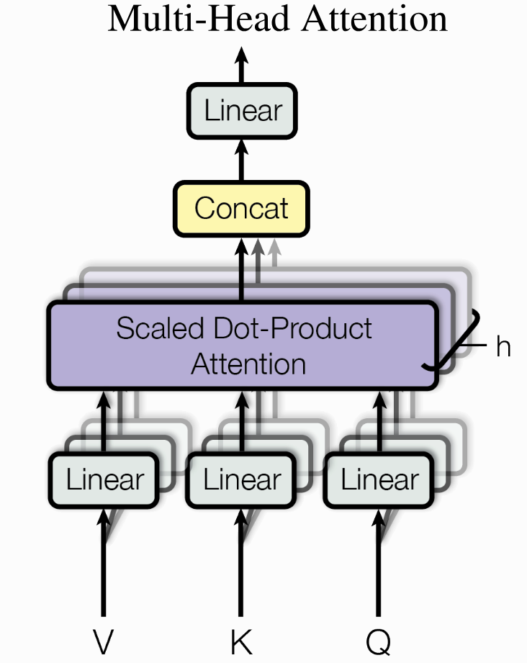









Output Dimensions
x
x
$$∈ ℝ^{N × (h ⋅d)}$$
$$∈ ℝ^{\left(h ⋅d\right) × d_{out}}$$
Head = 1 (without MHA)
h₁
h₁
$${ ∈ℝ}^{N × d_{out}}$$
X
W^{O}
=
$$∈ ℝ^{N × (h ⋅d)}$$
$$Y_{h} ∈ ℝ^{N×d}$$
...
Head = 2 (with MHA)
$$Y_{2} ∈ ℝ^{N×d}$$
$$Y_{1} ∈ ℝ^{N×d}$$
$$h_{1}^{1}$$
h₁
X
W^{O}
=
$$h_{1}^{2}$$

Slide 32
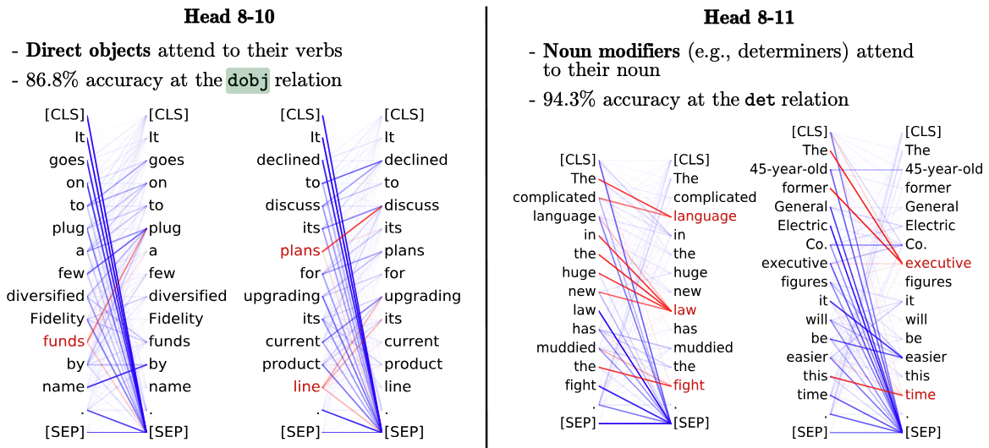
MHA 比較好嗎？
Clark, Kevin, et al. "What Does BERT Look at? An Analysis of BERT’s Attention." Proceedings of the 2019 ACL Workshop BlackboxNLP: Analyzing and Interpreting Neural Networks for NLP. 2019.
實驗證明：不同 head 關注的地方不太一樣
<layer>-<head number>
關注受詞
關注限定詞

Slide 33
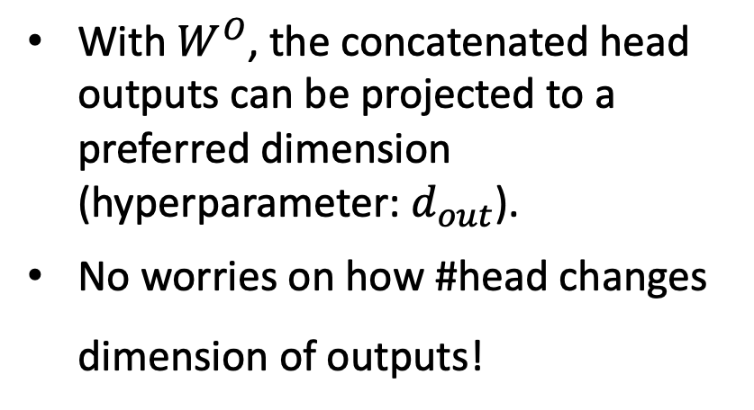

Summary of MHA
With $W^{O}$, the concatenated head outputs can be projected to a preferred dimension (hyperparameter: $d_{out}$).
No worries on how #head changes dimension of outputs!
$${ ∈ℝ}^{N × d_{out}}$$
$$∈ ℝ^{N × (h ⋅d)}$$
$$Y_{h} ∈ ℝ^{N×d}$$
...
$$Y_{2} ∈ ℝ^{N×d}$$
$$Y_{1} ∈ ℝ^{N×d}$$

Slide 34
Outline of Transformer
Vaswani, Ashish, et al. "Attention is all you need." NeurIPS (2017).
Add: Residual Connection
Norm: Layer Normalization

Slide 35
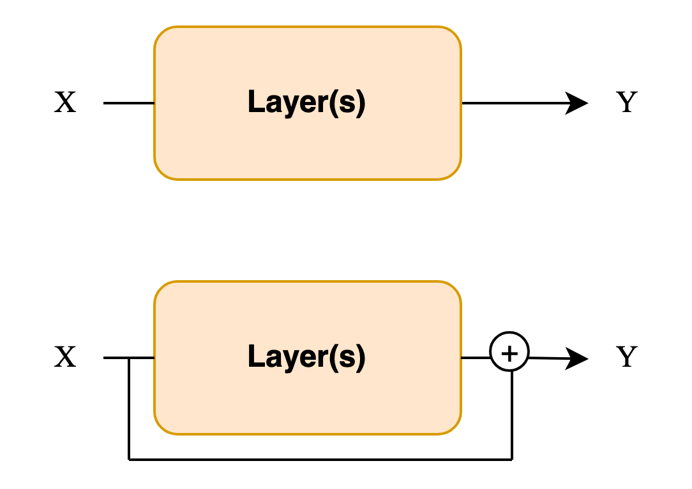
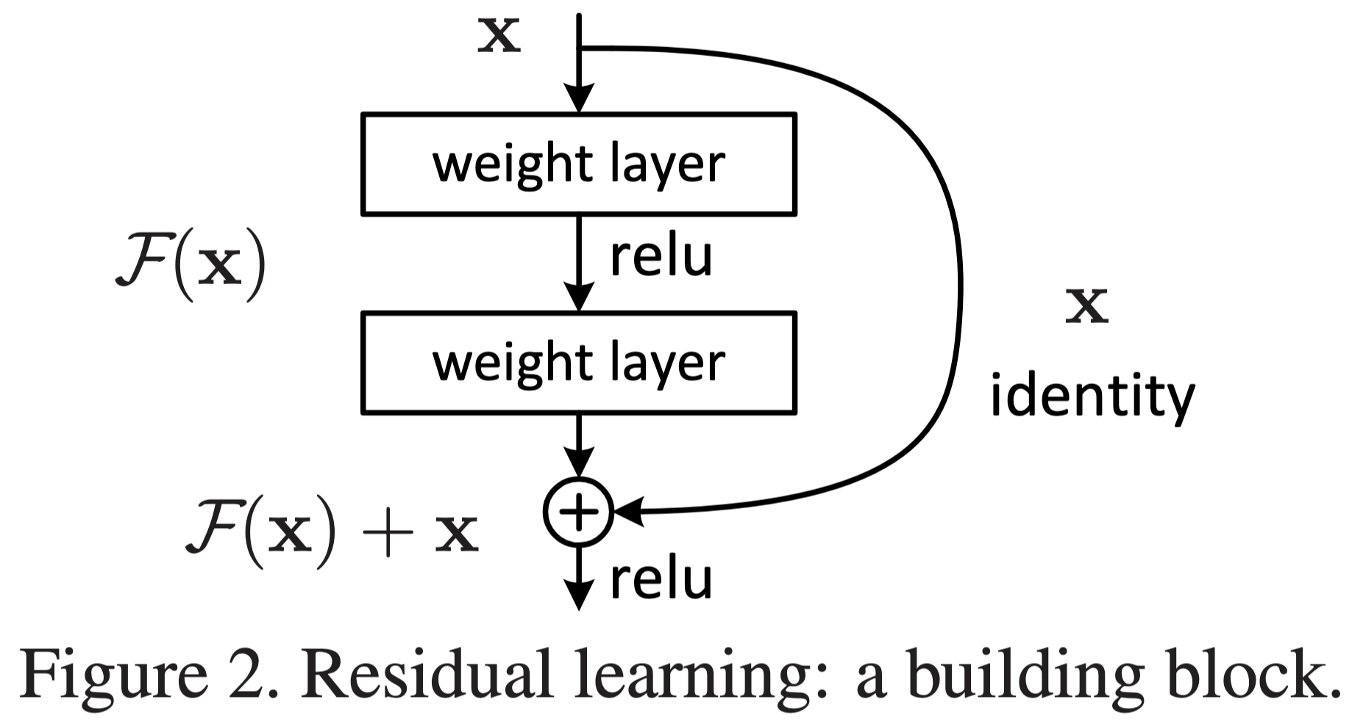
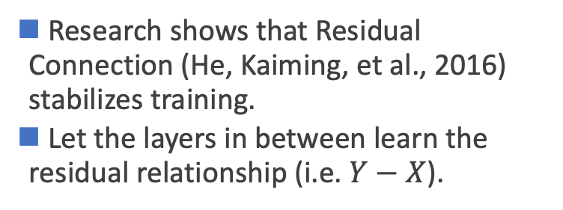
Add & Norm
Research shows that Residual Connection (He, Kaiming, et al., 2016) stabilizes training.
Let the layers in between learn the residual relationship (i.e. $Y−X$).
Standard
Residual
He, Kaiming, et al. "Deep residual learning for image recognition." Proceedings of the IEEE conference on computer vision and pattern recognition (2016).

Slide 36
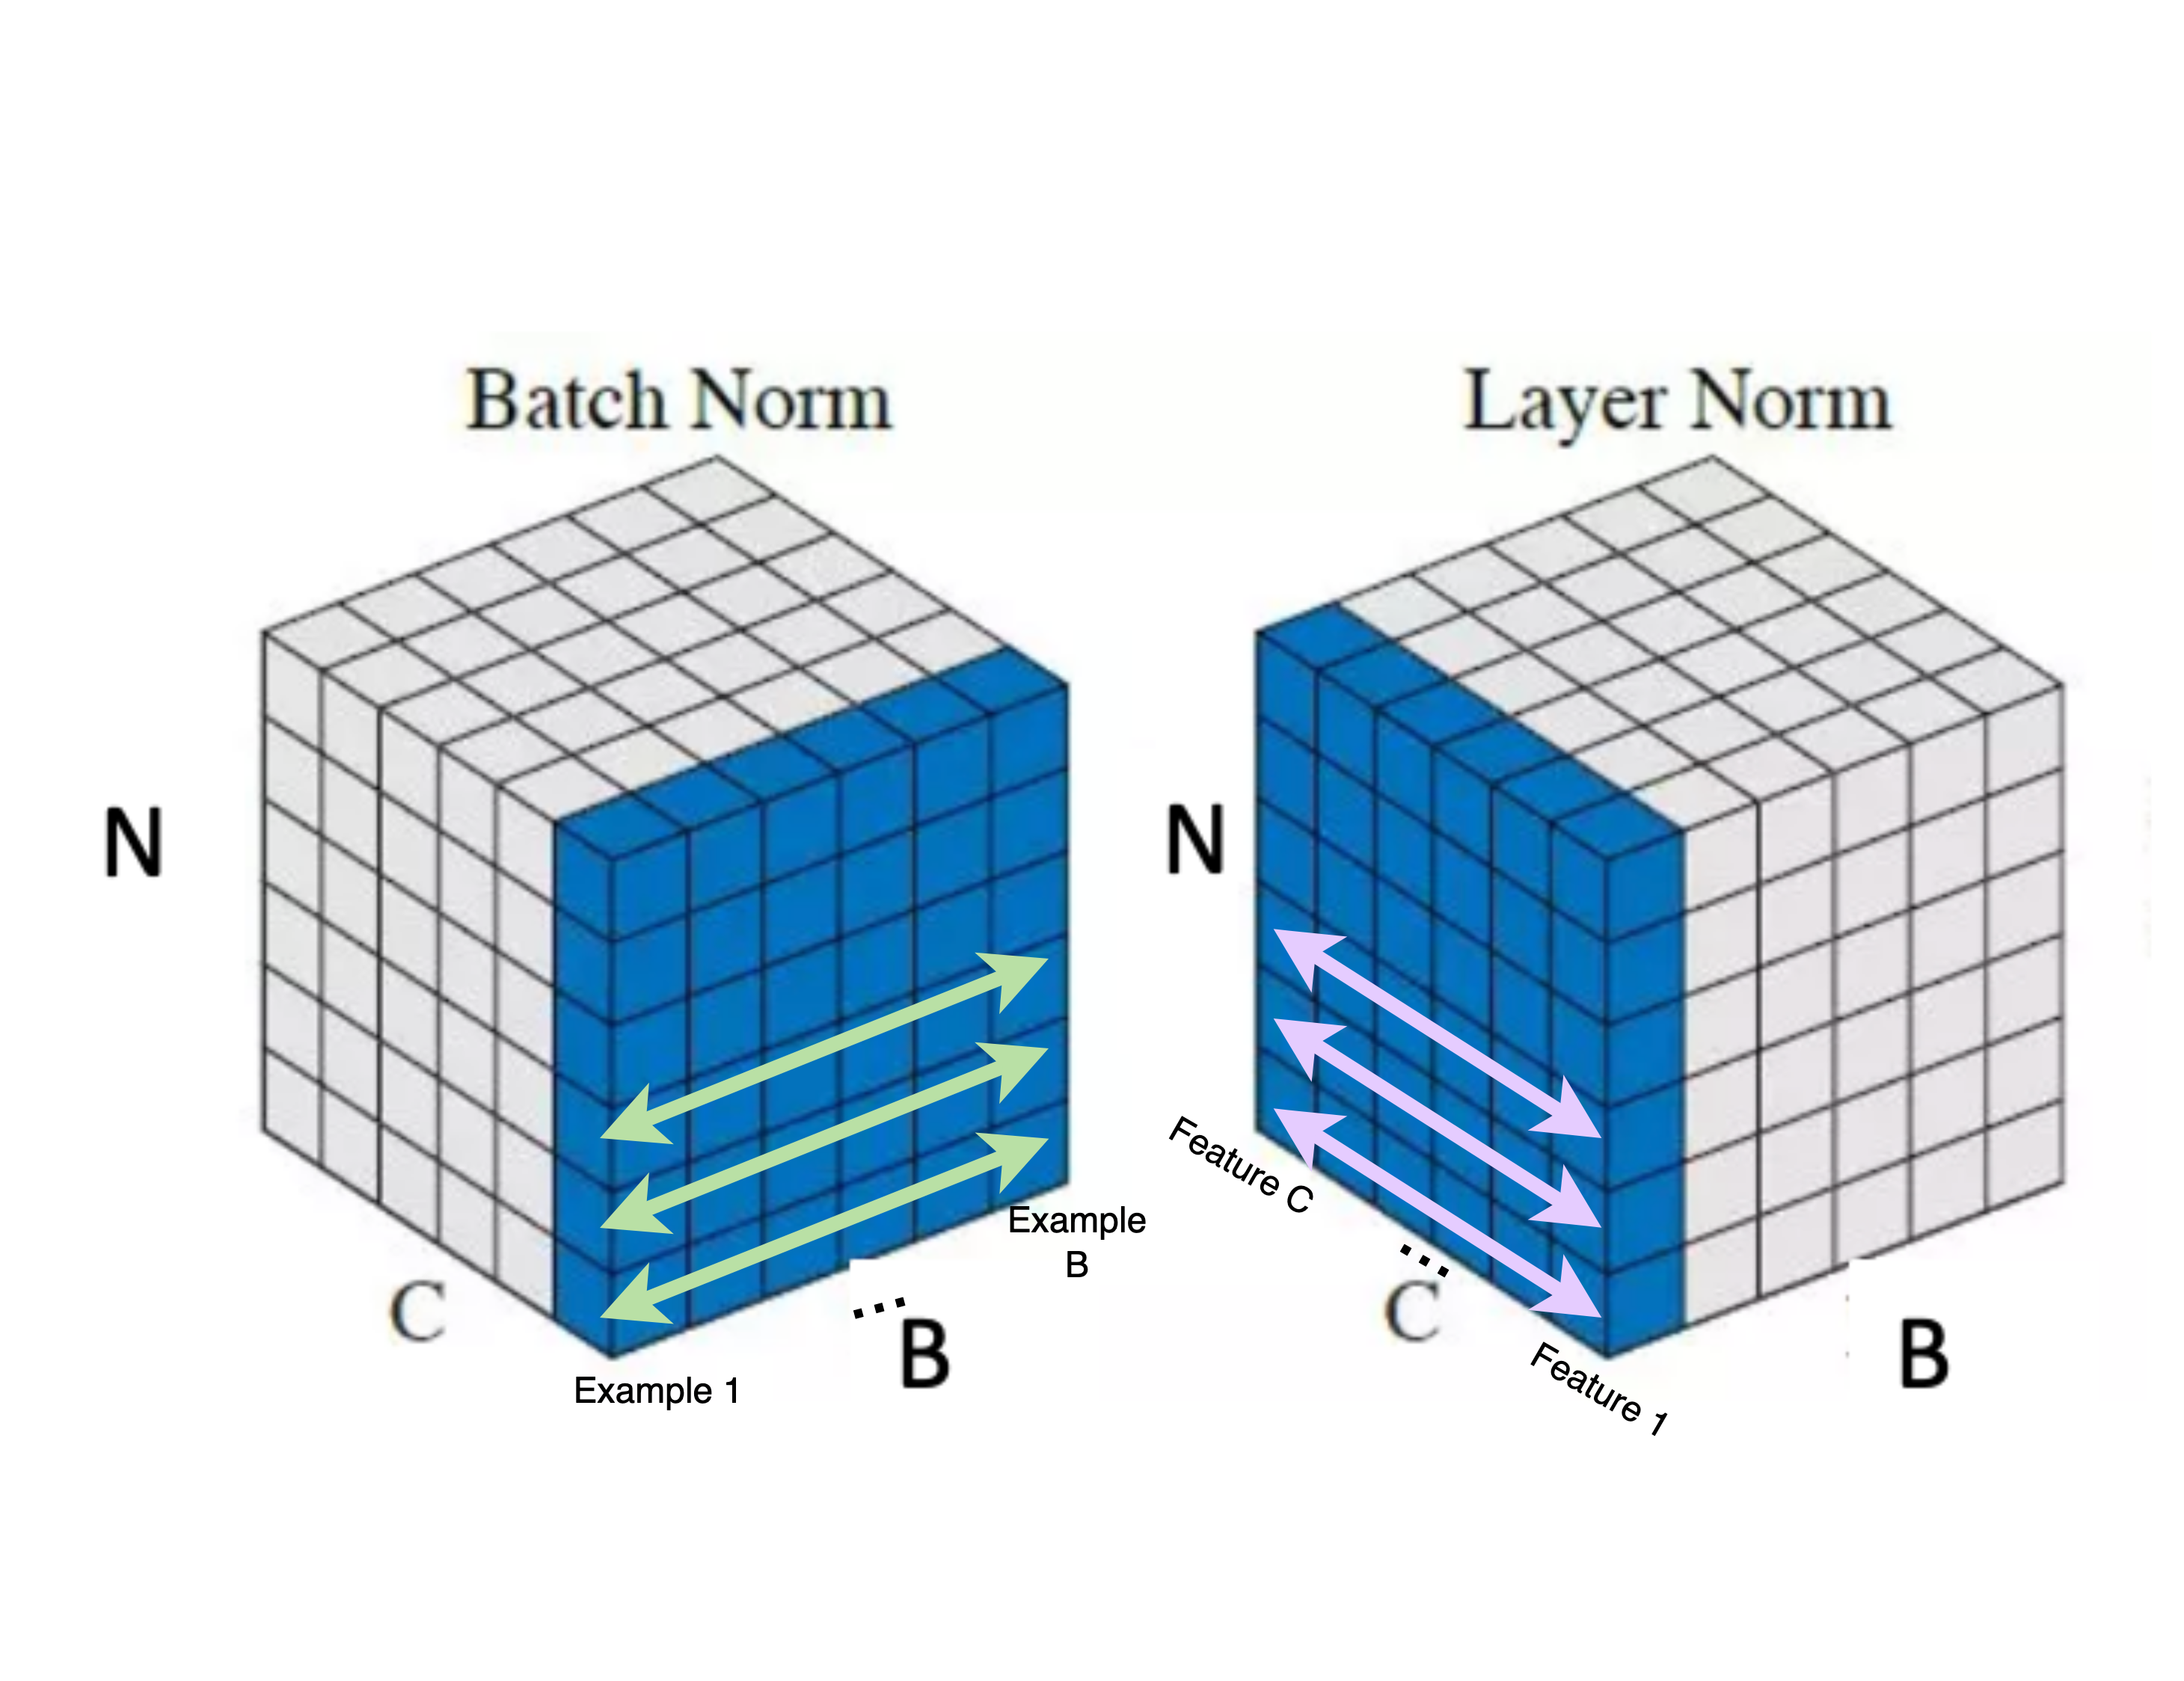








Add & Norm
B: Batch Size
C: Channels / Embedding Feature Dimension
N: Sequence length
Layer Norm: For an input vector, calculate its mean and std across embedding dimension (within an example).
$norm\left(X\right)=\frac{X−μ}{σ}$
計算：$μ$ (平均數) & $σ$ (標準差)
$$x_{1}$$
$$h_{1}$$
$${h′}_{1}$$
...
...
...
$$x_{n}$$
$$h_{j}$$
$${h′}_{j}$$
(Batch Normalization)
Ba, Jimmy Lei, Jamie Ryan Kiros, and Geoffrey E. Hinton. "Layer normalization." arXiv preprint arXiv:1607.06450 (2016).

Slide 37
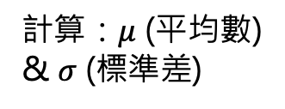
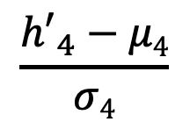
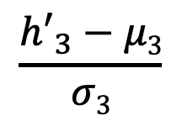
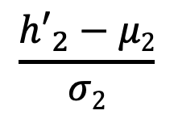
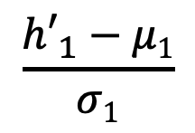
Add & Norm
$$\frac{{h′}_{1}−μ1}{σ1}$$
$$\frac{{h′}_{2}−μ2}{σ2}$$
$$\frac{{h′}_{3}−μ3}{σ3}$$
$$\frac{{h′}_{4}−μ4}{σ4}$$
h₁
h₂
h₃
h₄
計算：$μ$ (平均數) & $σ$ (標準差)
a₁
a₂
a₃
a₄
q₁
k₁
v₁
q₂
k₂
v₂
q₃
k₃
v₃
q₄
k₄
v₄
e₁
I
e₂
printed
e₃
Hello
e₄
world
Ba, Jimmy Lei, Jamie Ryan Kiros, and Geoffrey E. Hinton. "Layer normalization." arXiv preprint arXiv:1607.06450 (2016).

Slide 38
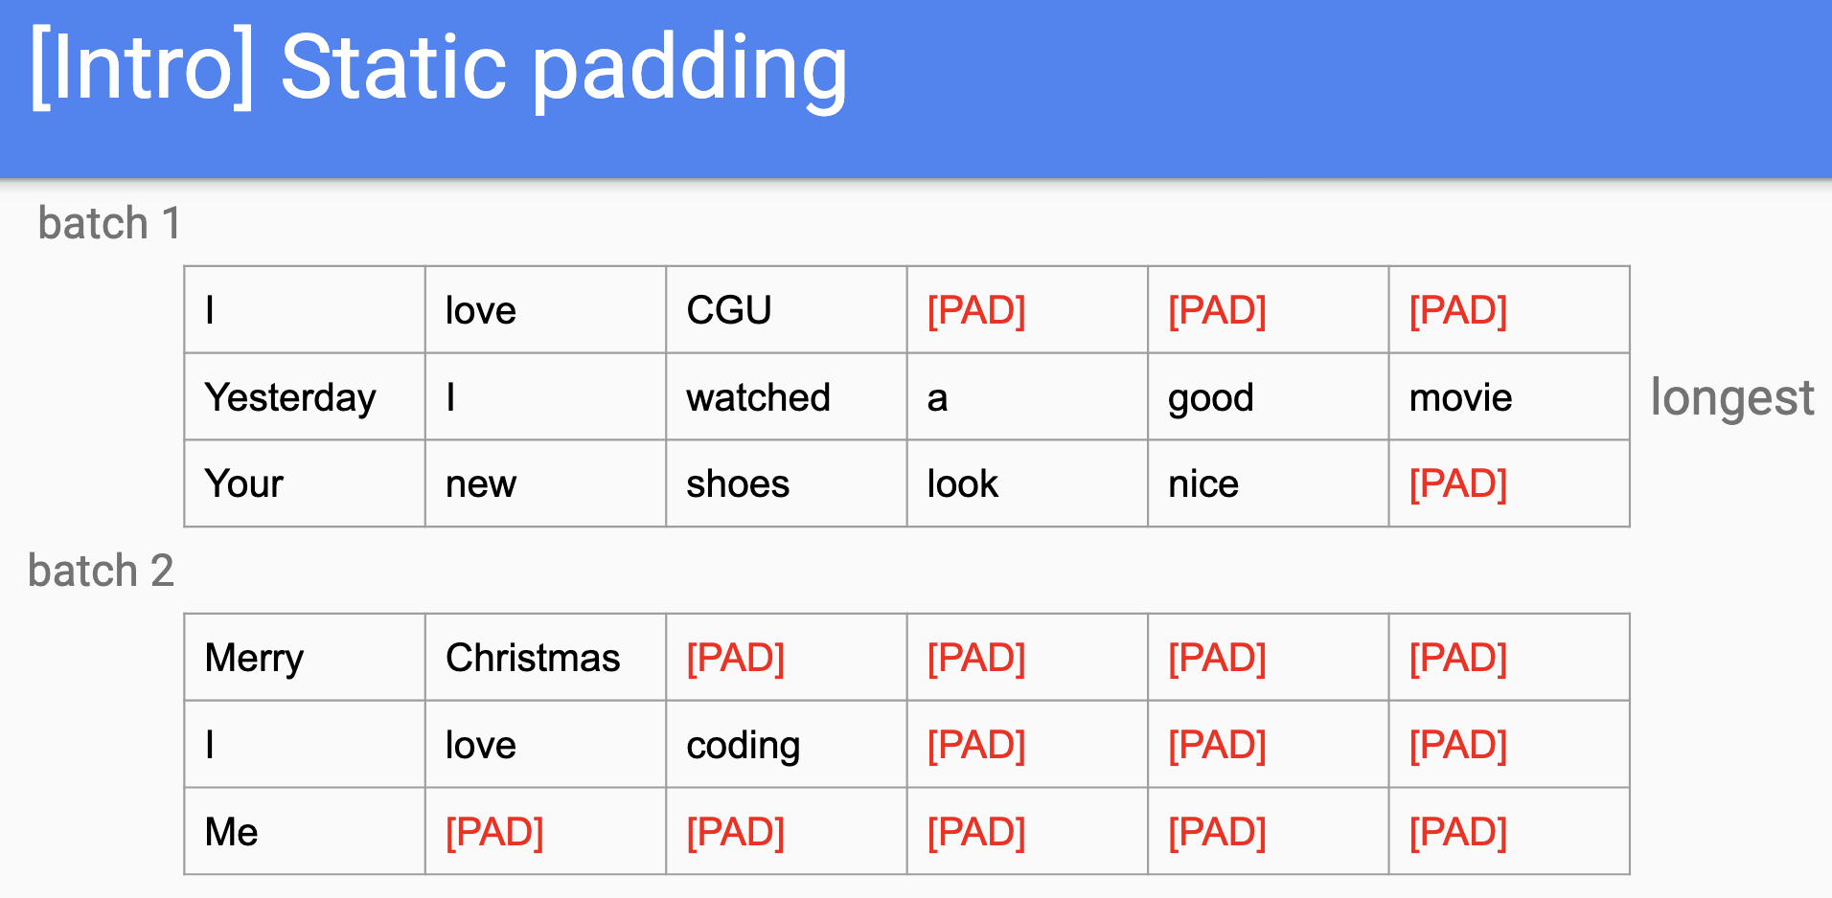
Why LN not BN?
資料長度差距
模型實作表現差異

Slide 39
Outline of Transformer
Vaswani, Ashish, et al. "Attention is all you need." NeurIPS (2017).

Slide 40
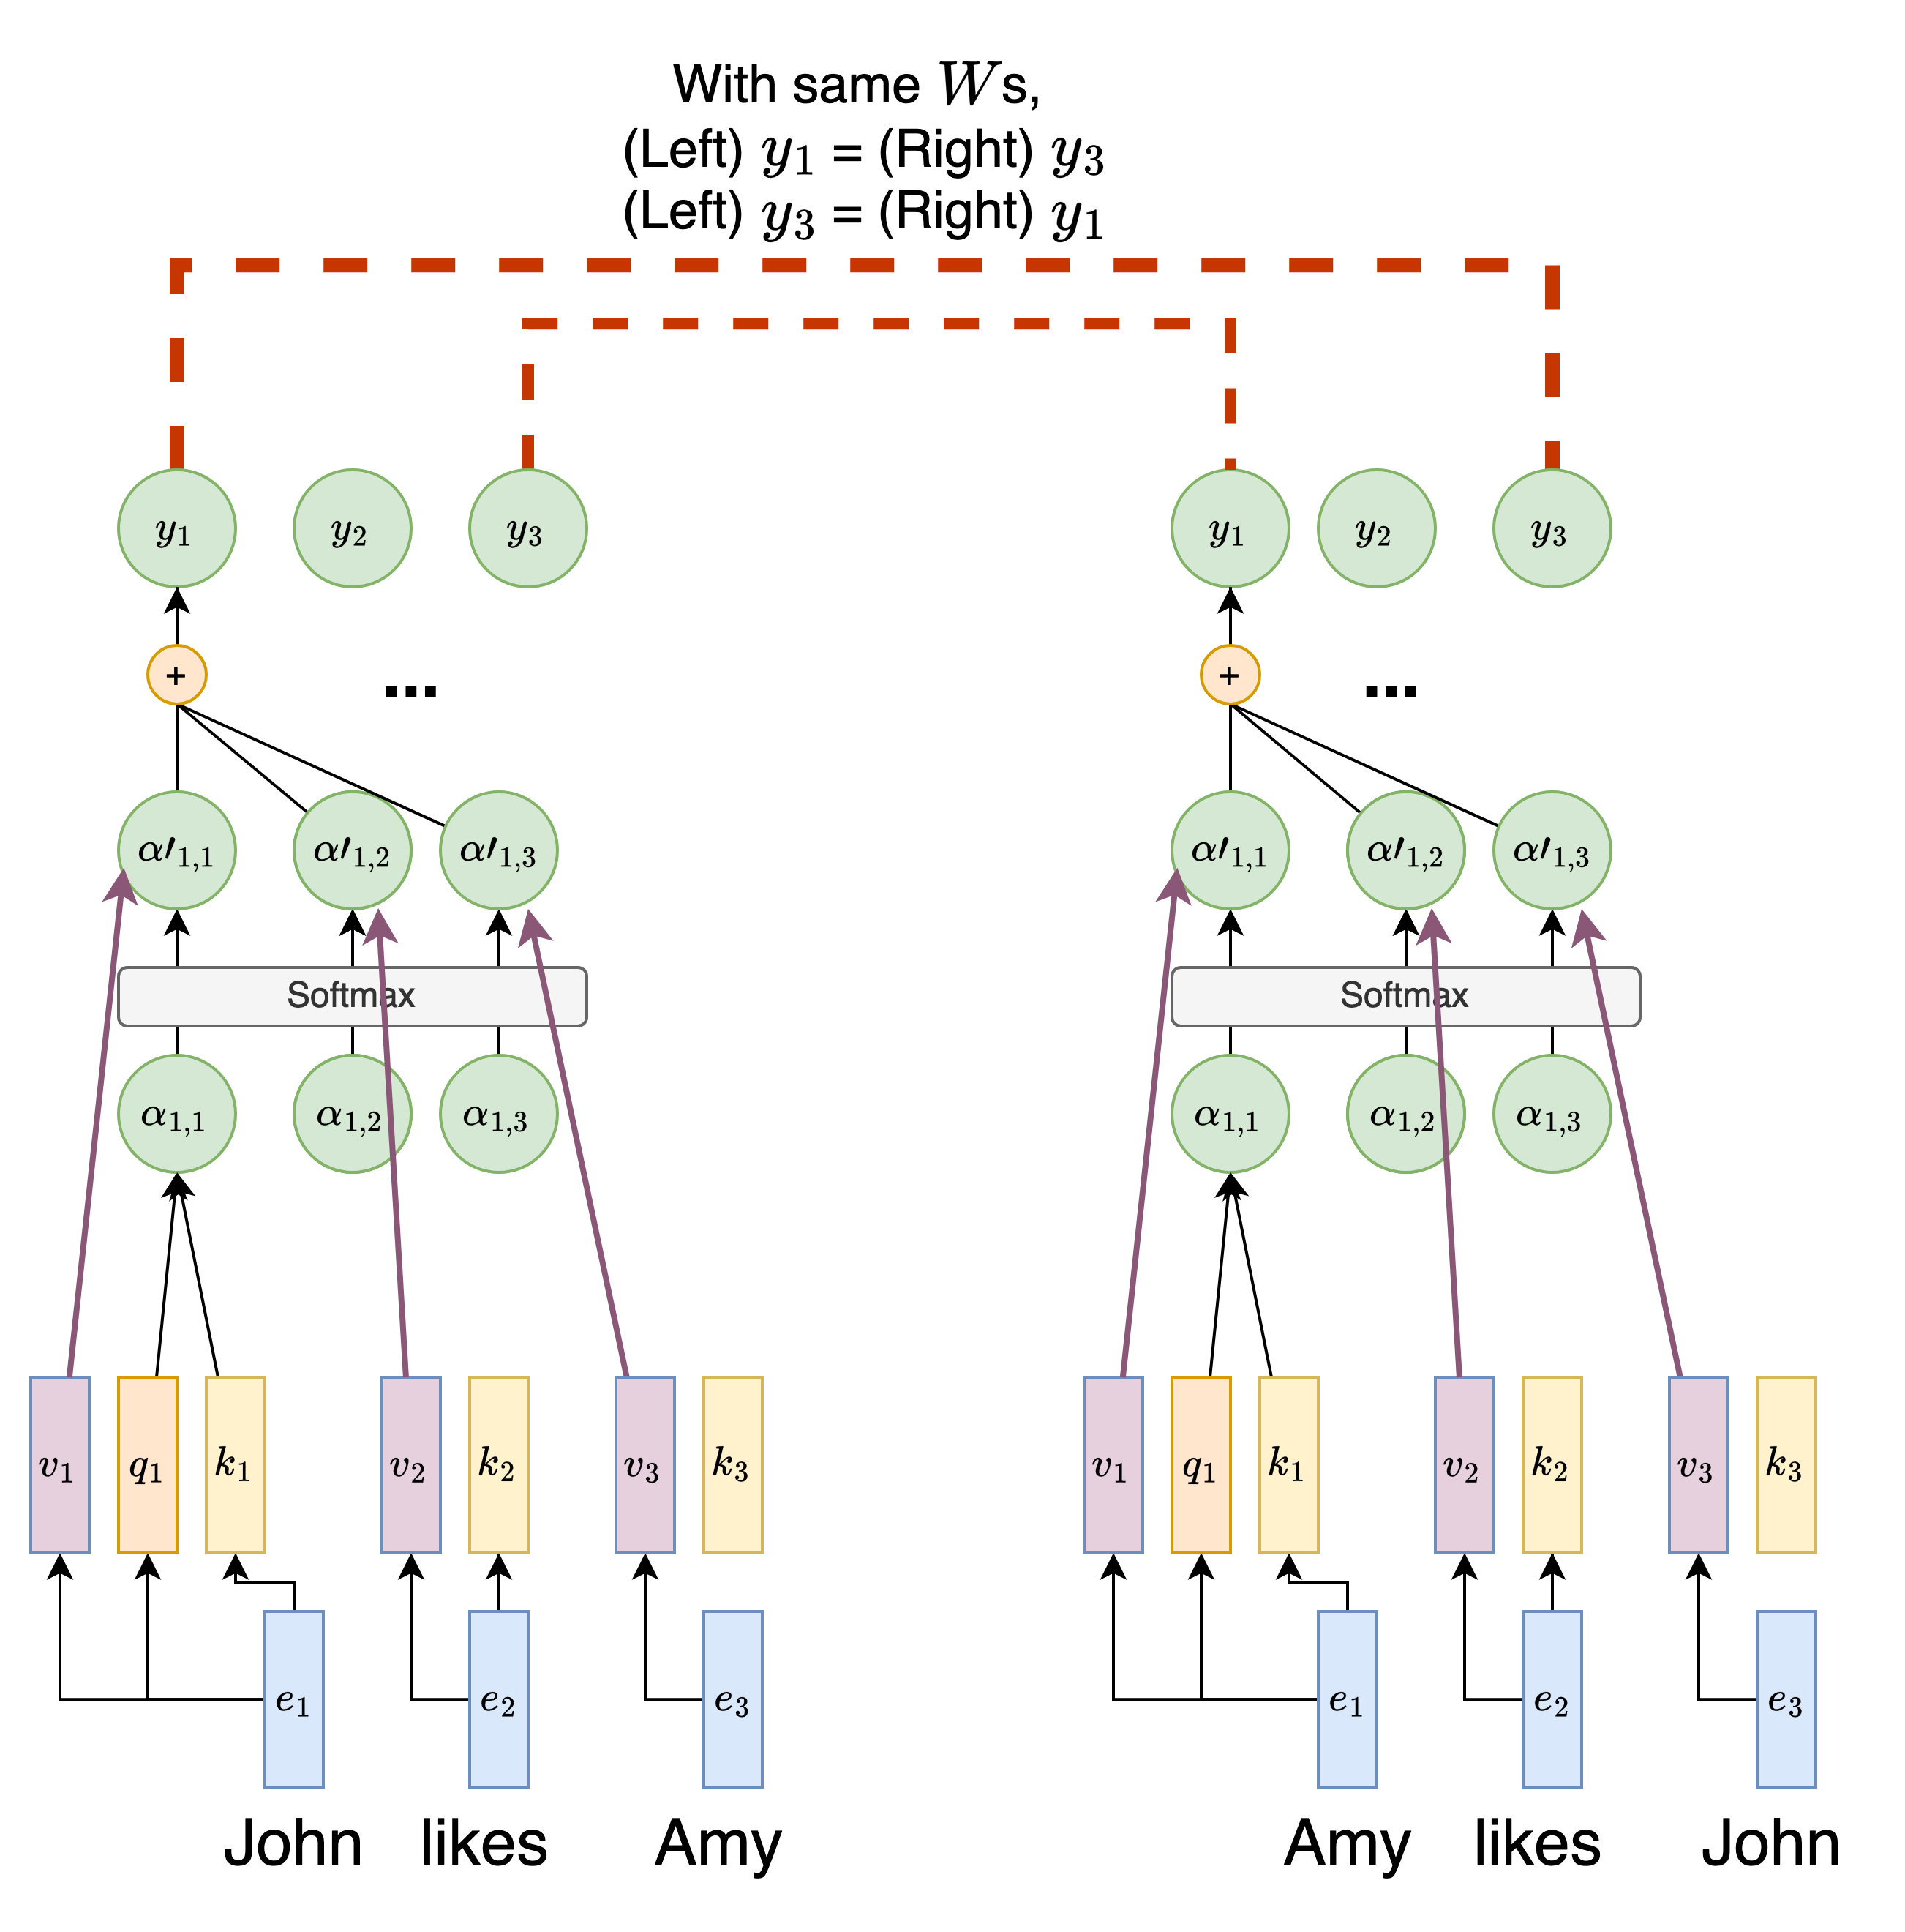
Lack of Position Modeling
RNN 有位置資訊 (因為 RNN step-by-step 處理文字)
然而，Transformer 中 self-attention 的操作遺失了 step-by-step 處理文字的方式，故缺少位置資訊
不同語意的句子但文字資訊卻沒有根據上下文而變化
Notes:
RNNs use the recurrent nature to encode relative distance, but self-attention alone does not have the concept of distance.
Figure link: https://www.google.com/imgres?imgurl=https%3A%2F%2Fen.pimg.jp%2F062%2F372%2F497%2F1%2F62372497.jpg&tbnid=h12XO59LOC-2AM&vet=12ahUKEwi-hZz5-aeEAxUjiq8BHWxaD30QMygLegQIARBw..i&imgrefurl=https%3A%2F%2Fwww.pixtastock.com%2Fillustration%2F62372497&docid=EjyqzObtASteNM&w=450&h=468&q=trouble%20face%20cute%20&ved=2ahUKEwi-hZz5-aeEAxUjiq8BHWxaD30QMygLegQIARBw

Slide 41
常見位置資訊作法：Learned Positional Embeddings
Self-attention
Self-attention
p₁
e₁
p₂
e₂
p₃
e₃
p₁
e₁
p₂
e₂
p₃
e₃
+
+
+
+
+
+
1
John
2
likes
3
Amy
1
Amy
2
likes
3
John
此做法又稱絕對位置資訊編碼 (Absolute positional Encoding)

Slide 42
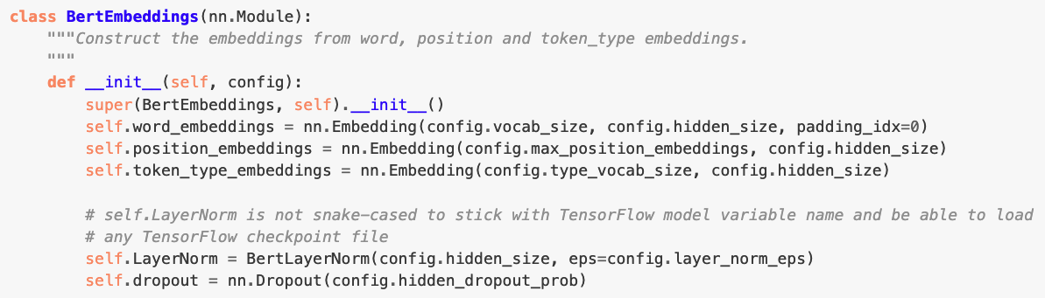
Learned Positional Embeddings 程式碼
https://huggingface.co/transformers/v2.1.1/_modules/transformers/modeling_bert.html
缺點：Learned Positional Embeddings 不會超出 max_position 之後的資訊

Slide 43
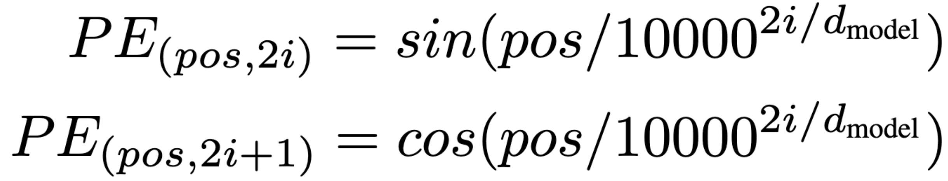
Positional Encoding in Transformer
創造出相對位置的 embeddings
核心精神：利用三角函數的週期性來建構序列資訊
偶數的 embedding 單元 (2i , i = 0, 2, 4, …, d_{model} / 2 - 2)：Sin 函數
奇數的 embedding 單元 (2i+1, i = 1, 3, 5, …, d_{model} / 2 - 1)： Cosine 函數
i越大代表分母的指數越大，sin的角度越小
10000是實驗得出的較佳數值
輸入序列中任一token的位置
Figure source: https://nlp.seas.harvard.edu/annotated-transformer/#positional-encoding
Notes:
sin(wt)，w是角速度，t是時間，在這邊指的是pos
w=2π/λ
PE公式可寫成sin(2πpos / 10000^{2i / d_{model}} * 2π)
因此λ為10000^{2i / d_{model}} * 2π
i最小時λ為2π
i最大時λ為10000 * 2π

Slide 44
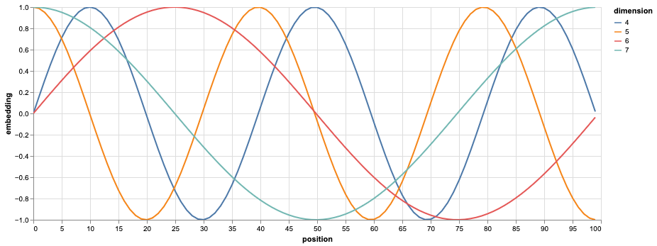
Positional Encoding Visualization
Question: 為什麼需要同時有 Sin 和 Cosine 的函數？
Ans: 藉由不同週期性來捕捉序列中各個位置的關係
Figure source: https://nlp.seas.harvard.edu/annotated-transformer/#positional-encoding

Slide 45
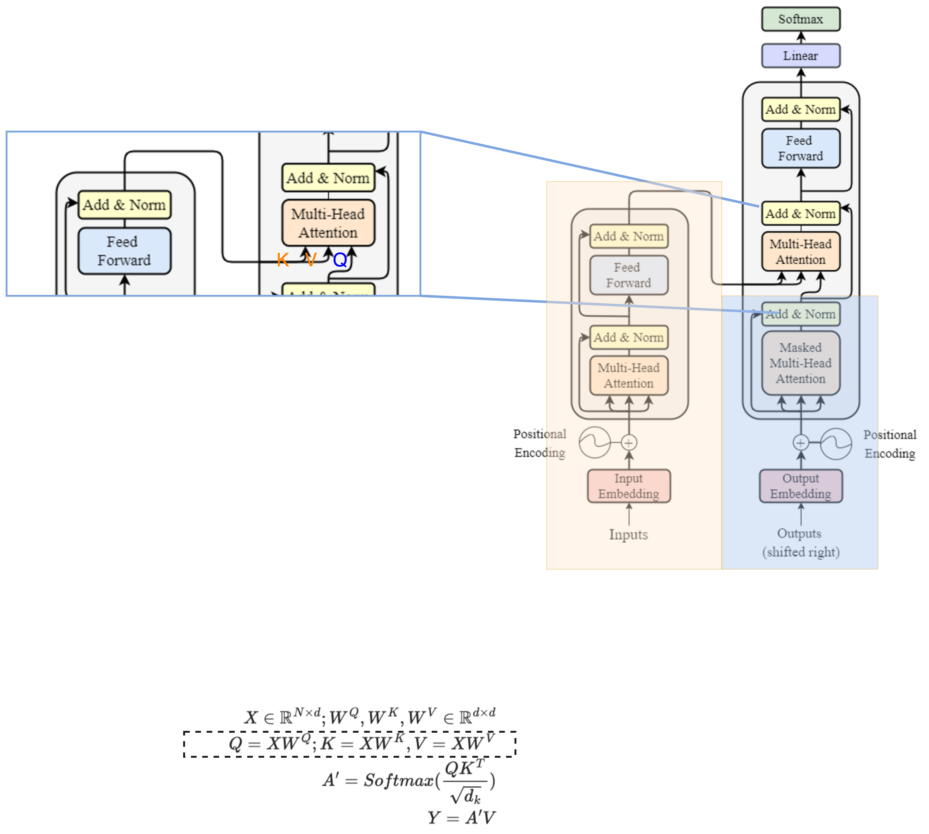
Encoder-Decoder 橋樑: Cross-Attention
K, V uses the output from encoder as their X;
Q uses the decoder’s information as X.
This is
Notes:
K, V uses the output from encoder as their X;
Q uses the decoder’s information as X.

Slide 46
Cross-attention
Encoder
h'₁
Weighted sum
a'₁
a'₂
a'₃
k₁
v₁
k₂
v₂
k₃
v₃
q₁
🎯
e₁
I
e₂
print
e₃
Hello
e₁
BOS

Slide 47
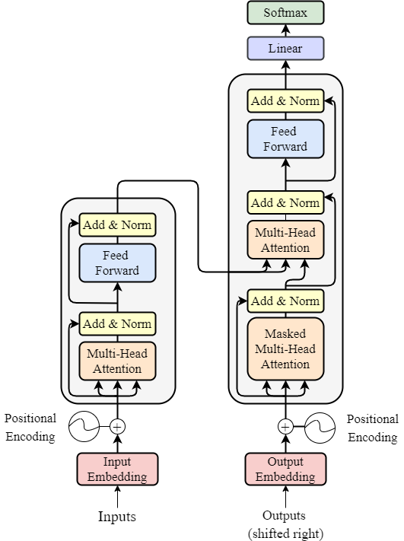


Number of Layers
Vaswani, Ashish, et al. "Attention is all you need." Advances in neural information processing systems 30 (2017).
o$utput ∈ ℝ^{N × d }$
Input, output dimension match!
We can have multiple encoders stacked up, to increase the number of trainable parameters.
N *
input$∈ ℝ^{N × d }$

Slide 48
Outline of Transformer
Vaswani, Ashish, et al. "Attention is all you need." NeurIPS (2017).
Feed Forward Networks:
Simply multiply by a weight matrix (MLP).
Used to project to a specific dimension.

Slide 49
[Recap] Text Generation with RNN
Hidden size: 100
Vocab
Prob
a
...
apple
...
b
...
banana
...
elephant
...
eraser
...
...
zoo
0.0001
...
0.600
...
0.0001
...
0.0003
...
0.300
...
0.05
...
...
0.0001
$$h$$
Classification Layer
(Hidden size Vocab_size)
RNN
RNN
RNN
$$h′$$
Vocab
size
I
love
an

Slide 50
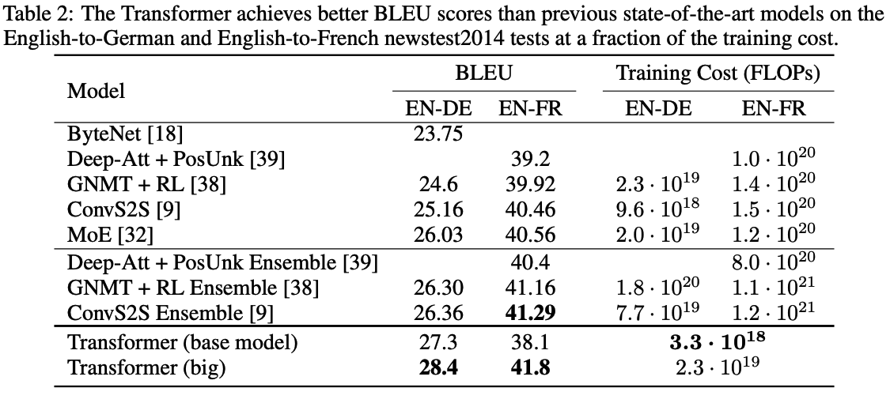
Transformers’ Achievements
1. In original paper, State-of-The-Art (SoTA) of machine translation.
6 encoders,
6 decoders,
h = 512, 100K train steps.
6 encoders,
6 decoders,
h = 1024, 300K train steps.
Vaswani, Ashish, et al. "Attention is all you need." Advances in neural information processing systems 30 (2017).
https://arxiv.org/abs/1706.03762

Slide 51
Transformer Variants (there are many more)
Universal Transformer
Adds Adaptive Computation Time
Dehghani, Mostafa, et al. "Universal transformers." arXiv preprint arXiv:1807.03819 (2018).
Longformer
Tackles long documents
Iz Beltagy, et al. (2020). Longformer: The Long-Document Transformer. arXiv:2004.05150.
Roformer
Changes the design of positional encoding
Su, Jianlin, et al. "RoFormer: Enhanced Transformer with Rotary Position Embedding. CoRR abs/2104.09864 (2021)." arXiv preprint arXiv:2104.09864 (2021).
Vision Transformer
Tackles vision tasks
Alexey Dosovitskiy, et al. “An Image is Worth 16x16 Words: Transformers for Image Recognition at Scale.” International Conference on Learning Representations. 2021.

Slide 52
Tokens vs. words
token 是 (語言) 模型在每個時間點處理的單位
word 是語言本身的單位
token 可以是 word，也可以是 sub-word
一個 word 可以是一個 token，但單純講 token 不一定指的是 word
Traditional word tokenization
Sub-word Tokenization
I
print
Hello
world
I
prin
t
Hell
o
world
Transformer 採用此方式

Slide 53

Transformer 架構常用於現代 AI 模型
For example:
BERT (Bidirectional encoder representations from transformers)
Devlin et al., 2018
GPT series
N=12
Encoder
(BERT)

Slide 54
Additional Links
https://nlp.seas.harvard.edu/annotated-transformer/
https://datascience.stackexchange.com/questions/82451/why-is-10000-used-as-the-denominator-in-positional-encodings-in-the-transformer

Slide 55
Announcements

Slide 56
Project checkpoints
Week 9: 確定各組的題目
Week 12: 進度報告 PPT (5 pages)
Week 14: 進度報告 PPT (5+5 pages), Presentations (selected teams)
Week 16: Final presentations for all teams
Week 16-17: 繳交書面報告以及程式碼

Slide 57
Project 各個階段分數佔比
Final Project 佔學期總成績 40%
查核點 (週次) | 對象: 繳交內容 | 分數佔比
Checkpoint1 (Week 12) | All teams: 進度報告 PPT (5 pages)檔案 | 5%
Checkpoint2 (Week 14) | All teams: 進度報告 PPT (5+5 pages*)檔案 Selected teams: 取6組 (1題目2組) 於課堂中報告，1組10min | 5%
Checkpoint3 (Week 16) | All teams: 最終口頭報告 | 15%
Checkpoint4 (Week 16-17) | All teams: 書面報告檔案 (含程式碼)、小平台 (optional) | 15%
*繼承Checkpoint1內容+實作

Slide 58
Thank you!
Instructor: 林英嘉
✉️ yjlin@cgu.edu.tw
TA: 劉美辰
✉️ m1461014@cgu.edu.tw

