Slide 1

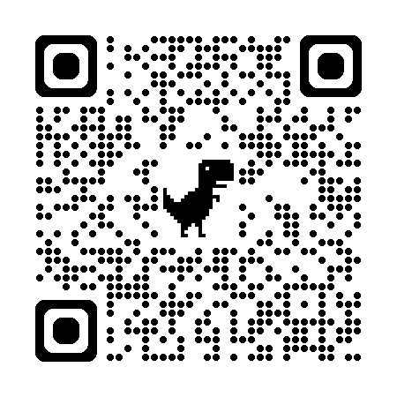

深度學習
Deep Learning
⭐️ DL Training Tips
Instructor: 林英嘉 (Ying-Jia Lin)
2026/10/21
Course GitHub
Slido # DL1021

Slide 2
Outline
Model training tips [70 min]
  EarlyStopping
  Regularization and AdamW
  Batch Normalization
  Dropout
Code demo [10 min]
Term Project [50 min]
Quiz [20 min]

Slide 3


[Recap] 如何訓練模型：資料集
Training Set
(訓練資料集)
Test Set
(測試資料集)
Training Set
(訓練資料集)
Validation Set
(驗證資料集)

Slide 4
訓練模型的目標
你所能收集到的資料
Training Set
(訓練資料集)
Test Set
(測試資料集)
Model
Training Set
(訓練資料集)
Validation Set
(驗證資料集)
目標在測試集上得到很好的效果，代表泛化能力強 (Generalization)

Slide 5
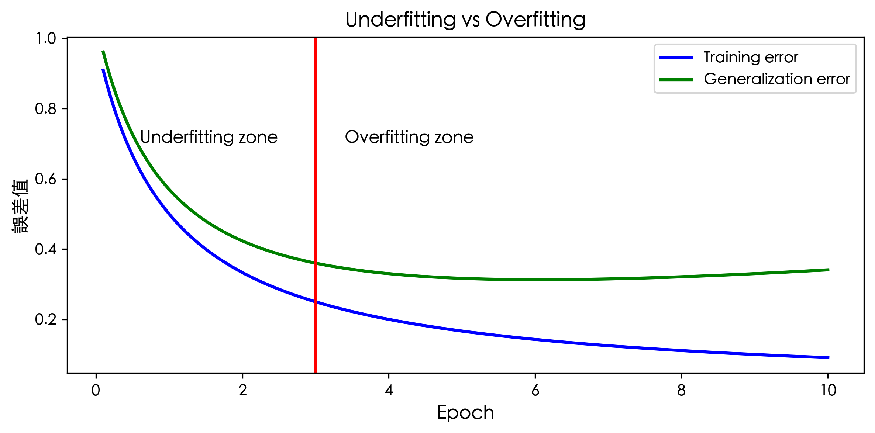
訓練機器學習模型時可能發生的情況
code/w7_plot_overfitting.py

Slide 6
[定義] Overfitting 與 Underfitting
Underfitting (欠擬合): 模型無法在 training set 取得很低的誤差 (error; loss)
Overfitting (過擬合): 模型的 training error 與 test error 差異很大
  test error 通常代表 validation loss
  常見模型可以呈現很小的 training error，但 test error 仍大
Notes:
Underfitting occurs when the model is not able to obtain a sufficiently low error value on the training set.
Overfitting occurs when the gap between the training error and test error is too large.

Slide 7
Underfitting vs. Overfitting
code/w7_plot_overfitting.py

Slide 8
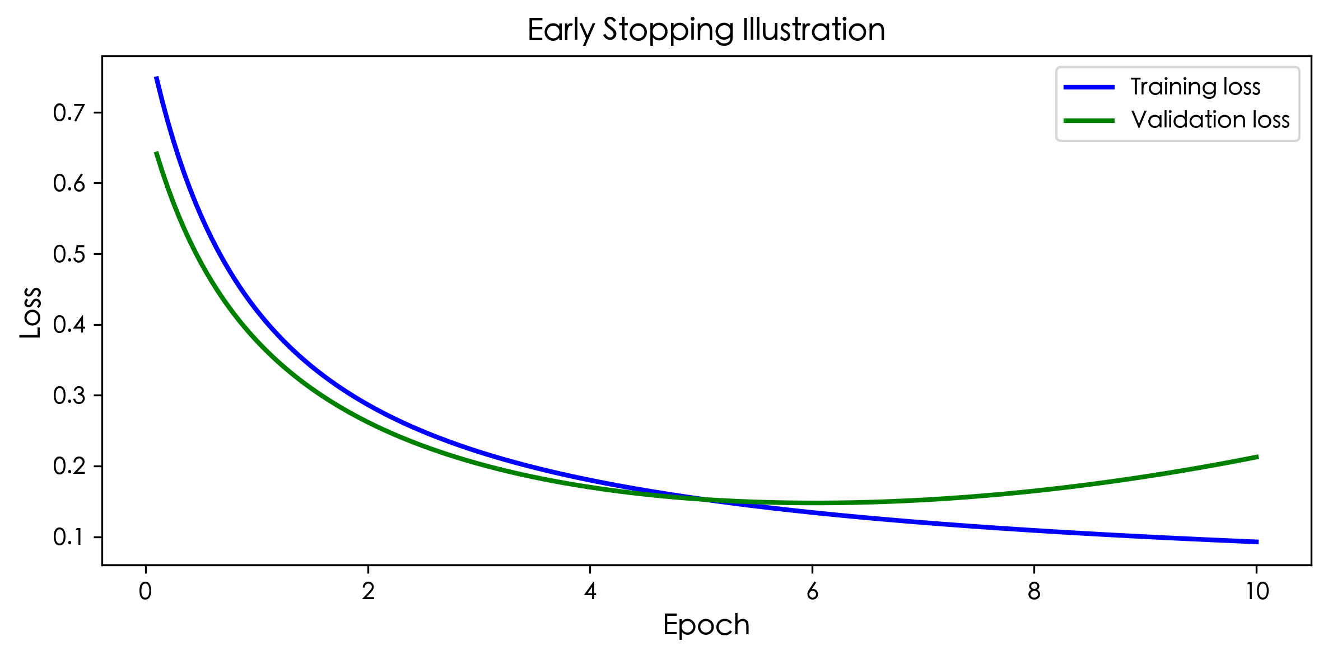
EarlyStopping 的良好時間點
code/w7_plot_es.py

Slide 9
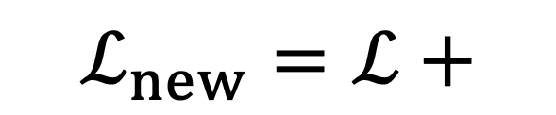
Regularization
定義：regularization (正則化) 是一種技巧來幫助模型減少 training error 與 test error 的差距 (並非降低 training error)
$$ℒ_{new}=ℒ+$$
regularization_term
Notes:
Regularization is any modification we make to a learning algorithm that is intended to reduce its generalization error but not its training error.

Slide 10
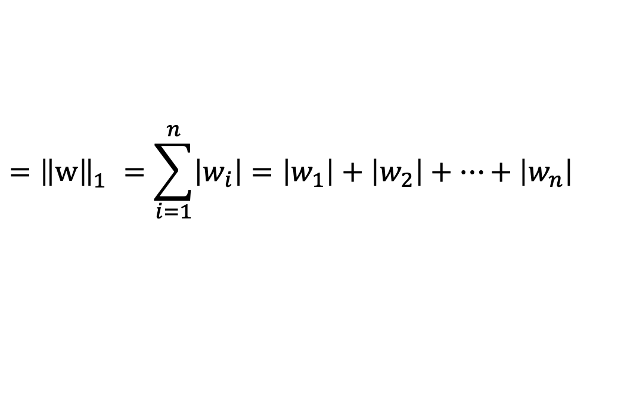
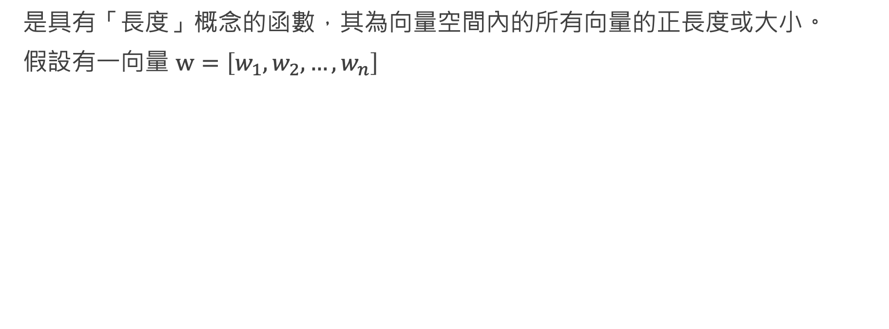
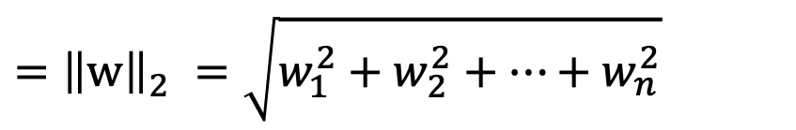
Norm (範數)
是具有「長度」概念的函數，其為向量空間內的所有向量的正長度或大小。
假設有一向量 $w=\left[w_{1},w_{2},…, w_{n}\right]$
$$={\left\|w\right\|}_{1}^{}=\sum_{i=1}^{n}{\left|w_{i}\right|}=\left|w_{1}\right|+\left|w_{2}\right|+…+\left|w_{n}\right|$$
L¹-Norm
$$={\left\|w\right\|}_{2}^{}=\sqrt{w_{1}^{2}+w_{2}^{2}+…+w_{n}^{2}}$$
L²-Norm

Slide 11

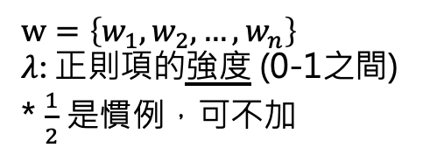
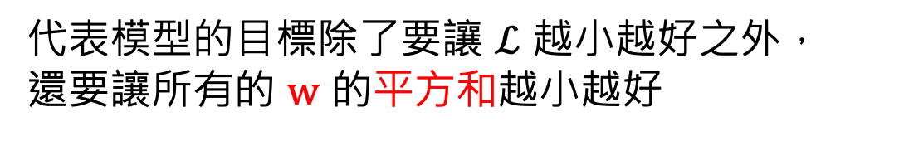

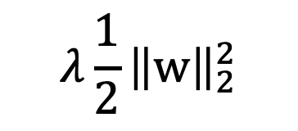
L² Regularization
$$w=\left\{w_{1},w_{2},…, w_{n}\right\}$$
$λ$: 正則項的強度 (0-1之間)
* $\frac{1}{2}$ 是慣例，可不加
$$λ\frac{1}{2}{\left\|w\right\|}_{2}^{2}$$
$$ℒ_{new}=ℒ+$$
$$w_{1}^{2}+w_{2}^{2}+…+w_{n}^{2}$$
代表模型的目標除了要讓 $ℒ$ 越小越好之外，
還要讓所有的 $w$ 的平方和越小越好
L²-Norm 說明：https://mathworld.wolfram.com/L2-Norm.html
Notes:
Regularization is any modification we make to a learning algorithm that is intended to reduce its generalization error but not its training error.

Slide 12
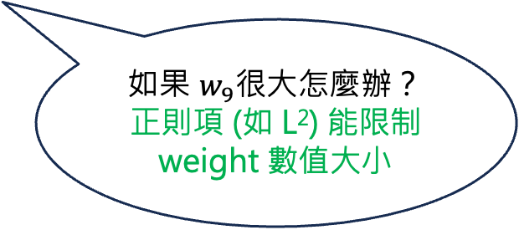
為什麼要增加正則項？
假設我們的模型：$\hat{y}=x_{1}w_{1}+x_{2}w_{2}^{2}+…+x_{9}w_{9}^{9}$
如果 $w_{9}$很大怎麼辦？
正則項 (如 L²) 能限制 weight 數值大小
如果沒有正則項，目標函數相當於是為 training set 量身打造
假設我們想要學出的模型：$y=x_{1}w_{1}+x_{2}w_{2}^{2}$
非常通用的模型，
可以在 unseen 資料上表現好

Slide 13
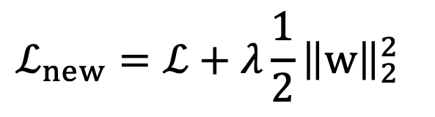
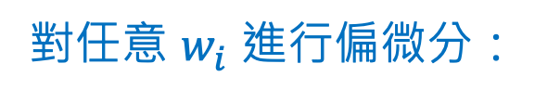
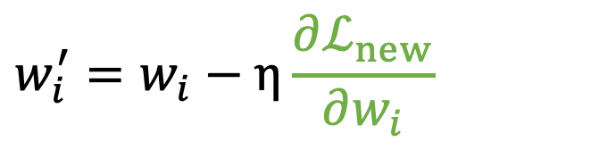
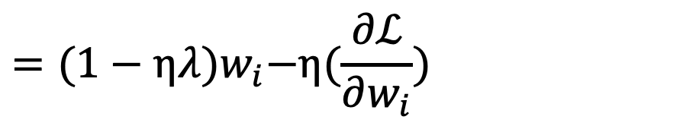
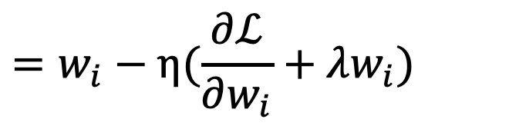
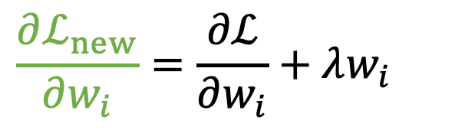
Gradient Descent with L² Regularization
$$ℒ_{new}=ℒ+λ\frac{1}{2}{\left\|w\right\|}_{2}^{2}$$
梯度下降：
$$w_{i}^{′}=w_{i}−η\frac{∂ℒ_{new}}{∂w_{i}}$$
對任意 $w_{i}$ 進行偏微分：
$$\frac{∂ℒ_{new}}{∂w_{i}}=\frac{∂ℒ}{∂w_{i}}+λw_{i}$$
$$=w_{i}−η(\frac{∂ℒ}{∂w_{i}}+λw_{i})$$
(代入)
$$={(1−ηλ)w}_{i}−η(\frac{∂ℒ}{∂w_{i}})$$
(移項)
每次更新都會倍數遞減 (weight decay)

Slide 14
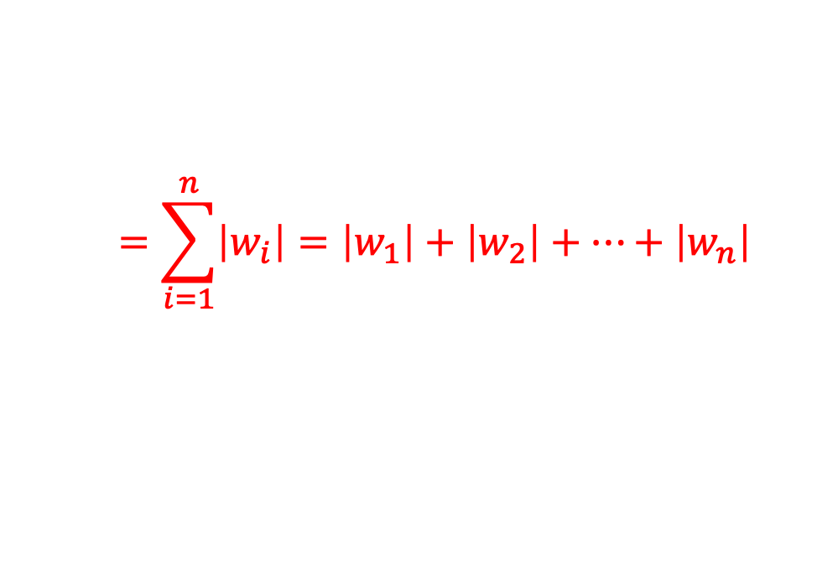

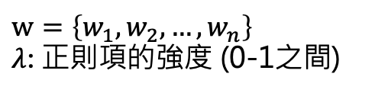
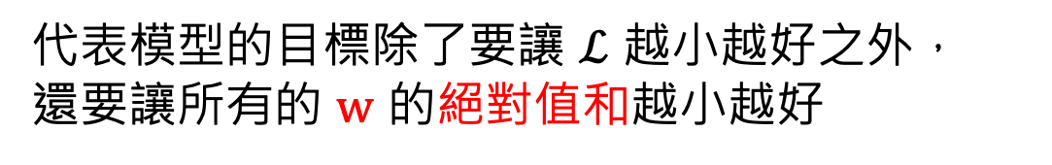
L¹ Regularization
$$w=\left\{w_{1},w_{2},…, w_{n}\right\}$$
$λ$: 正則項的強度 (0-1之間)
$$ℒ_{new}=ℒ+$$
$$λ{\left\|w\right\|}_{1}$$
$$=\sum_{i=1}^{n}{\left|w_{i}\right|}=\left|w_{1}\right|+\left|w_{2}\right|+…+\left|w_{n}\right|$$
L¹-Norm
代表模型的目標除了要讓 $ℒ$ 越小越好之外，
還要讓所有的 $w$ 的絕對值和越小越好
L¹-Norm 說明：https://mathworld.wolfram.com/L1-Norm.html
Notes:
Regularization is any modification we make to a learning algorithm that is intended to reduce its generalization error but not its training error.

Slide 15

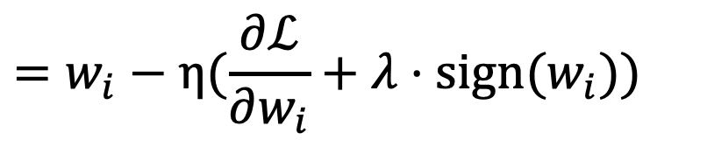
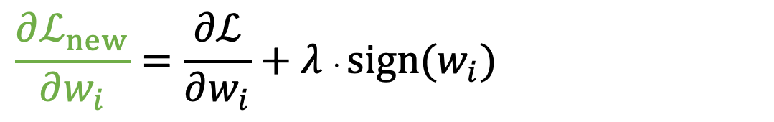
Gradient Descent with L1 Regularization
$$ℒ_{new}=ℒ+λ{\left\|w\right\|}_{1}$$
梯度下降：
$$w_{i}^{′}=w_{i}−η\frac{∂ℒ_{new}}{∂w_{i}}$$
對任意 $w_{i}$ 進行偏微分：
$$\frac{∂ℒ_{new}}{∂w_{i}}=\frac{∂ℒ}{∂w_{i}}+λ⋅sign(w_{i})$$
$$=w_{i}−η(\frac{∂ℒ}{∂w_{i}}+λ⋅sign(w_{i}))$$
(代入)
每次更新都會扣減 (weight decay)

Slide 16
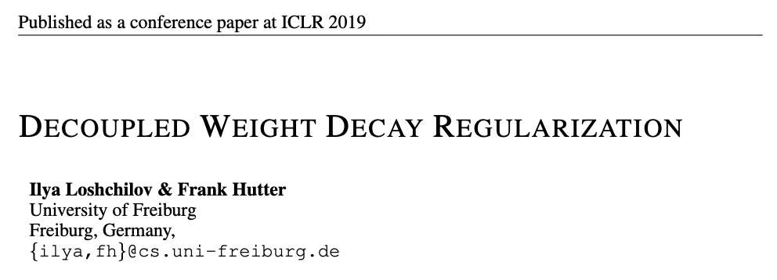
AdamW will be in Week 7
The paper of AdamW:
Week7: 過擬合、正規化、模型訓練技巧、期末專案介紹

Slide 17
[Recap] Adam
Adam: adaptive moment estimation
結合了 Momentum、Adagrad 和 RMSProp 的概念
Kingma, Diederik P., and Jimmy Ba. "Adam: A method for stochastic optimization." ICLR 2015. https://arxiv.org/abs/1412.6980

Slide 18
[Recap] 如何有效訓練深度學習模型？
Optimizer:
對梯度動手腳
  Momentum
自動調整學習率
  Adagrad
  RMSprop
  Adam

Slide 19
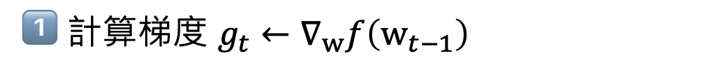
[Recap] Adam 流程
Adam: Momentum、Adagrad 和 RMSProp 的概念
1️⃣ 計算梯度 $g_{t}←∇_{w}f\left(w_{t−1}\right)$
2️⃣ 以移動平均紀錄梯度 $g_{t}$ (為了對梯度動手腳 -- Momentum)
3️⃣ 以移動平均紀錄梯度平方 $g_{t}^{2}$ (為了調整學習率 -- Adagrad)
4️⃣ 更新參數 $w_{t}←w_{t−1}−η{\hat{m}}_{t}\frac{1}{\sqrt{{\hat{v}}_{t}}+ε}$
Kingma, Diederik P., and Jimmy Ba. "Adam: A method for stochastic optimization." ICLR 2015. https://arxiv.org/abs/1412.6980

Slide 20
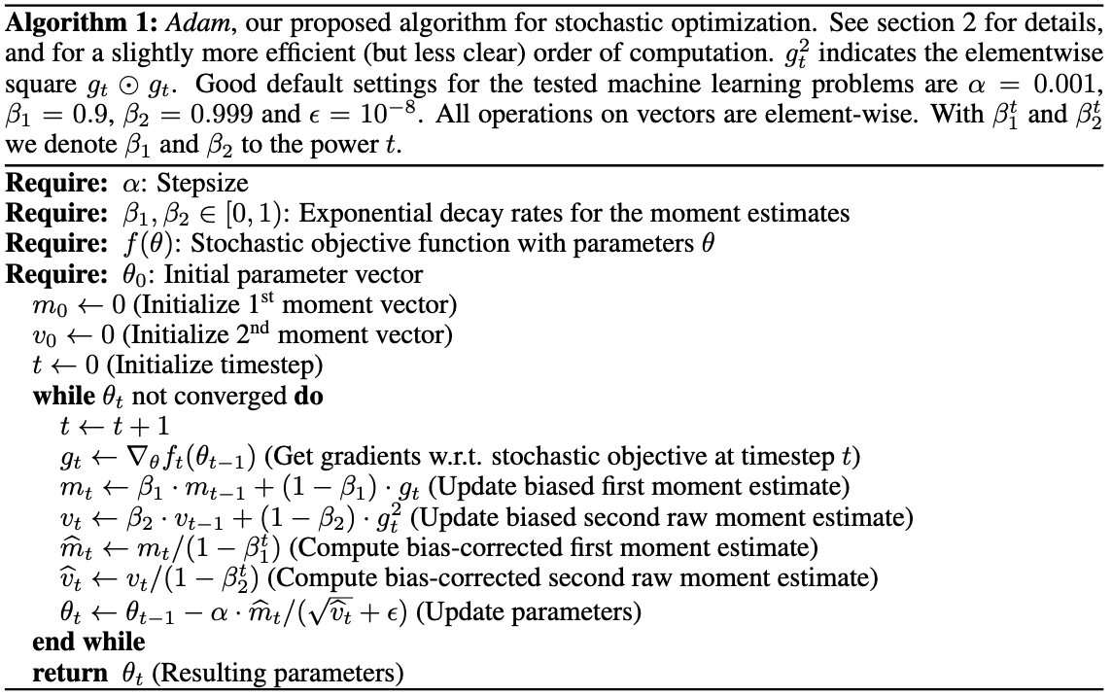
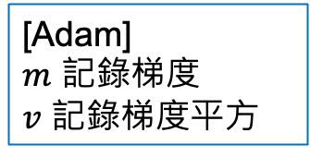
Adam
Kingma, Diederik P., and Jimmy Ba. "Adam: A method for stochastic optimization." ICLR 2015. https://arxiv.org/abs/1412.6980
Learning rate
Momentum
[Adam]
$m$ 記錄梯度
$v$ 記錄梯度平方
Adagrad, RMSProp
移動平均取自 RMSProp
Adagrad

Slide 21
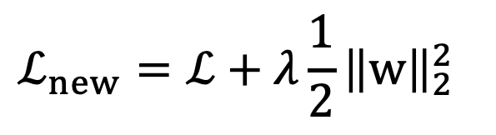


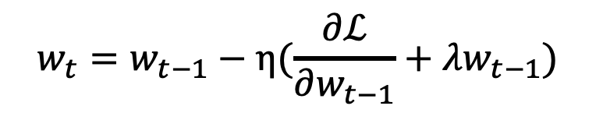
[實作細節] 把 L² Regularization 加到 SGD
$$ℒ_{new}=ℒ+λ\frac{1}{2}{\left\|w\right\|}_{2}^{2}$$
Loshchilov, Ilya, and Frank Hutter. “Decoupled Weight Decay Regularization.” International Conference on Learning Representations (2019).
總目標：
$$+ λw_{t−1}$$
請見 AdamW 論文 Proposition 1 proof
或本簡報 p13
1️⃣ 計算梯度 $g_{t}←∇_{w}f\left(w_{t−1}\right)$
2️⃣ 更新參數 $w_{t}←w_{t−1}−ηg_{t}$
等價於
$$w_{t}=w_{t−1}−η(\frac{∂ℒ}{∂w_{t−1}}+λw_{t−1})$$
GD：

Slide 22

[實作細節] 把 L2 Regularization 加到 Adam
在SGD正確，但在Adam是錯的，因為改變1️⃣的梯度會影響到梯度紀錄
$$+ λw_{t−1}$$
1️⃣ 計算梯度 $g_{t}←∇_{w}f\left(w_{t−1}\right)$
2️⃣ 以移動平均紀錄梯度 $g_{t}$ (為了對梯度動手腳 -- Momentum)
3️⃣ 以移動平均紀錄梯度平方 $g_{t}^{2}$ (為了調整學習率 -- Adagrad)
4️⃣ 更新參數 $w_{t}←w_{t−1}−η{\hat{m}}_{t}\frac{1}{\sqrt{{\hat{v}}_{t}}+ε}$
Loshchilov, Ilya, and Frank Hutter. “Decoupled Weight Decay Regularization.” International Conference on Learning Representations (2019).

Slide 23


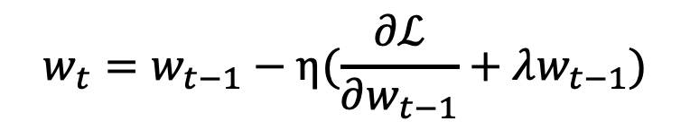
AdamW
分離的
AdamW: Adam with decoupled weight decay
1️⃣ 計算梯度 $g_{t}←∇_{w}f\left(w_{t−1}\right)$
$$+ λw_{t−1}$$
2️⃣ 以移動平均紀錄梯度 $g_{t}$ (為了對梯度動手腳 -- Momentum)
3️⃣ 以移動平均紀錄梯度平方 $g_{t}^{2}$ (為了調整學習率 -- Adagrad)
4️⃣ 更新參數 $w_{t}←w_{t−1}−η({\hat{m}}_{t}\frac{1}{\sqrt{{\hat{v}}_{t}}+ε}+λw_{t−1})$
$$w_{t}=w_{t−1}−η(\frac{∂ℒ}{∂w_{t−1}}+λw_{t−1})$$
Loshchilov, Ilya, and Frank Hutter. “Decoupled Weight Decay Regularization.” International Conference on Learning Representations (2019).

Slide 24
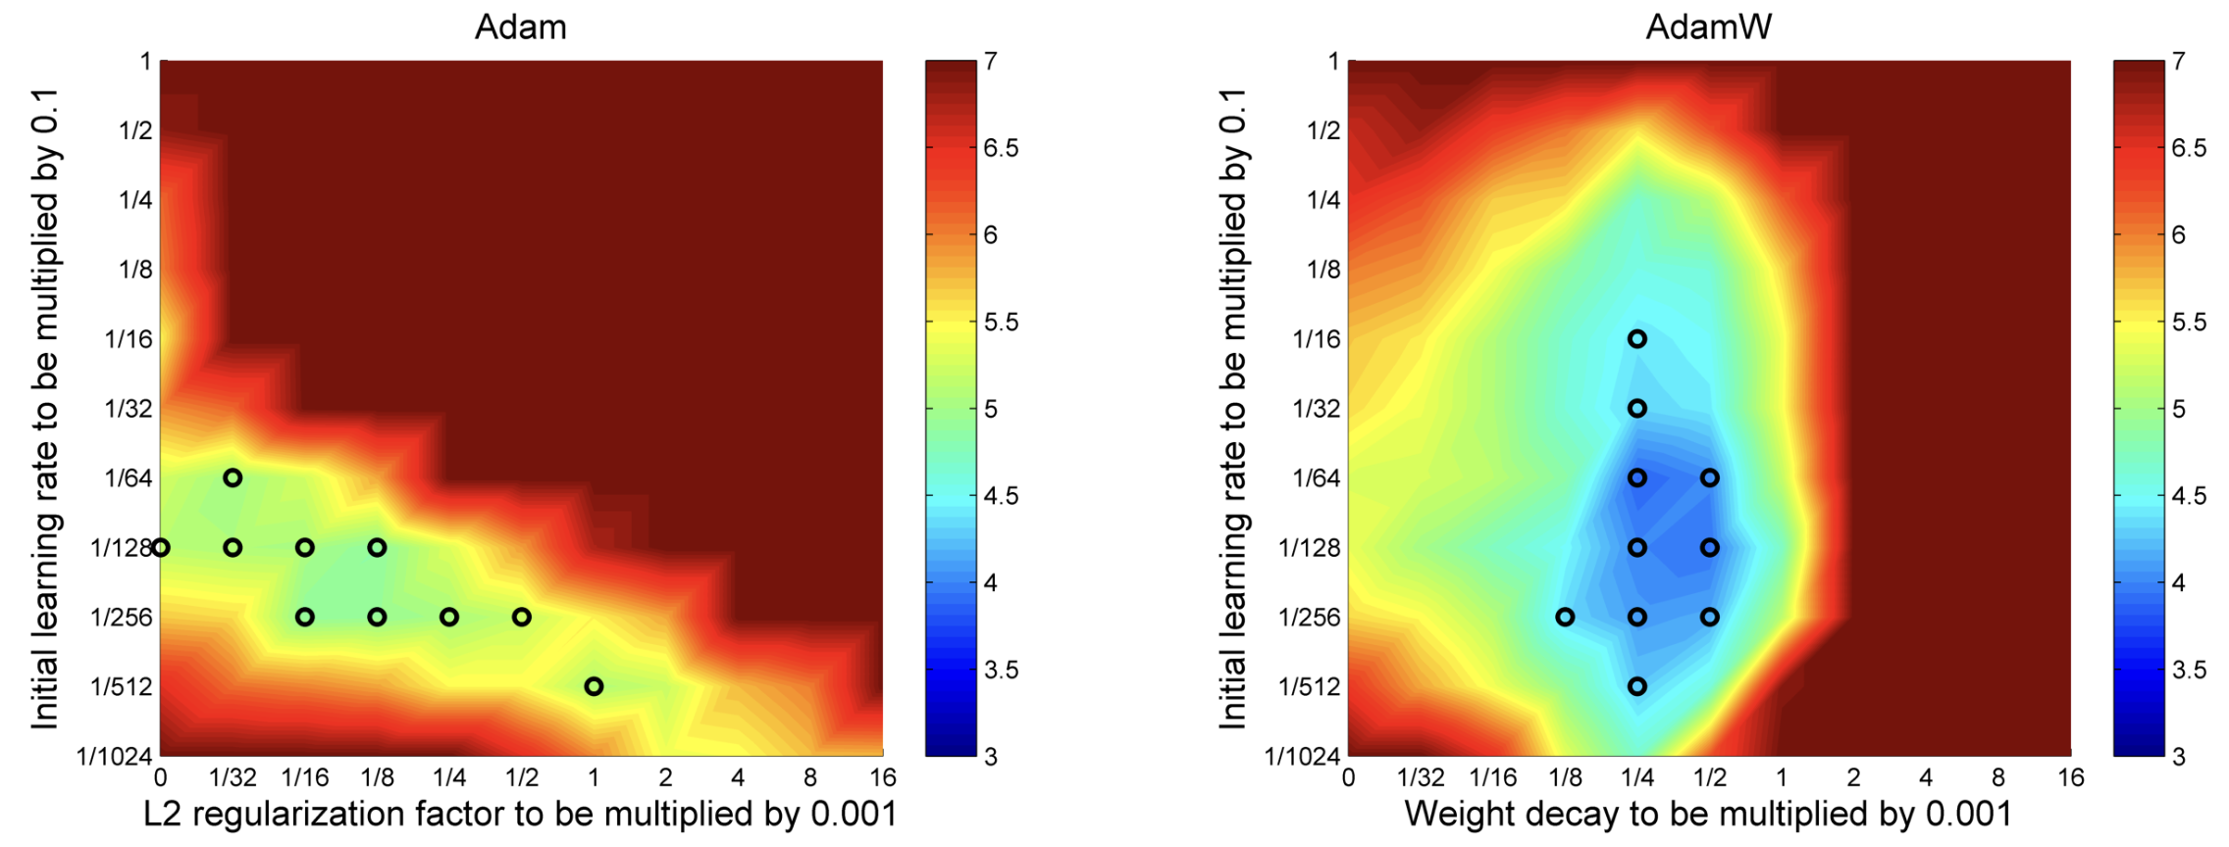
Performance: Adam vs. AdamW
Loshchilov, Ilya, and Frank Hutter. “Decoupled Weight Decay Regularization.” International Conference on Learning Representations (2019).

Slide 25
延伸學習
李宏毅老師影片
https://youtu.be/xki61j7z-30?si=ofWigNuHKkTdPC4f&t=3463

Slide 26
Batch Normalization

Slide 27

The whole CNN
Convolution
Pooling
Flatten
BatchNorm
BatchNorm
Fully-connected Networks
Pooling
Convolution
…
Convolution
Classification
BatchNorm
Pooling

Slide 28
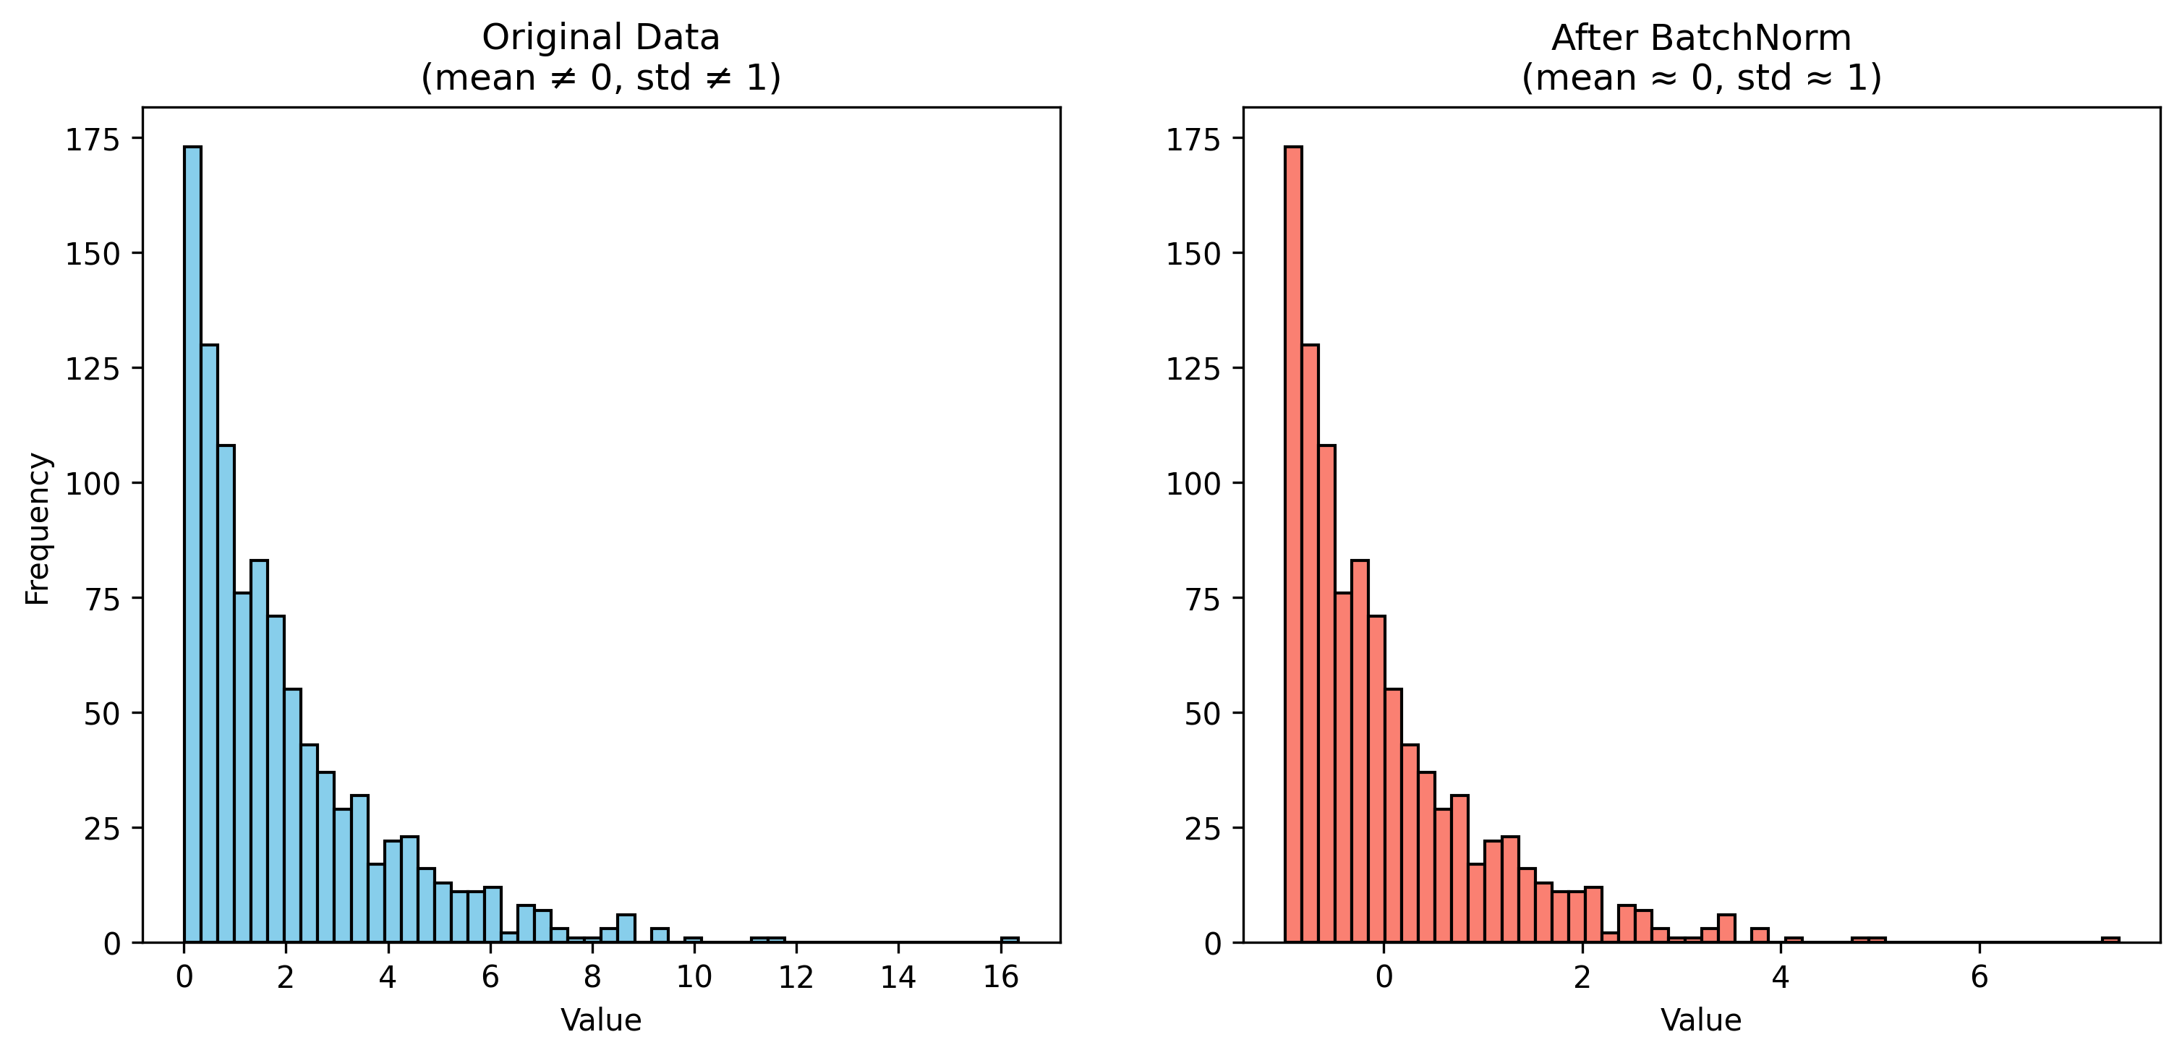
Batch Normalization (BatchNorm)
BatchNorm 對數值進行轉換，使得轉換後的數值的平均值為零、標準差為1
類似於統計上的 Z-score standardization

Slide 29






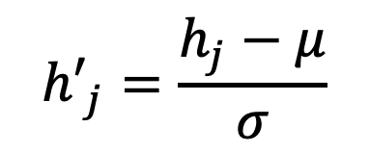

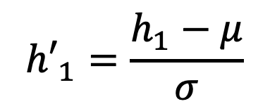
MLP 中的 BatchNorm
計算：$μ$ (平均數) & $σ$ (標準差)
$${h′}_{1}=\frac{h_{1}−μ}{σ}$$
$$x_{1}$$
$$h_{1}$$
$${h′}_{1}$$
...
...
...
$${h′}_{j}=\frac{h_{j}−μ}{σ}$$
$$x_{n}$$
$$h_{j}$$
$${h′}_{j}$$
Ioffe, Sergey, and Christian Szegedy. "Batch normalization: Accelerating deep network training by reducing internal covariate shift." International conference on machine learning. 2015.

Slide 30
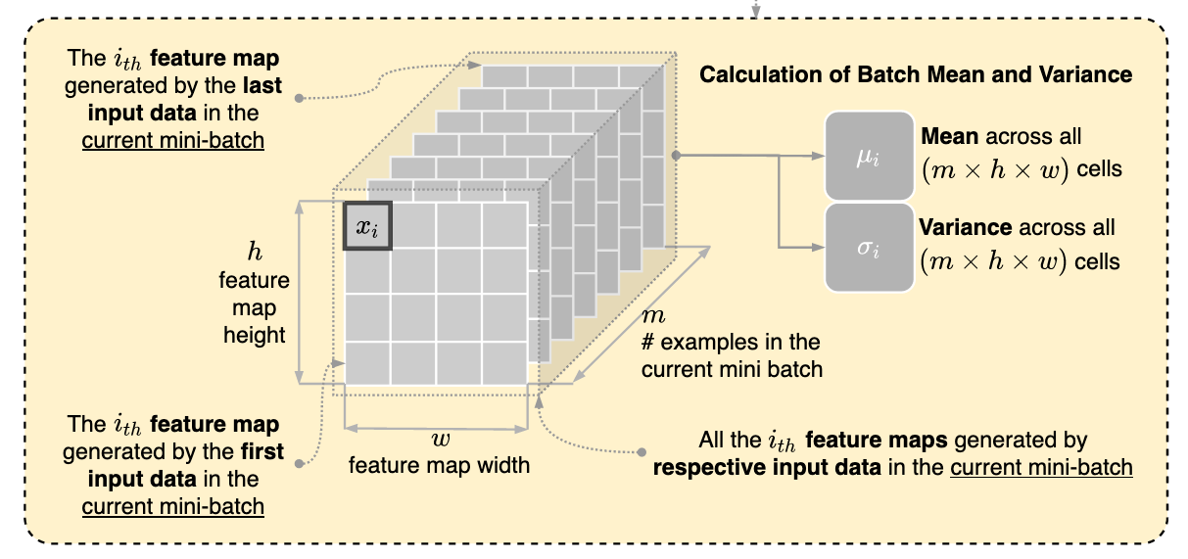
BatchNorm During Training
Figure source: https://stackoverow.com/questions/65613694/calculation-of-mean-and-variance-in-flbatch-normalization-in-convolutional-neural

Slide 31
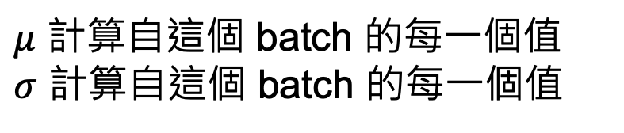
CNN 中的 BatchNorm
1 | 3 | 1 | 2
-1 | 1 | 1 | 0
0 | 1 | 1 | 0
0 | 0 | 1 | 2
1 | 3 | 1 | 2
-1 | 1 | 1 | 0
0 | 1 | 1 | 0
0 | 0 | 1 | 2
1 | 3 | 1 | 2
-1 | 1 | 1 | 0
0 | 1 | 1 | 0
0 | 0 | 1 | 2
1 | 3 | 1 | 2
-1 | 1 | 1 | 0
0 | 1 | 1 | 0
0 | 0 | 1 | 2
x0 | x1 | x2 | x3
x4 | x5 | x6 | x7
x8 | x9 | x10 | x11
x12 | x13 | x14 | x15
$μ$ 計算自這個 batch 的每一個值
$σ$ 計算自這個 batch 的每一個值
batch_size
(5, 4, 4)
(batch_size, height, width)
參考：https://stackoverow.com/questions/65613694/calculation-of-mean-and-variance-in-flbatch-normalization-in-convolutional-neural

Slide 32


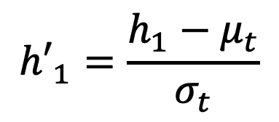











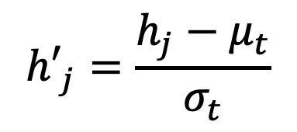



BatchNorm During Test (Inference)
Training
計算：$μ$ (平均數) & $σ$ (標準差)
https://pytorch.org/docs/stable/generated/torch.nn.BatchNorm2d.html
$$x_{1}$$
$$h_{1}$$
$${h′}_{1}$$
Moving average
$$μ_{t}=αμ_{t}+\left(1−α\right)μ_{t−1}$$
...
...
...
$$x_{n}$$
$$h_{j}$$
$${h′}_{j}$$
$$σ_{t}=ασ_{t}+\left(1−α\right)σ_{t−1}$$
Inference
momentum ($α$) 常見設定為0.1
$${h′}_{1}=\frac{h_{1}−μ_{t}}{σ_{t}}$$
$$x_{1}$$
$$h_{1}$$
$${h′}_{1}$$
假設只有1張影像
...
...
...
$${h′}_{j}=\frac{h_{j}−μ_{t}}{σ_{t}}$$
$$x_{n}$$
$$h_{j}$$
$${h′}_{j}$$

Slide 33
[觀察] BatchNorm
BatchNorm 可以：
  減少不同特徵尺度帶來的偏差，避免梯度爆炸或消失
  提高模型訓練時的穩定性，加速收斂

Slide 34
Dropout

Slide 35
Dropout
每輪訓練時，神經網路每一層的輸入值部份以 p 的機率隨機替換成 0
  p 是超參數
可防止模型過擬合 (over-fitting)，增強模型的泛化能力 (generalization)
x
x
(Output)
Srivastava, Nitish, et al. "Dropout: a simple way to prevent neural networks from overfitting." The journal of machine learning research 15.1 (2014): 1929-1958.

Slide 36
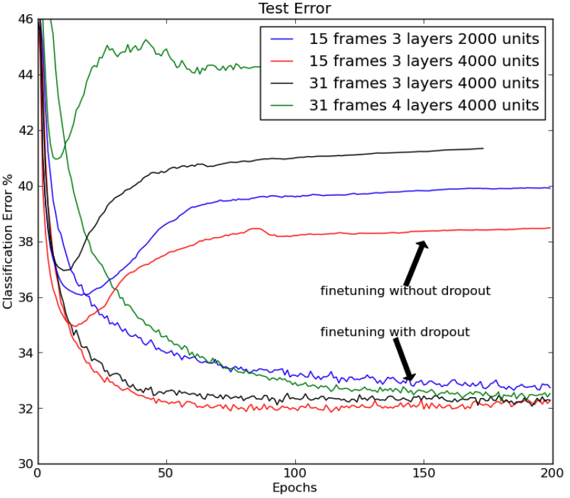
Dropout may improve generalization
Srivastava, Nitish, et al. "Dropout: a simple way to prevent neural networks from overfitting." The journal of machine learning research 15.1 (2014): 1929-1958.

Slide 37
model.eval()
使用 training 時取得的平均值跟標準差來算 batch normalization
關閉 dropout (保留所有的神經元)
  測試時已經不需要再更新模型
  去除隨機性

Slide 38
深度學習
Deep Learning
Project Introduction
Instructor: 林英嘉 (Ying-Jia Lin)
2026/10/21
Course GitHub
Slido # DL1021

Slide 39
Outline of tasks
Platform | Competition Name | 資料類型 | 難度 | 任務類型 | 特別之處
Kaggle | ISIC 2024 - Skin Cancer Detection with 3D-TBP | Image | ⭐️ | Binary Classification* | Class imbalance
 | RSNA Pneumonia | Image | ⭐️⭐️ | Object Detection | 非單純分類
 | Name That LLM | Text | ⭐️ | Text Classification* | 資料分佈
Codabench | SemEval 2027 Task 2 | Text | ⭐️⭐️ | Text Classification | 範例較少
* Code Competition
Notes:
Co

Slide 40
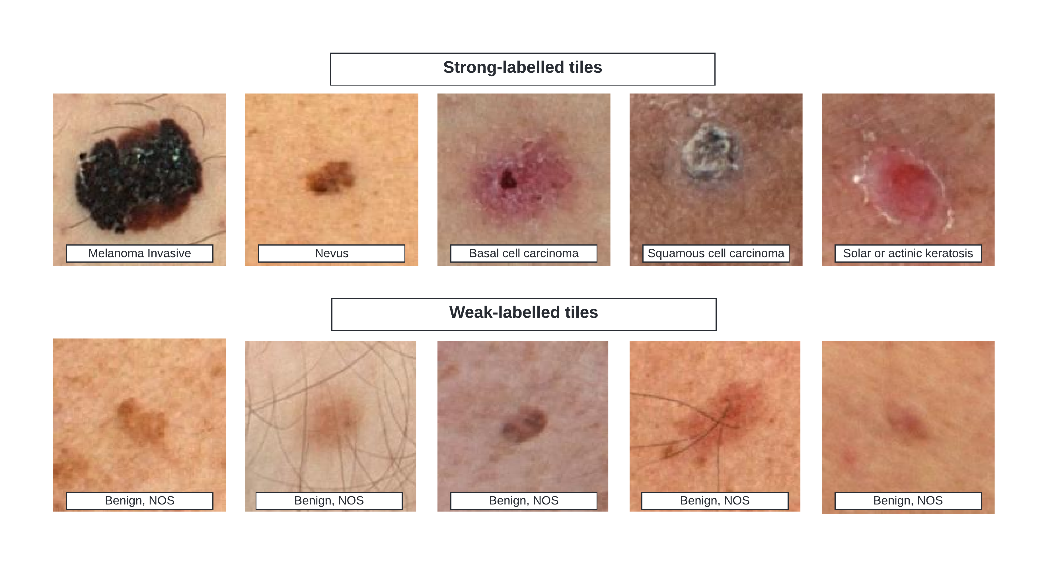
ISIC 2024 - Skin Cancer Detection with 3D-TBP

Slide 41
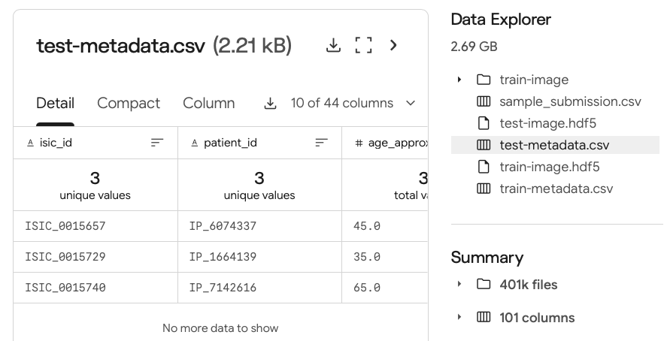
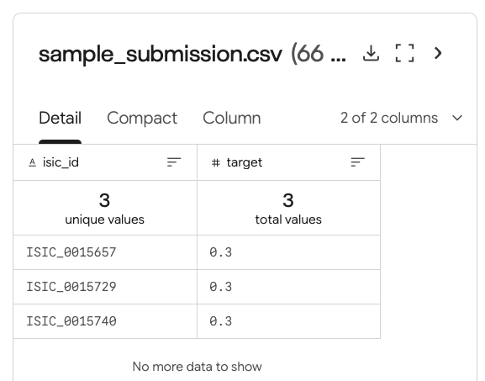
test-metadata & submission.csv

Slide 42
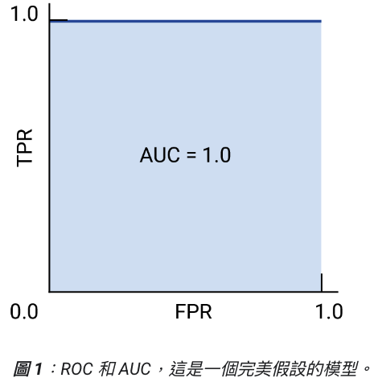
ROC Curve
(Useful!!) https://developers.google.com/machine-learning/crash-course/classification/roc-and-auc?hl=zh-tw
ROC curve: Receiver operating characteristic curve (接收者操作特徵曲線)
ROC curve 定義: 針對不同的模型分類門檻下的模型表現圖
  X軸：False positive rate (FPR); Y軸：True positive rate (TPR)
  AUC: ROC 的底面下面積 (越大越好)
?

Slide 43
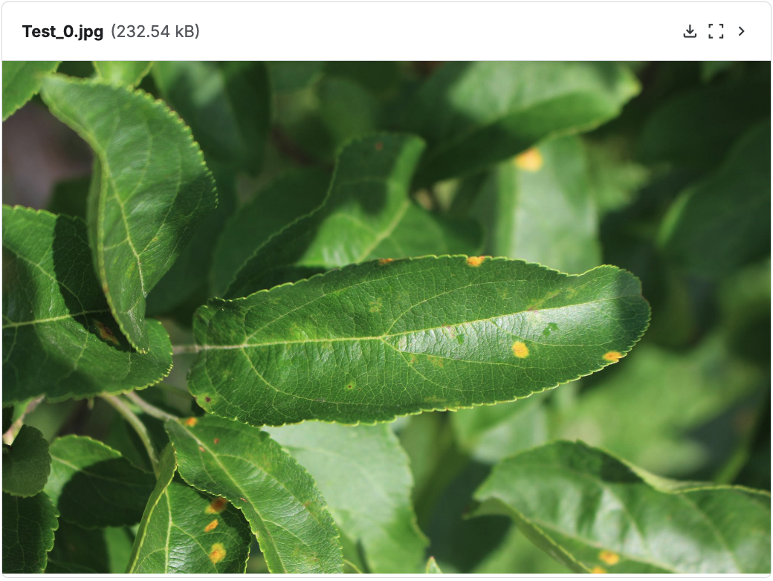
模型分類門檻 (Threshold)
Rust
模型輸出
答案
Model
機率 = 0.55
1
我們應該設多少門檻？
threshold = 0.5 -> 模型預測為1，正確數量+1
threshold = 0.6 -> 模型預測為0，正確數量-1

Slide 44
TPR and FPR 範例
假設我們用模型對10個人做COVID-19檢測：
(COVID-19 代表 positive)
healthy
COVID-19
💪
💪
💪
🦠
🦠
💪
💪
🦠
🦠
🦠
模型預測為疾病的機率值 (%)
0
20
40
60
80
100

Slide 45
TPR and FPR 範例 (TPR)
假設我們用模型對10個人做COVID-19檢測：
(healthy 代表 negative; COVID-19 代表 positive)
True positive rate (TPR) = 4 / 5 = 0.8
healthy
COVID-19
❌
💪
💪
💪
🦠
🦠
💪
💪
🦠
🦠
🦠
模型預測為疾病的機率值 (%)
0
20
40
60
80
100

Slide 46
TPR and FPR 範例 (FPR)
假設我們用模型對10個人做COVID-19檢測：
(healthy 代表 negative; COVID-19 代表 positive)
False positive rate (FPR) = 2 / 5 = 0.4
healthy
COVID-19
💪
💪
🦠
💪
❌
🦠
❌
💪
💪
🦠
🦠
🦠
模型預測為疾病的機率值 (%)
0
20
40
60
80
100

Slide 47
ROC Curve
假設我們用模型對10個人做COVID-19檢測：
(healthy 代表 negative; COVID-19 代表 positive)
1.0
0.8
TPR: 1.0, FPR: 1.0
0.6
TPR
healthy
COVID-19
0.4
0.2
0
💪
0
0.2
0.4
0.6
0.8
1.0
💪
🦠
💪
❌
🦠
❌
❌
FPR
💪
💪
🦠
🦠
🦠
❌
❌
模型預測為疾病的機率值 (%)
0
20
40
60
80
100

Slide 48
ROC Curve
假設我們用模型對10個人做COVID-19檢測：
(healthy 代表 negative; COVID-19 代表 positive)
1.0
0.8
TPR: 1.0, FPR: 0.8
0.6
TPR
healthy
COVID-19
0.4
0.2
0
💪
0
0.2
0.4
0.6
0.8
1.0
💪
🦠
💪
❌
🦠
❌
FPR
💪
💪
🦠
🦠
🦠
❌
❌
模型預測為疾病的機率值 (%)
0
20
40
60
80
100

Slide 49
ROC Curve
假設我們用模型對10個人做COVID-19檢測：
(healthy 代表 negative; COVID-19 代表 positive)
1.0
0.8
TPR: 1.0, FPR: 0.6
0.6
TPR
healthy
COVID-19
0.4
0.2
0
💪
0
0.2
0.4
0.6
0.8
1.0
💪
🦠
💪
❌
🦠
❌
FPR
💪
💪
🦠
🦠
🦠
❌
模型預測為疾病的機率值 (%)
0
20
40
60
80
100

Slide 50
ROC Curve
假設我們用模型對10個人做COVID-19檢測：
(healthy 代表 negative; COVID-19 代表 positive)
1.0
0.8
TPR: 0.8, FPR: 0.6
0.6
TPR
healthy
COVID-19
0.4
0.2
0
💪
0
0.2
0.4
0.6
0.8
1.0
❌
💪
❌
💪
🦠
❌
🦠
FPR
💪
💪
🦠
🦠
🦠
❌
模型預測為疾病的機率值 (%)
0
20
40
60
80
100

Slide 51
ROC Curve
假設我們用模型對10個人做COVID-19檢測：
(healthy 代表 negative; COVID-19 代表 positive)
1.0
0.8
TPR: 0.8, FPR: 0.4
0.6
TPR
healthy
COVID-19
0.4
0.2
0
💪
0
0.2
0.4
0.6
0.8
1.0
❌
💪
❌
💪
🦠
❌
🦠
FPR
💪
💪
🦠
🦠
🦠
模型預測為疾病的機率值 (%)
0
20
40
60
80
100

Slide 52
ROC Curve
假設我們用模型對10個人做COVID-19檢測：
(healthy 代表 negative; COVID-19 代表 positive)
1.0
0.8
TPR: 0.8, FPR: 0.2
0.6
TPR
healthy
COVID-19
0.4
0.2
0
💪
0
0.2
0.4
0.6
0.8
1.0
❌
💪
❌
💪
🦠
🦠
FPR
💪
💪
🦠
🦠
🦠
模型預測為疾病的機率值 (%)
0
20
40
60
80
100

Slide 53
ROC Curve
假設我們用模型對10個人做COVID-19檢測：
(healthy 代表 negative; COVID-19 代表 positive)
1.0
0.8
TPR: 0.6, FPR: 0.2
0.6
TPR
healthy
COVID-19
0.4
0.2
0
💪
0
0.2
0.4
0.6
0.8
1.0
❌
💪
❌
💪
🦠
🦠
FPR
❌
🦠
🦠
💪
💪
🦠
模型預測為疾病的機率值 (%)
0
20
40
60
80
100

Slide 54
ROC Curve
假設我們用模型對10個人做COVID-19檢測：
(healthy 代表 negative; COVID-19 代表 positive)
1.0
0.8
TPR: 0.4, FPR: 0.0
0.6
TPR
healthy
COVID-19
0.4
0.2
0
❌
💪
💪
0
0.2
0.4
0.6
0.8
1.0
💪
🦠
🦠
FPR
🦠
🦠
❌
❌
💪
💪
🦠
模型預測為疾病的機率值 (%)
0
20
40
60
80
100

Slide 55
ROC Curve
假設我們用模型對10個人做COVID-19檢測：
(healthy 代表 negative; COVID-19 代表 positive)
1.0
0.8
TPR: 0.0, FPR: 0.0
0.6
TPR
healthy
COVID-19
0.4
0.2
0
❌
💪
💪
❌
0
0.2
0.4
0.6
0.8
1.0
💪
🦠
🦠
❌
FPR
🦠
🦠
❌
❌
💪
💪
🦠
模型預測為疾病的機率值 (%)
0
20
40
60
80
100

Slide 56
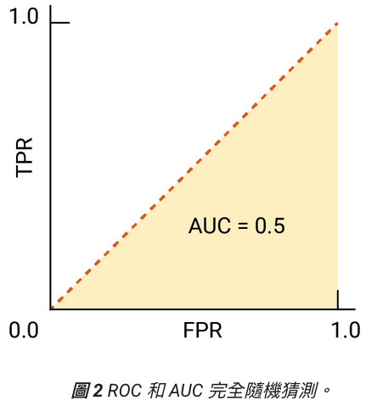
ROC Curve (bad case)
(Useful!!) https://developers.google.com/machine-learning/crash-course/classification/roc-and-auc?hl=zh-tw
Bad case: 模型對於 positive 和 negative 區分能力差
healthy
COVID-19
💪
🦠
🦠
💪
💪
🦠
💪
🦠
🦠
💪
0
20
40
60
80
100

Slide 57
完美模型的條件
分類結果完全正確
  沒有誤判
    No False Negatives: TPR 越高越好
    No False Positives: FPR 越低越好
完美模型中存在一個「理想 threshold 區間」，使我們能同時得到 TPR = 1 且 FPR = 0

Slide 58
Confusion Matrix (混淆矩陣) for ROC
 | Actually positive | Actually negative
Predicted positive | True positive (TP) | False positive (FP)
Predicted negative | False negative (FN) | True negative (TN)
TP / (TP + FN): True Positive Rate (TPR)
  又稱作 Recall
FP / (FP+TN): False Positive Rate (FPR)

Slide 59
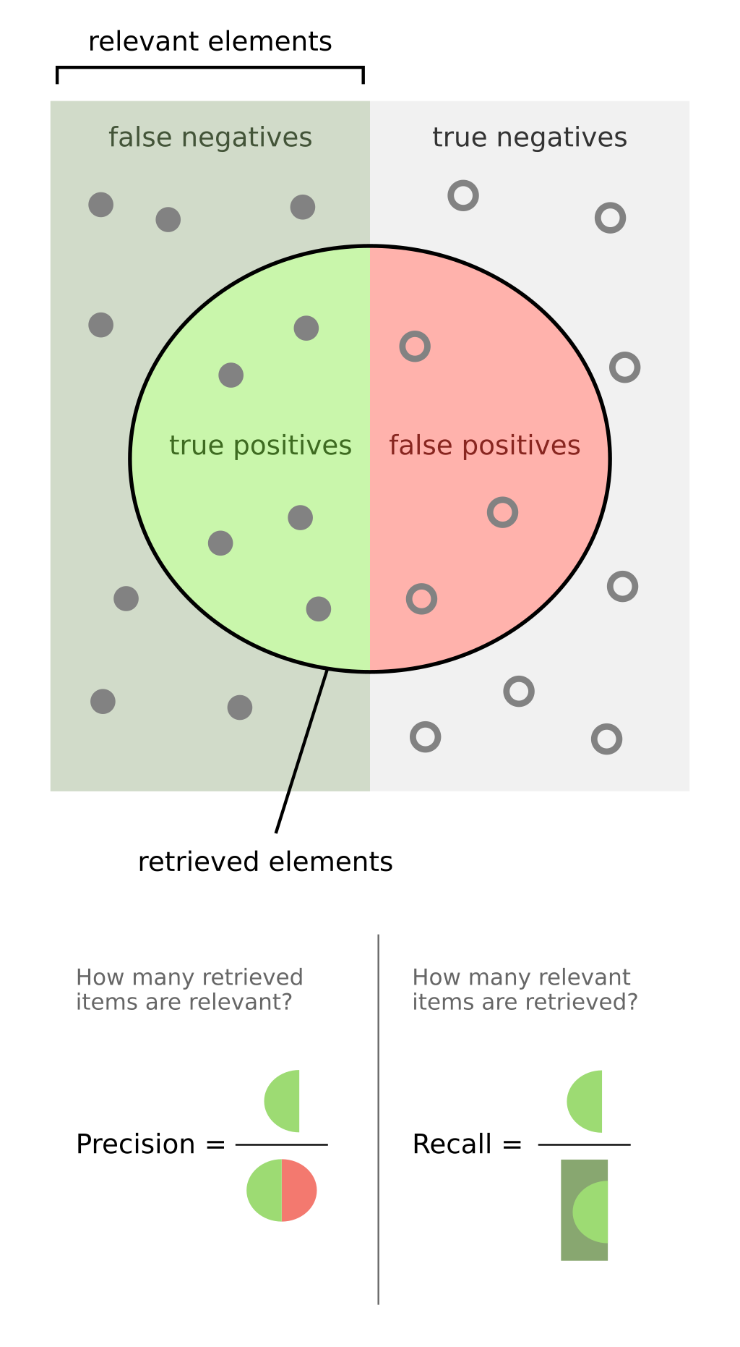
Recall and Precision
(正確答案)
(模型預測)
https://en.wikipedia.org/wiki/Precision_and_recall

Slide 60
Confusion Matrix for General Uses
 | Actually positive | Actually negative
Predicted positive | True positive (TP) | False positive (FP)
Predicted negative | False negative (FN) | True negative (TN)
斜對角數值越大越好
  TP 和 TN 越大越好
Precision = TP / (TP + FP)
  模型預測的TP比例
Recall = TP / (TP + FN)
F1-score (廣義) = 2(Precision*Recall) / (Precision+Recall)

Slide 61
roc_curve using scikit-learn
https://scikit-learn.org/stable/modules/generated/sklearn.metrics.roc_curve.html
import numpy as np from sklearn import metrics y = np.array([1, 1, 2, 2]) scores = np.array([0.1, 0.4, 0.35, 0.8]) fpr, tpr, thresholds = metrics.roc_curve(y, scores, pos_label=2)

Slide 62
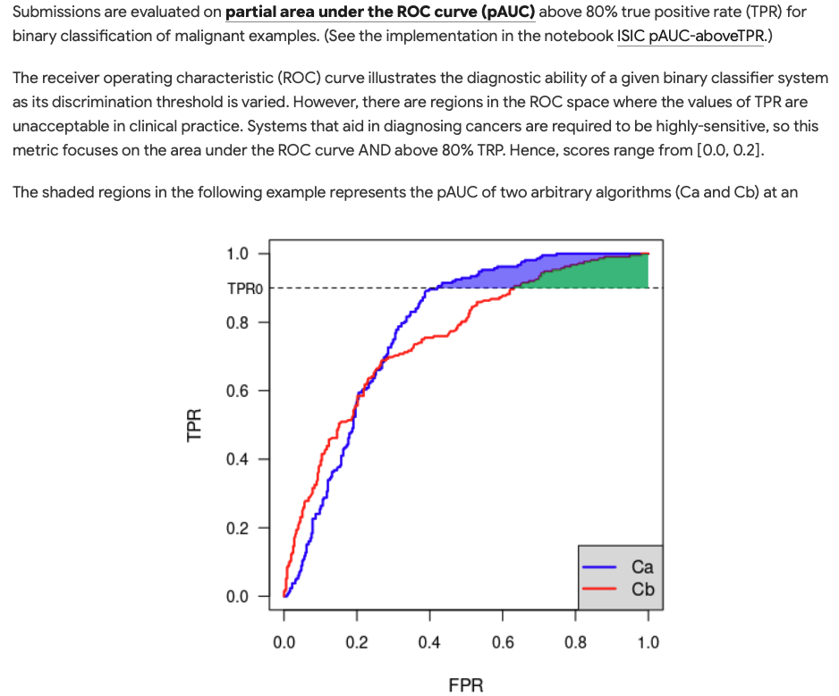
Partial AUC (pAUC)

Slide 63
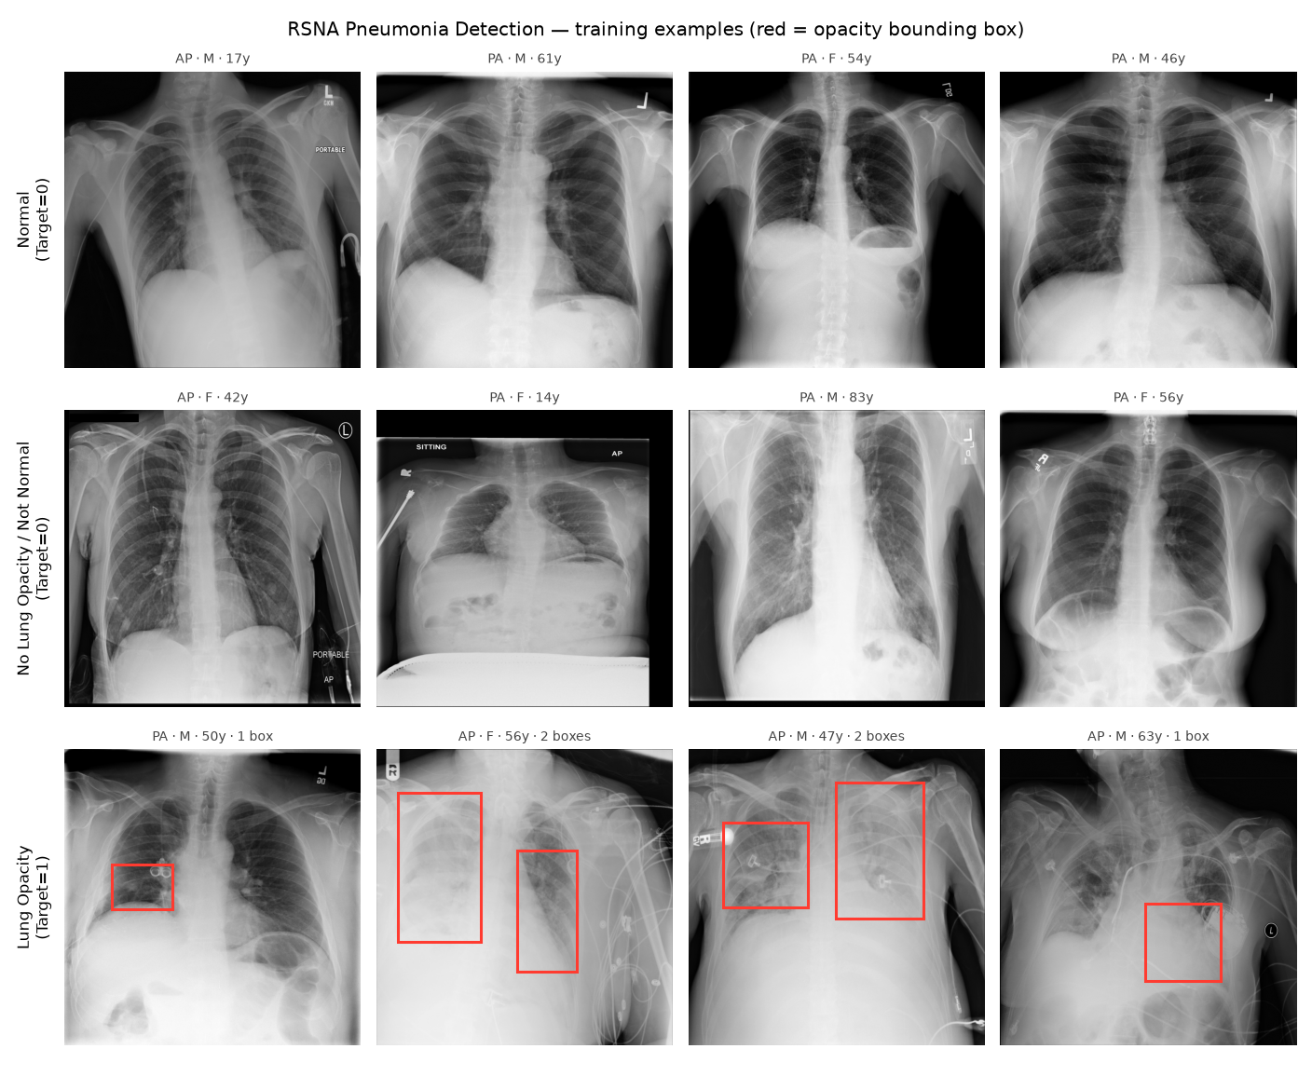
RSNA Pneumonia Detection

Slide 64
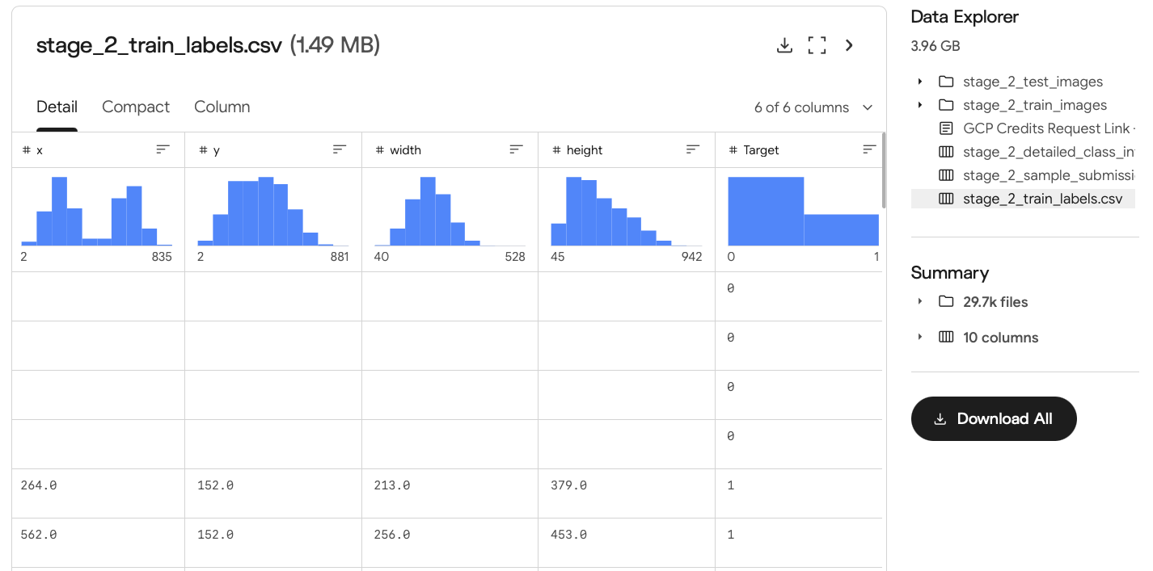
RSNA Pneumonia – training data

Slide 65
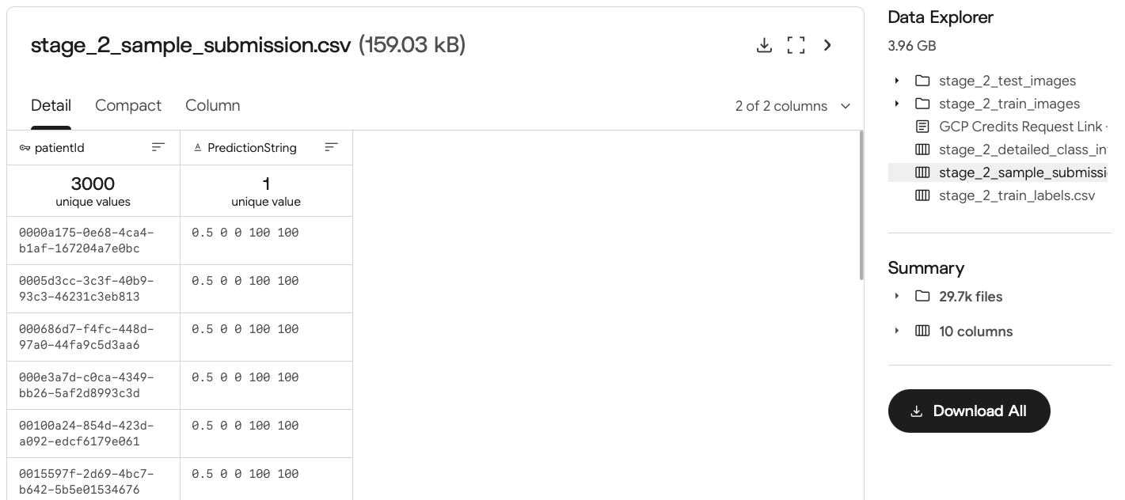
RSNA Pneumonia – 上傳內容
NOTE: In nearly all cases confidence will have no impact on scoring. It exists primarily to allow for submission boxes to be evaluated in a particular order to resolve extreme edge cases. None of these edge cases are known to exist in the data set. If you do not wish to use or calculate confidence you can use a placeholder value - like 1.0 - to indicate that no particular order applies to the evaluation of your submission boxes.

Slide 66
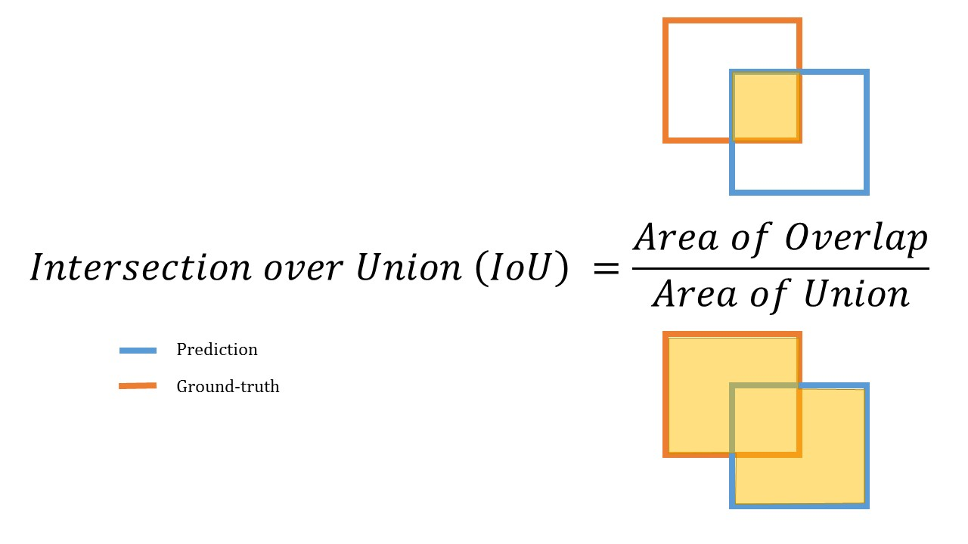
評估指標：IOU (Intersection over Union)
Figure source: https://www.kaggle.com/competitions/rsna-pneumonia-detection-challenge/overview

Slide 67


RSNA Pneumonia – 評估指標
https://yy-programer.blogspot.com/2020/06/iouapmap.html

Slide 68

Name That LLM – 資料（不一定訓練）

Slide 69


Name That LLM – 上傳內容

Slide 70

評估指標：18 個模型的平均 Acc.
Figure source: https://www.kaggle.com/competitions/rsna-pneumonia-detection-challenge/overview

Slide 71

Figure source: https://inigolopezgazpio.net/SemEval-2027-Task-2-DiCo-NLI/

Slide 72
Natural Language Inference (NLI)
前提 (premise)
假設 (Hypothesis)
LABEL
Everyone is hungry.
Someone is hungry.
Entailment (蘊含)
Someone is hungry.
Everyone is hungry.
Neutral (中立)
Someone is hungry.
No one is hungry.
Contradiction (反對)

Slide 73
Directional Consistent NLI (Dico-NLI)
前提 (premise)
假設 (Hypothesis)
NLI LABEL
Dico-NLI LABEL
Everyone is hungry.
Someone is hungry.
Entailment (蘊含)
Forward Entailment
Someone is hungry.
Everyone is hungry.
Neutral (中立)
Backward Entailment
Someone is hungry.
No one is hungry.
Contradiction (反對)
-
Someone is hungry.
At least one person is hungry.
Contradiction (反對)
Equivalence

Slide 74

Dico-NLI Dataset Statistics

Slide 75
評估指標
Metric | What is measues
Weighted F1 | sklearn.metrics.f1_score(y_true, y_pred, average="weighted")
SoftCons | Input 兩句前後交換，模型是否會輸出相反的 labels (無論答案是否正確)
HardCons | Input 兩句前後交換，模型是否會輸出相反的 labels (答案必須正確)

Slide 76


Examples for SoftCons and HardCons
SoftCons
HardCons

Slide 77

官方範例程式碼以及上傳平台
https://inigolopezgazpio.net/SemEval-2027-Task-2-DiCo-NLI/starter_kit/
https://www.codabench.org/competitions/18038/

Slide 78
Thank you!
Instructor: 林英嘉
✉️ yjlin@cgu.edu.tw
TA: 鄭茹云
✉️ m1461010@cgu.edu.tw

