Slide 1



自然語言處理與應用 Natural Language Processing and Applications
Mixture of Experts (MoE)
Instructor: 林英嘉 (Ying-Jia Lin)
2025/06/01
Course GitHub
Slido # NLP_0601

Slide 2
Outline
學期主題回顧
Introduction to Mixture of Experts

Slide 3
學期主題回顧

Slide 4
Road Map of Natural Language Processing
Statistical Language Models (W2)
Concept of N-gram
First word vectors
RNN
Transformers
(W4, W5, W6)
Attention (W5, W6)
Byte-pair Encoding (W5)
結合
讓模型自己學
Beam Search (W7)
Word2vec, GloVe (W3)
(shallow NN)
Top-p / Top-k Sampling (W10)
Pre-training + Fine-tuning 主體模型一致
BERT (W7), RoBERTa (W7), GPT 1-3 (W7), InstructGPT (W10)
NLG Evaluations:
BLEU, ROUGE (W10)
BERTScore, BLEURT, GPTRank (W15)
Large Language Models: PEFT (W12), Llama (W13), RAG (W14),
Mixture of Experts (W16, today)

Slide 5
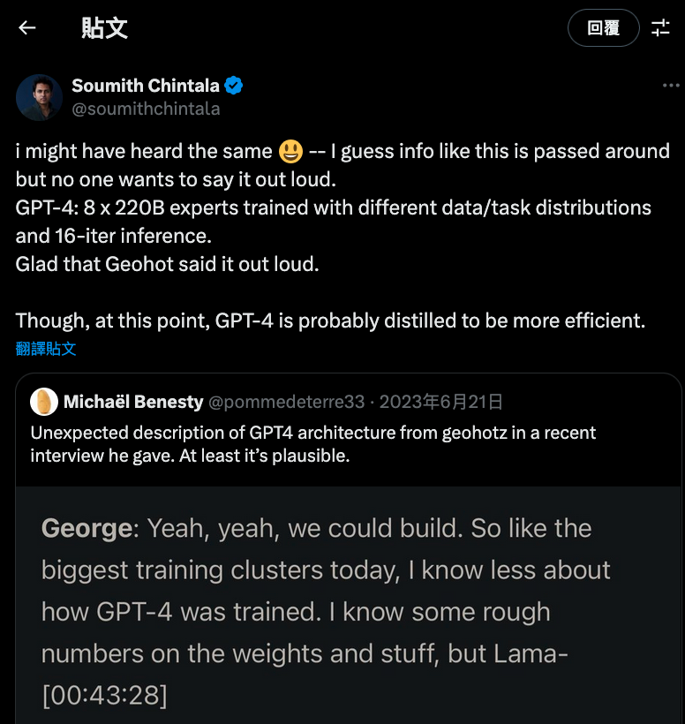
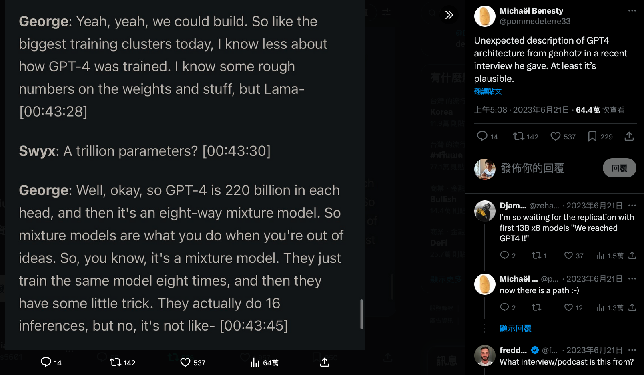
Why do we need to learn MoE?
PyTorch 創始者推測 GPT-4 採用 MoE
https://x.com/soumithchintala/status/1671267150101721090

Slide 6
Why do we need to learn MoE?
Model | Release Date | Active Parameters (Total Parameters) | Company
DeepSeek-V3 | 2024/12/27 | 37B (671B), 256 experts | DeepSeek
DeepSeek-R1 | 2025/1/22 | 37B (671B), 256 experts | DeepSeek
Llama 4 Maverick | 2025/4/5 | 17B (400B), 128 experts | Meta
Mixtral 8x7B | 2024/1/8 | 13B (47B), 8 experts | Mistral AI

Slide 7
MoE

Slide 8
[Recap] Transformer block
Transformer block (layer)
Layer Norm
+
+
+
h₁
h₂
h₃
Feed Forward
x
x
x
xN
Layer Norm
a₁
a₂
a₃
Self Attention
Layer
Q₁
K₁
V₁
Q₂
K₂
V₂
Q₃
K₃
V₃
Text & Position Embed
e₁
I
e₂
printed
e₃
Hello

Slide 9
Mixture of Experts (MoE)
Transformer block (layer)
Layer Norm
Layer Norm
Layer Norm
Feed Forward
Expert 1
Expert 2
Expert 3
Expert 1
Expert 2
Expert 3
xN
Layer Norm
x
x
p = 0.65
p = 0.75
Self Attention
Layer
路由器
(Router)
路由器
(Router)
Text & Position Embed
e₁
e₂
(來自第一次 Add & Norm 的輸出)
(來自第一次 Add & Norm 的輸出)

Slide 10

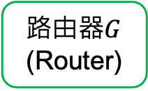
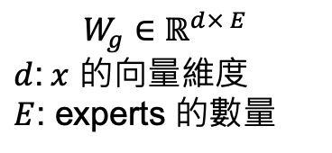
Router
Router 是一個小型神經網路，用來決定輸入 token 該被送到哪一個或哪幾個 experts，又稱作 Gating Network
Layer Norm
Expert 1
Expert 2
Expert 3
x
p = 0.65
路由器$G$
(Router)
$$G\left(x\right)=Softmax\left(x⋅W_{g}\right)$$
$$W_{g}∈ℝ^{d× E}$$
$d$:$x$ 的向量維度
$E$: experts 的數量
e₁
(來自第一次 Add & Norm 的輸出)

Slide 11
Expert 是什麼？
主要是看你放在哪裡，Expert 就會是一樣的架構
Transformer block (layer)
Layer Norm
Experts:
FFN
FFN
FFN
E.g., Switch Transformer, Mistral 8x7B, DeepSeek
Feed Forward
xN
Layer Norm
Self Attention
Layer
Experts:
Self Attn.
Self Attn.
Self Attn.
E.g., MoA (Zhang et al., 2022), SwitchHead (Csordás at al., 2024)
Text & Position Embed

Slide 12
Active Parameters (以Mistral 8x7B為例)
Feed Forward (for generation)
Layer Norm
Feed Forward
FFN
FFN
FFN
FFN
FFN
FFN
FFN
FFN
第32層
Transformer
Layer
Layer Norm
Router
原本是7B
外加了32層的(FFN+Router) 參數
一個FFN: 4096*14336*3 (SwiGLU)
一個Router: 4096*8 = 32768
層: (4096*14336*3+32768)*32約5.6B
Self Attention
Layer
...
每層由 Router 產生的數值選 Top-k個 experts (k=2)
Layer Norm
Feed Forward
FFN
FFN
FFN
FFN
FFN
FFN
FFN
FFN
第1層
Transformer
Layer
Layer Norm
Router
Self Attention
Layer
Active parameters
Text & Position Embed
Partial parameters

Slide 13
Online resources
Stanford CS25: V4 I Demystifying Mixtral of Experts
[IBM Technology] What is Mixture of Experts?
Important papers
近代 MoE 開山之作
Outrageously Large Neural Networks: The Sparsely-Gated Mixture-of-Experts Layer (Shazeer et al., 2017)
MoE on Transformers (T5)
Switch Transformers (Fedus et al., 2021)

Slide 14
Bonus
以 Unsloth fine-tune 一個 LLM
上傳到 Hugging Face model，撰寫 README

Slide 15
Thank you!
Instructor: 林英嘉
✉️ yjlin@cgu.edu.tw

