Slide 1

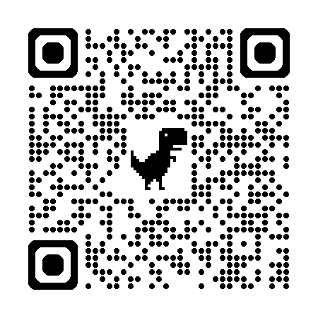
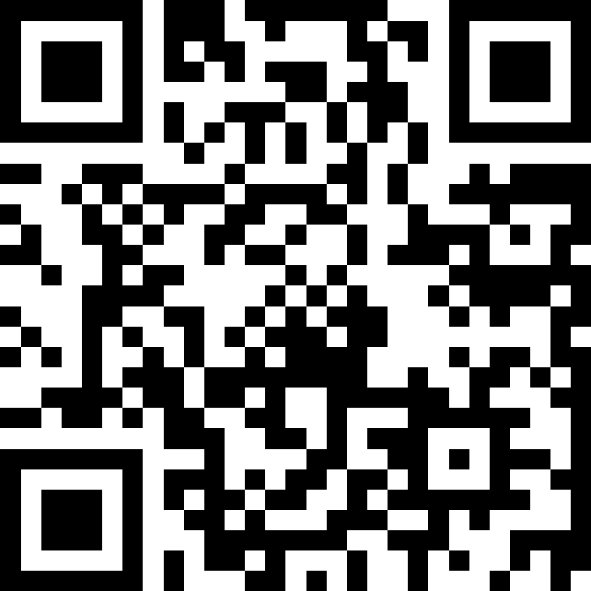
自然語言處理與應用 Natural Language Processing and Applications
Project Introduction
Instructor: 林英嘉 (Ying-Jia Lin)
2025/04/07
Course GitHub
Slido # NLP_0407

Slide 2

What is Kaggle?
Kaggle is a platform that provides:
Real-word datasets for machine learning
Competitions with prizes (sometimes with money)
Discussion forum with a lots of code examples

Slide 3
Kaggle submission types
Traditional competitions
Upload submission file (e.g., *.csv)
Code / Notebook competitions
Upload code (e.g., *.ipynb)
本課程 projects 採用此方式

Slide 4
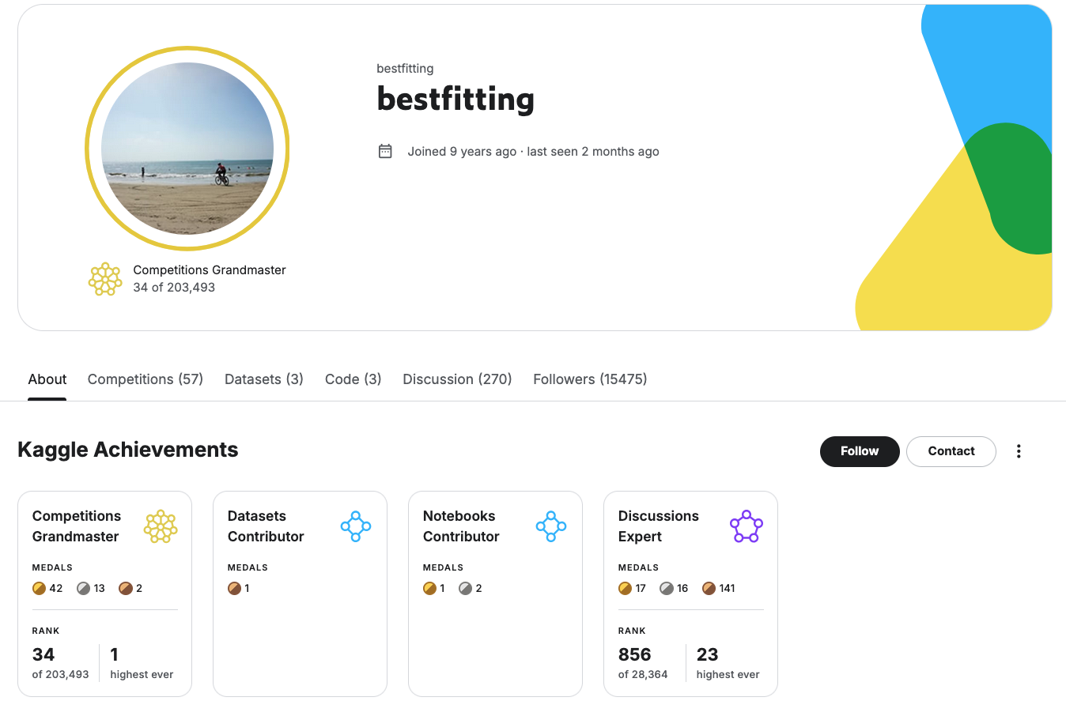
If you play Kaggle a lot …
Figure source: https://www.kaggle.com/bestfitting

Slide 5
Outline of tasks
Platform | Competition Name | Data Type | Task Type
Kaggle | LLM Classification Finetuning | text | Text classification
 | NBME - Score Clinical Patient Notes | text | Token classification (like Named Entity Recognition)
 | LLM - Detect AI Generated Text | text | Text classification

Slide 6
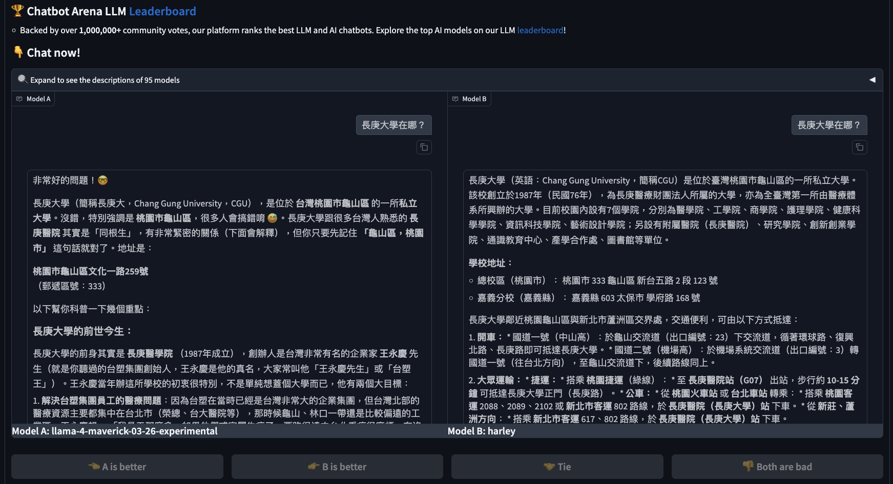
LLM Classification Finetuning (intro)
Chatbot Arena: https://lmarena.ai/?leaderboard

Slide 7
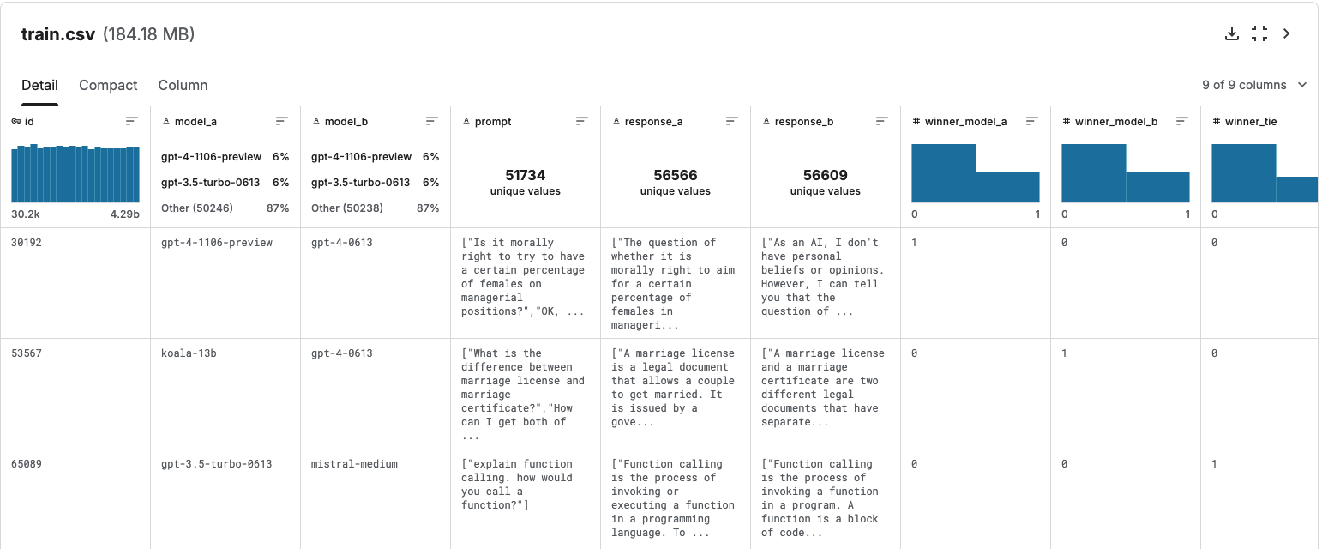
LLM Classification Finetuning (data example)
約55K rows

Slide 8
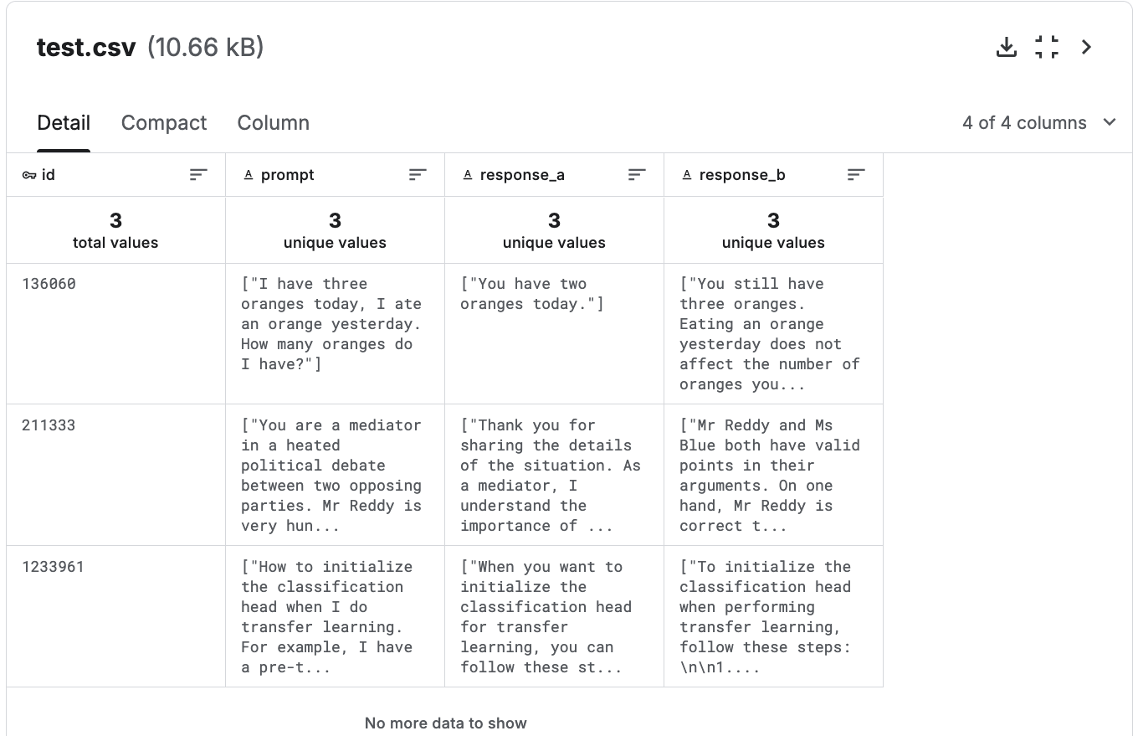
LLM Classification Finetuning (data example)
此競賽為 Code competition
因此 test set 實際上不公開

Slide 9
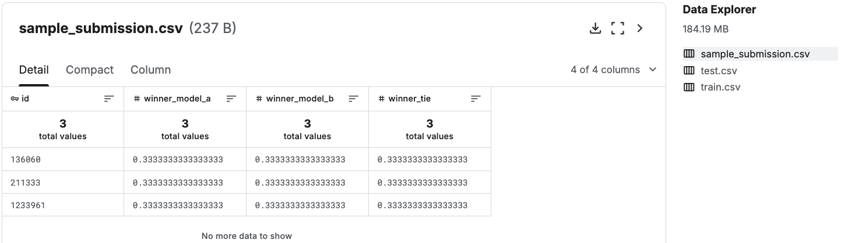
LLM Classification Finetuning (submission)
上傳到 Kaggle Leaderboard 需要實作 .ipynb
你的 code 需要能 predict test.csv 並產生檔案名稱為 submission.csv 的檔案，Kaggle 才能幫你執行程式碼並打分數，可參考 LMSYS: KerasNLP Starter

Slide 10
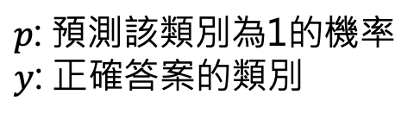
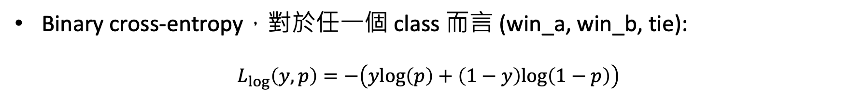
LLM Classification Finetuning (evaluation)
Binary cross-entropy，對於任一個 class 而言 (win_a, win_b, tie):
$$L_{log}\left(y,p\right)=−\left(ylog\left(p\right)+\left(1−y\right)log\left(1−p\right)\right)$$
$p$: 預測該類別為1的機率
$y$: 正確答案的類別
Leaderboard 比的是 test set的 Loss 值 (越小越好)
https://www.kaggle.com/code/metric/log-loss

Slide 11
NBME - Score Clinical Patient Notes
找出 patient note 中的重要特徵，例如：
輸入一篇 patient note，輸出為 “diminished appetite”
競賽的實際範例：
>>> import pandas as pd >>> df = pd.read_csv("patient_notes.csv") >>> df[df["pn_num"]==16].pn_history.values[0][696:724] 'dad with recent heart attcak'

Slide 12
NBME – patient note example
>>> df[df["pn_num"]==16].pn_history.values[0]
HPI: 17yo M presents with palpitations. Patient reports 3-4 months of intermittent episodes of "heart beating/pounding out of my chest." 2 days ago during a soccer game had an episode, but this time had chest pressure and felt as if he were going to pass out (did not lose conciousness). Of note patient endorses abusing adderall, primarily to study (1-3 times per week). Before recent soccer game, took adderrall night before and morning of game. Denies shortness of breath, diaphoresis, fevers, chills, headache, fatigue, changes in sleep, changes in vision/hearing, abdominal paun, changes in bowel or urinary habits. \r\nPMHx: none\r\nRx: uses friends adderrall\r\nFHx: mom with "thyroid disease," dad with recent heart attcak\r\nAll: none\r\nImmunizations: up to date\r\nSHx: Freshmen in college. Endorses 3-4 drinks 3 nights / week (on weekends), denies tabacco, endorses trying marijuana. Sexually active with girlfriend x 1 year, uses condoms

Slide 13
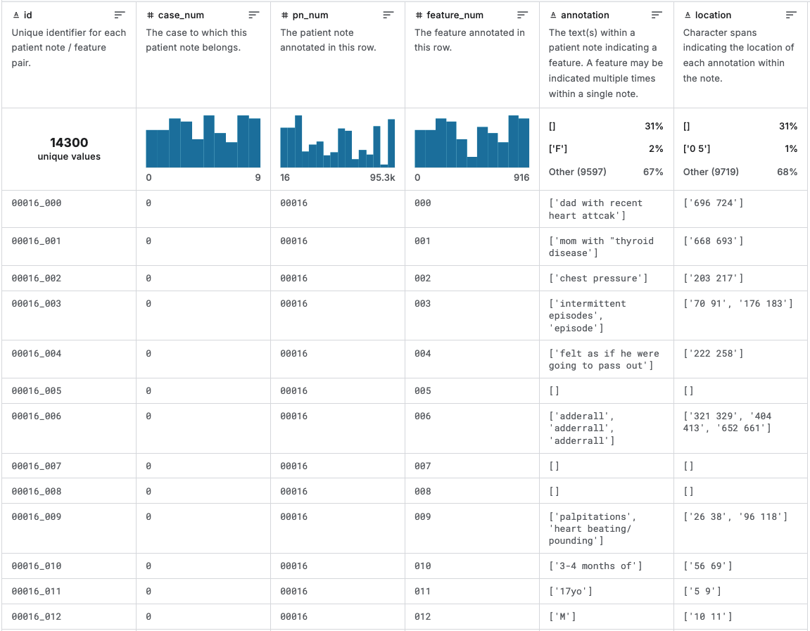
NBME - Score Clinical Patient Notes (data example - train.csv)
但有的feature可能沒有標註
每筆資料都有feature_num代號

Slide 14
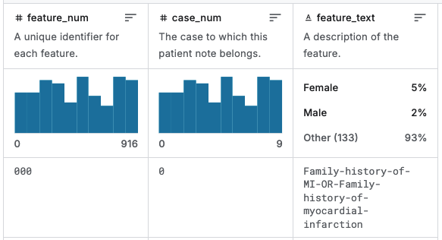
NBME - Score Clinical Patient Notes (data example - features.csv)
競賽的實際範例：
>>> import pandas as pd >>> df = pd.read_csv("patient_notes.csv") >>> df[df["pn_num"]==16].pn_history.values[0][696:724] 'dad with recent heart attcak'

Slide 15
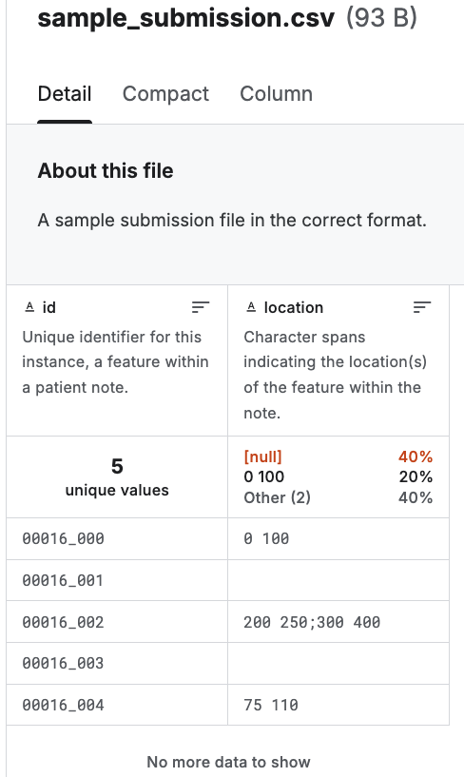
NBME - Score Clinical Patient Notes (submission and evaluation)
只需要預測 location 即可
上傳到 Kaggle Leaderboard 需要實作 .ipynb
你的 code 需要能 predict test.csv 並產生檔案名稱為 submission.csv 的檔案，Kaggle 才能幫你執行程式碼並打分數，可參考 NBME / Deberta-base baseline [inference]

Slide 16
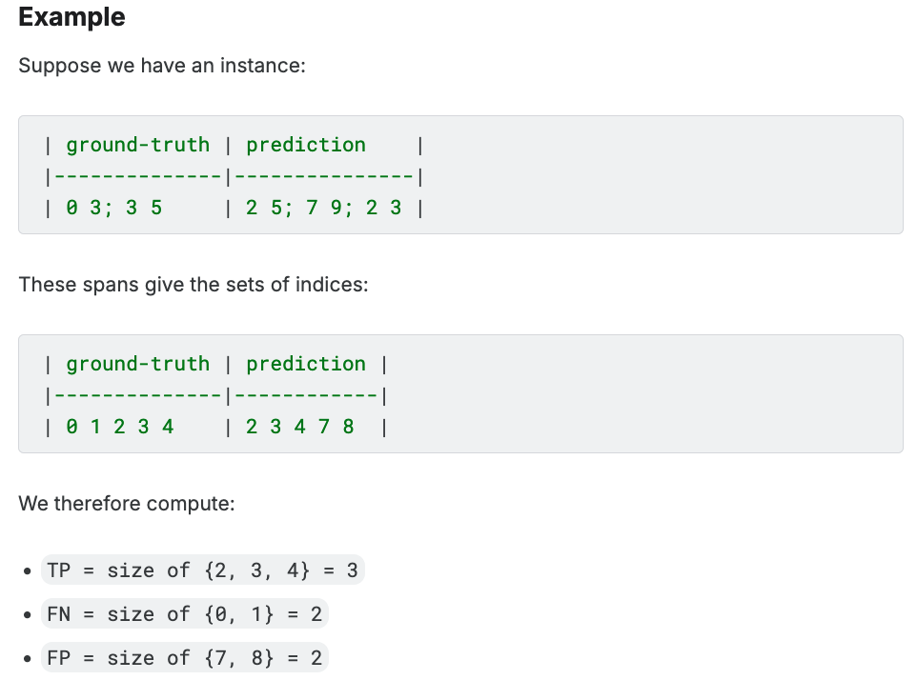
NBME - Score Clinical Patient Notes (evaluation)
Metric: Micro F1-score

Slide 17
Confusion Matrix
 | Actually positive | Actually negative
Predicted positive | True positive (TP) | False positive (FP)
Predicted negative | False negative (FN) | True negative (TN)
Precision = TP / (TP + FP)
模型預測的TP比例
Recall = TP / (TP + FN)
True Positive Rate (TPR)
F1-score (廣義) = 2(Precision*Recall) / (Precision+Recall)

Slide 18
Macro vs. Micro
假設總共有100筆資料：
每一筆都算出一個 F1-score，最後取平均 => Macro F1-score
加總全部100筆的 TP, FN 以及 FP 之後，再算出 F1-score => Micro F1-score

Slide 19
LLM - Detect AI Generated Text
The competition dataset comprises about 10,000 essays
Some written by students and some generated by a variety of large language models (LLMs).
The goal of the competition is to determine whether or not essay was generated by an LLM.

Slide 20
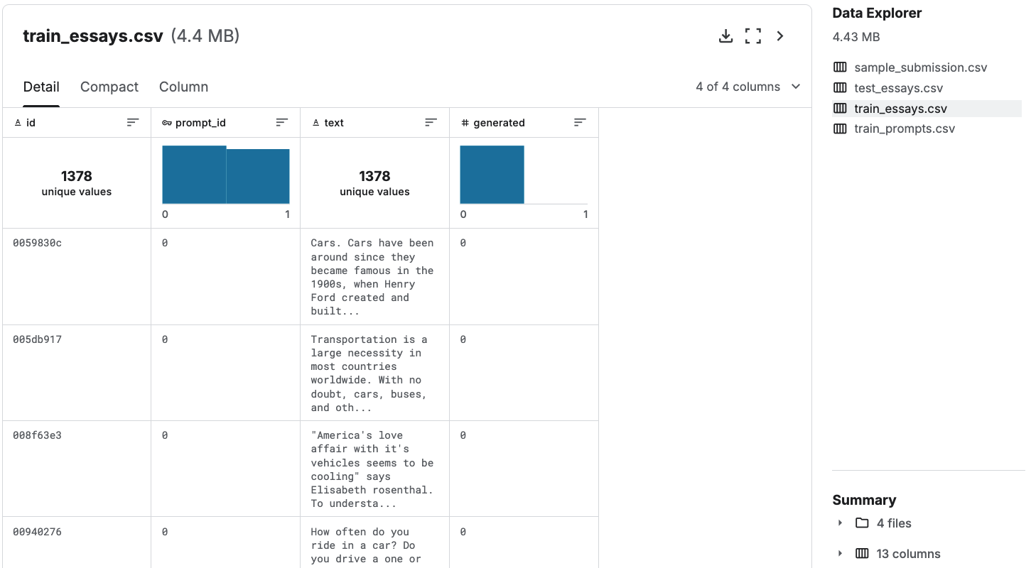
LLM - Detect AI Generated Text (data)
0 代表人寫的文章，訓練集只有人寫的
可能有幫助的外部資料集：https://www.kaggle.com/datasets/alejopaullier/daigt-external-dataset

Slide 21
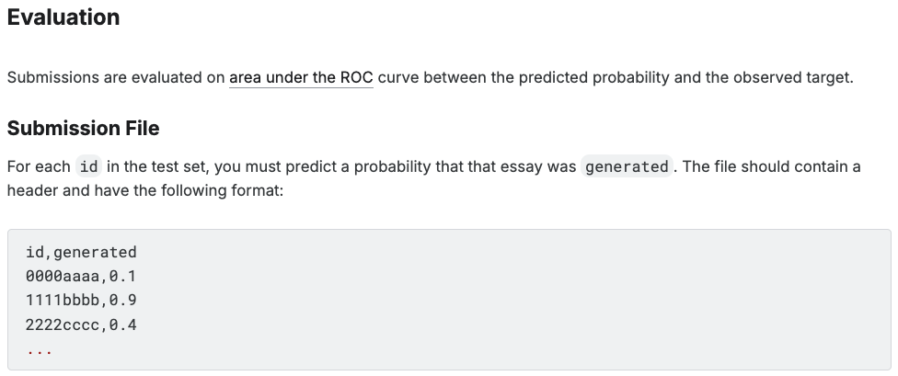
LLM - Detect AI Generated Text (submission and evaluation)
上傳到 Kaggle Leaderboard 需要實作 .ipynb
你的 code 需要能 predict test_essays.csv 並產生檔案名稱為 submission.csv 的檔案，Kaggle 才能幫你執行程式碼並打分數，可參考 0.960| Phrases are keys

Slide 22
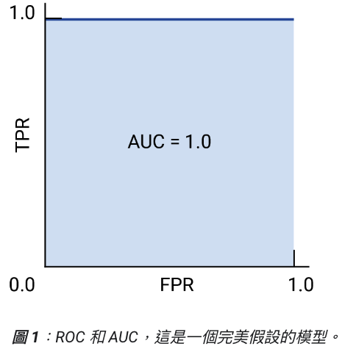
ROC Curve
(Useful!!) https://developers.google.com/machine-learning/crash-course/classification/roc-and-auc?hl=zh-tw
ROC: Receiver operating characteristic curve (接收者操作特徵曲線)
AUC: ROC 的底面下面積 (越大越好)
TP / (TP + FN): True Positive Rate (TPR)
又稱作 Recall
FP / (FP+TN): False Positive Rate (FPR)

Slide 23
Project checkpoints (暫定)
Week 9: 確定各組的題目
Week 11: 進度報告 PPT (5 pages)
Week 13: 進度報告 PPT (5+5 pages), Presentations (selected teams)
Week 15 – Week 16: Final presentations for all teams (maybe poster)
Week 16 結束前: 繳交書面報告以及程式碼

Slide 24
期末 Project 規定
需要上傳 Kaggle Leaderboard
請留意，每個題目都是 Code competition，code 必須沒有 bug 才能上傳
project 進度 (至少最後一次書面報告前) 需涵蓋大型語言模型的實驗，開源 (e.g., Llama) 或閉源 (e.g., ChatGPT) 模型皆可
每次報告都需要列出每位組員的貢獻內容，以及組員間的工作比重 (%)

Slide 25
生成式 AI 融入教材核銷
三月：3/24 (一)
四月：4/21 (一)
五月：5/20 (二)

Slide 26
準備項目 (updated)
收據 (付款的學生需要簽名)
目前受理項目為：
ChatGPT Plus (USD 20 / 月)
Colab Pro (USD 10.49 / 月)
OpenAI API (一個月以 USD 19 為限，見下一頁)
購買 ChatGPT plus 請下載 invoice，非 receipt
刷卡明細 (付款的學生需要簽名)
因此，每個項目需要收據*1 + 刷卡明細*1

Slide 27
Thank you!
Instructor: 林英嘉
✉️ yjlin@cgu.edu.tw

