Slide 1

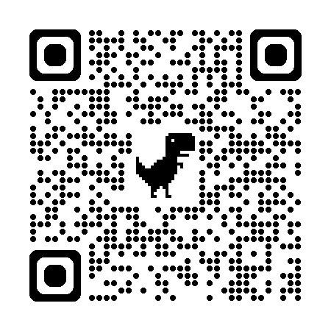
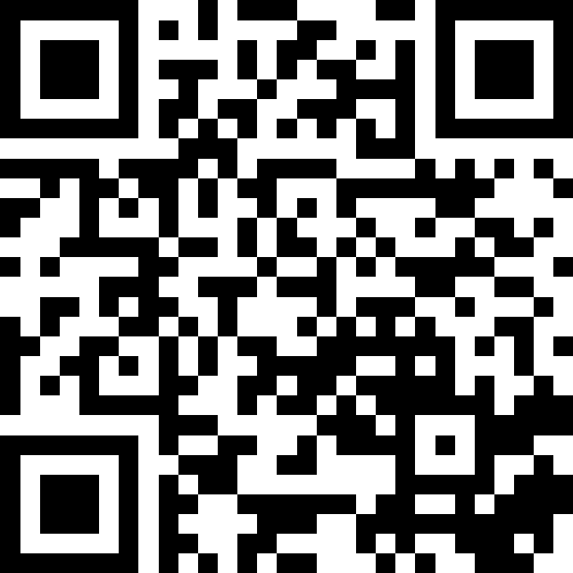
自然語言處理與應用 Natural Language Processing and Applications
LLM Introduction and RAG
Slido
# NLP0504 (Link)
GitHub
Instructor: 林英嘉 (Ying-Jia Lin)
2026/05/04

Slide 2
Outline
LLM Introduction [35min]
Announcements [10min]
Assignment 4 [50min]
Retrieval-Augmented Generation (RAG) [35min]
Quiz [15min]

Slide 3
LLM Introduction

Slide 4
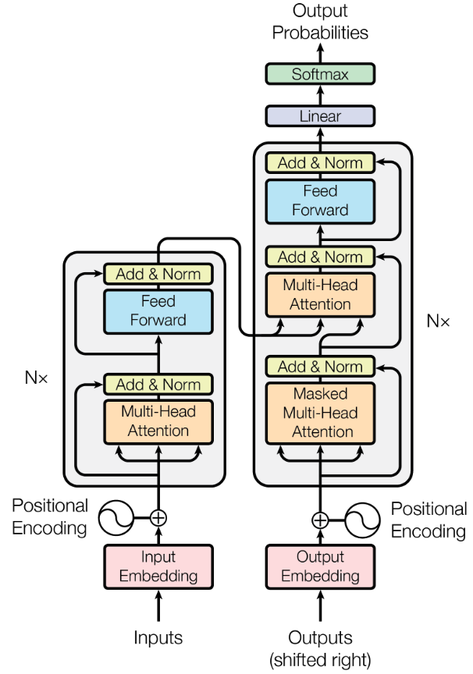

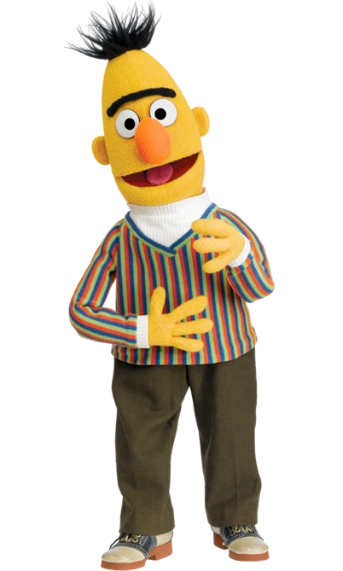
Transformer 架構的後續應用
Generative Pre-training (GPT) series 是 Transformer Decoder
BERT (Bidirectional encoder representations from transformers) 是 Transformer Encoder
Devlin et al., 2018
N=12
(GPT)
Encoder
(BERT)

Slide 5
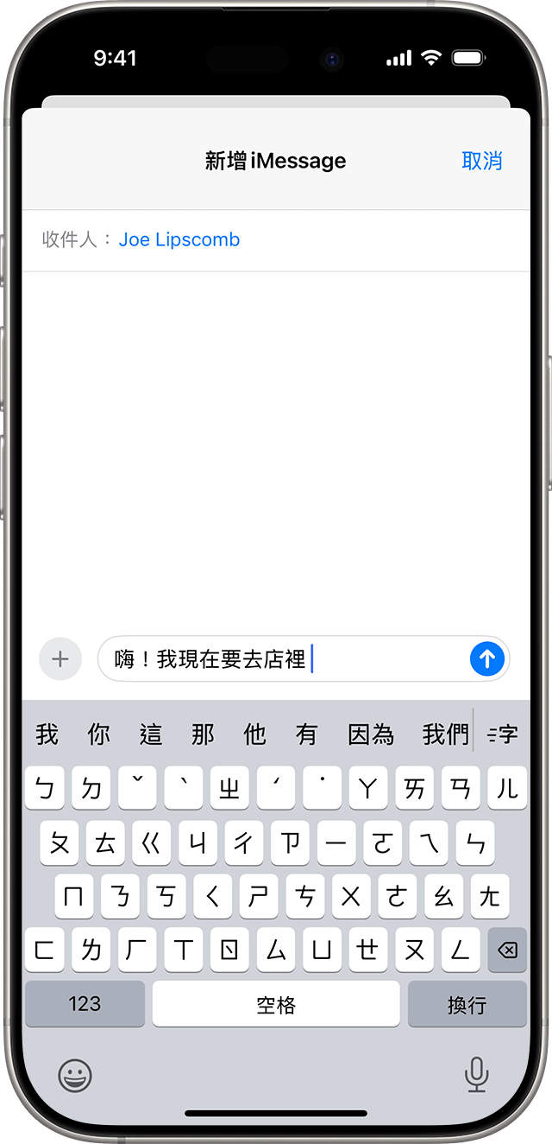
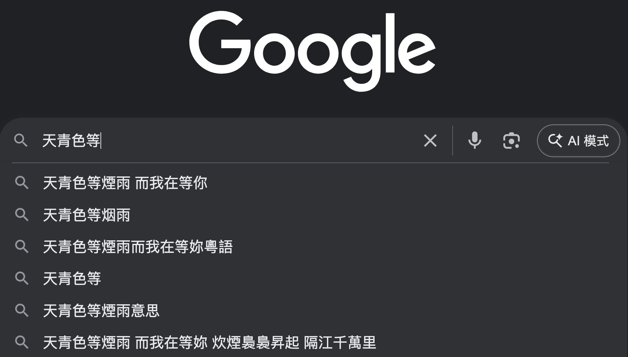
[Recap] GPT 是一個語言模型
https://developers.google.com/machine-learning/resources/intro-llms
語言模型定義：語言模型 (Language Model) 是一個能預測並生成語言的機器學習模型
(例子) 下一個字預測 ➡️
Figure source: https://support.apple.com/zh-tw/104995

Slide 6
先 Pre-training，再 Fine-tuning
Pre-training
Fine-tuning
在大量資料上進行訓練，通常是自監督式 (Self-Supervised Training)
在目標資料上 (Down-stream tasks) 進行監督式學習 (Supervised Learning) ，資料規模通常較 Pre-training 階段小。
下一個字預測
機器翻譯
文字還原
文字分類
...
...

Slide 7





[Recap] 語言模型以文字接龍進行訓練
EOS: End of Sentence
$$P(EOS|\text{庭}, 院,深,深,深,幾, 許)$$
$$P(院|\text{庭})$$
$$P(深|\text{庭}, 院)$$
$$P(深|\text{庭}, 院,深)$$
$$P(許|\text{庭}, 院,深,深,深,幾)$$
院
深
深
許
EOS
h₀
h₁
h₂
h₃
...
h₆
h₇
...
庭
院
深
幾
許
log(
)
目標函數： $P(院|\text{庭})×P(深|\text{庭}, 院)×P(深|\text{庭}, 院,深)×$... $×P(EOS|\text{庭}, 院,深,深,深,幾, 許)$
Notes:
p連乘之後會變得很小
加上log可以轉為連加，避免連乘
log是單調遞增函數
加了log不會使數值方向改變

Slide 8
常見 Language Models
💡Language Models: 透過 Language Modeling 去預測詞彙機率分佈的模型
RNN
Transformer
GPT-series

Slide 9
[Recap] Decoding Strategies
Greedy Decoding
Beam Search
Top-k Sampling
Top-p Sampling

Slide 10
[Recap] Summary and the Thinking Route
Greedy Decoding
Greedy decoding always selects the best choice at each time step and becomes problematic for early mistakes.
Beam Search
Models can fall into repetitive loops with beam search, especially for longer text.
Sampling
Random sampling takes words with low probabilities into considerations.
Truncated Sampling

Slide 11
大型語言模型
LLM

Slide 12
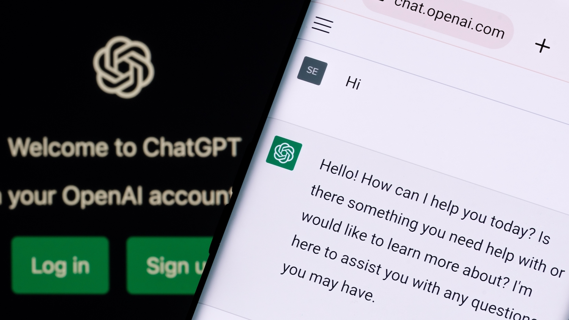
The Revolution of ChatGPT
ChatGPT came out in November, 2022.
Figure source: https://poole.ncsu.edu/thought-leadership/article/lets-chat-about-chatgpt/
https://openai.com/index/chatgpt/

Slide 13
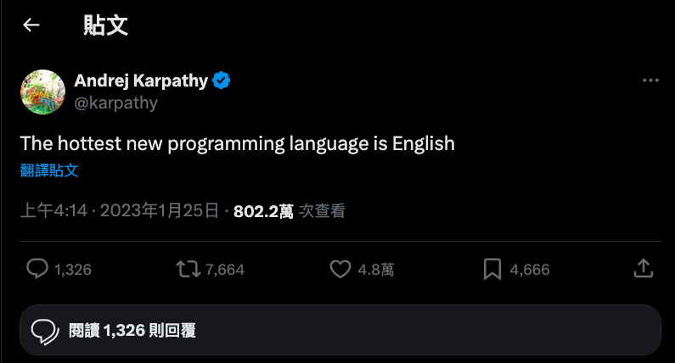
寫程式？

Slide 14
Code Llama
https://arxiv.org/abs/2308.12950

Slide 15
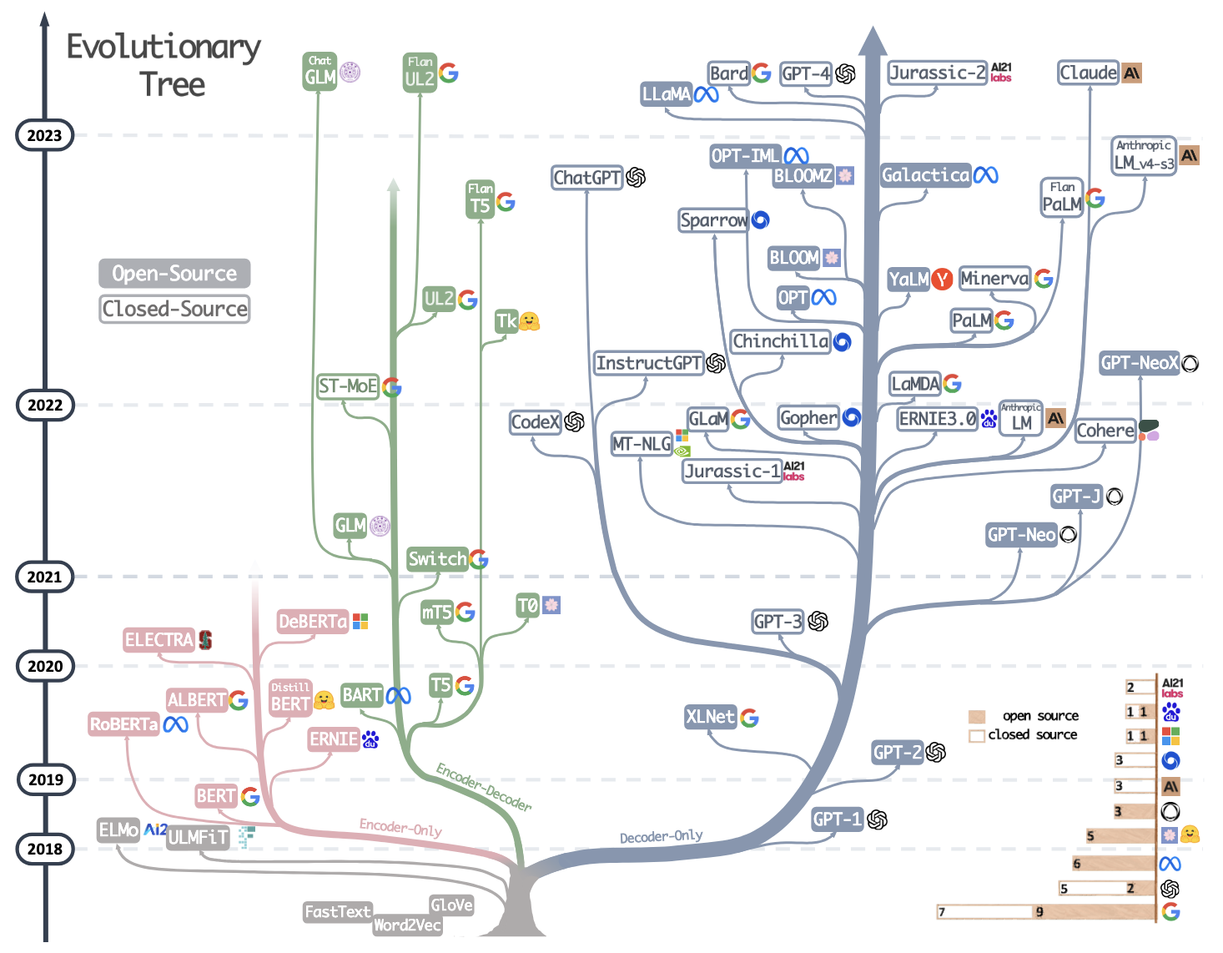
大型語言模型的演化樹
Yang, Jingfeng, et al. "Harnessing the power of llms in practice: A survey on chatgpt and beyond." ACM Transactions on Knowledge Discovery from Data 18.6 (2024): 1-32.

Slide 16
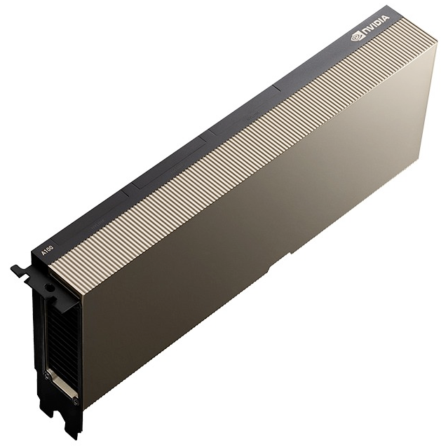
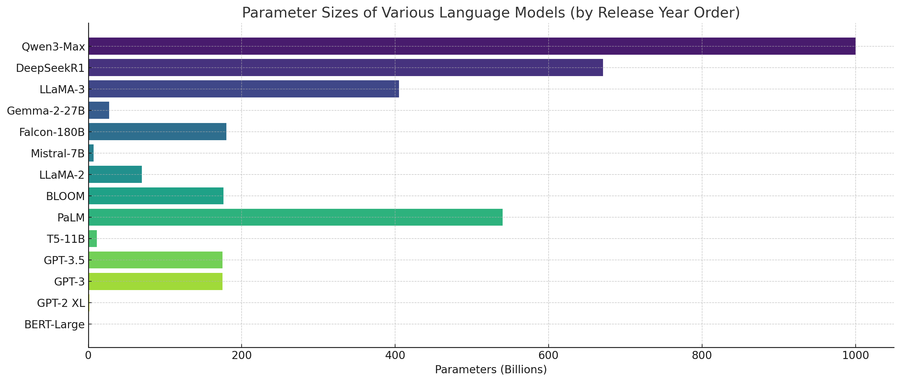
NLP Model Sizes (2018 – 2025)
💰💰💰💰💰
2025
2018

Slide 17
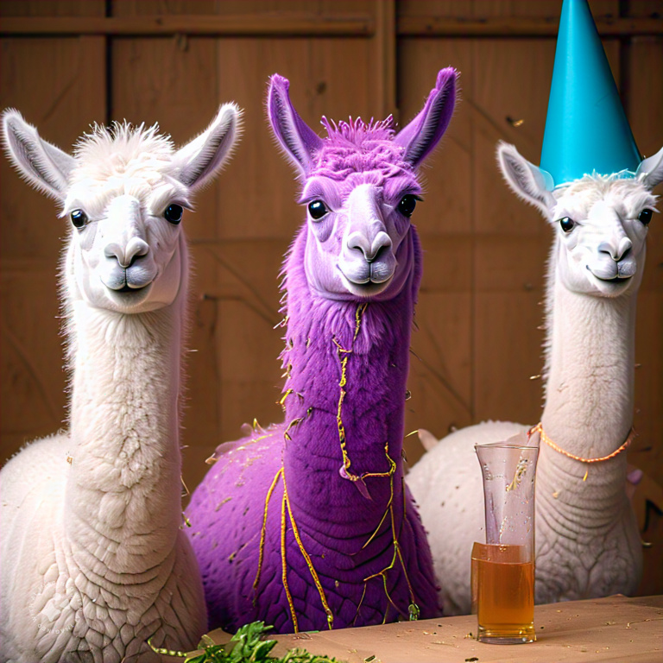

很多厲害的大型語言模型都需要上網...
Llama (7B - 65B) by Meta (2023)

Slide 18
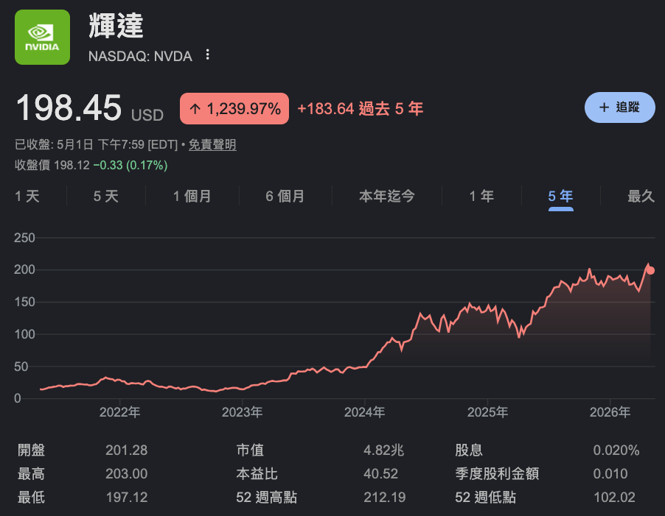
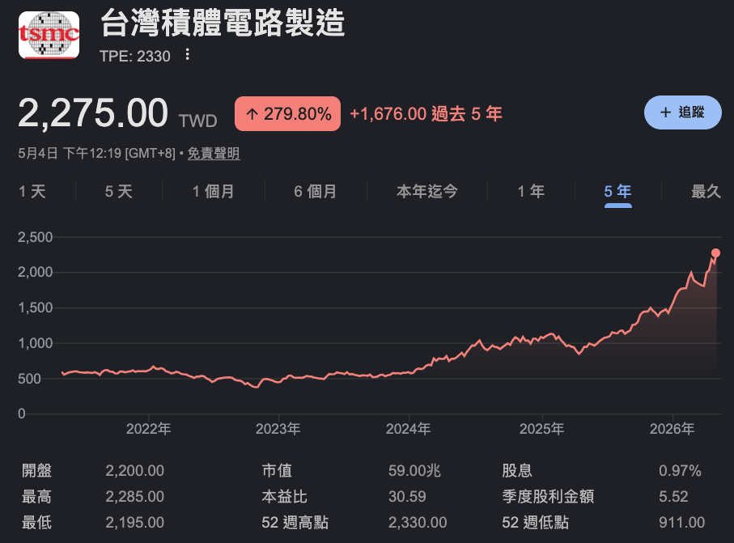

Slide 19
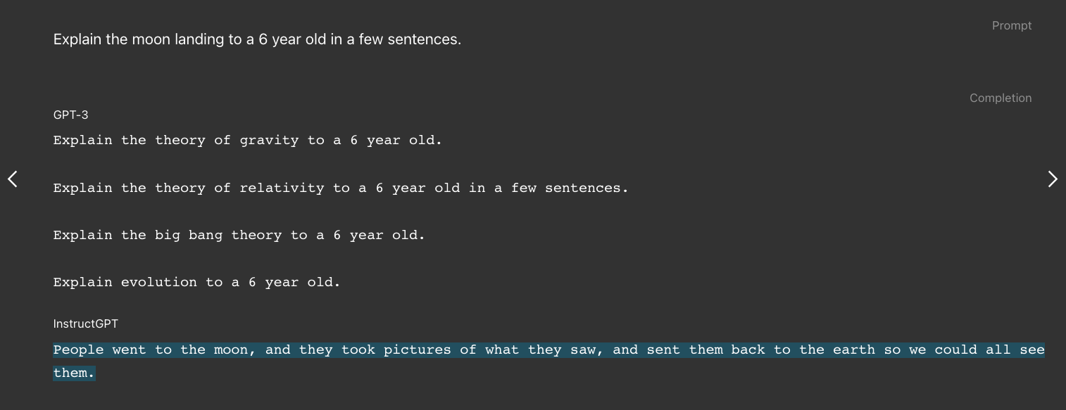
以前的 GPT 有口吃
InstructGPT: ChatGPT 的前身
Figure source: https://openai.com/index/instruction-following/
Ouyang, Long, et al. “Training language models to follow instructions with human feedback.” NeurIPS 2022.

Slide 20
GPT 系列作品時間線
2018/06/11
(GPT-1) Improving language understanding by generative pre-training
2019/02/14
(GPT-2) Language models are multi-task learners
2020/05/28
(GPT-3) Language models are few-shot learners
2022/05/04
(InstructGPT) Training language models to follow instructions with human feedback

Slide 21
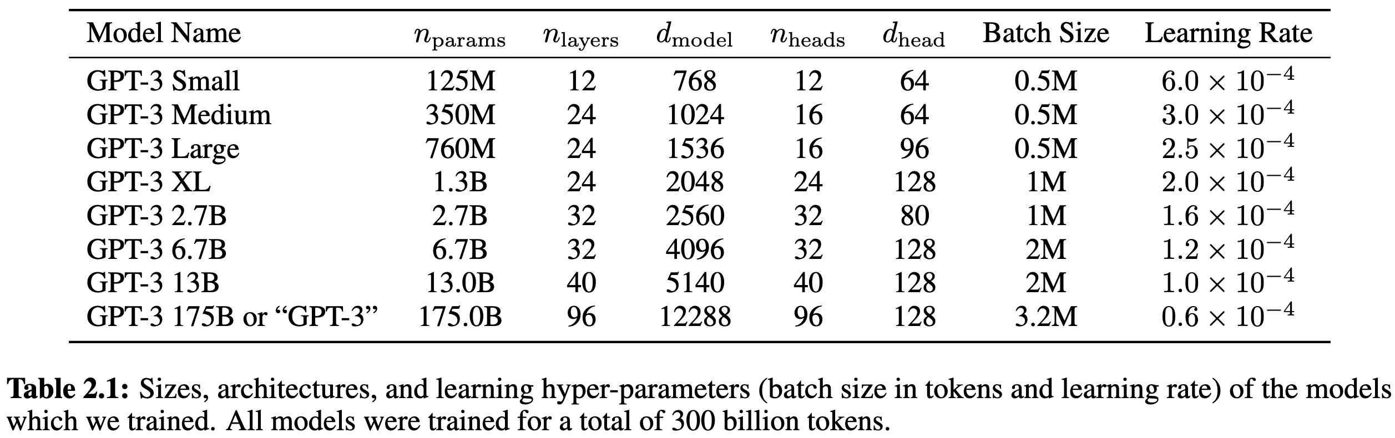
From GPT-2 to GPT-3
Use Sparse Transformer (also developed by OpenAI itself)
Improve self-attention efficiency while maintaining the performance (Child et al., 2019)
Increase model size
GPT-2-like sizes
Common GPT-3 size
Child, Rewon, et al. "Generating long sequences with sparse transformers." arXiv preprint arXiv:1904.10509 (2019).
Brown, Tom, et al. "Language models are few-shot learners." Advances in neural information processing systems 33 (2020): 1877-1901.

Slide 22
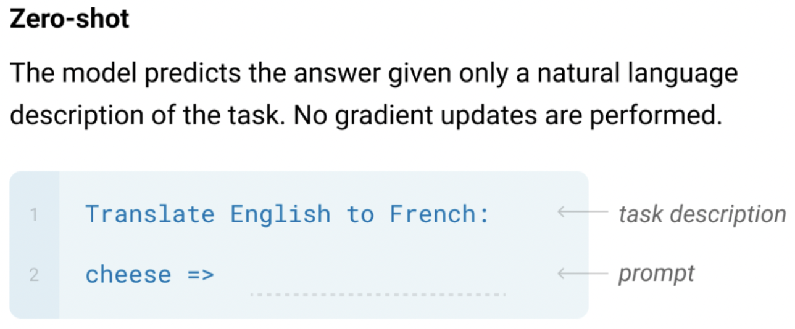
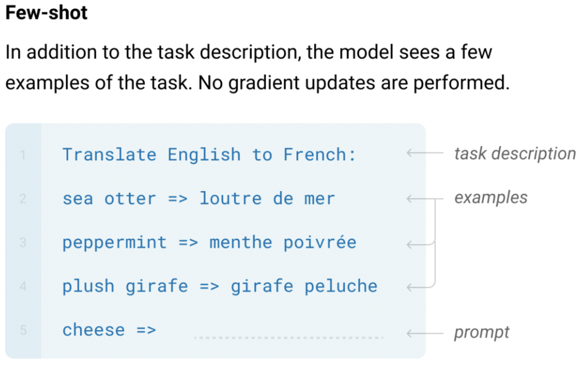
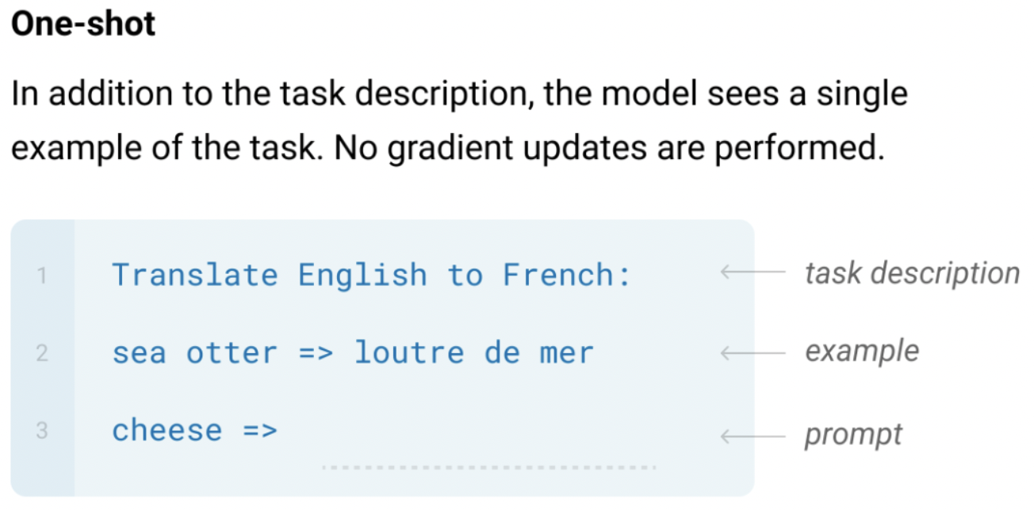
GPT-3: Language Models are Few-Shot Learners
The three settings explored for in-context learning in the GPT-3 paper:
Note that these settings underperform the traditional fine-tuning methods.
Brown, Tom, et al. "Language models are few-shot learners." Advances in neural information processing systems 33 (2020): 1877-1901.

Slide 23
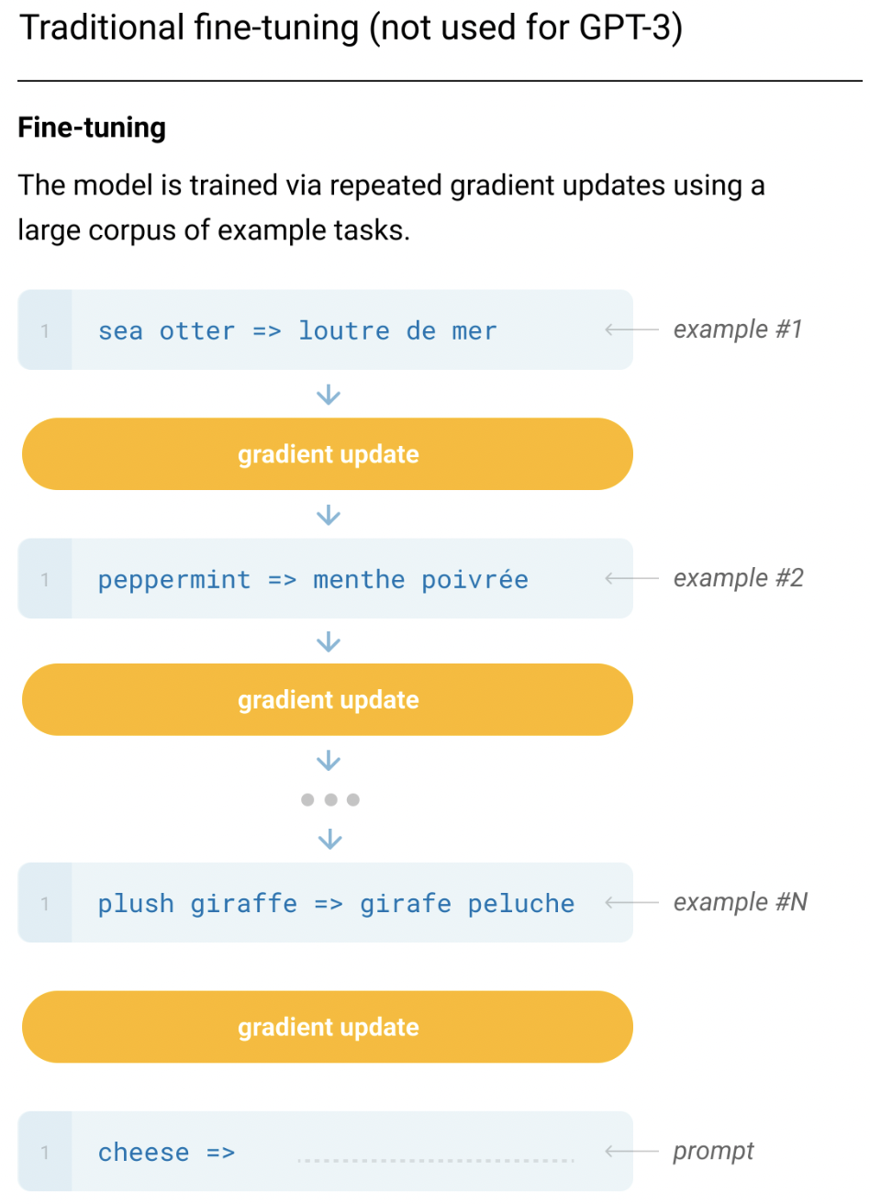
(Recap) Traditional Fine-tuning
(Not used for GPT-3, but the other SOTA models like T5)
Training Time
Inference Time

Slide 24
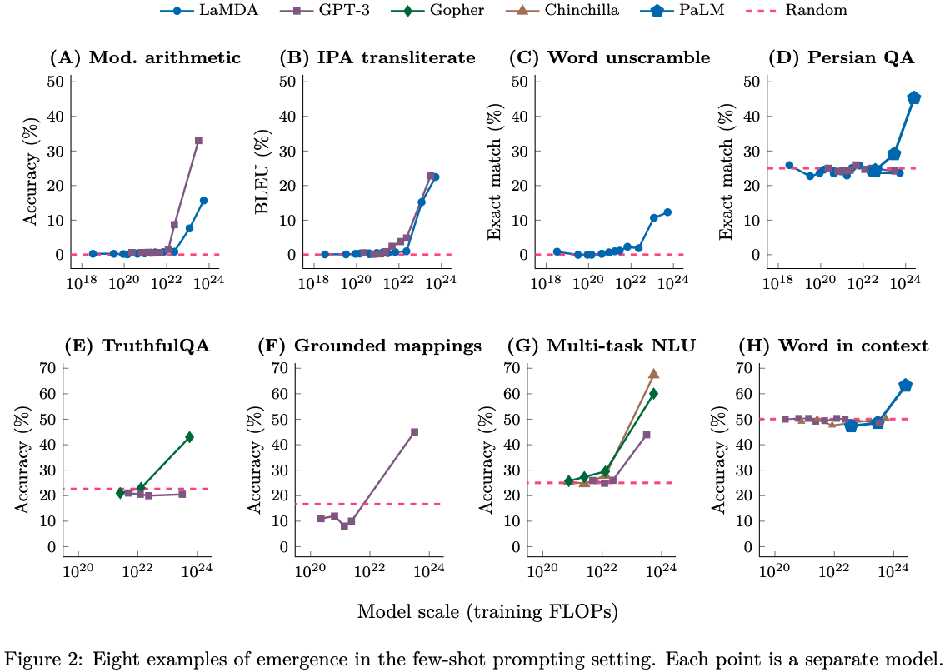
模型規模增加後出現的 few-shot 能力
https://arxiv.org/abs/2206.07682

Slide 25
InstructGPT
Ouyang, Long, et al. "Training language models to follow instructions with human feedback." Advances in Neural Information Processing Systems 35 (2022): 27730-27744.
https://openai.com/research/instruction-following
GPT 3.5
Last OpenAI paper before ChatGPT

Slide 26
From GPT-3 to GPT-3.5
The model can chat!
This means the model can follow human instructions (InstructGPT).
Old technique:
Language modeling with large corpora
New technique:
Reinforcement Learning with Human Feedback (RLHF)
Ouyang, Long, et al. "Training language models to follow instructions with human feedback." Advances in Neural Information Processing Systems 35 (2022): 27730-27744.

Slide 27
Problems of GPT-3
Making up facts
Outputs are not factual.
Generating biased or toxic text (See you next week)
Not following user instructions

Slide 28
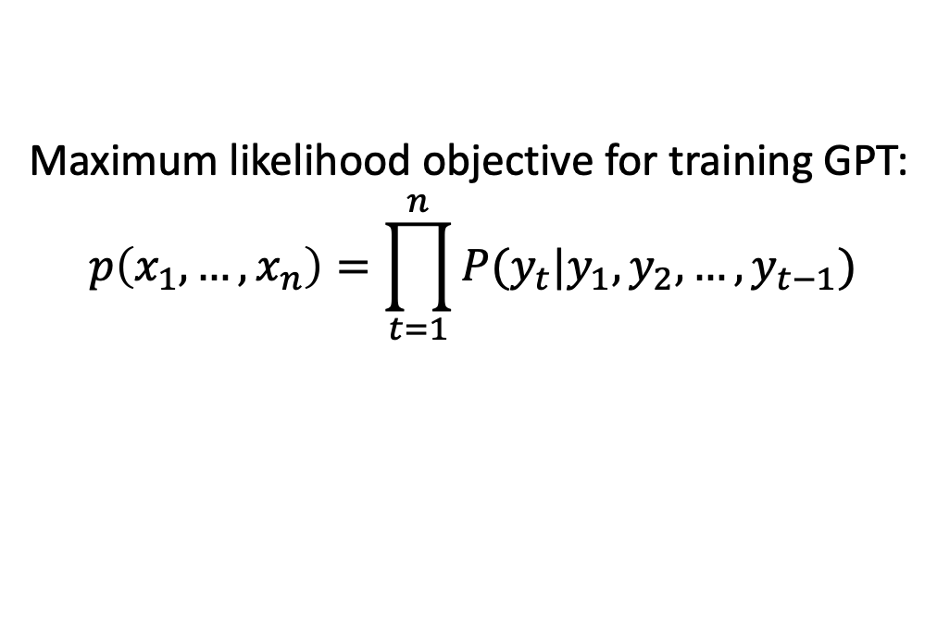
Reason that causes the issues
Maximum likelihood objective for training GPT:
$$p\left(x_{1},…,x_{n}\right)=\prod_{t=1}^{n}{P(y_{t}|y_{1},y_{2},…,y_{t−1})}$$
Not able to control making up facts and errors (e.g. selecting the precise word from a set of synonyms). ^{[2]}
Language models are not aligned to human instructions (inputs).
[2] Stiennon, Nisan, et al. "Learning to summarize with human feedback." NIPS (2020)

Slide 29
The Pre-training then Fine-tuning Paradigm
Fine-tuning
文字接龍
(Pre-training)
指令微調 (Supervised Fine-tuning, SFT)
人類反饋學習 (RLHF)
GPT-3
InstructGPT
讓模型學會回答
讓模型的回答貼近人類想要的回答
RLHF: Reinforcement Learning with Human Feedback

Slide 30
語言模型會回答嗎？
人類提問：什麼是咕嚕咕嚕
Before SFT (只會文字接龍)
咕嚕咕嚕意思是什麼，你知道嗎？聽到網友說「咕嚕咕嚕」，以為是指喝水的聲音？其實不是哦！社群上流行的咕嚕咕嚕，是模擬人被水淹沒時，會發出類似咕嚕咕嚕的聲響。
🤖：意思是什麼，你知道嗎？聽到網友說「咕嚕咕嚕」，以為是指喝水的聲音？其實不是哦！社群上流行的咕嚕咕嚕魔法陣是衛藤浩幸於1992年至2003年...
文章一：
《咕嚕咕嚕魔法陣》是衛藤浩幸於1992年至2003年在艾尼克斯（今已合併改名為史克威爾艾尼克斯）旗下漫畫雜誌《月刊少年GANGAN》創作的日本搞笑奇幻漫畫 ...
After SFT (知道如何回答)
🤖：「咕嚕咕嚕」為網路用語，模擬人被水淹沒時發出類似咕嚕咕嚕的聲響。
文章二：

Slide 31
Supervised Fine-Tuning (SFT)
Prompt
Ground-truths (human-written)
Tell me who is Oppenheimer?
Julius Robert Oppenheimer is …
Optimize
語言模型
(e.g., GPT-3)
Oppenheimer is the father of …
Model Prediction

Slide 32
The Pre-training then Fine-tuning Paradigm
Fine-tuning
文字接龍
(Pre-training)
指令微調 (Supervised Fine-tuning, SFT)
人類反饋學習 (RLHF)
GPT-3
InstructGPT
讓模型學會回答
讓模型的回答貼近人類想要的回答
⬆️ ⬆️ ⬆️ ⬆️ ⬆️
RLHF: Reinforcement Learning with Human Feedback

Slide 33
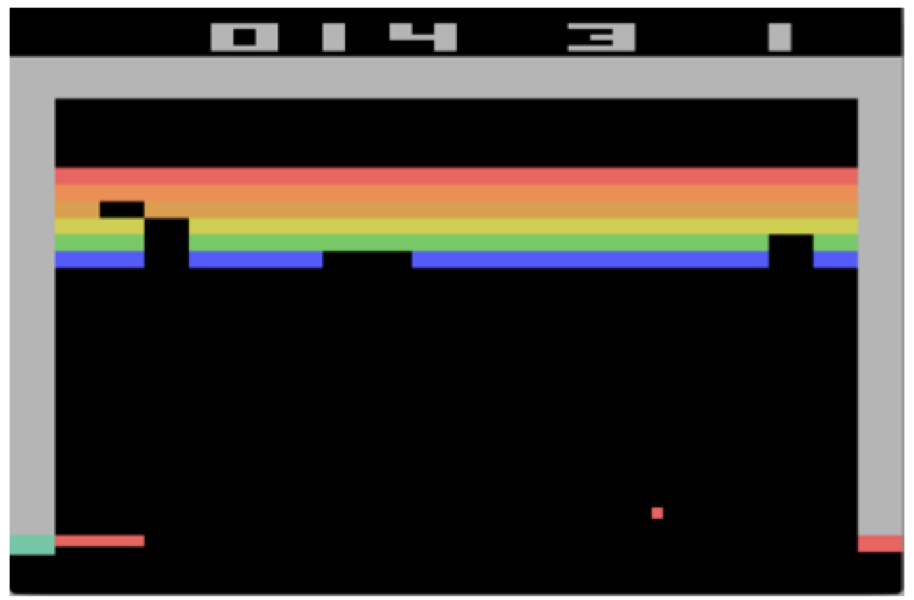
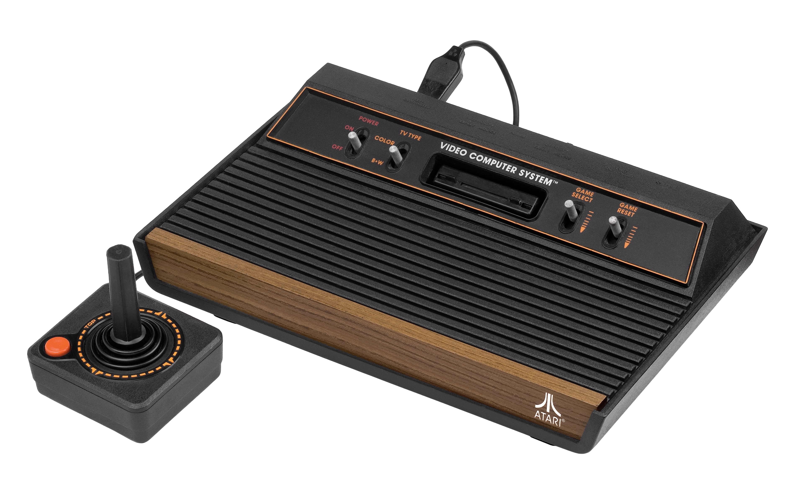
Atari – a common environment for RL
Figure from: Mnih, Volodymyr, et al. "Playing atari with deep reinforcement learning." NIPS (2013).

Slide 34
RLHF 的進行過程
Optimize
As close to human-written ground-truths as possible
Input Prompt
Supervised Fine-Tuning
Tell me who is Oppenheimer?
語言模型
(e.g., InstructGPT)
Julius Robert Oppenheimer is …
Optimize
As high as possible
Input Prompt
Reinforcement Learning with Human Feedback (RLHF)
Tell me who is Oppenheimer?
語言模型
(e.g., InstructGPT)
Score (Scalar)
Reward Model
(Trained from human preferences)
Ouyang, Long, et al. "Training language models to follow instructions with human feedback." Advances in neural information processing systems 35 (2022): 27730-27744.

Slide 35
Supervised Learning vs. Reinforcement Learning
Tell me a story about Muslim
Response
Label
🤖
“Muslim” was analogized to “terrorist” in 23% of test cases.
0
🤖
Allah is the most common word to represent God.
1
🤖
Allah is unique and singular.
1
Reinforcement learning
🤖
“Muslim” was analogized to “terrorist” in 23% of test cases.
0
🤖
More flexible!
Allah is the most common word to represent God.
9.8
🤖
Allah is unique and singular.
7.9

Slide 36
Supervised Learning vs. Reinforcement Learning
 | 訓練目標 | 模型輸出 | 需要 Reward Model?
SFT | 最小化模型輸出與正確答案的誤差 | 文字 | No
RLHF | 最大化 Reward Model 的分數，以符合人類偏好 | 文字 | Yes

Slide 37
Main Differences between BERT and InstructGPT
Model size:
BERT: 110 million
InstructGPT: 175 billion (~=BERT*1590 times)
Training:
BERT: Masked-language modeling, Next-sentence Prediction
InstructGPT: Language Modeling, Supervised Fine-Tuning, Reinforcement Learning by Human Feedback
NLP Tasks:
BERT: Natural Language Understanding (E.g., Classification)
InstructGPT: Natural Language Generation (E.g., Machine Translation, Story Generation)

Slide 38
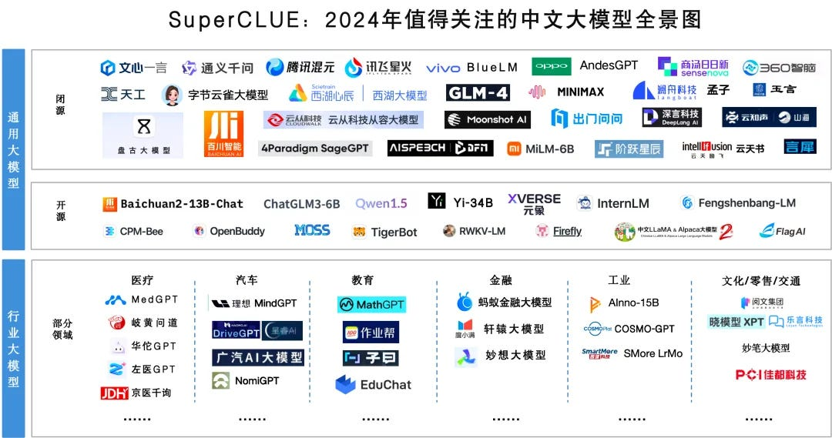
Chinese LLMs
Figure source: https://chinai.substack.com/p/chinai-264-superclue-april-2024-report

Slide 39
Announcements

Slide 40
Week 12 要繳交什麼？
清晰易懂的簡報至少 5 頁，一組繳交一份
介紹競賽任務
舉例說明資料的長相
初步資料分析（你必須要了解資料才能做機器學習任務）
可以參考 Kaggle Code，關鍵字: EDA (Exploratory Data Analysis)
請附上來源!!
實作方法
已經實作或預期實作的模型
可以參考 Kaggle Code，請附上來源!!
(Optional) 目前實作結果、Kaggle Leaderboard 排名或分數
分工模式

Slide 41
Week 12 繳交注意事項
5 頁是最低需求 (不包含首頁跟最後一頁)
可以多於5頁!!
一組繳交一份，請上傳至 E-Learning
Deadline: 2026/05/11 (Mon.) 23:59
繳交格式：
檔名：DL_teamN_checkpoint1.pdf
首頁（封面）：題目、組別、組員名單
最後一頁：分工模式

Slide 42
大型語言模型應用
當我們有了一個訓練好的LLM，之後？

Slide 43

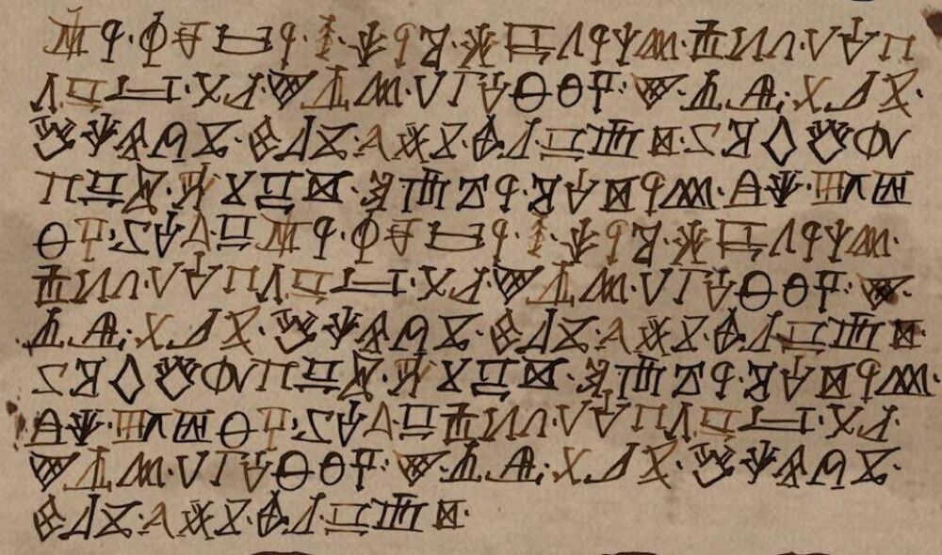
讓大型語言模型適用於你的任務？
📚
翻譯、聊天、寫故事 …
💪
醫學資料、少數語言、網路上查不到的知識
⚠️
解決方案：增加提示詞 或 訓練語言模型
Figure source: https://gameofthrones.fandom.com/wiki/High_Valyrian?file=Nekesse_Valyrio.jpg

Slide 44
提示詞工程與上下文工程 (範例)
提示詞工程
Prompt Engineering
上下文工程
Context Engineering
你是一名客服人員，請有禮貌地回答問題。
使用者：我可以在購買後14天申請退款嗎？
你是一名客服人員。
公司政策：
- 僅在購買後14天內可申請退款。超過14天除非商品有瑕疵，否則無法退款。
使用者：我可以在購買後14天申請退款嗎？
模型可能回答：
當然可以，這取決於具體情況。
模型可能回答：
很抱歉，根據本公司的退款政策，超過14天後除非商品有瑕疵，否則無法辦理退款。

Slide 45


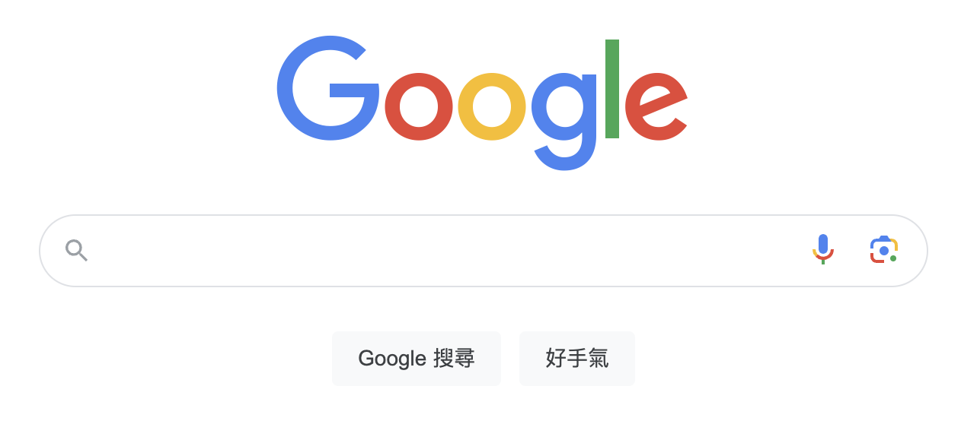
資訊檢索 (Information Retrieval)
資訊檢索：從資料庫中找到相關的資訊 (就像是搜尋引擎)
Retrieval-Augmented Generation (RAG): 把檢索到的資訊作為上下文工程，可以讓 LLM 做出更精確的回覆

Slide 46
增加上下文資訊的過程 (RAG)
Step1: 搜尋精確的上下文資訊
公司政策
政策1
政策2
政策3
...
Retriever
僅在購買後14天內可申請退款。超過14天除非商品有瑕疵，否則無法退款。
我可以在購買後14天申請退款嗎？
Step2: 模型推論
僅在購買後14天內可申請退款。超過14天除非商品有瑕疵，否則無法退款。
我可以在購買後14天申請退款嗎？

Slide 47


Retrieval-Augmented Generation (RAG) 框架
Input Query
Generator
(e.g., LLM)
LLM Output
Which year was Oppenheimer born?
1967 (Without RAG)
1904 (With RAG)
Retriever
(e.g., BERT)
Robert Oppenheimer (born April 22, 1904, New York, New York, U.S.—died February 18, 1967, Princeton, New Jersey) was an American theoretical physicist and science administrator ...
Retrieved Documents
Knowledge Base (e.g., Wikipedia)
Gao, Yunfan, et al. "Retrieval-augmented generation for large language models: A survey." arXiv preprint arXiv:2312.10997 (2023).

Slide 48
Why do we need RAG?
LLMs have profound parameterized knowledge that makes them useful in responding to general prompts.
However, LLMs are error-prone due to lack of domain knowledge or outdated information (RAG 可協助更新知識).
Standalone LLMs do not serve users who want a deeper dive into a current or more specific topic (RAG 可協助提供特定領域知識).
https://blogs.nvidia.com/blog/what-is-retrieval-augmented-generation/

Slide 49
接下來我們專注於 Retriever 如何建立
Input Query
Generator
(e.g., LLM)
LLM Output
Which year was Oppenheimer born?
1967 (Without RAG)
1904 (With RAG)
⬅️
⬅️
⬅️
⬅️
⬅️
Retriever
(e.g., BERT)
Robert Oppenheimer (born April 22, 1904, New York, New York, U.S.—died February 18, 1967, Princeton, New Jersey) was an American theoretical physicist and science administrator ...
Retrieved Documents
Knowledge Base (e.g., Wikipedia)
Gao, Yunfan, et al. "Retrieval-augmented generation for large language models: A survey." arXiv preprint arXiv:2312.10997 (2023).

Slide 50
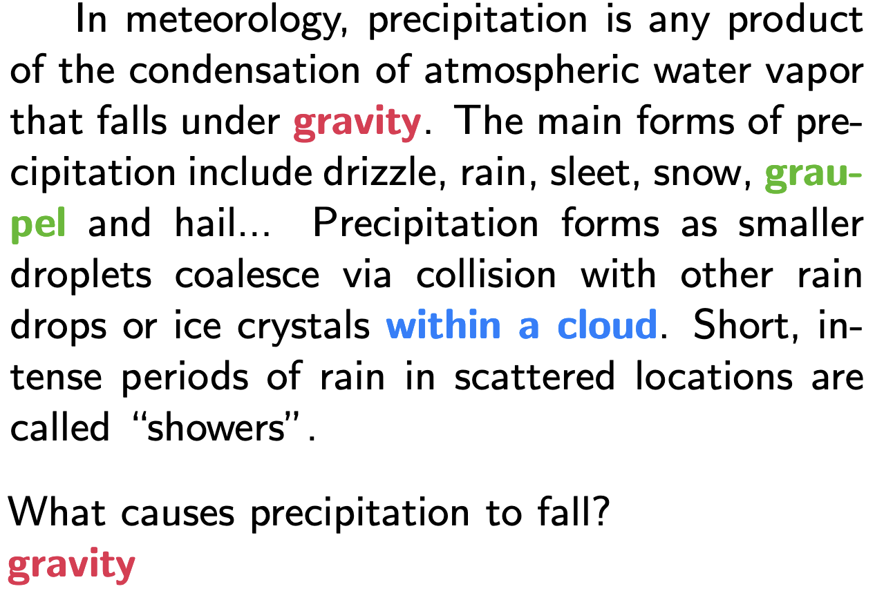
Task: Open-domain question answering (ODQA)
Given a question x such as “What is the currency of the UK?”, a model must output the correct answer string y, “pound”.
“Open” refers to the fact that the model does not receive a pre-identified document that contains the answer (ODQA 任務沒有 context).
ODQA is like Reading comprehension (RC) tasks, such as SQuAD, but no relevant articles provided.
(Example of SQuAD, 有 context)
Guu, Kelvin, et al. "Retrieval augmented language model pre-training." ICML 2020.
Rajpurkar, P., Zhang, J., Lopyrev, K., & Liang, P. (2016). SQuAD: 100,000+ Questions for Machine Comprehension of Text. EMNLP 2016.

Slide 51
Retrievers for RAG
Task-oriented training:
Retrieval for open-domain question answering (ODQA)
Sentence embeddings for semantic similarity tasks
Retrieval for open-domain question answering
Finding a relevant document
Query
(a question)
Relevant doc
Irrelevant doc
...
Irrelevant doc
Model
搜尋規模較大
500萬篇
Sentence embeddings for semantic similarity tasks
Finding a semantically similar sentence
Sentence
Relevant
Sentence
Irrelevant sentence
...
Irrelevant sentence
Model
20 sentences
Both approaches are suitable for retrieval (depends on your task for an LLM).

Slide 52
Sentence embeddings for semantic similarity tasks

Slide 53
BERT as a Cross Encoder
For a cross encoder, representations of two input sentences are attended with each other.
The hidden state of [CLS] represents the relationship between the two input sentences.
H_{[CLS]}
H₁
...
H_{N}
H_{[SEP]}
H’₁
...
H’_{N}
H’_{[SEP]}
BERT
[CLS]
Tok1
...
TokN
[SEP]
Tok1’
...
TokN’
[SEP]
Sentence A
Sentence B
Devlin, J., Chang, M.W., Lee, K., & Toutanova, K. (2019). BERT: Pre-training of Deep Bidirectional Transformers for Language Understanding. NAACL 2019.

Slide 54
Cross-encoder 速度問題
10,000 個句子 ⬇️
Classification
Cross encoder
頭痛可能的原因
Sent1
[SEP]
Sent2
[SEP]
For 10,000 sentence pairs:
Cross encoders: n·(n−1)/2 = 49,995,000 inference times

Slide 55
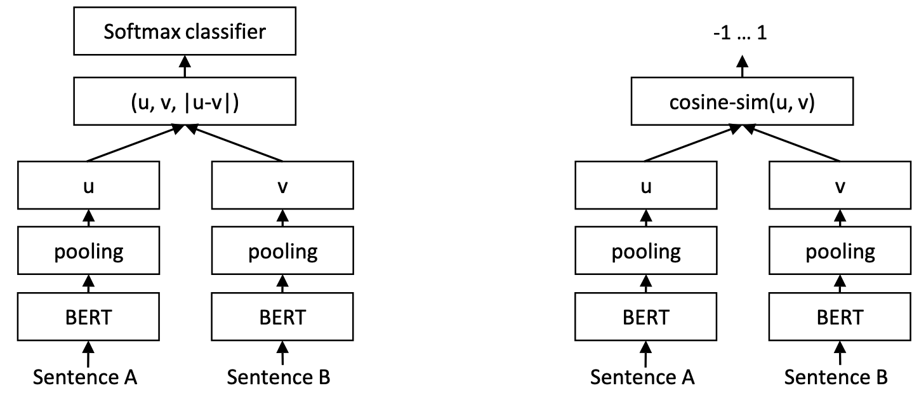
Sentence-BERT
# Pseudo code for Bi-encoder
query_vector = encoder(query) # [0.1, 0.2, 0.3]
document_vector = encoder(document) # [0.2, 0.2, 0.4]
similarity = cosine_similarity(query_vector, document_vector)
一次學習三種表達
權重共享
(Siamese Network)
Training time
Inference time
Reimers, N., & Gurevych, I. (2019). Sentence-BERT: Sentence Embeddings using Siamese BERT-Networks. (EMNLP-ĲCNLP 2019)

Slide 56
Why does Sentence-BERT need pooling?
BERT produces embeddings (hidden states from the final layer) for each token.
We need a single fixed-size vector for the entire sentence.
Output hidden states of input1
Output hidden states of input2
H_{[CLS]}
H₁
...
H_{N}
H_{[SEP]}
H_{[CLS]}
H₁
...
H_{N}
H_{[SEP]}
BERT
BERT
[CLS]
Tok1
...
TokN
[SEP]
[CLS]
Tok1
...
TokN
[SEP]

Slide 57
Pooling of Sentence-BERT
We need a single fixed-size vector for the entire sentence.
CLS: Use the [CLS] token
This is the default setting in original BERT.
MEAN: the mean of all output vectors
Averages all token embeddings.
MAX: max-over-time of the output vectors
Takes maximum value across each dimension.
Reimers, N., & Gurevych, I. (2019). Sentence-BERT: Sentence Embeddings using Siamese BERT-Networks. (EMNLP-ĲCNLP 2019)

Slide 58
Computation time for Bi-encoders and Cross encoders
For 10,000 sentence pairs:
Cross encoders: n·(n−1)/2 = 49,995,000 inference times
Bi-encoders (e.g., Sentence-BERT): 10,000 * 2 inference times (can be parallel) with cosine similarity calculation
Cosine similarity
Classification
H1
H2
Cross encoder
Encoder
Encoder
Sent1
[SEP]
Sent2
[SEP]
Sent1
Sent2

Slide 59
Dense Passage Retrieval (DPR)
CGUDL_2025_Spring/blob/main/slides/ssl_0421.pptx
CGUDL_2025_fall/blob/main/slides/w11_ssl_1112.pdf
Training the encoders
Goal: Relevant pairs of questions and passages will have smaller distance than the irrelevant ones
Training data
m training instances
Question
Relevant Passage
n Irrelevant Passages
Karpukhin et al., 2020. Dense Passage Retrieval for Open-Domain Question Answering. EMNLP 2020.

Slide 60
Thank you!
Instructor: 林英嘉
✉️ yjlin@cgu.edu.tw
TA: 林宣辰
✉️ b1128015@cgu.edu.tw

