Slide 1

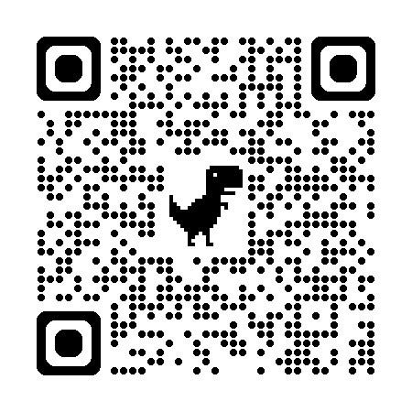
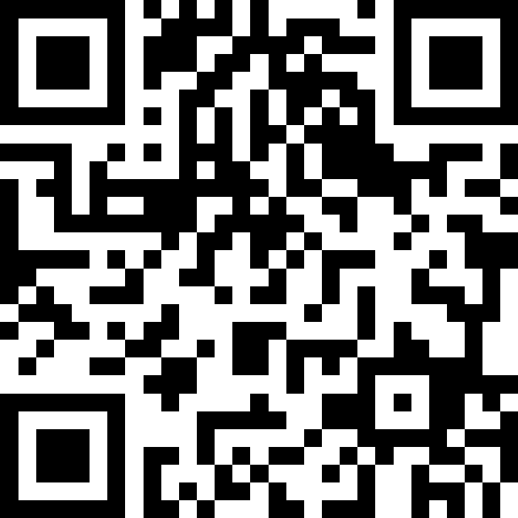
自然語言處理與應用 Natural Language Processing and Applications
文字向量基礎
Slido
# NLP0302 (Link)
GitHub
Instructor: 林英嘉 (Ying-Jia Lin)
2026/03/02

Slide 2
Outline
文字向量基礎
Introduction to embeddings
Sentence embeddings
Word embeddings

Slide 3


影像 vs. 文字
28 x 28 的矩陣
I want to study AI
?
Figure source: https://kopu.chat/wp-content/uploads/2017/04/binary-507x380.jpeg

Slide 4
Embeddings（嵌入）
💡在NLP 中，Embeddings 代表把文字（word / token / sentence）映射成向量，使得向量之間的距離或方向能反映它在語料中的用法與語意相似性。
Tokyo
[0.12, 0.33, 0.73, ...]
Embedding Model
Kuala Lumpur
[0.24, 0.63, 0.39, ...]
Japan
[0.03, 0.86, 0.21, ...]
Malaysia
[0.18, 0.47, 0.75, ...]

Slide 5
Embedding: 把(語義)資訊嵌入到向量中
📍
Tokyo
Tokyo
[0.12, 0.33, 0.73, ...]
🇯🇵
Japan
Kuala Lumpur
[0.24, 0.63, 0.39, ...]
Japan
[0.03, 0.86, 0.21, ...]
📍
Kuala Lumpur
Malaysia
[0.18, 0.47, 0.75, ...]
🇲🇾
Malaysia

Slide 6
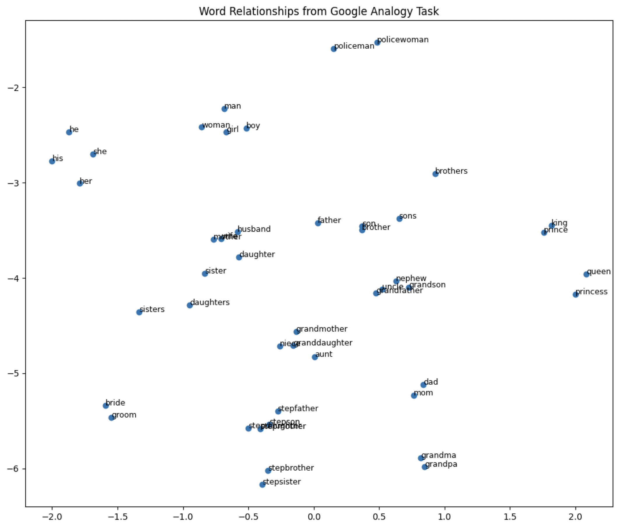
詞向量視覺化
Word embedding model: glove-wiki-gigaword-100
Dimension reduction: t-SNE
Dataset: Mikolov et al., 2013
Try it: https://www.cs.cmu.edu/~dst/WordEmbeddingDemo/

Slide 7
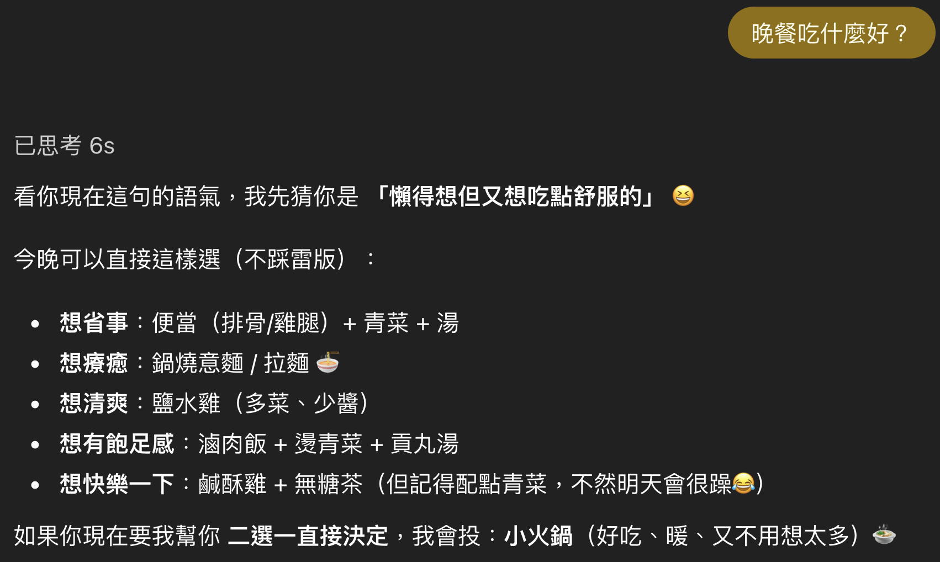
ChatGPT 也是在根據向量的語義進行回答

Slide 8
Outline
文字向量基礎
Introduction to embeddings
Sentence embeddings
Word embeddings

Slide 9
詞向量 vs. 句向量
Word Embedding Model
Tokyo
[0.12, 0.33, 0.73, ...]
Sentence Embedding Model
晚餐吃什麼？
[0.36, 0.45, 0.78, ...]

Slide 10


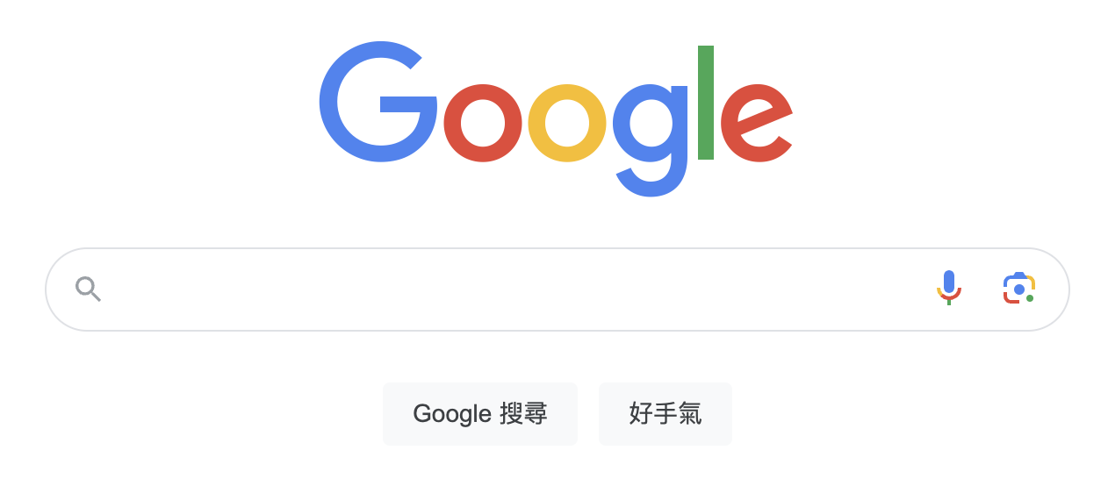
Google Search (Retrieval)
Retrieval: get relevant information from a pool (like a search engine)
誰是 Alex Honnold？

Slide 11
Google Search vs. 向量化
相似度
[0.15, 0.82, -0.34, ...]
99%
[0.93, -0.32, 0.43, ...]
98%
誰是 Alex Honnold？
[0.54, 0.95, -0.61, ...]
[0.08, 0.02, 0.83, ...]
97%
NLP 的 Embeddings: 語意資訊被嵌入到（高維度）向量空間

Slide 12
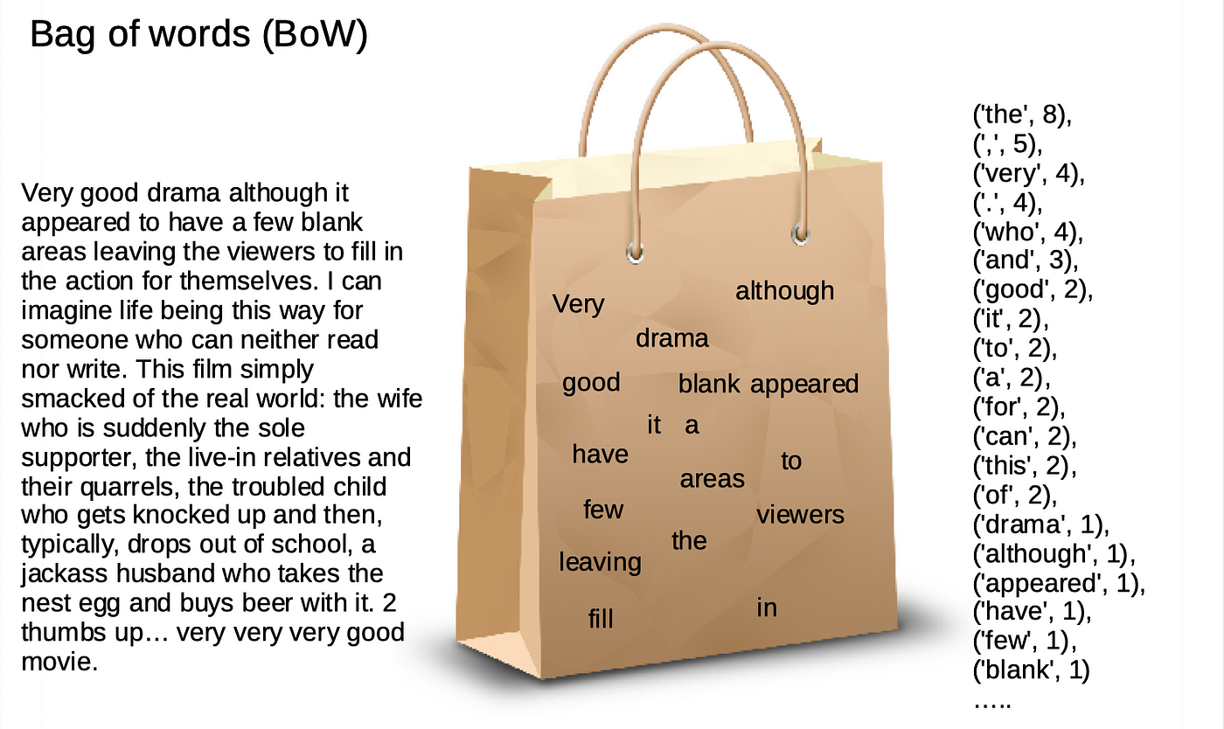
Bag-of-words Model
Meaning: Each document (sentence) carries a bag of words.
Figure source: https://sfhsu29.medium.com/nlp-入門-1-text-classification-sentiment-analysis-極簡易情感分類器-bag-of-words-naive-bayes-e40d61de9a7f

Slide 13
Bag-of-words Model (Example 1)
https://github.com/mcps5601/CGUNLP_2025_Spring/code/bow.py
Step 1: Find unique words (vocab)
Corpus
apple
eat
I
like
to
TV
watch
you
D1
I like to eat apple
Step 2: Form document vectors
D2
You like to watch TV
D1
[1, 1, 1, 1, 1, 0, 0, 0]
D2
[0, 0, 0, 1, 1, 1, 1, 1]
Notes:
The vector size is equal to the vocab size.
Each position of a vector is corresponding to the position in the vocab.

Slide 14
Bag-of-words Model (Example 2)
Step 1: Find unique words (vocab)
Corpus
apple
eat
I
like
to
TV
watch
you
D1
I like like to eat apple
Step 2: Form document vectors
D2
You I like to watch TV
D1
[1, 1, 1, 2, 1, 0, 0, 0]
D2
[0, 0, 1, 1, 1, 1, 1, 1]
Notes:
The vector size is equal to the vocab size.
Each position of a vector is corresponding to the position in the vocab.

Slide 15
TF-IDF
TF (Term Frequency; 詞頻)
IDF (Inverse Document Frequency; 逆文本頻率)
TF x IDF
＝關鍵字分數
某詞出現在該句子的頻率
某詞出現在全部文本的頻率的倒數

Slide 16
TF-IDF 為什麼這樣設計？
想像你撿到了班上三位同學的日記：
日記 A (小明的)： 「我 今天 去 吃 漢堡，漢堡 超 好吃。」
日記 B (小華的)： 「我 今天 去 學校 上課，好 累。」
日記 C (小美的)： 「我 今天 跟 媽媽 去 買 菜。」
日記 A 裡的內容觀察：
單字 | TF (在這篇很多?) | IDF (在別篇很少?) | 結果 (TF-IDF) | 意義
我 | 是 (1次) | 否 (每句都有) | 低分 | 雜訊/不重要
今天 | 是 (1次) | 否 (每句都有) | 低分 | 雜訊/不重要
漢堡 | 是 (2次) | 是 (別句都沒提) | 高分 | 關鍵字！

Slide 17
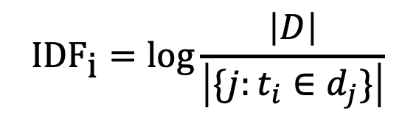
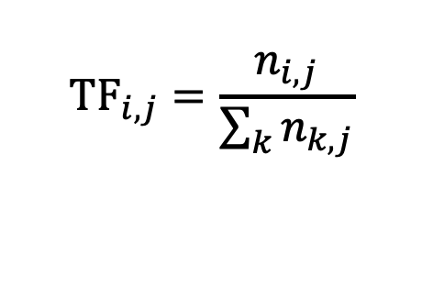


TF-IDF 的公式
The mathematical representation of TF-IDF:
Where is the i-th word in the j-th document in the dataset.
TF (Term Frequency)
Represents the "frequency" of a term appearing in a text.
IDF (Inverse Document Frequency)
Aims for terms to have higher specificity, meaning the fewer texts in the dataset contain the term, the better.
where
$${TF}_{i,j}=\frac{n_{i,j}}{\sum_{k}{n_{k,j}}}$$
$$\text{ID}{\text{F}}_{\text{i}}=\log{\frac{\left|D\right|}{\left|\{j:t_{i}∈d_{j}\}\right|}}$$
TF-IDF
$$=TF×IDF$$
$$n_{i,j}$$

Slide 18
Sentence Embeddings: TF-IDF
日記 A (小明的)：「我 今天 去 吃 漢堡，漢堡 超 好吃。」
日記 B (小華的)：「我 今天 去 學校 上課，好累。」
日記 C (小美的)：「我 今天 跟 媽媽 去 買 菜。」
字典大小
 | 我 | 今天 | 去 | 吃 | 漢堡 | 超 | 好吃 | 學校 | 好累 | 跟 | ...
TF | 1/8 =0.125 | 1/8 =0.125 | 1/8 =0.125 | 1/8 =0.125 | 2/8 =0.25 | 1/8 =0.125 | 1/8 =0.125 | 0 | 0 | 0
IDF | log(3/3)=0 | log(3/3)=0 | log(3/3)=0 | log(3/1)=0.48 | log(3/1)=0.48 | log(3/1)=0.48 | log(3/1)=0.48 | log(3/1)=0.48 | log(3/1)=0.48 | log(3/1)=0.48
分數(TFxIDF) | 0 | 0 | 0 | 0.06 | 0.12 | 0.06 | 0.06 | 0 | 0 | 0

Slide 19
TF-IDF 的問題
在 TF-IDF 的世界裡，字跟字是完全獨立的。
句子 A： 「我很快樂」
句子 B： 「我很開心」
本質上仍是詞袋模型 (Bag-of-words) ，不分「順序」
句子 A： 「小明喜歡小華」
句子 B： 「小華喜歡小明」

Slide 20
Outline
文字向量基礎
Introduction to embeddings
Sentence embeddings
Word embeddings

Slide 21
Word Representations
like
🖥️
?
apple
Basic Approach
apple
[1, 0, 0, 0, 0, 0, 0, 0]
One hot encodings with each vector size equal to the vocab size (8 in this case)
Corpus
eat
[0, 1, 0, 0, 0, 0, 0, 0]
I like to eat apple
I
[0, 0, 1, 0, 0, 0, 0, 0]
Vocabulary
Pros: handy, training-free
Cons: sparse matrix which occupies much memory
You like to watch TV
like
[0, 0, 0, 1, 0, 0, 0, 0]
watch
[0, 0, 0, 0, 1, 0, 0, 0]
to
[0, 0, 0, 0, 0, 1, 0, 0]
...

Slide 22
詞嵌入：把詞嵌入到向量 (Word2Vec)
Input
Prediction
[1] Mikolov et al. "Distributed representations of words and phrases and their compositionality." NeurIPS 2013.
Steve
Jobs
Word2Vec
(CBOW)
[MASK]
founded
Apple
非常大量的語料庫 (例如：Wikipedia)
Inc.
[MASK]
Steve
[MASK]
Jobs
Word2Vec
(Skip-gram)
founded
[MASK]
Apple
[MASK]
Inc.

Slide 23
每個字，都是一段向量 – 詞向量
Word2Vec 的範例長相:
D: Dimension size (e.g., 300)
apple -0.110960 0.016115 -0.004809 0.033589 0.121455 …
banana -0.027713 -0.015676 0.003314 0.077602 0.159718 …
…
…
…
V: Vocabulary size
(e.g., 30,000)

Slide 24
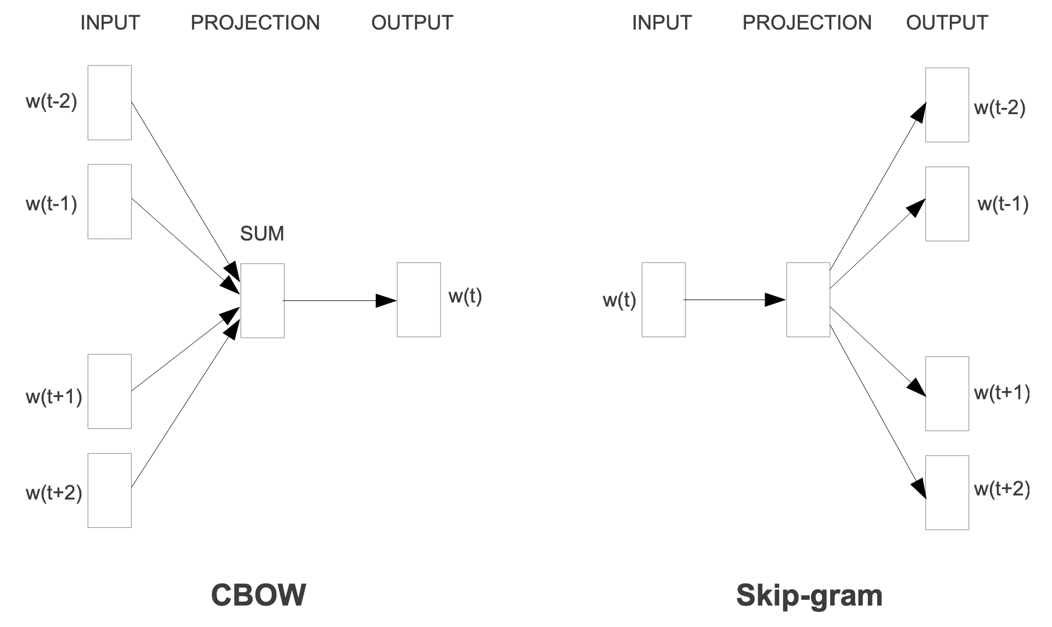
Word2Vec: CBOW vs. Skip-gram
Mikolov et al. "Efficient estimation of word representations in vector space." arXiv preprint arXiv:1301.3781 (2013).

Slide 25
How to train? (以 Skip-gram 為例, 1/2)
-0.110960 0.016115 -0.004809 0.033589 0.121455 …
-0.027713 -0.015676 0.003314 0.077602 0.159718 …
…
…
…
W₁: VxD
Input Embeddings
-0.110960 0.016115 -0.004809 0.033589 0.121455 …
-0.027713 -0.015676 0.003314 0.077602 0.159718 …
…
…
…
Output Embeddings
W₂: VxD

Slide 26
Embedding Lookup
Index
Vocab | Dimension 1 | Dimension 2
I | -0.47030617476956654 | -4.440892098500626e-16
love | -8.326672684688674e-16 | 0.4464710977801294
do | 8.881784197001252e-16 | 0.7838949952895327
deep | -0.4915010045415975 | -1.3016463110087907e-16
learning | -1.582067810090848e-15 | 0.4314767609119055
NLP | -0.2523320838384413 | -2.1837832516159107e-16
programming | -0.6881623238553303 | -1.914220234434739e-16
0
1
2
3
4
5
6

Slide 27
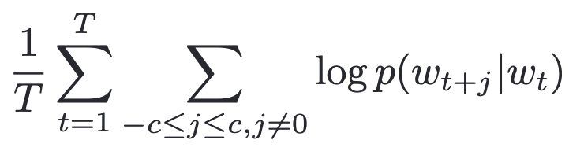
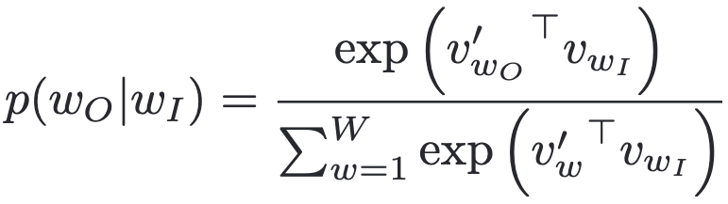
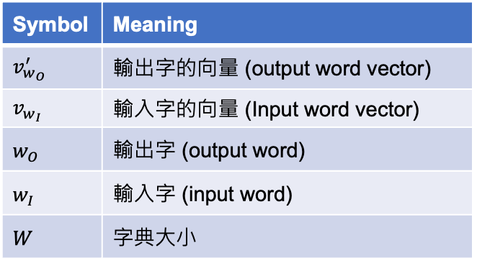
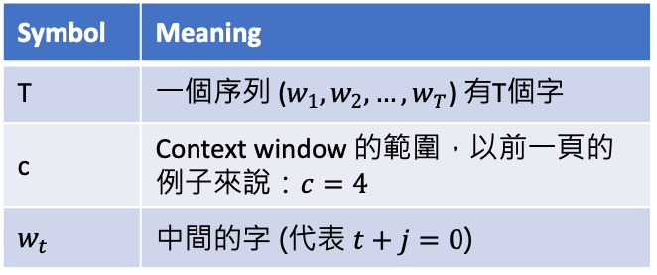
How to train? (以 Skip-gram 為例, 2/2)
Symbol | Meaning
T | 一個序列 ($w_{1},w_{2},…,w_{T}$) 有T個字
c | Context window 的範圍，以前一頁的例子來說：$c=4$
$$w_{t}$$ | 中間的字 (代表 $t+j=0$)
中間字預測周圍字的機率值
Softmax function
Symbol | Meaning
$$v_{w_{O}}^{′}$$ | 輸出字的向量 (output word vector)
$$v_{w_{I}}$$ | 輸入字的向量 (Input word vector)
$$w_{O}$$ | 輸出字 (output word)
$$w_{I}$$ | 輸入字 (input word)
$$W$$ | 字典大小
內積

Slide 28


為什麼要取 log?
考慮到一些極端數值：
$${10}^{4}−{10}^{3}$$
如果取log之後：
$$log{10}^{4}−log{10}^{3}=4−3$$
會讓數值範圍變小，使機器學習的最佳化過程穩定
會降低極端值的影響，避免 outliers 影響訓練結果
https://datascience.stackexchange.com/questions/40089/what-is-the-reason-behind-taking-log-transformation-of-few-continuous-variables

Slide 29
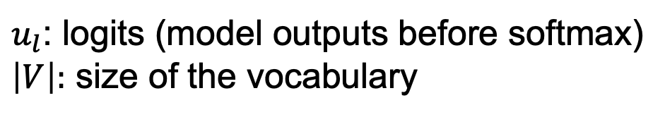
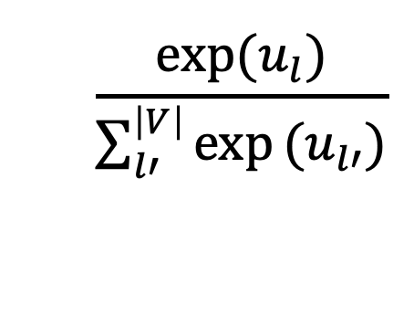
Softmax
When generating the next word, `softmax` is performed to get the probabilities among the words in the vocabulary.
Softmax formula:
$$\frac{\text{exp}\text{(}u_{l}\text{)}}{\sum_{l′}^{\left|V\right|}{\text{exp}}(u_{l′})}$$
使用 exp 來取得機率的主要原因：
恆正
符號不變性
$u_{l}$: logits (model outputs before softmax)
$\left|V\right|:$ size of the vocabulary

Slide 30
Softmax
Word
Logits
Probability
the
am
no
a
/
0.0011
0.0012
0.0013
0.0014
0.0015
0.78
0.11
0.03
0.02
0.06
Example
Vocab
SUM = 1
Note that softmax is required for every decoding strategies since we need to find out the next word from a vocabulary.

Slide 31
Advanced Techniques of Word2vec
Speed up the training process of Word2vec
Hierarchical Softmax
Negative Sampling
Mikolov et al. "Distributed representations of words and phrases and their compositionality." NeurIPS 2013.

Slide 32
Hierarchical Softmax Overview
總目標：近似輸出層，因為在 Vocab size 很大的情況下做 Softmax 計算量很大
訓練流程：
Step1: 把字典的字根據頻率建立出一棵 Huffman Tree
Step2: 以 internal nodes 的權重 (vectors) 代替輸出層，從 root node 開始計算往下走每層的機率值 Softmax(dot_product)，每層都只做二元分類
Step3: 調整 internal nodes 的權重
Huffman Tree 是一種最佳前綴編碼樹 (optimal prefix code tree)，其特性是：
頻率較高的詞會被分配較短的路徑，使得它們的預測成本較低。
頻率較低的詞會有較長的路徑，以減少總體的編碼長度。
Mikolov et al. "Distributed representations of words and phrases and their compositionality." NeurIPS 2013.

Slide 33
Huffman Tree 快速範例
假設有 4 個符號，出現頻率如下：A: 5、B: 7、C: 10、D: 15
Step 3. 給予標記
Step 1. 每個符號先當一棵樹
Step 2. 每次合併「頻率最小的兩棵樹」
(37)
(12)
D(15)
(22)
1
0
A(5) B(7) C(10) D(15)
A(5)
B(7)
C(10)
D(15)
C(10)
(12)
11
10
(22)
A(5)
B(7)
110
111
C(10)
(12)
A(5)
B(7)
D(15)

Slide 34








Hierarchical Softmax
Mikolov et al. "Distributed representations of words and phrases and their compositionality." NeurIPS 2013.
$$w_{fruit}$$
$$v_{1}$$
P(Mangosteen|fruit)=?
Internal nodes (帶有 weights)
Softmax
字典中的字 (越上層詞頻越高，結構為 Huffman Tree)
$$v_{2}$$
$$v_{3}$$
Softmax
$$v_{4}$$
$$v_{5}$$
the
of
Softmax
$$v_{6}$$
$$v_{7}$$
Softmax
訓練目標為最大化路徑中每個節點經過Softmax後結果相乘的機率值
Mangosteen

Slide 35
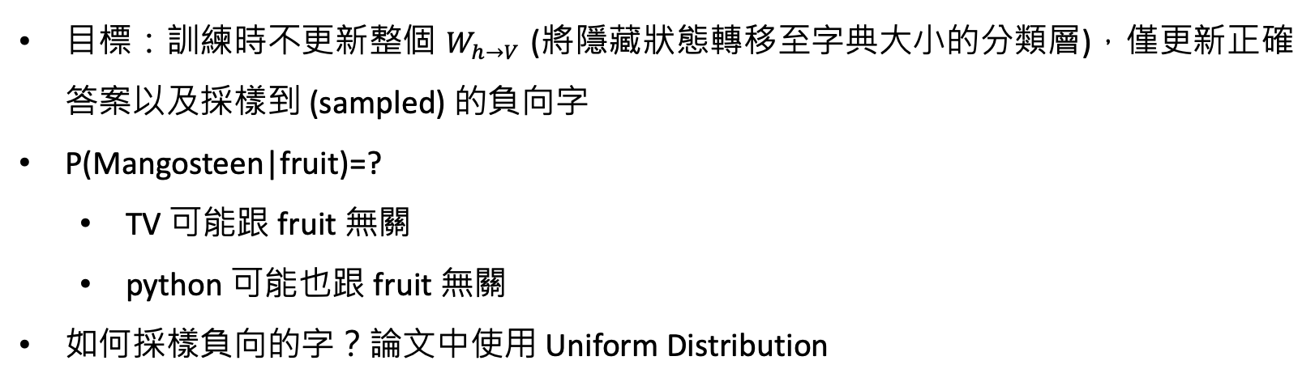
Negative Sampling Overview
目標：訓練時不更新整個 $W_{h→V}$ (將隱藏狀態轉移至字典大小的分類層)，僅更新正確答案以及採樣到 (sampled) 的負向字
P(Mangosteen|fruit)=?
TV 可能跟 fruit 無關
python 可能也跟 fruit 無關
如何採樣負向的字？論文中使用 Uniform Distribution
Mikolov et al. "Distributed representations of words and phrases and their compositionality." NeurIPS 2013.

Slide 36
Negative Sampling
Vocab
Prob
P(Mangosteen|fruit)=?
TV
...
Mangosteen
...
NLP
...
...
python
...
zip
...
...
。
0.0001
...
0.600
...
0.0001
...
0.0003
...
0.0001
...
0.0001
...
...
0.0001
Negative word
Dot product
Softmax
Vocab
size
Negative word
Mikolov et al. "Distributed representations of words and phrases and their compositionality." NeurIPS 2013.

Slide 37
Negative Sampling Details
Negative words 要設定成多少呢？
5–20 are useful for small training datasets
2–5 for large training datasets
(Empirical setting; Hyperparameter)
https://radimrehurek.com/gensim/models/word2vec.html
Mikolov et al. "Distributed representations of words and phrases and their compositionality." NeurIPS 2013.

Slide 38
詞向量視覺化
Word embedding model: glove-wiki-gigaword-100
Dimension reduction: t-SNE
Dataset: Mikolov et al., 2013
Try it: https://www.cs.cmu.edu/~dst/WordEmbeddingDemo/

Slide 39
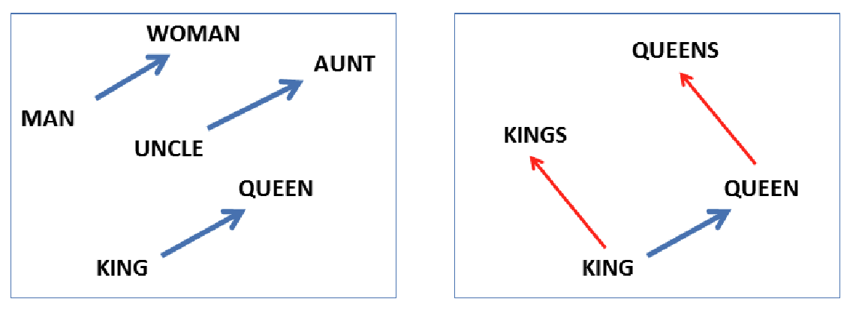
Word Analogy (左：semantic, 右: syntactic)
b - a = d - c
d = b - a + c
b
d
d
d - b
a
d - c
c
b
b - a
c
c - a
a
b – a = d – c
(移項) d – b = c - a
Mikolov et al. “Linguistic regularities in continuous space word representations.” NAACL 2013.

Slide 40
The Two Word2vec Papers
Mikolov et al. "Efficient estimation of word representations in vector space." arXiv preprint arXiv:1301.3781 (2013).
介紹 CBOW 以及 Skip-gram
Mikolov et al. "Distributed representations of words and phrases and their compositionality." NeurIPS 2013.
針對 Skip-gram 來進行詳細說明，並且介紹加速訓練的方法：
(1) Hierarchical Softmax (2) Negative Sampling

Slide 41
Thank you!
Instructor: 林英嘉
✉️ yjlin@cgu.edu.tw
TA: 林宣辰
✉️ b1128015@cgu.edu.tw

