Slide 1



自然語言處理與應用 Natural Language Processing and Applications
BERT and its Family
Slido
# NLP0330 (Link)
GitHub
Instructor: 林英嘉 (Ying-Jia Lin)
2026/03/30

Slide 2
Outline
Recap [15 min]
Positional Encoding [20 min]
Cross-attention [15 min]
BERT and its Family [50 min]
Code [35 min]
Quiz [15 min]

Slide 3
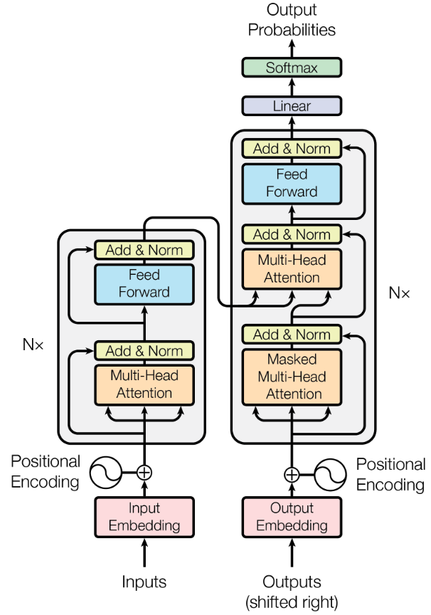
Outline of Transformer
Vaswani, Ashish, et al. "Attention is all you need." NeurIPS (2017).

Slide 4
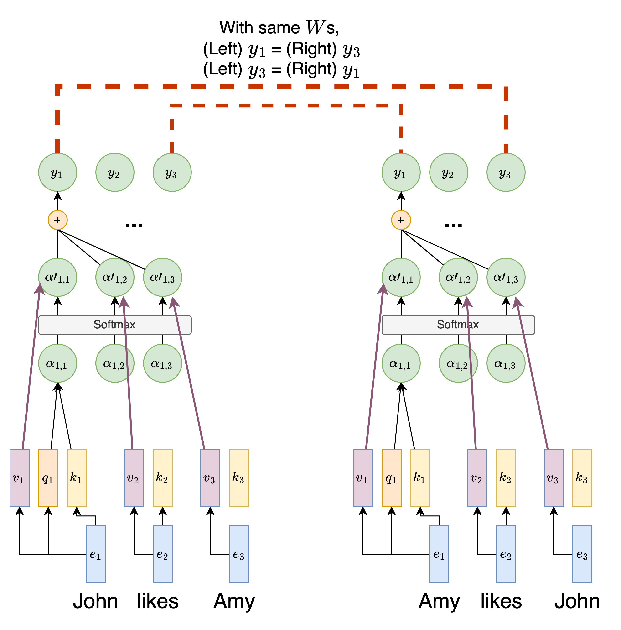
Lack of Position Modeling
RNN 有位置資訊 (因為 RNN step-by-step 處理文字)
然而，Transformer 中 self-attention 的操作遺失了 step-by-step 處理文字的方式，故缺少位置資訊
不同語意的句子但文字資訊卻沒有根據上下文而變化
Notes:
RNNs use the recurrent nature to encode relative distance, but self-attention alone does not have the concept of distance.
Figure link: https://www.google.com/imgres?imgurl=https%3A%2F%2Fen.pimg.jp%2F062%2F372%2F497%2F1%2F62372497.jpg&tbnid=h12XO59LOC-2AM&vet=12ahUKEwi-hZz5-aeEAxUjiq8BHWxaD30QMygLegQIARBw..i&imgrefurl=https%3A%2F%2Fwww.pixtastock.com%2Fillustration%2F62372497&docid=EjyqzObtASteNM&w=450&h=468&q=trouble%20face%20cute%20&ved=2ahUKEwi-hZz5-aeEAxUjiq8BHWxaD30QMygLegQIARBw

Slide 5
常見位置資訊作法：Learned Positional Embeddings (PE)
Self-attention
Self-attention
p₁
e₁
p₂
e₂
p₃
e₃
p₁
e₁
p₂
e₂
p₃
e₃
+
+
+
+
+
+
1
John
2
likes
3
Amy
1
Amy
2
likes
3
John
此做法又稱絕對位置資訊編碼 (Absolute positional Encoding)

Slide 6
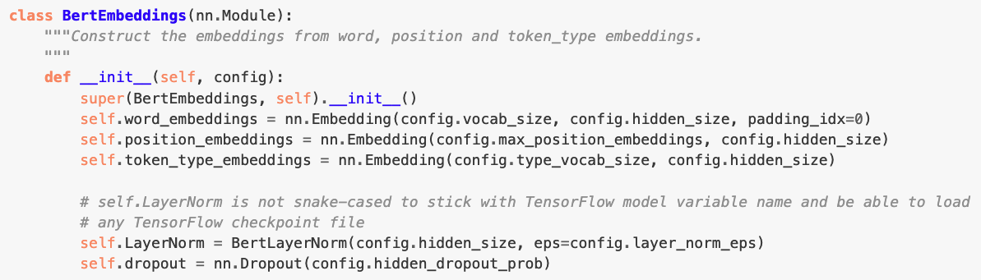
Learned Positional Embeddings 程式碼
https://huggingface.co/transformers/v2.1.1/_modules/transformers/modeling_bert.html
缺點：Learned Positional Embeddings 不會超出 max_position 之後的資訊

Slide 7
BERT PE 範例
假設 `max_position_embeddings = 5`，`hidden_size = 4`，那麼 `nn.Embedding(5, 4)` 會建立一張這樣的表：
位置 0 → [0.12, -0.34, 0.56, 0.78]
位置 1 → [0.91, 0.23, -0.45, 0.67]
位置 2 → [-0.11, 0.88, 0.33, -0.52]
位置 3 → [0.44, -0.76, 0.21, 0.95]
位置 4 → [-0.63, 0.15, 0.82, -0.37]
當輸入句子 `"我 喜歡 NLP"` 時，三個 token 分別在位置 0、1、2：
"我" → 查位置 0 → [0.12, -0.34, 0.56, 0.78]
"喜歡" → 查位置 1 → [0.91, 0.23, -0.45, 0.67]
"NLP" → 查位置 2 → [-0.11, 0.88, 0.33, -0.52]

Slide 8
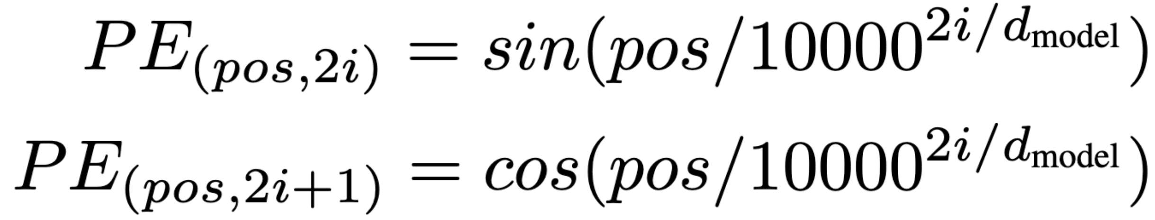
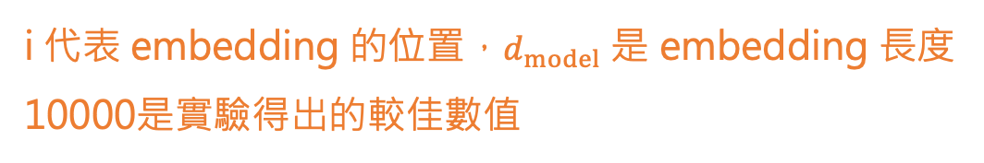
Positional Encoding in Transformer
以絕對位置編碼創造出相對位置的 embeddings
核心精神：利用三角函數的週期性來建構序列資訊
i 代表 embedding 的位置，$d_{model}$ 是 embedding 長度
10000是實驗得出的較佳數值
輸入序列中任一token的位置
Notes:
sin(wt)，w是角速度，t是時間，在這邊指的是pos
w=2π/λ
PE公式可寫成sin(2πpos / 10000^{2i / d_{model}} * 2π)
因此λ為10000^{2i / d_{model}} * 2π
i最小時λ為2π
i最大時λ為10000 * 2π

Slide 9
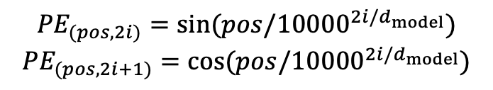

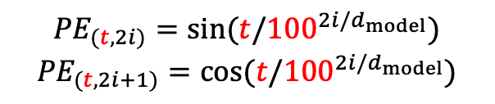
Transformer PE 範例
分母：
i = 0 -> 100⁰ = 1
i = 1 -> 100^{1/2} = 10
$${PE}_{(t,2i)}=sin⁡(t/{100}^{2i/d_{model}})$$
$${PE}_{(t,2i+1)}=cos⁡(t/{100}^{2i/d_{model}})$$
$${PE}_{(pos,2i)}=sin⁡(pos/{10000}^{2i/d_{model}})$$
$${PE}_{(pos,2i+1)}=cos⁡(pos/{10000}^{2i/d_{model}})$$
設 $d_{model}$ = 4
i = 0
i = 1
token | sin(t/1) | cos(t/1) | sin(t/10) | cos(t/10)
I | 0.00 | 1.00 | 0.00 | 1.00
love | 0.84 | 0.54 | 0.10 | 1.00
nlp | 0.91 | -0.42 | 0.20 | 0.98
. | 0.14 | -0.99 | 0.30 | 0.96
I
love
nlp
.
[
] I 的 PE
t=0
[
] Iove 的 PE
t=1
[
] nlp 的 PE
t=2
[
] . 的 PE
t=3

Slide 10
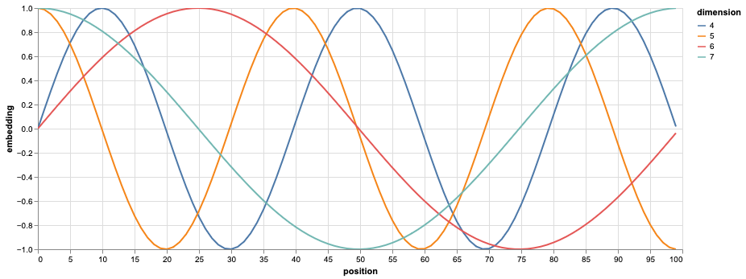
Positional Encoding Visualization
i越大 -> 分母越大 -> 相位變化越慢 -> 頻率越小
sin30∘=0.5
sin150 ∘=0.5
vs.
(sin30 ∘,cos30 ∘)=(0.5,0.866)
(sin150∘,cos150 ∘)=(0.5,−0.866)
Question: 為什麼需要同時有 Sin 和 Cosine 的函數？
Ans: 藉由不同週期性來捕捉序列中各個位置的關係
Figure source: https://nlp.seas.harvard.edu/annotated-transformer/#positional-encoding

Slide 11
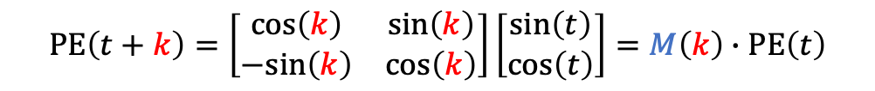



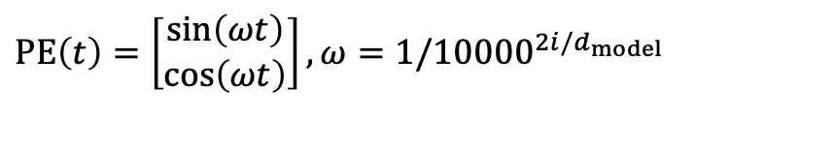
為什麼需要同時有 Sin 和 Cos 函數?
設 $d_{model}$ = 2
$$PE\left(t\right)=\left[\begin{matrix}\sin\left(ωt\right) \\ \cos\left(ωt\right)\end{matrix}\right], ω=1/{10000}^{2i/d_{model}}$$
(為求公式簡潔，本頁會省略 $ω$)
$$PE\left(t+k\right)=\left[\begin{matrix}cos\left(k\right) & sin\left(k\right) \\ −sin\left(k\right) & cos\left(k\right)\end{matrix}\right]\left[\begin{matrix}sin\left(t\right) \\ cos\left(t\right)\end{matrix}\right]=M\left(k\right)∙PE\left(t\right)$$
旋轉矩陣
$$score=\left(t時間點的input\right)W_{Q}∙W_{K}^{T}{\left(t+k時間點的input\right)}^{T}$$
$$=\left(x_{t}+PE\left(t\right)\right)W_{Q}∙W_{K}^{T}{\left(x_{t+k}+PE\left(t+k\right)\right)}^{T}$$
➡️$PE\left(t\right)∙W_{Q}{∙W}_{K}^{T}∙{PE\left(t+k\right)}^{T}=PE\left(t\right)∙W_{Q}{∙W}_{K}^{T}∙$ ${\left(M\left(k\right)∙PE\left(t\right)\right)}^{T}$
💡讓模型在計算 attention 時能留意相對位置 (角度) 關係

Slide 12
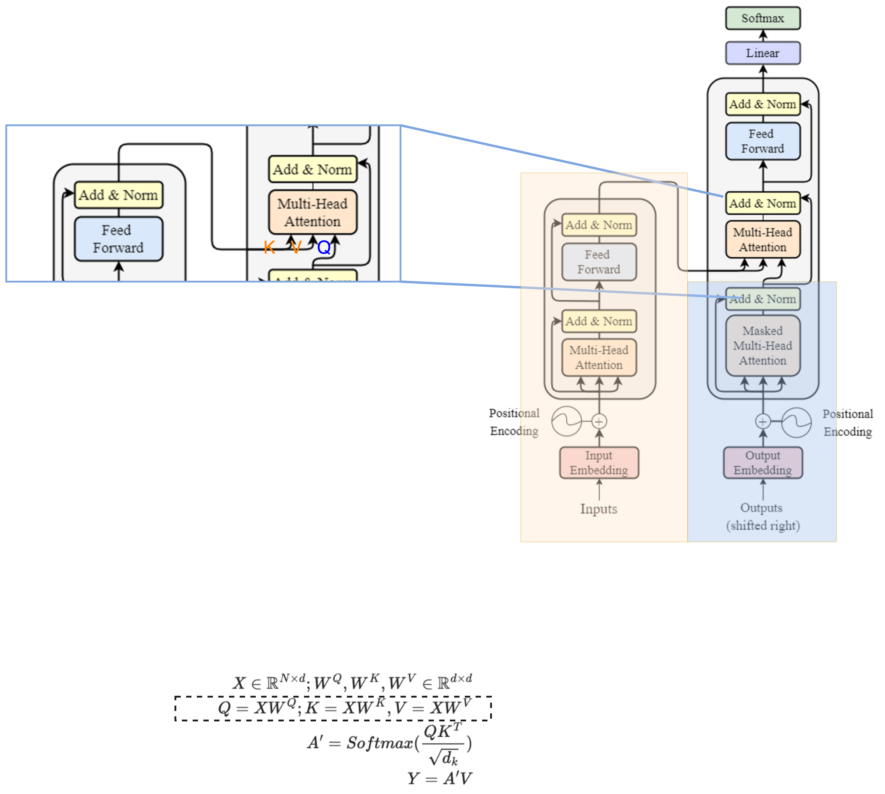
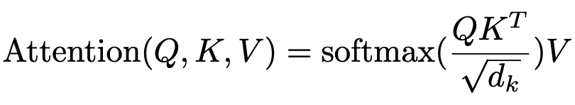
Encoder-Decoder 橋樑: Cross-Attention
K, V uses the output from encoder as their X;
Q uses the decoder’s information as X.
This is
Notes:
K, V uses the output from encoder as their X;
Q uses the decoder’s information as X.

Slide 13
Cross-attention
Encoder
h'₁
Weighted sum
a'₁
a'₂
a'₃
k₁
v₁
k₂
v₂
k₃
v₃
q₁
🎯
e₁
I
e₂
print
e₃
Hello
e₁
BOS

Slide 14
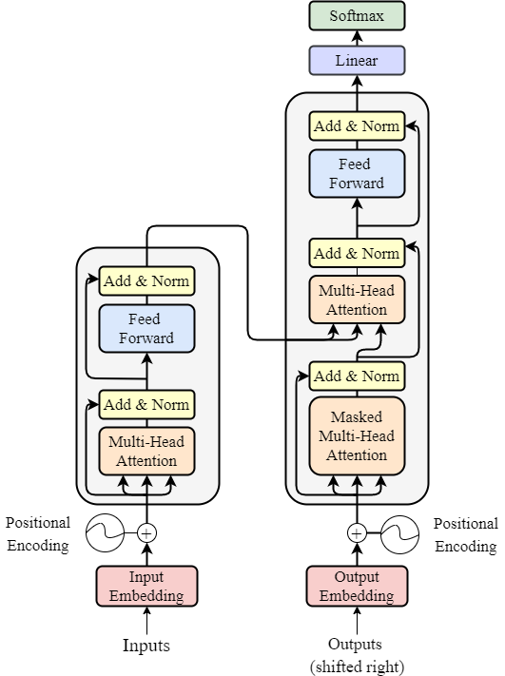


Number of Layers
Vaswani, Ashish, et al. "Attention is all you need." Advances in neural information processing systems 30 (2017).
o$utput ∈ ℝ^{N × d }$
Input, output dimension match!
We can have multiple encoders stacked up, to increase the number of trainable parameters.
N *
input$∈ ℝ^{N × d }$

Slide 15
Outline of Transformer
Vaswani, Ashish, et al. "Attention is all you need." NeurIPS (2017).
Feed Forward Networks:
Simply multiply by a weight matrix (MLP).
Used to project to a specific dimension.

Slide 16

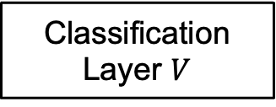
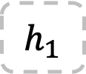
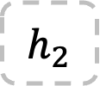
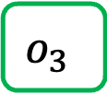

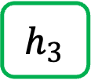

[Recap] Text Generation with RNN
*本頁的RNN不包含輸出層$V$
Vocab
Prob
(1, hidden_size)
(1, hidden_size)
(1, hidden_size)
a
...
apple
...
b
...
banana
...
elephant
...
eraser
...
...
zoo
0.0001
...
0.600
...
0.0001
...
0.0003
...
0.300
...
0.05
...
...
0.0001
$$h_{1}$$
$$h_{2}$$
$$h_{3}$$
Classification Layer $V$
Softmax
(1, Vocab_size)
RNN
$$h_{1}$$
RNN
$$h_{2}$$
RNN
$$o_{3}$$
Vocab
size
I
love
an
Word embeddings

Slide 17
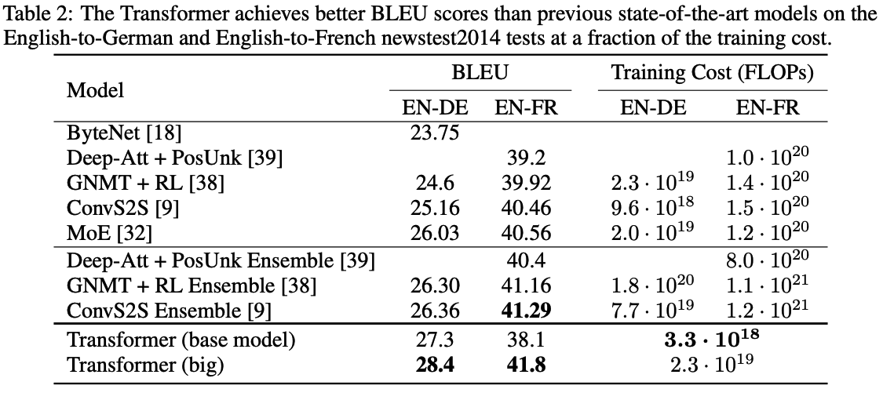
Transformers’ Achievements
1. In original paper, State-of-The-Art (SoTA) of machine translation.
6 encoders,
6 decoders,
h = 512, 100K train steps.
6 encoders,
6 decoders,
h = 1024, 300K train steps.
Vaswani, Ashish, et al. "Attention is all you need." Advances in neural information processing systems 30 (2017).
https://arxiv.org/abs/1706.03762

Slide 18
Transformer Variants (there are many more)
Universal Transformer
Adds Adaptive Computation Time
Dehghani, Mostafa, et al. "Universal transformers." arXiv preprint arXiv:1807.03819 (2018).
Longformer
Tackles long documents
Iz Beltagy, et al. (2020). Longformer: The Long-Document Transformer. arXiv:2004.05150.
Roformer
Changes the design of positional encoding
Su, Jianlin, et al. "RoFormer: Enhanced Transformer with Rotary Position Embedding. CoRR abs/2104.09864 (2021)." arXiv preprint arXiv:2104.09864 (2021).
Vision Transformer
Tackles vision tasks
Alexey Dosovitskiy, et al. “An Image is Worth 16x16 Words: Transformers for Image Recognition at Scale.” International Conference on Learning Representations. 2021.

Slide 19
Additional Links
https://nlp.seas.harvard.edu/annotated-transformer/
https://datascience.stackexchange.com/questions/82451/why-is-10000-used-as-the-denominator-in-positional-encodings-in-the-transformer

Slide 20
BERT and its Family
ELMo
BERT
RoBERTa
SpanBERT
DeBERTa

Slide 21
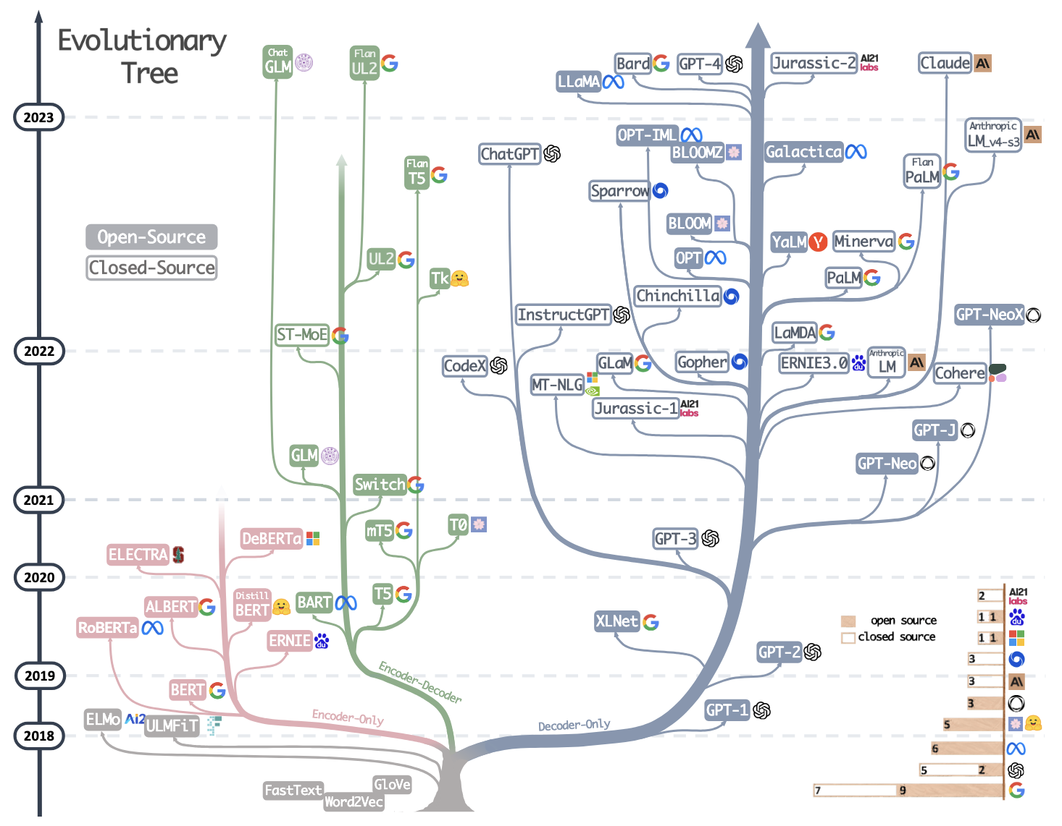
Evolutionary Tree of Large Language Models
Yang, Jingfeng, et al. "Harnessing the power of llms in practice: A survey on chatgpt and beyond." ACM Transactions on Knowledge Discovery from Data 18.6 (2024): 1-32.

Slide 22

Context Matters: ELMo (Peters et al., 2018)
Rather than using a fixed representation for each word, ELMo considers the entire sentence before assigning each word in it an embedding.
ELMo embeddings
ELMo
Words to embed
I
record
the
record
Peters, M., Neumann, M., Iyyer, M., Gardner, M., Clark, C., Lee, K., & Zettlemoyer, L. Deep Contextualized Word Representations. NAACL 2018.

Slide 23








Bidirectional RNN with 2 Layers
$$h_{1}^{2}$$
$$h_{2}^{2}$$
$$h_{3}^{2}$$
$$h_{4}^{2}$$
Layer 2
RNN²
RNN²
RNN²
RNN²
RNN²
RNN²
RNN²
RNN²
$$h_{1}^{1}$$
$$h_{2}^{1}$$
$$h_{3}^{1}$$
$$h_{4}^{1}$$
Layer 1
RNN¹
RNN¹
RNN¹
RNN¹
RNN¹
RNN¹
RNN¹
RNN¹
e₁
e₂
e₃
e₄

Slide 24






ELMo (1)
ELMo 是一個兩層的Bi-LSTM
在第1層和第2層之間有: residual connections
$$h_{1}^{2}$$
$$h_{2}^{2}$$
$$h_{3}^{2}$$
$$h_{4}^{2}$$
Layer 2
RNN²
RNN²
RNN²
RNN²
Add
(residual connection)
RNN²
RNN²
RNN²
RNN²
$$h_{1}^{1}$$
$$h_{2}^{1}$$
$$h_{3}^{1}$$
$$h_{4}^{1}$$
Layer 1
RNN¹
RNN¹
RNN¹
RNN¹
RNN¹
RNN¹
RNN¹
RNN¹
e₁
e₂
e₃
e₄

Slide 25


ELMo (2)
$$h_{1}^{2}$$
ELMo 的輸出是 embedding
ELMo 是 contextual embedding
每個 token 的 embedding 由 input embedding 和每一層的 hidden state 做 concatenation
Layer 2
RNN²
Add
(residual connection)
RNN²
$$h_{1}^{1}$$
e₁
$$h_{1}^{1}$$
$$h_{1}^{2}$$
Layer 1
RNN¹
Pre-trained
GloVe (size: 300)
(size: 512)
(size: 512)
RNN¹
token₁ 的 token embedding (size: 1324)
e₁

Slide 26

ELMo 的使用方法
This movie was awful. The ending was absolutely horrible.
Classifier
Positive
Negative
FFN
h_{n}
h₀
RNN
RNN
RNN
RNN
e₁
e₂
e₃
e_{n}

Slide 27
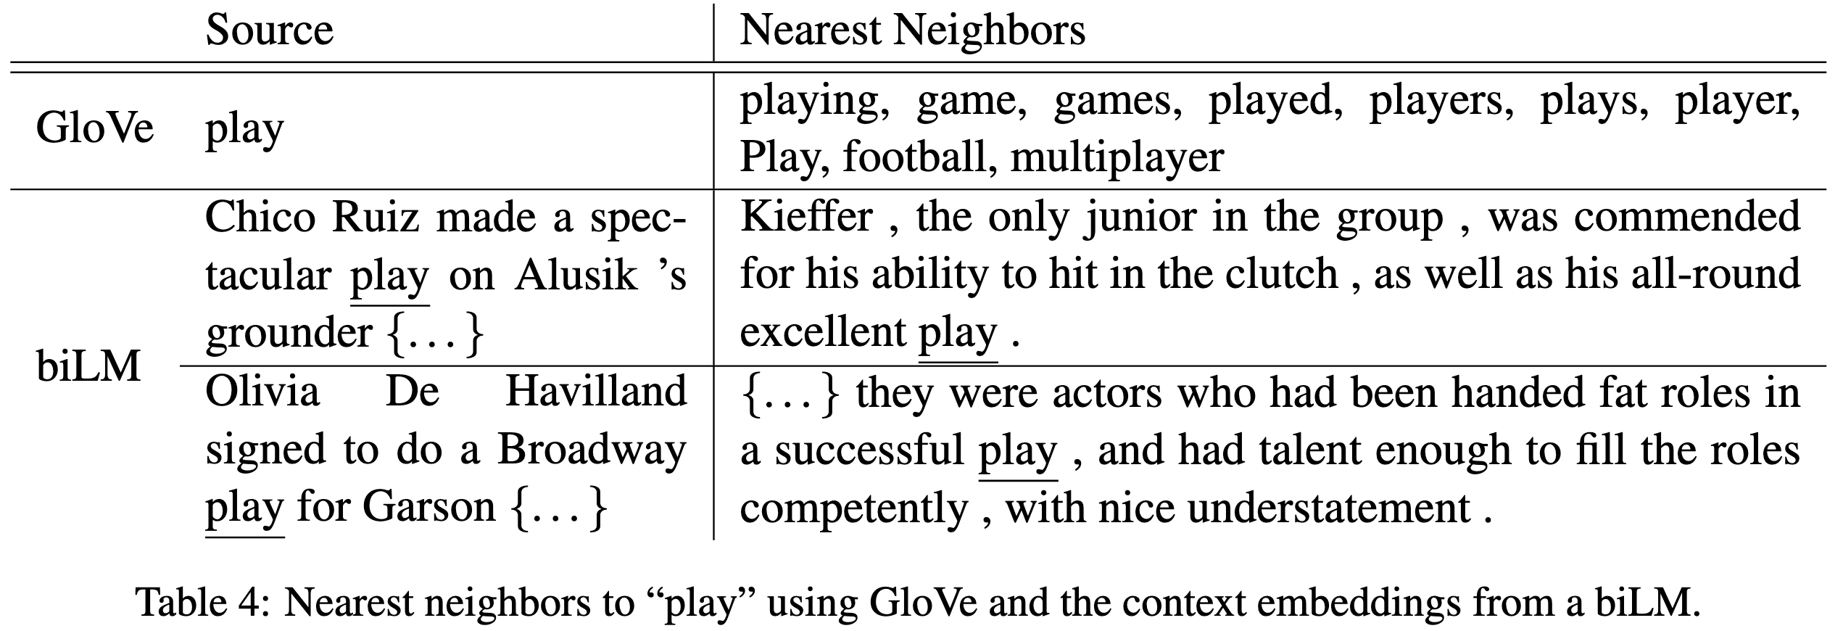
ELMo 相較於詞嵌入確實具備上下文語意資訊
跟球類有關的 play
跟表演有關的 play
Peters, M., Neumann, M., Iyyer, M., Gardner, M., Clark, C., Lee, K., & Zettlemoyer, L. Deep Contextualized Word Representations. NAACL 2018.

Slide 28
The Pre-training then Fine-tuning Paradigm
Pre-training
Fine-tuning
在大量資料上進行訓練，通常是自監督式 (Self-Supervised Training)
在目標資料上 (Down-stream tasks) 進行訓練，通常是監督式 (Supervised Training)，也就是需要有標註的資料才能進行模型訓練

Slide 29
Feature-based and Fine-tuning approaches
Feature-based approach – ELMo
ELMo 並無針對下游任務設計模型結構
ELMo 是一種外掛、增幅器，接在別人的工作上
Fine-tuning approach – GPT, BERT
涵蓋下游任務設計
Pre-trained Model
New Layer (s)

Slide 30
Static Embedding vs. Contextual Embedding
Type | Models
Static Embedding | Word2Vec, GloVe, …
Contextual Embedding | RNN, ELMo, BERT, GPT, ...

Slide 31
BERT and its Family
ELMo
BERT
RoBERTa
SpanBERT
DeBERTa

Slide 32


Transformer 架構的後續應用
Generative Pre-training (GPT) series
BERT (Bidirectional encoder representations from transformers)
Devlin et al., 2018
N=12
(GPT)
Encoder
(BERT)

Slide 33
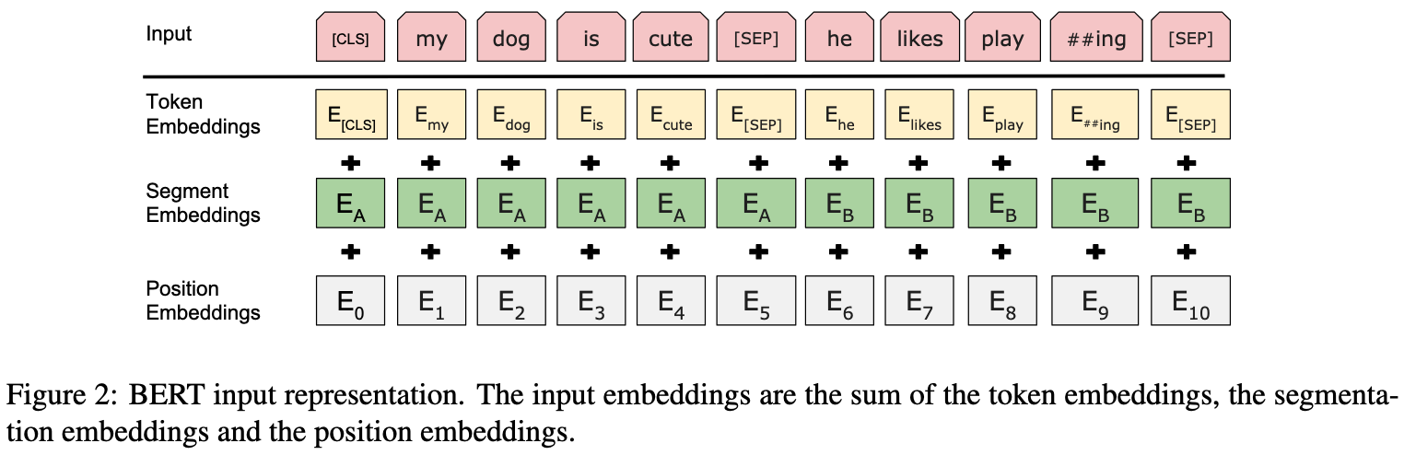
BERT 的輸入
Devlin, Jacob, et al. "BERT: Pre-training of Deep Bidirectional Transformers for Language Understanding." NAACL 2019.

Slide 34
BERT (Bidirectional Encoder Representations from Transformers)
BERT 有兩種預訓練任務：
Masked Language Modelling
Next Sentence Prediction
bank
binary classification
BERT
(Transformer Encoder)
BERT
(Transformer Encoder)
[CLS]
open
a
[MASK]
account
[SEP]
[CLS]
study
hard
[SEP]
plz
[SEP]
Devlin, Jacob, et al. "BERT: Pre-training of Deep Bidirectional Transformers for Language Understanding." NAACL 2019.

Slide 35
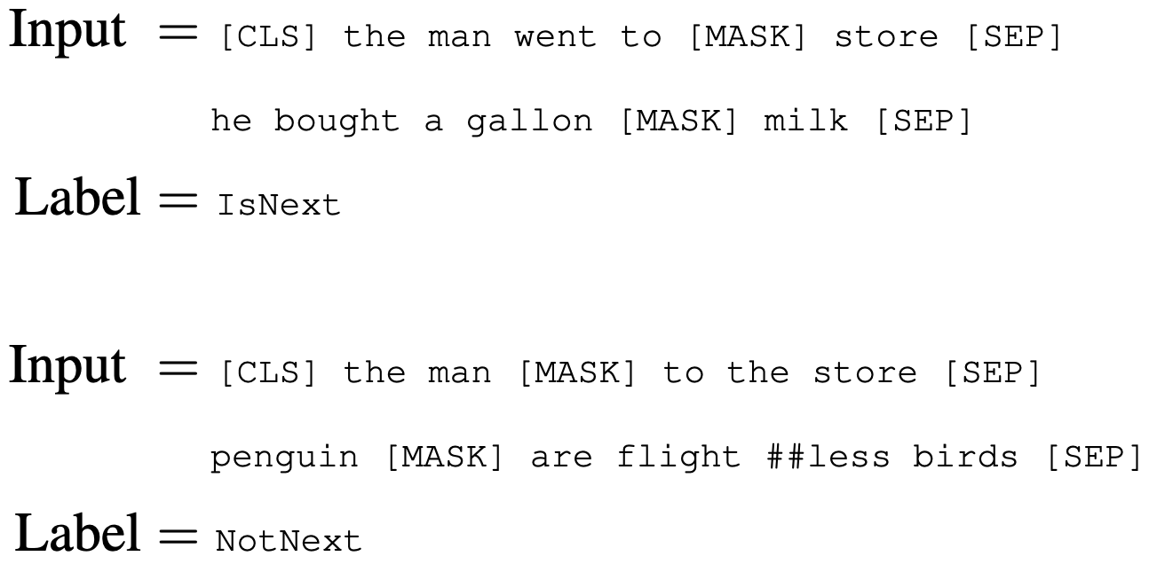
Next Sentence Prediction (NSP)
Binarized next sentence prediction task
Aimed at making BERT better on understanding the relationship between two sentences

Slide 36
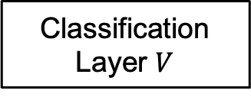
進行 MLM 時的 BERT 結構
MLM Head
所有 tokens 的 hidden states
Classification Layer $V$

Slide 37
進行 NSP 時的 BERT 結構
[CLS] token 的 hidden state
Binary Classification Layer

Slide 38
Fine-tuning BERT (Sentence Classification)
Single-sentence classification
Sentence pair classification
class
class
Linear
Linear
BERT
(Contextual Embedding)
BERT
(Contextual Embedding)
[CLS]
open
a
POST
account
[SEP]
[CLS]
Good
movie
[SEP]
Bravo
[SEP]
Sentence1
Sentence2

Slide 39
任務：Question Answering / 閱讀理解
Question: To whom did the Virgin Mary allegedly appear in 1858 in Lourdes France?
Context: Architecturally, the school has a Catholic character. Atop the Main Building\'s gold dome is a golden statue of the Virgin Mary. Immediately in front of the Main Building and facing it, is a copper statue of Christ with arms upraised with the legend "Venite Ad Me Omnes". Next to the Main Building is the Basilica of the Sacred Heart. Immediately behind the basilica is the Grotto, a Marian place of prayer and reflection. It is a replica of the grotto at Lourdes, France where the Virgin Mary reputedly appeared to Saint Bernadette Soubirous in 1858. At the end of the main drive (and in a direct line that connects through 3 statues and the Gold Dome), is a simple, modern stone statue of Mary.
Answer: { "text": [ "Saint Bernadette Soubirous" ], "answer_start": [ 515 ] }
https://huggingface.co/docs/transformers/en/tasks/question_answering

Slide 40
Fine-tuning BERT (Question Answering)
S
E
S
E
S
E
S
E
:
Dot product
Softmax
:
Dot product
Start
vector
End vector
BERT
(Contextual Embedding)
[CLS]
Tok 1
Tok 2
Tok 3
[SEP]
Tok 1
Tok 2
Tok 3
Tok 4
[SEP]
Question
Paragraph

Slide 41
任務：命名實體辨識 (Named Entity Recognition, NER)
B-Person
B-Location
I-Location
I-Location
E-Person
John Wick was admitted to Taipei Veterans General Hospital on March 3, 2023 due to pneumonia.
O
O
O
E-Location
O
B-Time
E-Time
O
O
B-Disease
 | Meaning
B | Beginning
I | Inside
O | Outside
E | End

Slide 42
Fine-tuning BERT (NER)
不會計算 loss
不會計算 loss
O
O
O
B
I
O
Linear
Linear
Linear
Linear
Linear
Linear
BERT
(Contextual Embedding)
[CLS]
open
a
POST
account
[SEP]

Slide 43
BERT and its Family
ELMo
BERT
RoBERTa
SpanBERT
DeBERTa

Slide 44
RoBERTa: A Robustly Optimized BERT Pretraining Approach
和 BERT 的結構完全一樣
預訓練移除 Next Sentence Prediction (NSP)，且使用更多的資料進行預訓練
Dynamic masking (BERT 全部的資料集只做一次隨機 masking)
更好的超參數 (batch size, learning_rate, num_epochs)
實務上確實效能通常比 BERT 還要好
Rejected by ICLR 2020. https://openreview.net/forum?id=SyxS0T4tvS

Slide 45

RoBERTa was rejected by ICLR.
Citations: 26136
(2026/03/27)

Slide 46
BERT and its Family
ELMo
BERT
RoBERTa
SpanBERT
DeBERTa

Slide 47








SpanBERT
https://arxiv.org/pdf/1907.10529
基於MLM的新目標函數: Span Boundary Objective (SBO)
➡️ 一次 mask 一段 span，每次的目標為還原 span 中的其中一個字
(boundary)
a
hot
topic
(boundary)
$$x_{3}$$
$$p_{1}$$
$$x_{4}$$
$$p_{2}$$
$$x_{5}$$
$$p_{3}$$
$$x_{6}$$
$$x_{7}$$
Transformer Encoder
Generative
AI
is
[MASK]
[MASK]
[MASK]
right
now
$ℒ\left(hot\right)=ℒ_{MLM}\left(hot\right)+ℒ_{SBO}\left(hot\right)=−logP\left(hot\right| x_{5})−$ $logP\left(hot\right| x_{3},x_{7},p_{2})$

Slide 48
Extensions of BERT (Summary)
Model | MLM task | NSP task | Release
BERT | Static masking | Sentence relationship | 2018/10
RoBERTa | Dynamic masking | Remove NSP task | 2019/07
SpanBERT | Span masking | Remove NSP task | 2019/07

Slide 49
BERT and its Family
ELMo
BERT
RoBERTa
SpanBERT
DeBERTa

Slide 50
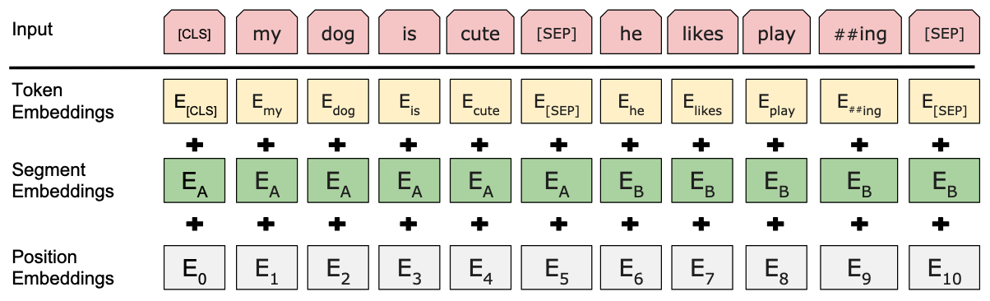
Positional Encodings 常常是加在 Input

Slide 51
相對位置的重要性
He, Pengcheng, et al. "DeBERTa: Decoding-enhanced BERT with Disentangled Attention." ICLR 2021.
[句子1]
I am studying deep learning today.
[句子2]
We discussed a deep neural architecture for robots, and later talked about learning strategies.
💡 attention weight 不能只由內容決定，還要由相對位置決定

Slide 52




[Recap] Transformer 的權重值
可以被訓練的參數
$$Q$$
$$KT$$
(
)
$$T$$
q₁
e₁
e₁
k₁
k₂
k₃
=
W^{Q}
=
q₂
e₂
e₂
W^{K}
q₃
e₃
e₃
N x d_{q}
N x d_{model}
d_{model} x d_{q}
d_{k} x N
N x d_{model}
d_{model} x d_{k}
$$V$$
v₁
e₁
v₂
=
e₂
W^{V}
v₃
e₃
N x d_{v}
N x d_{model}
d_{model} x d_{v}

Slide 53


















DeBERTa 的 Queries, Keys
He, Pengcheng, et al. "DeBERTa: Decoding-enhanced BERT with Disentangled Attention." ICLR 2021.
$$Q_{C}^{}$$
$$K_{C}^{T}$$
(
)
$$q_{1}^{c}$$
e₁
e₁
$$T$$
$$k_{1}^{c}$$
$$k_{2}^{c}$$
$$k_{3}^{c}$$
$$q_{2}^{c}$$
=
W_{Q,c}
=
W_{K,c}
e₂
e₂
$$q_{3}^{c}$$
e₃
e₃
N x d_{q}
N x d_{model}
d_{model} x d_{q}
d_{k} x N
N x d_{model}
d_{model} x d_{k}
$$Q_{P}^{}$$
$$K_{P}^{T}$$
(
)
$$T$$
$$q_{1}^{p}$$
p₁
p₁
$$k_{1}^{p}$$
$$k_{2}^{p}$$
$$k_{3}^{p}$$
=
W_{Q,p}
=
W_{K,p}
$$q_{2}^{p}$$
p₂
p₂
$$q_{3}^{p}$$
p₃
p₃
N x d_{q}
N x d_{model}
d_{model} x d_{q}
N x d_{model}
d_{model} x d_{q}

Slide 54

























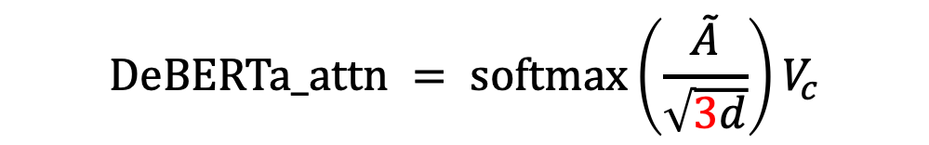

DeBERTa Attention
$$V$$
v₁
e₁
v₂
=
e₂
W^{V}
v₃
e₃
N x d_{v}
N x d_{model}
d_{model} x d_{v}
$$Q_{C}^{}$$
$$K_{C}^{T}$$
$$Q_{C}^{}$$
$$K_{P}^{T}$$
$$Q_{P}^{}$$
$$K_{C}^{T}$$
$$q_{1}^{c}$$
$$q_{1}^{c}$$
$$q_{1}^{p}$$
$$k_{1}^{c}$$
$$k_{2}^{c}$$
$$k_{3}^{c}$$
$$k_{1}^{p}$$
$$k_{2}^{p}$$
$$k_{3}^{p}$$
$$k_{1}^{c}$$
$$k_{2}^{c}$$
$$k_{3}^{c}$$
$$\tilde{A}=$$
$$q_{2}^{c}$$
$$+$$
$$q_{2}^{c}$$
$$+$$
$$q_{2}^{p}$$
$$q_{3}^{c}$$
$$q_{3}^{c}$$
$$q_{3}^{p}$$
(本頁的 positional embedding 對象有經過簡化)
$$DeBERTa_attn = softmax\left(\frac{\tilde{A}}{\sqrt{3d}}\right)V_{c}$$

Slide 55
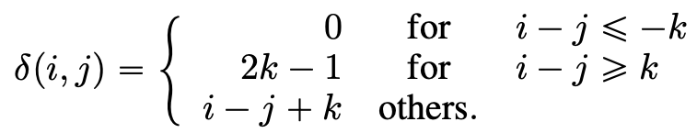
Positional Embedding 要取哪一個？
總 PE 的形狀為 (num_positions, embed_size)
假設k=4
🎯
0
1
4
...
99
i=0
j=0 時，取 index 為 4 的 PE
j=4 時，取 index 為 0 的 PE
j=1 時，取 index 為 3 的 PE
j=99 時，也取 index 為 0 的 PE

Slide 56

Why there’s no $Q_{P}^{}×K_{P}^{T}$?
💡 「設定上」是相對距離和語義內容具備關聯性
➡️ 相對距離和相對距離理論上不應貢獻資訊量

Slide 57
Thank you!
Instructor: 林英嘉
✉️ yjlin@cgu.edu.tw
TA: 林宣辰
✉️ b1128015@cgu.edu.tw

