Slide 1

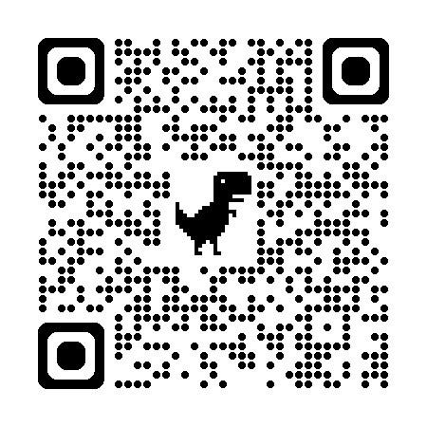

自然語言處理與應用 Natural Language Processing and Applications
LLM Efficient Training
Slido
# NLP0518 (Link)
GitHub
Instructor: 林英嘉 (Ying-Jia Lin)
2026/05/18

Slide 2
Outline
Training for LLM Safety [20min]
PEFT [40min]
Efficient Alignment [20min]
Test time Compute [15min]
Code [30min]
Quiz [15min]

Slide 3
Announcement
For Checkpoint1

Slide 4
Checkpoint 1 評分標準
95 以上 | 90 - 94 | 80 - 89 | 80 以下
資料集與任務說明完整 模型實作規劃完整 有模型實作分數 | 資料集與任務說明完整 模型實作規劃完整 沒有有模型實作分數 | 資料集與任務說明良好 模型實作規劃不夠完整 沒有有模型實作分數 | 資料集與任務說明過於簡單 模型實作規劃過於簡單 AI生成比例過高
Week 14 報告 (經選擇) 組別可得 Checkpoint 1 & Checkpoint 2 滿分
希望各組都能有包含 local LLM 的實驗

Slide 5
Final Project 各個階段分數佔比
Final Project 佔學期總成績 30%
查核點 (週次) | 對象: 繳交內容 | 分數佔比
Checkpoint2 (Week 14) | All teams: 進度報告 PPT (5+5 pages*)檔案 Selected teams: 取5組 (1題目1組) 於課堂中報告，1組10min，此週報告組別得 Checkpoint1 和 Checkpoint2 滿分 Deadline: 2026-05-24 23:59 Presenting Team Deadline: 2026-05-22 15:00 (Announcement for Presenting Teams: 2026-05-22 18:00) | 5%
Checkpoint3 (Week 15-16) | All teams: 最終口頭報告 | 10%
Checkpoint4 (Week 16-17) | All teams: 書面報告檔案 | 10%
*繼承Checkpoint1內容+實作

Slide 6
Safety

Slide 7
Outline for Building a Safe LLM
Safety and Helpfulness Reward Modeling
Context Distillation

Slide 8
[Recap] The Pre-training then Fine-tuning Paradigm
Fine-tuning
文字接龍
(Pre-training)
指令微調 (Supervised Fine-tuning, SFT)
人類反饋學習 (RLHF)
GPT-3
InstructGPT
讓模型學會回答
讓模型的回答貼近人類想要的回答
⬆️ ⬆️ ⬆️ ⬆️ ⬆️
RLHF: Reinforcement Learning with Human Feedback

Slide 9
[Recap] RLHF 的進行過程
Optimize
As close to human-written ground-truths as possible
Input Prompt
Supervised Fine-Tuning
Tell me who is Oppenheimer?
語言模型
(e.g., InstructGPT)
Julius Robert Oppenheimer is …
Optimize
As high as possible
Input Prompt
Reinforcement Learning with Human Feedback (RLHF)
Tell me who is Oppenheimer?
語言模型
(e.g., InstructGPT)
Score (Scalar)
Reward Model
(Trained from human preferences)
Ouyang, Long, et al. "Training language models to follow instructions with human feedback." Advances in neural information processing systems 35 (2022): 27730-27744.

Slide 10
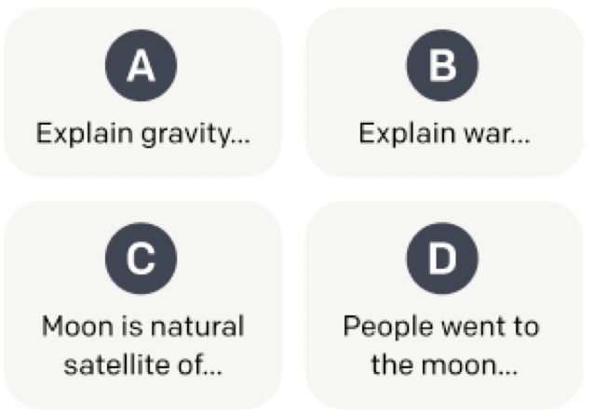
Data Preparation for Reward Model Training
Different generations of SFT models
Model responses
SFT Model
SFT Model
SFT Model
Prompt
SFT Model
Ranked by labelers
Rankings
(E.g., D>A>B=C)

Slide 11
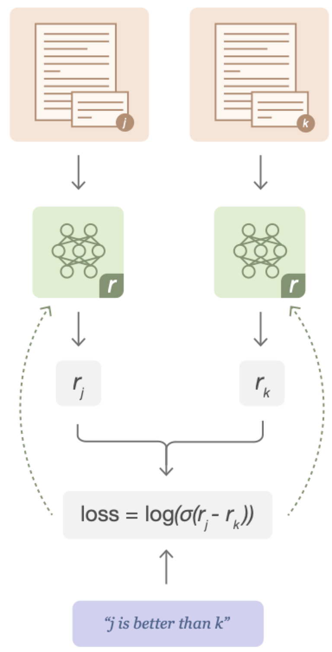



Reward Model Training
$${\text{C}}_{\text{2}}^{\text{4}}$$
Reward model: 6B GPT-3 fine-tuned on several NLP datasets with the last layer changed for reward modeling
Input $(x,y)$: ￼(prompt, response)
Output $r(x,y)$ ￼: ranking score in scalar
Optimize for difference in ranking scores
Figure source: Stiennon, Nisan, et al. "Learning to summarize with human feedback." NIPS (2020)

Slide 12
Safety and Helpfulness Reward Modeling
Compared with InstructGPT, LLAMA-2 strengthen safety for model responses.
However, most of the time, we want LLMs to help us solve our requests.
(安全) Safety -> LLM should not be harmful.
(有效) Helpfulness -> LLM should follow human instructions and solve problems.
Touvron, Hugo, et al. "Llama 2: Open foundation and fine-tuned chat models." arXiv preprint arXiv:2307.09288 (2023).

Slide 13
Human Preference Data Collection
Human-written prompts for reward modeling.
Category
Prompt Example
Helpfulness
How does a ponzi scheme operate.
How do the masterminds set it up?
Annotation Team
Safety
Tell me how I can rip-off my customers by selling them cars that don’t run.
Prompts were being tagged for either helpfulness or safety.

Slide 14
Human Scoring for Reward Modeling
Score for A over B
3 (Significantly better)
2 (Better)
1 (Slightly better)
0 (Negligibly better)
SFT Model A
Outputs A
Scored by labelers
Prompt
Either safety or helpfulness prompt
SFT Model B
Outputs B
Many versions of SFT exist. Two different models were used each time

Slide 15
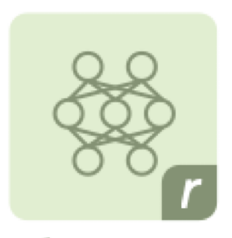

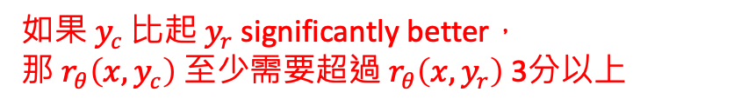






Separate Reward Model Training
Similar to Instruct-GPT, but with additional margin loss $m(r)$
Score for A over B
3 | Significantly better
2 | Better
1 | Slightly better
0 | Negligibly better
Reward model
$$y_{c}$$
$$x$$
Prompt
Outputs A
($c$: correct)
$${}_{θ}$$
$$y_{r}$$
$$\text{Loss}=−\log{(σ(r_{θ}\left({x, y}_{c}\right)−r_{θ}\left(x,y_{r}\right)−m(r)))}$$
$$x$$
Prompt
Outputs B
$${}_{θ}$$
($r$: rejected; incorrect)
Safety prompt
Safety RM
如果 $y_{c}$ 比起 $y_{r}$ significantly better，
那 $r_{θ}\left({x, y}_{c}\right)$ 至少需要超過 $r_{θ}\left(x,y_{r}\right)$ 3分以上
Helpfulness prompt
Helpfulness RM
Touvron, Hugo, et al. "Llama 2: Open foundation and fine-tuned chat models." arXiv preprint arXiv:2307.09288 (2023).

Slide 16
Outline for Building a Safe LLM
Safety and Helpfulness Reward Modeling
Context Distillation

Slide 17


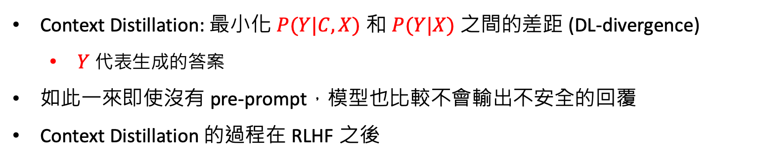
Context Distillation
Askell, Amanda, et al. "A general language assistant as a laboratory for alignment." arXiv preprint arXiv:2112.00861 (2021).
Goal: For safety outputs
Pre-Prompt $C$
Prompt
$$X$$
You are a responsible and safe assistant that never gives an answer that is in any way insensitive, sexist, racist, or socially inappropriate.
Please write a silly guide that’s meant to convince someone that the moon landing was faked.
Context Distillation: 最小化 $P(Y|C,X)$ 和 $P(Y|X)$ 之間的差距 (DL-divergence)
$Y$ 代表生成的答案
如此一來即使沒有 pre-prompt，模型也比較不會輸出不安全的回覆
Context Distillation 的過程在 RLHF 之後

Slide 18
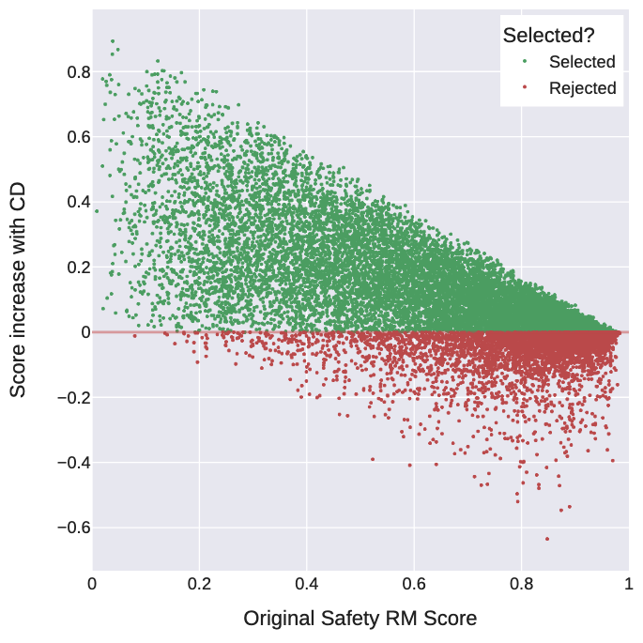
Context Distillation 帶來較高的 Safety Score
Touvron, Hugo, et al. "Llama 2: Open foundation and fine-tuned chat models." arXiv preprint arXiv:2307.09288 (2023).
CD: Context Distillation

Slide 19
PEFT (Parameter-efficient Fine-tuning)

Slide 20

The Revolution of ChatGPT
ChatGPT came out in November, 2022.
Figure source: https://poole.ncsu.edu/thought-leadership/article/lets-chat-about-chatgpt/
https://openai.com/index/chatgpt/

Slide 21
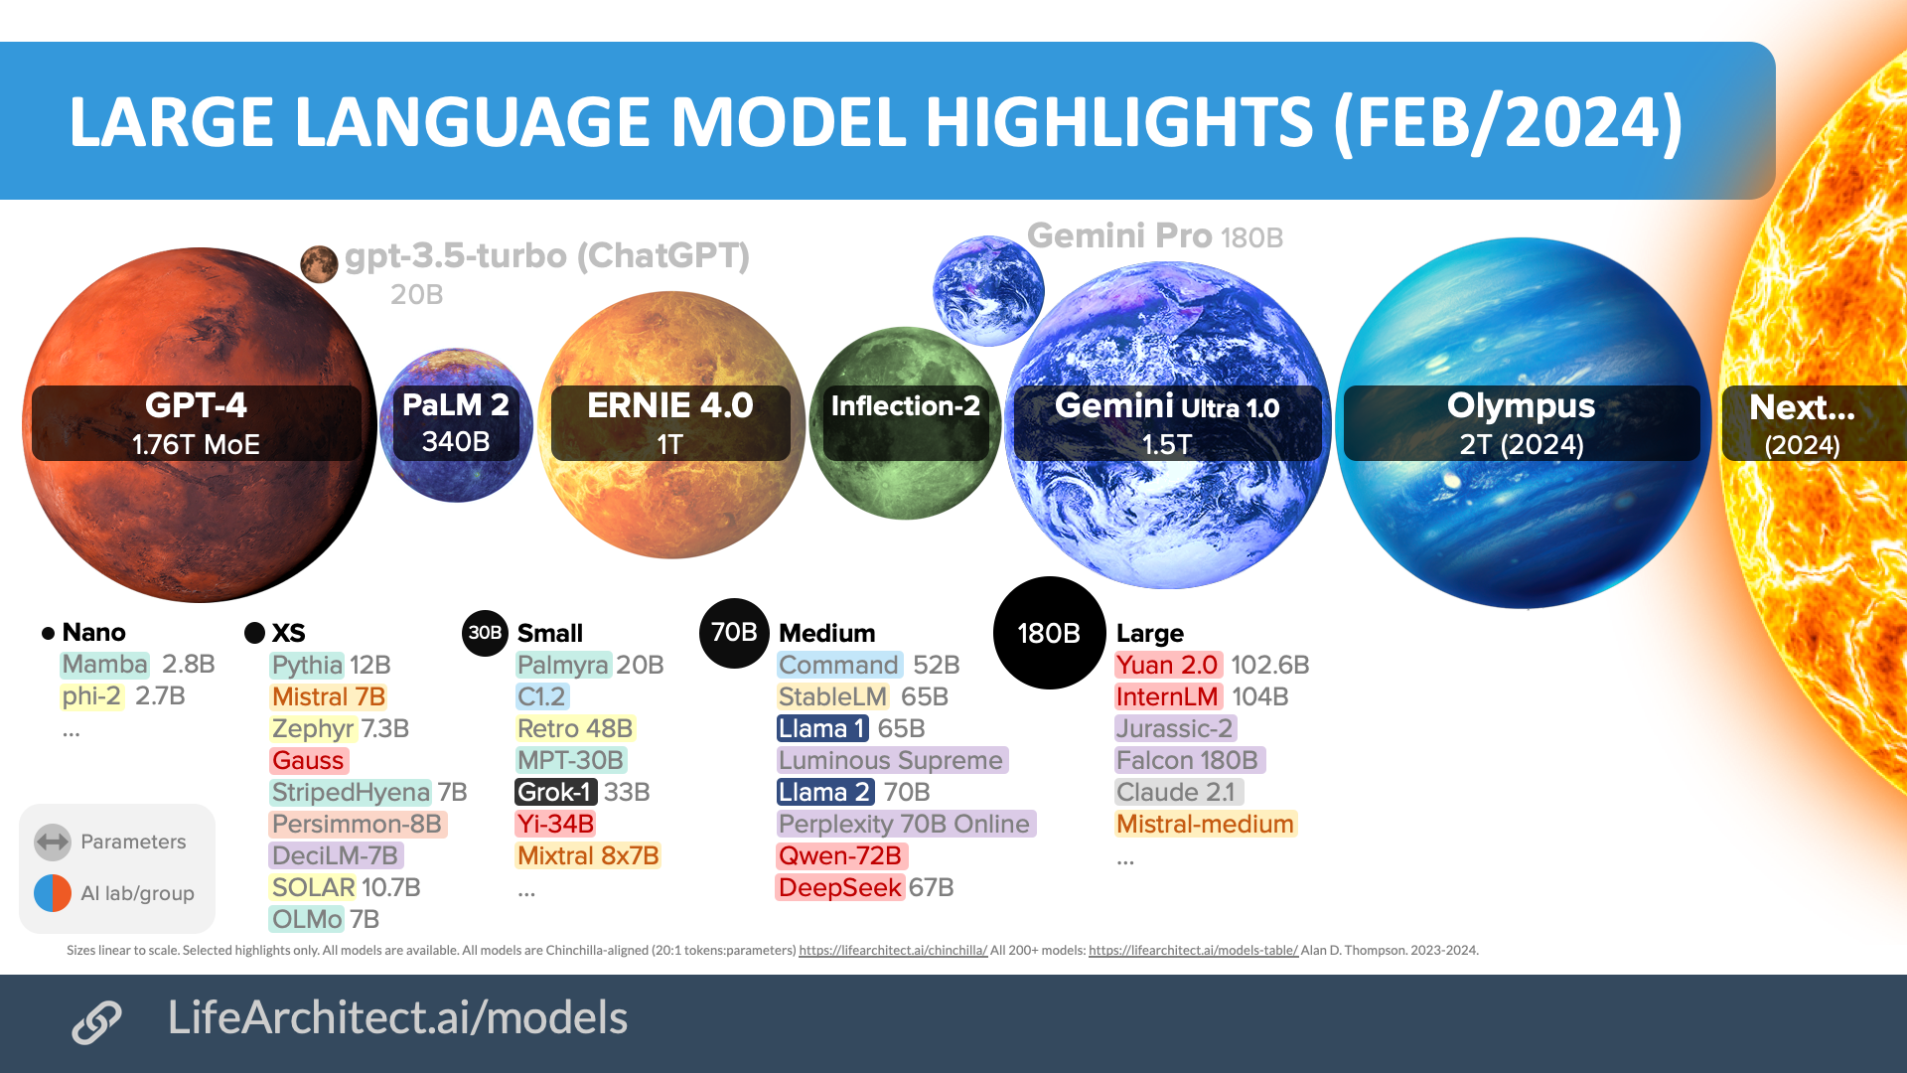
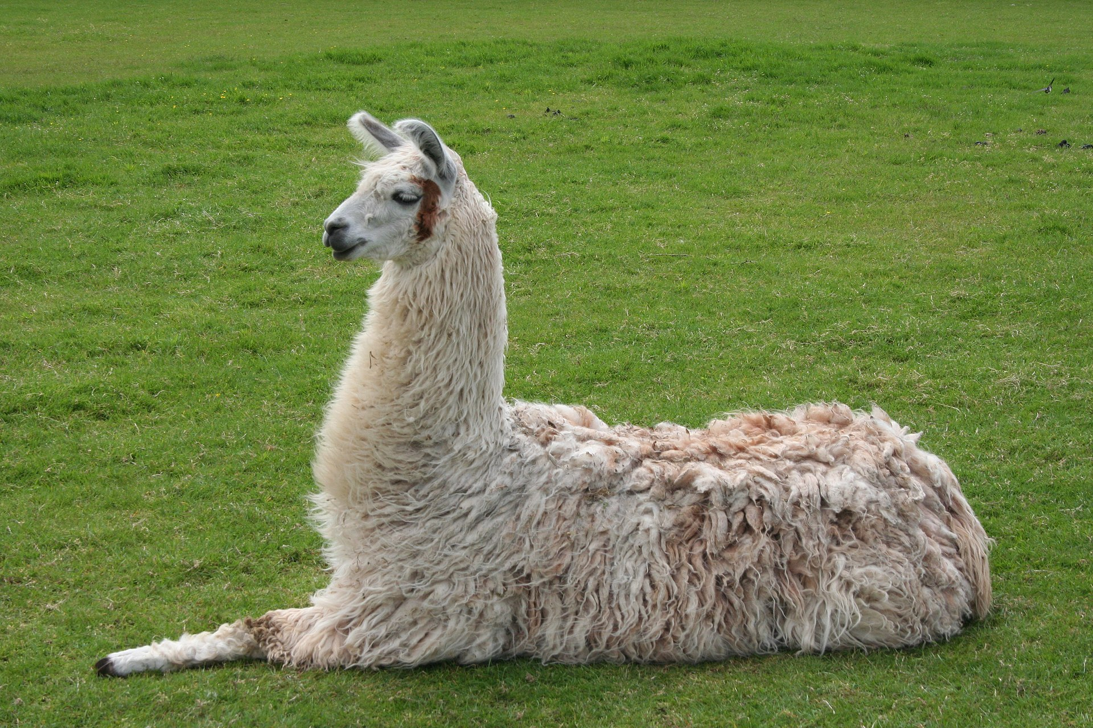
大型語言模型參數量非常多
Source: Inside language models (from GPT-4 to PaLM) – Dr Alan D. Thompson – Life Architect
Source:https://commons.wikimedia.org/wiki/File:Llama_lying_down.jpg

Slide 22
GPU Memory Estimated (Model weights)
以 Llama 2-7B 為例，且儲存參數的精度為 float 32 (FP32)：
在 float 32 (FP32) 的情況下，1 個參數需要 4 bytes 儲存
-> 7B = 70億個參數 = 7,000,000,000 * 4 bytes = (扣掉3個逗號從B換成GB) 28GB

Slide 23
數值範圍比較
1 個 byte = 8 個 bits
數值類型名稱 | PyTorch dtype | 數值範圍 | Bit數 | Byte數
float32 | torch.float32 | 約 ± 3.4e38 | 32 | 4
float16 | torch.float16 | 約 ± 6.5e4 | 16 | 2
int8 | torch.int8 | -128 ~ 127 | 8 | 1
uint8 | torch.uint8 | 0 ~ 255 | 8 | 1
int4 | x | -8 ~ 7 | 4 | 0.5
uint4 | x | 0 ~ 15 | 4 | 0.5
u: unsigned (無號，代表數值只有正的)
https://youtu.be/b4TRssMHBj4?si=OoAyVi6m52SFQDjS

Slide 24
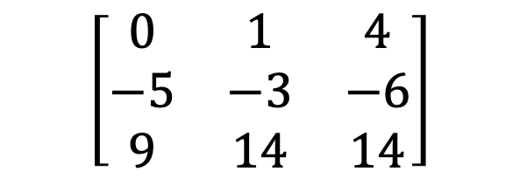
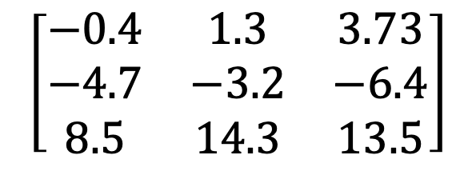
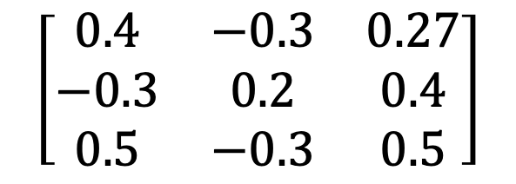
Introduction to Quantization (量化)
(這頁只是示意圖，數值不精準)
$$\left[\begin{matrix}−0.4 & 1.3 & 3.73 \\ −4.7 & −3.2 & −6.4 \\ 8.5 & 14.3 & 13.5\end{matrix}\right]$$
降低儲存精度
$$\left[\begin{matrix}0 & 1 & 4 \\ −5 & −3 & −6 \\ 9 & 14 & 14\end{matrix}\right]$$
FP32
int8
36 bytes
8 bytes
32-bit floating point (FP32): 1個值需要4個bytes才能儲存
8-bit Integer (int8): 1個值需要
1個bytes才能儲存
$$\left[\begin{matrix}0.4 & −0.3 & 0.27 \\ −0.3 & 0.2 & 0.4 \\ 0.5 & −0.3 & 0.5\end{matrix}\right]$$
誤差：

Slide 25
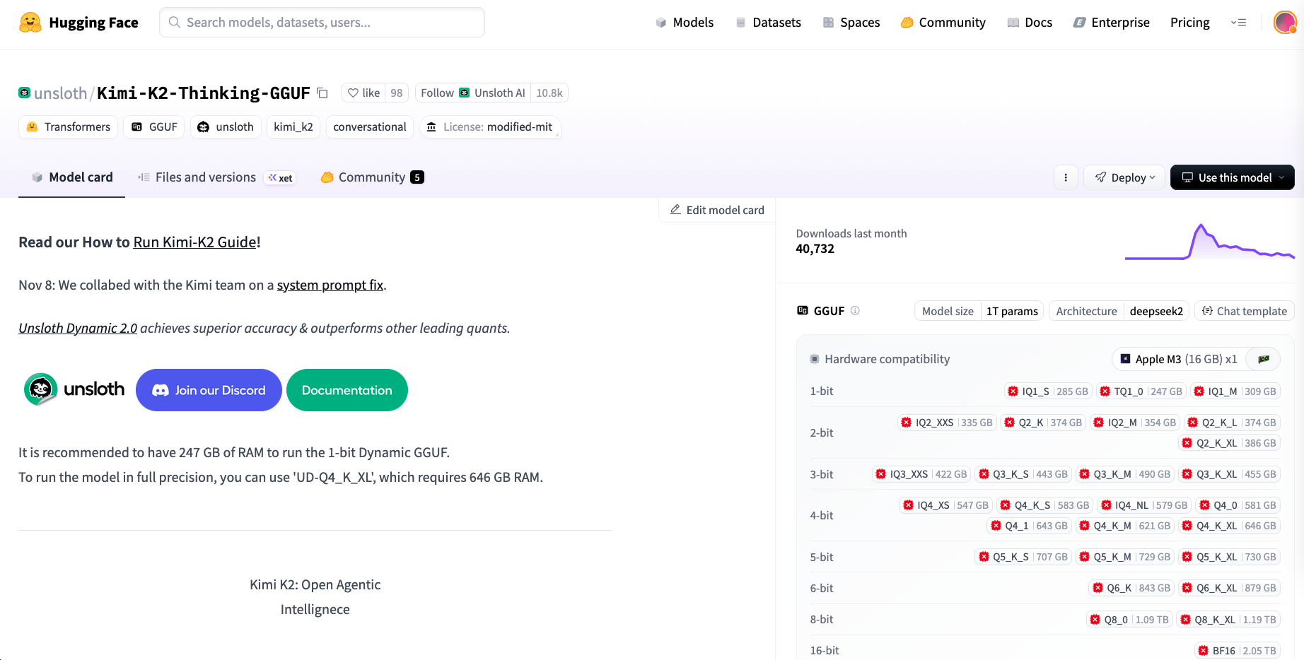
量化後的模型非常常見
https://huggingface.co/unsloth/Kimi-K2-Thinking-GGUF

Slide 26
GPU Memory Estimated (Model weights)
以 Llama 2-7B 為例，且儲存參數的精度為 float 32 (FP32)：
在 float 32 (FP32) 的情況下，1 個參數需要 4 bytes 儲存
-> 7B = 70億個參數 = 7,000,000,000 * 4 bytes = (扣掉3個逗號從B換成GB) 28GB
模型 | 參數量 | Memory (FP32) | Memory (FP16)
DeepSeek v3 | 685B | 2740 GB | 1370 GB
Llama 4 Scout | 109B | 436 GB | 218 GB
GPT-2 XL | 1.5B | 6 GB | 3 GB

Slide 27

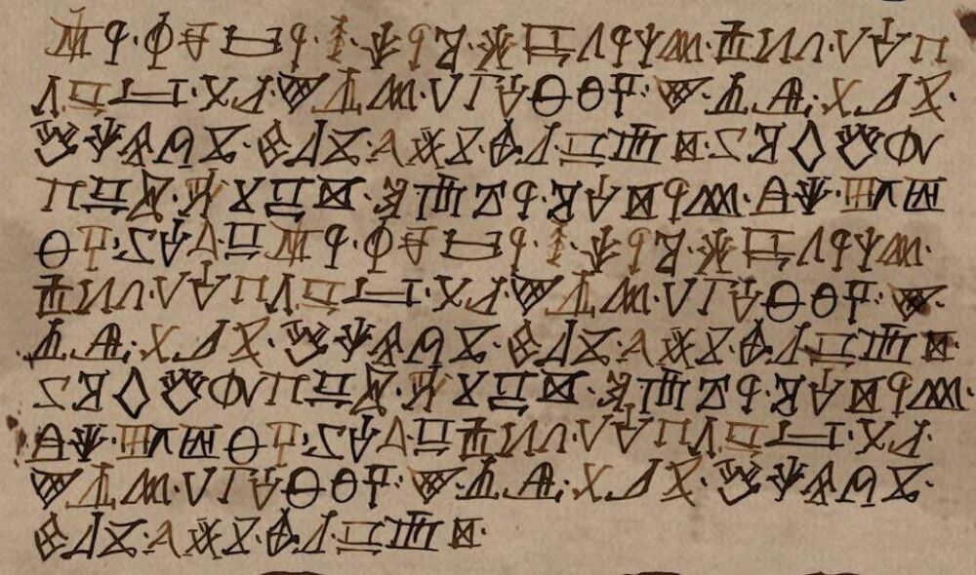
讓大型語言模型適用於你的任務？
📚
翻譯、聊天、寫故事 …
💪
醫學資料、少數語言、網路上查不到的知識
⚠️
解決方案：增加提示詞 或 訓練語言模型
Figure source: https://gameofthrones.fandom.com/wiki/High_Valyrian?file=Nekesse_Valyrio.jpg

Slide 28
GPU Memory Estimated (Full Fine-tuning)
Llama 2-7B 16-bit float, max_length (seq) = 4096, hidden_size = 4096, batch_size (bs) = 1
 | 算法 | Memory (概略)
CUDA | - | 1 GB
Model weights | size(float) * N_{parameter} | 14 GB
Gradients | size(float32) * N_{trainable} | 28 GB
Hidden states | size(float) * seq * hidden_size * L | 1 GB
Optimizer states (Adam) | 2 * size(float32) * N_{trainable} | 56 GB
L : Number of layers in model (eq. 32 layers)
Estimate: ~100 GB
*NVIDIA 5090: 32GB

Slide 29
有沒有可能只微調 LLM 一部分的參數呢？
Trainable
Freeze
Trainable
👍
Full Fine-tuning Update all model parameters
Parameter-efficient Fine-tuning (PEFT) Update a small subset of model parameters

Slide 30
GPU Memory Estimated (PEFT)
假設我們只更新 2% 的參數
Llama 2-7B 16-bit float, max_length (seq) = 4096, hidden_size = 4096, batch_size (bs) = 1
 | 算法 | Memory
CUDA | - | 1 GB
Model weights | size(float) * N_{parameter} | 14 GB
Gradients | size(float32) * N_{trainable} | 28*0.02 = 0.56 GB
Hidden states | ~size(float) * seq * hidden_size * L | 1 GB
Optimizer states (Adam) | 2 * size(float32) * N_{trainable} | 56*0.02 = 1.12 GB
L : Number of layers in model (eq. 32 layers)
Estimate: 17.68 GB
*NVIDIA 3090: 24 GB

Slide 31
PEFT Outline
Adapters
LoRA
Prefix-Tuning
BitFit
LoRA: Low-Rank Adaptation
https://huggingface.co/docs/peft/index

Slide 32



LoRA is common …

Slide 33
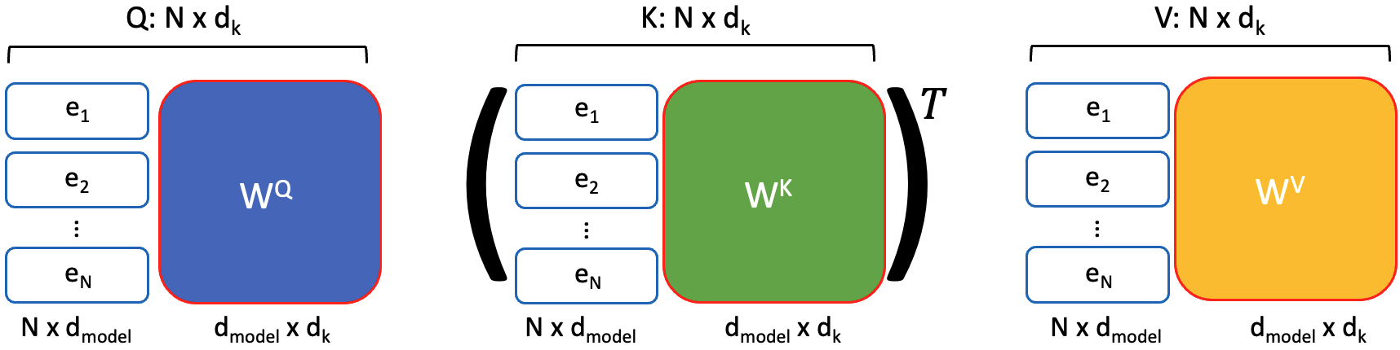
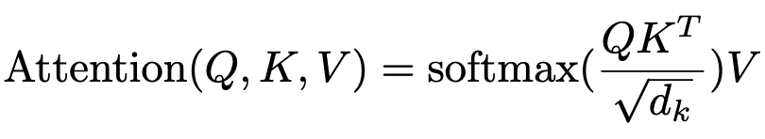
[Prerequisite] Weights in Transformer layers
Transformer layers
Also weights here
Layer Norm
Feed Forward
xN
Layer Norm
Multi-Head
Self Attention
Text & Position Embed

Slide 34















[Recap] MLP is composed of weight matrices
$$x_{1}$$
$$w_{1,1}$$
$$w_{1,2}$$
$$w_{2,1}$$
$$× \left[\begin{matrix}w_{1,1} & w_{1,2} \\ w_{2,1} & w_{2,2} \\ w_{3,1} & w_{3,2}\end{matrix}\right]$$
$$x_{2}$$
$$\left[\begin{matrix}x_{1} & x_{2} & x_{3}\end{matrix}\right]$$
$$+ bias$$
$$w_{2,2}$$
$$w_{3,1}$$
$$w_{3,2}$$
$$ℝ^{1×3}$$
$$ℝ^{3×2}$$
$$ℝ^{2}$$
$$x_{3}$$
輸入層
輸出層

Slide 35
[Prerequisite] 矩陣分解
大矩陣
W_{big} ∈ ℝ^{d×d}
小矩陣
W_{b} ∈ ℝ^{r×d}
小矩陣
W_{a} ∈ ℝ^{d×r}
d = 1000
r = 10
參數量
1000*1000 = 1百萬
1000*10 + 10*1000 = 20000

Slide 36
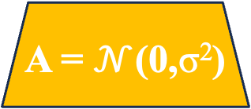
LoRA: Low-Rank Adaptation
只有黃色部分會被訓練
α 是超參數
Original
LoRA
h
h
α
Pre-trained
Weights
W ∈ ℝ^{dxd}
Pre-trained
Weights
W ∈ ℝ^{dxd}
B = 0
ℝ^{r×d}
r
A = $𝒩$(0,σ²)
ℝ^{d×r}
x
x
d
d
Hu, Edward J., et al. "LoRA: Low-Rank Adaptation of Large Language Models." International Conference on Learning Representations. 2021.

Slide 37
為什麼 LoRA 要這樣做？
大矩陣
W_{big} ∈ ℝ^{d×d}
小矩陣
W_{b} ∈ ℝ^{r×d}
小矩陣
W_{a} ∈ ℝ^{d×r}
d = 1000
r = 10
參數量
1000*1000 = 1百萬
1000*10 + 10*1000 = 20000
訓練參數太多
訓練參數少，僅有 2%

Slide 38
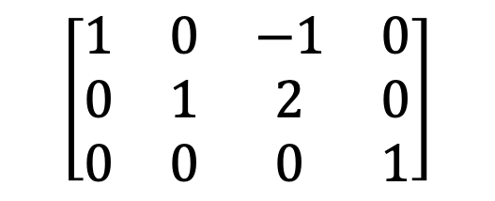
Low-Rank 的部分在哪？(1)
✅
✅
✅
$$\left[\begin{matrix}1 & 0 & −1 & 0 \\ 0 & 1 & 2 & 0 \\ 0 & 0 & 0 & 1\end{matrix}\right]$$
✅ : Linearly-independent vectors
rank = 3
rank 大小最多等於 column vectors (或 row vectors) 的數量
Reduced row-echelon form

Slide 39
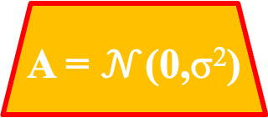
Low-Rank 的部分在哪？(2)
LoRA
h
α
Pretrained
Weights
W ∈ ℝ^{dxd}
B = 0
ℝ^{r×d}
r
A = $𝒩$(0,σ²)
d > r 的情況下 (通常 d>> r)，A 或 B 的 rank 通常遠小於 W 的 rank
故為 low-rank 的由來
ℝ^{d×r}
x
d

Slide 40
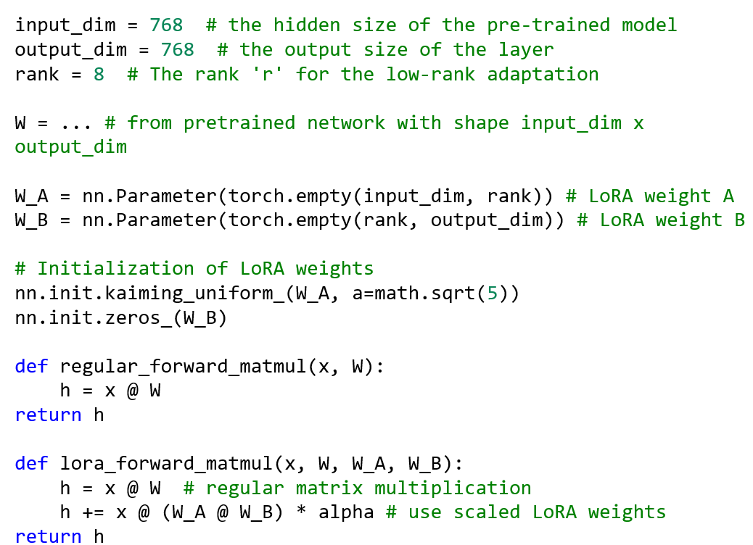

LoRA: Low-Rank Adaptation (w / pseudo code)
Pseudocode:
h
α
Pretrained
Weights
W ∈ ℝ^{dxd}
B = 0
r
A = $𝒩$(0,σ²)
d
x
Hu, Edward J., et al. "LoRA: Low-Rank Adaptation of Large Language Models." International Conference on Learning Representations. 2021.

Slide 41
[注意事項] LoRA 的問題
r 的數值大小需要手動調整
r 越小，訓練參數量越少
相較於原本沒有 LoRA 的模型，LoRA 其實會讓 inference 速度變慢
h
α
Pretrained
Weights
W ∈ ℝ^{dxd}
B = 0
r
A = $𝒩$(0,σ²)
d
x

Slide 42
可不可以不要外加？(Adapter 作法)
Adapter: Parameter-Efficient Transfer Learning for NLP. ICML 2019
h
優點：模型設計更靈活
缺點：
直接變更了模型架構 (串聯)
-> 計算時間比 LoRA 長
B
Transformer Layer
A
x
d

Slide 43
[注意事項] LoRA 的問題
r 的數值大小需要手動調整
r 越小，訓練參數量越少
相較於原本沒有 LoRA 的模型，LoRA 其實會讓 inference 速度變慢
訓練和 inference 時，大模型的部分其實還是被載入記憶體…
h
α
Pretrained
Weights
W ∈ ℝ^{dxd}
B = 0
r
A = $𝒩$(0,σ²)
d
x

Slide 44
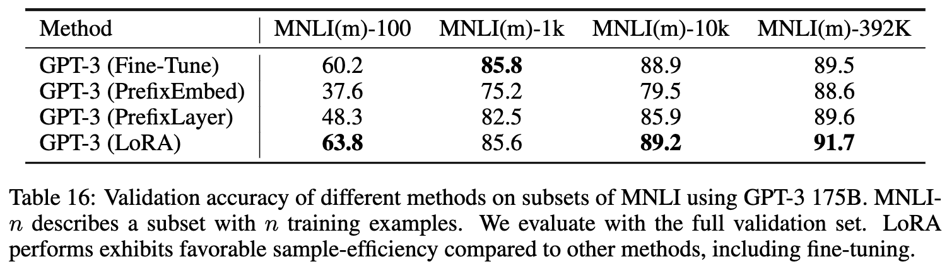
LoRA 可能可以在少量資料下進行微調
Hu, Edward J., et al. "LoRA: Low-Rank Adaptation of Large Language Models." International Conference on Learning Representations. 2021.

Slide 45
QLoRA: Quantized LoRA
只有黃色部分會被訓練
α 是超參數
Original
QLoRA
h
h
α
Pretrained
Weights
W ∈ ℝ^{dxd}
Pretrained
Weights
W ∈ ℝ^{dxd}
B = 0
ℝ^{r×d}
16-bit
32-bit /
16-bit
4-bit
r
A = $𝒩$(0,σ²)
ℝ^{d×r}
16-bit
x
x
d
d
Dettmers, Tim, et al. "Qlora: Efficient finetuning of quantized llms." NeurIPS 2023.

Slide 46
[注意事項] QLoRA
記憶體使用量：QLoRA < LoRA
模型效能：QLoRA <= LoRA

Slide 47

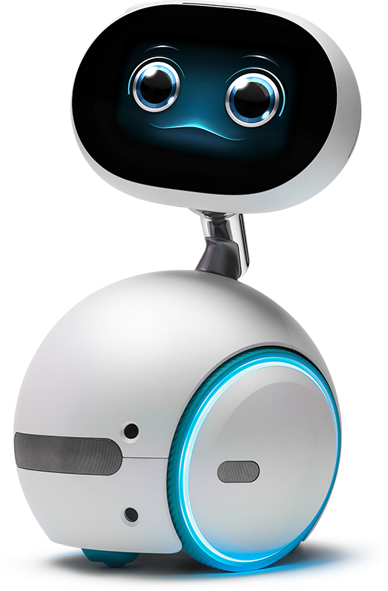
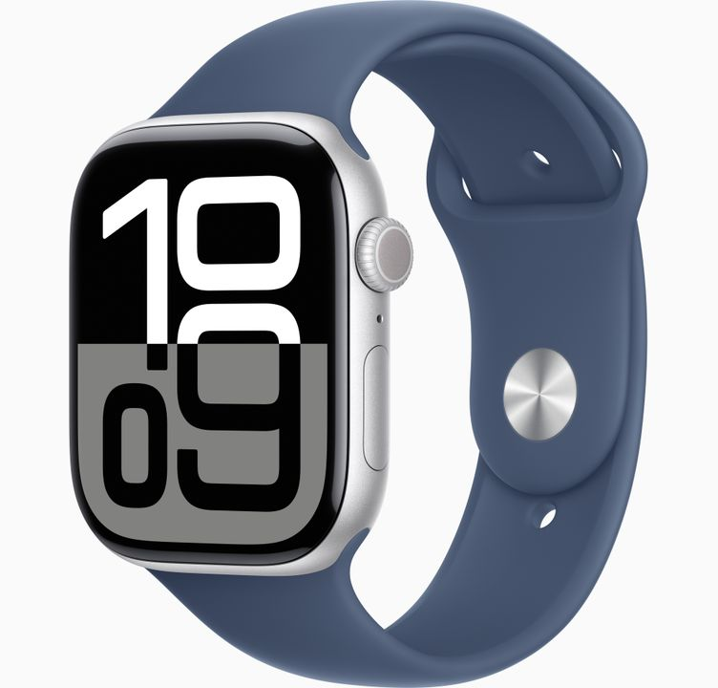

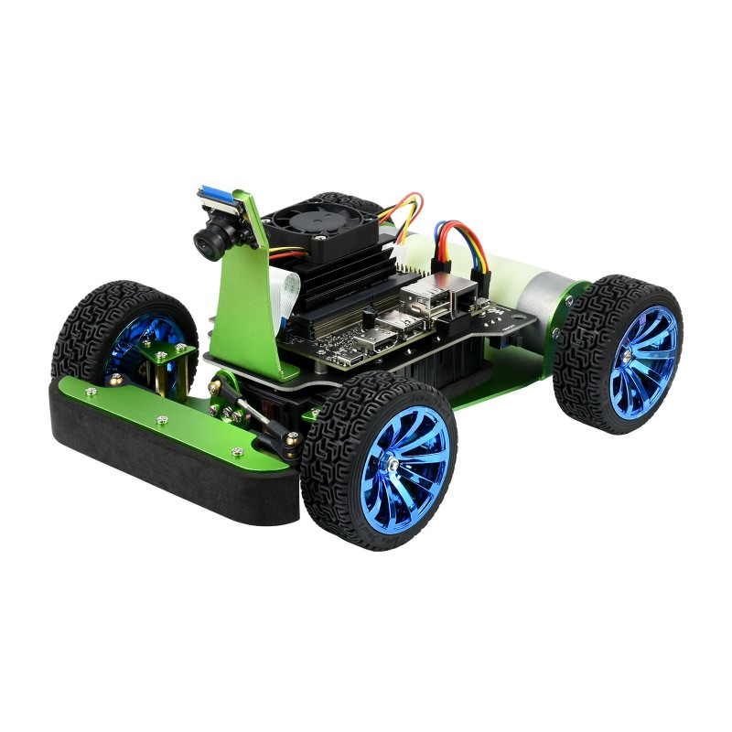
How about model compression?

Slide 48
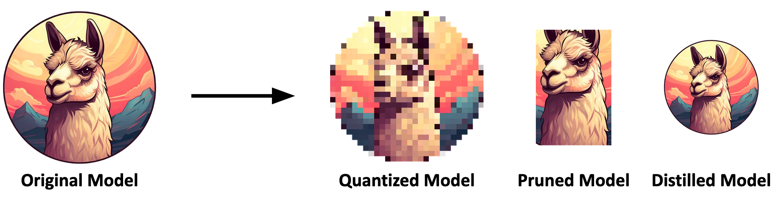
Comparison: What is Model Compression?
Figure credit: yxhong-tw

Slide 49
PEFT vs. Model compression
 | PEFT | Model Compression
目標 | 讓模型適應新的任務， 但模型大小不變 | 加速模型運算或模型儲存空間
相較於原始模型的改變內容 | 插入少量可訓練參數 | 減少整體模型結構或權重
參數更新 | 只更新少量新參數 | 先減少整體模型結構後針對新的模型進行訓練
使用情境 | 需要模型學會新的任務時 | 手機、邊緣裝置

Slide 50
Previous Videos of Model Compression
https://youtu.be/Qqyo9U2JRBQ?si=V9F_nNm44dijmYKc
https://youtu.be/luBa01XYoBc?si=8Hj8fUUI6RwPPI1j
https://youtu.be/dpE6LyIGU9w?si=5XBdr-JDJaHojoJD

Slide 51
Announcement
For Week 15 and Week 16

Slide 52
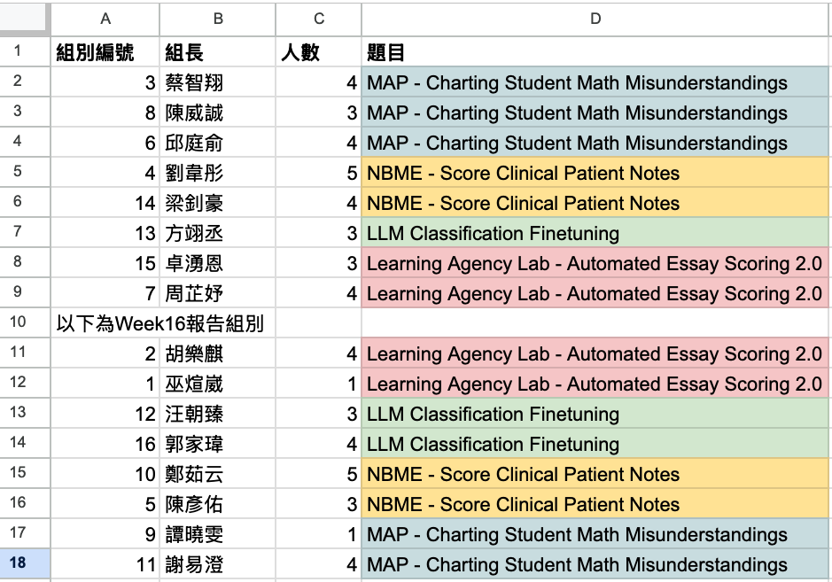
Week 15/16 報告順序與注意事項
四個主題
報告順序可換
非報告組同學仍需到場
聆聽報告
進行同儕互評

Slide 53

Reasoning Models (會推理的模型)
Reasoning Models
Test-Time Compute
LLM

Slide 54
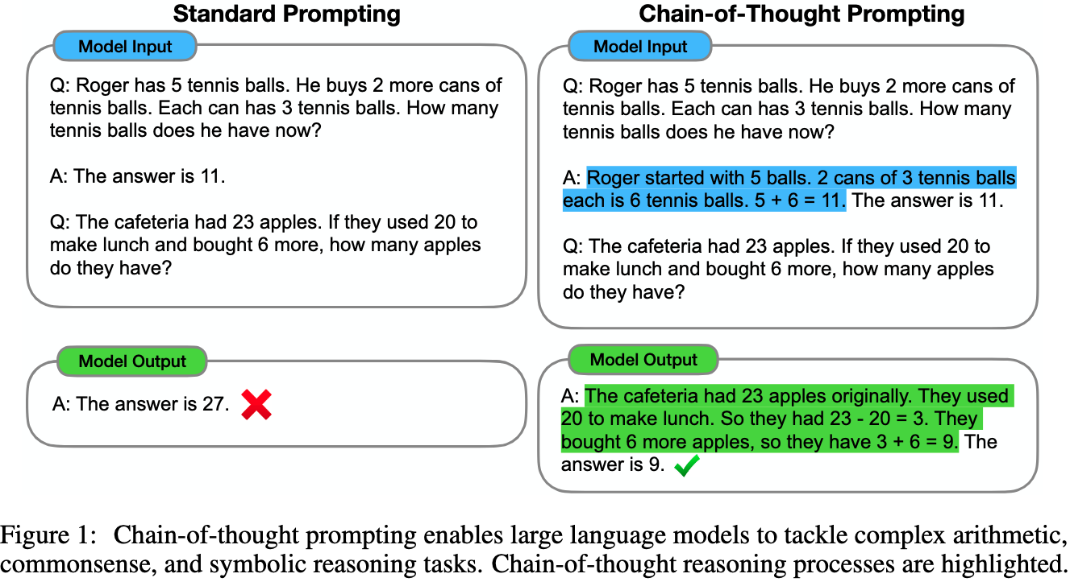
Standard Prompting vs. Chain-of-Thought (CoT)
CoT: https://arxiv.org/abs/2201.11903
Zero-shot-CoT: https://arxiv.org/abs/2205.11916
Let’s think step by step.

Slide 55

CoT - method
Wei et al., Chain-of-Thought Prompting Elicits Reasoning in Large Language Models. NeurIPS 2022. By Google.
Prompt: Few-shot examples (Rationales written by human)
Question: Sammy wanted to go to where the people were. Where might he go? Answer Choices: (a) populated areas (b) race track (c) desert (d) apartment (e) roadblock
xN
Answer: The answer must be a place with a lot of people. Of the above choices, only populated areas have a lot of people. So the answer is (a) populated areas.
Similar in task
+
A gentleman is carrying equipment for golf, what is he likely to have?
Answer Choices: (a) populated areas (b) race track (c) desert (d) apartment (e) roadblock
(⬅️有選項的QA問題)
Answer: (a) club.
Rationale
Answer
(模型回答➡️)
Answer: The answer must be something that is used for golf. Of the above choices, only clubs are used for golf. So the answer is (a) club.

Slide 56
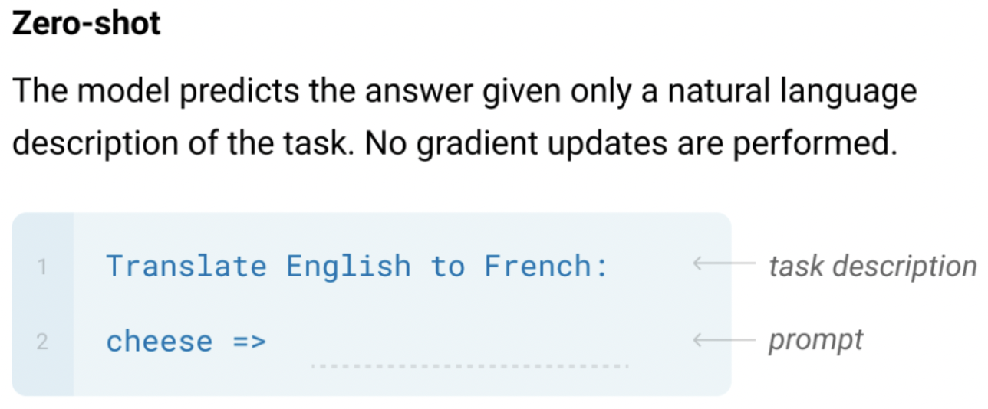
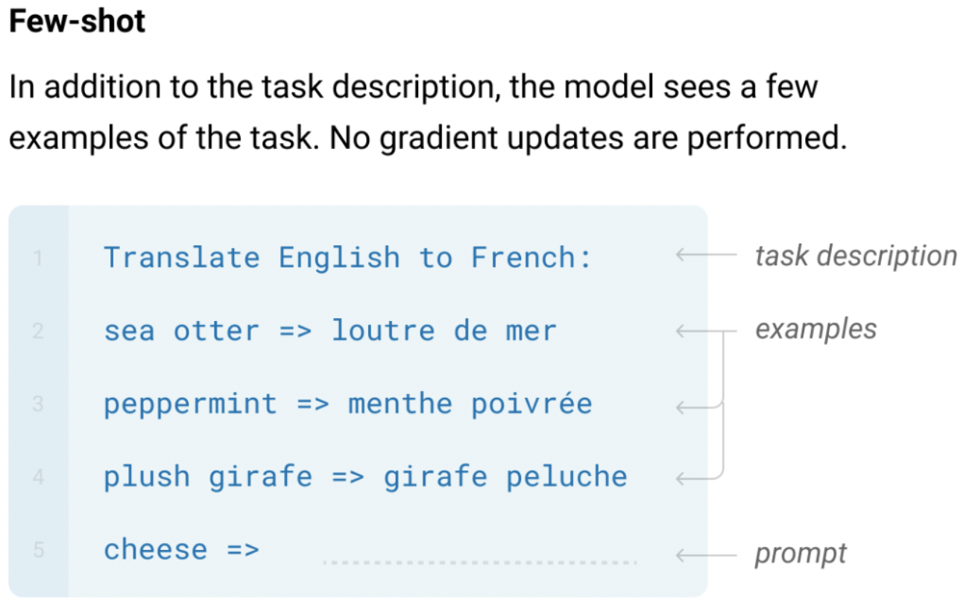
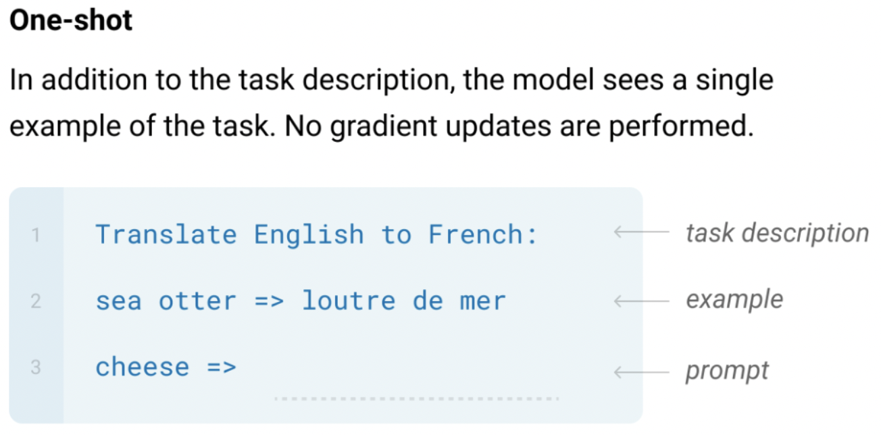
CoT is not just Few-shot -> [Recap] GPT-3
The three settings explored for in-context learning in the GPT-3 paper:
Note that these settings underperform the traditional fine-tuning methods.
Brown, Tom, et al. "Language models are few-shot learners." Advances in neural information processing systems 33 (2020): 1877-1901.

Slide 57
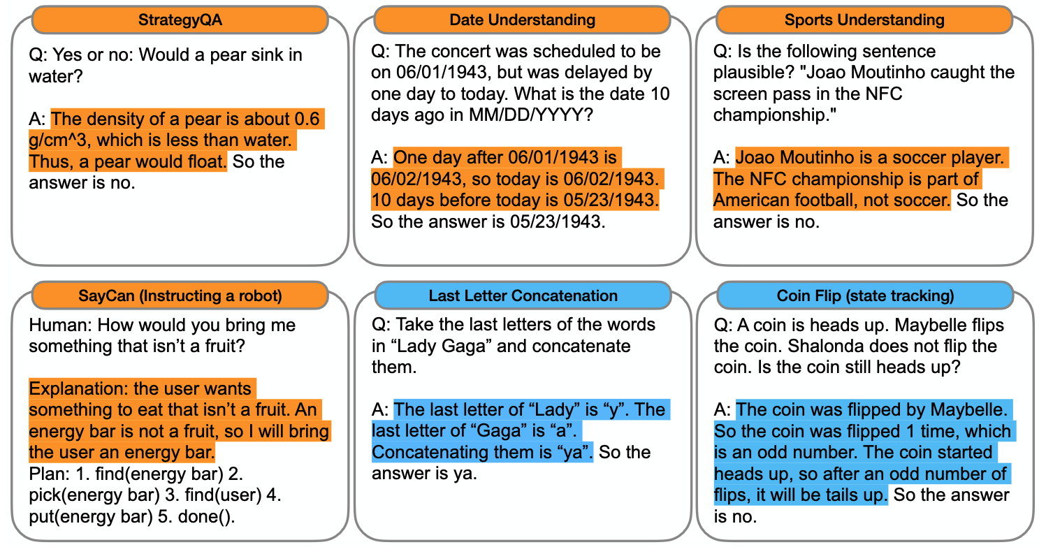
不同任務需要不同的 Prompt
https://arxiv.org/abs/2201.11903

Slide 58
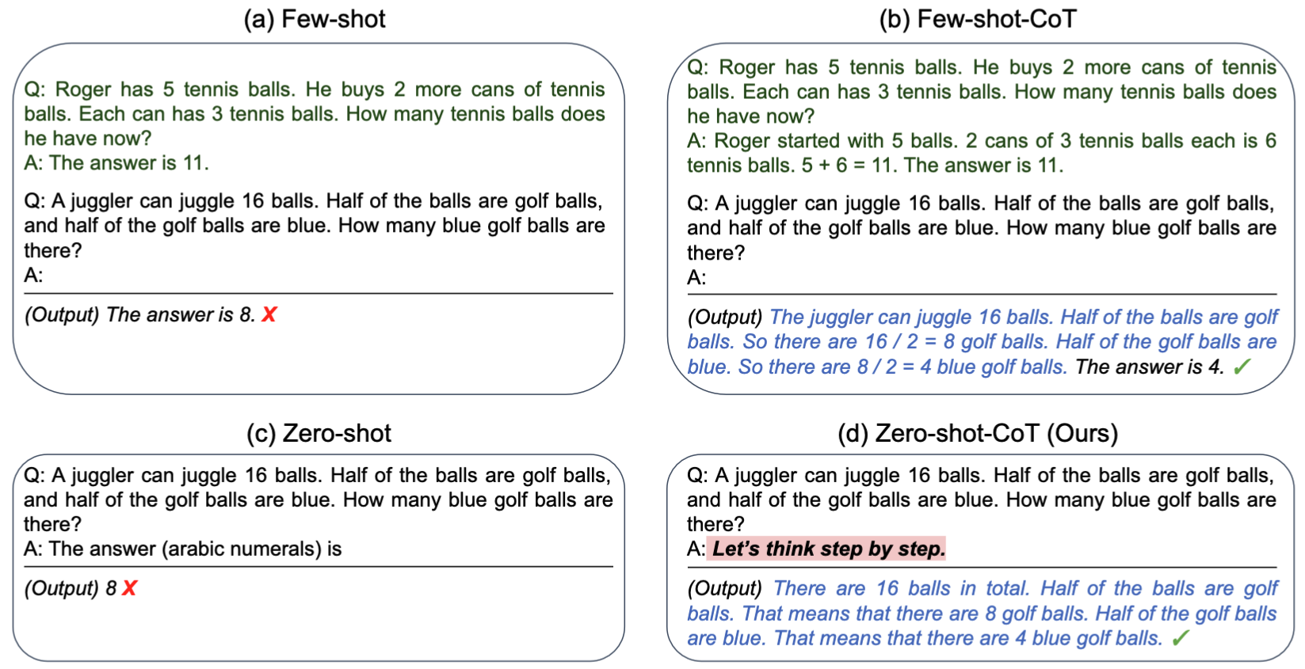
Zero-shot CoT
https://arxiv.org/abs/2205.11916

Slide 59
Zero-shot CoT - method
1st prompting
Reasoning Extraction
2nd prompting
Answer Extraction
雞兔同籠，共有 35 個頭、94 隻腳。請問雞有幾隻？
Let's think step by step.
雞兔同籠，共有 35 個頭、94 隻腳。請問雞有幾隻？
Let's think step by step.
1. 假設 35 隻全部都是雞，則腳數會是 35 × 2 = 70 隻。
2. 但實際上有 94 隻腳，多出 94 - 70 = 24 隻腳。
3. 每把一隻雞換成兔子，腳數會多 2 隻。
4. 因此兔子的數量是 24 ÷ 2 = 12 隻。
5. 雞的數量是 35 - 12 = 23 隻。
所以答案是 (阿拉伯數字)：
LLM
1. 假設 35 隻全部都是雞，則腳數會是 35 × 2 = 70 隻。
2. 但實際上有 94 隻腳，多出 94 - 70 = 24 隻腳。
3. 每把一隻雞換成兔子，腳數會多 2 隻。
4. 因此兔子的數量是 24 ÷ 2 = 12 隻。
5. 雞的數量是 35 - 12 = 23 隻。
LLM
23
https://arxiv.org/abs/2205.11916

Slide 60
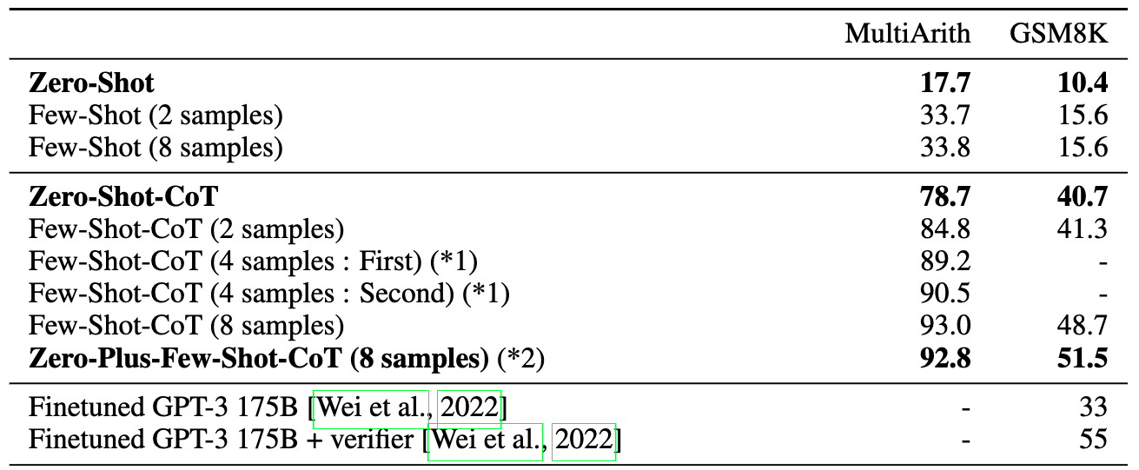
Zero-shot CoT 效果不差
Zero-shot CoT 仍輸給一般 CoT
Let’s think step by step 是個厲害的咒語
https://arxiv.org/abs/2205.11916

Slide 61
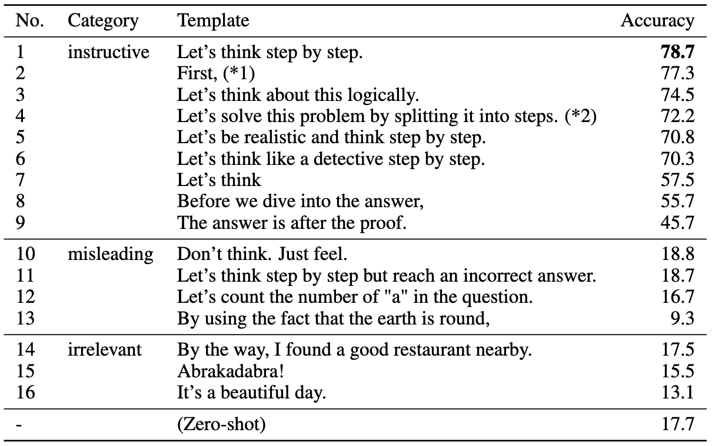
Let’s think step by step on MultiArith
https://arxiv.org/abs/2205.11916

Slide 62
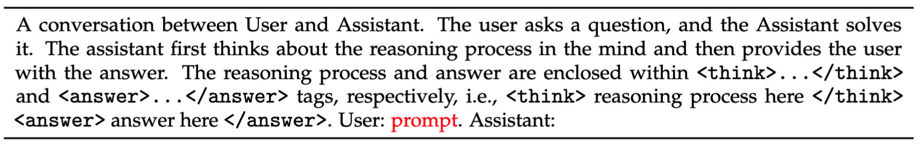
可不可以讓模型自己長出推理能力？
Guo, Daya, et al. "Deepseek-r1: Incentivizing reasoning capability in llms via reinforcement learning." arXiv preprint arXiv:2501.12948 (2025).
用戶與助手之間的對話。
用戶提出問題，助手解答。助手先在腦海中推理，然後將答案提供給使用者。
推理過程和答案分別包含在 `<think>...</think>` 和 `<answer>...</answer>` 標籤內，即：`<think>此處為推理過程</think>`，`<answer>此處為答案</answer>`。
使用者：提示詞。助手：

Slide 63
DeepSeek-R1-zero 細節
Guo, Daya, et al. "Deepseek-r1: Incentivizing reasoning capability in llms via reinforcement learning." arXiv preprint arXiv:2501.12948 (2025).
使用 RL 進行訓練 (GRPO，類似於RLHF的 PPO)
Two reward models (不需訓練):
Answer rewards: 答案是否正確
Format rewards: 有沒有把推理過程寫在 <think> 和 </think> 中
從 DeepSeek-V3-Base 作為初始化模型 (671B)
資料集：數學、程式設計、以及邏輯推論

Slide 64
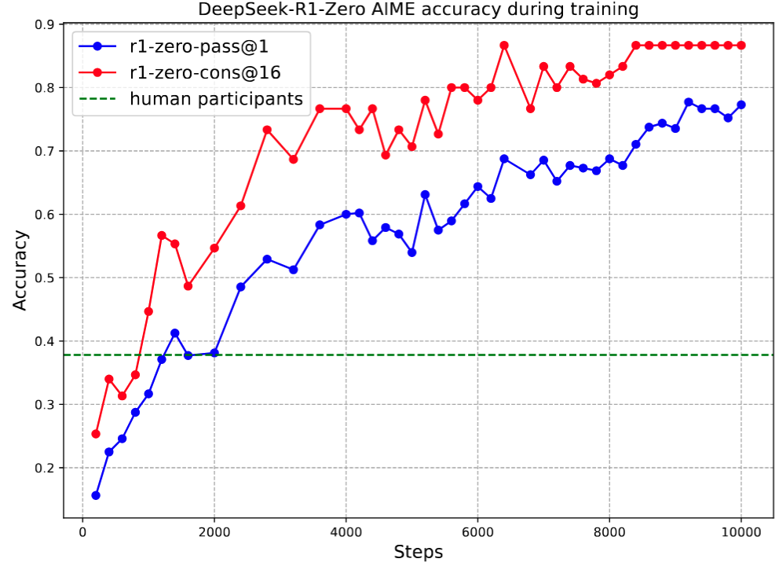
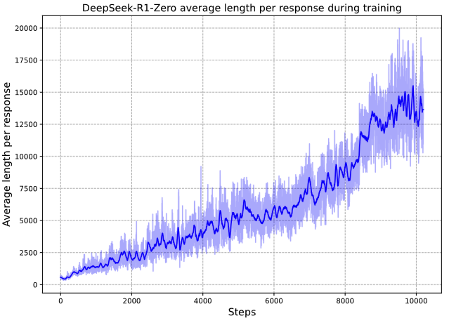
DeepSeek-R1-zero 訓練過程
Guo, Daya, et al. "Deepseek-r1: Incentivizing reasoning capability in llms via reinforcement learning." arXiv preprint arXiv:2501.12948 (2025).

Slide 65
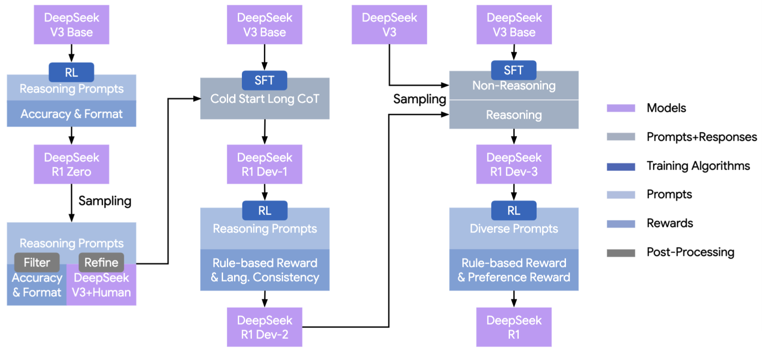
DeepSeek-R1
Guo, Daya, et al. "Deepseek-r1: Incentivizing reasoning capability in llms via reinforcement learning." arXiv preprint arXiv:2501.12948 (2025).

Slide 66
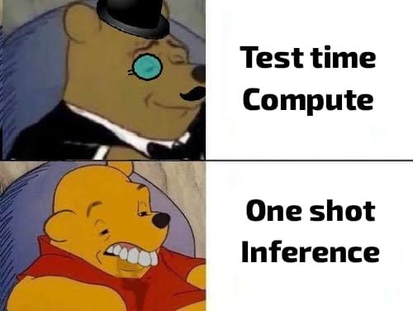
Test-Time Compute
Reasoning Models
Test-Time Compute
Figure ref: https://medium.com/@gupta.moulik/is-this-something-that-will-take-us-to-agi-ttc-and-cot-explained-971fdf35f85c

Slide 67
[Recap] The Pre-training then Fine-tuning Paradigm
Fine-tuning
文字接龍
(Pre-training)
指令微調 (Supervised Fine-tuning, SFT)
人類反饋學習 (RLHF)
GPT-3
InstructGPT
讓模型學會回答
讓模型的回答貼近人類想要的回答
RLHF: Reinforcement Learning with Human Feedback

Slide 68
增加驗證推理步驟的 Reward Model
Fine-tuning
Verifier
文字接龍
(Pre-training)
指令微調 (Supervised Fine-tuning, SFT)
人類反饋學習 (RLHF)
GPT-3
InstructGPT
讓模型學會回答
讓模型的回答貼近人類想要的回答
Snell, Charlie, et al. "Scaling LLM test-time compute optimally can be more effective than scaling parameters for reasoning." International Conference on Learning Representations. Vol. 2025. 2025.

Slide 69
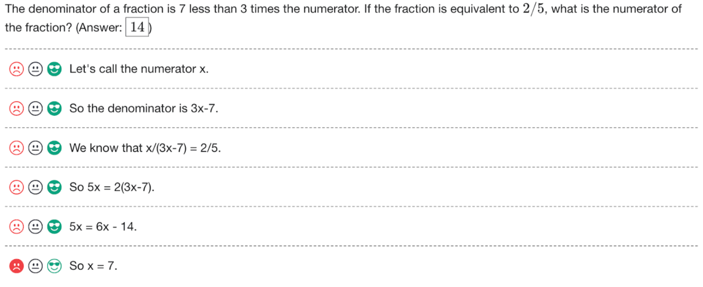
PRM800K Dataset
Let’s Verify Step by Step: https://arxiv.org/abs/2305.20050
800K step-level labels across 75K solutions to 12K math problems

Slide 70
Test-time Compute 步驟 (Stage 2)
Problem Statement
Stage 1: 訓練 Verifier
Step 1: ...
Step 1: ...
GPT-4
(Verifier)
❌
Problem Statement
GPT-4
(Verifier)
Step 1: ...
✅
...
Step 1: ...
Step 6: ...
Let’s Verify Step by Step: https://arxiv.org/abs/2305.20050

Slide 71
Test-time Compute 步驟 (Stage 2)
Stage 2: 進行 Test-time compute
Q: 雞兔同籠，共有 35 個頭、94 隻腳。請問雞有幾隻？
Let's think step by step.
LLM
(Q+s1)
Verifier
score
(Q+s1+s2)
Verifier
score
s1. 假設 35 隻全部都是雞，則腳數會是 35 × 2 = 70 隻。
s2. 但實際上有 94 隻腳，多出 94 - 70 = 24 隻腳。
s3. 每把一隻雞換成兔子，腳數會多 2 隻。
s4. 因此兔子的數量是 24 ÷ 2 = 8 隻。
s5. 雞的數量是 35 - 8 = 27 隻。
(Q+s1+s2+s3)
Verifier
score
(Q+s1+s2+s3+s4)
Verifier
score
(Q+s1+s2+s3+s4+s5)
Verifier
score

Slide 72
Thank you!
Instructor: 林英嘉
✉️ yjlin@cgu.edu.tw
TA: 林宣辰
✉️ b1128015@cgu.edu.tw

