Slide 1
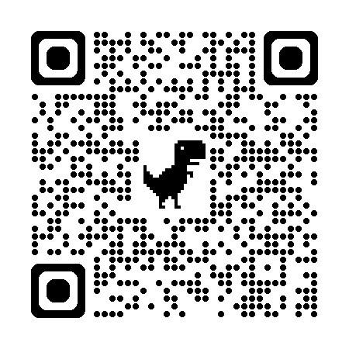
Course Website
114-2
自然語言處理與
應用
https://github.com/mcps5601/CGUNLP_2026_Spring

Slide 2


自然語言處理與應用 Natural Language Processing and Applications
Course Introduction
Slido
# NLP0223 (Link)
Instructor: 林英嘉 (Ying-Jia Lin)
2026/02/23

Slide 3




About Me
Experience and Education (Time)
Assistant Professor | Department of Artificial Intelligence, Chang Gung University (2025/02 - )
Postdoctoral Researcher | Department of Computer Science, National Tsing Hua University (2024/09 - 2025/01)
Ph.D. | Department of Computer Science and Information Engineering, National Cheng Kung University (2019/08 - 2024/02)
M.S. | Institute of Biomedical Informatics, National Yang-Ming University (2017/09 - 2019/07)
B.S. | Department of Biomedical Sciences, Chang Gung University (2013/09 - 2017/06)
🪖

Slide 4
Outline
Introduction to Natural Language Processing
Introduction to Large Language Models
Course Introduction and requirements

Slide 5
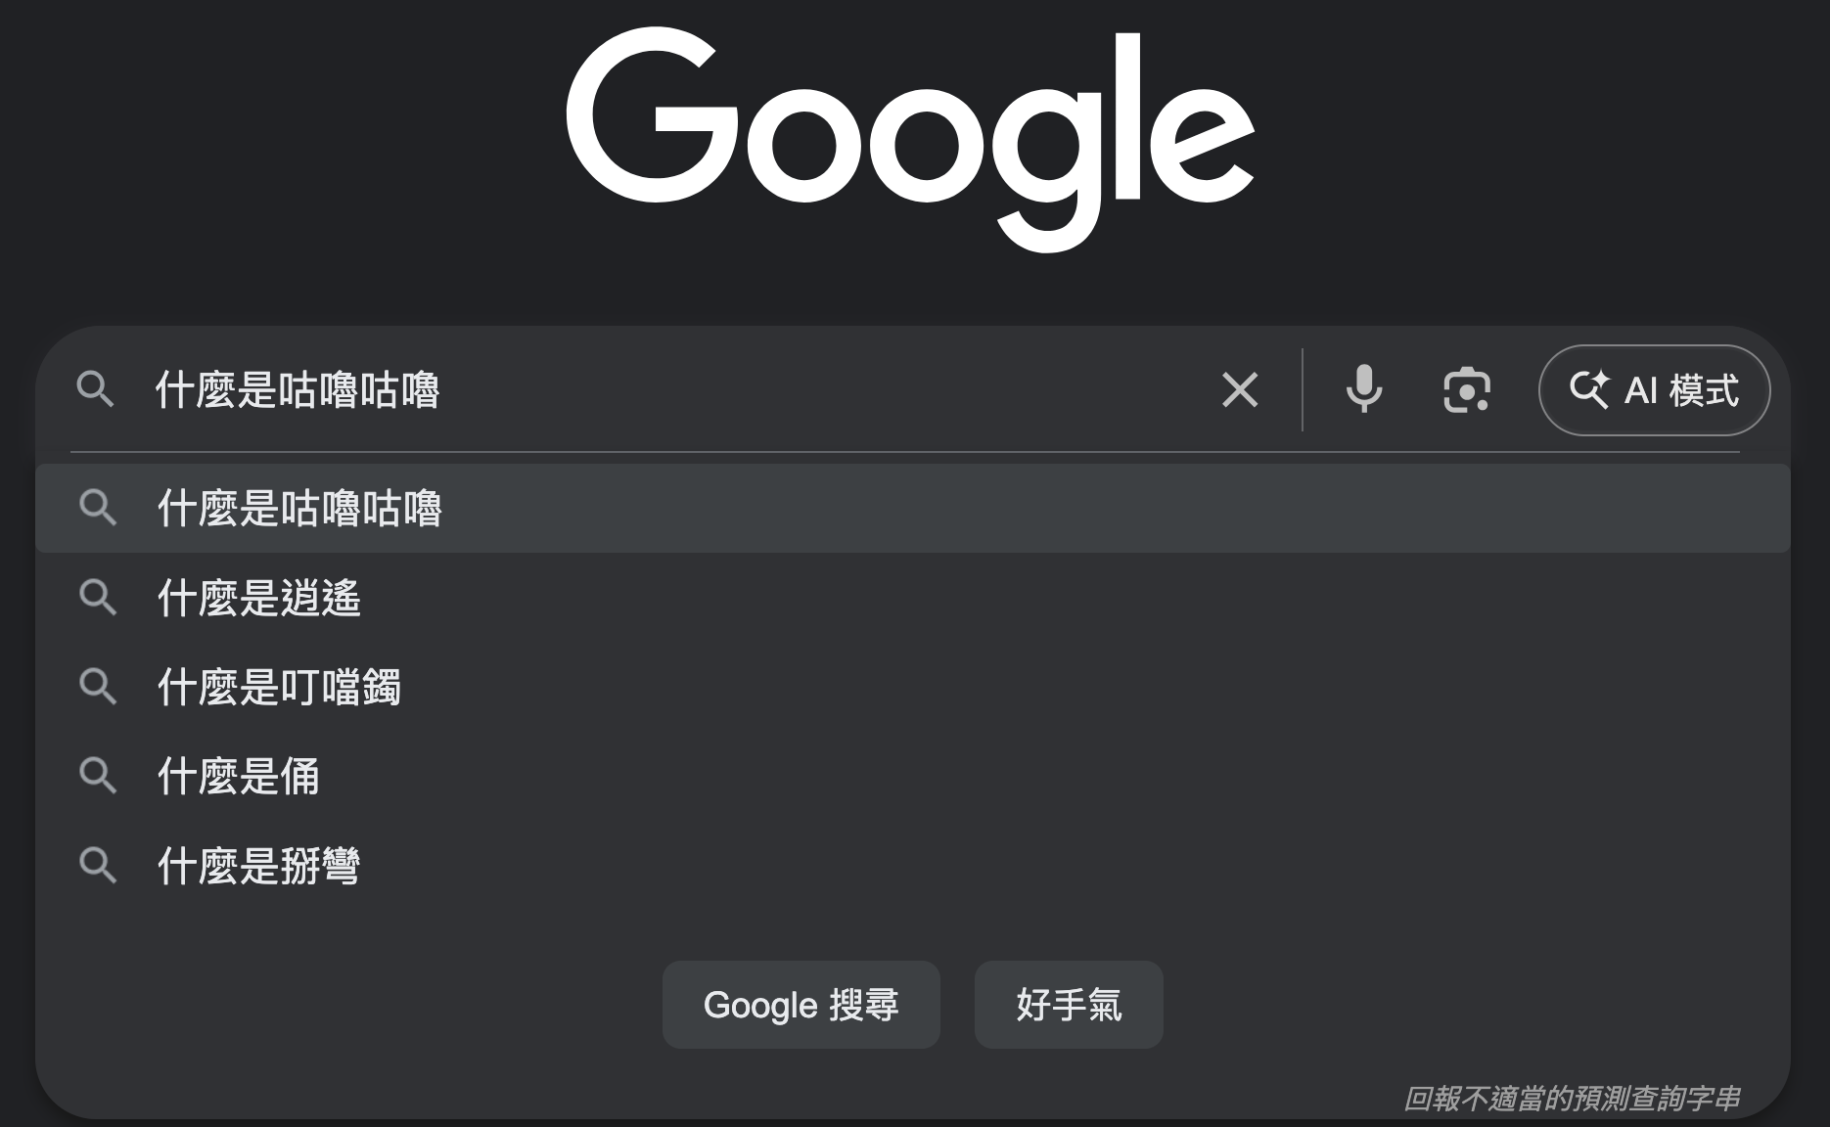
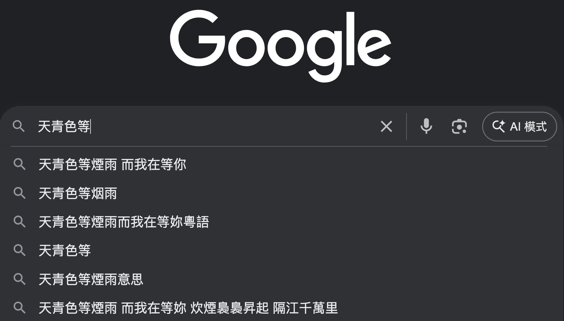
什麼是自然語言處理（Natural Language Processing, NLP）？
文字搜尋
下一個字預測

Slide 6
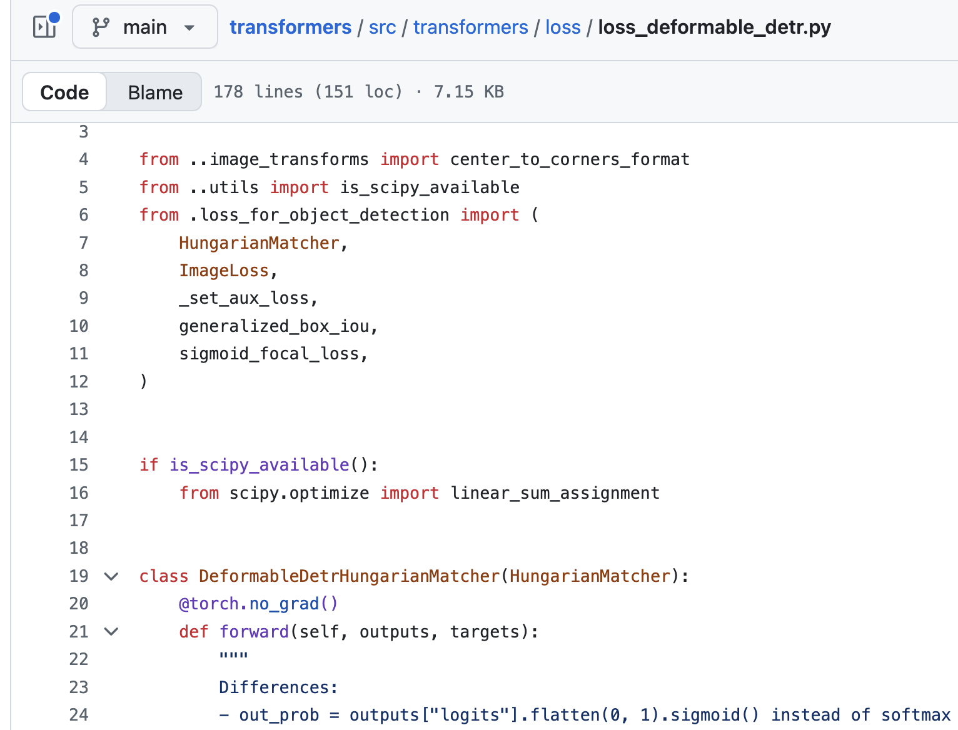
程式語言 vs. 自然語言
程式語言
自然語言
先生不知何許人也，亦不詳其姓字。宅邊有五柳樹，因以為號焉
閑靜少言，不慕榮利。好讀書，不求甚解，每有會意，便欣然忘食。性嗜酒，家貧，不能常得。親舊知其如此，或置酒而招之。造飲輒盡，期在必醉，既醉而退，曾不吝情去留。環堵蕭然，不蔽風日；短褐穿結，簞瓢屢空。——晏如也。常著文章自娛，頗示己志。忘懷得失，以此自終。
贊曰：黔婁之妻有言：「不戚戚於貧賤，不汲汲於富貴。」極其言，茲若人儔乎？酣觴賦詩，以樂其志。無懷氏之民歟！葛天氏之民歟！

Slide 7
什麼是自然語言處理？
天青色等煙雨
🖥️
?
I like apple!
自然語言處理（Natural Language Processing, NLP）
是讓電腦能「理解、分析、產生」人類語言的技術。
定義 ➡️

Slide 8
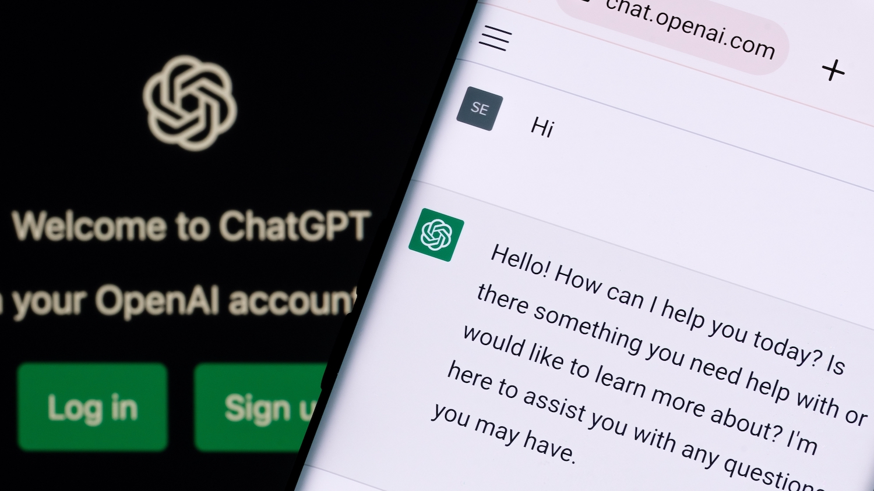
The Revolution of ChatGPT
ChatGPT came out in November, 2022.
Figure source: https://poole.ncsu.edu/thought-leadership/article/lets-chat-about-chatgpt/
https://openai.com/index/chatgpt/

Slide 9
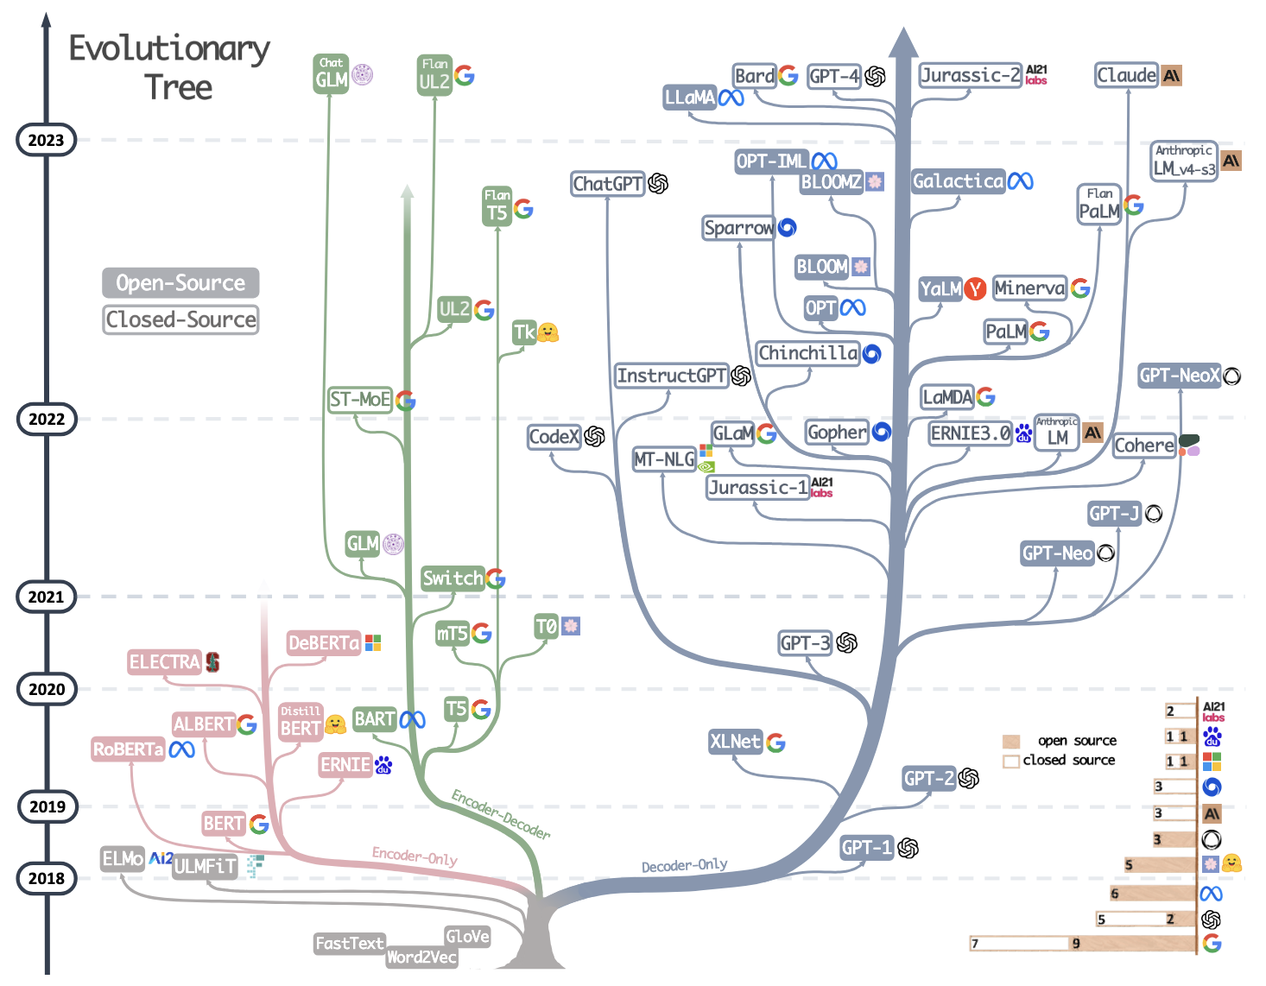
大型語言模型的演化樹
Yang, Jingfeng, et al. "Harnessing the power of llms in practice: A survey on chatgpt and beyond." ACM Transactions on Knowledge Discovery from Data 18.6 (2024): 1-32.

Slide 10
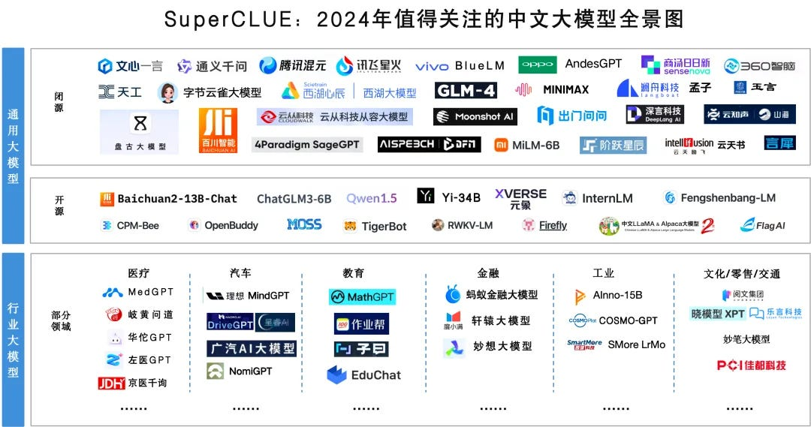
Chinese LLMs
Figure source: https://chinai.substack.com/p/chinai-264-superclue-april-2024-report

Slide 11
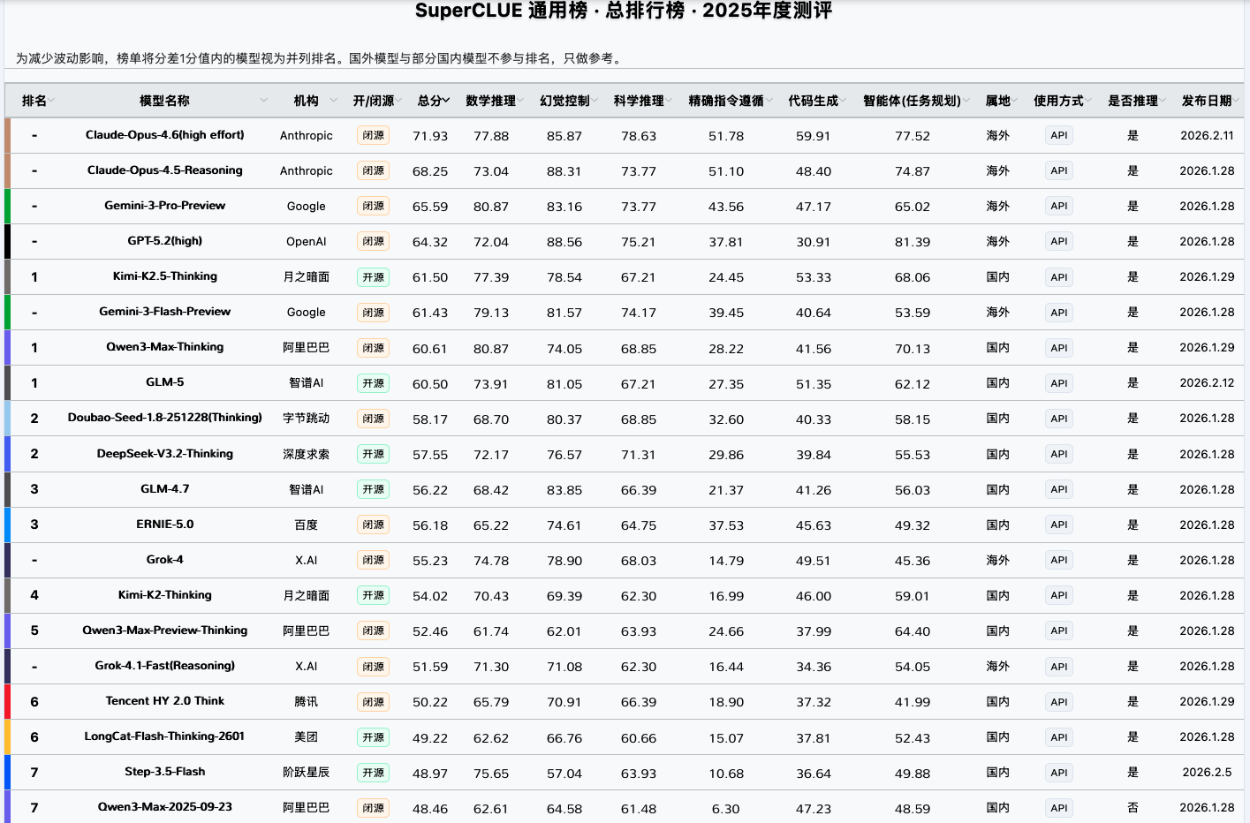
SuperCLUE Leaderboard
Figure source: https://www.superclueai.com/

Slide 12
自然語言處理（廣義）屬於一 機器學習領域的任務

Slide 13

Venn Diagram about AI, ML, and DL
Machine Learning (ML)
Deep Learning (DL)
Ex. Logistic Regression
Ex. 專家系統 (Expert system; Knowledge base)
Ex. Multi-layer Perceptron
NLP
Artificial Intelligence (AI)

Slide 14
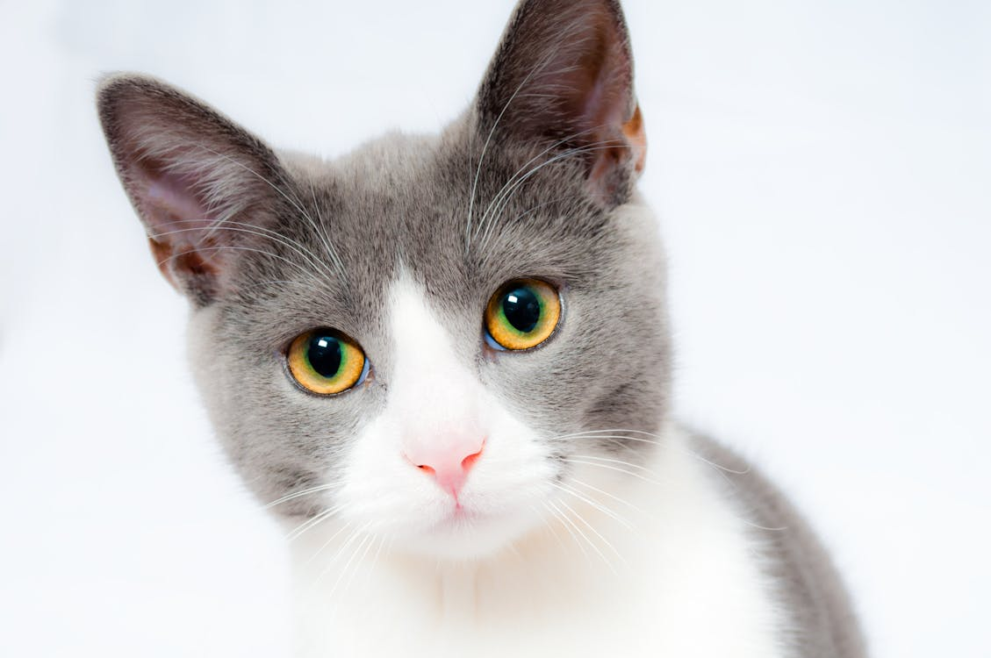

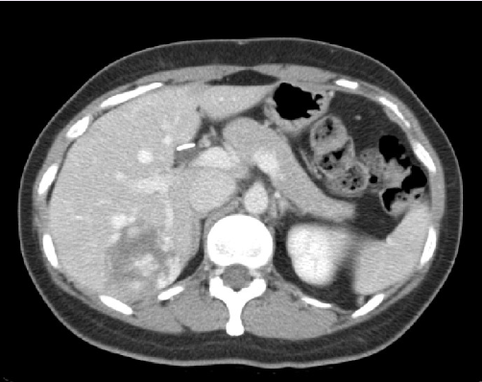
What is Deep Learning?
We start the concepts from machine learning.
Machine Learning function!
Cat
Classifier
Dog
Apple
Classifier
Malignant
Benign

Slide 15
How about DL in Natural Language Processing?
Sentiment Analysis (IMDb dataset ^{[1]})
This movie was awful. The ending was absolutely horrible.
Classifier
Positive
Negative
Translation, EN-ZH (WMT-19 dataset ^{[2]})
Machine Translation Model
Yet not nearly enough has been invested in this effort.
但目前這方面的投入還遠遠不夠。
[1] https://huggingface.co/datasets/stanfordnlp/imdb
[2] https://huggingface.co/datasets/wmt/wmt19/viewer/zh-en

Slide 16
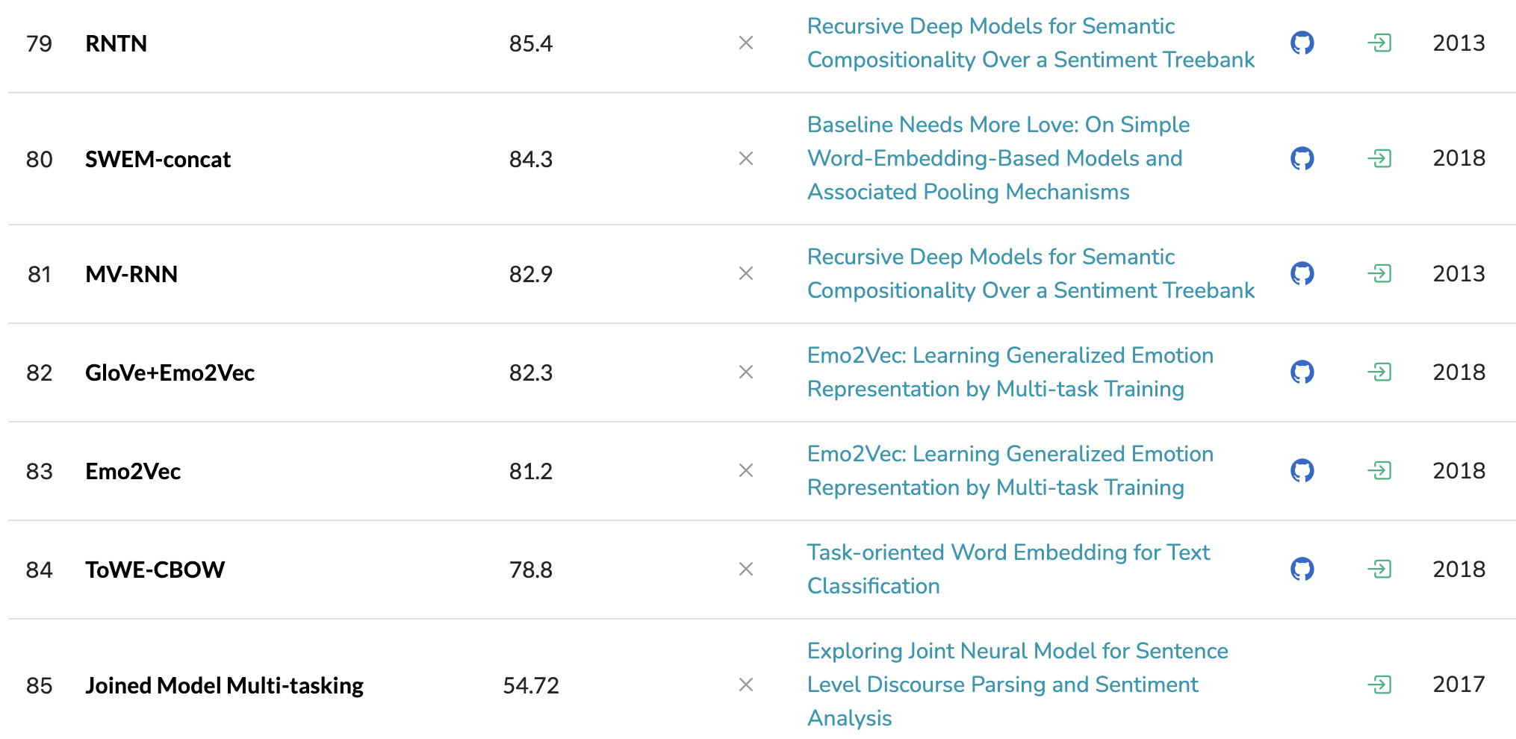
Why do we need DL in NLP?
https://paperswithcode.com/sota/sentiment-analysis-on-sst-2-binary
Liu, Qian, et al. "Task-oriented word embedding for text classification." Proceedings of the 27th international conference on computational linguistics. 2018.

Slide 17
電腦是如何學習自然語言呢？

Slide 18


影像 vs. 文字
28 x 28 的矩陣
I want to study AI
?
Figure source: https://kopu.chat/wp-content/uploads/2017/04/binary-507x380.jpeg

Slide 19
Word Representations
like
🖥️
?
apple
Basic Approach
apple
[1, 0, 0, 0, 0, 0, 0, 0]
One hot encodings with each vector size equal to the vocab size (8 in this case)
Corpus
eat
[0, 1, 0, 0, 0, 0, 0, 0]
I like to eat apple
I
[0, 0, 1, 0, 0, 0, 0, 0]
Vocabulary
Pros: handy, training-free
Cons: sparse matrix which occupies much memory
You like to watch TV
like
[0, 0, 0, 1, 0, 0, 0, 0]
watch
[0, 0, 0, 0, 1, 0, 0, 0]
to
[0, 0, 0, 0, 0, 1, 0, 0]
...

Slide 20

詞嵌入：把詞嵌入到向量 (Word2Vec)
Input
Prediction
[1] Mikolov et al. "Distributed representations of words and phrases and their compositionality." NeurIPS 2013.
Steve
Jobs
CBOW ^{[1]}
(Continuous Bag-of-Words)
[MASK]
founded
Apple
非常大量的語料庫 (例如：Wikipedia)
Inc.
[MASK]
Steve
[MASK]
Jobs
Skip-gram ^{[1]}
founded
[MASK]
Apple
[MASK]
Inc.

Slide 21
每個字，都是一段向量 – 詞向量
Word2Vec 的範例長相:
Dimension size (e.g., 300)
apple -0.110960 0.016115 -0.004809 0.033589 0.121455 …
banana -0.027713 -0.015676 0.003314 0.077602 0.159718 …
…
…
…
Vocabulary size
(e.g., 30,000)

Slide 22
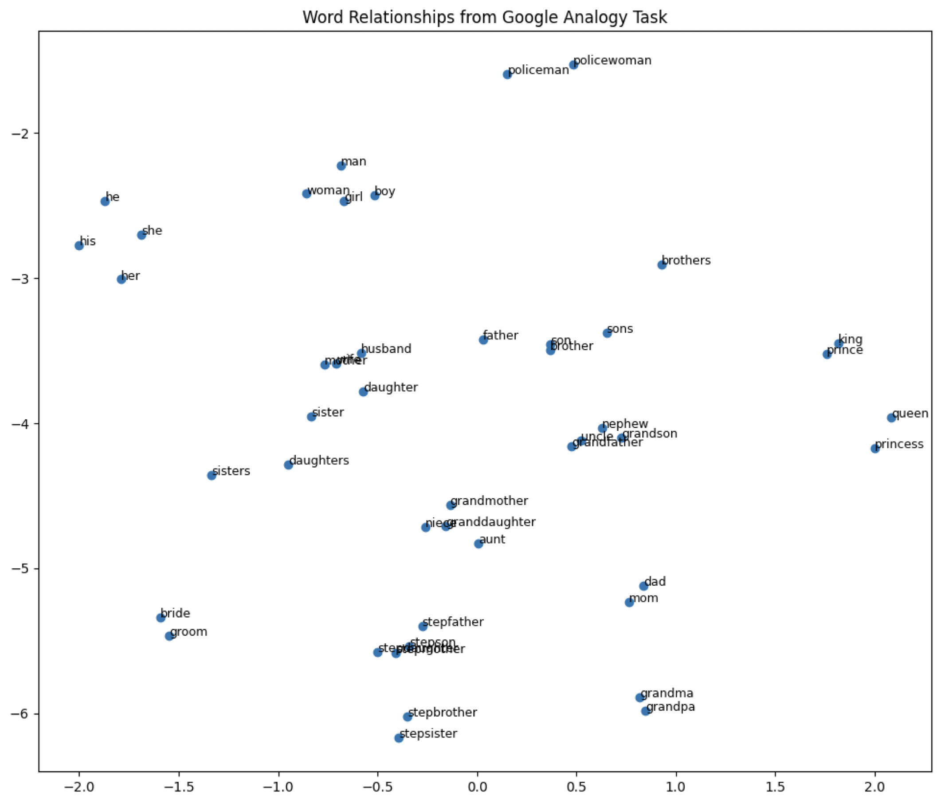
Word Embeddings 視覺化
Word embedding model: glove-wiki-gigaword-100
Dimension reduction: t-SNE
Dataset: Mikolov et al., 2013

Slide 23
Problems of Traditional Word Embeddings
Out-of-vocabulary problem
Model architecture for down-stream applications
Context-dependent representations

Slide 24
The Out-of-vocabulary Problem
Before training word embeddings, words are split by whitespaces for English corpora
Vocabulary
(假設字典的內容由a排到z)
apple
300-dimensional vector
...
jobs
300-dimensional vector
Word2vec
(Embeddings)
...
jobs
300-dimensional vector
...
QAQ
?
...
如果字沒有出現在字典中 (可能此字不存在於訓練資料)，那它就不會有對應的字向量

Slide 25
Sub-word Tokenization (Byte Pair Encoding)
Byte Pair Encoding (BPE)^{[3]} is a sub-word (子詞) tokenization technique used to handle rare words by breaking them into more frequent sub-word units.
Example sentence:
I printed Hello world.
Traditional word tokenization
Traditional with BPE
I
printed
Hello
world
I
prin
ted
Hell
o
world
分詞方法的決定是無監督式的
[3] Sennrich et al. "Neural Machine Translation of Rare Words with Subword Units." ACL 2016.

Slide 26
Sub-word Tokenization 的好處
With sub-word tokenization algorithms like BPE, we can handle representations for unknown words (or mis-spelled words).
In machine translation , the compound word issues between source and target languages can be alleviated.
State-of-the-art pre-trained language models (e.g., GPT-3, BERT) adopt sub-word tokenization algorithms before pre-training.

Slide 27
Problems of Traditional Word Embeddings
Out-of-vocabulary problem
Model architecture for down-stream applications
Context-dependent representations

Slide 28
The Pre-training then Fine-tuning Paradigm
Pre-training
Fine-tuning
在大量資料上進行訓練，通常是自監督式 (Self-Supervised Training)
在目標資料上進行訓練，通常是監督式 (Supervised Training)，也就是需要有標註的資料才能進行模型訓練

Slide 29
Contextual Word Representations (RNN)
open a bank account
on the river bank
the same word vector
Recurrent Neural Network
(Contextual Embedding)
Recurrent Neural Network
(Contextual Embedding)
open
a
bank
account
on
the
river
bank
How about bi-directional?

Slide 30
Contextual Word Representations (Transformer)
open a bank account
on the river bank
the same word vector
Self-attention
Self-attention
Transformer
(Contextual Embedding)
Transformer
(Contextual Embedding)
open
a
bank
account
on
the
river
bank

Slide 31
Model Training: Pre-training and Fine-Tuning
Step1: Pre-training (use large-scale corpora)
Model (e.g., Word2vec, BERT)
Open a [MASK] account
bank
Step2: Fine-Tuning (use datasets from target tasks)
Model (e.g., Word2vec + RNN; BERT + Classifier)
It was a good movie!
Positive
Devlin, Jacob, et al. "BERT: Pre-training of Deep Bidirectional Transformers for Language Understanding." NAACL 2019.

Slide 32
BERT (Bidirectional Encoder Representations from Transformers)
BERT 有兩種預訓練任務：
Masked Language Modelling
Next Sentence Prediction
bank
binary classification
BERT
(Transformer Encoder)
BERT
(Transformer Encoder)
[CLS]
open
a
[MASK]
account
[SEP]
[CLS]
study
hard
[SEP]
plz
[SEP]
Devlin, Jacob, et al. "BERT: Pre-training of Deep Bidirectional Transformers for Language Understanding." NAACL 2019.

Slide 33

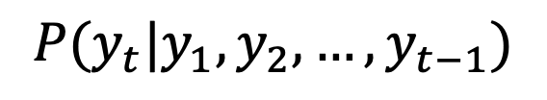
Generative Pre-Training (GPT)
(The next word)
y₈
$$P(y_{t}|y_{1},y_{2},…,y_{t−1})$$
Language Model
A model that assigns probabilities to upcoming words is called a language model.
The task involving predictions of upcoming words is language modeling.
y₁
y₂
y₃
y₄
y₅
y₆
y₇

Slide 34
GPT 系列作品（有透露細節的）時間線
2018/06/11
(GPT-1) Improving language understanding by generative pre-training
2019/02/14
(GPT-2) Language models are multi-task learners
2020/05/28
(GPT-3) Language models are few-shot learners
2022/05/04
(InstructGPT) Training language models to follow instructions with human feedback

Slide 35
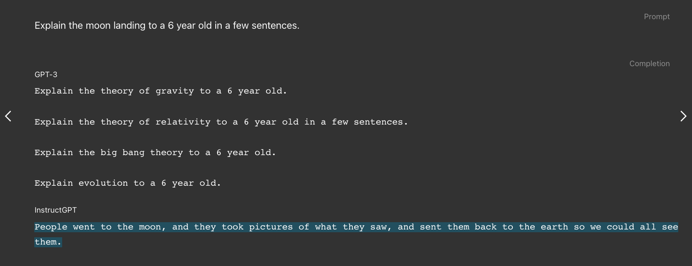
以前的 GPT 有口吃
InstructGPT: ChatGPT 的前身
Figure source: https://openai.com/index/instruction-following/
Ouyang, Long, et al. “Training language models to follow instructions with human feedback.” NeurIPS 2022.

Slide 36
The Pre-training then Fine-tuning Paradigm
Fine-tuning
文字接龍
(Pre-training)
指令微調 (Supervised Fine-tuning, SFT)
人類反饋學習 (RLHF)
GPT-3
InstructGPT
讓模型學會回答
讓模型的回答貼近人類想要的回答
RLHF: Reinforcement Learning with Human Feedback

Slide 37
RLHF 的進行過程
Optimize
As close to human-written ground-truths as possible
Input Prompt
Supervised Fine-Tuning
Tell me who is Oppenheimer?
語言模型
(e.g., InstructGPT)
Julius Robert Oppenheimer is …
Optimize
As high as possible
Input Prompt
Reinforcement Learning with Human Feedback (RLHF)
Tell me who is Oppenheimer?
語言模型
(e.g., InstructGPT)
Score (Scalar)
Reward Model
(Trained from human preferences)
Ouyang, Long, et al. "Training language models to follow instructions with human feedback." Advances in neural information processing systems 35 (2022): 27730-27744.

Slide 38
Main Differences between BERT and InstructGPT
Model size:
BERT: 110 million
InstructGPT: 175 billion (~=BERT*1590 times)
Training:
BERT: Masked-language modeling, Next-sentence Prediction
InstructGPT: Language Modeling, Supervised Fine-Tuning, Reinforcement Learning by Human Feedback
NLP Tasks:
BERT: Natural Language Understanding (E.g., Classification)
InstructGPT: Natural Language Generation (E.g., Machine Translation, Story Generation)

Slide 39
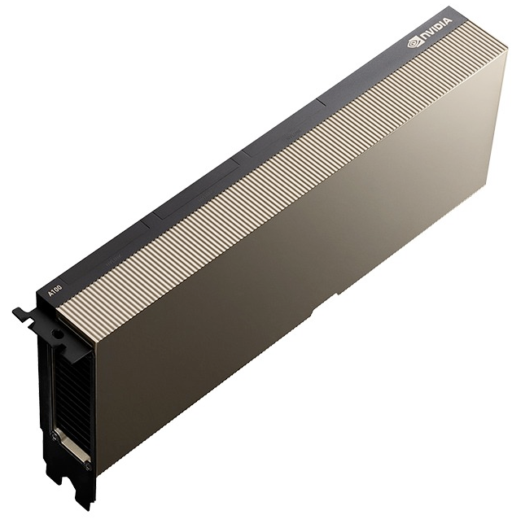
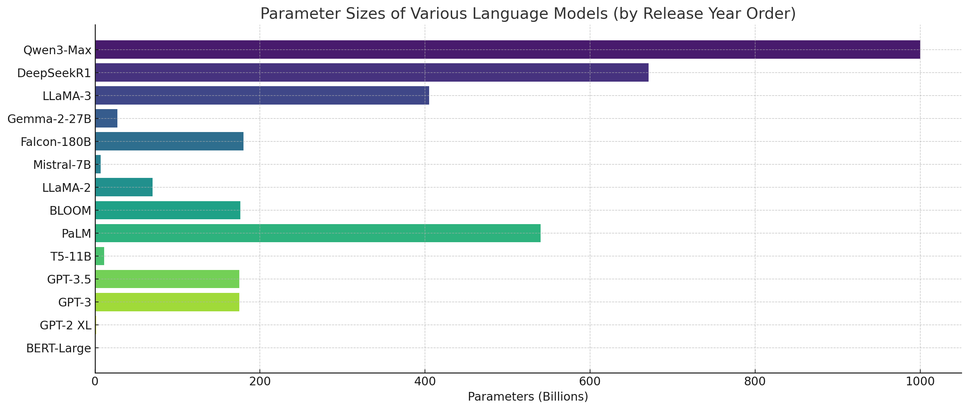
NLP Model Sizes (2018 – 2025)
💰💰💰💰💰
2025
2018

Slide 40
The Revolution of ChatGPT
ChatGPT came out in November, 2022.
Figure source: https://poole.ncsu.edu/thought-leadership/article/lets-chat-about-chatgpt/
https://openai.com/index/chatgpt/

Slide 41
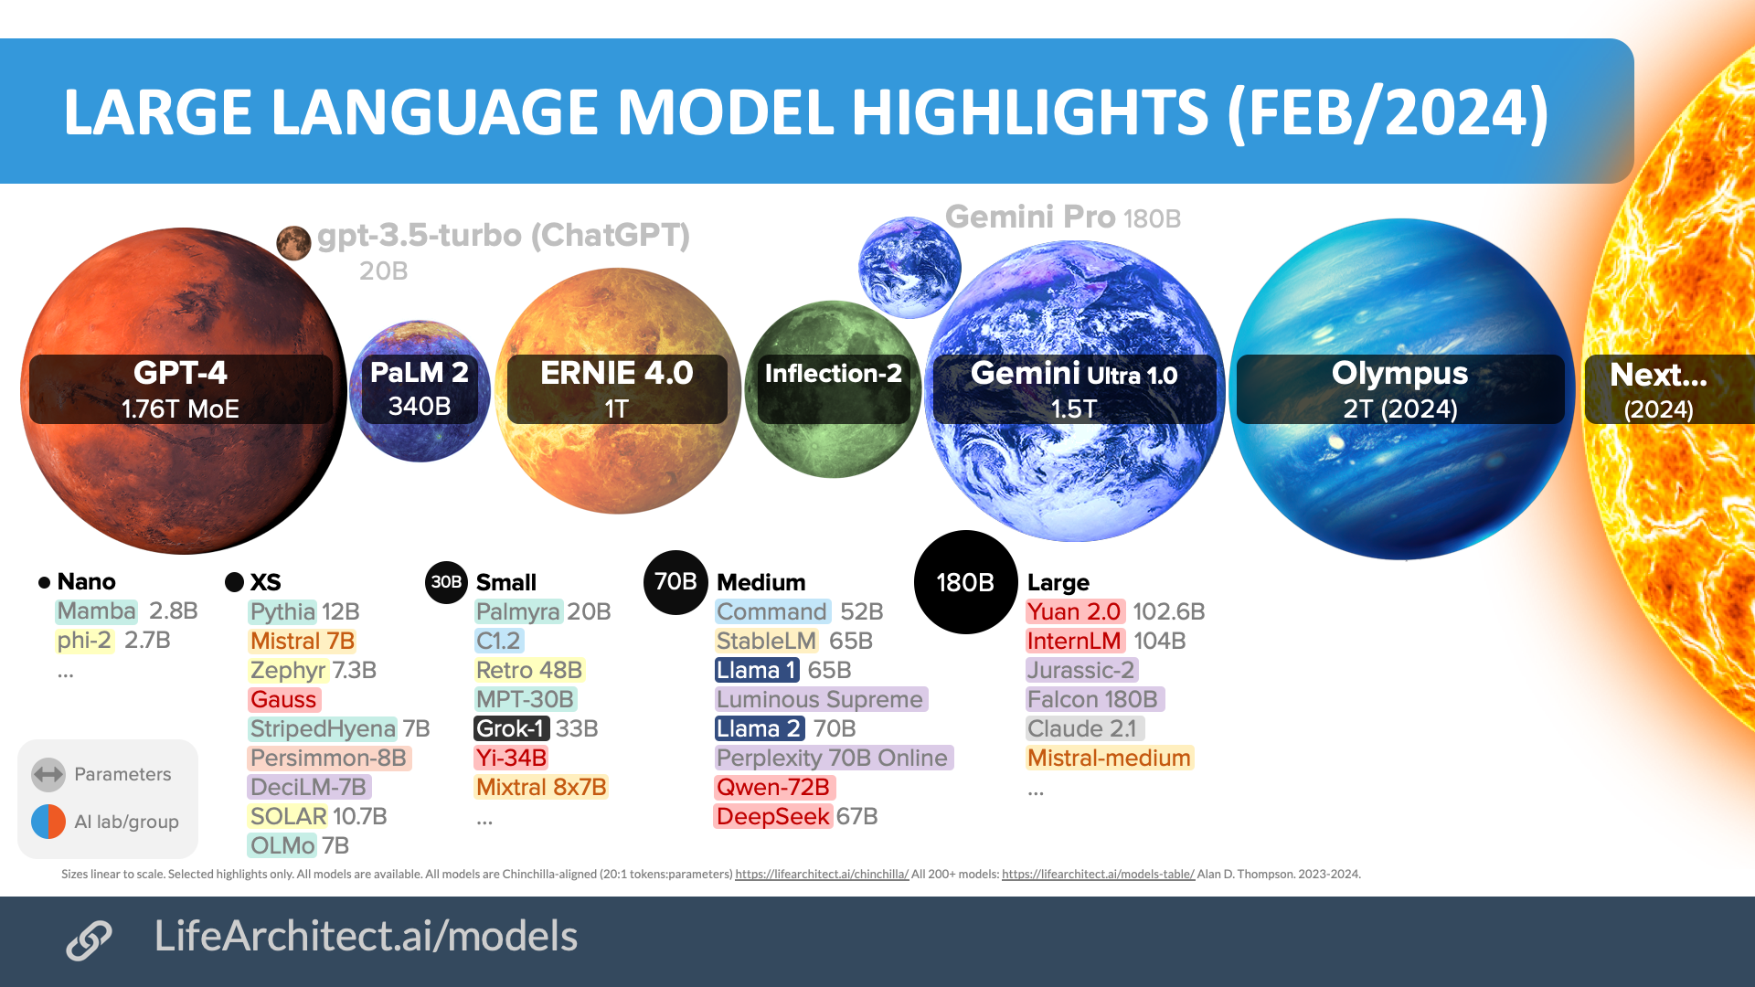
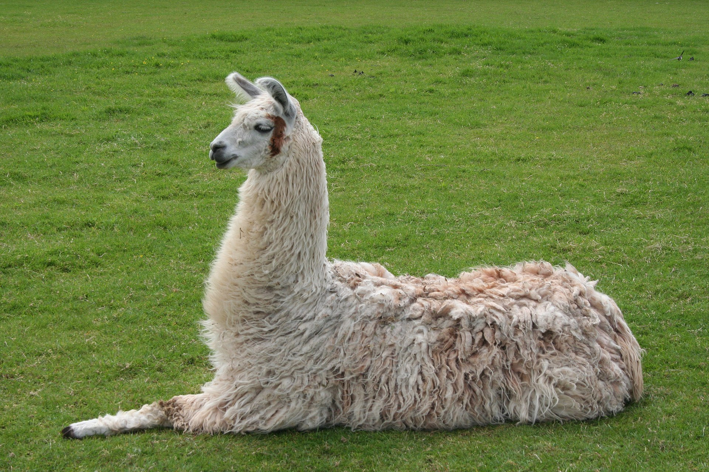
LLM Size Highlights
Source: Inside language models (from GPT-4 to PaLM) – Dr Alan D. Thompson – Life Architect
Source:https://commons.wikimedia.org/wiki/File:Llama_lying_down.jpg

Slide 42
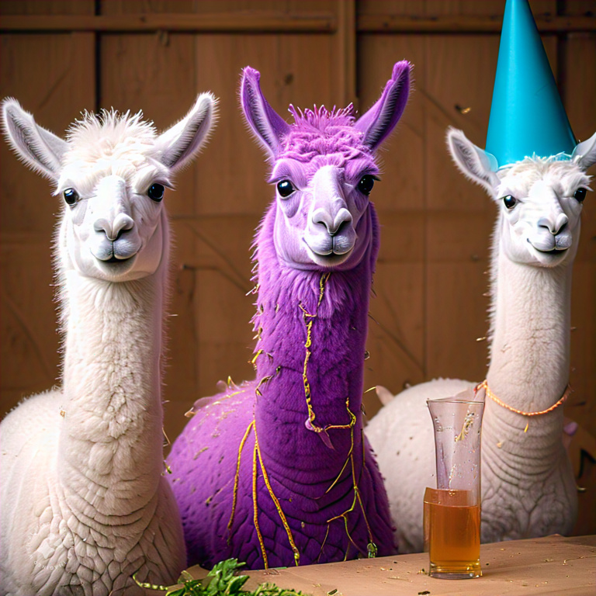

很多厲害的LLMs都需要上網且不公開...
Llama (7B - 65B) by Meta (2023)
Llama1: https://arxiv.org/abs/2302.13971
Llama2: https://arxiv.org/abs/2307.09288
Llama3:
https://arxiv.org/abs/2407.21783

Slide 43
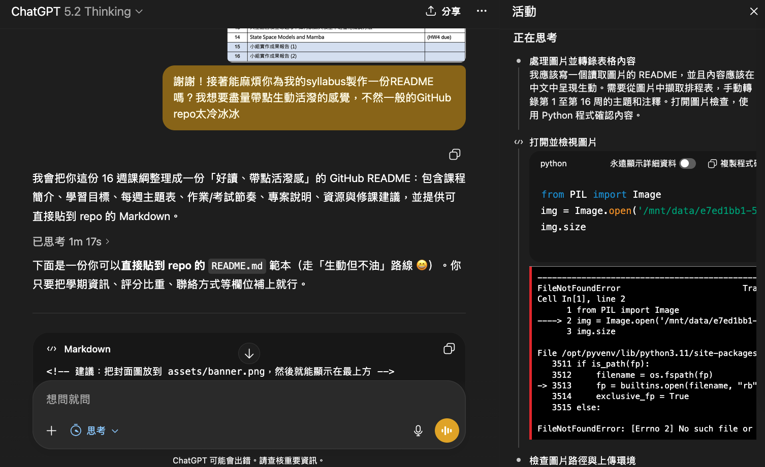
大型語言模型會思考？

Slide 44
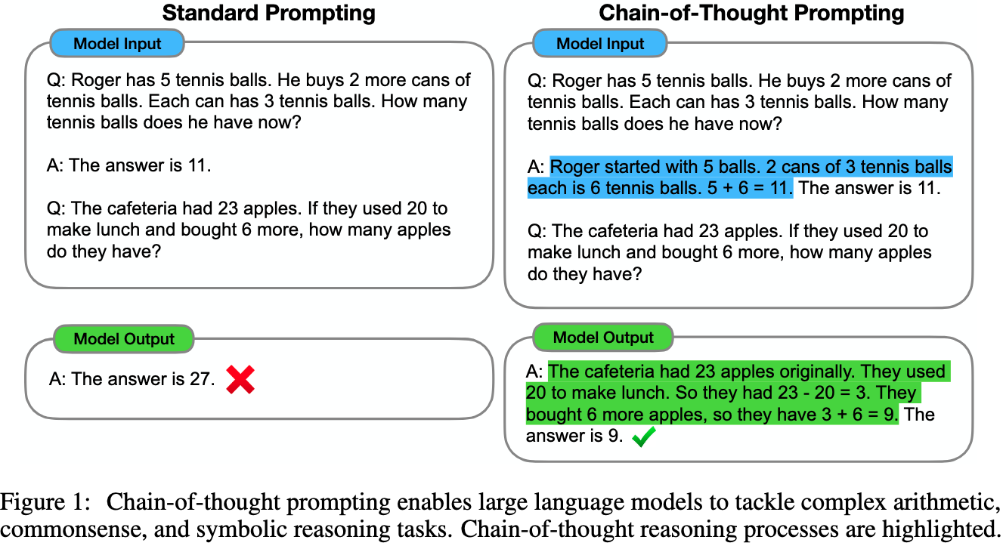
Chain-of-Thought (CoT)
CoT: https://arxiv.org/abs/2201.11903
Zero-shot-CoT: https://arxiv.org/abs/2205.11916
Let’s think step by step.

Slide 45
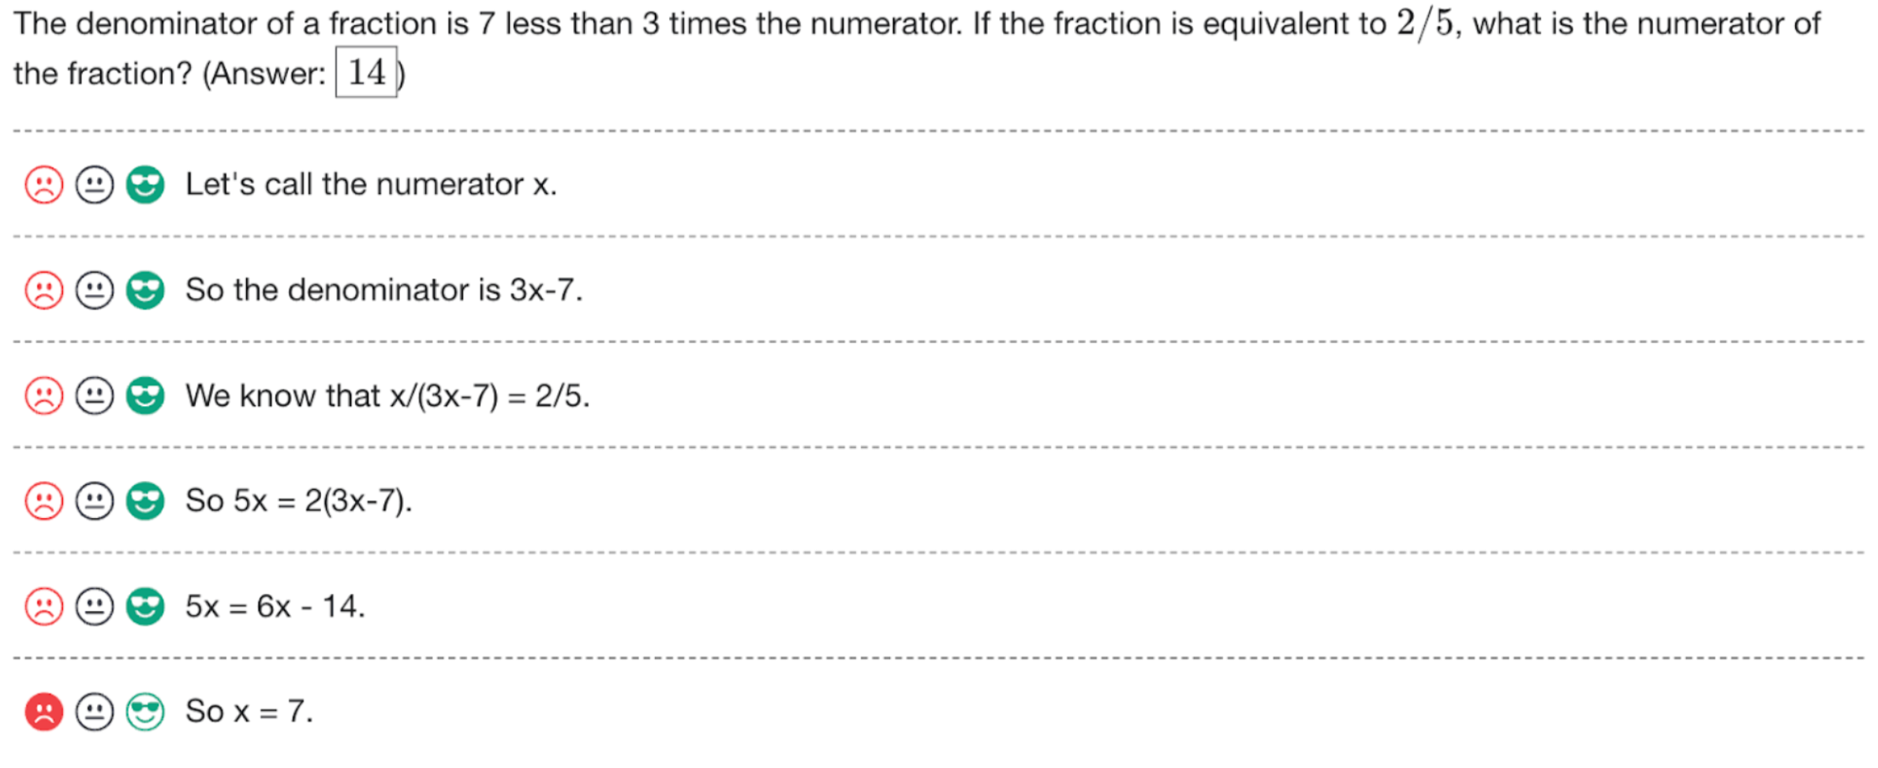
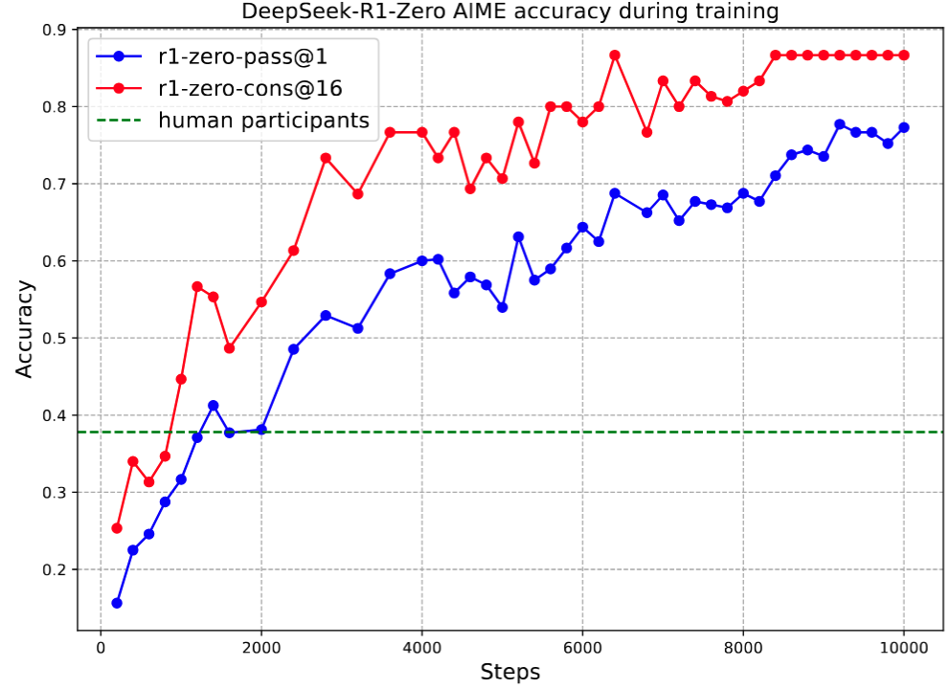
Training with Reasoning Tasks
Let’s Verify Step by Step: https://arxiv.org/abs/2305.20050DeepSeek-R1: https://arxiv.org/abs/2501.12948

Slide 46
我們這學期要學什麼？

Slide 47
這門課的目標 🎯
能夠「理解」主流 NLP / LLM 方法在做什麼
不是只會背名詞、不是只會看別人的部落格 / 重點整理
能夠運用現成工具（尤其是 🤗 Transformers 生態）把模型跑起來、改得動
知道如何進階 ➡️ 評估、幻覺、安全性、RAG
如果你曾經覺得「LLM 很神，但我不知道它到底在神什麼」
—— 那這門課就是你的解謎本 📚🧩

Slide 48
1. 自然語言處理基本功 (如何表達字詞)
Week 1 – Week 3
自然語言處理介紹
文字向量基礎與詞嵌入模型
遞迴神經網路與長短期記憶網絡
i
love
deep
learning
like
🖥️
?
apple

Slide 49


2. 現代自然語言處理基本功
Week 4 – Week 5
注意力機制以及 Sub-word 分詞法
Transformer 架構
i
love
deep
learning
Context vector
…
$$h_{t−1}^{d}$$
$$h_{t}^{d}$$
Encoder time steps
Decoder time steps

Slide 50









進階自然語言處理 (1)
Week 6 – Week 11
BERT。 、GPT、文字生成策略
HuggingFace 函式庫實作教學
InstructGPT, RLHF, LLM
PPO, GRPO
Retrieval-augmented Generation
Output sequence
$${\hat{y}}_{1}$$
$${\hat{y}}_{2}$$
……
$${\hat{y}}_{t−1}$$
$${\hat{y}}_{t}$$
Decoder
_
$${\hat{y}}_{1}$$
……
$${\hat{y}}_{t−2}$$
$${\hat{y}}_{t−1}$$
(Start)

Slide 51

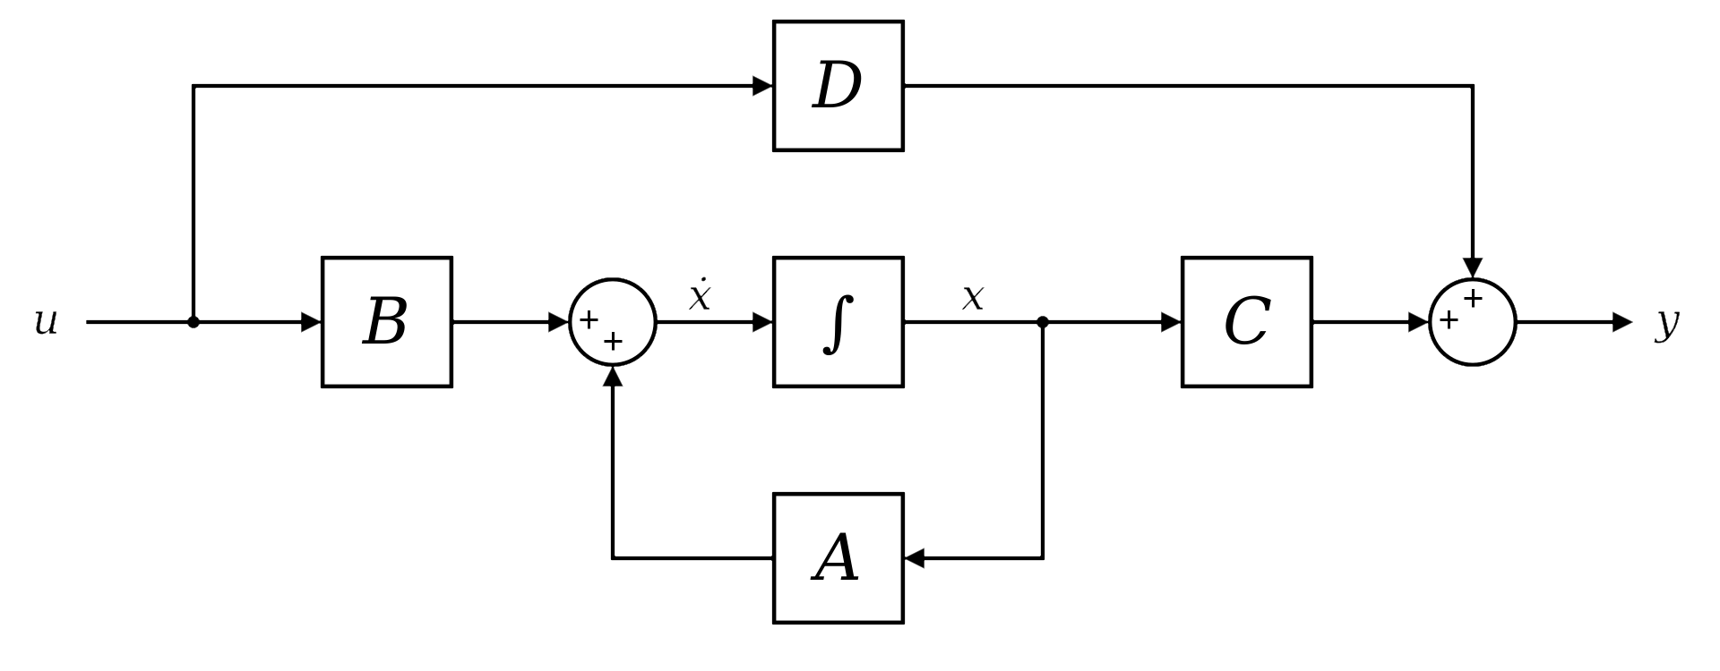
自然語言處理應用
Week 12 – Week 14
NLP Evaluations
Hallucinations? Safety?
如何省力訓練大模型？➡️ Test-time Compute
State Space Models and Mamba
⬅️ Figure source: https://huggingface.co/blog/lbourdois/get-on-the-ssm-train

Slide 52
Common NLP tasks
Text Classification
Text Generation
Sequence Tagging
Text Matching
Sentiment Analysis
Machine Translation
Part-of-speech tagging
Semantic Textual Similarity
Natural Language Inference (NLI)
Summarization
Named Entity Recognition (NER)
Retrieval
Dialogue Generation
Word Segmentation

Slide 53
我可以修這門課嗎？
建議有以下基礎：
✅ 基礎 Deep Learning
✅ 基礎 Python
✅ 一點點機率/線代概念
願意花時間學習知識、學習除錯、學習驗證

Slide 54
Syllabus
Week | Topic | Note
1 | 自然語言處理介紹以及本課程綱要
2 | 文字向量基礎與詞嵌入模型 | HW1
3 | 遞迴神經網路與長短期記憶網絡
4 | 注意力機制與現代字詞分割演算法
5 | Transformer 模型架構介紹 | HW2 (HW1 due)
6 | BERT 與它的好夥伴：基於編碼器架構的 Transformer 模型
7 | 清明連假
8 | GPT-1 到 GPT-3：基於解碼器架構的 Transformer 模型 文字生成策略 | HW3 (HW2 due)
9 | 期中考
10 | HuggingFace 函式庫實作教學
11 | 大型語言模型專題 1：指令微調與基於人類回饋的強化學習 & Retrieval Augmented Generation (RAG) | HW4 (HW3 due)
12 | 大型語言模型專題 2：如何評量模型的成效 / 幻覺 / 安全性？
13 | 大型語言模型專題 3：如何訓練大模型？輕量化微調方法
14 | State Space Models and Mamba | (HW4 due)
15 | 小組實作成果報告 (1)
16 | 小組實作成果報告 (2)
Tutorial
Exam
Report

Slide 55
PyTorch Tutorial
PyTorch Basics:
https://youtu.be/nJpkmWbteTU?si=Ay2EEiXlWHDL9D-K
PyTorch Modeling:
https://youtu.be/NEBJqya2IDs?si=-xX7dC_T3mDSAqjf
https://youtu.be/41r4nmeGitk?si=veztiILno9PUZuex

Slide 56
Scoring
Assignments (4 times): 30%
Quizzes: 1% x 10 times
Mid-term Exam: 30%
Term Project: 30%

Slide 57
About the Quizzes
不定時，代表出席分數，若多於10次即僅採計10次
與當週的上課內容有關
Feel free to search the Internet

Slide 58
About the Assignments
與當週或鄰近週次的上課內容有關
作業一定都會有範例程式碼 (Sample Code)
需要寫 report

Slide 59
作業可不可以用AI？
可以使用，但不得直接複製貼上
若使用 AI 生成程式碼，須以註解形式說明，例如：
class MLP(nn.Module): def __init__(self): # 以下幾行由gpt-5生成 # 建構MLP的輸入層、中間層、以及輸出層 self.layer_1 = nn.Linear(28*28, hidden_size1) self.layer_2 = nn.Linear(256, hidden_size2) self.cls_layer = nn.Linear(hidden_size2, 10) self.relu = nn.ReLU()

Slide 60
Final Project 是什麼？
Final Project 是一種完整的訓練
你將自行從頭到尾做完一個題目，包含：
資料前處理 (Data Pre-processing)
模型訓練 (Model Training)
模型評估 (Evaluations) -->了解問題並改進模型
每組人數待修課同學總數訂定，原則上最多 4 人/組

Slide 61
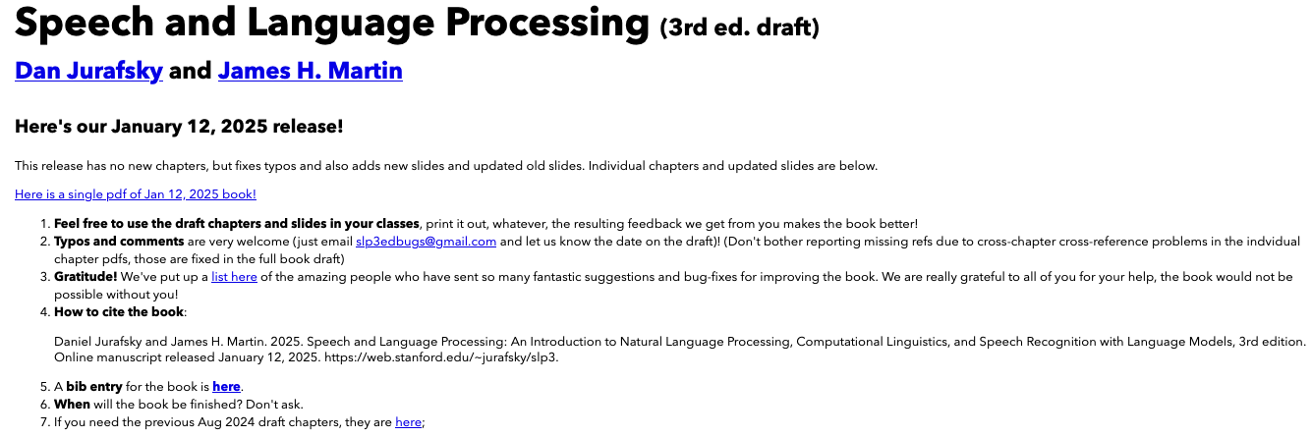
Textbook
Speech and Language Processing (3rd ed. draft) Dan Jurafsky and James H. Martin.
Free Online book (Jan 2026 version):
https://web.stanford.edu/~jurafsky/slp3/

Slide 62
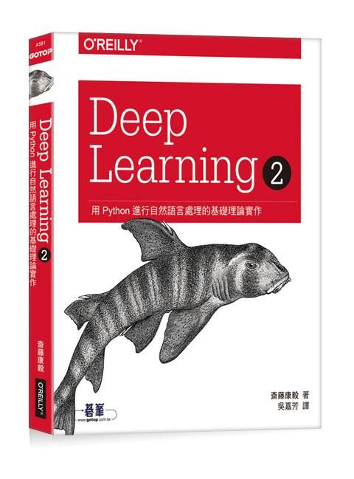
Reference book
Deep Learning 2｜用Python進行自然語言處理的基礎理論實作，歐萊禮 (ISBN: 9789865020675)
GitHub of this book:
https://github.com/oreilly-japan/deep-learning-from-scratch-2

Slide 63
生成式AI融合教學
以組為單位
ChatGPT Plus Claude Pro
Google Colab Pro 雲端運算付費服務
OpenAI /Gemini API 呼叫大型語言模型進行生成式服務

Slide 64
Contact Information
Instructor: 林英嘉
✉️ yjlin@cgu.edu.tw
🕘 Office Hour: 歡迎來信預約，一定沒問題
寄信前請在主旨加註記 [自然語言處理]

Slide 65
Thank you!
Instructor: 林英嘉
✉️ yjlin@cgu.edu.tw
TA: 林宣辰
✉️ b1128015@cgu.edu.tw

