Slide 1



自然語言處理與應用 Natural Language Processing and Applications
Project Introduction
Slido
# NLP0413 (Link)
GitHub
Instructor: 林英嘉 (Ying-Jia Lin)
2026/04/13

Slide 2
Week 8 Outline
Project Introduction (40 min)
Assignment 3 Introduction (50 min)
GPT and language modeling (30 min)
助教宣布事項 (10 min)
Quiz (10 min)

Slide 3

What is Kaggle?
Kaggle is a platform that provides:
Real-word datasets for machine learning
Competitions with prizes (sometimes with money)
Discussion forum with a lots of code examples

Slide 4
Kaggle submission types
Traditional competitions
Upload submission file (e.g., *.csv)
Code / Notebook competitions
Upload code (e.g., *.ipynb)
本課程 Term project 採用此方式

Slide 5
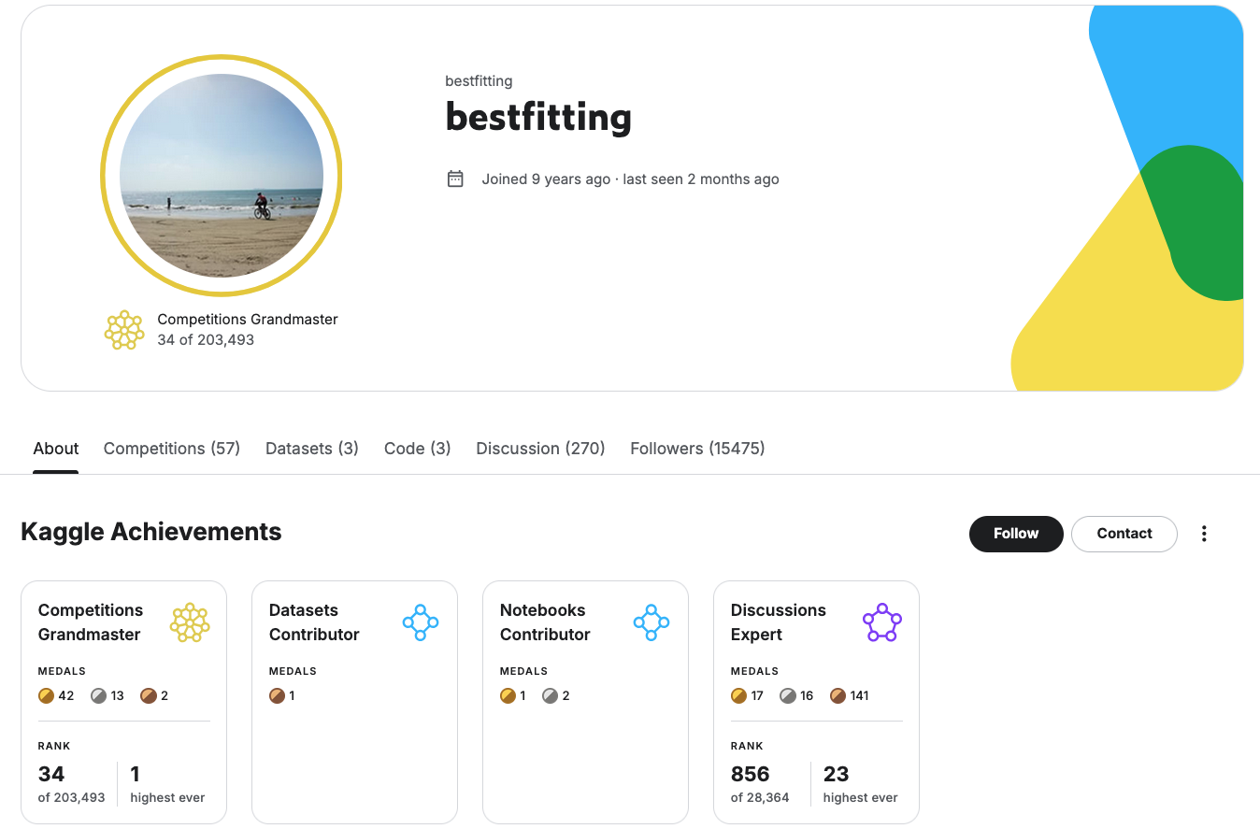
If you play Kaggle a lot …
Figure source: https://www.kaggle.com/bestfitting

Slide 6
Outline of tasks (ALL NLP)
Platform | Competition Name | Task Type (廣義) | Task Type (狹義)
Kaggle | LLM Classification Finetuning | Text classification | Preference Ranking
 | NBME - Score Clinical Patient Notes | Token classification | Span Extraction
 | MAP - Charting Student Math Misunderstandings | Retrieval | Ranking
 | Learning Agency Lab - Automated Essay Scoring 2.0 | Regression | Scoring
 | The Learning Agency Lab - PII Data Detection | Token classification | Named Entity Recognition (NER)

Slide 7
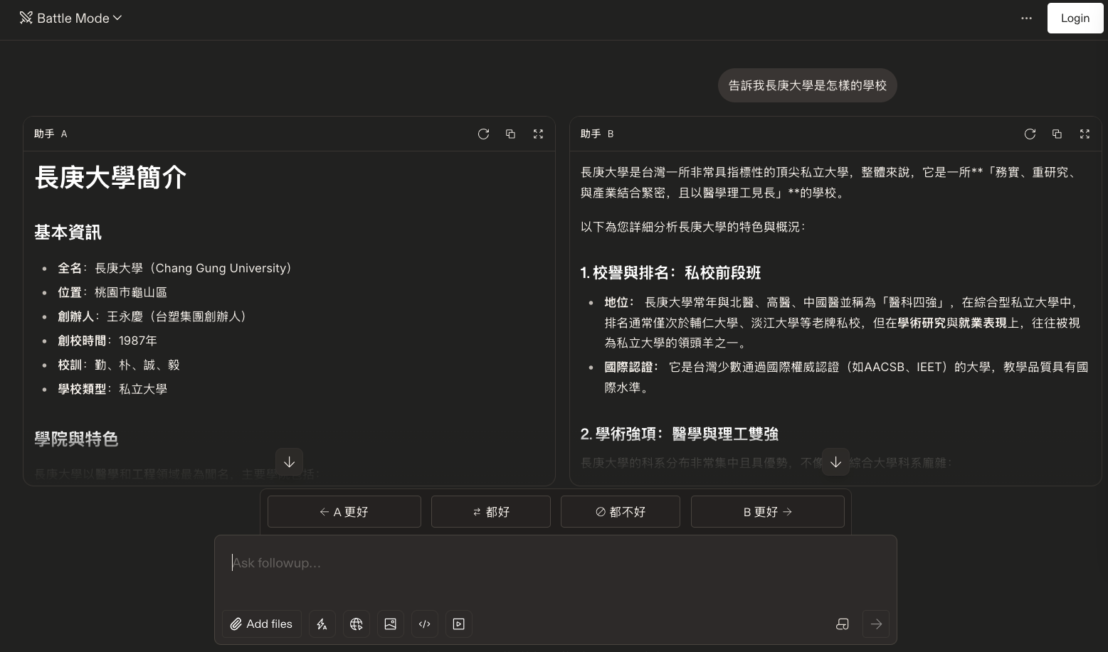
LLM Classification Finetuning (intro)
Chatbot Arena: https://arena.ai/

Slide 8
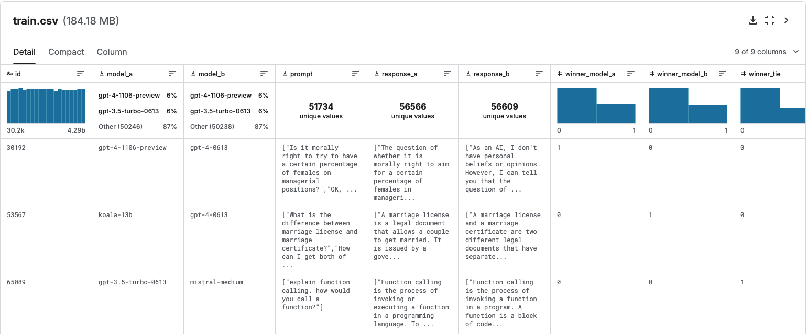
LLM Classification Finetuning (data example)
約55K rows

Slide 9
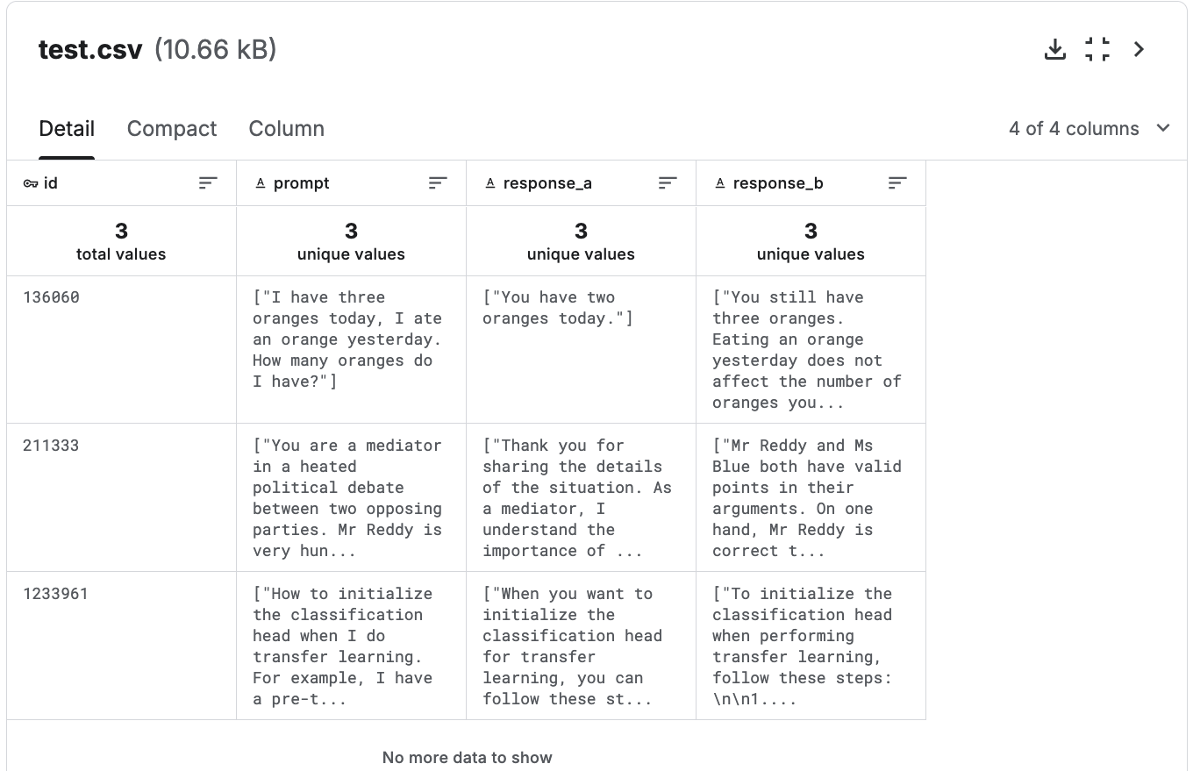
LLM Classification Finetuning (data example)
此競賽為 Code competition
因此 test set 實際上不公開

Slide 10
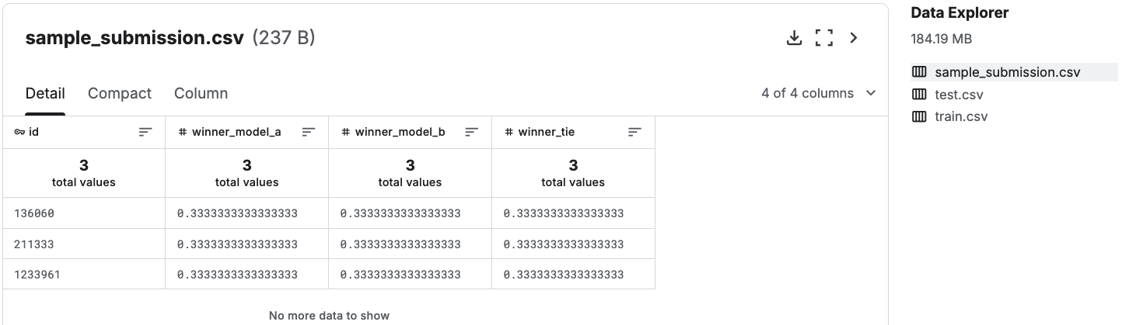
LLM Classification Finetuning (submission)
上傳到 Kaggle Leaderboard 需要實作 .ipynb
你的 code 需要能 predict test.csv 並產生檔案名稱為 submission.csv 的檔案，Kaggle 才能幫你執行程式碼並打分數，可參考 LMSYS: KerasNLP Starter

Slide 11
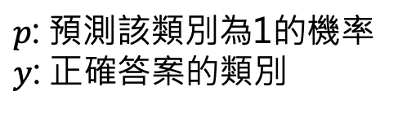
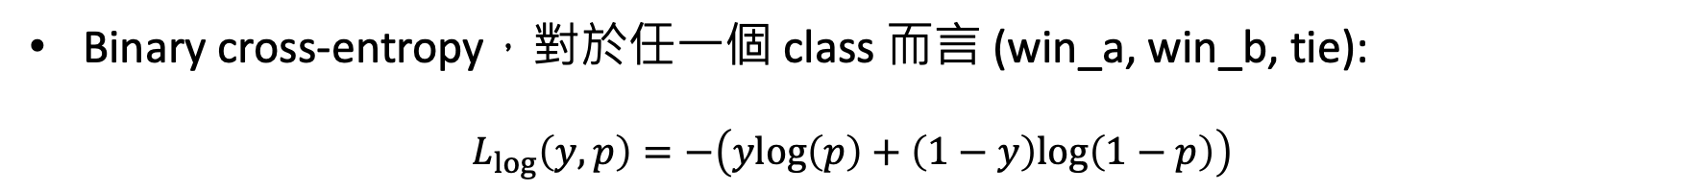
LLM Classification Finetuning (evaluation)
Binary cross-entropy，對於任一個 class 而言 (win_a, win_b, tie):
$$L_{log}\left(y,p\right)=−\left(ylog\left(p\right)+\left(1−y\right)log\left(1−p\right)\right)$$
$p$: 預測該類別為1的機率
$y$: 正確答案的類別
Leaderboard 比的是 test set的 Loss 值 (越小越好)
https://www.kaggle.com/code/metric/log-loss

Slide 12
NBME - Score Clinical Patient Notes
找出 patient note 中的重要特徵，例如：
輸入一篇 patient note
輸出為 “diminished appetite”
競賽的資料：
features.csv
patient_notes.csv
train.csv
test.csv
sample_submission.csv

Slide 13
NBME – patient note example
競賽的實際範例：
>>> import pandas as pd >>> df = pd.read_csv("patient_notes.csv") >>> df[df["pn_num"]==16].pn_history.values[0][696:724] 'dad with recent heart attcak'

Slide 14
NBME – patient note example
>>> df[df["pn_num"]==16].pn_history.values[0]
HPI: 17yo M presents with palpitations. Patient reports 3-4 months of intermittent episodes of "heart beating/pounding out of my chest." 2 days ago during a soccer game had an episode, but this time had chest pressure and felt as if he were going to pass out (did not lose conciousness). Of note patient endorses abusing adderall, primarily to study (1-3 times per week). Before recent soccer game, took adderrall night before and morning of game. Denies shortness of breath, diaphoresis, fevers, chills, headache, fatigue, changes in sleep, changes in vision/hearing, abdominal paun, changes in bowel or urinary habits. \r\nPMHx: none\r\nRx: uses friends adderrall\r\nFHx: mom with "thyroid disease," dad with recent heart attcak\r\nAll: none\r\nImmunizations: up to date\r\nSHx: Freshmen in college. Endorses 3-4 drinks 3 nights / week (on weekends), denies tabacco, endorses trying marijuana. Sexually active with girlfriend x 1 year, uses condoms

Slide 15
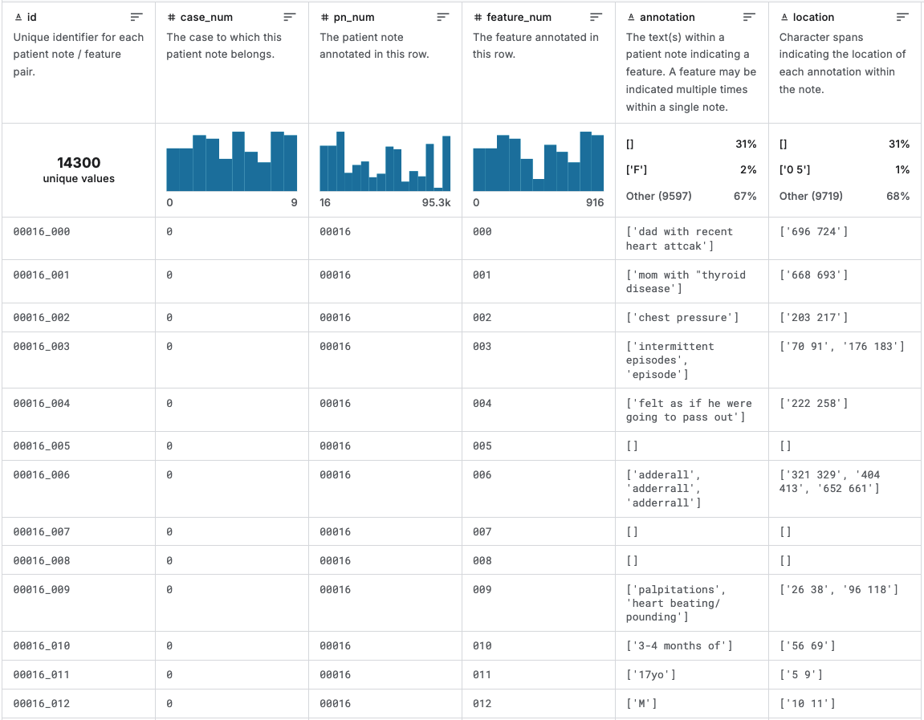
NBME - Score Clinical Patient Notes (data example - train.csv)
但有的feature可能沒有標註
每筆資料都有feature_num代號

Slide 16
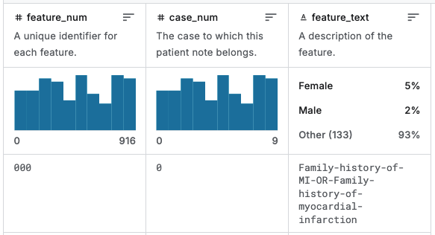
NBME - Score Clinical Patient Notes (data example - features.csv)
我們可以在 features.csv 中找到 feature_text (以 feature_num 去關聯)：

Slide 17
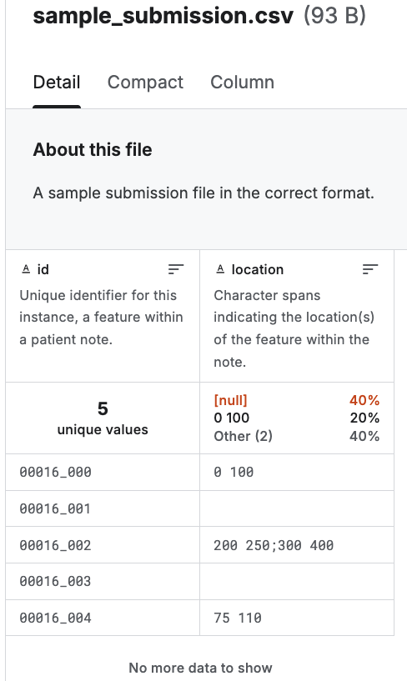
NBME - Score Clinical Patient Notes (submission and evaluation)
只需要預測 location 即可
上傳到 Kaggle Leaderboard 需要實作 .ipynb
你的 code 需要能 predict test.csv 並產生檔案名稱為 submission.csv 的檔案，Kaggle 才能幫你執行程式碼並打分數，可參考 NBME / Deberta-base baseline [inference]

Slide 18
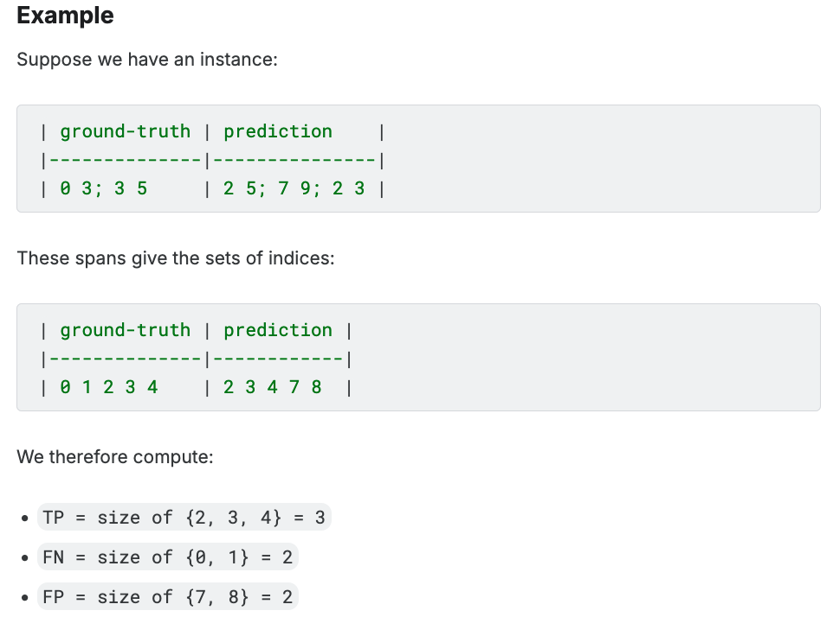
NBME - Score Clinical Patient Notes (evaluation)
Metric: Micro F1-score

Slide 19
Confusion Matrix
 | Actually positive | Actually negative
Predicted positive | True positive (TP) | False positive (FP)
Predicted negative | False negative (FN) | True negative (TN)
Precision = TP / (TP + FP)
模型預測的TP比例
Recall = TP / (TP + FN)
True Positive Rate (TPR)
F1-score (廣義) = 2(Precision*Recall) / (Precision+Recall)

Slide 20
Macro vs. Micro
假設總共有100筆資料：
每一筆都算出一個 F1-score，最後取平均 => Macro F1-score
加總全部100筆的 TP, FN 以及 FP 之後，再算出 F1-score => Micro F1-score

Slide 21
MAP - Charting Student Math Misunderstandings
MAP: Misconception Annotation Project
輸入：Question text, Multiple-choice (MC) answer, StudentExplaination
輸出：數學錯誤的「類型」
Wrong_operation
Wrong_term
Definition
Division
... (含有 N/A)

Slide 22
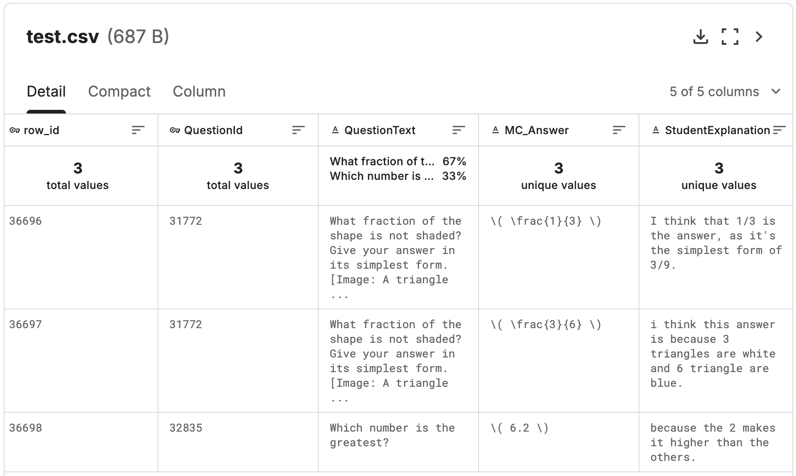
MAP 資料集範例

Slide 23
評估指標：Mean Average Precision@3
Precision = TP / (TP + FP)
以檢索的角度：
Precision@k = 前 k 個預測中，正確答案出現的比例
假設某題正解是 A：
模型預測：[B, A, C]
Precision 為 1/2 (因為A在第2名)
假設某題正解是 B：
模型預測：[B, A, C]
Precision 為 1.0 (因為B在第1名)
MAP = (1/2 + 1.0) / 2 = 0.75

Slide 24
Learning Agency Lab - Automated Essay Scoring 2.0 (AES)
輸入：一篇文章
輸出：該文章的分數 (1 – 6 分)
分數的意義詳細說明：Link
分數 | 意義
6 | 表現非常成熟。觀點清楚、論證強、結構流暢、用字句型好，錯誤很少。
5 | 整體表現很好。內容完整、推理不錯、組織清楚，語言使用也佳，但偶爾有小失誤。
4 | 達到基本要求。能表達觀點，也有一定支持與組織，但品質不夠穩，語言和結構上有些小問題。
3 | 還在發展中。有觀點，但支持不足或不夠一致，組織較弱，語言表達也開始出現明顯問題。
2 | 掌握度偏低。觀點模糊、例子不足、結構差，語言錯誤較多，甚至會影響理解。
1 | 表現很差。幾乎沒有成形的觀點，內容混亂，語言錯誤嚴重，常常讓人難以理解。
Notes:
這個任務有點像訓練一個會幫作文評分的 AI，也就是模擬老師看完文章後給分數。

Slide 25
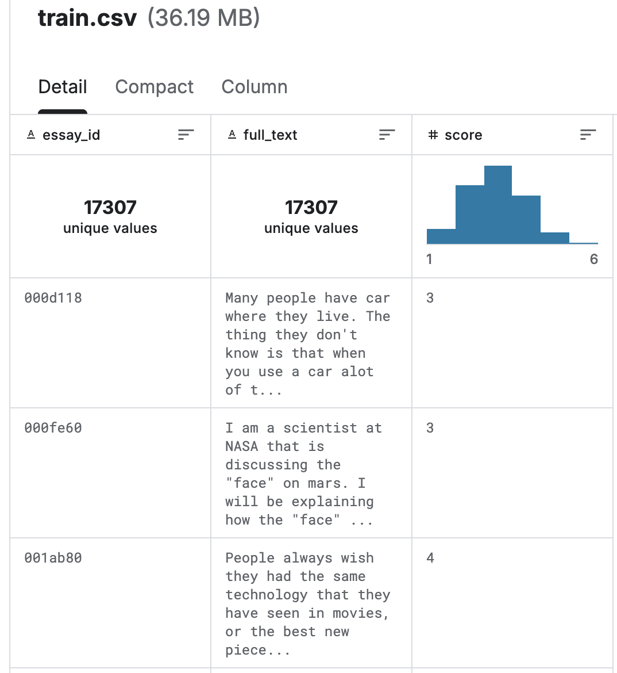
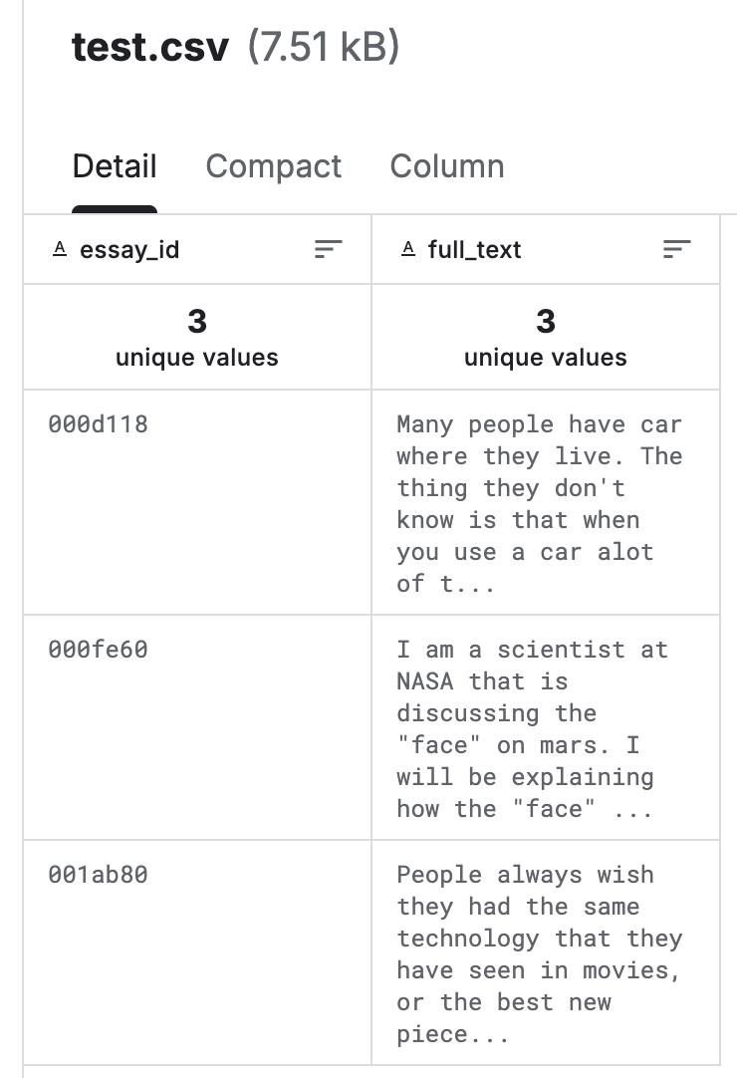
AES 資料集範例

Slide 26

評估指標：Quadratic Weighted Kappa (QWK)
$QWK=1−\frac{實際觀察到的不一致程度}{隨機情況下的不一致程度}$
「實際觀察到的不一致程度」：代表模型預測與標準分數之間的落差有多大
考慮「隨機情況下的不一致程度」：排除資料集具備類別偏差性的可能
避免模型只是剛好猜中常見分數，看起來表現不錯
分數項需要越小越好，但 QWK = 1 – 分數項 代表數值越大越好
QWK 越接近 1，代表模型與人工評分越一致

Slide 27
The Learning Agency Lab - PII Data Detection (NER Recap)
B-Person
B-Location
I-Location
I-Location
E-Person
John Wick was admitted to Taipei Veterans General Hospital on March 3, 2023 due to pneumonia.
O
O
O
E-Location
O
B-Time
E-Time
O
O
B-Disease
 | Meaning
B | Beginning
I | Inside
O | Outside
E | End

Slide 28
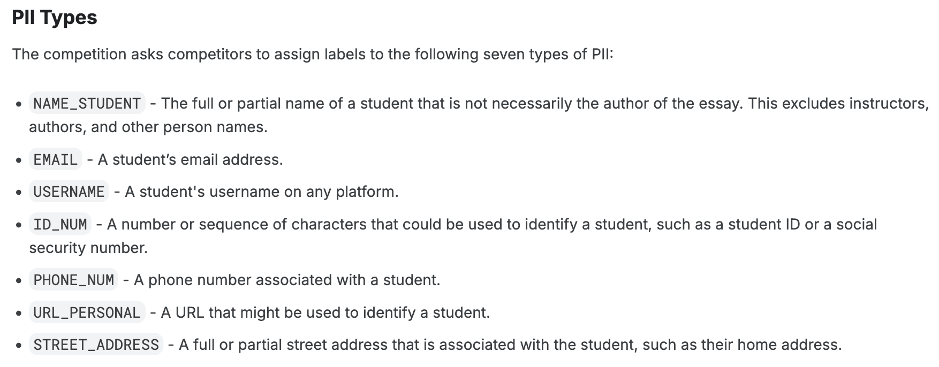
The Learning Agency Lab - PII Data Detection
任務目標：找出學生文章中的 personally identifiable information (PII)
輸入：一篇文章
輸出：每個 token 的標籤 (BIO格式)
但上傳時僅需要提供預測為 PII 的 tokens

Slide 29
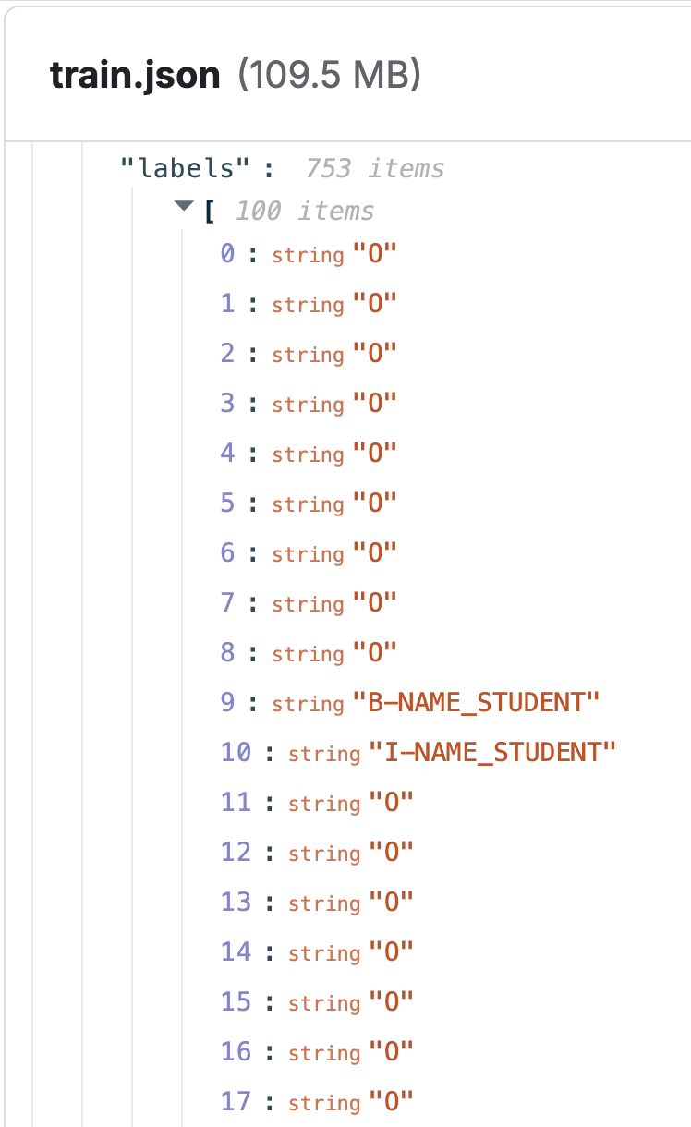
PII 資料集範例
https://www.kaggle.com/competitions/pii-detection-removal-from-educational-data/data?select=train.json

Slide 30
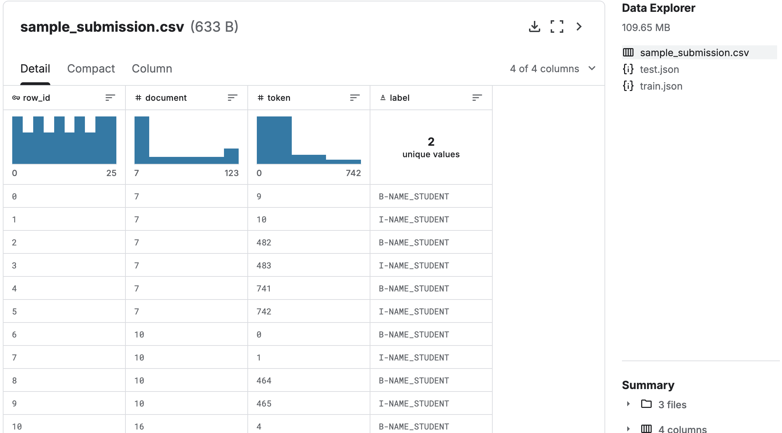
PII 資料集範例
https://www.kaggle.com/competitions/pii-detection-removal-from-educational-data/data?select=train.json

Slide 31




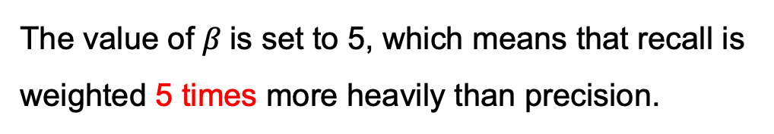


PII 任務的評估指標： $Ｆ_{β}$
The value of $β$is set to 5, which means that recall is weighted 5 times more heavily than precision.
$$F_{1}=\frac{2PR}{P+R}$$
假設 P 代表 Precision, R 代表 Recall：
那是因為 $β=1$
$$F_{β}=\frac{(1+β^{2})PR}{β^{2}P+R}$$
$$=\frac{1+β^{2}}{β^{2}\frac{1}{R}+\frac{1}{P}}$$
分子分母同除以 $PR$

Slide 32
Project checkpoints
Week 9: 期中考
Week 12: 進度報告 PPT (5 pages)
Week 14: 進度報告 PPT (5+5 pages), Presentations (selected teams)
Week 15 – Week 16: Final presentations for all teams
Week 17 結束前: 繳交書面報告 (Word 檔案，並非簡報貼上) 以及程式碼

Slide 33
期末 Project 規定
需要上傳 Kaggle Leaderboard
請留意，每個題目都是 Code competition，code 必須沒有 bug 才能上傳
project 進度 (至少最後一次書面報告前) 需涵蓋大型語言模型的實驗，開源 (e.g., Llama) 或閉源 (e.g., ChatGPT) 模型皆可
每次報告都需要列出每位組員的貢獻內容，以及組員間的工作比重 (%)

Slide 34
Final Project 各個階段分數佔比
Final Project 佔學期總成績 30%
查核點 (週次) | 對象: 繳交內容 | 分數佔比
Checkpoint1 (Week 12) | All teams: 進度報告 PPT (5 pages)檔案 | 5%
Checkpoint2 (Week 14) | All teams: 進度報告 PPT (5+5 pages*)檔案 Selected teams: 取5組 (1題目1組) 於課堂中報告，1組10min，此週報告組別得 Checkpoint1 和 Checkpoint2 滿分 | 5%
Checkpoint3 (Week 15-16) | All teams: 最終口頭報告 | 10%
Checkpoint4 (Week 16-17) | All teams: 書面報告檔案 | 10%
*繼承Checkpoint1內容+實作

Slide 35
Thank you!
Instructor: 林英嘉
✉️ yjlin@cgu.edu.tw
TA: 林宣辰
✉️ b1128015@cgu.edu.tw

