Slide 1



自然語言處理與應用 Natural Language Processing and Applications
Transformer
Slido
# NLP0323 (Link)
GitHub
Instructor: 林英嘉 (Ying-Jia Lin)
2026/03/23

Slide 2
Outline
Recaps [10 min]
Transformers [90 min]
Homework 2 [30 min]
Quiz [15 min]

Slide 3
深度學習常見模型架構
CNN
(著重局部資訊)
RNN
(著重記憶力)
Transformer
(著重全局資訊與記憶力)
i
love
deep
learning
i
love
deep
learning

Slide 4
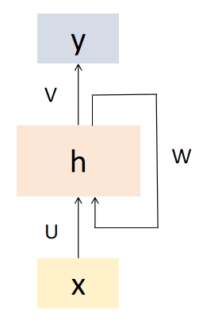
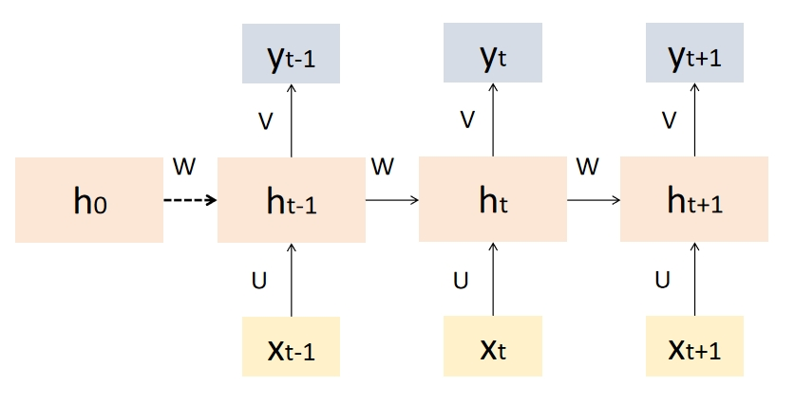
[Recap] Recurrent Neural Networks (RNN)
Recurrent Neural Networks (RNNs) are a type of artificial neural network designed to handle sequential data by capturing temporal dependencies.
RNN 的“遞迴”是指它在每一個時間步中重複使用相同的參數（同一組權重），並把先前的隱藏狀態傳到下一個時間步
U
U
U
U
W
W
W
W

Slide 5

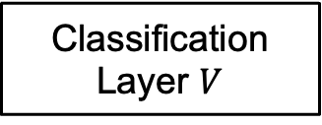
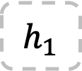
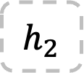
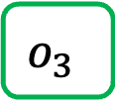

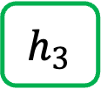

[Recap] Text Generation with RNN
*本頁的RNN不包含輸出層$V$
Vocab
Prob
(1, hidden_size)
(1, hidden_size)
(1, hidden_size)
a
...
apple
...
b
...
banana
...
elephant
...
eraser
...
...
zoo
0.0001
...
0.600
...
0.0001
...
0.0003
...
0.300
...
0.05
...
...
0.0001
$$h_{1}$$
$$h_{2}$$
$$h_{3}$$
Classification Layer $V$
Softmax
(1, Vocab_size)
RNN
$$h_{1}$$
RNN
$$h_{2}$$
RNN
$$o_{3}$$
Vocab
size
I
love
an
Word embeddings

Slide 6
[Recap] RNN 的記憶力意義
得知第一個字為「庭」
已經包含了「庭院深」的資訊
已經包含了「庭院深深深幾許」的資訊
h₀
h₁
h₂
h₃
...
h₆
h₇
...
庭
院
深
幾
許

Slide 7
為什麼我們需要序列模型?
Contextual Embedding
(具備上下文知識的表達)
RNN
RNN
RNN
RNN
RNN
RNN
RNN
RNN
open
a
bank
account
on
the
river
bank
Same word embedding

Slide 8















Encoder and Decoder
輸出是 hidden states
輸出是 sequence (文字)
$${\hat{y}}_{1}$$
$${\hat{y}}_{2}$$
……
$${\hat{y}}_{t−1}$$
$${\hat{y}}_{t}$$
$$h_{0}$$
$$h_{1}$$
……
$$h_{n−2}$$
$$C$$
FFN (linear layer(s))
Encoder
Decoder
$$h_{init}$$
……
_
$${\hat{y}}_{1}$$
……
$${\hat{y}}_{t−2}$$
$${\hat{y}}_{t−1}$$
_
$$x1$$
$$x_{n−2}$$
$$x_{n−1}$$
(Start)
(Start)
Input sequence
(Encoder 的輸出有很多種被Decoder運用的方式)

Slide 9

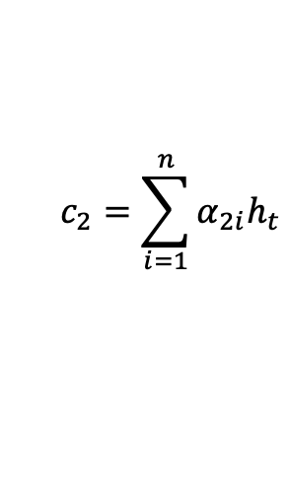
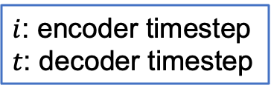








機器翻譯 (with Attention, t = 2)
$$\vec{h_{i}}=\left[\vec{h_{i}} ; \overset{←}{h_{i}}\right]$$
$i$: encoder timestep
$t$: decoder timestep
$$c_{2}=\sum_{i=1}^{n}{α_{2i}h_{t}}$$
Context vector
I
$$α_{21}$$
$$α_{22}$$
$$α_{23}$$
$$α_{24}$$
$$α_{25}$$
Linear
$$\overset{←}{h_{i}}$$
$$\vec{h_{i}}$$
$$s_{1}$$
RNN
RNN
RNN
RNN
RNN
RNN
我
想
要
放
假
_
Notes:
(Laser pointer)
Attention mechanism starts from the encoder hidden states which can be concatenated by bi-directional outputs.
Called $h_{i}^{e}$
than the temporal attention score $e_{ti}$ is obtained by the alignment model
The alignment model is a feed forward network, which scores how well the inputs at position i and outputs at timestep t match
Then the attention score alpha is computed by a softmax function
Finally, the context vector of weighted sum is used to compute output at the decoding timestep t

Slide 10







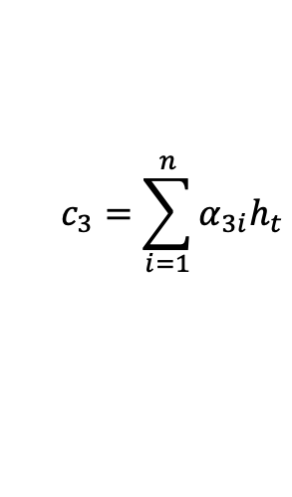
機器翻譯 (with Attention, t = 3)
$$\vec{h_{i}}=\left[\vec{h_{i}} ; \overset{←}{h_{i}}\right]$$
$i$: encoder timestep
$t$: decoder timestep
$$c_{3}=\sum_{i=1}^{n}{α_{3i}h_{t}}$$
Context vector
I
want
$$α_{31}$$
$$α_{32}$$
$$α_{33}$$
$$α_{34}$$
$$α_{35}$$
Linear
Linear
$$\overset{←}{h_{i}}$$
$$\vec{h_{i}}$$
$$s_{1}$$
$$s_{2}$$
RNN
RNN
RNN
RNN
RNN
RNN
RNN
我
想
要
放
假
_
I
Notes:
(Laser pointer)
Attention mechanism starts from the encoder hidden states which can be concatenated by bi-directional outputs.
Called $h_{i}^{e}$
than the temporal attention score $e_{ti}$ is obtained by the alignment model
The alignment model is a feed forward network, which scores how well the inputs at position i and outputs at timestep t match
Then the attention score alpha is computed by a softmax function
Finally, the context vector of weighted sum is used to compute output at the decoding timestep t

Slide 11
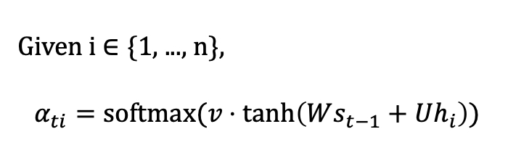

Additive Attention (算出 $α_{ti}$)
$$\vec{h_{i}}=\left[\vec{h_{i}} ; \overset{←}{h_{i}}\right]$$
$i$: encoder timestep
$t$: decoder timestep
$$c_{3}=\sum_{i=1}^{n}{α_{3i}h_{t}}$$
Given i $∈$ {1, ..., n},
$$α_{ti}=softmax(v⋅\tanh\left(Ws_{t−1}+Uh_{i}\right))$$
Context vector
I
want
$$α_{31}$$
$$α_{32}$$
$$α_{33}$$
$$α_{34}$$
$$α_{35}$$
Linear
Linear
Additive Attention
$$\overset{←}{h_{i}}$$
$$\vec{h_{i}}$$
$$s_{1}$$
$$s_{2}$$
轉為1個
數字
RNN
RNN
RNN
RNN
RNN
RNN
RNN
我
想
要
放
假
_
I
Notes:
形狀小百科
h_i: 2H
U: (H, 2H)
s_t: H
W: (H, H)
v: (1, H)

Slide 12

Transformer

Slide 13
RNN 與 CNN 作為序列模型的問題
問題：RNN 難以平行化
問題：CNN 著重局部資訊
RNN
RNN
RNN
RNN
Pooling
CNN
CNN
CNN
open
a
bank
account
open
a
bank
account

Slide 14
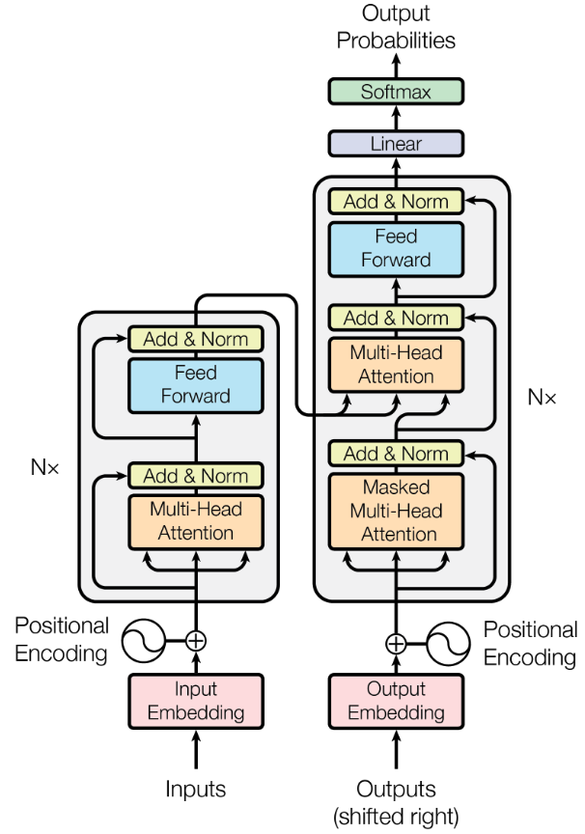
Overview of Transformer
Vaswani, Ashish, et al. "Attention is all you need." NeurIPS (2017).
Decoder
Encoder

Slide 15
Outline of Transformer
Vaswani, Ashish, et al. "Attention is all you need." NeurIPS (2017).

Slide 16
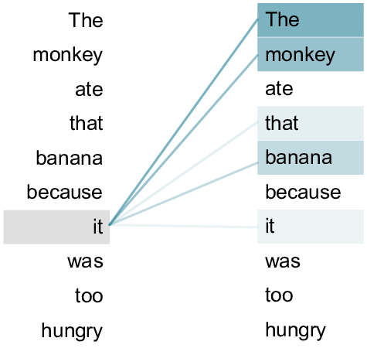
Transformer
Source: An example of the self-attention mechanism following long-distance... | Download Scientific Diagram (researchgate.net)
Transformer 來自論文：Attention Is All You Need (Vaswani et al., 2017)
Transformer 內部的主要機制為 Self-attention
Self-attention: 句子內的每個 token 自己跟自己做 attention
attention 進行的過程需要主動與被動
Self-attention
open
a
bank
account

Slide 17
Query (Q), Key (K), and Value (V)
t = 1
h₁
Weighted sum
a₁
a₂
a₃
a₄
q₁
k₁
v₁
q₂
k₂
v₂
q₃
k₃
v₃
q₄
k₄
v₄
🎯
e₁
I
e₂
printed
e₃
Hello
e₄
world

Slide 18
Query (Q), Key (K), and Value (V)
t = 2
h₁
h₂
Weighted sum
a₁
a₂
a₃
a₄
q₁
k₁
v₁
q₂
k₂
v₂
q₃
k₃
v₃
q₄
k₄
v₄
🎯
e₁
I
e₂
printed
e₃
Hello
e₄
world

Slide 19

QKV 的比喻
Vaswani, Ashish, et al. "Attention is all you need." NeurIPS (2017).
Query
Key
Value
Query: (主動) 查詢的關鍵字；Key: (被動) 查詢的對象
Value: 值，根據關鍵字與對象匹配程度被加權整合的資訊
Notes:
https://stats.stackexchange.com/questions/421935/what-exactly-are-keys-queries-and-values-in-attention-mechanisms

Slide 20
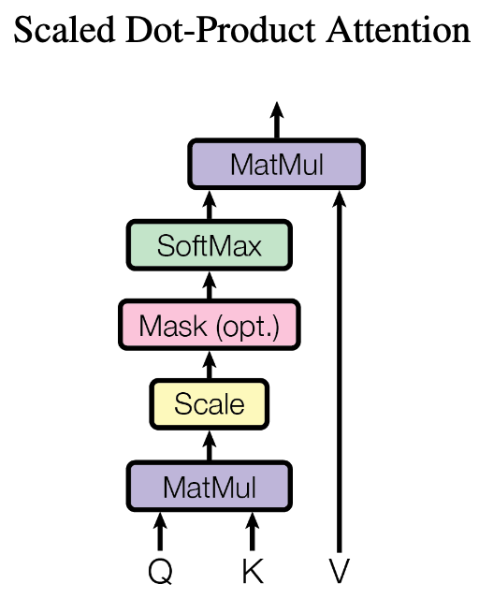
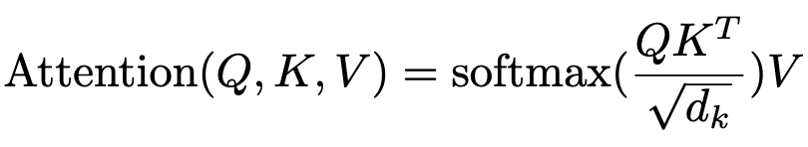



為什麼 Transformers 可以平行化？
d_{k} : queries 和 keys 的維度大小
(自注意力機制可以利用矩陣乘積來進行平行化計算)
通常設置 d_{q} = d_{k} = d_{v}
$$Q$$
$$KT$$
$$V$$
q₁
v₁
k₁
k₂
k₃
q₂
v₂
q₃
v₃
N x d_{q}
d_{k} x N
N x d_{v}
q₁
k₁
v₁
q₂
k₂
v₂
q₃
k₃
v₃
e₁
I
e₂
printed
e₃
Hello

Slide 21

Transformers 的權重值 (1/2)
可以被訓練的參數
Q: N x d_{q}
K: N x d_{k}
V: N x d_{v}
(
)
$$T$$
e₁
e₁
e₁
e₂
W^{Q}
e₂
W^{K}
e₂
W^{V}
e₃
e₃
e₃
N x d_{model}
d_{model} x d_{q}
N x d_{model}
d_{model} x d_{k}
N x d_{model}
d_{model} x d_{v}
e₁
e₁
e₁
e₂
e₂
e₂
e₃
e₃
e₃
d_{model} : Embedding 的維度大小
I
printed
Hello

Slide 22




Transformers 的權重值 (2/2)
可以被訓練的參數
$$Q$$
$$KT$$
(
)
$$T$$
q₁
e₁
e₁
k₁
k₂
k₃
=
W^{Q}
=
q₂
e₂
e₂
W^{K}
q₃
e₃
e₃
N x d_{q}
N x d_{model}
d_{model} x d_{q}
d_{k} x N
N x d_{model}
d_{model} x d_{k}
$$V$$
v₁
e₁
v₂
=
e₂
W^{V}
v₃
e₃
N x d_{v}
N x d_{model}
d_{model} x d_{v}

Slide 23
Self-attention 的公式與縮放項

Slide 24
Query (Q), Key (K), and Value (V)
t = 1
h₁
Weighted sum
a₁
a₂
a₃
a₄
q₁
k₁
v₁
q₂
k₂
v₂
q₃
k₃
v₃
q₄
k₄
v₄
🎯
e₁
I
e₂
printed
e₃
Hello
e₄
world

Slide 25
Query (Q), Key (K), and Value (V)
t = 2
h₁
h₂
Weighted sum
a₁
a₂
a₃
a₄
q₁
k₁
v₁
q₂
k₂
v₂
q₃
k₃
v₃
q₄
k₄
v₄
🎯
e₁
I
e₂
printed
e₃
Hello
e₄
world

Slide 26
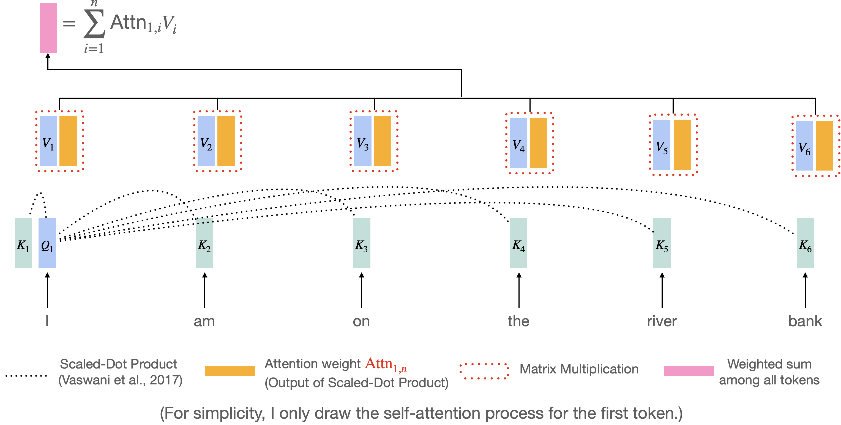
Self-Attention (Transformer) 過程
Vaswani et al. "Attention is all you need." NeurIPS 2017.
https://research.google/blog/transformer-a-novel-neural-network-architecture-for-language-understanding/

Slide 27
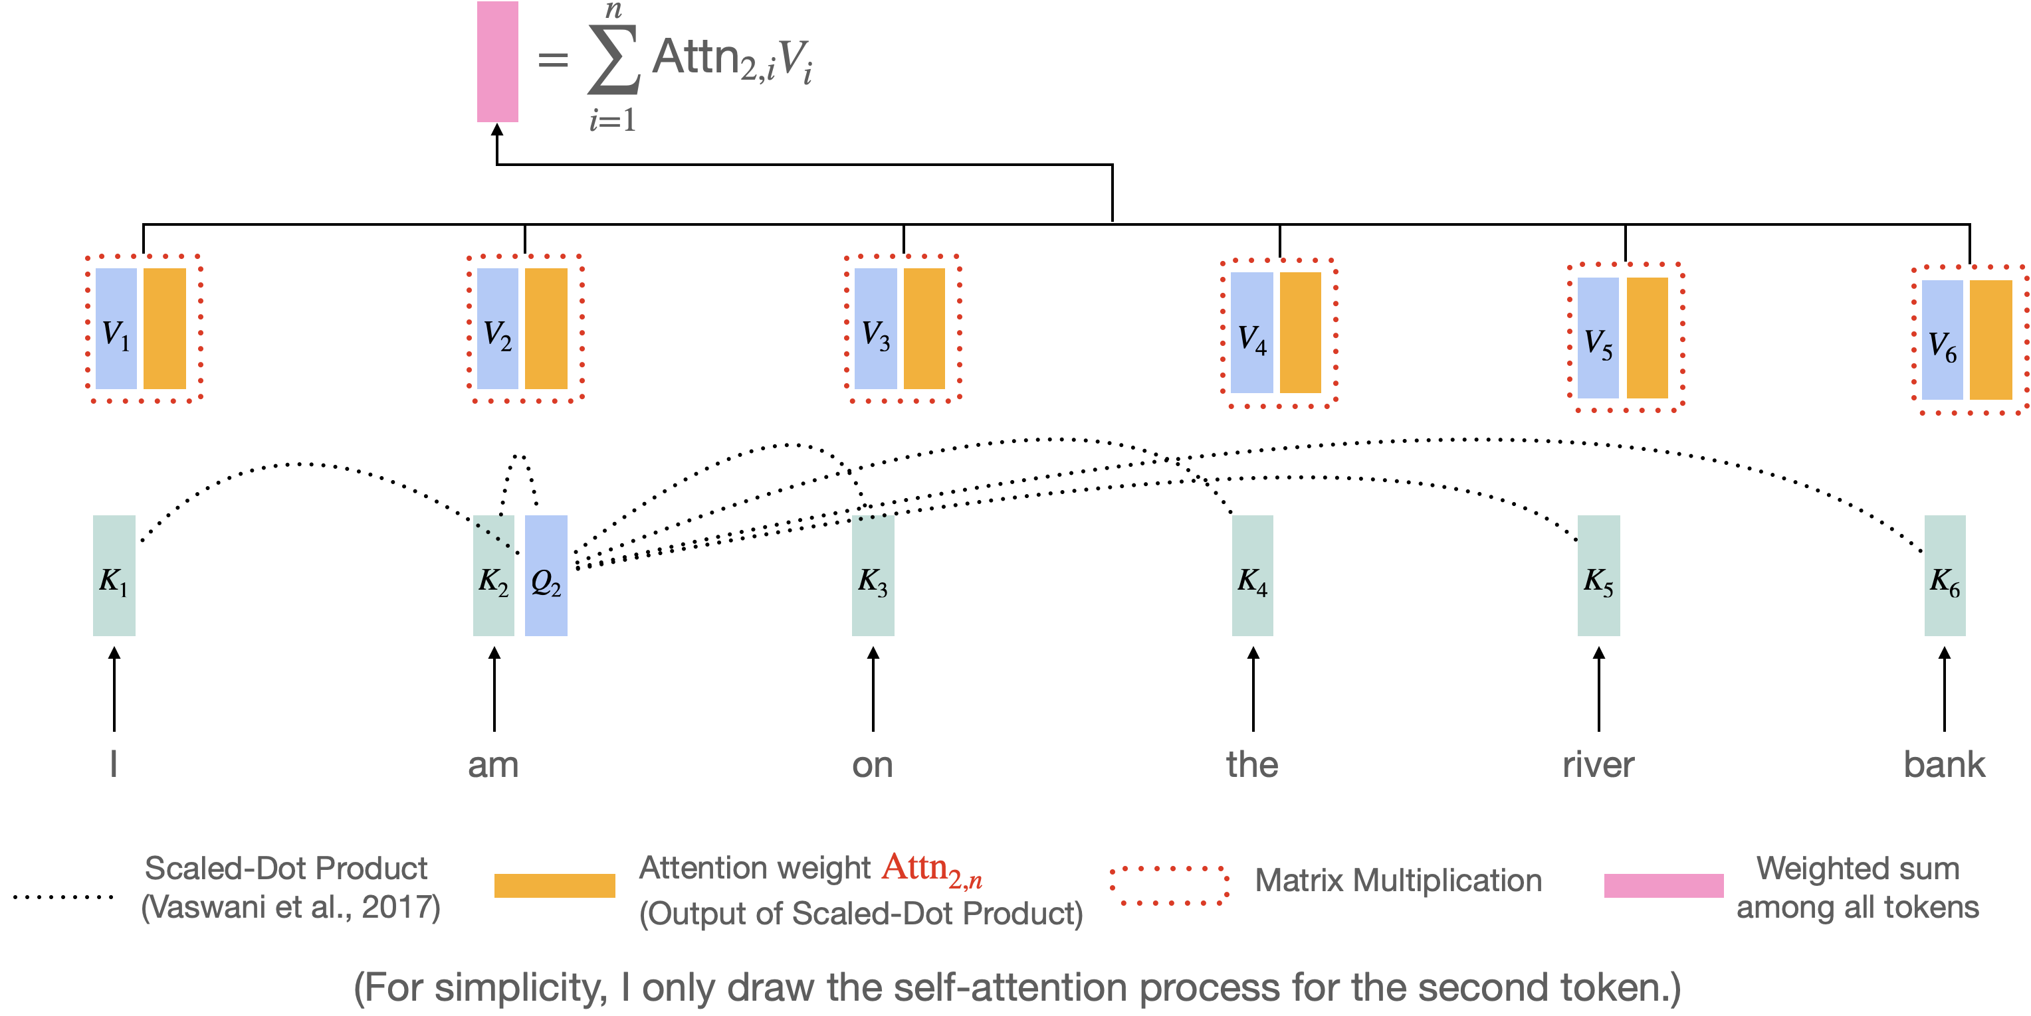
Self-Attention (Transformer) 過程
Vaswani et al. "Attention is all you need." NeurIPS 2017.
https://research.google/blog/transformer-a-novel-neural-network-architecture-for-language-understanding/

Slide 28
Self-attention 動畫
Figure source: https://research.google/blog/transformer-a-novel-neural-network-architecture-for-language-understanding/

Slide 29
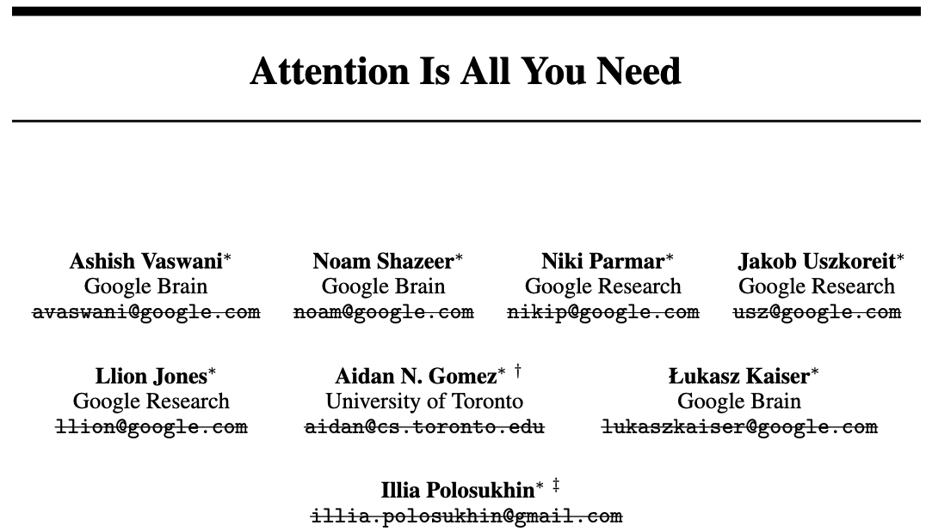
Essential AI
Anthropic
Inceptive
Cohere
Sakana AI
OpenAI
NEAR
https://arxiv.org/abs/1706.03762v6

Slide 30
Multi-Head Attention (MHA)
到目前為止，我們已經介紹了 self-attention
We query the search engine
We search engine tries to map our query to the keys
The outputs are the attended values (e.g., the best matched videos).
試想：如果我們想要模型注意到多種語言行爲呢？

Slide 31
語言存在多種行為 / 模式
語義（這人可能會 programming）
e₁
I
e₂
printed
e₃
Hello
e₄
world
時態
h₁
<- Softmax 也是一種 max，只能取得一種最有可能的語言模式
有沒有可能讓模型同時學到多種語言模式？
-> Multi-head Attention

Slide 32


















Multi-Head Attention (MHA)
上標: head
下標: token index
Head = 1 (without MHA)
q₁
k₁
v₁
q₂
k₂
v₂
q₃
k₃
v₃
e₁
I
e₂
printed
e₃
Hello
Head = 2 (with MHA)
$$q_{1}^{1}$$
$$q_{1}^{2}$$
$$k_{1}^{1}$$
$$k_{1}^{2}$$
$$v_{1}^{1}$$
$$v_{1}^{2}$$
$$q_{2}^{1}$$
$$q_{2}^{2}$$
$$k_{2}^{1}$$
$$k_{2}^{2}$$
$$v_{2}^{1}$$
$$v_{2}^{2}$$
$$q_{3}^{1}$$
$$q_{3}^{2}$$
$$k_{3}^{1}$$
$$k_{3}^{2}$$
$$v_{3}^{1}$$
$$v_{3}^{2}$$
e₁
I
e₂
printed
e₃
Hello

Slide 33

















Query (Q), Key (K), and Value (V) with MHA
Head = 2, 使用第一個 head
$$h_{1}^{1}$$
Weighted sum
$$a_{1}^{1}$$
$$a_{2}^{1}$$
$$a_{3}^{1}$$
$$a_{4}^{1}$$
$$q_{1}^{1}$$
$$k_{1}^{1}$$
$$v_{1}^{1}$$
$$q_{2}^{1}$$
$$k_{2}^{1}$$
$$v_{2}^{1}$$
$$q_{3}^{1}$$
$$k_{3}^{1}$$
$$v_{3}^{1}$$
$$q_{4}^{1}$$
$$k_{4}^{1}$$
$$v_{4}^{1}$$
🎯
e₁
I
e₂
printed
e₃
Hello
e₄
world

Slide 34

















Query (Q), Key (K), and Value (V) with MHA
Head = 2, 使用第二個 head
$$h_{1}^{2}$$
Weighted sum
$$a_{1}^{2}$$
$$a_{2}^{2}$$
$$a_{3}^{2}$$
$$a_{4}^{2}$$
$$q_{1}^{2}$$
$$k_{1}^{2}$$
$$v_{1}^{2}$$
$$q_{2}^{2}$$
$$k_{2}^{2}$$
$$v_{2}^{2}$$
$$q_{3}^{2}$$
$$k_{3}^{2}$$
$$v_{3}^{2}$$
$$q_{4}^{2}$$
$$k_{4}^{2}$$
$$v_{4}^{2}$$
🎯
e₁
I
e₂
printed
e₃
Hello
e₄
world

Slide 35









Input Dimensions of MHA
Head = 1 (without MHA)
$$Q$$
q₁
e₁
=
W^{Q}
q₂
e₂
q₃
e₃
N x d_{q}
N x d_{model}
d_{model} x d_{q}
Head = 2 (with MHA)
d_{k} / 2
d_{k} / 2
d_{k} / 2
d_{k} / 2
$$q_{1}^{1}$$
$$q_{1}^{2}$$
e₁
$$q_{2}^{1}$$
$$q_{2}^{2}$$
=
e₂
$$W_{Q}^{1}$$
$$W_{Q}^{2}$$
$$q_{3}^{1}$$
$$q_{3}^{2}$$
e₃
N x d_{q}
N x d_{model}
d_{model} x d_{q}

Slide 36

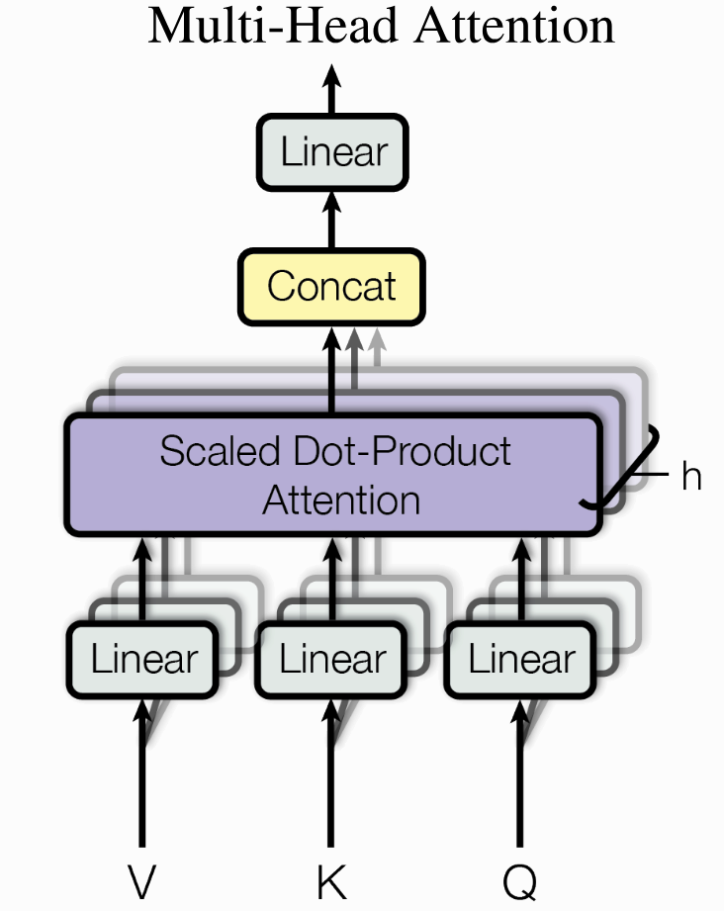









Output Dimensions
x
x
$$∈ ℝ^{N × (h ⋅d)}$$
$$∈ ℝ^{\left(h ⋅d\right) × d_{out}}$$
Head = 1 (without MHA)
h₁
h₁
$${ ∈ℝ}^{N × d_{out}}$$
X
W^{O}
=
$$∈ ℝ^{N × (h ⋅d)}$$
$$Y_{h} ∈ ℝ^{N×d}$$
...
Head = 2 (with MHA)
$$Y_{2} ∈ ℝ^{N×d}$$
$$Y_{1} ∈ ℝ^{N×d}$$
$$h_{1}^{1}$$
h₁
X
W^{O}
=
$$h_{1}^{2}$$

Slide 37
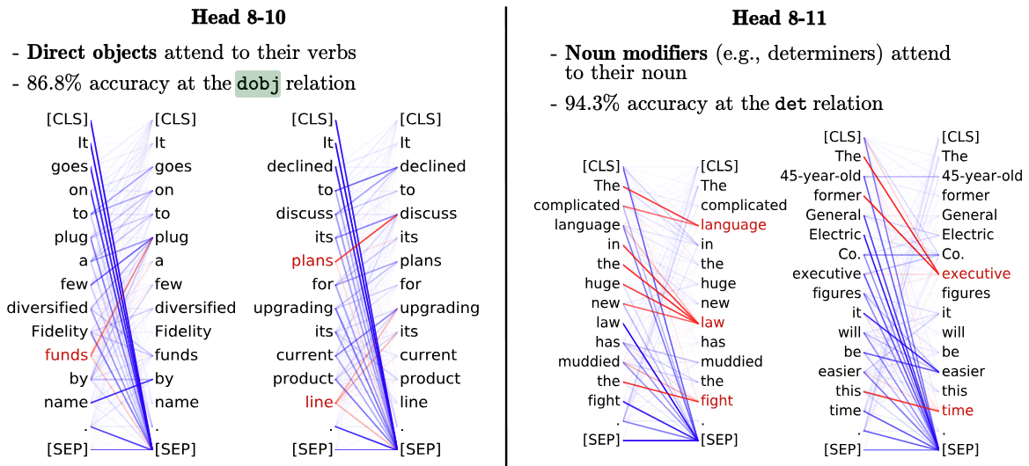
MHA 比較好嗎？
Clark, Kevin, et al. "What Does BERT Look at? An Analysis of BERT’s Attention." Proceedings of the 2019 ACL Workshop BlackboxNLP: Analyzing and Interpreting Neural Networks for NLP. 2019.
實驗證明：不同 head 關注的地方不太一樣
<layer>-<head number>
關注受詞
關注限定詞

Slide 38

MHA 的過程中涵蓋了多次 softmax
$${ ∈ℝ}^{N × d_{out}}$$
$$∈ ℝ^{N × (h ⋅d)}$$
每次 scaled dot-product attention 都會做 softmax
$$Y_{h} ∈ ℝ^{N×d}$$
...
$$Y_{2} ∈ ℝ^{N×d}$$
$$Y_{1} ∈ ℝ^{N×d}$$

Slide 39
Summary of MHA
透過 MHA，模型會將表示投影到多個不同的子空間，讓每個 head 各自進行 self-attention，因此同一個時間點可以同時從不同角度捕捉序列中的關係
標準 Transformer 的 num_heads 通常不改變最終輸出維度，因為總模型維度 d_model 固定，head 數改變時會相應調整每個 head 的維度
$${ ∈ℝ}^{N × d_{out}}$$
$$∈ ℝ^{N × (h ⋅d)}$$
$$Y_{h} ∈ ℝ^{N×d}$$
...
$$Y_{2} ∈ ℝ^{N×d}$$
$$Y_{1} ∈ ℝ^{N×d}$$

Slide 40
Outline of Transformer
Vaswani, Ashish, et al. "Attention is all you need." NeurIPS (2017).
Add: Residual Connection
Norm: Layer Normalization

Slide 41
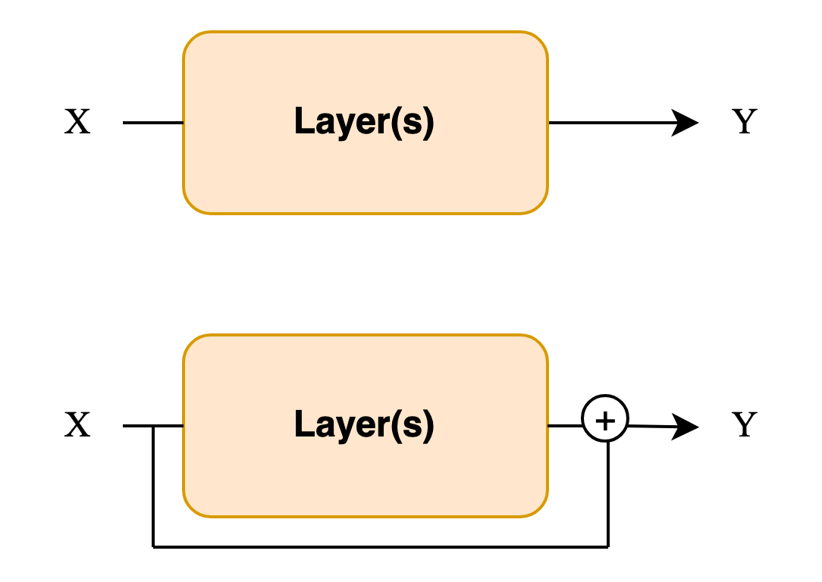
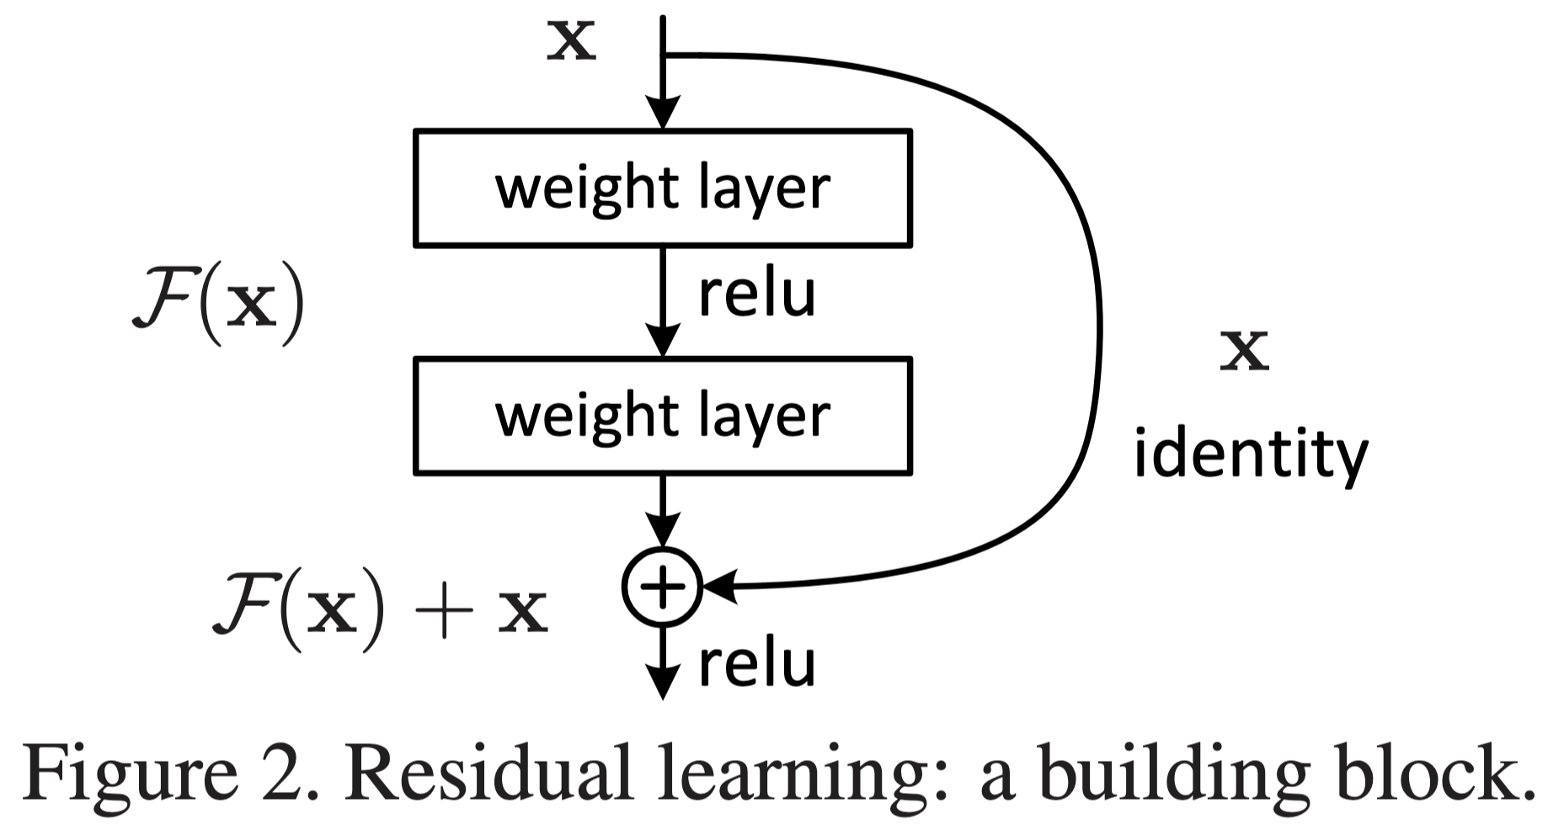
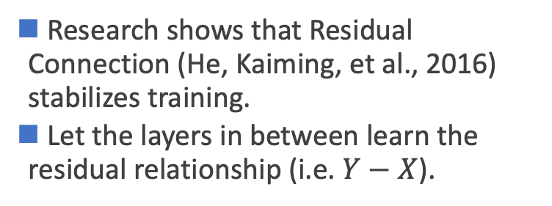
Add & Norm
Research shows that Residual Connection (He, Kaiming, et al., 2016) stabilizes training.
Let the layers in between learn the residual relationship (i.e. $Y−X$).
Standard
Residual
He, Kaiming, et al. "Deep residual learning for image recognition." Proceedings of the IEEE conference on computer vision and pattern recognition (2016).

Slide 42
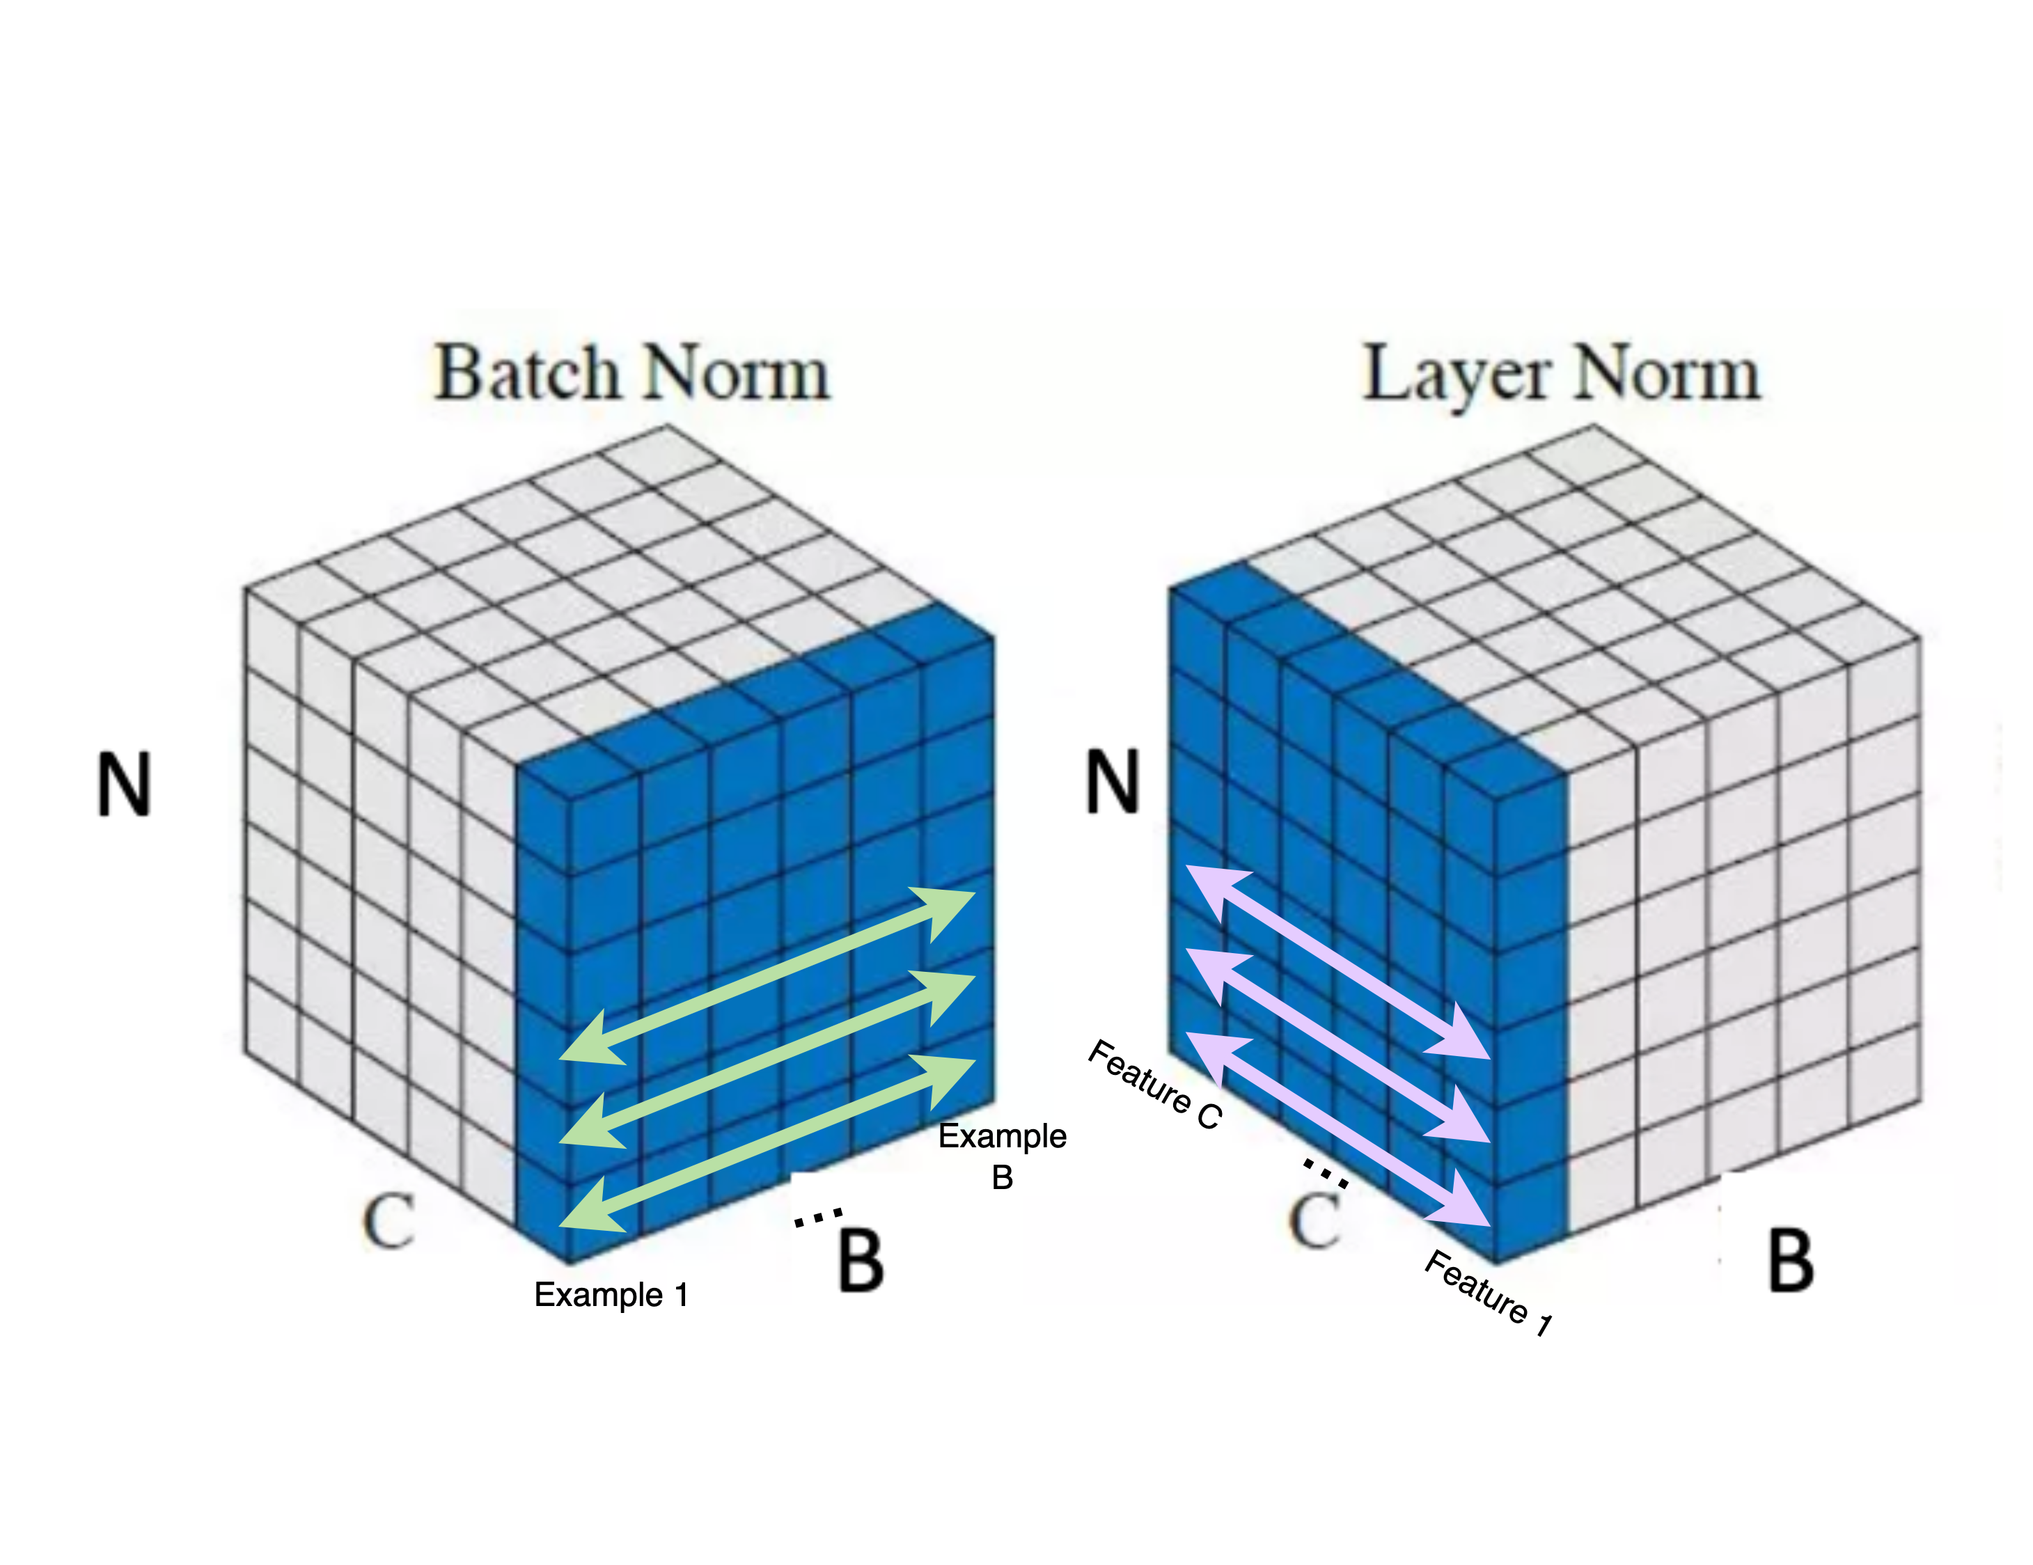








Add & Norm (Layer Normalization)
B: Batch Size
C: Channels / Feature Dimension
N: Sequence length (CNN 中代表長x寬的數目)
Layer Norm: For an input vector, calculate its mean and std across embedding dimension (within an example).
$norm\left(X\right)=\frac{X−μ}{σ}$
計算：$μ$ (平均數) & $σ$ (標準差)
$$x_{1}$$
$$h_{1}$$
$${h′}_{1}$$
...
...
...
$$x_{n}$$
$$h_{j}$$
$${h′}_{j}$$
(Batch Normalization)
Ba, Jimmy Lei, Jamie Ryan Kiros, and Geoffrey E. Hinton. "Layer normalization." arXiv preprint arXiv:1607.06450 (2016).
Notes:
可以把 FN 想成 Feature Normalization

Slide 43
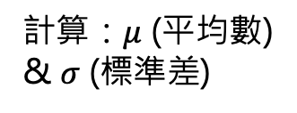
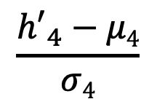
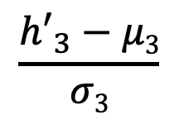
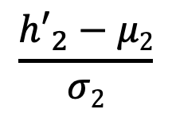
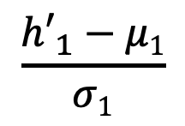
Add & Norm (Layer Normalization)
$$\frac{{h′}_{1}−μ1}{σ1}$$
$$\frac{{h′}_{2}−μ2}{σ2}$$
$$\frac{{h′}_{3}−μ3}{σ3}$$
$$\frac{{h′}_{4}−μ4}{σ4}$$
h₁
h₂
h₃
h₄
計算：$μ$ (平均數) & $σ$ (標準差)
a₁
a₂
a₃
a₄
q₁
k₁
v₁
q₂
k₂
v₂
q₃
k₃
v₃
q₄
k₄
v₄
e₁
I
e₂
printed
e₃
Hello
e₄
world
Ba, Jimmy Lei, Jamie Ryan Kiros, and Geoffrey E. Hinton. "Layer normalization." arXiv preprint arXiv:1607.06450 (2016).
Notes:
簡單來說，LN會在每個時間點的 hidden state 都算出一組平均數跟標準差

Slide 44
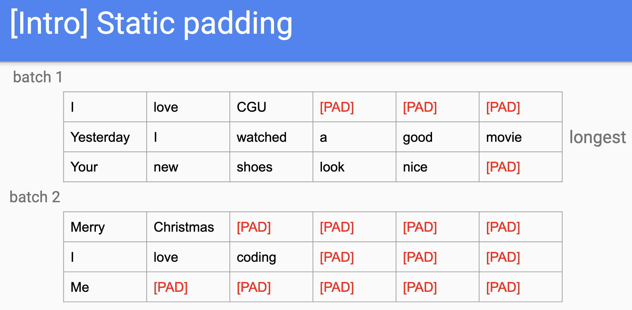
Why LN not BN?
資料長度差距
模型實作表現差異

Slide 45
Outline of Transformer
Vaswani, Ashish, et al. "Attention is all you need." NeurIPS (2017).

Slide 46
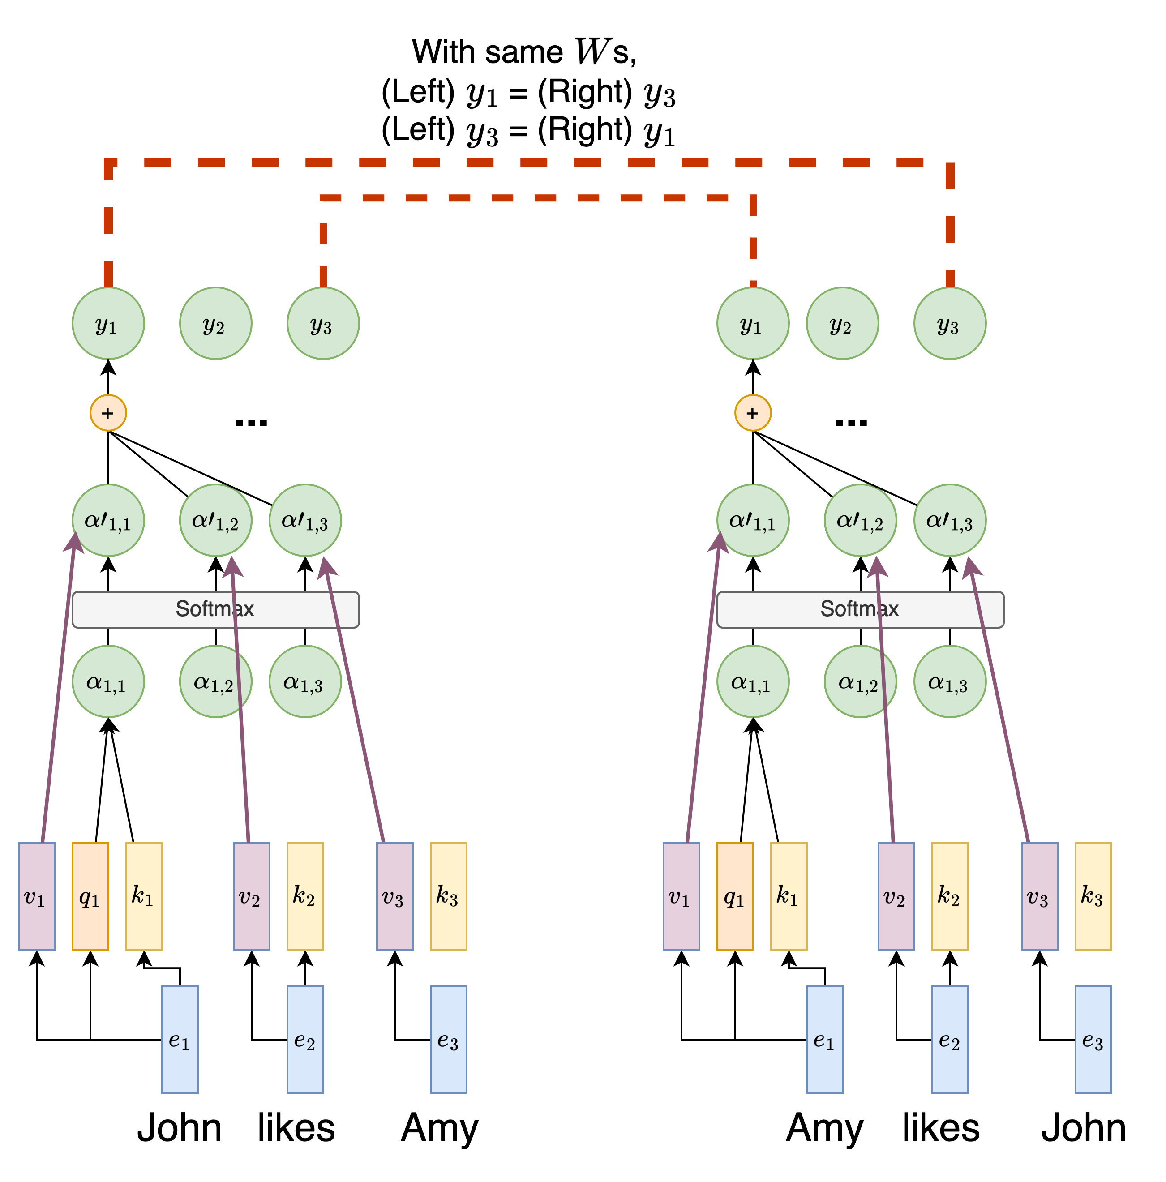
Lack of Position Modeling
RNN 有位置資訊 (因為 RNN step-by-step 處理文字)
然而，Transformer 中 self-attention 的操作遺失了 step-by-step 處理文字的方式，故缺少位置資訊
不同語意的句子但文字資訊卻沒有根據上下文而變化
Notes:
RNNs use the recurrent nature to encode relative distance, but self-attention alone does not have the concept of distance.
Figure link: https://www.google.com/imgres?imgurl=https%3A%2F%2Fen.pimg.jp%2F062%2F372%2F497%2F1%2F62372497.jpg&tbnid=h12XO59LOC-2AM&vet=12ahUKEwi-hZz5-aeEAxUjiq8BHWxaD30QMygLegQIARBw..i&imgrefurl=https%3A%2F%2Fwww.pixtastock.com%2Fillustration%2F62372497&docid=EjyqzObtASteNM&w=450&h=468&q=trouble%20face%20cute%20&ved=2ahUKEwi-hZz5-aeEAxUjiq8BHWxaD30QMygLegQIARBw

Slide 47
常見位置資訊作法：Learned Positional Embeddings
Self-attention
Self-attention
p₁
e₁
p₂
e₂
p₃
e₃
p₁
e₁
p₂
e₂
p₃
e₃
+
+
+
+
+
+
1
John
2
likes
3
Amy
1
Amy
2
likes
3
John
此做法又稱絕對位置資訊編碼 (Absolute positional Encoding)

Slide 48
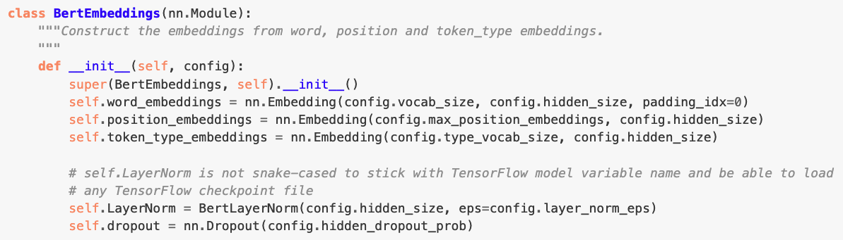
Learned Positional Embeddings 程式碼
https://huggingface.co/transformers/v2.1.1/_modules/transformers/modeling_bert.html
缺點：Learned Positional Embeddings 不會超出 max_position 之後的資訊

Slide 49
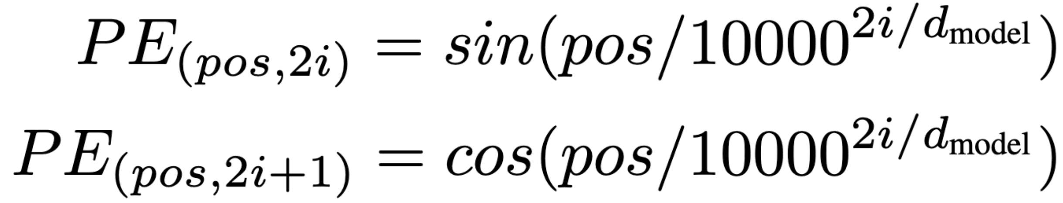
Positional Encoding in Transformer
創造出相對位置的 embeddings
核心精神：利用三角函數的週期性來建構序列資訊
偶數的 embedding 單元 (2i , i = 0, 2, 4, …, d_{model} / 2 - 2)：Sin 函數
奇數的 embedding 單元 (2i+1, i = 1, 3, 5, …, d_{model} / 2 - 1)： Cosine 函數
i越大 -> 分母越大 -> 相位變化越慢 -> 頻率越小
10000是實驗得出的較佳數值
輸入序列中任一token的位置
Figure source: https://nlp.seas.harvard.edu/annotated-transformer/#positional-encoding
Notes:
sin(wt)，w是角速度，t是時間，在這邊指的是pos
w=2π/λ
PE公式可寫成sin(2πpos / 10000^{2i / d_{model}} * 2π)
因此λ為10000^{2i / d_{model}} * 2π
i最小時λ為2π
i最大時λ為10000 * 2π

Slide 50
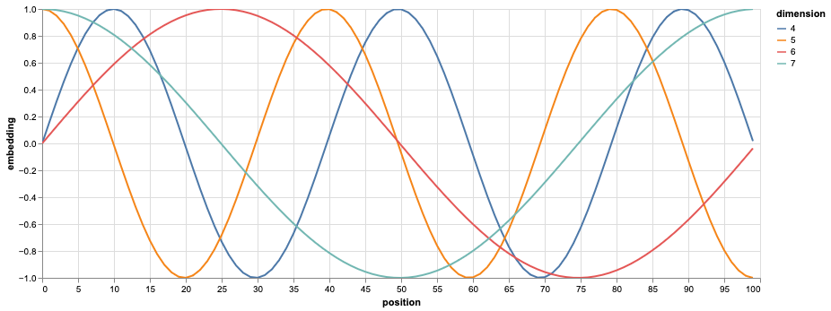
Positional Encoding Visualization
sin30∘=0.5
sin150 ∘=0.5
vs.
(sin30 ∘,cos30 ∘)=(0.5,0.866)
(sin150∘,cos150 ∘)=(0.5,−0.866)
Question: 為什麼需要同時有 Sin 和 Cosine 的函數？
Ans: 藉由不同週期性來捕捉序列中各個位置的關係
Figure source: https://nlp.seas.harvard.edu/annotated-transformer/#positional-encoding

Slide 51
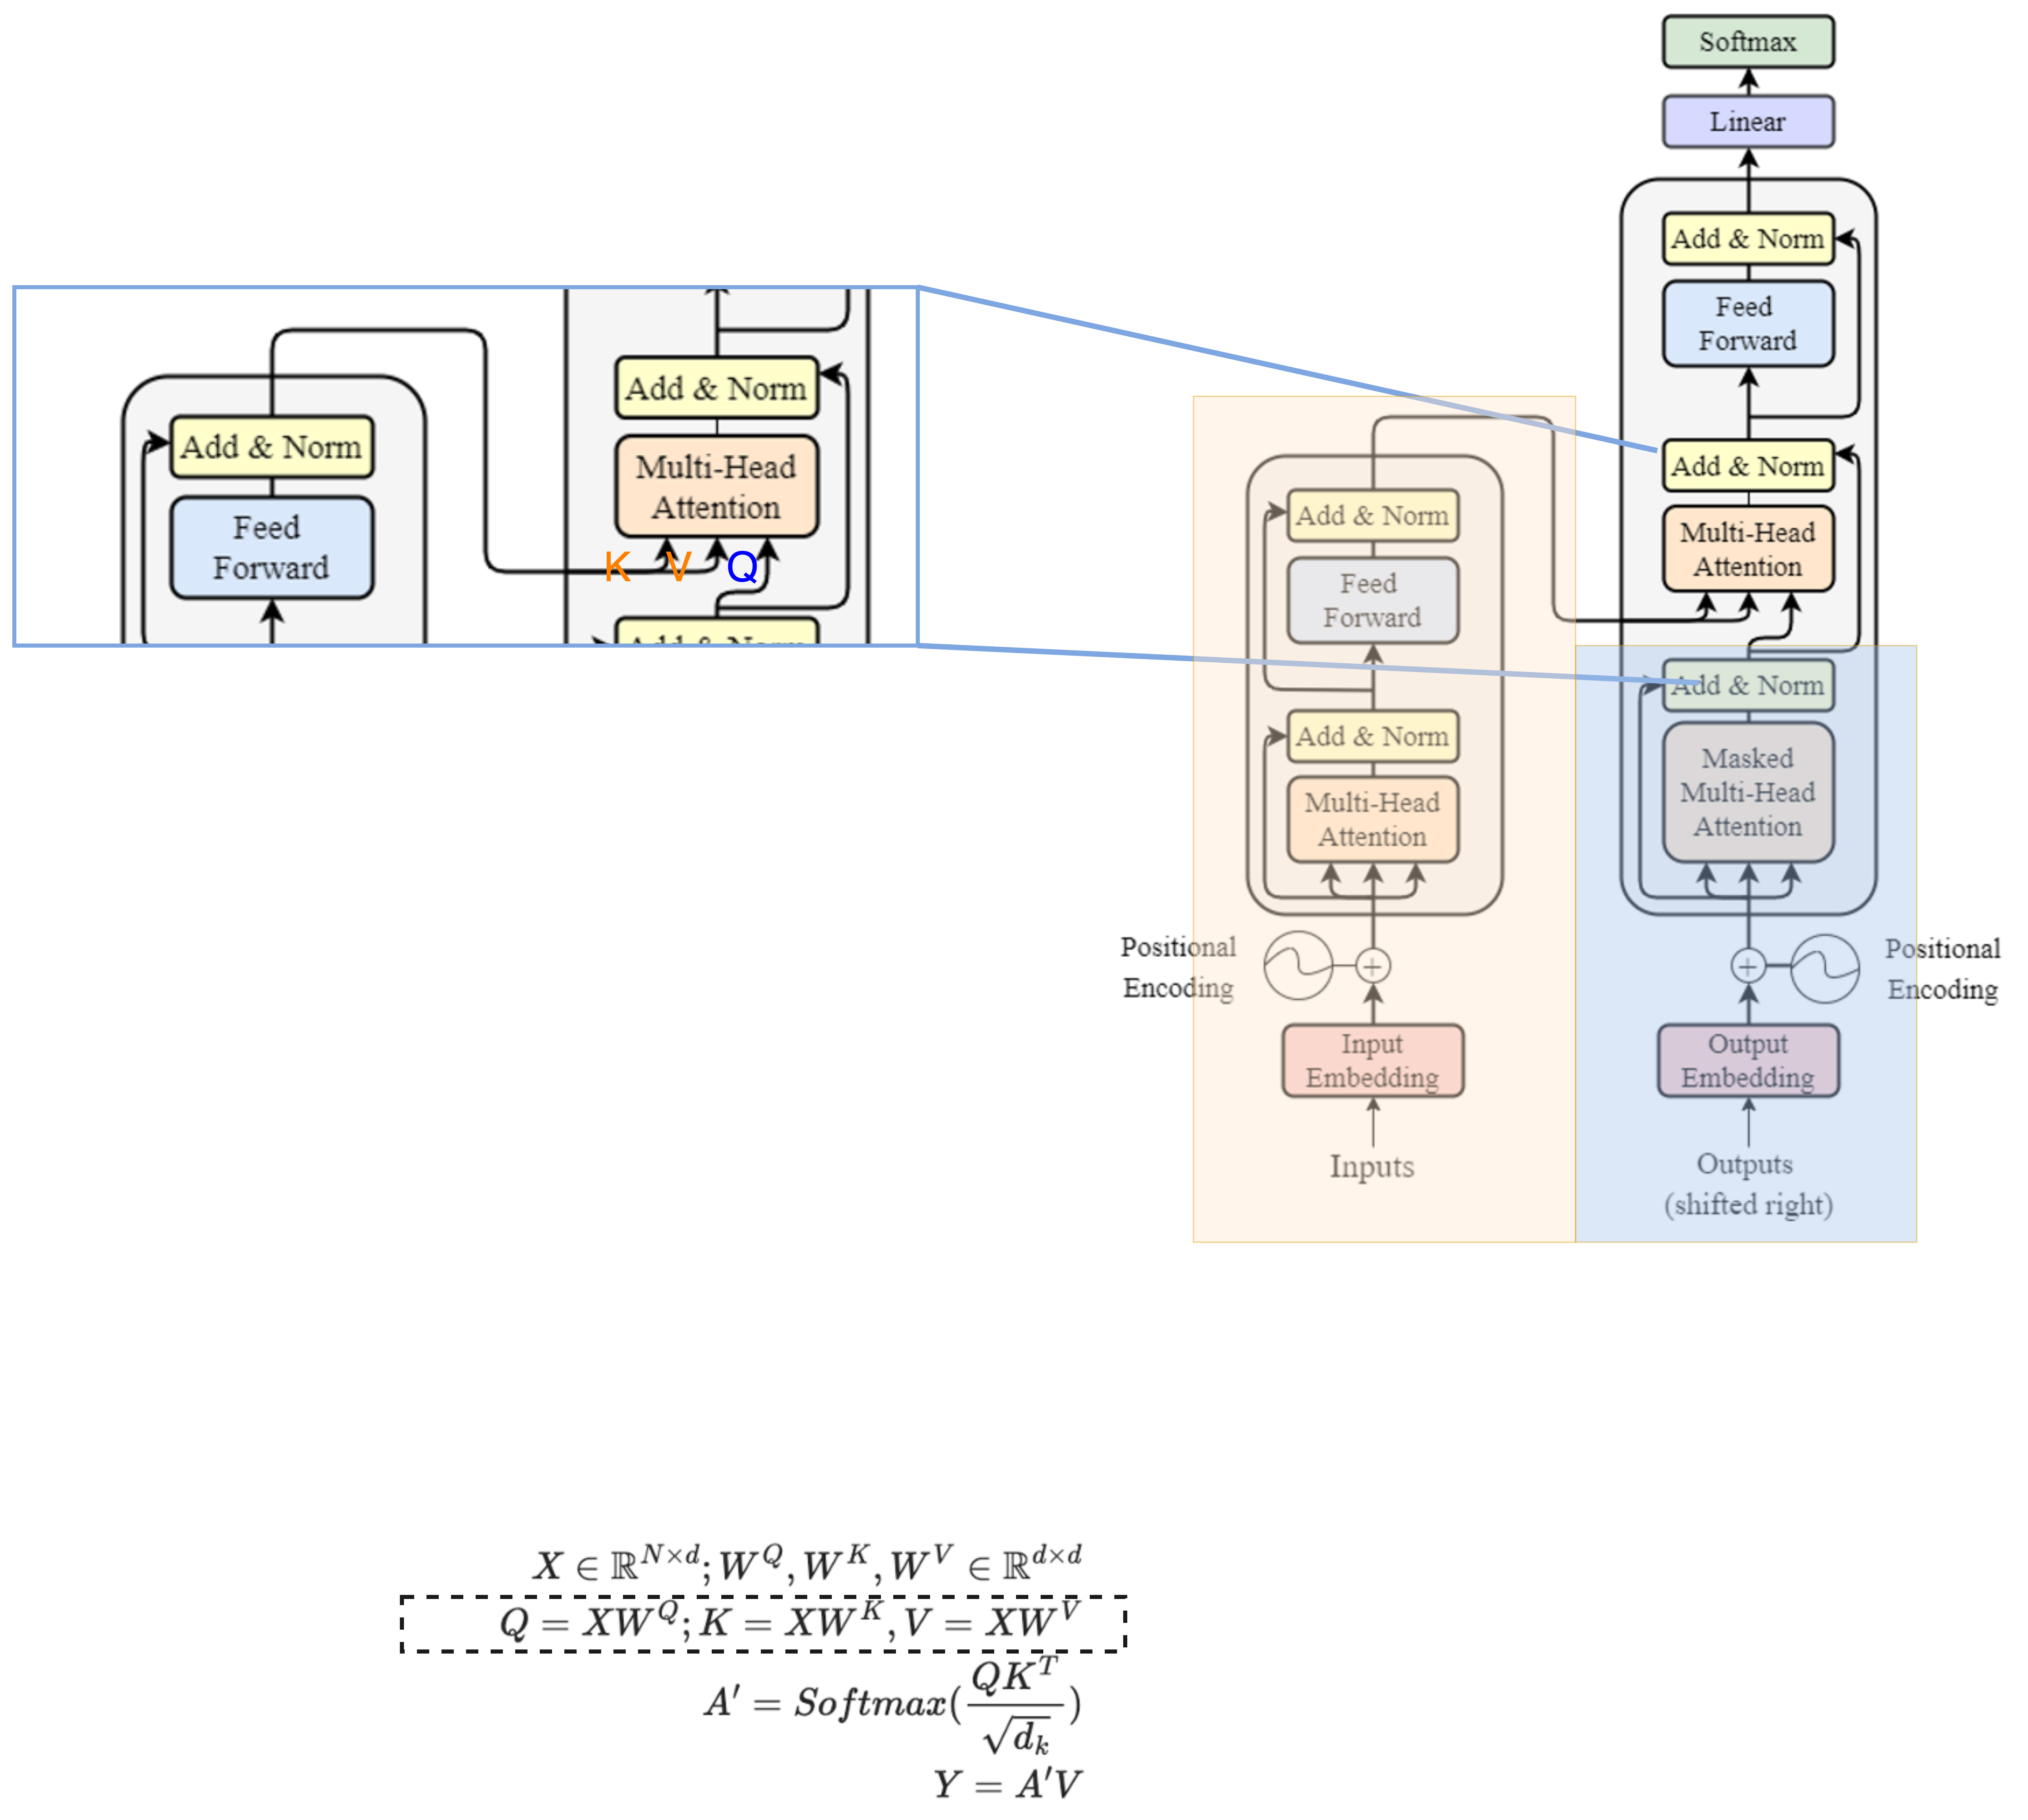
Encoder-Decoder 橋樑: Cross-Attention
K, V uses the output from encoder as their X;
Q uses the decoder’s information as X.
This is
Notes:
K, V uses the output from encoder as their X;
Q uses the decoder’s information as X.

Slide 52
Cross-attention
Encoder
h'₁
Weighted sum
a'₁
a'₂
a'₃
k₁
v₁
k₂
v₂
k₃
v₃
q₁
🎯
e₁
I
e₂
print
e₃
Hello
e₁
BOS

Slide 53
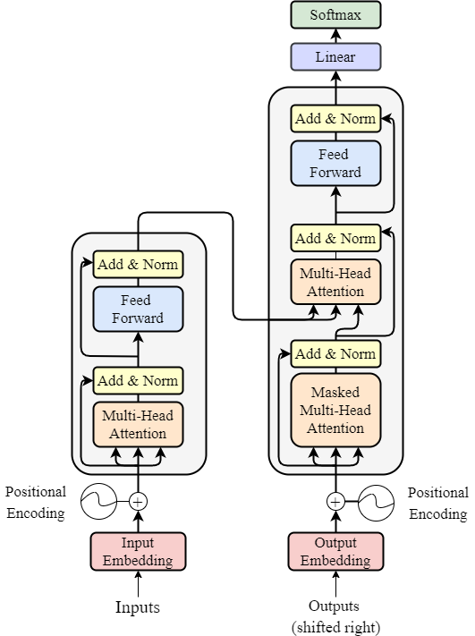


Number of Layers
Vaswani, Ashish, et al. "Attention is all you need." Advances in neural information processing systems 30 (2017).
o$utput ∈ ℝ^{N × d }$
Input, output dimension match!
We can have multiple encoders stacked up, to increase the number of trainable parameters.
N *
input$∈ ℝ^{N × d }$

Slide 54
Outline of Transformer
Vaswani, Ashish, et al. "Attention is all you need." NeurIPS (2017).
Feed Forward Networks:
Simply multiply by a weight matrix (MLP).
Used to project to a specific dimension.

Slide 55
[Recap] Text Generation with RNN
*本頁的RNN不包含輸出層$V$
Vocab
Prob
(1, hidden_size)
(1, hidden_size)
(1, hidden_size)
a
...
apple
...
b
...
banana
...
elephant
...
eraser
...
...
zoo
0.0001
...
0.600
...
0.0001
...
0.0003
...
0.300
...
0.05
...
...
0.0001
$$h_{1}$$
$$h_{2}$$
$$h_{3}$$
Classification Layer $V$
Softmax
(1, Vocab_size)
RNN
$$h_{1}$$
RNN
$$h_{2}$$
RNN
$$o_{3}$$
Vocab
size
I
love
an
Word embeddings

Slide 56
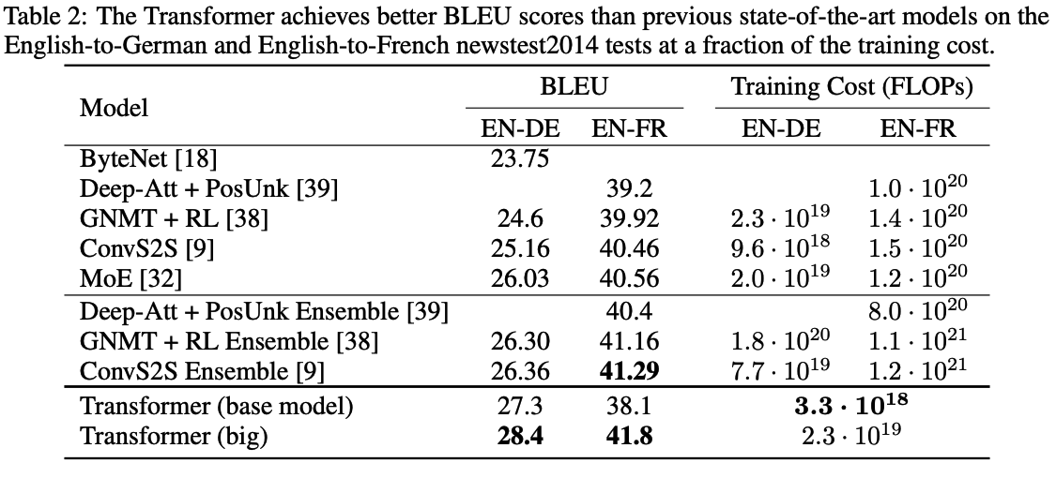
Transformers’ Achievements
1. In original paper, State-of-The-Art (SoTA) of machine translation.
6 encoders,
6 decoders,
h = 512, 100K train steps.
6 encoders,
6 decoders,
h = 1024, 300K train steps.
Vaswani, Ashish, et al. "Attention is all you need." Advances in neural information processing systems 30 (2017).
https://arxiv.org/abs/1706.03762

Slide 57
Transformer Variants (there are many more)
Universal Transformer
Adds Adaptive Computation Time
Dehghani, Mostafa, et al. "Universal transformers." arXiv preprint arXiv:1807.03819 (2018).
Longformer
Tackles long documents
Iz Beltagy, et al. (2020). Longformer: The Long-Document Transformer. arXiv:2004.05150.
Roformer
Changes the design of positional encoding
Su, Jianlin, et al. "RoFormer: Enhanced Transformer with Rotary Position Embedding. CoRR abs/2104.09864 (2021)." arXiv preprint arXiv:2104.09864 (2021).
Vision Transformer
Tackles vision tasks
Alexey Dosovitskiy, et al. “An Image is Worth 16x16 Words: Transformers for Image Recognition at Scale.” International Conference on Learning Representations. 2021.

Slide 58
Additional Links
https://nlp.seas.harvard.edu/annotated-transformer/
https://datascience.stackexchange.com/questions/82451/why-is-10000-used-as-the-denominator-in-positional-encodings-in-the-transformer

Slide 59
Thank you!
Instructor: 林英嘉
✉️ yjlin@cgu.edu.tw
TA: 林宣辰
✉️ b1128015@cgu.edu.tw

