Slide 1



自然語言處理與應用 Natural Language Processing and Applications
Hugging Face Tutorial
Slido
# NLP0427 (Link)
GitHub
Instructor: 林英嘉 (Ying-Jia Lin)
2026/04/27

Slide 2
What you will learn in this tutorial
Training and evaluating GPT-2 / T5 on abstractive summarization
Dataset: Chinese abstractive summarization
Objective: Cross-entropy
Main packages: PyTorch, Hugging Face, ROUGE

Slide 3
Why do we need to learn GPT-2?
GPT-2 is the last open-source model in the GPT series from OpenAI.
Language generation is hard, and GPT-2 is a good start point.
GPT-2 is not big. It is feasible for low-budget machines.
GPT-2 (12-layer; 124M), GPT-2-medium (24-layer; 345M), GPT-2-large (36-layer; 762M), GPT-2-xl (48-layer; 1.5B)

Slide 4
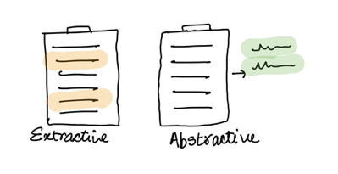
Introduction to Text Summarization
Extractive summarization
Generate a short text summary for a document by selecting salient sentences in the documents.
Abstractive summarization
Generate novel words and phrases not featured in the source text.
Example:
The Queen's Birthday holiday road toll stands at zero for the first time since records began.
Ext summary: The Queen's holiday road toll stands at zero.
Abs summary: The Queen's holiday slashes road toll.

Slide 5
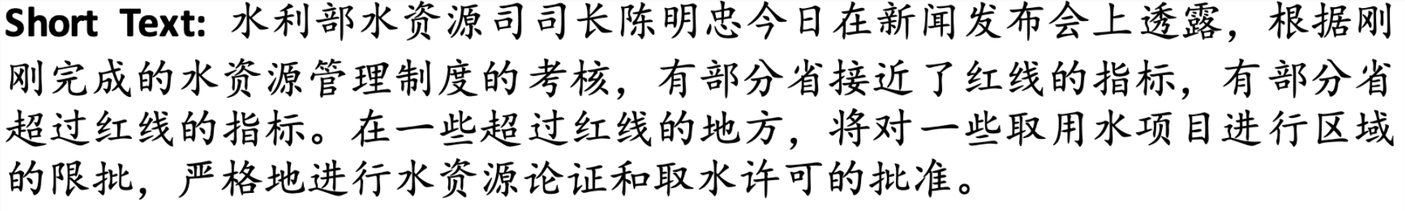
Task: Chinese Abstractive Summarization
Dataset: LCSTS (A Large-Scale Chinese Short Text Summarization Dataset)^{[1]}
[1] Hu, Baotian, Qingcai Chen, and Fangze Zhu. "LCSTS: A Large Scale Chinese Short Text Summarization Dataset." Proceedings of the 2015 Conference on Empirical Methods in Natural Language Processing. 2015.

Slide 6
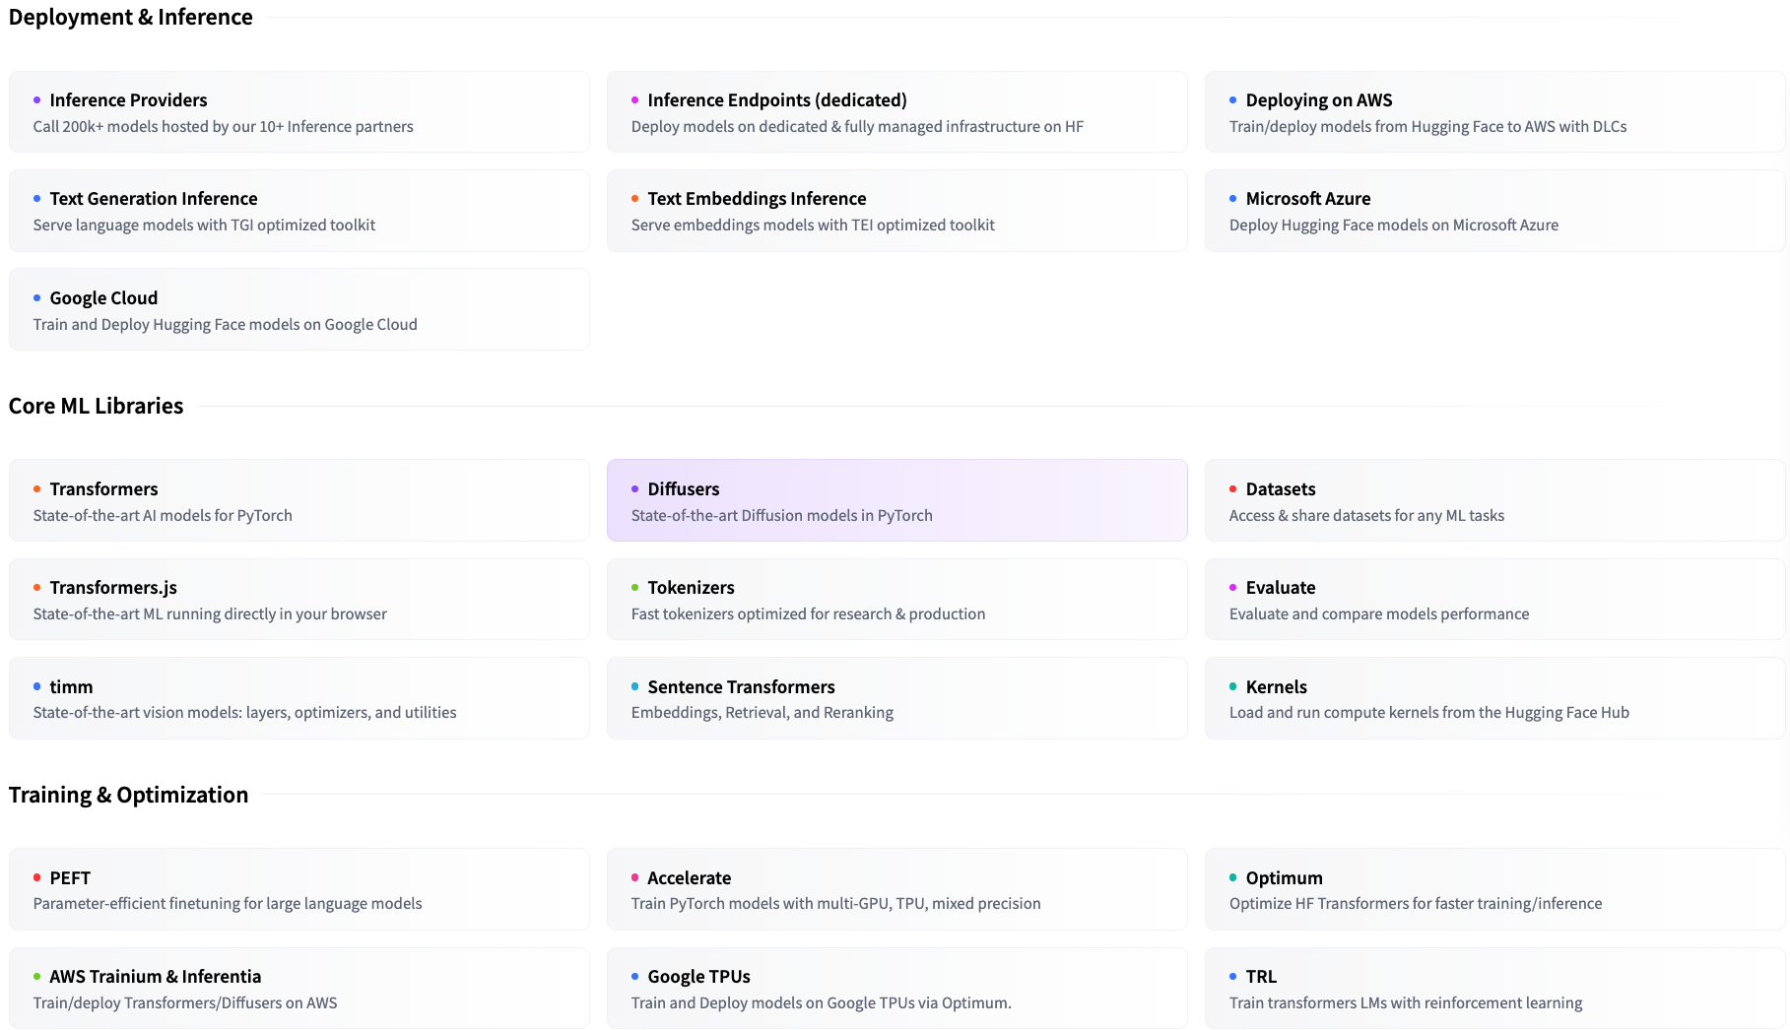
今日著重在 Hugging Face Transformers
https://huggingface.co/docs

Slide 7
Language Model vs. Masked Language Model
y₂
y₃
y₄
y₅
y₆
y₇
y₈
Casual Language Model
(E.g., GPT)
Language Model
y₁
y₂
y₃
y₄
y₅
y₆
y₇
y₄
Masked Language Model
(E.g., BERT)
Masked Language Model (MLM)
y₁
y₂
y₃
?
y₅
y₆
y₇
(Mask)

Slide 8
Language Model vs. Seq2seq Model
y₂
y₃
y₄
y₅
y₆
y₇
y₈
Casual Language Model
(E.g., GPT)
Language Model
y₁
y₂
y₃
y₄
y₅
y₆
y₇
(Target output)
y₁
y₂
y₃
y₄
y₅
y₆
y₇
y₈
Sequence to sequence Model
(E.g., T5; Vanilla Transformers)
Encoder
Decoder
Attention
x₁
x₂
x₃
x₄
x₅
x₆
x₇
x₈
_
y₁
y₂
y₃
y₄
y₅
y₆
y₇
(Source input)
(Start)

Slide 9
Load LCSTS via Hugging Face Dataset
Hugging Face dataset link
raw_train = load_dataset(
"hugcyp/LCSTS", split="train", cache_dir="./cache/"
).to_list()
raw_val = load_dataset(
"hugcyp/LCSTS", split="validation", cache_dir="./cache/"
).to_list()
Sometimes checking the Hugging Face dataset is slow, it will be faster if we transform the dataset object into a list using .to_list().

Slide 10
Let’s try it
1. 用 load_dataset() 把 train 和 validation 分開讀進來
2. 觀察 1~2 筆 samples

Slide 11
Auto Classes (models, tokenizers)
In many cases, the architecture you want to use can be guessed from the name or the path of the pretrained model you are supplying to the from_pretrained method.
AutoClasses are here to do this job for you so that you automatically retrieve the relevant model given the name/path to the pretrained weights/config/vocabulary:
Ex: model = AutoModel.from_pretrained('bert-base-cased') will create an instance of the BERT base model (cased).
https://huggingface.co/transformers/v3.0.2/model_doc/auto.html

Slide 12
Generative Models in Auto Classes
Casual Language Model
(E.g., GPT, Llama)
AutoModelForCausalLM (link)
GPT2LMHeadModel (link)
LlamaForCausalLM (link)
Masked Language Model
(E.g., BERT)
AutoModelForMaskedLM (link)
BertForMaskedLM (link)
Sequence to sequence Model
(E.g., T5; Vanilla Transformers)
AutoModelForSeq2SeqLM (link)
T5ForConditionalGeneration (link)

Slide 13
Outline
GPT-2 (native PyTorch)
T5 (Hugging Face Dataset and Trainer)

Slide 14
Load the Tokenizer and the Model
Hugging Face model link
model_name = "uer/gpt2-chinese-cluecorpussmall"
tokenizer = AutoTokenizer.from_pretrained(
model_name,
padding_side="left”,
)
tokenizer.add_special_tokens({"eos_token": "<|endoftext|>"})
model.resize_token_embeddings(len(tokenizer))
Optional

Slide 15
Left padding
In text generation, sometimes we set padding_side=’left', when loading tokenizer.
If padding is at the end of the prompt, new tokens may be generated after the padding, which is illogical.
<bos> | Recite | the | first | law | <sum> | <pad> | <pad> | <pad>
<bos> | How | are | you | <sum> | <pad> | <pad> | <pad> | <pad>
<bos> | Who | is | the | first | president | of | U.S. | <sum>
Left-padding
Aligning the new tokens.
<pad> | <pad> | <pad> | <bos> | Recite | the | first | law | <sum>
<pad> | <pad> | <pad> | <pad> | <bos> | How | are | you | <sum>
<bos> | Who | is | the | first | president | of | U.S. | <sum>

Slide 16
About Padding
 | Fine-tuning | Test time (inference)
策略一 | Left padding + set [PAD] as -100 in labels (this tutorial) | Left padding (this tutorial)
策略二 | Right padding + set [PAD] as -100 in labels | Use test_batch_size as 1
Fine-tuning 的策略一可搭配 Test time 的任一策略
Fine-tuning 的策略二只建議搭配 Test time 的策略二

Slide 17
Set [PAD] as -100 in labels
https://github.com/huggingface/transformers/blob/main/src/transformers/models/gpt2/modeling_gpt2.py#L1264-L1267
r"""
labels (`torch.LongTensor` of shape `(batch_size, sequence_length)`, *optional*):
Labels for language modeling. Note that the labels **are shifted** inside the model, i.e. you can set
`labels = input_ids` Indices are selected in `[-100, 0, ..., config.vocab_size]` All labels set to `-100`
are ignored (masked), the loss is only computed for labels in `[0, ..., config.vocab_size]`
"""

Slide 18
Load the Tokenizer and the Model
Hugging Face model link
model_name = "uer/gpt2-chinese-cluecorpussmall"
tokenizer = AutoTokenizer.from_pretrained(
model_name,
padding_side="left”,
)
tokenizer.add_special_tokens({"eos_token": "<|endoftext|>"})
model.resize_token_embeddings(len(tokenizer))
Increasing the size will add newly initialized vectors at the end. Reducing the size will remove vectors from the end. (link)

Slide 19
resize_token_embeddings
新增 embedding 的情況：
^{新增的 embedding 還沒有被訓練過}
透過 torch 的 nn.Embedding 來新增 token 的向量
https://github.com/huggingface/transformers/blob/v4.51.3/src/transformers/modeling_utils.py#L2802-L2807
torch 的 nn.Embedding 的初始化範圍是 normal distribution 0到1之間

Slide 20
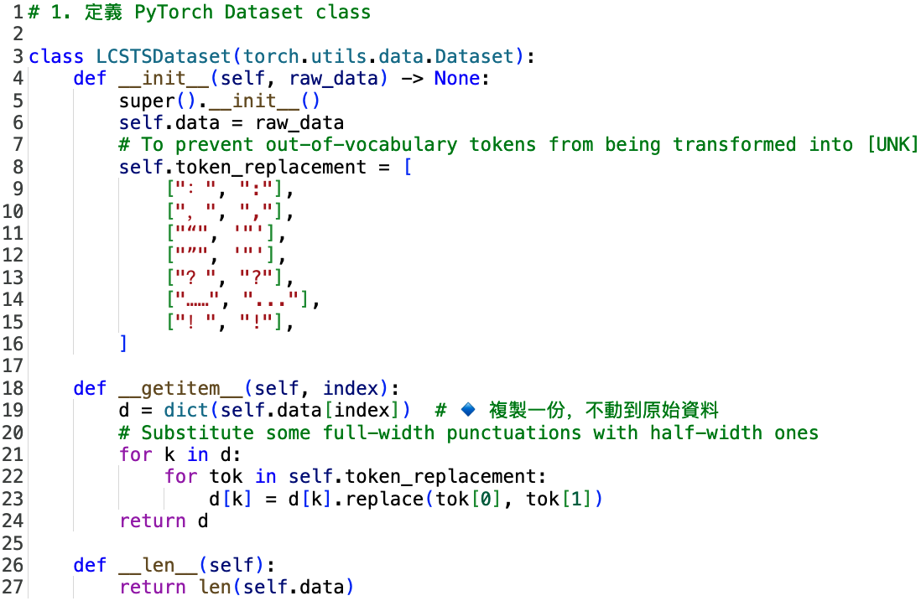
Create the PyTorch Dataset
To prevent out-of-vocabulary tokens from being transformed into [UNK]
You can use the Hugging Face dataset without building a PyTorch dataset class.
However, language generation is complicated. We suggest building your first code with native PyTorch.
Run:
train_set = LCSTSDataset(raw_train)
val_set = LCSTSDataset(raw_val)

Slide 21
Create the PyTorch DataLoader for Data Batching
Input data for training (source + summary)
Labels (auto-regressive; thus, basically input_ids themselves)
Input data for predictions (source only)

Slide 22
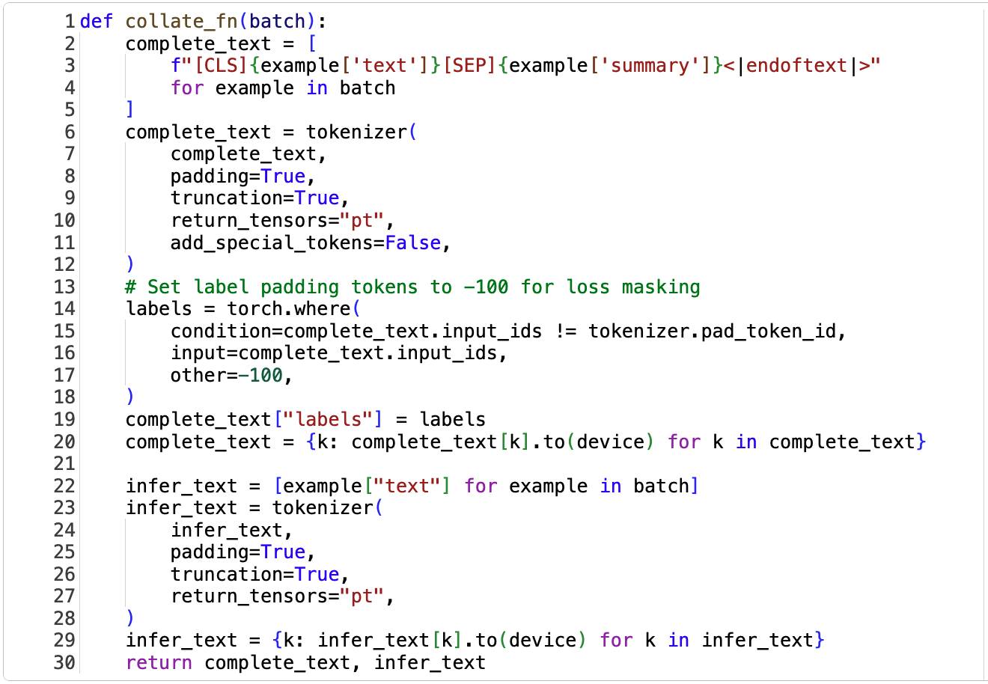
Overview
1
2
3

Slide 23
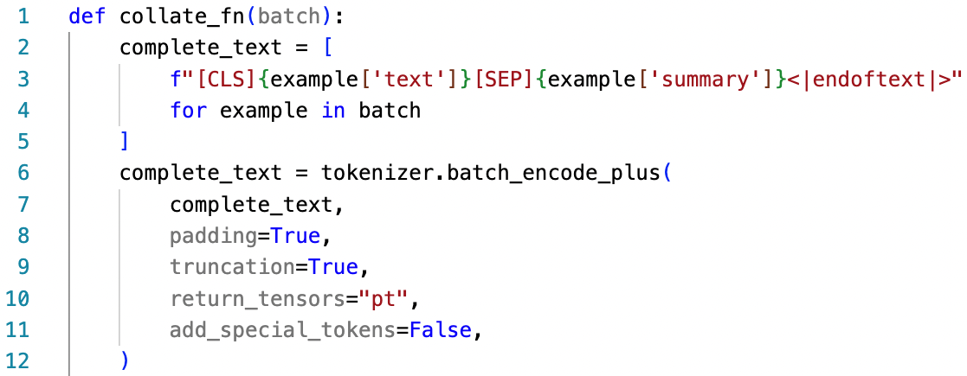
Create the PyTorch DataLoader for Data Batching: 1. Input Data for Training
You can omit the [CLS] token before fine-tuning!
[CLS]
Source article
[SEP]
Summary
<|endoftext|>

Slide 24
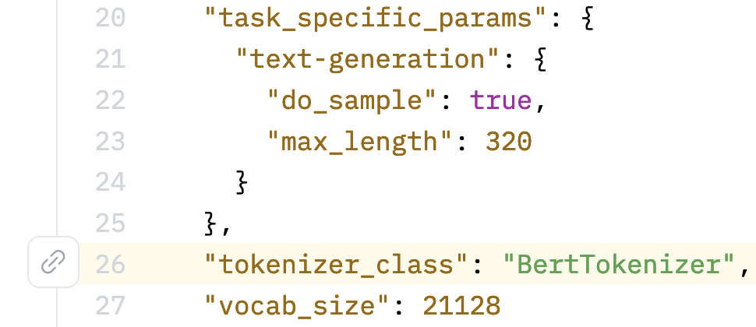
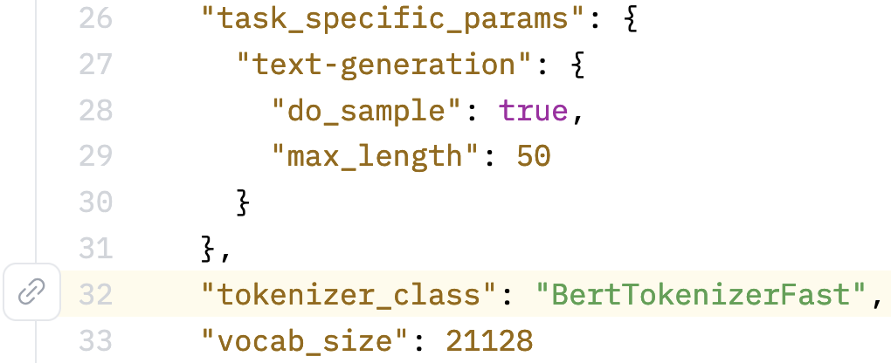
uer/gpt2-chinese-cluecorpussmall uses BertTokenizer
https://huggingface.co/uer/gpt2-chinese-cluecorpussmall/blob/main/config.json#L26
https://huggingface.co/ckiplab/gpt2-base-chinese/blob/main/config.json#L32

Slide 25
English GPT-2 for Text Summarization^{[2]}
> To induce summarization behavior, we can add the text TL;DR: after the article ^{[2]}
TL;DR
Ideally, the model may learn [SEP] as a signal to perform summarization.
[CLS]
Source article
[SEP]
Summary
<|endoftext|>
(You can try it.)
Ideally, the model may learn <|endoftext|> as a signal to end generation.
[2] Radford, A., Wu, J., Child, R., Luan, D., Amodei, D., & Sutskever, I. (2019). Language models are unsupervised multitask learners. OpenAI blog, 1(8), 9.

Slide 26
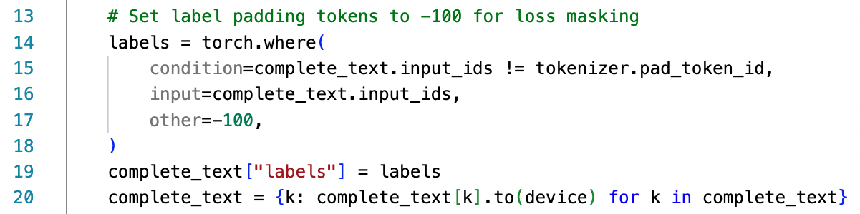
Create the PyTorch DataLoader for Data Batching: 2. Labels (auto-regressive)
(We are still at the collate_fn function.)
this is sentence a
[PAD]
[PAD]
this
is
sentence
a
labels
-100
-100
1212
318
6827
317
this is is is sentence b
this
is
is
is
sentence
b
labels
1212
318
318
318
6827
347

Slide 27
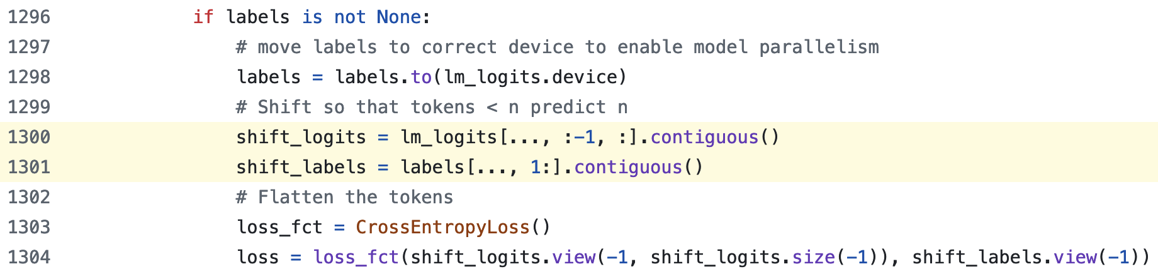
GPT2LMHeadModel shifts logits and labels
https://github.com/huggingface/transformers/blob/main/src/transformers/models/gpt2/modeling_gpt2.py#L1300-L1301
Shape of lm_logits: [batch_size, seq_length, hidden_size]
:-1 代表取到倒數第二個
1: 代表答案後移一格
.contiguous(): https://youtu.be/FGJSGAt_9Ks?si=GMxxS2Oi742e2BhI&t=1261

Slide 28
GPT-2 的 shift labels 對齊
沒有 shift
我
愛
吃
蘋
果
eos
模型預測
輸入句子
(正確答案)
bos
我
愛
吃
蘋
果
eos
往右 shift
我
愛
吃
蘋
果
模型預測
輸入句子
(正確答案)
我
愛
吃
蘋
果

Slide 29
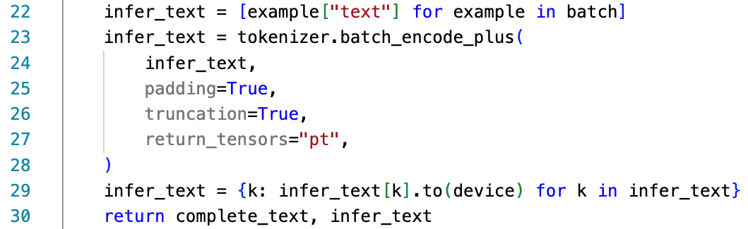
Create the PyTorch DataLoader for Data Batching: 3. Input Data for Predictions
(We are still at the collate_fn function.)
We will use `infer_text` during evaluations.
If you omit the [CLS] token during fine-tuning, then you don’t need to add [CLS] before evaluations!
[CLS]
Source article
[SEP]
Summary
<|endoftext|>

Slide 30
Create the PyTorch DataLoader for Data Batching: 1. Input Data for Training [Recap]
You can omit the [CLS] token before fine-tuning!
[CLS]
Source article
[SEP]
Summary
<|endoftext|>

Slide 31
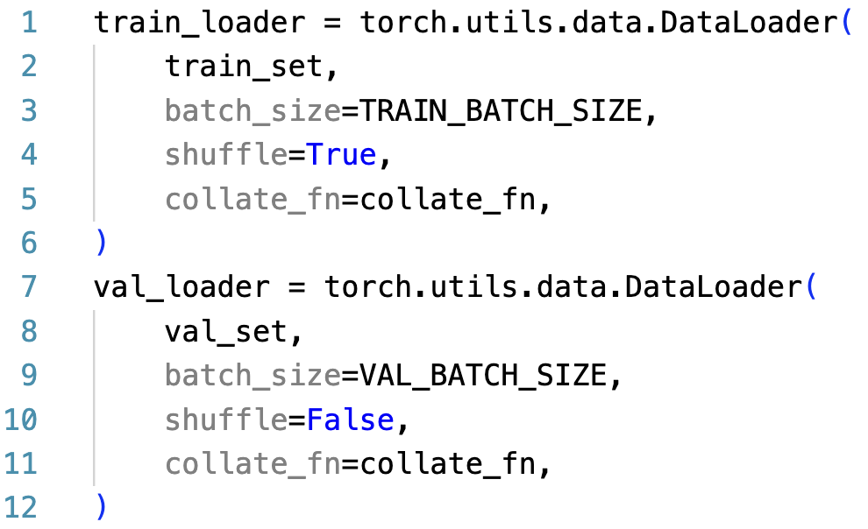
Create the PyTorch DataLoader for Data Batching
Prevent a model from overfitting on data order
We don’t need to use the test set because there is no public test labels (summaries).
See https://huggingface.co/datasets/hugcyp/LCSTS/viewer/default/test

Slide 32
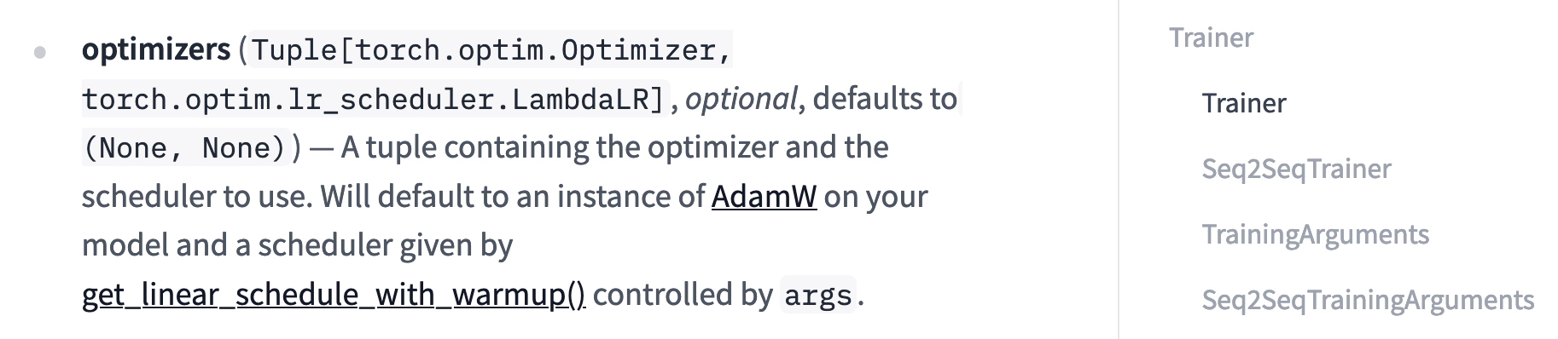
Set up Optimizer
optimizer = torch.optim.AdamW(model.parameters(), lr=LR)
https://pytorch.org/docs/stable/generated/torch.optim.AdamW.html
https://huggingface.co/docs/transformers/main_classes/trainer

Slide 33
Let’s try it
1. 開 train 一下模型

Slide 34
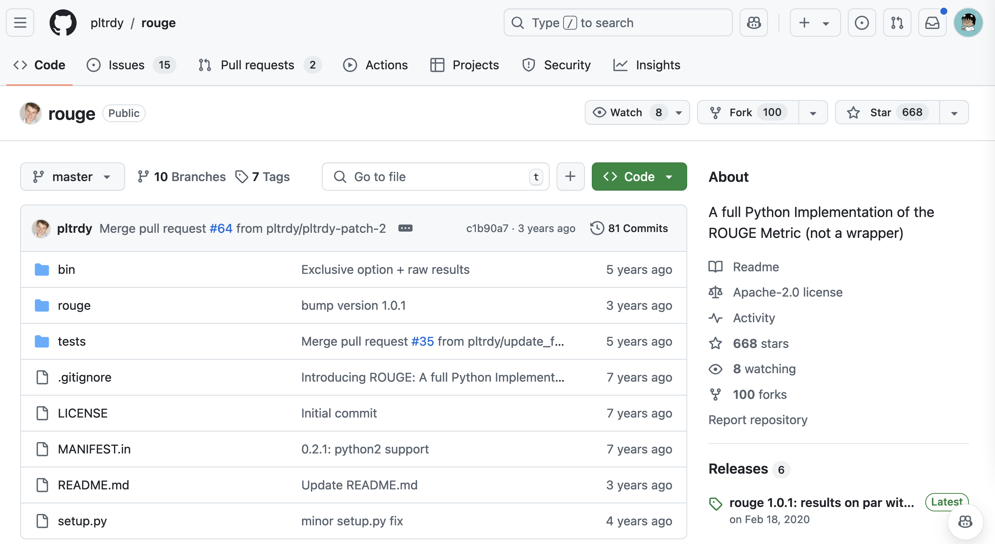
Set up Evaluation Metric
rouge_metric = Rouge()
https://github.com/pltrdy/rouge

Slide 35
Generating step-by-step
y₁
y₂
y₃
y₄
y₅
y₆
y₇
y₈
Casual Language Model
(E.g., GPT)
Language Model
_
y₁
y₂
y₃
y₄
y₅
y₆
y₇
Training time: update the model through hidden states
Test time: perform decoding for each step

Slide 36
Decoding strategies
Popular decoding strategies:
Greedy decoding
Beam search
Top-k sampling
Top-p sampling
https://huggingface.co/blog/how-to-generate

Slide 37
How to let a model generate step-by-step?
We can use model.generate()
There are two main advantages of model.generate():
We don’t need to write a decoding loop on our own.
We don’t need to implement decoding strategies by ourselves.
[Useful!!] https://huggingface.co/blog/how-to-generate

Slide 38
Pseudo code of a decoding loop
for step in range(max_length):
# Forward pass through the model
outputs = model.decoder(
input_ids=decoder_input_ids,
encoder_outputs=encoder_outputs
)
# Take the last hidden state's logits
logits = outputs.logits[-1] # shape: (vocab_size,)
# Apply softmax to get probabilities (optional, since argmax is invariant)
probs = softmax(logits)
# Select the token with the highest probability (greedy decoding)
next_token_id = argmax(probs)
# Append the predicted token to the decoder inputs
decoder_input_ids.append(next_token_id)
# If EOS token is generated, stop decoding
if next_token_id == EOS_TOKEN_ID:
break

Slide 39
Perform Evaluations
Input:
[CLS]
Source article
[SEP]
Expected output of model.generate():
[CLS]
Source article
[SEP]
Summary
<|endoftext|>
Gold:
Summary

Slide 40
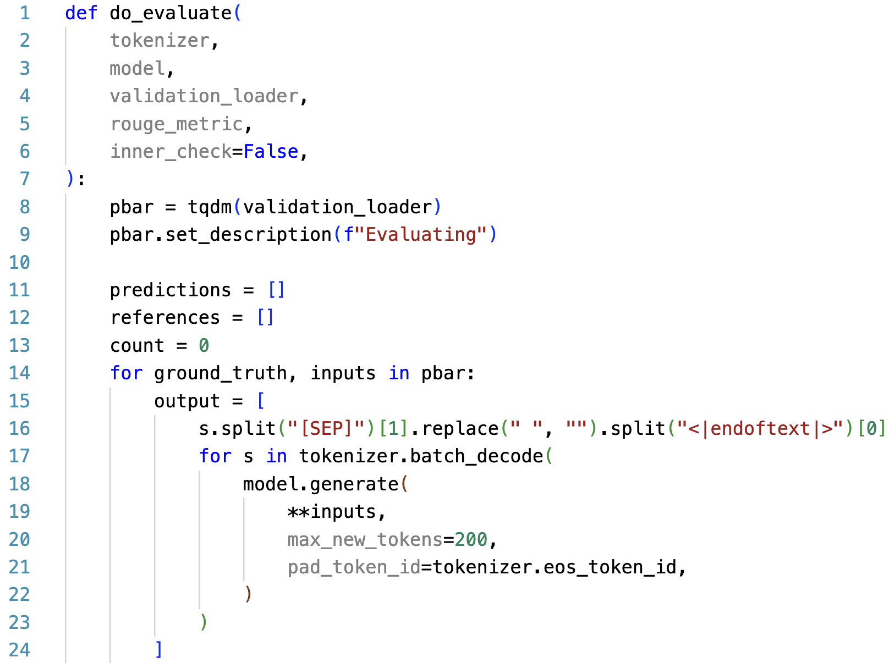
Perform Evaluations
Output Part
Expected output of model.generate():
[CLS]
Source article
[SEP]
Summary
<|endoftext|>

Slide 41
Decoding 後的處理 (接續上一頁)
output = [
s.split("[SEP]")[1].replace(" ", "").split("<|endoftext|>")[0]
for s in tokenizer.batch_decode(
model.generate(
**inputs,
max_new_tokens=200, # Maximum number of tokens to generate
pad_token_id=tokenizer.eos_token_id,
)
)
]
s: [CLS] 中國 足協 今 日 宣布 與 國際 足聯 達成 合作 協議 [SEP] 中國 足協 與 國際 簽署 協議 <|endoftext|>
s.split("[SEP]")[1]: 中國 足協 與 國際 足聯 簽署 協議 <|endoftext|>
.replace(" ", ""): 中國足協與國際足聯簽署協議<|endoftext|>
.split("<|endoftext|>")[0]:中國足協與國際足聯簽署協議

Slide 42
通常我們會設置 max_new_tokens
output = [
s.split("[SEP]")[1].replace(" ", "").split("<|endoftext|>")[0]
for s in tokenizer.batch_decode(
model.generate(
**inputs,
max_new_tokens=200, # Maximum number of tokens to generate
pad_token_id=tokenizer.eos_token_id,
)
)
]
如果你不設 max_new_tokens，那模型 outputs 就會受到 max_length 控制：
[CLS]
Source article
[SEP]
Summary
<|endoftext|>
連 inputs 的部分都算進去 max_length

Slide 43
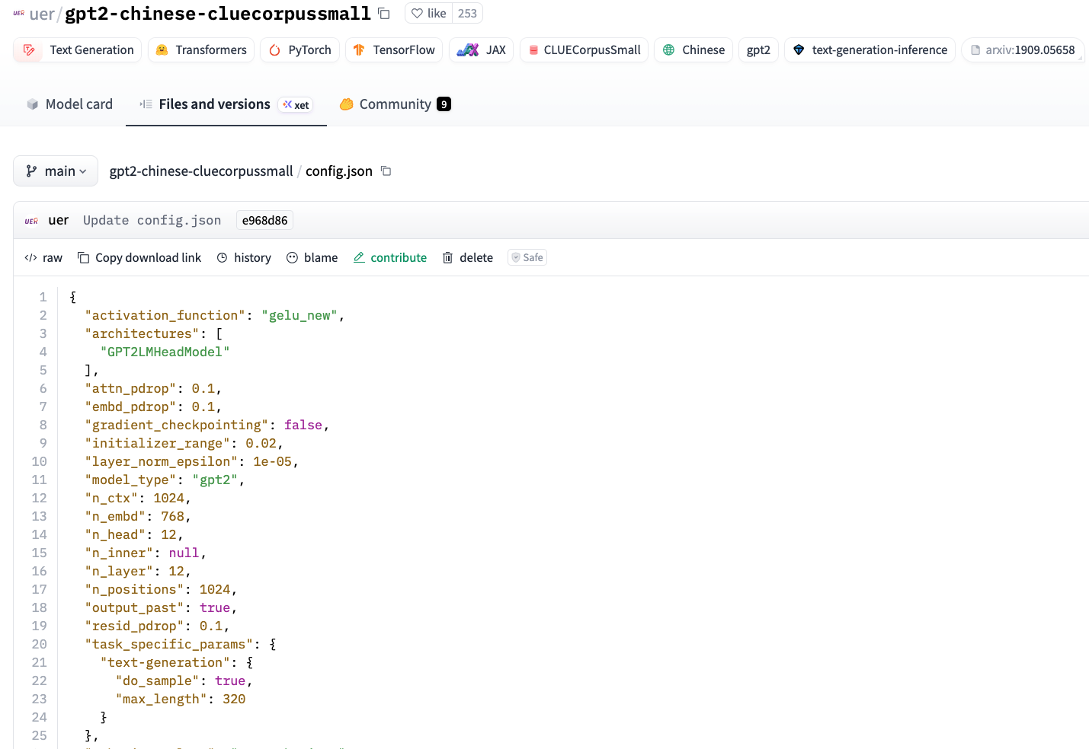
查看 model config 最簡單的方式
https://huggingface.co/uer/gpt2-chinese-cluecorpussmall/blob/main/config.json

Slide 44
在 batch 生成時要用 EOS 去替代 Padding
output = [
s.split("[SEP]")[1].replace(" ", "").split("<|endoftext|>")[0]
for s in tokenizer.batch_decode(
model.generate(
**inputs,
max_new_tokens=200, # Maximum number of tokens to generate
pad_token_id=tokenizer.eos_token_id,
)
)
]
原因：GPT-2 沒有 [PAD] token!
假設一個 batch 在生成時：
Sent1: 中國 足球 協會 今天 ... <|endoftext|>
Sent2: 美國 <|endoftext|> <|endoftext|> <|endoftext|> <|endoftext|> <|endoftext|>

Slide 45
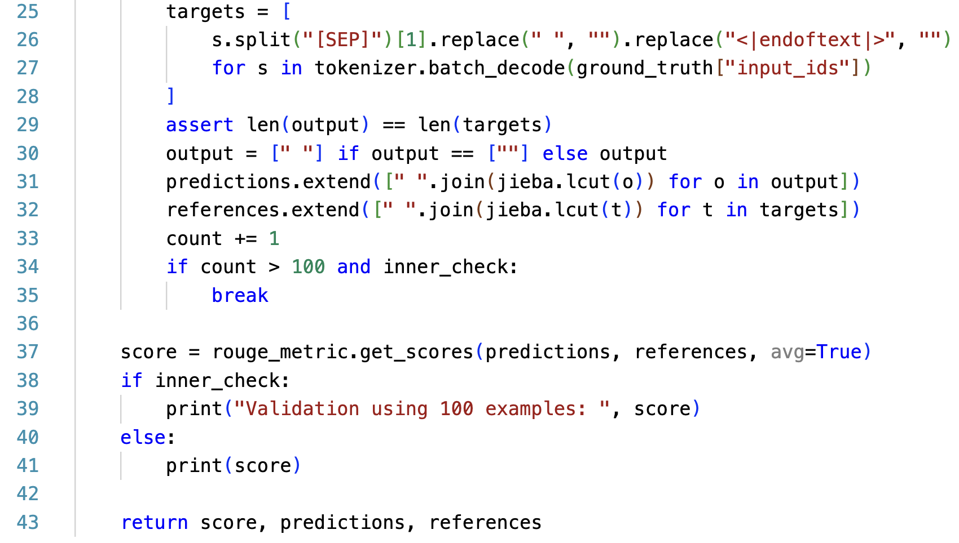
do_evaluate 的 targets
同「Decoding後的處理」那頁
ground_truth (對應 collate_fn 的 complete_text):
[CLS]
Source article
[SEP]
Summary
<|endoftext|>

Slide 46
do_evaluate 的 predictions
outputs 和 targets 現在都是文字
使用結巴斷詞後，才會計算 ROUGE (正確答案和預測的重疊率)

Slide 47
do_evaluate 的 score
avg=True: perform averaging for all the tested instances

Slide 48
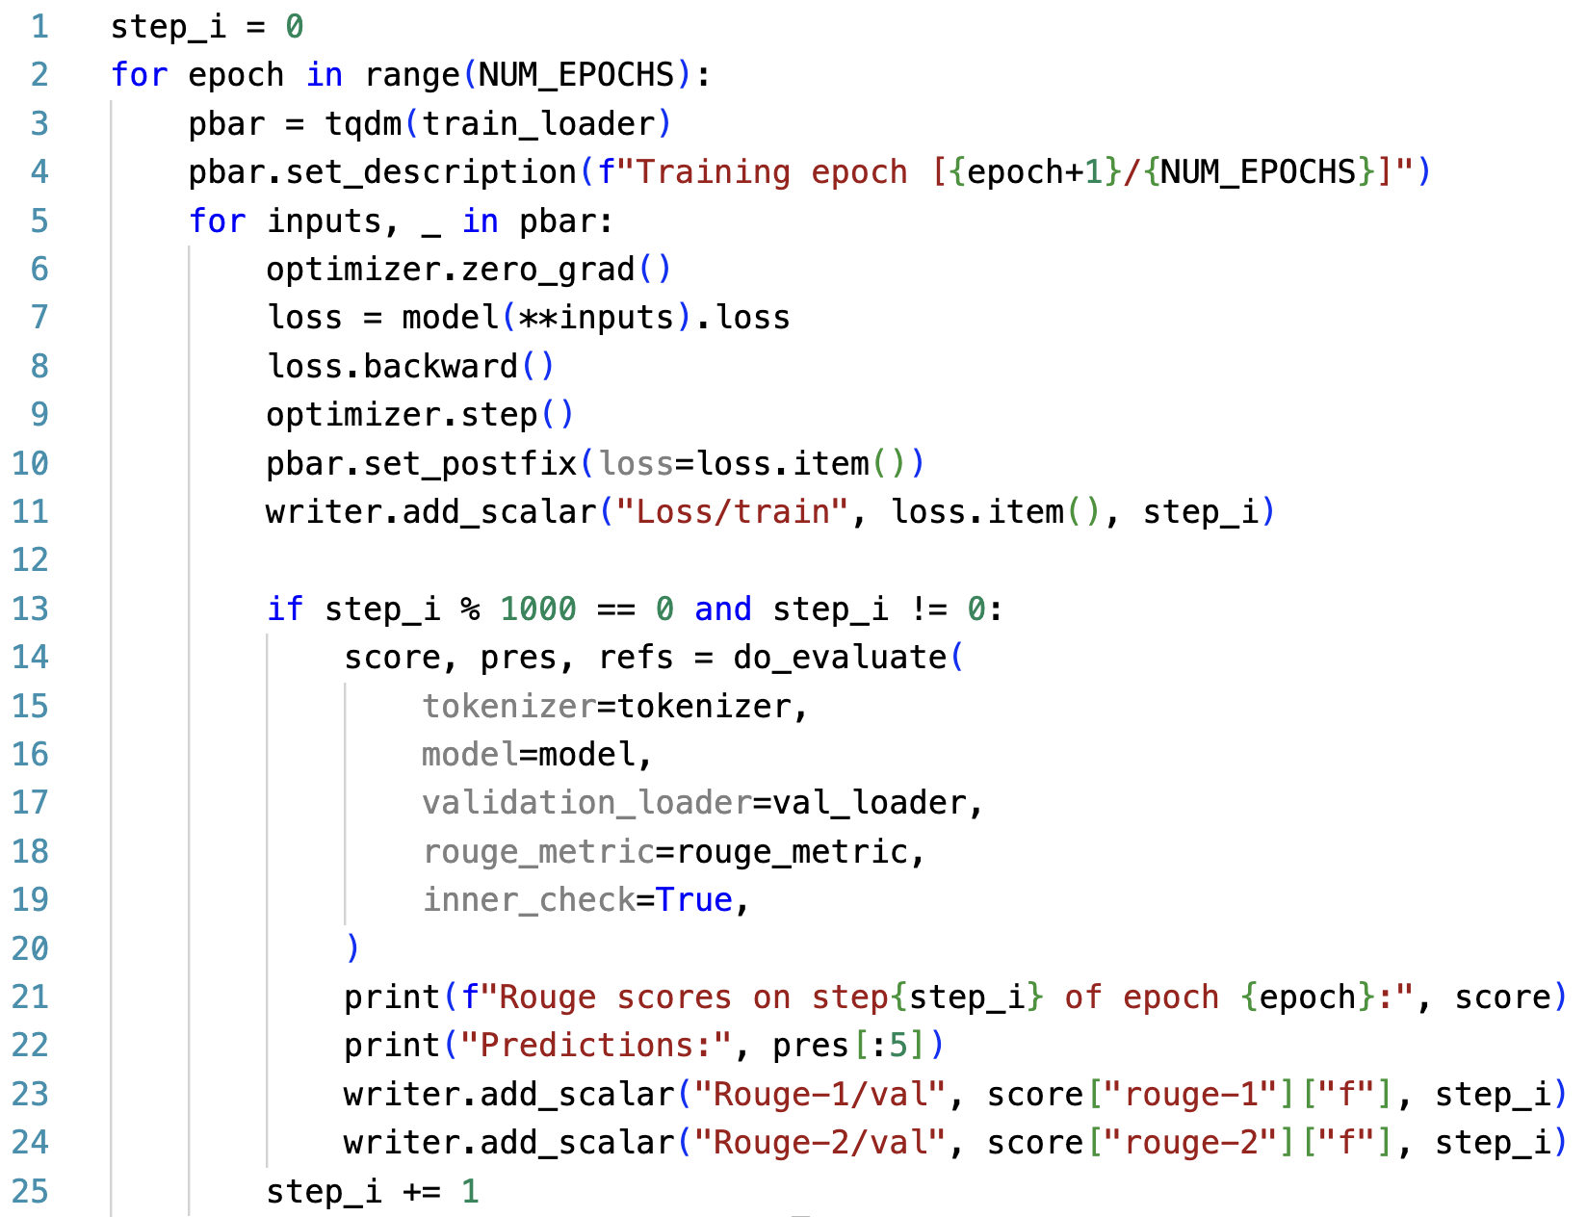
完整的 Training Loop

Slide 49
Let’s try it
1. 看一下你自己的 Wandb

Slide 50
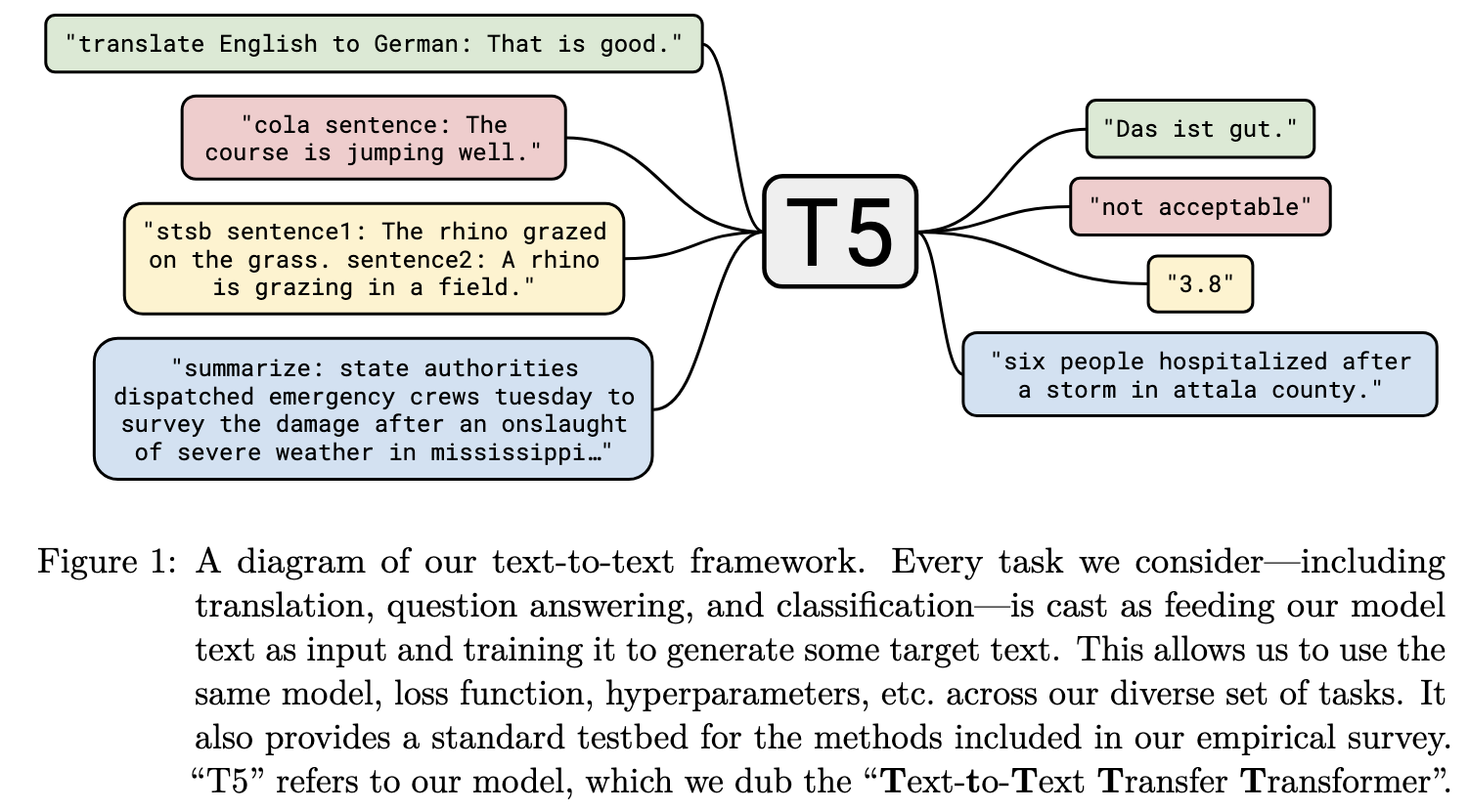
T5 ^{[4]}
[4] Raffel, Colin, et al. "Exploring the limits of transfer learning with a unified text-to-text transformer." Journal of machine learning research 21.140 (2020): 1-67.

Slide 51
Language Model vs. Seq2seq Model
y₂
y₃
y₄
y₅
y₆
y₇
y₈
Casual Language Model
(E.g., GPT)
Language Model
y₁
y₂
y₃
y₄
y₅
y₆
y₇
(Target output)
y₁
y₂
y₃
y₄
y₅
y₆
y₇
y₈
Sequence to sequence Model
(E.g., T5; Vanilla Transformers)
Encoder
Decoder
Attention
x₁
x₂
x₃
x₄
x₅
x₆
x₇
x₈
_
y₁
y₂
y₃
y₄
y₅
y₆
y₇
(Source input)
(Start)

Slide 52
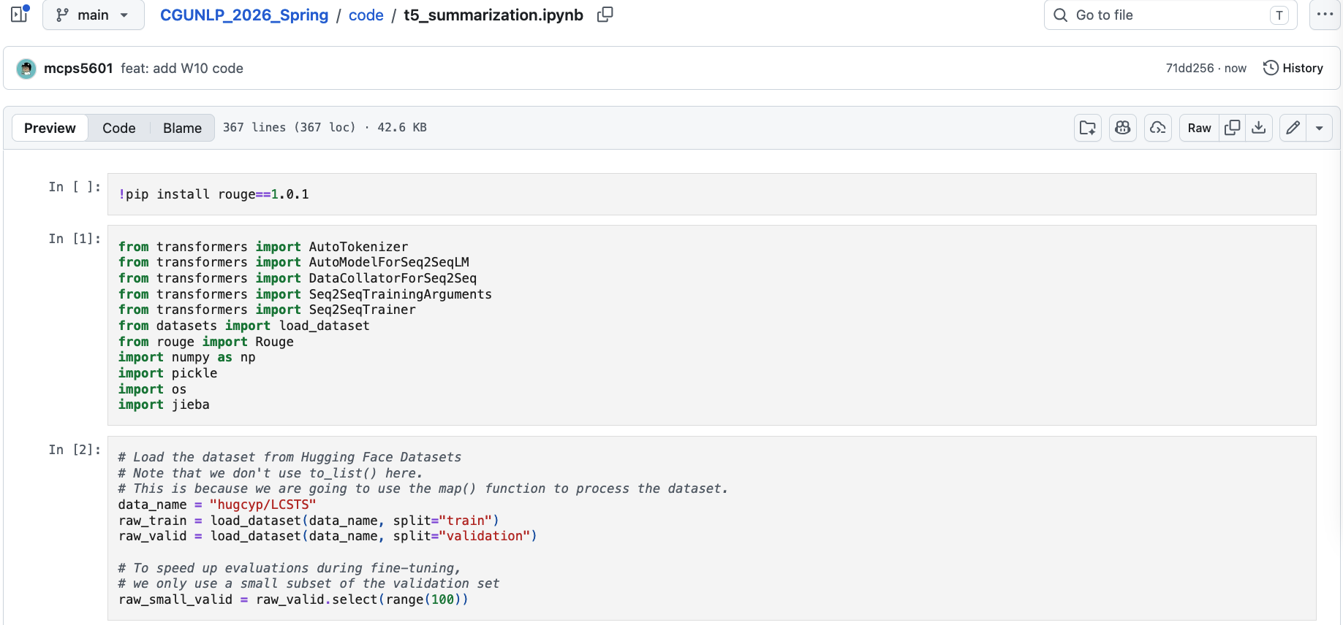
See `code/t5_summarization.ipynb`

Slide 53
Thank you!
Instructor: 林英嘉
✉️ yjlin@cgu.edu.tw
TA: 林宣辰
✉️ b1128015@cgu.edu.tw

