Slide 1

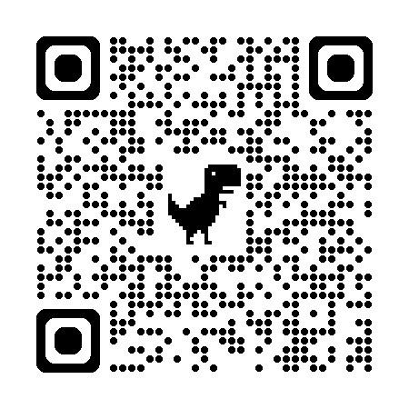
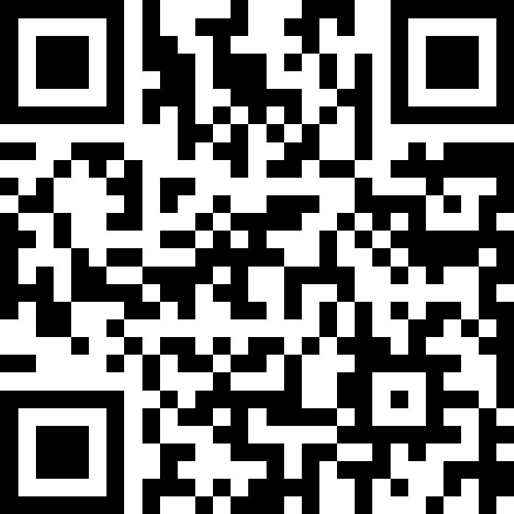
自然語言處理與應用 Natural Language Processing and Applications
Decoder-based Models
Slido
# NLP0413 (Link)
GitHub
Instructor: 林英嘉 (Ying-Jia Lin)
2026/04/13

Slide 2
Outline
GPT and language modeling
Decoding strategies
Greedy Decoding
Beam Search
Top-k Sampling
Top-p Sampling

Slide 3
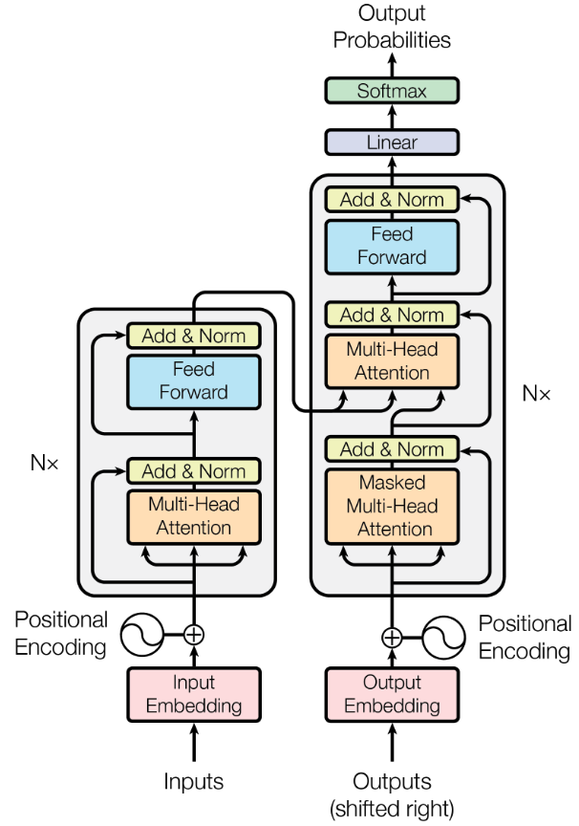

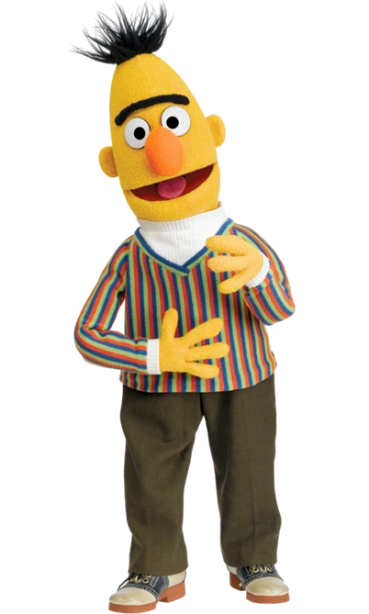
Transformer 架構的後續應用
Generative Pre-training (GPT) series 是 Transformer Decoder
BERT (Bidirectional encoder representations from transformers) 是 Transformer Encoder
Devlin et al., 2018
N=12
(GPT)
Encoder
(BERT)

Slide 4
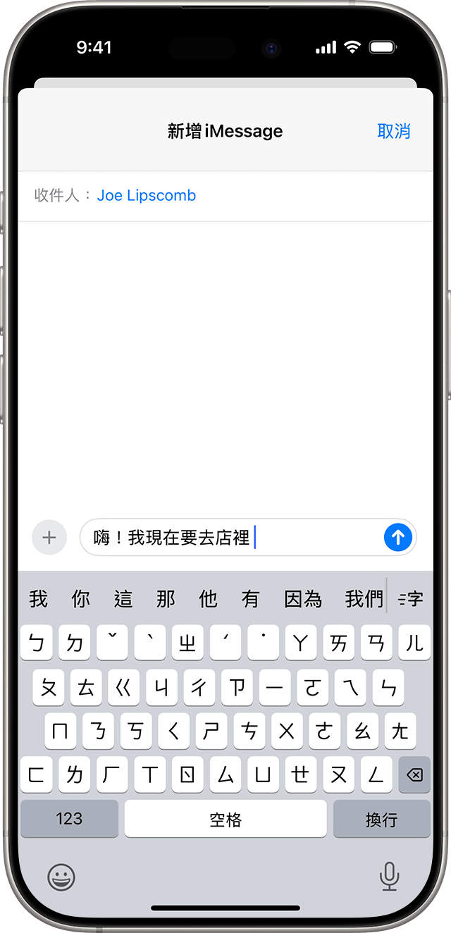
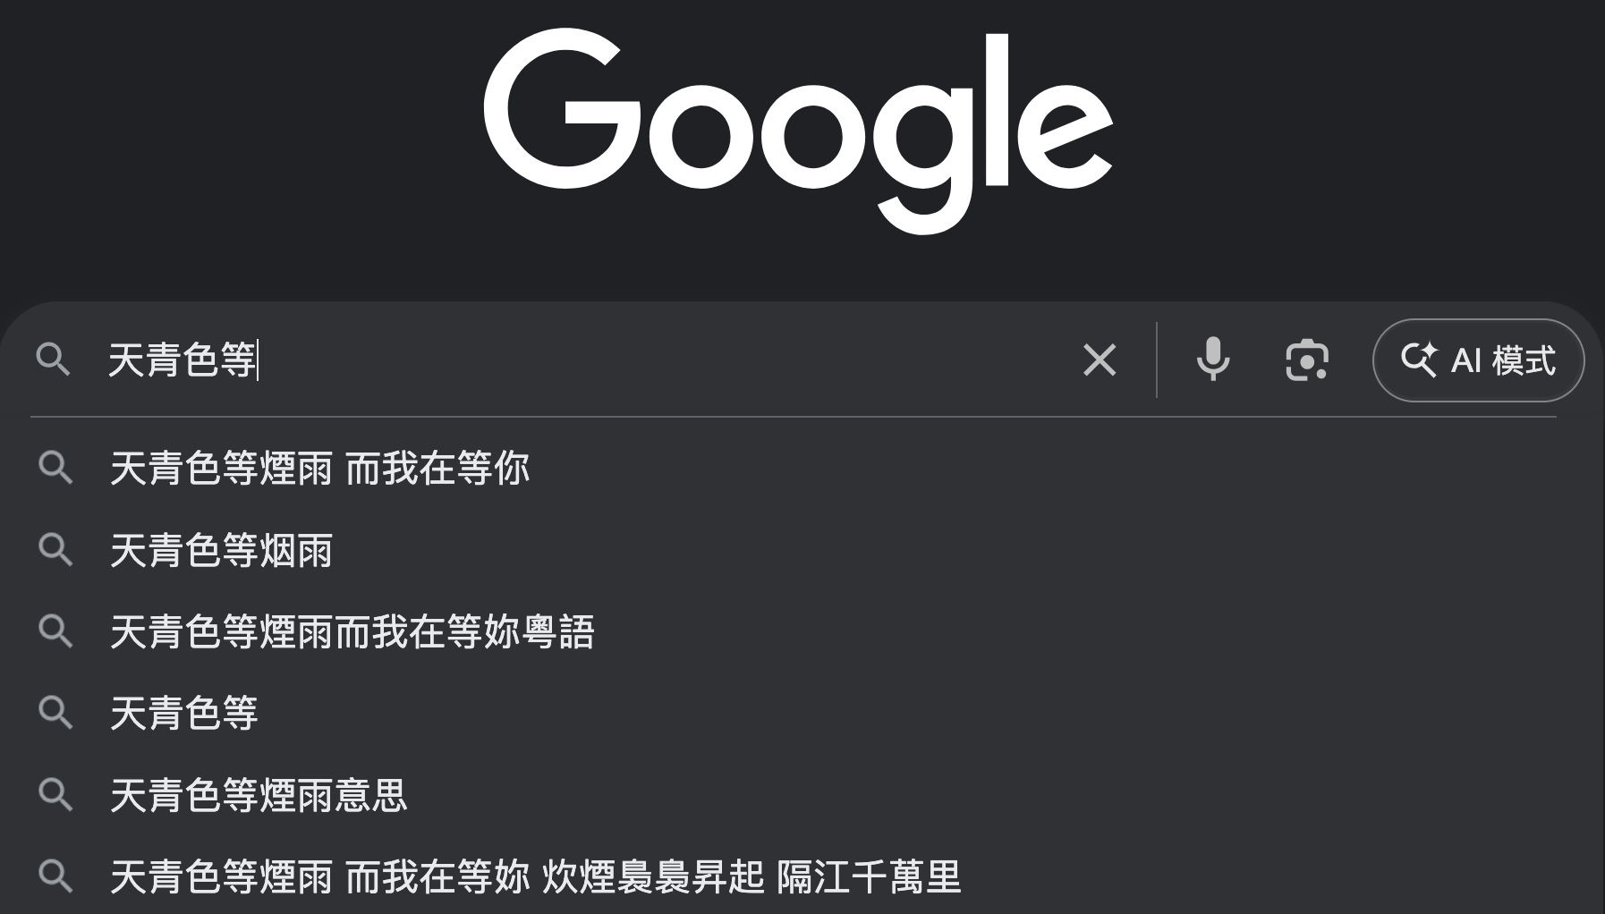
GPT 是一個語言模型
https://developers.google.com/machine-learning/resources/intro-llms
語言模型定義：語言模型 (Language Model) 是一個能預測並生成語言的機器學習模型
(例子) 下一個字預測 ➡️
Figure source: https://support.apple.com/zh-tw/104995

Slide 5
[RNN Recap] 條件機率
假設要讓模型生成一個句子：「天氣真好」
天
氣
真
好
RNN
RNN
RNN
RNN
開始字詞 (BOS)
天
氣
真
P(天|BOS)
P(氣|BOS、天)
P(真|BOS、天、氣)
P(好|BOS、天、氣、真)

Slide 6
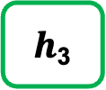
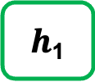
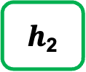
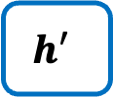
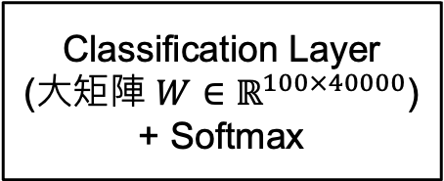
[Recap] 文字生成過程
假設 Hidden size 為 100；字典大小（vocab_size）為 40000
字典裡面的字
機率值
(長度為100的向量)
(長度為100的向量)
(長度為100的向量)
Classification Layer
(大矩陣 $W∈ℝ^{100×40000}$)
+ Softmax
a
...
apple
...
b
...
banana
...
elephant
...
eraser
...
...
zoo
0.0001
...
0.600
...
0.0001
...
0.0003
...
0.300
...
0.05
...
...
0.0001
$h$₁
$h$₂
$h$₃
RNN
RNN
RNN
$$h′$$
Vocab
size
(長度為40000的向量)
I
love
an

Slide 7
常見 Language Models
💡Language Models: 透過 Language Modeling 去預測詞彙機率分佈的模型
RNN
Transformer
GPT-series

Slide 8
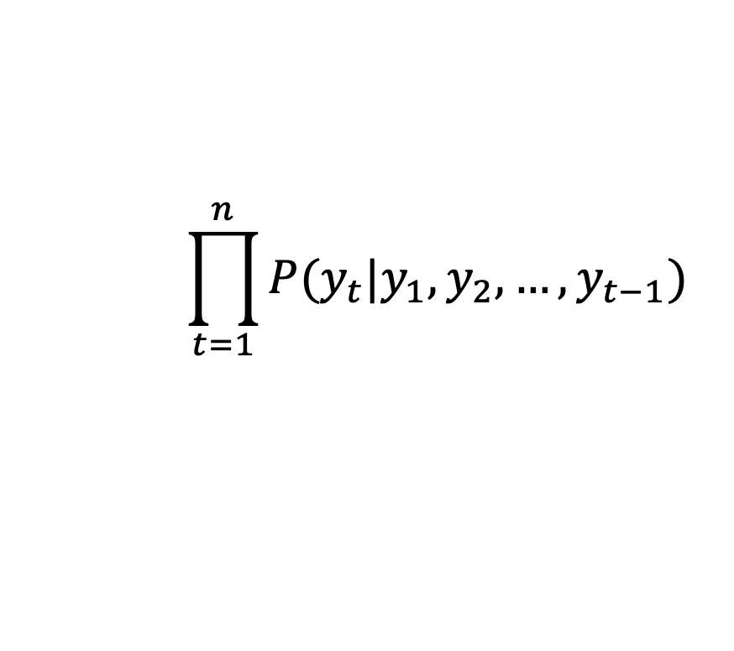




訓練 GPT 最大化每個時間點的機率
$$P(y_{2}| y_{1})$$
$$P\left(y_{3}\right|y_{1},y_{2})$$
$$⋅⋅⋅$$
$$P\left(y_{8}\right|y_{1},y_{2},y_{3},y_{4},y_{5},y_{6},y_{7})$$
y₂
y₃
y₄
y₅
y₆
y₇
y₈
目標函數：
Language Model
$$\prod_{t=1}^{n}{P(y_{t}|y_{1},y_{2},…,y_{t−1})}$$
Language Modeling
y₁
y₂
y₃
y₄
y₅
y₆
y₇
Self-attention 不可及的範圍

Slide 9
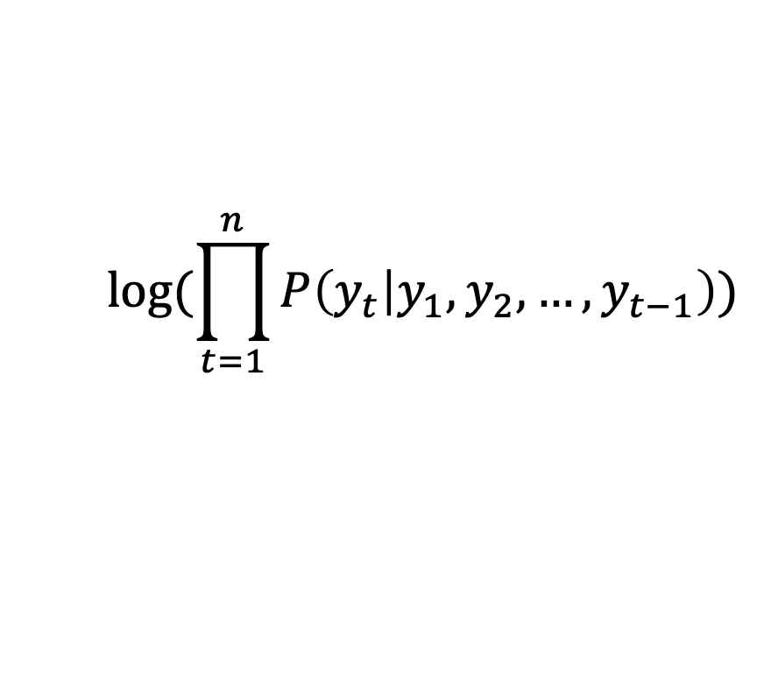
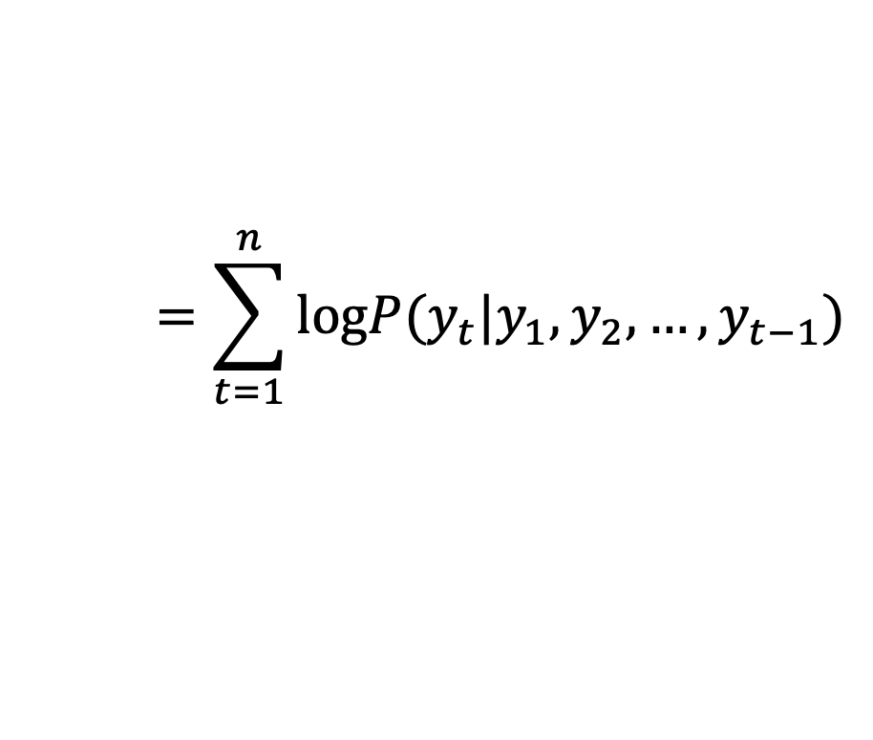
Language Modeling and Cross-entropy
整句機率是很多條件機率一路相乘 (隨著t增加結果接近 0)，因此通常會取log：
$$log⁡(\prod_{t=1}^{n}{P\left(y_{t} | y_{1},y_{2},…,y_{t−1}\right)})$$
$$=\sum_{t=1}^{n}{logP(y_{t}|y_{1},y_{2},…,y_{t−1})}$$
越大越好
加上負號之後就是 Cross-entropy
(loss 越小越好)

Slide 10





[Recap] RNN 以文字接龍進行訓練
EOS: End of Sentence
$$P(EOS|\text{庭}, 院,深,深,深,幾, 許)$$
$$P(院|\text{庭})$$
$$P(深|\text{庭}, 院)$$
$$P(深|\text{庭}, 院,深)$$
$$P(許|\text{庭}, 院,深,深,深,幾)$$
院
深
深
許
EOS
h₀
h₁
h₂
h₃
...
h₆
h₇
...
庭
院
深
幾
許
log(
)
目標函數： $P(院|\text{庭})×P(深|\text{庭}, 院)×P(深|\text{庭}, 院,深)×$... $×P(EOS|\text{庭}, 院,深,深,深,幾, 許)$
Notes:
p連乘之後會變得很小
加上log可以轉為連加，避免連乘
log是單調遞增函數
加了log不會使數值方向改變

Slide 11
Language Modeling 對每個 token 都做分類
Language modeling 在 t 時間點的正確答案是 t+1 的字詞
Token
Logits
取 Softmax 後之機率
正確答案
CGU
I
love
hate
like
0.0011
0.0012
0.0013
0.0014
0.0015
0.78
0.11
0.03
0.02
0.06
1
0
0
0
0
I love CGU
Example
Vocab
(假設只有5個字)
t
t+1
Cross-entropy

Slide 12









Language Models 終究是 left-to-right
y₁
y₂
y₃
y₄
y₅
y₆
y₇
y₈
(2018年的Google) GPT-1 不好，因為訓練無雙向，BERT 最棒
越接近越好
$${\hat{y}}_{1}$$
$${\hat{y}}_{2}$$
$${\hat{y}}_{3}$$
$${\hat{y}}_{4}$$
$${\hat{y}}_{5}$$
$${\hat{y}}_{6}$$
$${\hat{y}}_{7}$$
$${\hat{y}}_{8}$$
Decoder
_
y₁
y₂
y₃
y₄
y₅
y₆
y₇
(Start)

Slide 13
Encoder vs. Decoder in Pre-training
 | Encoder (e.g., BERT) | Decoder (e.g., GPT)
Pre-training 方式 | 克漏字 | 文字接龍
Pre-training 目標 | 透過預測被遮住的字來讓模型熟悉字跟字之間的關係 | 透過根據上下文預測下一個字來讓模型熟悉字跟字之間的關係
Pre-training data 使用效率 | 較低 (可能存在 tokens 沒有被 masked 過) | 較高

Slide 14
GPT-1 與 BERT 的 Fine-tuning
以 Classification 為例
維度意義：
(batch_size, sequence_length, hidden_size)
class
B x 1 x C
Linear
class
Linear
B x 1 x H
B x 1 x H
BERT
(Transformer Encoder)
Transformer Decoder
[CLS]
open
a
POST
account
[SEP]
y₁
y₂
y₃
y₄
y₅
y₆
y₇
這
火
鍋
真
是
好
吃

Slide 15
訓練語言 模型的方式

Slide 16
How to train a (Conditional) Language Model?
First, we need a training corpus.
Example: I love reading books.
Language modeling (Unsupervised)
Machine Translation (Supervised)
I
love
I
love
reading
books
English
I
love
reading
我
愛
閱
讀
Chinese
I
love
reading
books

Slide 17













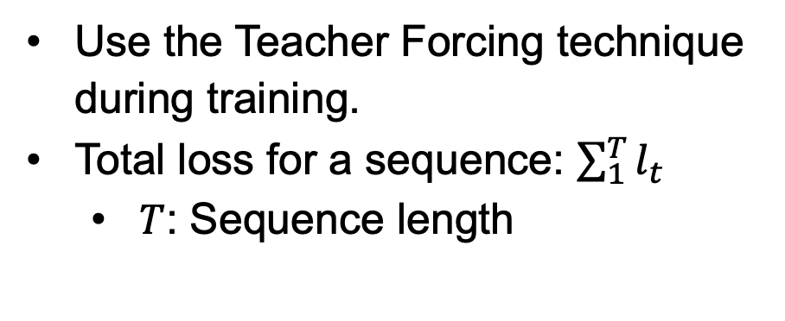




Teacher Forcing – Training Time
Use the Teacher Forcing technique during training.
Total loss for a sequence: $\sum_{1}^{T}{l_{t}}$
$T$: Sequence length
Teacher Forcing
y₁
y₂
y₃
y₄
y₅
y₆
y₇
y₈
$$l_{1}$$
$$l_{2}$$
$$l_{3}$$
$$l_{4}$$
$$l_{5}$$
$$l_{6}$$
$$l_{7}$$
$$l_{8}$$
Cross-
entropy
$${\hat{y}}_{1}$$
$${\hat{y}}_{2}$$
$${\hat{y}}_{3}$$
$${\hat{y}}_{4}$$
$${\hat{y}}_{5}$$
$${\hat{y}}_{6}$$
$${\hat{y}}_{7}$$
$${\hat{y}}_{8}$$
Encoder
Decoder
Attention
x₁
x₂
x₃
x₄
x₅
x₆
x₇
x₈
_
y₁
y₂
y₃
y₄
y₅
y₆
y₇
(Start)
注意！下一個時間點不是丟 $\hat{y}$

Slide 18


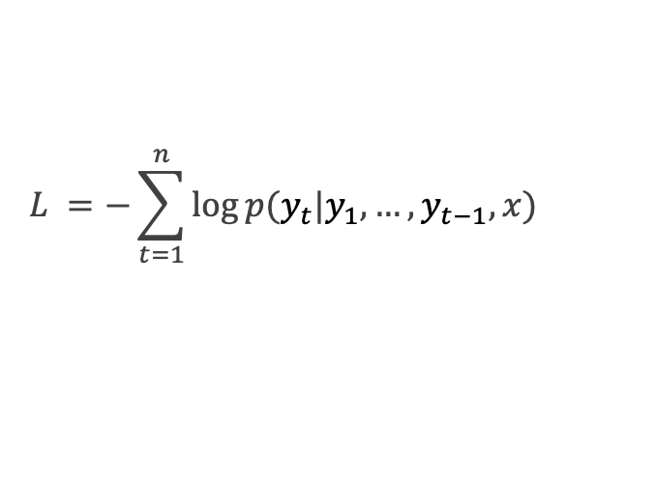









Teacher Forcing – Training Time
$$L =−\sum_{t=1}^{n}{\log{p(y_{t}|y_{1},…,y_{t−1},x)}}$$
During training:
$${\hat{y}}_{1}$$
$${\hat{y}}_{2}$$
……
$${\hat{y}}_{t−1}$$
$${\hat{y}}_{t}$$
Decoder
……
$$y_{1}$$
$$y2$$
$$y_{t−1}$$
$$y_{t}$$
Ground truth sequence
_
$$y_{1}$$
……
$$y_{t−2}$$
$$y_{t−1}$$
(Start)
Notes:
During training, decoder output y hat at each decoding time step
With the ground truth input the produce the output token

Slide 19







Teacher Forcing – Testing Time
During testing:
Output sequence
Advantage: stabilize training and increase performance
Question: How does the next word be determined?
$${\hat{y}}_{1}$$
$${\hat{y}}_{2}$$
……
$${\hat{y}}_{t−1}$$
$${\hat{y}}_{t}$$
Decoder
_
$${\hat{y}}_{1}$$
……
$${\hat{y}}_{t−2}$$
$${\hat{y}}_{t−1}$$
(Start)
Notes:
However, during testing, the output y hat at each time step will be directly feed to the next time step as input

Slide 20
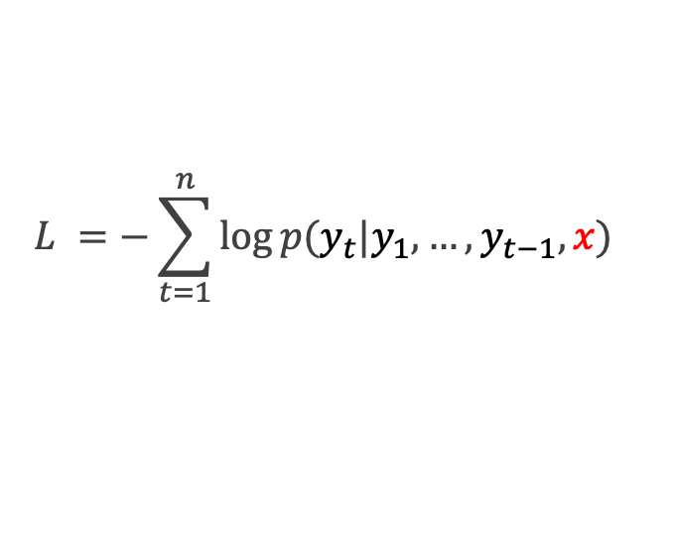
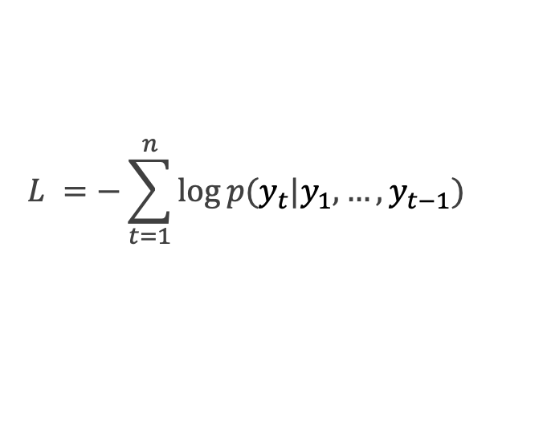
Language Modeling Objectives 小整理
Conditional Language Modeling (有 Encoder, $x$ 代表來源端, 例如：原始 Transformer)
$$L =−\sum_{t=1}^{n}{\log{p(y_{t}|y_{1},…,y_{t−1},x)}}$$
(Autoregressive) Language Modeling (只有 Decoder, 例如：GPT, Llama 等大型語言模型)
$$L =−\sum_{t=1}^{n}{\log{p(y_{t}|y_{1},…,y_{t−1})}}$$
Notes:
自迴歸：用自己過去的值來預測自己未來的值

Slide 21
Decoding Strategies 4/27 見！
Greedy Decoding
Beam Search
Top-k Sampling
Top-p Sampling

Slide 22





Greedy Decoding
Example: I love reading books.
Output sequence
我
愛
閱
$$讀$$
argmax
argmax
argmax
argmax
$$h_{1}$$
$$h_{2}$$
$$h_{3}$$
$$h_{4}$$
Decoder
_
我
愛
閱
(Start)

Slide 23
文字生成過程 – Greedy Decoding
假設 Hidden size 為 100；字典大小（vocab_size）為 40000
字典裡面的字
機率值
(長度為100的向量)
(長度為100的向量)
(長度為100的向量)
Classification Layer
(大矩陣 $W∈ℝ^{100×40000}$)
+ Softmax
a
...
apple
...
b
...
banana
...
elephant
...
eraser
...
...
zoo
0.0001
...
0.600
...
0.0001
...
0.0003
...
0.300
...
0.05
...
...
0.0001
$h$₁
$h$₂
$h$₃
RNN
RNN
RNN
$$h′$$
Vocab
size
(長度為40000的向量)
I
love
an

Slide 24




Problem of Greedy Decoding
Greedy decoding cannot undo!
Ground-truth: 我愛閱讀
Decoding Process
我
我
愛
我
愛
打
Mistake occurs
我
愛
打
球
More mistake occur
$$t=1$$
$$t=2$$
$$t=3$$
$$t=4$$

Slide 25
Re-thinking Greedy Decoding
Greedy decoding cannot undo!
Greedy decoding only provides one best choice at each time step.
How about providing more than one choices at each time step?
Beam Search

Slide 26
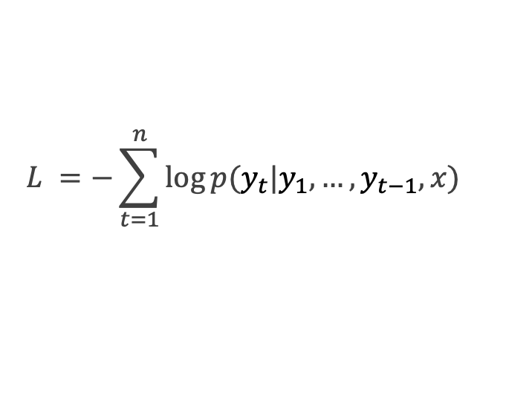
Beam Search
我們假設 `Beam size` (or `Beam width`) = 2
This means that the number of candidates will be preserved at each decoding time.
Beam size is a hyperparameter for beam search decoding.
At each decoding time step, a score is calculated via the following equation:
$$L =−\sum_{t=1}^{n}{\log{p(y_{t}|y_{1},…,y_{t−1},x)}}$$
*代表 (強調) 當前時間點生成機率最大的選項

Slide 27

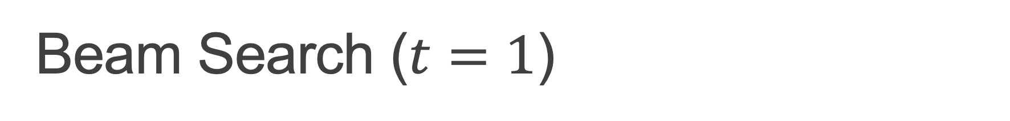

Beam Search ($t=1$)
`Beam size` = 2
$$\log{p\left( \text{I} \right| \text{Start} )=}−0.7$$
I
At this decoding step, two choices are preserved.
_
(Start)
You
$$\log{p\left(\text{You}\right| \text{Start} )=}−0.9$$

Slide 28


Beam Search ($t=1$)
`Beam size` = 2
$$−0.7$$
I
At this decoding step, two choices are preserved.
_
(Start)
You
$$−0.9$$

Slide 29


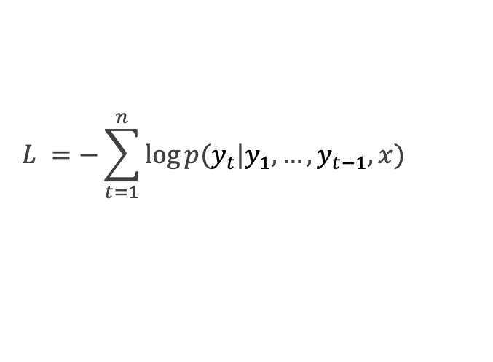



Beam Search ($t=2$)
`Beam size` = 2
$$L =−\sum_{t=1}^{n}{\log{p(y_{t}|y_{1},…,y_{t−1},x)}}$$
$$−0.7+\log{p\left( \text{like} \right| \text{Start}\text{, }\text{I})=}−1.7$$
$$−0.7$$
like
Note the loglikelihood! Being close to zero is better!
I
At this decoding step, two choices are preserved, and the other two are discarded.
want
_
$$−0.7+\log{p\left( \text{want} \right| \text{Start}\text{, }\text{I})=}−2.9$$
$$−0.9+\log{p\left( \text{want} \right| \text{Start}\text{, }\text{You})=}−1.6$$
(Start)
want
You
are
$$−0.9$$
$$−0.9+\log{p\left( \text{are} \right| \text{Start}\text{,}\text{You})=}−1.8$$

Slide 30




Beam Search ($t=2$)
`Beam size` = 2
$$−1.7$$
$$−0.7$$
like
I
want
_
$$−2.9$$
(Start)
$$−1.6$$
want
You
are
$$−0.9$$
$$−1.8$$

Slide 31
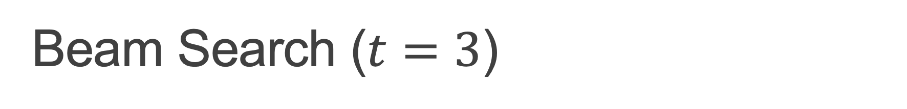



Beam Search ($t=3$)
`Beam size` = 2
$$−1.7$$
to
$$−1.7+\log{p\left( \text{to} \right| \text{Start}\text{, }\text{I}\text{, }\text{like})=}−2.8$$
$$−0.7$$
like
I
books
$$−1.7+\log{p\left( \text{books} \right| \text{Start}\text{, }\text{I}\text{, }\text{like})=}−2.5$$
want
_
$$−2.9$$
$$−1.6$$
to
$$−1.6+\log{p\left( \text{to} \right| \text{Start}\text{,} \text{You}\text{, }\text{want})=}−2.9$$
(Start)
want
You
tea
$$−1.7+\log{p\left( \text{tea} \right| \text{Start}\text{, }\text{You}\text{, }\text{want})=}−3.8$$
are
$$−0.9$$
$$−1.8$$

Slide 32
Beam Search ($t=3$)
`Beam size` = 2
$$−1.7$$
to
$$−1.7+\log{p\left( \text{to} \right| \text{Start}\text{, }\text{I}\text{, }\text{like})=}−2.8$$
$$−0.7$$
like
I
books
$$−1.7+\log{p\left( \text{books} \right| \text{Start}\text{, }\text{I}\text{, }\text{like})=}−2.5$$
want
_
$$−2.9$$
$$−1.6$$
to
$$−1.6+\log{p\left( \text{to} \right| \text{Start}\text{,}\text{You}\text{, }\text{want})=}−2.9$$
(Start)
want
You
tea
$$−1.7+\log{p\left( \text{tea} \right| \text{Start}\text{, }\text{You}\text{, }\text{want})=}−3.8$$
are
$$−0.9$$
$$−1.8$$

Slide 33






Beam Search ($t=3$)
`Beam size` = 2
$$−2.8$$
$$−1.7$$
to
$$−0.7$$
like
I
books
want
$$−2.5$$
_
$$−2.9$$
$$−2.9$$
$$−1.6$$
to
(Start)
want
You
tea
are
$$−0.9$$
$$−3.8$$
$$−1.8$$

Slide 34

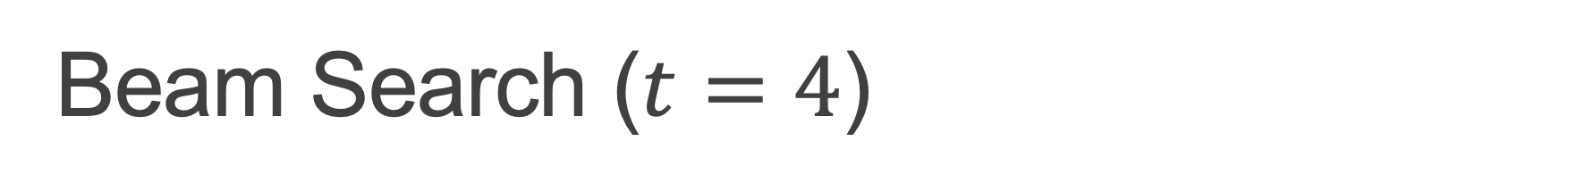



Beam Search ($t=4$)
`Beam size` = 2
$$−4.1$$
$$−2.8$$
read
$$−1.7$$
to
$$−0.7$$
like
watch
I
books
$$−3.2$$
want
$$−2.5$$
$$−3.3$$
and
_
$$−2.9$$
$$−2.9$$
$$−1.6$$
to
(Start)
party
want
You
tea
$$−3.5$$
are
$$−0.9$$
$$−3.8$$
$$−1.8$$

Slide 35
Beam Search ($t=4$)
`Beam size` = 2
$$−4.1$$
$$−2.8$$
read
$$−1.7$$
to
$$−0.7$$
like
watch
I
books
$$−3.2$$
want
$$−2.5$$
$$−3.3$$
and
_
$$−2.9$$
$$−2.9$$
$$−1.6$$
to
(Start)
party
want
You
tea
$$−3.5$$
are
$$−0.9$$
$$−3.8$$
$$−1.8$$

Slide 36

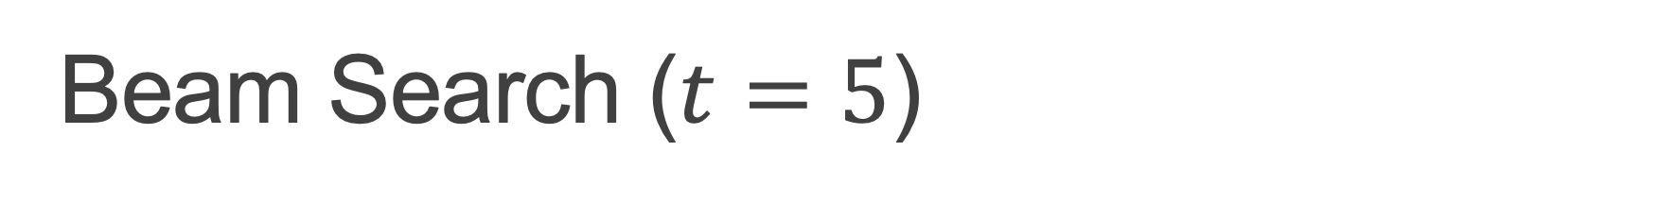



Beam Search ($t=5$)
`Beam size` = 2
$$−4.1$$
$$−4.8$$
$$−2.8$$
read
tv
$$−1.7$$
to
$$−0.7$$
like
watch
horror
I
books
$$−3.2$$
$$−3.7$$
want
$$−2.5$$
$$−3.3$$
$$−4.5$$
and
write
_
$$−2.9$$
$$−2.9$$
$$−1.6$$
to
(Start)
party
horror
want
You
tea
$$−3.5$$
$$−4.3$$
are
$$−0.9$$
$$−3.8$$
$$−1.8$$

Slide 37
Beam Search ($t=5$)
`Beam size` = 2
$$−4.1$$
$$−4.8$$
$$−2.8$$
read
tv
$$−1.7$$
to
$$−0.7$$
like
watch
horror
I
books
$$−3.2$$
$$−3.7$$
want
$$−2.5$$
$$−3.3$$
$$−4.5$$
and
write
_
$$−2.9$$
$$−2.9$$
$$−1.6$$
to
(Start)
party
horror
want
You
tea
$$−3.5$$
$$−4.3$$
are
$$−0.9$$
$$−3.8$$
$$−1.8$$

Slide 38





Beam Search ($t=6$)
`Beam size` = 2
$$−4.1$$
$$−4.8$$
$$−2.8$$
read
tv
$$−5.1$$
$$−1.7$$
to
things
$$−0.7$$
like
watch
horror
I
books
$$−3.2$$
$$−3.7$$
movies
want
$$−2.5$$
$$−3.3$$
$$−4.5$$
$$−4.6$$
and
write
$$−5.0$$
_
$$−2.9$$
$$−2.9$$
games
$$−1.6$$
to
(Start)
party
horror
want
$$−3.5$$
$$−4.3$$
movies
You
tea
are
$$−5.3$$
$$−0.9$$
$$−3.8$$
$$−1.8$$

Slide 39
Beam Search ($t=6$)
`Beam size` = 2
$$−4.1$$
$$−4.8$$
$$−2.8$$
read
tv
$$−5.1$$
$$−1.7$$
to
things
$$−0.7$$
like
watch
horror
I
books
$$−3.2$$
$$−3.7$$
movies
want
$$−2.5$$
$$−3.3$$
$$−4.5$$
$$−4.6$$
and
write
$$−5.0$$
_
$$−2.9$$
$$−2.9$$
games
$$−1.6$$
to
(Start)
party
horror
want
$$−3.5$$
$$−4.3$$
movies
You
tea
are
$$−5.3$$
$$−0.9$$
$$−3.8$$
$$−1.8$$

Slide 40
Stop Criterion (停止生成的情況)
有兩種常見的停止條件 (適用於所有 decoding strategies):
We consider a sequence of generation complete when the <EOS> token is produced by a model. *<EOS>: End of sequence
範例：<Start> I like to watch horror movies <EOS>
A generated sequence reaches a pre-defined maximal length.

Slide 41
Problem of Beam Search (1)
Longer candidates will have lower scores.
(Let’s see again the 6th time step)

Slide 42


Beam Search ($t=6$)
`Beam size` = 2
$$−4.1$$
$$−4.8$$
$$−2.8$$
read
tv
$$−5.1$$
$$−1.7$$
to
things
$$−0.7$$
like
watch
horror
I
books
$$−3.2$$
$$−3.7$$
movies
want
$$−2.5$$
$$−3.3$$
$$−4.5$$
$$−4.6$$
and
write
$$−5.0$$
_
$$−2.9$$
$$−2.9$$
games
$$−1.6$$
to
(Start)
party
horror
want
$$−3.5$$
$$−4.3$$
movies
You
tea
are
$$−5.3$$
$$−0.9$$
$$−3.8$$
$$−1.8$$

Slide 43
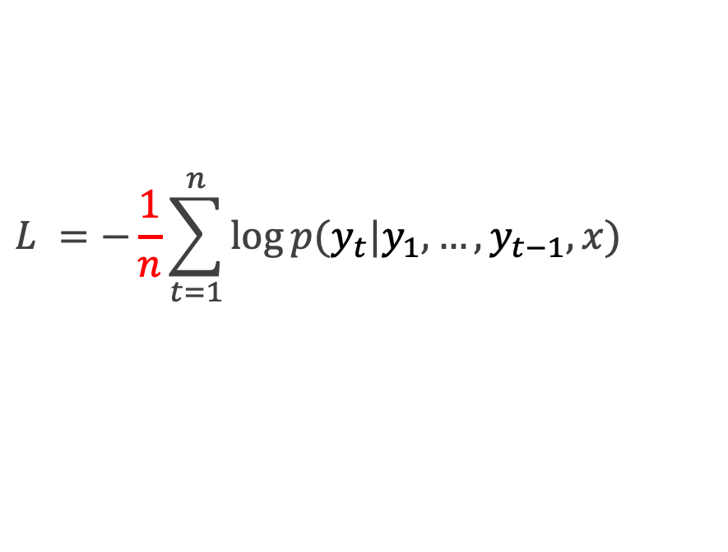
Problem of Beam Search (1)
Longer candidates will have lower scores.
Solution: Perform normalization to penalize on length
$$L =−\frac{1}{n}\sum_{t=1}^{n}{\log{p(y_{t}|y_{1},…,y_{t−1},x)}}$$

Slide 44


Beam Search ($t=6$)
`Beam size` = 2
$$−4.1$$
$$−4.8$$
$$−2.8$$
read
tv
$$−5.1$$
$$−1.7$$
to
things
$$−0.7$$
like
watch
horror
I
books
$$−3.2$$
$$−3.7$$
movies
want
$$−2.5$$
$$−3.3$$
$$−4.5$$
$−4.6$ / 6 = -0.77
and
write
$$−5.0$$
_
$$−2.9$$
$−2.9$/ 3 = -0.97
games
$$−1.6$$
to
(Start)
party
horror
want
$$−3.5$$
$$−4.3$$
movies
You
tea
are
$$−5.3$$
$$−0.9$$
$$−3.8$$
$$−1.8$$

Slide 45
Problem of Beam Search (2)
像 beam search 這種以「找出機率最高的輸出」為目標的解碼策略，即使用上當時最強的模型（如 2020 年的 GPT-2 Large），生成出來的文字仍然會嚴重退化，例如出現大量重複的字詞。
Holtzman, Ari, et al. "The Curious Case of Neural Text Degeneration." International Conference on Learning Representations (ICLR). 2020.

Slide 46
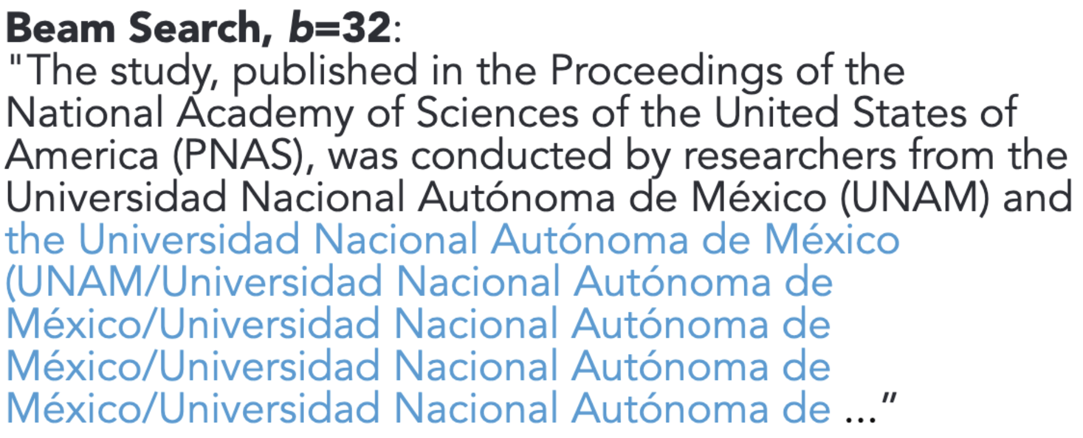
Problem of Beam Search (3)
Context: In a shocking finding, scientist discovered a herd of unicorns living in a remote, previously unexplored valley, in the Andes Mountains. Even more surprising to the researchers was the fact that the unicorns spoke perfect English.
翻譯：在一項令人震驚的發現中，科學家發現一群獨角獸生活在安地斯山脈中一個偏遠、過去從未被探索過的山谷裡。讓研究人員更感到驚訝的是，這些獨角獸竟然能說一口流利的英語。
Holtzman, Ari, et al. "The Curious Case of Neural Text Degeneration." International Conference on Learning Representations (ICLR). 2020.
Notes:
一旦模型生成了 "Universidad Nacional Autónoma de México"，下一次再出現 "Universidad" 的機率就會變得非常高（因為前文剛講過，self-attention 會強化這個 pattern）。

Slide 47
思考 Greedy Decoding 的問題
現代語言模型通常使用 maximum likelihood 的方式 (language modeling) 進行訓練，這會導致模型過度偏向常見或高頻 tokens
當模型在 early steps 中對某些 tokens 給予極高機率時，這些 tokens 所在的路徑就會大幅壓制了其他 candidate tokens，導致生成缺少多樣性，甚至進入重複生成的loop (例如 I don’t know I don’t know I don’t know …)
Holtzman, Ari, et al. "The Curious Case of Neural Text Degeneration." International Conference on Learning Representations (ICLR). 2020.

Slide 48
[Summary] Strategy for MLE decoding
Maximum Likelihood Estimation (MLE): greedy decoding, beam search
既然機率值最高的不是我們想要的字詞
Strategy: Add more randomness!

Slide 49
Strategy for MLE decoding: 改用 Sampling
Sampling 就是「讓模型隨機選下一個詞，而不是每次都選最有可能的那個詞」。
Sampling 是根據模型對每個詞給出的 機率分布 來進行「隨機抽樣」
Token | Probability (p)
cat | 0.5
dog | 0.3
car | 0.15
book | 0.05
Sampling 不是亂抽！
而是根據機率 (模型的信心) 來產生下一次生成

Slide 50
Summary and the Thinking Route
Greedy Decoding
Greedy decoding always selects the best choice at each time step and becomes problematic for early mistakes.
Beam Search
Models can fall into repetitive loops with beam search, especially for longer text.
Sampling

Slide 51
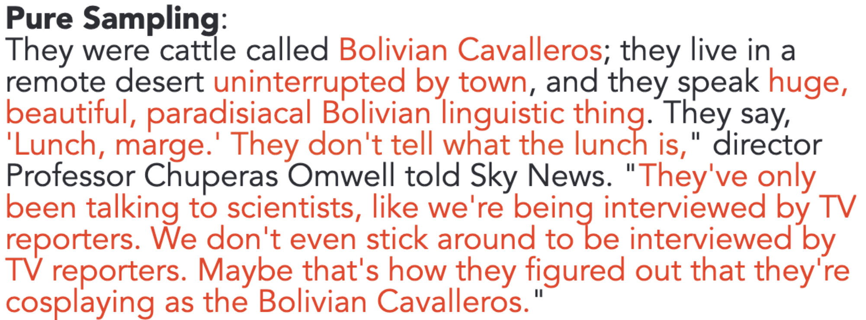
Problem of Pure Sampling
獨角獸
Context: In a shocking finding, scientist discovered a herd of unicorns living in a remote, previously unexplored valley, in the Andes Mountains. Even more surprising to the researchers was the fact that the unicorns spoke perfect English.
山谷
英語
如果完全 random sampling
它們是被稱為「玻利維亞騎士」的牛；他們住在
遠離城鎮的偏遠沙漠，他們說話很大聲，
美麗、天堂般的玻利維亞語言。他們說，
「吃午餐了，瑪姬。」他們沒有告訴午餐是什麼，」導演
丘佩拉斯·奧姆威爾教授告訴天空新聞。 「他們只是
和科學家交談，就像接受電視採訪一樣
記者。我們甚至沒有留下來接受採訪
電視記者。也許這就是他們發現他們
扮演玻利維亞騎士。 」
Holtzman, Ari, et al. "The Curious Case of Neural Text Degeneration." International Conference on Learning Representations (ICLR). 2020.

Slide 52
Why is Pure Sampling so weak?
Pure Sampling does not show repetitive loop, but the result becomes incoherent and almost unrelated to the context
Why? -> Unreliable tail
Token
Prob
the
am
no
a
/
...
...
...
...
...
...
...
...
...
0.0011
0.0012
0.0013
0.0014
0.0015
...
...
...
...
...
...
...
...
...
Words that have low probabilities
Example
Vocab

Slide 53
[Summary] Strategy for Sampling
Token
Prob
Bolivian
Chinese
Egyptian
...
...
...
...
...
...
...
...
...
Scottish
English
0.0011
0.0012
0.0013
...
...
...
...
...
...
...
...
...
0.09
0.10
Bad candidates
可能有很多字
但機率總和才10%
Good candidates
可能沒有很多字
但機率總和有90%
Let’s truncate the vocabulary!

Slide 54
Summary and the Thinking Route
Greedy Decoding
Greedy decoding always selects the best choice at each time step and becomes problematic for early mistakes.
Beam Search
Models can fall into repetitive loops with beam search, especially for longer text.
Sampling
Random sampling takes words with low probabilities into considerations.
Truncated Sampling

Slide 55
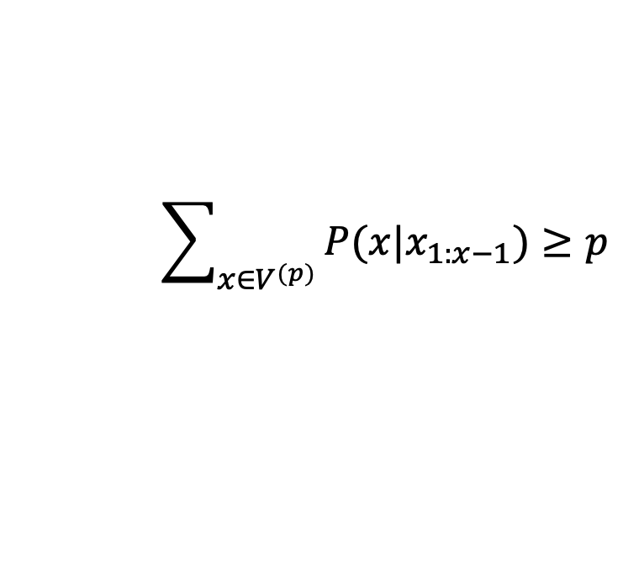
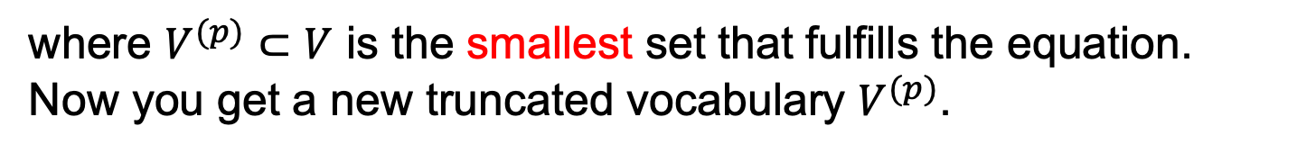
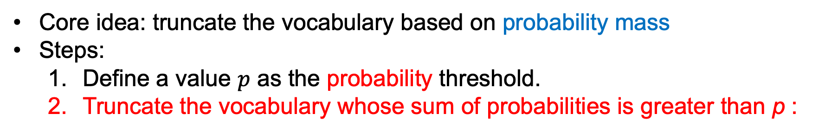
Top-p Sampling
Holtzman, Ari, et al. "The Curious Case of Neural Text Degeneration." International Conference on Learning Representations. 2020.
又稱作 Nucleus Sampling
Core idea: truncate the vocabulary based on probability mass
Steps:
Define a value $p$ as the probability threshold.
Truncate the vocabulary whose sum of probabilities is greater than p :
$$\sum_{x∈V^{(p)}}{P(x|x_{1:x−1})≥p}$$
where $V^{(p)}⊂V$ is the smallest set that fulfills the equation.
Now you get a new truncated vocabulary $V^{(p)}$.

Slide 56

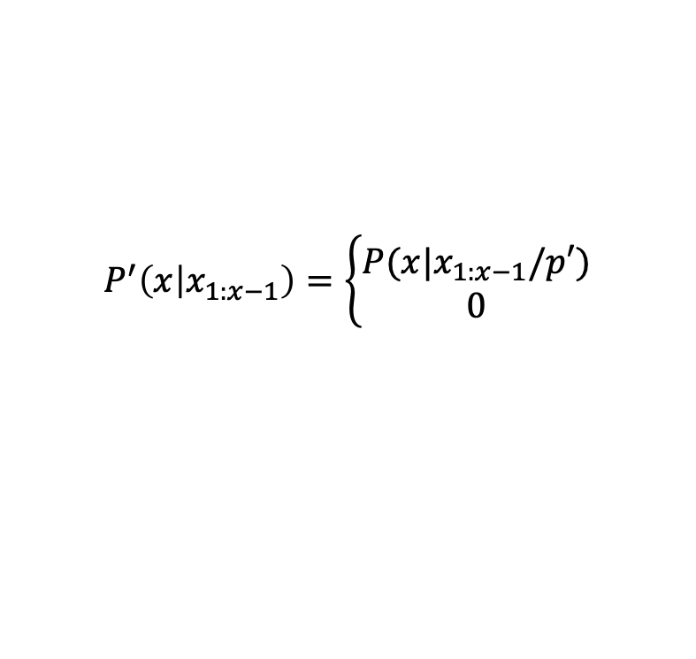
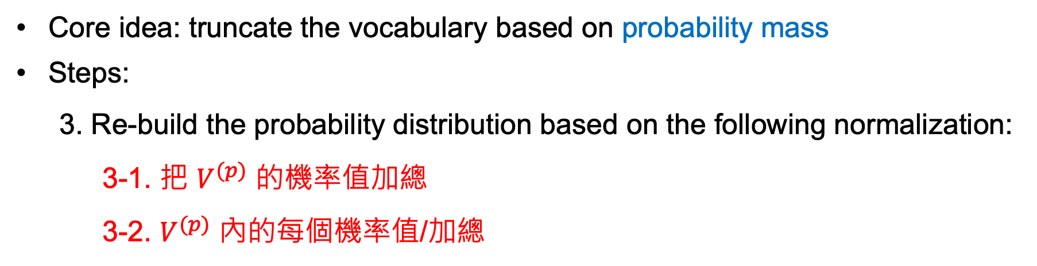
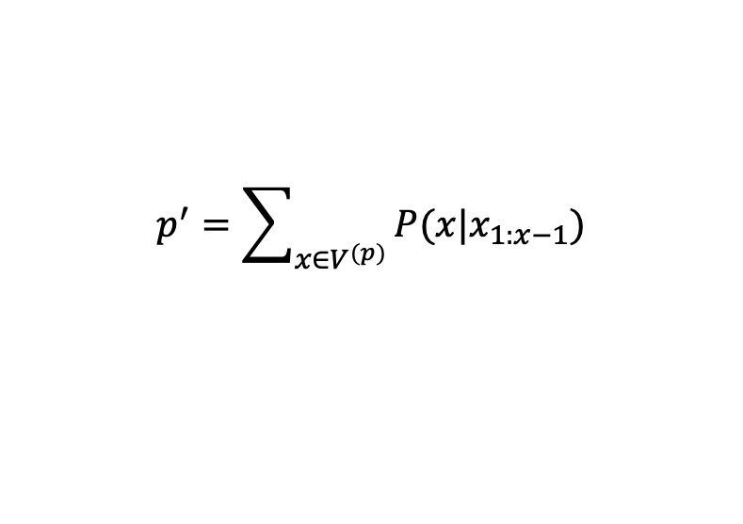
Top-p Sampling
Core idea: truncate the vocabulary based on probability mass
Steps:
3. Re-build the probability distribution based on the following normalization:
3-1. 把 $V^{(p)}$ 的機率值加總
3-2. $V^{(p)}$ 內的每個機率值/加總
$$p^{′}=\sum_{x∈V^{(p)}}{P(x|x_{1:x−1})}$$
$$P^{′}\left(x | x_{1:x−1}\right)=\left\{\begin{aligned}P(x|x_{1:x−1}/p′) \\ 0\end{aligned}\right.$$
if $x∈V^{(p)}$
otherwise

Slide 57

機率重新調整 toy example
任意門的機率：1/4
A
B
C
任意門的機率：0.25 / (0.25+0.25+0.25) = 1/3
A
竹蜻蜓A機率：0.25 / (0.25+0.25+0.25) = 1/3
竹蜻蜓Ｂ機率：0.25 / (0.25+0.25+0.25) = 1/3
A
B
B

Slide 58
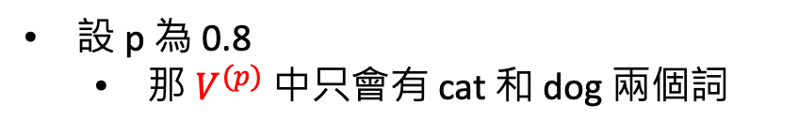
Top-p Sampling example
Token | Probability (p)
cat | 0.5
dog | 0.3
car | 0.15
book | 0.05
設 p 為 0.8
那 $V^{(p)}$ 中只會有 cat 和 dog 兩個詞

Slide 59
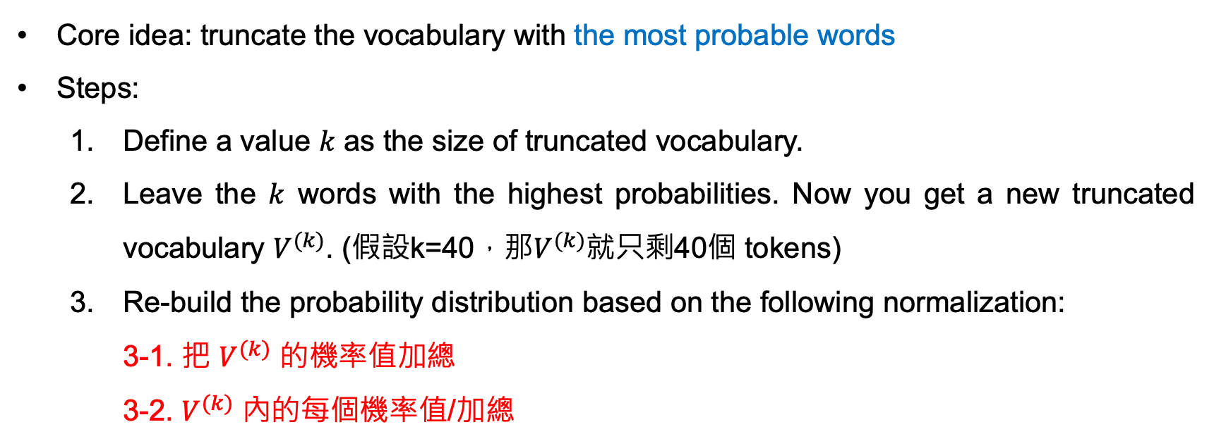
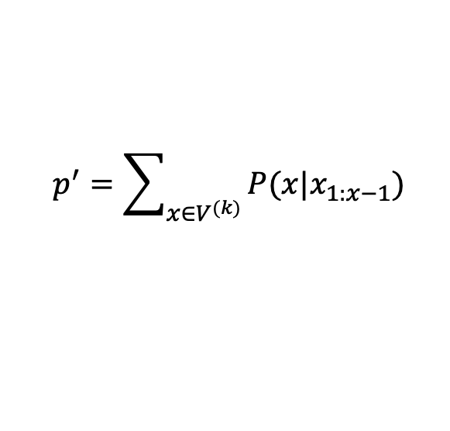

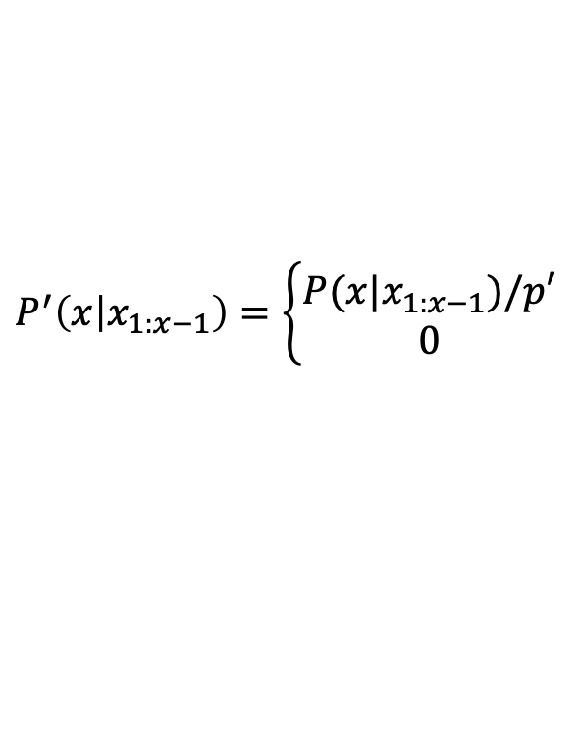
Top-k Sampling
Core idea: truncate the vocabulary with the most probable words
Steps:
Define a value $k$ as the size of truncated vocabulary.
Leave the $k$ words with the highest probabilities. Now you get a new truncated vocabulary $V^{(k)}$. (假設k=40，那$V^{(k)}$就只剩40個 tokens)
Re-build the probability distribution based on the following normalization:
3-1. 把 $V^{(k)}$ 的機率值加總
3-2. $V^{(k)}$ 內的每個機率值/加總
$$p^{′}=\sum_{x∈V^{(k)}}{P(x|x_{1:x−1})}$$
$$P^{′}\left(x | x_{1:x−1}\right)=\left\{\begin{aligned}P(x|x_{1:x−1})/p′ \\ 0\end{aligned}\right.$$
if $x∈V^{(k)}$
otherwise

Slide 60
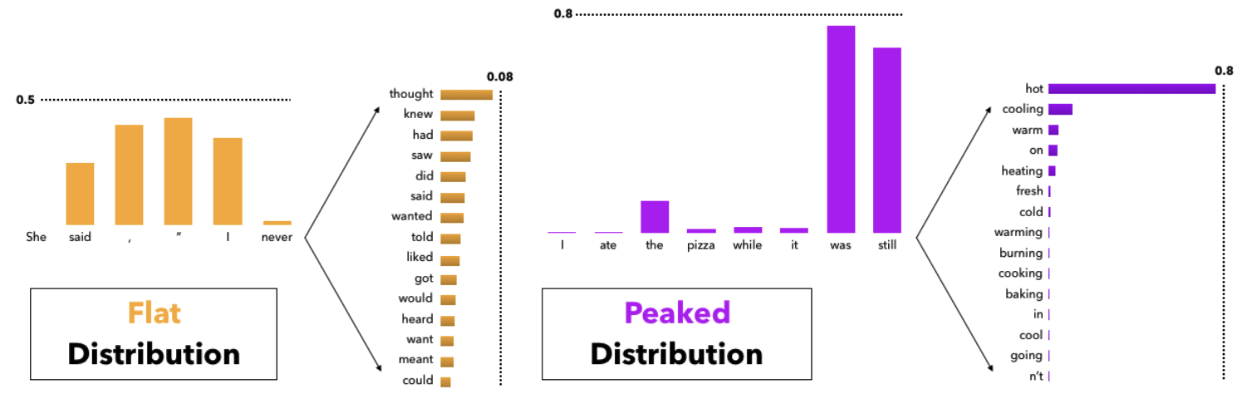
Problem of Top-k Sampling
Top-k sampling 的 k 值需根據情況調整
下一個機率值
下一個機率值
此時 k 如果太小的話，容易錯過最正確的字 -> k 要設大一點
此時 k 如果太大的話，容易取到與上下文無關的字 -> k 要設小一點

Slide 61
Problem of Top-k Sampling (看看 Top-p)
假設 p = 0.9
下一個機率值
下一個機率值
此時 k 如果太小的話，容易錯過最正確的字 -> k 要設大一點
此時 k 如果太大的話，容易取到與上下文無關的字 -> k 要設小一點

Slide 62
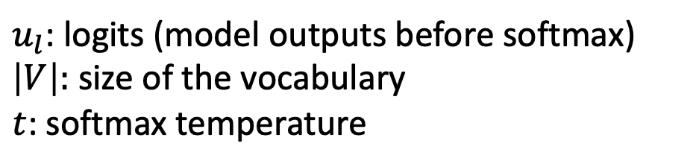
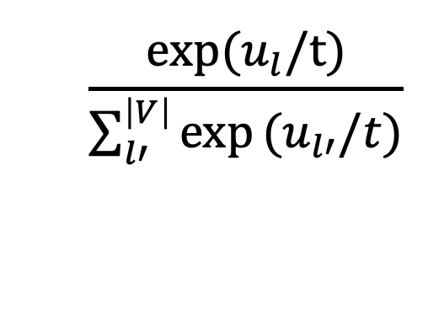
Softmax
When generating the next word, `softmax` is performed to get the probabilities among the words in the vocabulary.
Softmax formula:
$$\frac{\text{exp}\text{(}u_{l}/\text{t}\text{)}}{\sum_{l′}^{\left|V\right|}{\text{exp}}(u_{l′}/t)}$$
$u_{l}$: logits (model outputs before softmax)
$\left|V\right|:$ size of the vocabulary
$t$: softmax temperature

Slide 63
Softmax
Token
Logits
Probability
the
am
no
a
/
0.0011
0.0012
0.0013
0.0014
0.0015
0.78
0.11
0.03
0.02
0.06
Example
Vocab
Note that softmax is required for every decoding strategies since we need to find out the next word from a vocabulary.

Slide 64
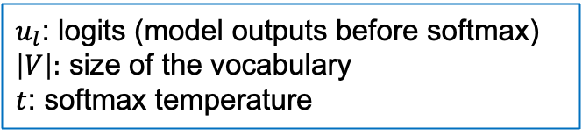
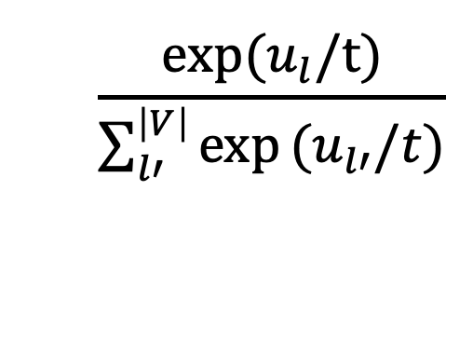
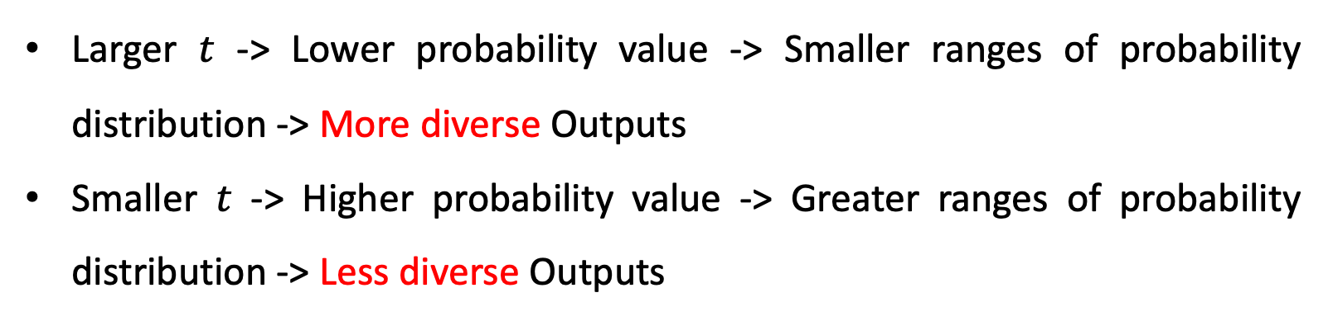
Properties of Softmax Temperature
$u_{l}$: logits (model outputs before softmax)
$\left|V\right|:$ size of the vocabulary
$t$: softmax temperature
Softmax formula:
$$\frac{\text{exp}\text{(}u_{l}/\text{t}\text{)}}{\sum_{l′}^{\left|V\right|}{\text{exp}}(u_{l′}/t)}$$
Larger $t$ -> Lower probability value -> Smaller ranges of probability distribution -> More diverse Outputs
Smaller $t$ -> Higher probability value -> Greater ranges of probability distribution -> Less diverse Outputs

Slide 65
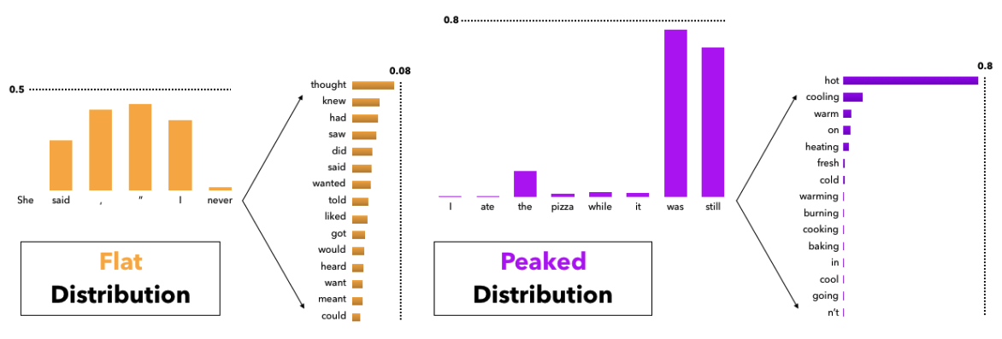
Softmax Temperature
Temperature 高的時候 (more diverse)
Temperature 低的時候 (less diverse)
Holtzman, Ari, et al. "The Curious Case of Neural Text Degeneration." International Conference on Learning Representations (ICLR). 2020.

Slide 66
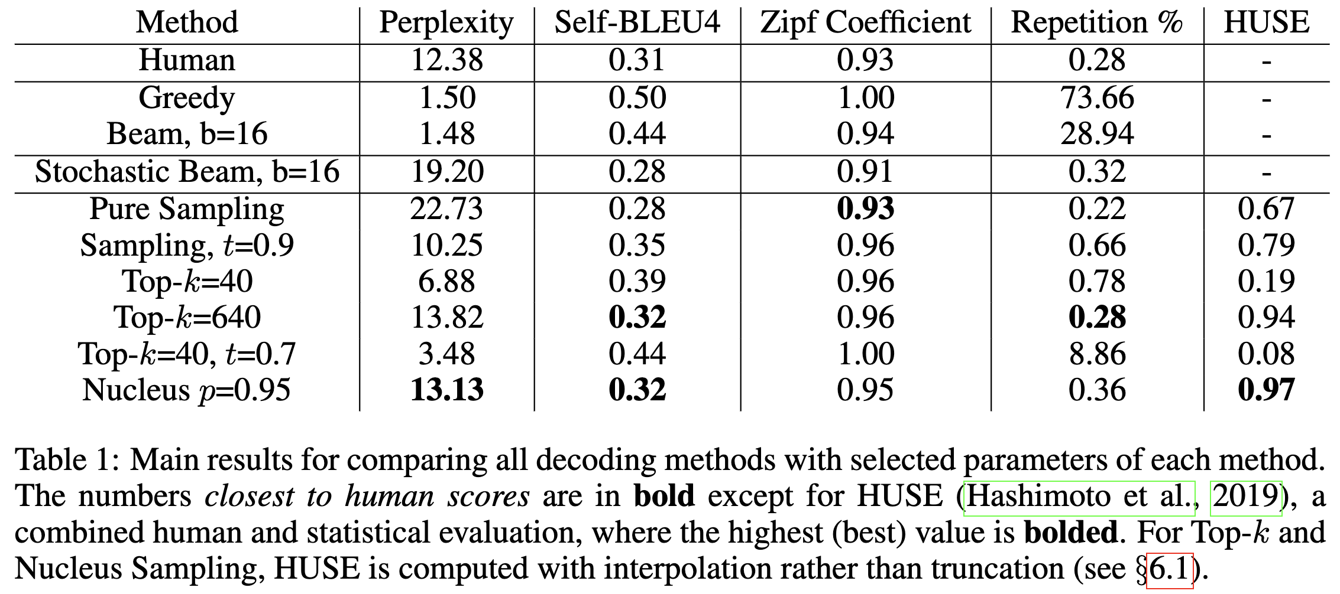
The k value should be carefully picked
Holtzman, Ari, et al. "The Curious Case of Neural Text Degeneration." International Conference on Learning Representations. 2019.

Slide 67
Comparison for Top-k and Top-p Sampling
 | Top-k Sampling | Top-p Sampling
Hyperparameter | k: top-k words are preserved | p: sum of the minimum set of words exceeds the value of p
Performance (Who is better?) | By cases (these two are both widely used)
Hyperparameter Tuning | Harder | Easier
Common Hyperparameter Value | k=40 | p=0.95

Slide 68
Thank you!
Instructor: 林英嘉
✉️ yjlin@cgu.edu.tw
TA: 林宣辰
✉️ b1128015@cgu.edu.tw

