Slide 1



自然語言處理與應用 Natural Language Processing and Applications
注意力機制與現代字詞分割演算法
Slido
# NLP0316 (Link)
GitHub
Instructor: 林英嘉 (Ying-Jia Lin)
2026/03/16

Slide 2


現代自然語言處理基本功
Week 4 – Week 5
Sub-word 分詞法, 注意力機制
Transformer 架構
i
love
deep
learning
Context vector
…
$$h_{t−1}^{d}$$
$$h_{t}^{d}$$
Encoder time steps
Decoder time steps

Slide 3
Outline
Announcement, GAI money [10 min]
Sub-word tokenization
Byte-pair Encoding (BPE) [30 min]
BPE Code [50 min]
Attention (Not self-attention) [30 min]
Quiz [20 min]

Slide 4
Sub-word Tokenization

Slide 5
Recap: Word Representations
Probability
apple
I
love
an
_
elephant
eraser
…
Vocabulary

Slide 6

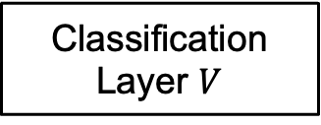
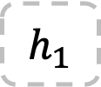
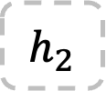
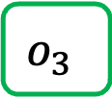

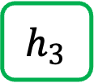

Recap: Text Generation with RNN
*本頁的RNN不包含輸出層$V$
Vocab
Prob
(1, hidden_size)
(1, hidden_size)
(1, hidden_size)
a
...
apple
...
b
...
banana
...
elephant
...
eraser
...
...
zoo
0.0001
...
0.600
...
0.0001
...
0.0003
...
0.300
...
0.05
...
...
0.0001
$$h_{1}$$
$$h_{2}$$
$$h_{3}$$
Classification Layer $V$
Softmax
(1, Vocab_size)
RNN
$$h_{1}$$
RNN
$$h_{2}$$
RNN
$$o_{3}$$
Vocab
size
I
love
an
Word embeddings

Slide 7
Basic Pipeline of Natural Language Processing
Build the vocabulary
Learn the representations
(Training)
Perform predictions
(Testing)

Slide 8
[Recap] How to build the vocabulary?
Segment words based on delimiters (e.g., white spaces).
Then we can collect the words from training corpora.
Vocabulary
Word | ID
and | 0
apples | 1
I | 2
like | 3
love | 4
pineapples | 5
. | 6
<UNK> | 7
I love apples. I like apples and pineapples.
(You can also perform stemming / lemmatization for building the vocabulary!)
Unknown words (not shown up in the training corpora)

Slide 9
Stemming (詞幹提取)
💡Stemming 是一種文字前處理方法，
目的是把不同變化型的單字，裁切成共同字根（stem），以減少詞彙數量。
Words | Stemmed results
connect, connected, connecting, connection | connect
study, studies, studied | studi
https://cloud.google.com/discover/what-is-stemming
https://www.nltk.org/howto/stem.html

Slide 10
Lemmatization (詞形還原)
💡類似於 stemming，lemmatization 也是一種文字前處理方法，
目的是把單字還原成它的字典原型 (lemma)，把不同詞形統一成同一個基本形式。
不同於 stemming， lemmatization 在處理字詞時會考慮到詞性和語言規則
Words | Lemma
connect, connected, connecting, connection | connect
study, studies, studied | study
running, ran | run
The autumn leaves are falling. | leaf (名詞)
He leaves the office at 6 PM. | leave (動詞)
https://www.nltk.org/api/nltk.stem.WordNetLemmatizer.html

Slide 11
Segmentation vs. Tokenization
All tokenization is segmentation, but not all segmentation is tokenization.
Segmentation can be:
Word segmentation from a sentence
Sentence segmentation from a document
Tokenization can be:
Word segmentation from a sentence (then `words` become `tokens`)
Sub-word tokenization from a word or sentence

Slide 12
Delimiter-based Segmentation
NLP
is
fun,
useful,
and
practical.
NLP is fun, useful, and practical. ->
西方語言是用 (e.g., 英語)
Cannot work for Chinese, Japanese.
模型訓練完成後，無法處理不在字典中的字 (這些字通常是因為不存在於訓練集)
此情況也包含拼錯字的情形

Slide 13
[Recap] Embedding Lookup
Index
Vocab | Dimension 1 | Dimension 2
I | -0.47030617476956654 | -4.440892098500626e-16
love | -8.326672684688674e-16 | 0.4464710977801294
do | 8.881784197001252e-16 | 0.7838949952895327
deep | -0.4915010045415975 | -1.3016463110087907e-16
learning | -1.582067810090848e-15 | 0.4314767609119055
NLP | -0.2523320838384413 | -2.1837832516159107e-16
programming | -0.6881623238553303 | -1.914220234434739e-16
0
1
2
3
4
5
6

Slide 14
Delimiter-based Segmentation (Continued.)
特別在機器翻譯任務，source 和 target 語言不一定 1-to-1 對齊
target language 出現複合詞時，如果模型只用 word-level token 難以學到複合關係；改用 subword，模型比較能學到可重複運用的對應關係
For example, sewage water treatment plant (English) -> Abwasserbehandlungsanlage (German)
sewage water
treatment
plant/facility
Sub-word units are favored.

Slide 15
Summary
為什麼我們需要 Sub-word Tokenization?
為了解決 OOV 的問題
有些語言特別容易出現長單詞，例如 Abwasserbehandlungsanlage 這種可拆式複合字
沒看過的字 (Unseen words)
擴增字典大小，如果原本字典在 30,000–50,000 個字，那如果用 Sub-word 的方式建立字典就可以在原本的字典大小範圍表達更多的字

Slide 16
Common Sub-word Tokenization Algorithms
Byte Pair Encoding (Sennrich et al., 2016)^{[1]}
WordPiece (Schuster and Nakajima, 2012)^{[2]}
Unigram Language Model (Kudo, 2018)^{[3]}
[1] Sennrich, Rico, Barry Haddow, and Alexandra Birch. "Neural Machine Translation of Rare Words with Subword Units." Proceedings of the 54th Annual Meeting of the Association for Computational Linguistics (ACL), 2016.
[2] Schuster, Mike, and Kaisuke Nakajima. "Japanese and korean voice search." 2012 IEEE international conference on acoustics, speech and signal processing (ICASSP). IEEE, 2012.
[3] Kudo, Taku. "Subword Regularization: Improving Neural Network Translation Models with Multiple Subword Candidates." Proceedings of the 56th Annual Meeting of the Association for Computational Linguistics (ACL). 2018.

Slide 17
Sub-word Tokenization (1)
Given a training corpus, we first turn each word into a sequence of characters (separated by spaces)
Training corpus
Word | Frequency
l o w </w> | 5
l o w e r </w> | 2
n e w e s t </w> | 6
w i d e s t </w> | 3
low low low low low lower lower newest newest newest newest newest newest widest widest widest
</w> is a special end-of-word symbol, allowing us to restore the original tokenization.

Slide 18
Sub-word Tokenization (1)
Initialize the vocabulary with the existing characters:
low low low low low lower lower newest newest newest newest newest newest widest widest widest
Initial vocab: </w>, d, e, i, l, n, o, r, s, t, w
(逗號不算)

Slide 19
Sub-word Tokenization (2)
Find the character pair with the highest frequency
Word | Frequency
l o w </w> | 5
l o w e r </w> | 2
n e w e s t </w> | 6
w i d e s t </w> | 3
Found “e s” with the highest frequency 6+3=9
Current Vocabulary: </w>, d, e, i, l, n, o, r, s, t, w

Slide 20
Sub-word Tokenization (3)
Add the pair with the highest frequency to the vocab
Word | Frequency
l o w </w> | 5
l o w e r </w> | 2
n e w e s t </w> | 6
w i d e s t </w> | 3
Current Vocabulary: </w>, d, e, i, l, n, o, r, s, t, w, es

Slide 21
Sub-word Tokenization (4)
Merge the characters by replacing all words in the corpus with the newly added pair.
Word | Frequency
l o w </w> | 5
l o w e r </w> | 2
n e w es t </w> | 6
w i d es t </w> | 3
Current Vocabulary: </w>, d, e, i, l, n, o, r, s, t, w, es

Slide 22
Sub-word Tokenization (2)
Repeated (2)-(4)
according to `num_merges`
Find the character pair with the highest frequency
Word | Frequency
l o w </w> | 5
l o w e r </w> | 2
n e w es t </w> | 6
w i d es t </w> | 3
Found “es t” with the highest frequency 6+3=9
Current Vocabulary: </w>, d, e, i, l, n, o, r, s, t, w, es

Slide 23
Sub-word Tokenization (3)
Repeated (2)-(4)
according to `num_merges`
Add the pair with the highest frequency to the vocab
Word | Frequency
l o w </w> | 5
l o w e r </w> | 2
n e w es t </w> | 6
w i d es t </w> | 3
Current Vocabulary: </w>, d, e, i, l, n, o, r, s, t, w, es, est

Slide 24
Sub-word Tokenization (4)
Repeated (2)-(4)
according to `num_merges`
Merge the characters by replacing all words in the corpus with the newly added pair.
Word | Frequency
l o w </w> | 5
l o w e r </w> | 2
n e w est </w> | 6
w i d est </w> | 3
Current Vocabulary: </w>, d, e, i, l, n, o, r, s, t, w, es, est

Slide 25
Sub-word Tokenization (2)
Repeated (2)-(4)
according to `num_merges`
Find the character pair with the highest frequency
Word | Frequency
l o w </w> | 5
l o w e r </w> | 2
n e w est </w> | 6
w i d est </w> | 3
Found “est </w>” with the highest frequency 6+3=9
Current Vocabulary: </w>, d, e, i, l, n, o, r, s, t, w, es, est

Slide 26
Sub-word Tokenization (3)
Repeated (2)-(4)
according to `num_merges`
Add the pair with the highest frequency to the vocab
Word | Frequency
l o w </w> | 5
l o w e r </w> | 2
n e w est </w> | 6
w i d est </w> | 3
Current Vocabulary: </w>, d, e, i, l, n, o, r, s, t, w, es, est, est</w>

Slide 27
Sub-word Tokenization (4)
Repeated (2)-(4)
according to `num_merges`
Merge the characters by replacing all words in the corpus with the newly added pair.
Word | Frequency
l o w </w> | 5
l o w e r </w> | 2
n e w est</w> | 6
w i d est</w> | 3
Current Vocabulary: </w>, d, e, i, l, n, o, r, s, t, w, es, est, est</w>

Slide 28
Sub-word Tokenization (2)
Repeated (2)-(4)
according to `num_merges`
Find the character pair with the highest frequency
Word | Frequency
l o w </w> | 5
l o w e r </w> | 2
n e w est</w> | 6
w i d est</w> | 3
Found “l o” with the highest frequency 5+2=7
Current Vocabulary: </w>, d, e, i, l, n, o, r, s, t, w, es, est, est</w>

Slide 29
Sub-word Tokenization (3)
Repeated (2)-(4)
according to `num_merges`
Add the pair with the highest frequency to the vocab
Word | Frequency
l o w </w> | 5
l o w e r </w> | 2
n e w est</w> | 6
w i d est</w> | 3
Current Vocabulary: </w>, d, e, i, l, n, o, r, s, t, w, es, est, est</w>, lo

Slide 30
Sub-word Tokenization (4)
Repeated (2)-(4)
according to `num_merges`
Merge the characters by replacing all words in the corpus with the newly added pair.
Word | Frequency
lo w </w> | 5
lo w e r </w> | 2
n e w est</w> | 6
w i d est</w> | 3
Current Vocabulary: </w>, d, e, i, l, n, o, r, s, t, w, es, est, est</w>, lo

Slide 31
Finishing the Sub-word Leaning
Assume `num_merges`=4 (we just repeated four times.)
`num_merges` is a hyperparameter that you need to set for BPE.
The learned vocabulary is: </w>, d, e, i, l, n, o, r, s, t, w, es, est, est</w>, lo

Slide 32
Tokenization with Learned BPE
The learned vocabulary is: </w>, d, e, i, l, n, o, r, s, t, w, es, est, est</w>, lo
We first turn each word into a sequence of characters with </w> placed at the end of a word, same as the first step during the learning phase.
Then we can merge the characters according to the learned vocabulary.
Examples:
l o w </w>
lo
w
</w>
w i d e s t </w>
w
i
d
est</w>

Slide 33
[注意事項] Tokenization with Learned BPE
合併的順序：left to right
在實際 tokenization 時，常會從左到右掃描字串，依照已學到的 merge rules 去合併
每次合併的依據：依照 learned merge rules 進行；若可形成較長的已學習子詞，通常會繼續合併 (e.g., low: l+o→lo, lo+w→low)

Slide 34
Properties of BPE
The final learned vocabulary size = initial size + `num_merges`
Initial vocab: </w>, d, e, i, l, n, o, r, s, t, w
Learned vocab: </w>, d, e, i, l, n, o, r, s, t, w, es, est, est</w>, lo
This algorithm is based on statistics, so frequent sub-word units in provided corpora will be put to the learned vocabulary.

Slide 35
Attention

Slide 36

Attention relationship among words
Katniss looked at Prim sleeping beside her and felt a sudden heaviness, because today was the Reaping.
?
特殊節日
沈重
任務1：找出與時間相關的字詞
注意力
任務2：情感分類任務

Slide 37

Attention

Slide 38
What is Attention?
💡 attention (注意力機制): 在理解一個輸入時，不平均看所有部分，而是根據當前任務，動態聚焦在更重要的位置。

Slide 39

RNNs for Sequence Classification
This movie was awful. The ending was absolutely horrible.
Classifier
Positive
Negative
Linear
h_{n}
h₀
RNN
RNN
RNN
RNN
x₁
x₂
x₃
x_{n}

Slide 40
Machine Translation
Sentiment Analysis (IMDb dataset ^{[1]})
This movie was awful. The ending was absolutely horrible.
Classifier
Positive
Negative
Translation, EN-ZH (WMT-19 dataset ^{[2]})
Machine Translation Model
Yet not nearly enough has been invested in this effort.
但目前這方面的投入還遠遠不夠。
[1] https://huggingface.co/datasets/stanfordnlp/imdb
[2] https://huggingface.co/datasets/wmt/wmt19/viewer/zh-en

Slide 41
RNNs for Machine Translation?
Method 1 (逐字對齊)
我
喜歡
NLP
FFN
FFN
FFN
h₂
h₂
h₃
RNN
RNN
RNN
I
love
NLP

Slide 42
RNNs for Machine Translation?
Method 1 (逐字對齊)
缺點：在不能逐字對齊的資料上效果不佳
私は
???
???
Target sequence:
私は NLP が好きです
FFN
FFN
FFN
h₂
h₂
h₃
RNN
RNN
RNN
I
love
NLP

Slide 43
RNNs for Machine Translation?
缺點：長距離的關係難以被記憶
Method 2 (利用特殊 token)
私は
NLP
が
FFN
FFN
FFN
FFN
FFN
FFN
...
h₂
h₂
h₃
h₄
h₅
h₆
RNN
RNN
RNN
RNN
RNN
RNN
...
I
like
NLP
[translate]
私は
NLP

Slide 44















Encoder and Decoder
輸出是 hidden states
輸出是 sequence (文字)
$${\hat{y}}_{1}$$
$${\hat{y}}_{2}$$
……
$${\hat{y}}_{t−1}$$
$${\hat{y}}_{t}$$
$$h_{0}$$
$$h_{1}$$
……
$$h_{n−2}$$
$$C$$
FFN (linear layer(s))
Encoder
Decoder
$$h_{init}$$
……
_
$${\hat{y}}_{1}$$
……
$${\hat{y}}_{t−2}$$
$${\hat{y}}_{t−1}$$
_
$$x1$$
$$x_{n−2}$$
$$x_{n−1}$$
(Start)
(Start)
Input sequence
(Encoder 的輸出有很多種被Decoder運用的方式)

Slide 45
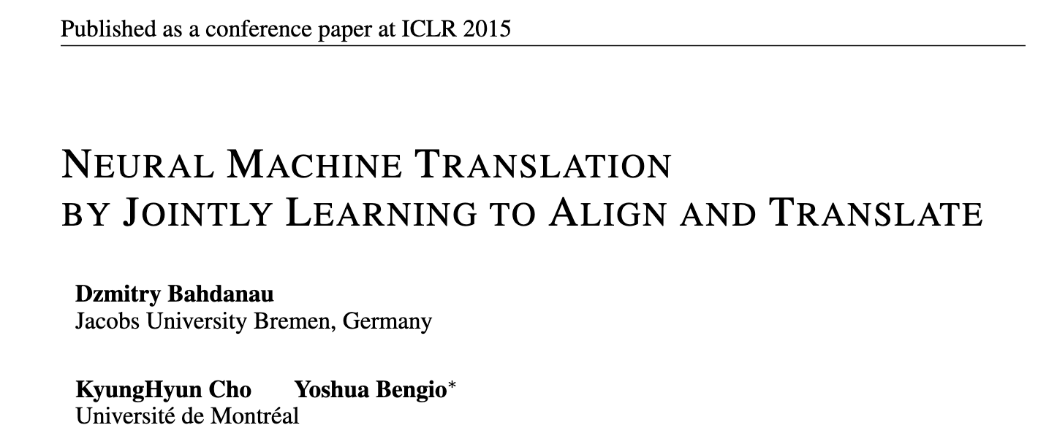
Notes:
Before we get into the intra-attention mechanism in this paper
Let’s recap the standard attention mechanism first.

Slide 46

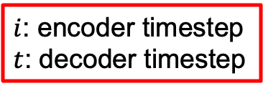








機器翻譯 (一般情況)
$i$: encoder timestep
$t$: decoder timestep
$$\vec{h_{i}}=\left[\vec{h_{i}} ; \overset{←}{h_{i}}\right]$$
I
want
a
day
off
[EOS]
Linear
Linear
Linear
Linear
Linear
Linear
$$\overset{←}{h_{i}}$$
$$\vec{h_{i}}$$
$$s_{1}$$
$$s_{2}$$
$$s_{3}$$
$$s_{4}$$
$$s_{5}$$
$$s_{6}$$
RNN
RNN
RNN
RNN
RNN
RNN
RNN
RNN
RNN
RNN
RNN
我
想
要
放
假
_
I
want
a
day
off
Notes:
(Laser pointer)
Attention mechanism starts from the encoder hidden states which can be concatenated by bi-directional outputs.
Called $h_{i}^{e}$
than the temporal attention score $e_{ti}$ is obtained by the alignment model
The alignment model is a feed forward network, which scores how well the inputs at position i and outputs at timestep t match
Then the attention score alpha is computed by a softmax function
Finally, the context vector of weighted sum is used to compute output at the decoding timestep t

Slide 47
一般情況的 encoder-decoder 有什麼問題？
依賴 encoder 的 hidden state
好像要你看完一整篇文章後，不能再回頭看原文，只能憑腦中最後留下的一小段印象把它完整翻譯出來
不管原句多短多長，最後都要塞進同樣大小的向量

Slide 48

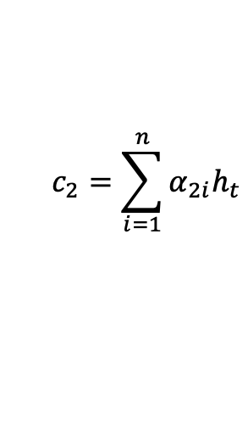
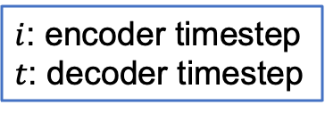






機器翻譯 (with Attention, t = 2)
$$\vec{h_{i}}=\left[\vec{h_{i}} ; \overset{←}{h_{i}}\right]$$
$i$: encoder timestep
$t$: decoder timestep
$$c_{2}=\sum_{i=1}^{n}{α_{2i}h_{t}}$$
Context vector
I
$$α_{21}$$
$$α_{22}$$
$$α_{23}$$
$$α_{24}$$
$$α_{25}$$
Linear
$$\overset{←}{h_{i}}$$
$$\vec{h_{i}}$$
$$s_{1}$$
RNN
RNN
RNN
RNN
RNN
RNN
我
想
要
放
假
_
Notes:
(Laser pointer)
Attention mechanism starts from the encoder hidden states which can be concatenated by bi-directional outputs.
Called $h_{i}^{e}$
than the temporal attention score $e_{ti}$ is obtained by the alignment model
The alignment model is a feed forward network, which scores how well the inputs at position i and outputs at timestep t match
Then the attention score alpha is computed by a softmax function
Finally, the context vector of weighted sum is used to compute output at the decoding timestep t

Slide 49






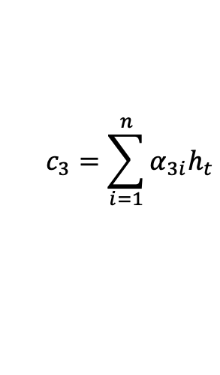
機器翻譯 (with Attention, t = 3)
$$\vec{h_{i}}=\left[\vec{h_{i}} ; \overset{←}{h_{i}}\right]$$
$i$: encoder timestep
$t$: decoder timestep
$$c_{3}=\sum_{i=1}^{n}{α_{3i}h_{t}}$$
Context vector
I
want
$$α_{31}$$
$$α_{32}$$
$$α_{33}$$
$$α_{34}$$
$$α_{35}$$
Linear
Linear
$$\overset{←}{h_{i}}$$
$$\vec{h_{i}}$$
$$s_{1}$$
$$s_{2}$$
RNN
RNN
RNN
RNN
RNN
RNN
RNN
我
想
要
放
假
_
I
Notes:
(Laser pointer)
Attention mechanism starts from the encoder hidden states which can be concatenated by bi-directional outputs.
Called $h_{i}^{e}$
than the temporal attention score $e_{ti}$ is obtained by the alignment model
The alignment model is a feed forward network, which scores how well the inputs at position i and outputs at timestep t match
Then the attention score alpha is computed by a softmax function
Finally, the context vector of weighted sum is used to compute output at the decoding timestep t

Slide 50
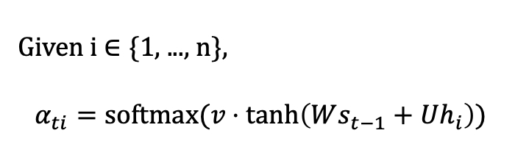
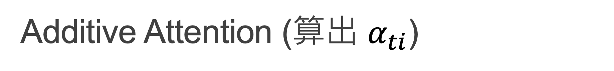
Additive Attention (算出 $α_{ti}$)
$$\vec{h_{i}}=\left[\vec{h_{i}} ; \overset{←}{h_{i}}\right]$$
$i$: encoder timestep
$t$: decoder timestep
$$c_{3}=\sum_{i=1}^{n}{α_{3i}h_{t}}$$
Given i $∈$ {1, ..., n},
$$α_{ti}=softmax(v⋅\tanh\left(Ws_{t−1}+Uh_{i}\right))$$
Context vector
I
want
$$α_{31}$$
$$α_{32}$$
$$α_{33}$$
$$α_{34}$$
$$α_{35}$$
Linear
Linear
Additive Attention
$$\overset{←}{h_{i}}$$
$$\vec{h_{i}}$$
$$s_{1}$$
$$s_{2}$$
轉為1個
數字
RNN
RNN
RNN
RNN
RNN
RNN
RNN
我
想
要
放
假
_
I
Notes:
形狀小百科
h_i: (2H, 1)
U: (H, 2H)
s_t: (H, 1)
W: (H, H)
v: (1, H)

Slide 51






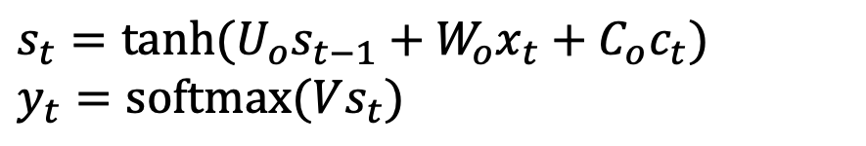




得到了 Context vector 之後
$$y_{t}$$
The equation on step t is:
, where $tanh$ is an activation function.
$$s_{t}=tanh(U_{o}s_{t−1}+W_{o}x_{t}+C_{o}c_{t})$$
$$y_{t}=softmax(Vs_{t})$$
$$V$$
$$s_{t}$$
+
$$U_{o}$$
$$W_{o}$$
$$C_{o}$$
爲方便同學理解，此頁為 Bahdanau et al. (2014). 的模型簡化版
$$s_{t−1}$$
$$x_{t}$$
$$c_{t}$$

Slide 52

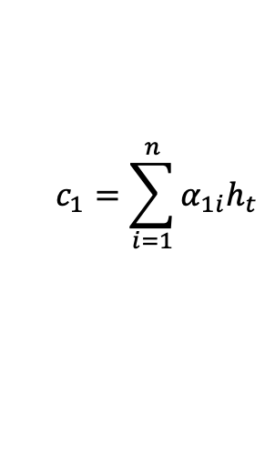



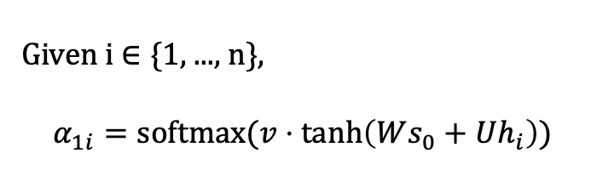



機器翻譯 (with Attention, t = 1)
$$\vec{h_{i}}=\left[\vec{h_{i}} ; \overset{←}{h_{i}}\right]$$
$i$: encoder timestep
$t$: decoder timestep
$$c_{1}=\sum_{i=1}^{n}{α_{1i}h_{t}}$$
Given i $∈$ {1, ..., n},
$$α_{1i}=softmax(v⋅\tanh\left(Ws_{0}+Uh_{i}\right))$$
Context vector
$$α_{11}$$
$$α_{12}$$
$$α_{13}$$
$$α_{14}$$
$$α_{15}$$
$$\overset{←}{h_{i}}$$
$$\vec{h_{i}}$$
$$s_{0}$$
$$=tanh⁡(W_{s}\overset{←}{h_{1}})$$
RNN
RNN
RNN
RNN
RNN
我
想
要
放
假
Notes:
$W_{s}$ 的維度為(H, H)

Slide 53
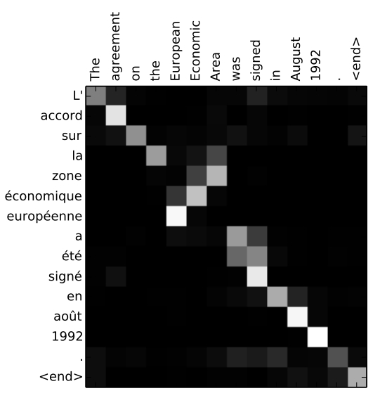
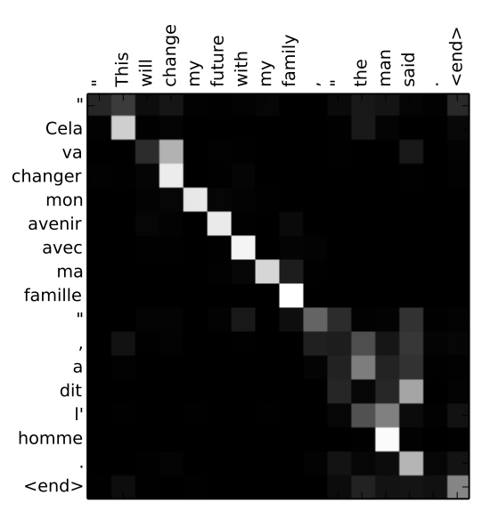
Attention
An example of machine translation.

Slide 54
Other Attention Approaches
Dot-product Attention: https://arxiv.org/abs/1508.04025
https://lilianweng.github.io/posts/2018-06-24-attention/

Slide 55
Thank you!
Instructor: 林英嘉
✉️ yjlin@cgu.edu.tw
TA: 林宣辰
✉️ b1128015@cgu.edu.tw

