Slide 1
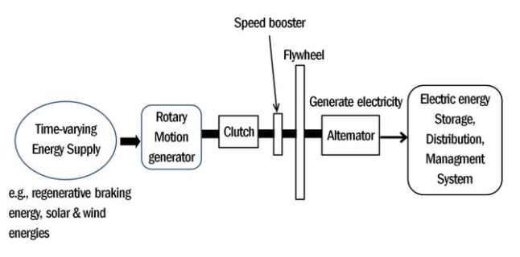

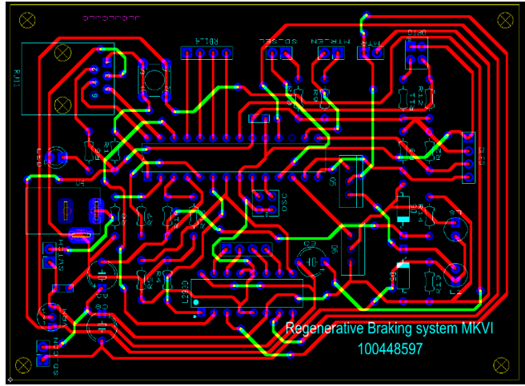
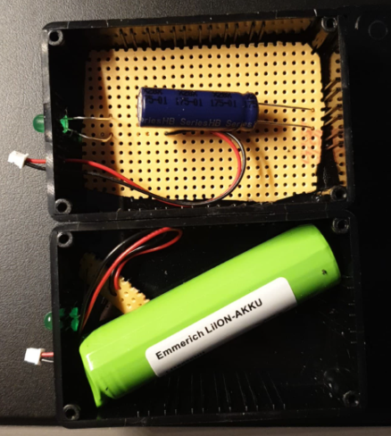
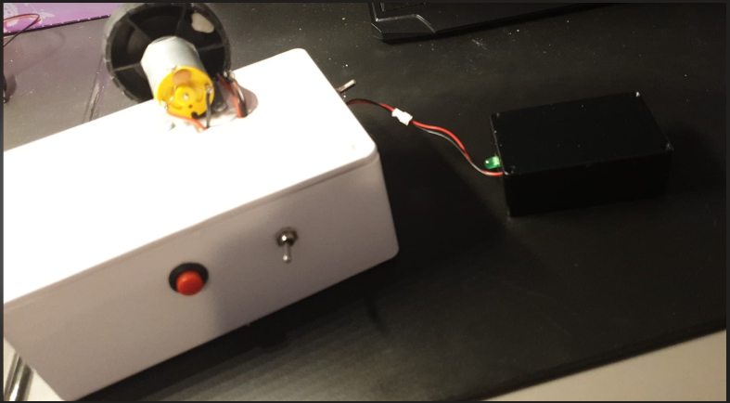

A comparison of li-ion cells and supercapacitors in the efficiency of a regenerative braking system for EVs
100448597
Supervisor: David Wilson
Introduction
Electric vehicles (EVs) have been around for many years and have since become increasingly popular in society. The rechargeable lithium-ion battery was commercialised in 1985 and since then it has become widespread in many commercial applications such as laptops, cell phones, alarm systems and recently EVs.
A regenerative braking system in an EV consists of taking the car’s kinetic energy and converting it into electrical energy; this energy is stored in Li-ion cells. Recent developments in solid-state storage devices (supercapacitors) could show not only improved performance, but a more environmentally friendly solution.
This project will be a comparison of Li-ion and supercapacitor battery technologies used in the context of a regenerative braking system. The efficiency will be measured by speeding up a DC motor to a set speed for both batteries then measuring the capacities of both batteries after they have been recharged with the back-emf of the DC motor.
Given the financial and time constrains of the project, this will be produced on a small scale, hence why a DC motor is used. The capacities of the Li-ion and supercapacitor battery packs will be limited (but approximately equal to ensure a fair comparison) because of the limited budget of £75.
Results
For each of the storage devices, the current was motor was sped up to certain (approximate) speeds and the current output of the buck converter was measured. Next, the time the LEDs stayed on was measured using a stopwatch. The % of battery filled was calculated and graphed vs the speed of the motor.
$$\% charged\left[\frac{Wh}{Wh}\right]=\frac{\frac{ V×I×s}{3600}}{max. capacity}×100\%$$
The supercapacitor proved to have regenerated almost double the amount of the Li-ion cell. This is because the supercapacitor is built to charge and discharge more quickly than the Li-ion cell.
In May 2016, a Tibetan river was contaminated by a nearby mine leak which killed all the fish and destroyed the surrounding ecosystem. The higher the demand for Lithium batteries, the higher the risk of pollution to the environment; cases like these pose the question of needing a more sustainable means of energy storage. Lithium mines around the world are not always in the best working conditions, not supporting the workers with protective equipment can be detrimental to their health and can lead to a disinterest in the future workforce.
PCB and prototype
The brain of this small-scale regenerative braking system is the PIC18F25K22 microcontroller, it controls all the inputs and outputs of the system. The two storage devices: the supercapacitor and Li-ion cell have two different operating voltages (2.5V and 3.7V). The user must have a choice to which one is used at a given time so one of the inputs is selecting the storage device. This tells the PIC how it should step down the back-emf coming from the motor.
A simple button or switch can be used to enable the motor to start moving, once it reaches a certain speed, it is turned off and the back-emf is fed through the buck converter into the storage device. The boost converter then takes said voltage and steps it back up at a level high enough for the PIC to measure current. This is done through a simple voltage divider for the voltage and the current is measured using a transconductance amplifier.
The speed of the wheel attached to the motor and is measured with an optocoupler. The optocoupler is used to measure how many rotations occur in one second and the RPM can be calculated. It is through this measurement that the motor can be stopped after x RPM.
Conclusion
Li-ion cells and supercapacitors are both very promising for the future of battery storage technology. In principle, Li-ion batteries are better for long range applications whereas supercapacitors are better for applications that require quick bursts of energy; this was seen through the various measurements taken from the prototype.
EVs are a new, emerging technology that is constantly changing. Now most if not all EV companies (primarily Tesla) are in the Li-ion market. Unfortunately, supercapacitors have not been made widely available yet in the EV market. Supercapacitors have many advantages in terms of the way they store and manage stored power, but the main disadvantage is that there is a very large cost that comes with these devices. With climate change being a concern, this only begs the change to a more sustainable and easy-to-obtain method of energy storage.
Li-ion cell & supercapacitor
Main system
Storage device
References
Barrera, P. (2020, August 20). Top Lithium Production by Country | Australia is First | INN. Investingnews. https://investingnews.com/daily/resource-investing/battery-metals-investing/lithium-investing/lithium-production-by-country/
Bousbaine, A. (2020). Lecture 5-Boost converters-V1-BB (p. 18).
Cordis. (2018). Clean and green supercapacitors for energy efficiency and transport applications | Results In Brief | CORDIS | European Commission. https://cordis.europa.eu/article/id/148917-clean-and-green-supercapacitors-for-energy-efficiency-and-transport-applications
Emmerich. (2017). 18650 Li ion cell. https://asset.conrad.com/media10/add/160267/c1/-/en/000251007DS01/datasheet-251007-emmerich-icr-18650nh-sp-non-standard-battery-rechargeable-18650-cable-li-ion-37-v-2200-mah.pdf

