Slide 1
IPv6 over Link-Local Discovery Protocol
draft-richardson-anima-l2-friendly-acp
M. Richardson (presenting)
Liang Xia
Jie Yang
IETF 108, ANIMA, 2020-07-30

Slide 2
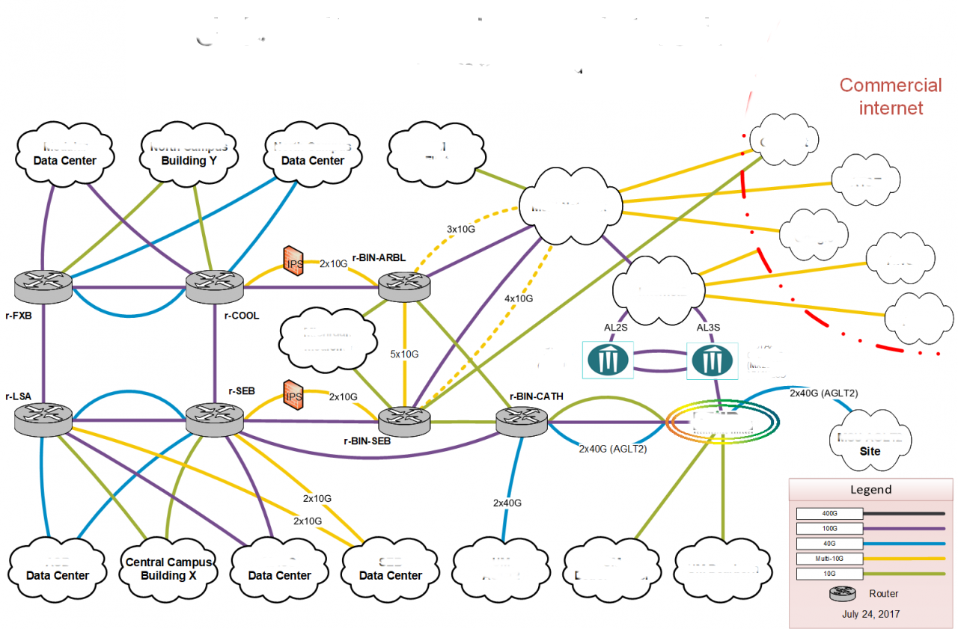
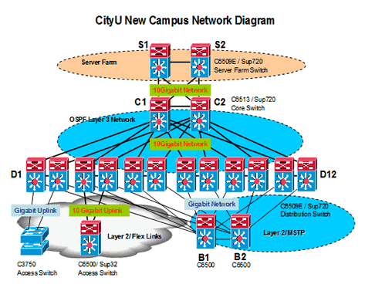
(recap) Challenges in creating
Autonomic Control Plane (ACP) in
Layer-2 Software Defined Networks (SDN)
SDN managed Layer-2 networks have multiple, redundant links between routers.
loops may be present, to be resolved by SDN controller

Slide 3
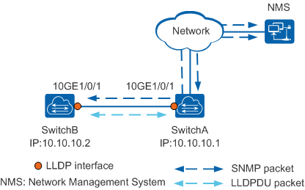
Background on LLDP
many issues
many found solution gross
we found we could make it work, but it required additional fabric configuration which defeated point of using this

Slide 4
Step back: define problem
The encapsulation should be capable of transferring full-size (1280 byte) IPv6 packets.
The encapsulation should not be confused with standard unicast IPv6 Ethernet encapsulation using EtherType 0x86DD.
Even when in a very primitive "default" or power-on configuration, a switching fabric should never forward frames received on one port to any other port.
It should be possible to send these frames from the forwarding engine to some control plane system for specific processing.
  (When doing so, the physical port number needs to be associated with the frame.)
It should be possible for control plane daemons to send frames for transmission on any port, and to that port only, even if that port is part of a larger layer-2 domain.

Slide 5
What we would like from the WG
do you think that this is a problem worth solving?
if so, then this becomes an IPv6-over-FOO document
  would like to ask the WG to refer this document to the IETF/IEEE coordination group for advice
  document might have to go 6man or ???

Slide 6
Thank You!

