Slide 1
Resiliency and Emergency Communication in Building Automation Systems
Wei Pan (William)
<william.panwei@huawai.com>
Michael Richardson <mcr+ietf@sandelman.ca>

Slide 2




Current Fire Alert Scenario
2
Typical disposal process:
1. The sensors detect exceptions and send alarms to the Management System.
2. The administrator identifies the alarm detail, such as which building and which floor.
3. The administrator (may notify other administrators to) check the CCTV live video of the corresponding building and floor.
4. The administrator (may notify other administrators to) open the gate machine and unlock the emergency exit.
Management System
Administrators
Core Switch
Switch
Switch
Gateway A
Gateway B
Gateway C
1
3
4
Smoke detector
Gas sensor
Temperature sensor
Camera
Gate machine / Emergency exit
Gateways are deployed in different locations (such as different floors).
Gateways are installed at different stages/different times, by different vendors
Monitoring Sensors
CCTV
Entrances and exits

Slide 3
Disadvantages of Current Solution
1. The whole process totally relies on the involvement of the data center side administrators, and they need to remotely trigger all commands.
If the network between the data center and the end devices is down, which is very likely in a disaster situation, then this process won’t be available.
2. The rate of false alarm is relatively high.
3. Administrator distractions may cause untimely responses.
Management System
Administrators
Core Switch
Switch
Switch
Gateway A
Gateway B
Gateway C
Smoke detector
Gas sensor
Temperature sensor
Camera
Gate machine / Emergency exit
Monitoring Sensors
CCTV
Entrances and exits

Slide 4
Gateway-to-Gateway Communications
Expect disposal process:
1. The sensors detect exceptions and trigger alarms, and these alarms will be spread to other Gateways by Gateway A.
2. Some cameras can use AI technologies to analyze images and videos, for example, detecting the movement of people. In this case, Gateway B can receive such a notification from the cameras, and spread it to Gateway C.
3. In response to Gateway A's alarm and Gateway B's notification, Gateway C gives commands to open the gate machine and unlock the emergency exit.
4. Gateway C may report this event disposal back to the management system and the administrators.
Management System
Administrators
4
Core Switch
Switch
Switch
Gateway A
Gateway B
Gateway C
1
2
3
Smoke detector
Gas sensor
Temperature sensor
Camera
Gate machine / Emergency exit
Monitoring Sensors
CCTV
Entrances and exits

Slide 5
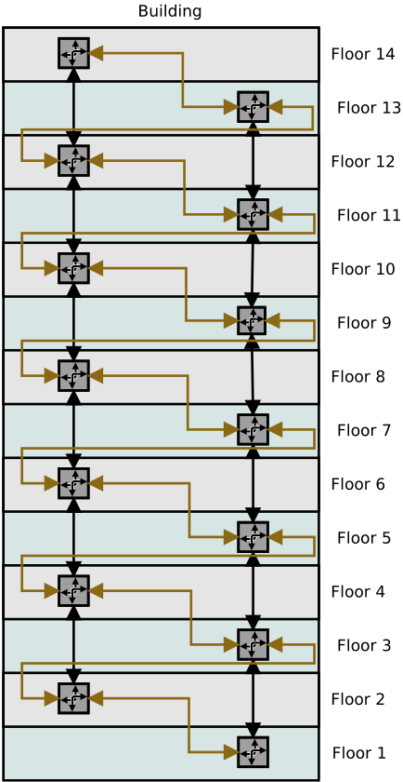
Generalize Problem to Multi-Storey Buildings
A gateway on each floor
  linked to gateway one floor up and one floor down
Redundancy provided by a second link to a gateway two floors away
  via a diverse path
  bigger buildings might have multiple gateways per floor
IPv4-think… form an L2 metro-ethernet ring.
  or SDN can do stuff
IPv6-think: OSPFv3? ROLL? SNAC?
  ROLL (RFC6550) actually pretty good fit
During a failure, communications between floors for coordination is important
  system is distributed, but needs awareness

Slide 6
SNAC’ing during a failure
network isolation reduces network to small groups of gateways
SNAC method lets’ adjacent floors communicate with other’s sensors
gateway devices may have significant intelligences (routers with VMs), but might have to turn that off when on battery
alternate solutions with ungrounded RPL (RFC6550) are possible
  RFC6550 also could be a SNAC solution

Slide 7

Conclusions and Discussion
this is a kind of edge between managed and unmanaged networks
  management can do some activities like pre-deploying credentials
this might not be close enough to home problem as described in SNAC problem statement to have anything in common
  or may be there are some interesting synergies
these slides are about the L3/routing problem in the building situation
there are L4→L9 problems as well
  come to our side meeting, Tuesday 18:00 in room Philadelphia South

