Slide 1
Provisioning of IoT devices:
Home Routers
Provisioning Initial Device Identifiers into Home Routers
draft-richardson-homerouter-provisioning-00
Michael Richardson
<mcr@sandelman.ca>

Slide 2
Motivation
Insert “Murai” story (now close to 5 years ago!)
admin/admin password is not good enough, but as soon as one does better, malware might collect/observe http. How?
  ARP spoofing of 192.168.1.1 is trivial, and even used intentionally to add VPN-security
Implementation of t2trg-idevid-considerations, anima-masa-considerations document

Slide 3
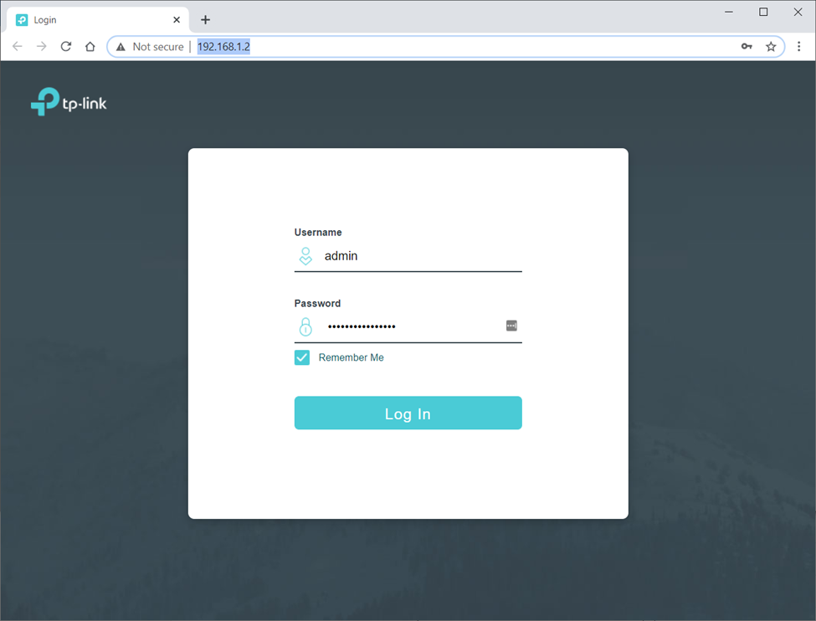
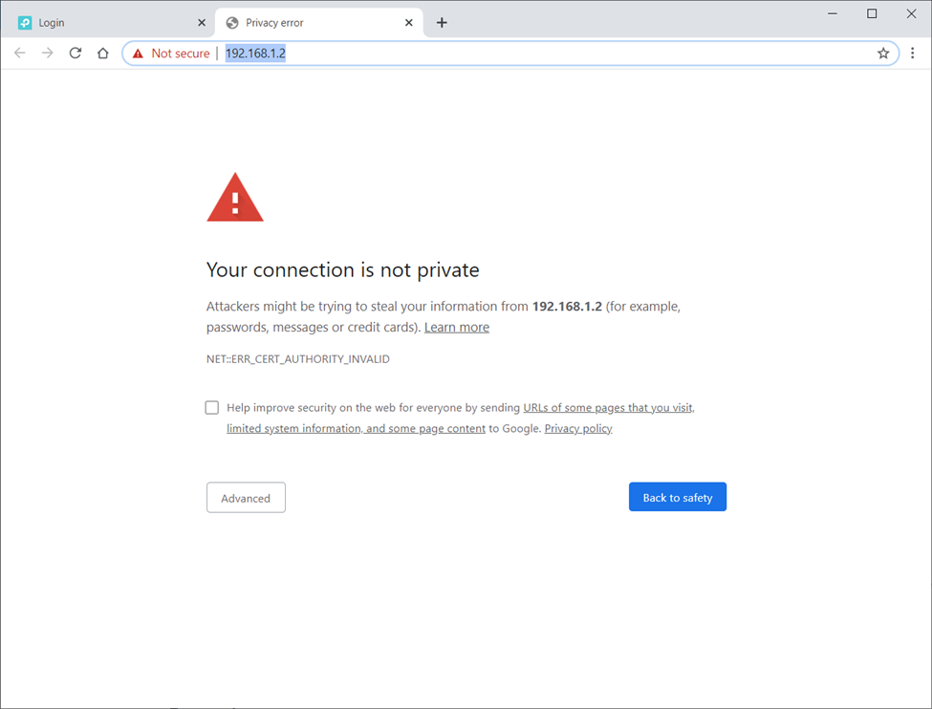
Motivation (2)
VS
Implicitely
Insecure
Explicitely
Insecure
These images from IoTSF ManySecured

Slide 4



Solution Outline part 1: put IDevID in
LetsEncrypt?
IDevID
Registrar
Zone
Controlled by
Manufacturer
dev.manu.example
ACME
Dynamic Update
To DNS w/ challenge
(dns-01)
IPv6 LL
LAN
Enhanced JSON
w/CSR + ULA
Certificate: n983287.dev.manu.example

Slide 5
Solution Outline part 2: populate DNS with name
IDevID
Cert Authority
Zone
Controlled by
Manufacturer
dev.manu.example
Dynamic Update
To DNS w/ AAAA
IPv6 LL
LAN
n983287.dev.manu.example
IN AAAA fdd4:444c:fc9f::1
Certificate: n983287.dev.manu.example
ULA: fdd4:444c:fc9f::1

Slide 6
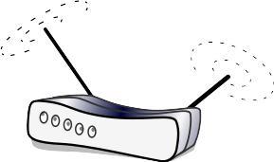

Solution Outline part 3: deployment
Zone
Controlled by
Manufacturer
dev.manu.example
https://n983287.dev.manu.example
ULA: fdd4:444c:fc9f::/48
n983287.dev.manu.example
IN AAAA fdd4:444c:fc9f::1
Also in /etc/hosts

Slide 7
Issues
Expiry of Certificate while device in in the box
  Requires online renewal when device online
  What is device needs human intervention to get online?
Unwillingness of some browsers to do IPv6 lookups
  Hack, also include 192.168.1.1 in /etc/hosts ICK.
  May be limited to Alphabet browsers/systems

Slide 8
Conclusion
Needs some work
Co-authors sought
Some overlap with DANISH (maybe)

