Slide 1
Proof of Presence
Endorsement

Slide 2

What is a typical Endorsement...
for instance: EUDI Wallet (wscd+wsca)
Needs to be certified by a Conformity Assessment Body
The qualification is about the category

Slide 3
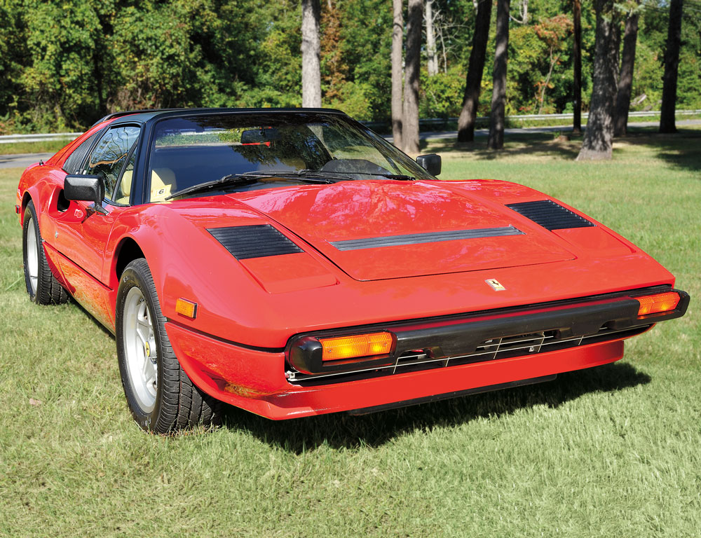
What is the router problem?
There is a need for certain information to be available in the form of an Endorsement
“My car is Red”
Car 438ABC is Red

Slide 4
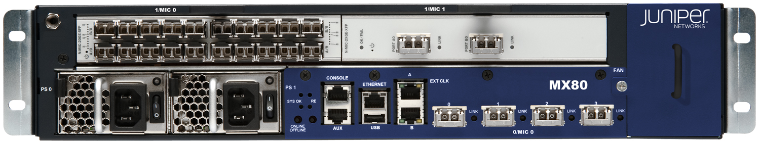
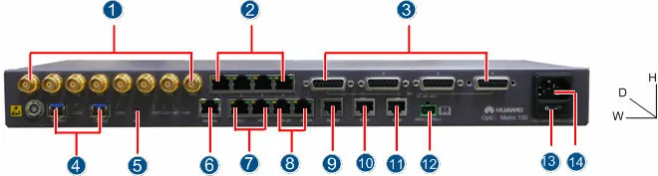
Router bdi2.core.rtr.storm.ca
Located at 151 Front Street, Toronto.
But, what’s the device’s public key/identity?
How can auditor be sure? All Juniper MX5 look the same.
Which cable is plugged into which port?

Slide 5
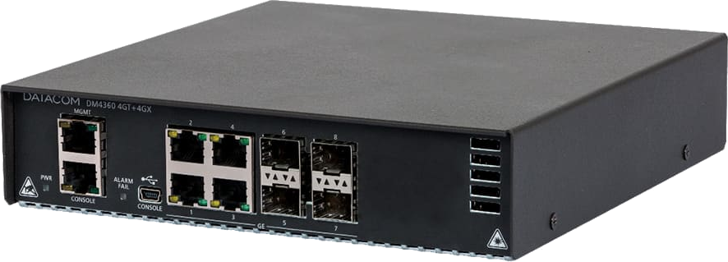
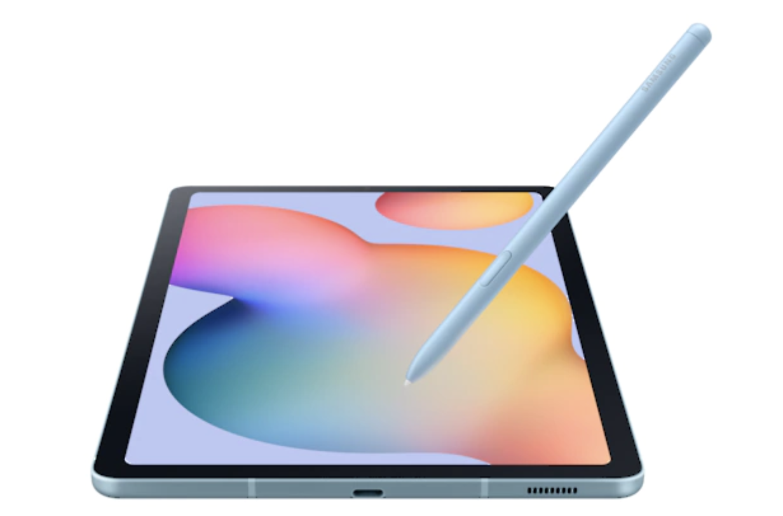
How do we find out?
walk up to the device
plug something in
exchange some signed data...
USB OTG cable

Slide 6
draft-richardson-rats-pop-endorsement
a serial console protocol... probably.
wait for login:/username:
login with “endorsementaudit” (no password)
could be just a “shell”
  better to have it run a custom program.
commands: “attestation-key”, “port-flash”, “port-down”, “port-up”,
“endorsements”
“exit”

Slide 7
Product is EAR
signed by device under audit’s (DUA) IDevID
so links up to PKI for vendor’s device identity
https://datatracker.ietf.org/doc/draft-richardson-rats-pop-endorsement/
verifier is auditor and auditor’s device
verifier will add additional information.
  like a picture of the device
  a list of cables/fibers/networks attached
Attestation Result is EAR
Result either goes up to cloud/infrastructure for later use.
Or: gets loaded into the DUA, having been signed by the audit/auditor’s infrastructure.

Slide 8
A connection to MUD, Ethernet
Since an IDevID is used, and can be returned, it can contain a MUD URL, which gives one many details about device type and access
Many devices do not have console port.
Would one want to do this over ethernet?
  IPv6-LL?
  LLDP?
Need to avoid being physically spoofed

