Slide 1
Avacado-mcrawf23
File created on: 1/8/24 4:06:46 PM PST

Slide 2
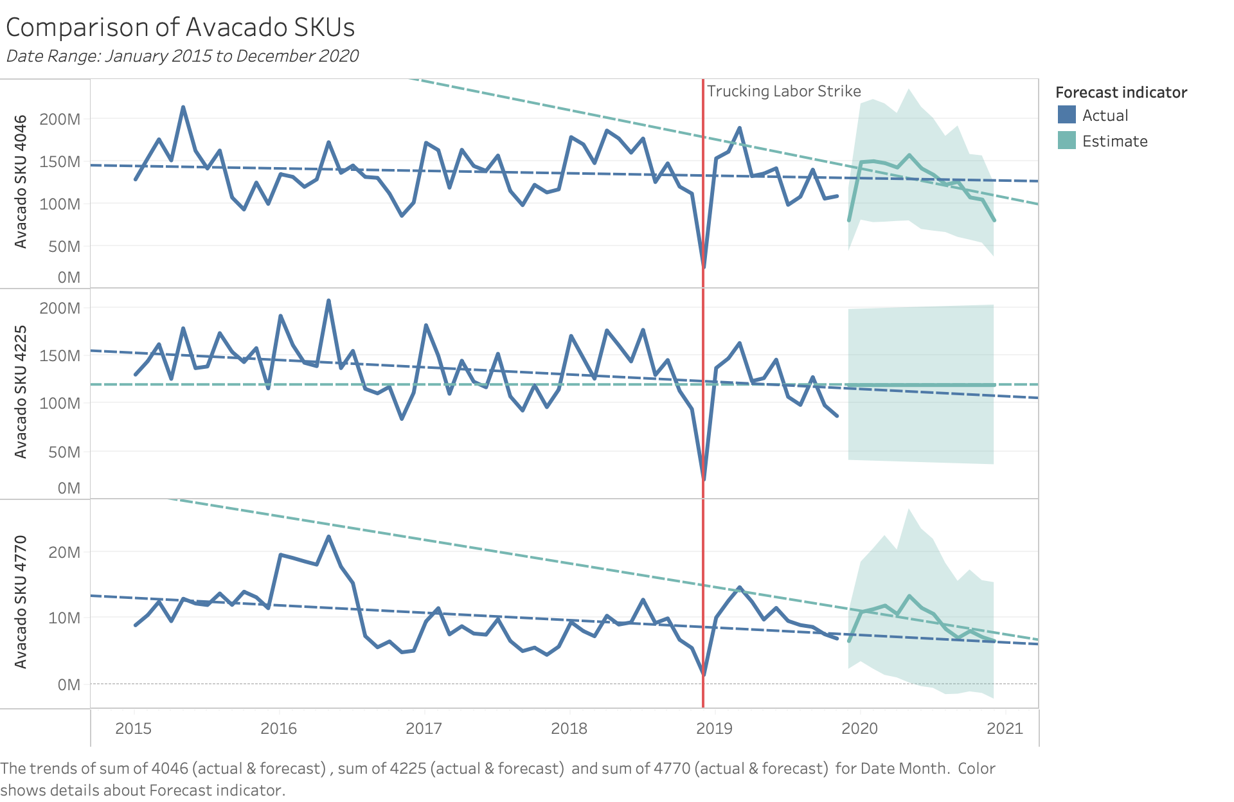

Slide 3
