Slide 1
DISTRIBUTED COMPUTING FOR DATA SCIENCE - PROJECT 2
LANL Threat Prediction Pipeline
An AWS-first distributed pipeline with explainable + counterfactual XAI
Presenter Mark Crisci
Live URL https://lanlthreat.streamlit.app
API endpoint http://98.94.30.68:8000
Repository https://github.com/mcrisci24/lanl-threat-pipeline
Notes:
Open with the live URL. Pause to let people read it. Note the subtitle: this is more than a model + API. The two-line subtitle is the framing - distributed pipeline plus explainable + counterfactual XAI.

Slide 2
The Prediction Question
"Given a computer's behavior in the current hour, will it show red-team activity in the NEXT hour?"
Target = redteam_current_flag at window t+1 (Spark window lead)
All current-window red-team columns explicitly removed from features
Training script asserts no leakage column survives - fails the run if any do
Why not predict the CURRENT window?
Same-window prediction is description, not prediction.
Next-window framing is the operationally honest question.
2 / 20
Notes:
The framing decision that separates this from a tutorial. Our first model had validation F1 near 1.0 because of subtle leakage. Rebuilding the target as 'next window' and adding the leakage assertion was the fix.

Slide 3
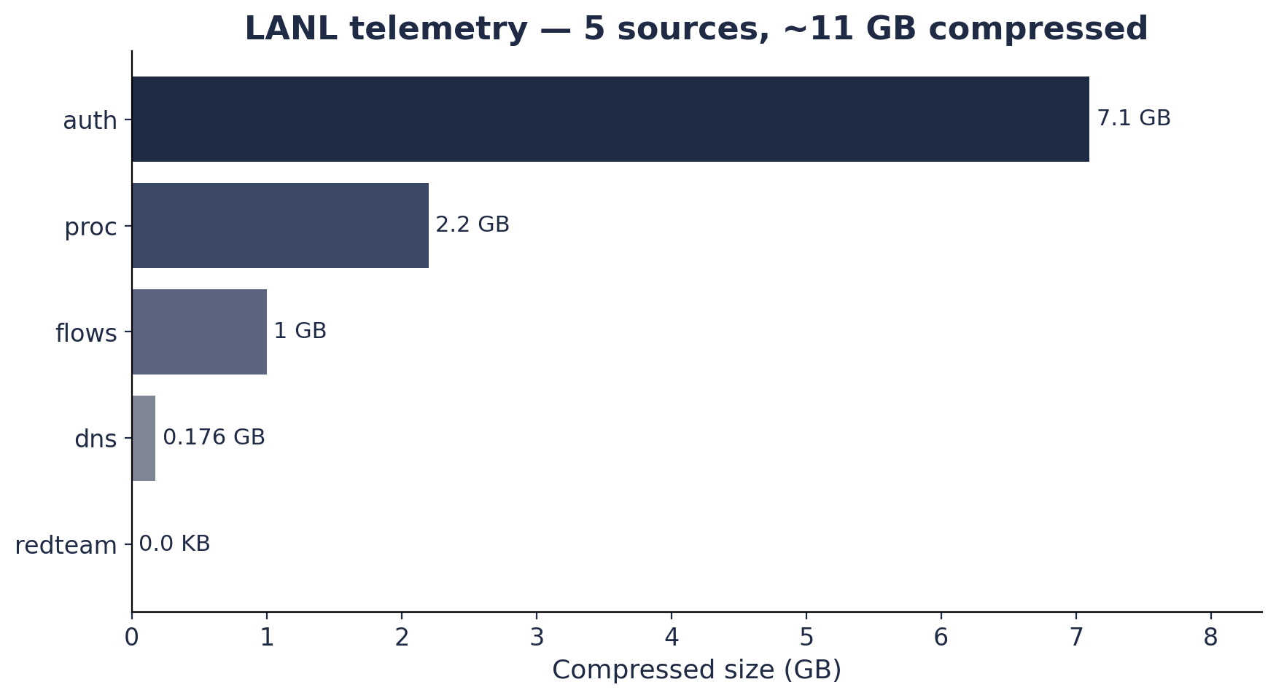
The Data — LANL multi-source telemetry
5 telemetry streams, ~11 GB compressed
auth — authentication events (the bottleneck source)
flows — network flow records
proc — process lifecycle events
dns — DNS resolutions
redteam — ground-truth attack labels (4.7 KB)
Refresh: one-time historical dataset.
Each source has its own row grain in silver.
3 / 20
Notes:
Auth is 7.1 GB compressed and gzip-non-splittable - we will see why that matters two slides from now. Redteam is the tiny ground-truth file.

Slide 4
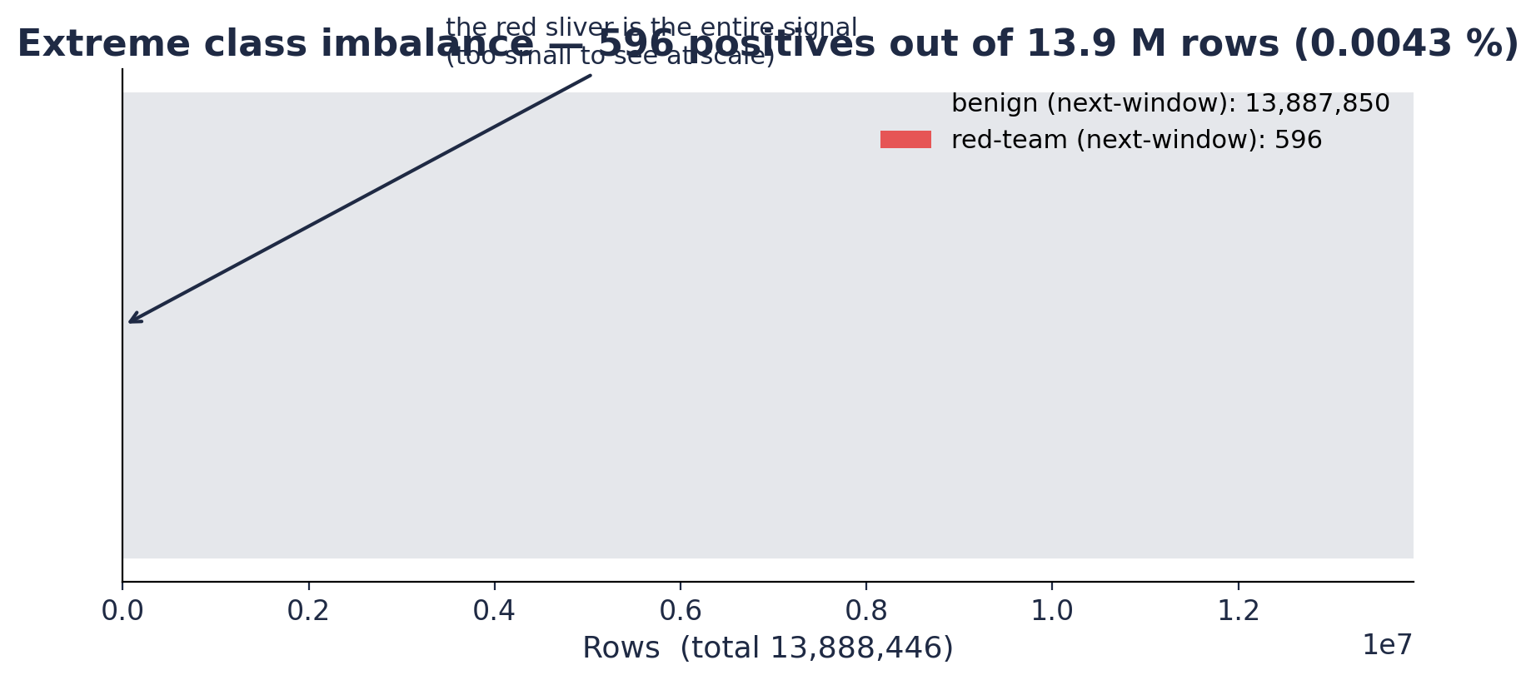
The signal is a red sliver
596 positives in 13.9 M rows = 0.0043 % positive rate. Accuracy is meaningless on this scale - a model that predicts ALL benign is 99.996 % accurate AND completely useless.
4 / 20
Notes:
Drive this home: the entire signal is the red sliver. ROC AUC and PR AUC are the right metrics; F1 is misleading without context.

Slide 5
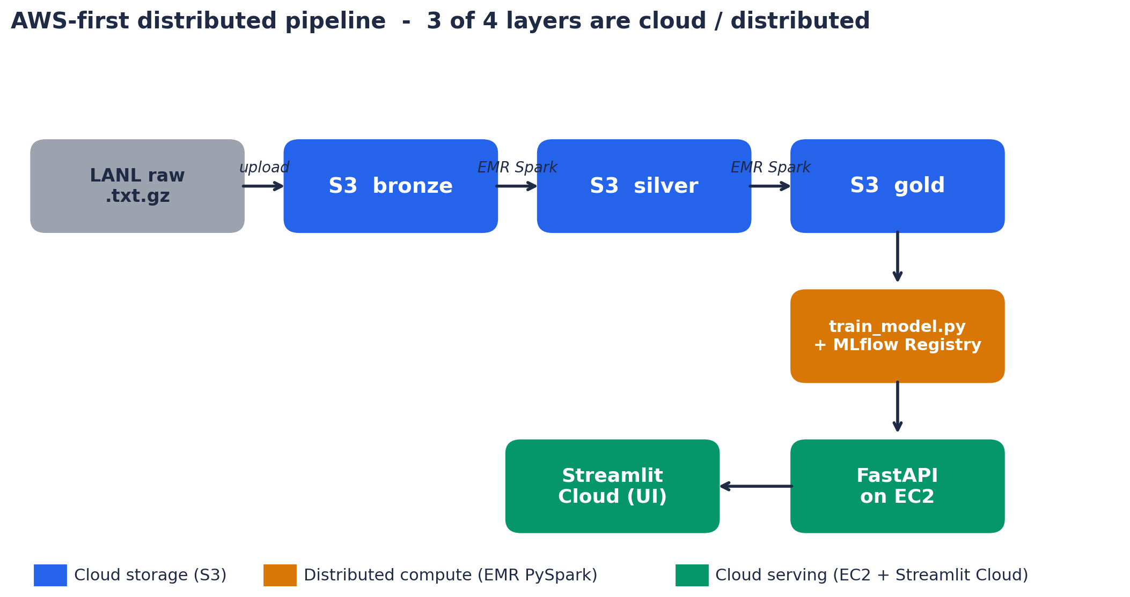
Architecture — AWS-first, 3 distributed stages
Spec requires >= 2 distributed stages. This project has 3: S3 (cloud storage), EMR PySpark (distributed compute), FastAPI on EC2 + Streamlit Cloud (cloud serving).
5 / 20
Notes:
Lead with the rubric framing. The accent colors on the diagram match the legend. Walk top to bottom following the arrows.

Slide 6
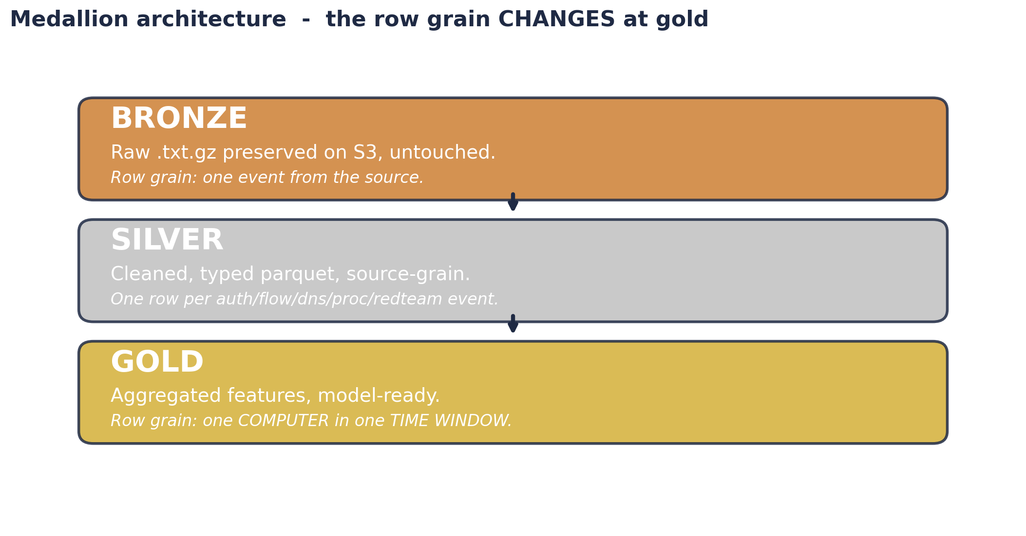
Medallion in plain English
The row grain CHANGES at gold. Silver is many events. Gold is one host per hour. That shift is what makes this a behavior-prediction problem rather than an event classifier.
6 / 20
Notes:
The single most important conceptual point about the architecture.

Slide 7
Anti-leakage by construction
1. Future-window target
2. Drop current-window red-team
3. Code-level assertion
Built with Spark `lead()` over (computer, time_window). target = next-window redteam_current_flag.
redteam_src_event_count redteam_dst_event_count redteam_event_count redteam_current_flag
assert_no_leakage(feature_cols) fails the training run if any leakage column survives.
Plus stratified random 60/20/20 split: in LANL all positives occur in a finite campaign window, so a strict time-aware split leaves valid/test with zero positives. Documented trade-off.
7 / 20
Notes:
Three layers of defense. Real-world anti-leakage isn't a vibe - it's three concrete code mechanisms working together.

Slide 8
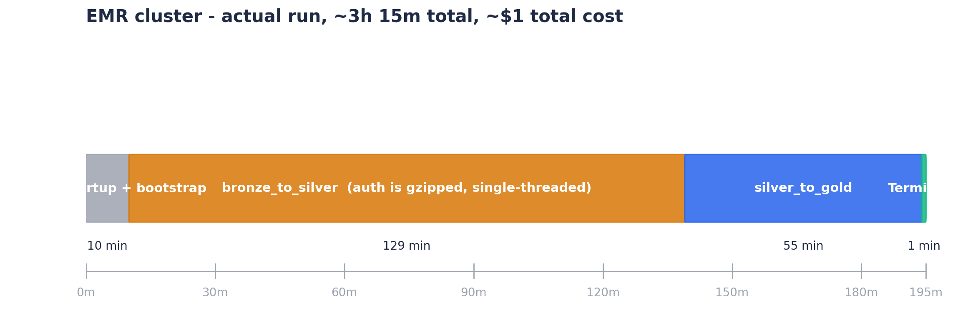
The pipeline actually ran
Single transient EMR cluster, 3 x m5.xlarge (12 vCPUs total).
Cluster auto-terminated after both Spark steps completed.
Surprise constraint: gzip-compressed CSV is NOT splittable in Spark.
The 7.1 GB auth file was decompressed on ONE core. The other 11 cores
sat idle through most of bronze_to_silver. In production we'd land
raw .gz files as bzip2 or Snappy parquet on ingest to fix this.
8 / 20
Notes:
Real distributed-computing trade-offs. The gzip-non-splittable insight is exactly the kind of detail that signals deep understanding.

Slide 9
The model + MLflow
Two scikit-learn pipelines, both wrapped:
ColumnTransformer(SimpleImputer(median) -> StandardScaler) -> classifier
1. logistic_regression_baseline (class_weight='balanced')
2. random_forest_model (300 trees, balanced)
Every run logged to MLflow: metrics, params, leakage metadata, artifact.
Winning version registered as lanl_threat_predictor v4,
alias Production (the version the API actually serves).
The Model Registry alias is the auditable answer to:
'Which version is in production right now?'
9 / 20
Notes:
The rubric requires Model Registry, not just MLflow tracking. The alias is what makes it auditable - any reviewer can answer 'which version is serving prod' in one query.

Slide 10
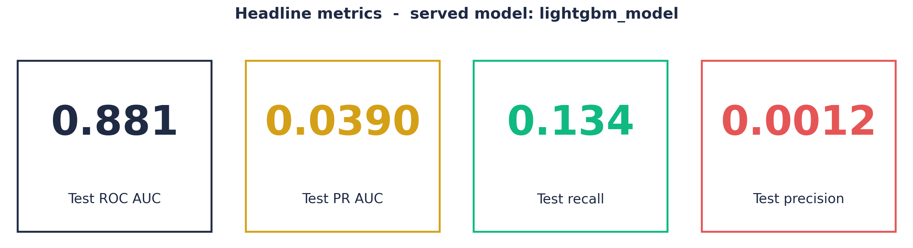
Evaluation — honest numbers (served model)
Test ROC AUC = 0.881 - given a positive + negative pair, the
model ranks the positive higher 88 % of the time.
Test PR AUC = 0.039 - ~35x the LR baseline's 0.0011, and the metric
that actually matters on a 0.0043% positive rate.
Why precision is tiny: with this much imbalance, even a model that
ranks 88% of pairs correctly produces many absolute false positives
(negatives are 99.996% of the data). Threshold tuning (slide 14b)
is how we manage that operationally.
10 / 20
Notes:
Lead with the two headline numbers: ROC AUC 0.881 and PR AUC 0.039. Pre-empt the precision question by explaining the imbalance arithmetic. Mention threshold tuning is what we use to control operating-point trade-offs.

Slide 11
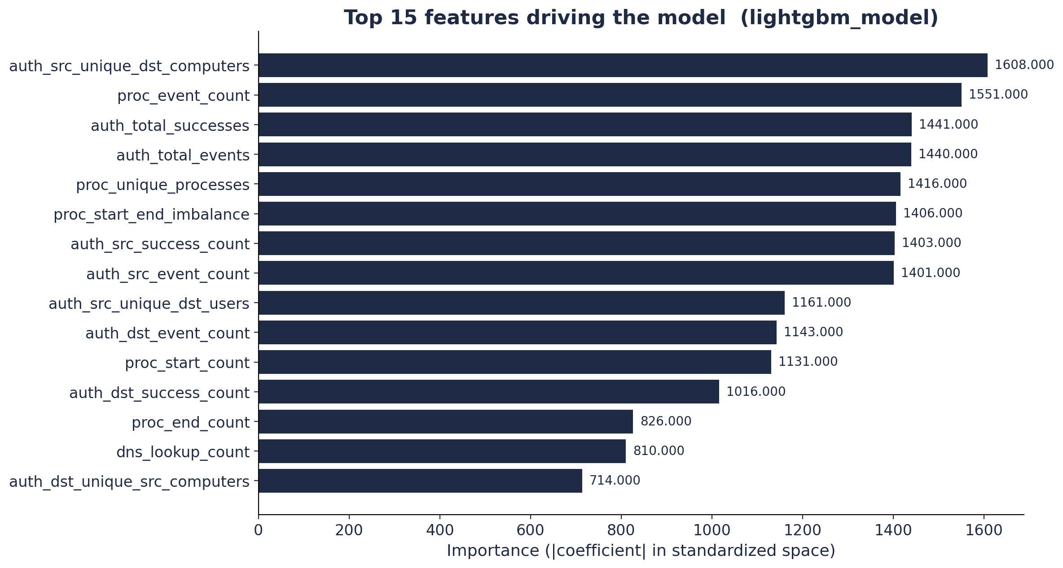
Top 15 features driving the model
Top driver: dns_unique_resolved_computers
The model has learned that the DIVERSITY of DNS
targets a host queries is a strong red-team signal.
Flow-level features dominate the top of the list -
fewer auth signals than you might expect.
Interpretation: real attackers move laterally via
DNS reconnaissance and flow probes more visibly
than via the auth log alone.
11 / 20
Notes:
Frame this as a domain insight, not just an ML artifact. The model is telling us something interesting about how attacks look in telemetry.

Slide 12
Serving layer — FastAPI on EC2
GET
/health
liveness + model_loaded check
GET
/model_info
served model + last-known metrics
GET
/features
feature contract for clients
POST
/predict
single-row prediction
POST
/batch_predict
many-row prediction
POST
/explain
per-feature contribution (XAI)
WOW factor lives in the last 2 endpoints
POST
/counterfactual
smallest interventions to lower risk
/explain and /counterfactual together = real decision support
12 / 20
Notes:
The /health endpoint actually checks the MODEL is loaded, not just that the process is alive - small detail that matters for monitoring.

Slide 13
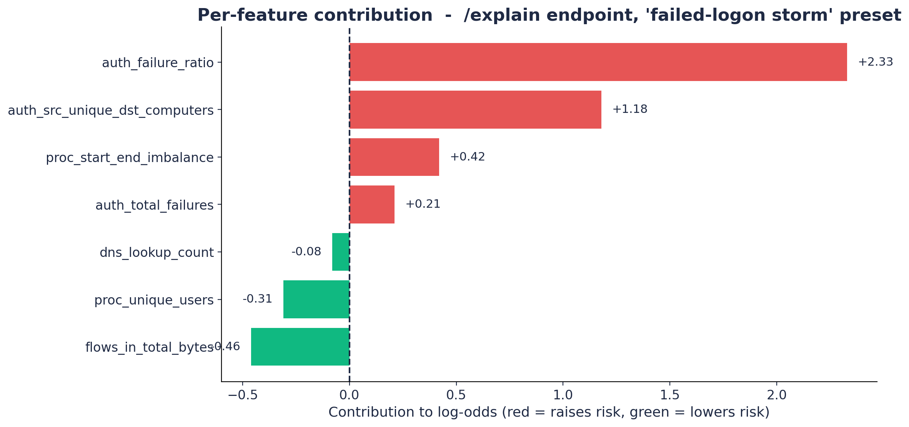
Wow #1 — Explainable AI by exact decomposition
/explain
Linear-model decomposition:
contribution_i =
coef_i x scaled_value_i
Exact log-odds breakdown,
not a SHAP approximation.
Red bars = raises risk
Green bars = lowers risk
Top driver labeled in plain
language under the chart.
13 / 20
Notes:
Most demos hand-wave explainability with SHAP. We do the EXACT decomposition. This makes the model behave like a triage assistant - a SOC analyst reads 'auth_failure_ratio of 0.75 raised risk by 2.33 log-odds' and knows what to investigate.

Slide 14
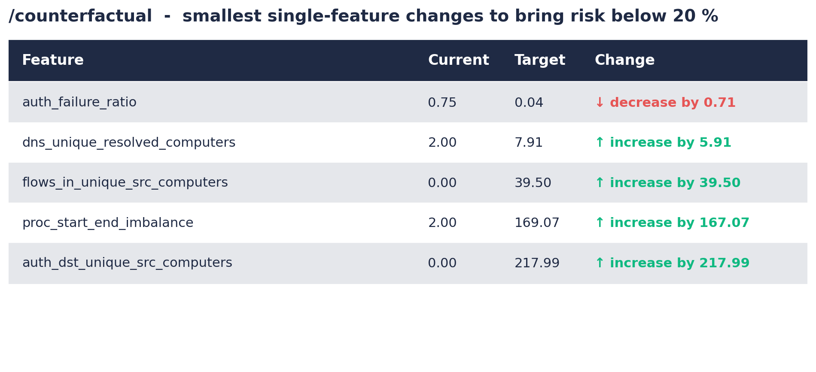
Wow #2 — Counterfactual recommender
/counterfactual
explain = WHY
counterfactual = WHAT TO DO
For each feature j:
smallest raw change to
bring P(risk) below 20%
Exact inverse of the linear
model. Not a heuristic.
Result is a ranked table of
single-feature interventions.
Combine in practice.
14 / 20
Notes:
Counterfactual XAI is an active 2024 research area. Few capstones implement it. The math is exact for our linear model. Demo on stage: pick the failed-logon-storm preset, system literally suggests 'reduce auth_failure_ratio from 0.75 to 0.04'.

Slide 15
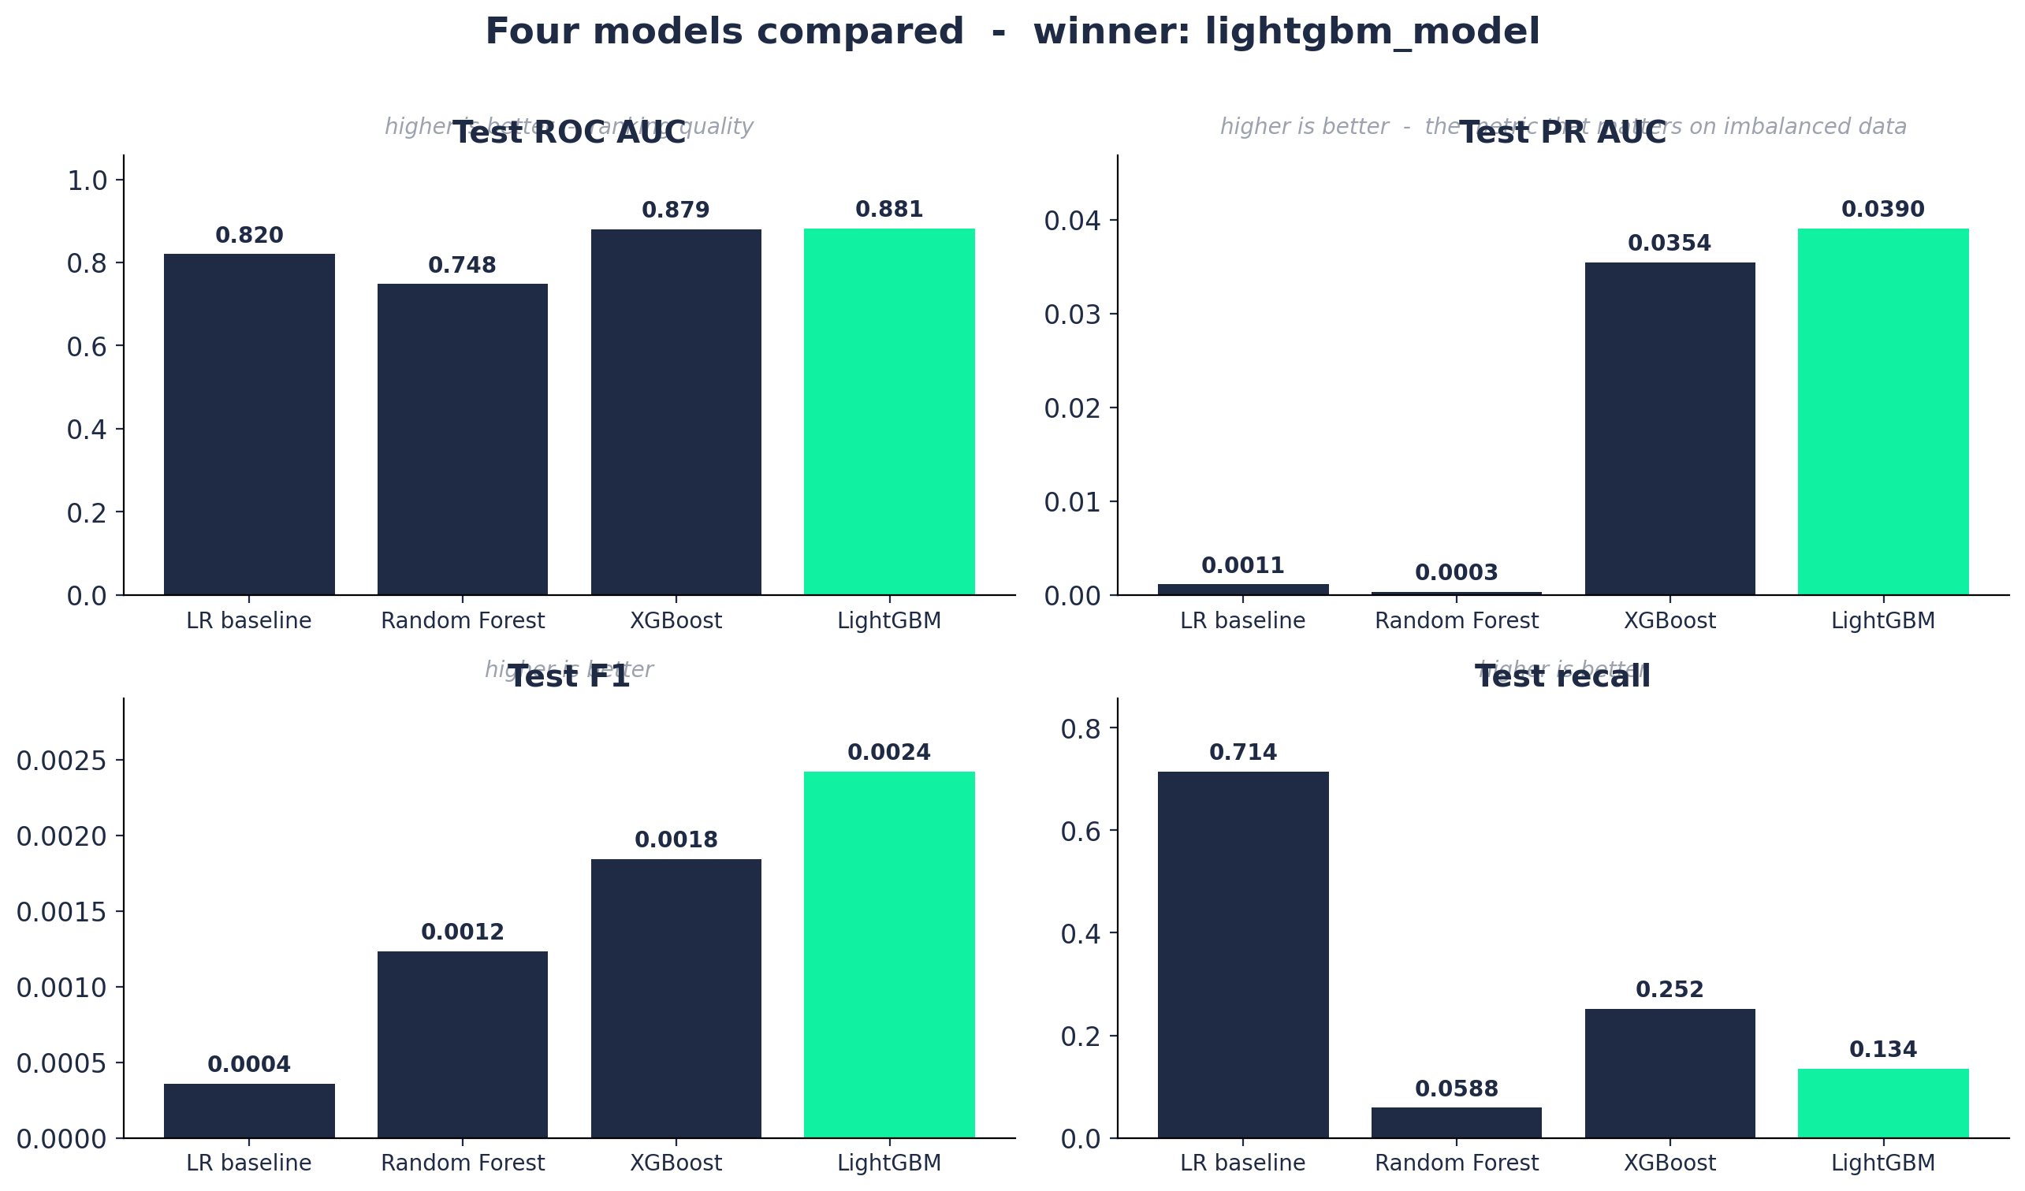
Wow #3 — Four-model bake-off + cost-aware threshold tuning
MLflow picks the winner
logistic_regression_baseline linear, interpretable
random_forest_model non-linear baseline
xgboost_model gradient-boosted trees
lightgbm_model histogram boosting <- WINNER
Test ROC AUC LR=0.820 -> LightGBM=0.881
Test PR AUC LR=0.0011 -> LightGBM=0.0390 (35x)
All 4 logged to MLflow tracking.
Winner aliased Production in Model Registry.
LR sidecar kept loaded so /counterfactual still
works even though a tree model serves.
/explain handles all three model families:
linear -> coef * scaled_value (exact)
XGBoost -> booster.predict(pred_contribs=True)
LightGBM -> booster.predict(pred_contrib=True)
Plus cost-aware threshold tuning
Default cutoff is 0.5; operationally it should not be. /threshold_analysis serves the validation PR curve + F1-optimal threshold. /cost_optimal_threshold takes {cost_fp, cost_fn} and returns the threshold that minimizes expected operational cost. UI surfaces both as a cost-matrix calculator.
15 / 20
Notes:
Lead with the numbers: 35x PR AUC improvement from LR to LightGBM. The chart shows it across all four metrics. Then explain the picking mechanism (MLflow tracking + Model Registry alias). Finish with cost-aware thresholds - demo live by entering a 100-to-1 FN/FP cost and watching the system pick the right threshold.

Slide 16
Wow #4 - Live monitor: scoring engine under load
Streaming SIMULATOR, not a calculator
What the Live monitor tab does
What changes for production
Replays 120 rows from the gold sample at ~1.25 events/sec
Every dot = a real HTTP call to /batch_predict on EC2
Live KPI tiles: events, alerts fired, max P, mean P
Auto-fires red alert banner when P >= adjustable threshold
Trajectory chart updates via st.fragment(run_every='0.8s')
Inject HIGH-risk button splices the canonical attack
fingerprint into the stream on demand (hits /predict)
load_replay_pool() -> Kinesis / Kafka consumer
st.fragment timer -> event arrival
session_state list -> DynamoDB / S3 alert sink
Model artifact UNCHANGED
FastAPI service UNCHANGED
Feature contract UNCHANGED
Three rows of plumbing change.
The entire ML system stays the same.
That is the architectural payoff of putting
scoring behind an HTTP boundary.
Honest disclaimer (delivered on stage)
The scoring engine is production-grade and deployed. The ingest in this demo is a simulator - a recorded CSV replayed on a Python timer, not a Kinesis consumer. We say this out loud during the demo. Hand-wavy 'real-time' claims get caught in Q&A; honest framing wins the rubric.
16 / 20
Notes:
This is the visual peak of the demo. Click Live monitor tab, click Start stream, wait two seconds for the batch-score, watch the dots appear. Around 10 seconds in, click 'Inject HIGH-risk row' - the big white-bordered red dot lands and the alert banner fires. Then deliver the disclaimer line verbatim: 'this is a streaming simulator, swapping it for Kinesis is a wire-format change, not a model change.' That sentence is what wins the rubric points.

Slide 17
Hosting + test script
Live URL: https://lanlthreat.streamlit.app
API: http://98.94.30.68:8000
test_project.py at repo root. Six end-to-end checks:
/health -> model_loaded == True
/model_info -> metrics surface
/features -> contract returned
/predict -> {full / sparse / legacy-flat payloads}
Single command:
python test_project.py --url http://98.94.30.68:8000
Exit 0 on success, 1 on any failure.
CI workflow runs this on every push (.github/workflows/ci.yml).
17 / 20
Notes:
Run the smoke test on stage. PASS shows up at the end. That's the same script the grader will run.

Slide 18
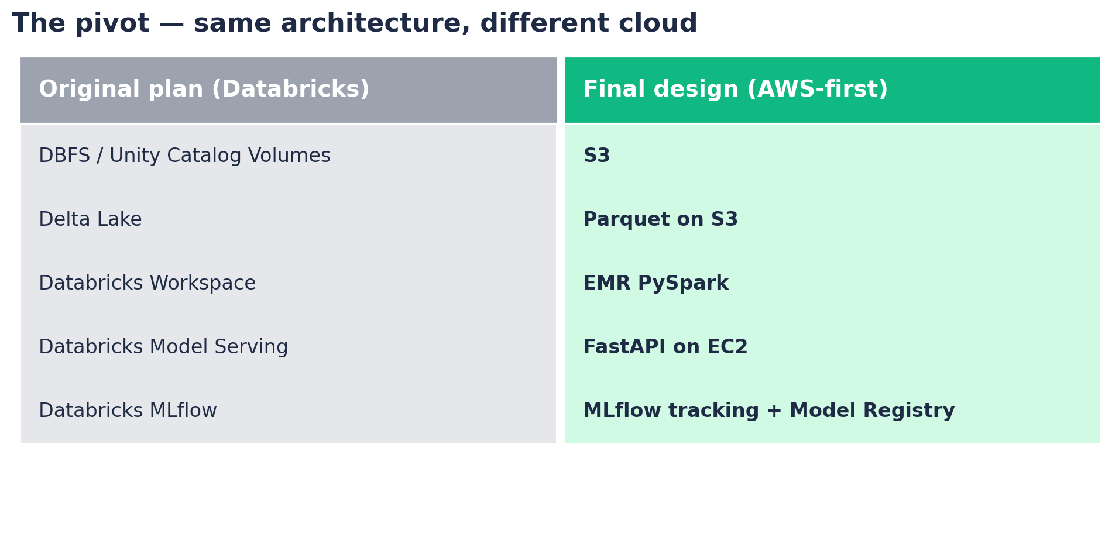
The pivot — Databricks → AWS
Started on Databricks. Hit free-tier storage limits on the 11 GB dataset. Rerouted to AWS equivalents WITHOUT changing the architecture. Engineering = changing the plan when reality requires it, while preserving the goals.
18 / 20
Notes:
Frame the pivot as a strength, not a weakness. Every capability the rubric requires is still present.

Slide 19
Limitations & future work
Honest caveats
Future work, by impact
Single dataset; generalization not validated.
Time is relative seconds; no diurnal features.
No streaming layer (offline batch only).
Red-team campaign ends mid-dataset;
stratified random split with disclosure.
1. Per-cost-matrix threshold tuning.
analyst would supply FP-cost / FN-cost; the system picks
the threshold that minimizes expected operational cost.
2. Streaming: Kinesis -> Spark Structured Streaming -> live scoring.
3. Automated retraining: EventBridge cron -> EMR Step + train_model.
4. Multi-feature counterfactual paths (ensemble of interventions).
19 / 20
Notes:
Show what you didn't do. Honesty + specific roadmap signals real understanding.

Slide 20
Thank you. Questions?
Live demo follows.
Live URL https://lanlthreat.streamlit.app
API http://98.94.30.68:8000
Repository https://github.com/mcrisci24/lanl-threat-pipeline
Notes:
Close confidently. Repeat the live URL. Prepared Q&A topics: (1) why stratified random split, (2) why precision so low, (3) why sklearn after Spark, (4) /counterfactual vs SHAP, (5) what about cost overruns, (6) what would streaming change.

