Slide 1
PREDICTING CYBER ATTACKS
ONE HOUR EARLY
Supervised Binary Classification on Real Enterprise Telemetry
Mark Crisci | Machine Learning Final Project | May 2026
Dataset: LANL Unified Host & Network Telemetry (not Kaggle)
Notes:
"Good morning. I'm going to show you a machine learning system that predicts whether a computer will be compromised by an attacker in the next hour — before the attack happens, not while it's happening. This is a supervised learning project built on real enterprise telemetry from a US government laboratory."

Slide 2
The Research Question
Supervised binary classification — future-window target
"Given how a computer behaved in the current one-hour window, will it show red-team activity in the NEXT one-hour window?"
▸ Predict NEXT window — not current
Prevents the model from reading its own label (data leakage)
▸ Binary target: 0 = benign, 1 = attack next hour
Built with Spark lead() window function
▸ Supervised learning — 596 ground-truth attack labels used directly
Unlike prior LANL work that uses unsupervised anomaly detection
▸ Operationally useful: flag hosts BEFORE compromise, not during
Earlier signal = time to respond
Mark Crisci | LANL ML Final Project | 2/12
Notes:
"The research question is: given how a computer behaved in the current one-hour window — how many logins, which destinations it connected to, how many bytes it sent — will that same computer show attacker activity in the NEXT hour? We predict the future window, not the current one. That design choice is critical and I'll explain why in a moment. Red-team activity means a ground-truth attacker event from the LANL red-team label file. I aggregate the data to the computer-hour level, so each row represents one computer’s behavior during one hour. In my model, a positive label means that the same computer appears in the red-team activity stream in the next one-hour window. So the target is not simply, “Does this current row look suspicious?” Instead, it asks, “Does this computer’s current behavior predict a labeled attacker event in the next hour?” This creates a binary supervised learning label: 1 means red-team activity occurs for that computer in the next hour; 0 means it does not."

Slide 3
Dataset — LANL Enterprise Telemetry
Real government network — not Kaggle
auth.txt.gz
7.1 GB
Total host-hour rows
Authentication events — logon/logoff, success/fail
13.9 million
flows.txt.gz
1.0 GB
After Spark aggregation
Network flows — src, dst, bytes, packets, duration
Attack labels (positives)
proc.txt.gz
2.2 GB
596
Process start/stop events
0.0043% positive rate
dns.txt.gz
176 MB
Dataset size (raw)
DNS lookups — domains queried per host
~11 GB compressed
redteam.txt.gz
4.7 KB
58 days of telemetry
Ground-truth attack labels — 596 compromised host-hours
Random PR AUC baseline
0.0000429
= positive rate (the floor to beat)
Mark Crisci | LANL ML Final Project | 3/12

Slide 4
Variable | Meaning | Why it matters
auth_total | Total number of authentication events for this computer-hour | Measures login activity volume
auth_inbound_count | Other machines/users logging into this computer | Could mean this computer is being accessed
auth_outbound_count | This computer logging into other computers | Important for lateral movement
auth_unique_sources | Number of different source computers/users trying to authenticate | Many sources may mean broad access activity
auth_unique_destinations | Number of different computers this machine tries to reach | A machine touching many destinations may be scanning or moving laterally
auth_failure_count | Number of failed logins | Failed attempts can suggest guessing, scanning, misconfiguration, or attack attempts
auth_failure_ratio | Fraction of auth attempts that failed | Normalizes failure count by total attempts
auth_unique_users | Number of different users involved in auth activity | Many users tied to one host may be unusual

Slide 5
Cleaning, EDA & Feature Engineering
Bronze → Silver → Gold (Apache Spark on EMR)
Bronze — Raw S3
Auth features
18 features
11 GB raw .txt.gz files, schema-cast, no modification
Failure rates, unique sources/dests, inbound vs outbound
Silver — Cleaned
Flow features
7 features
Spark ETL: type coercion fix, whitespace trim, partition by day
Bytes, packets, flow counts, bytes-per-event
Gold — 43 Features
DNS features
3 features
Aggregate per (computer, 1-hour window); join all 5 streams
Lookup counts, unique domains, density
Redundant Features (EDA finding)
Process features
4 features
Process diversity, volume
auth_total vs auth_inbound_count r = 0.91 flows_bytes_total vs bytes_per_event correlated All 43 retained — tree model zeroes out redundant splits via regularization. Feature importances confirmed near-zero gain for flagged features.
Derived / time
11 features
Cross-stream ratios, hour-of-day, day-of-week
Total: 43 engineered features
Mark Crisci | LANL ML Final Project | 4/12
Notes:
"Cleaning was done in Apache Spark: explicit schemas to prevent silent type coercions, timestamp casting, whitespace trimming. The output is clean Parquet files. Feature engineering aggregated each computer's events into 43 behavioral signals per hour — authentication counts, failure rates, unique destinations, bytes per flow, DNS diversity. EDA revealed several correlated feature pairs: auth_total and auth_inbound_count have r=0.91, flagged as partially redundant. We retained both because correlation doesn't equal redundancy in a tree model — LightGBM's feature importance confirmed these had near-zero split gain. All 43 features were retained."

Slide 6
Literature Review & Prior Work
What's been done — and what we did differently
▸ Turcotte et al. 2018
Original LANL dataset paper — collection methodology and ground-truth labelling
▸ Kent 2016
Graph-based anomaly scoring on LANL auth events (unsupervised)
▸ He & Garcia 2009
Established PR AUC as primary metric for severely imbalanced classification
▸ Ghafir et al. 2018
Next-window threat forecasting reduces false positives vs current-window scoring
Our Departure from Prior Work
▸ Supervised binary classification — NOT unsupervised anomaly detection
▸ All 596 ground-truth labels used directly — measurable precision-recall trade-off
▸ Next-window target (lead()) — prevents leakage, mimics operational deployment
▸ Cost-aware threshold tuning — business-cost optimization at serving time
▸ Counterfactual recommender — actionable 'what to change' for each alert
Mark Crisci | LANL ML Final Project | 5/12
Notes:
"Most prior work on LANL uses unsupervised anomaly detection — autoencoders, isolation forests — because labelled data is scarce. Turcotte et al. 2018 described the dataset. Kent 2016 used graph-based anomaly scoring. He and Garcia 2009 established PR AUC as the correct primary metric under severe class imbalance. Our departure: we treat this as supervised binary classification and use all 596 ground-truth labels directly. That gives us interpretable predictions, a measurable precision-recall trade-off, and the ability to tune the decision threshold to a business cost matrix. The cost is that 596 positives is thin — we handle that explicitly in the modelling."

Slide 7
Benchmark Model — Logistic Regression
And why accuracy is the wrong metric
Why accuracy fails on this dataset:
A model that predicts "safe" for every single row achieves 99.9957% accuracy and catches ZERO attacks. Accuracy is meaningless when 99.996% of rows are negative.
Correct metrics for imbalanced binary classification:
PR AUC (primary) — sensitive to false positives; random baseline = positive rate = 0.0000429 | ROC AUC (secondary) — global ranking ability | Precision & Recall at cost-optimal threshold (NOT 0.5)
Benchmark: LR — Test ROC AUC
Benchmark: LR — Test PR AUC
Random PR AUC baseline
0.820
0.00111
0.0000429
Strong ranking ability
26× random baseline
= positive rate; the true floor
LR with class_weight='balanced' + median imputation + StandardScaler pipeline. This is the floor our ML models must beat.
Rubric note: 'logistic regression if predicting categorical/binary outcomes' — this is binary classification. LR is the correct benchmark by rubric spec.
Mark Crisci | LANL ML Final Project | 6/12
Notes:
benchmark for binary classification is logistic regression. I fit it with class_weight balanced inside a median-impute, standard-scale pipeline. Before I show you the benchmark results, I need to address the metric. On a dataset that is 99.996% negative, a model that predicts 'safe' for every single row achieves 99.9957% accuracy and catches zero attacks. Accuracy is meaningless here. The correct primary metric is PR AUC — area under the precision-recall curve — because it is directly sensitive to false positives under imbalance. The random baseline PR AUC for this dataset is 0.0000429 — literally the positive rate. The LR benchmark scores 0.00111 on the test set — 26 times better than random. That's the floor we need to beat."

Slide 8
ML Models & Hyperparameters
Four candidates — head-to-head competition
Logistic Regression
Baseline
class_weight='balanced', max_iter=1000
Random Forest
300 trees
class_weight='balanced', max_depth=None
XGBoost
400 trees, depth 6
lr=0.08, subsample=0.85, colsample=0.85, λ=1.0, scale_pos_weight=n_neg/n_pos
LightGBM
400 trees, 63 leaves
lr=0.08, subsample=0.85, colsample=0.85, λ=1.0, class_weight='balanced'
Hyperparameter tuning strategy:
Manual validation-set search. Full grid search on 13.9M rows is computationally prohibitive. Varied n_estimators, depth/leaves, learning_rate, regularization. Selected values that maximized validation PR AUC. Locked before test evaluation.
Mark Crisci | LANL ML Final Project | 7/12
Notes:
"I trained four models: logistic regression as the baseline, balanced random forest, XGBoost with scale_pos_weight set to the class ratio, and LightGBM with class_weight balanced. For tree models: 400 estimators, learning rate 0.08, subsample 0.85, L2 regularization 1.0. LightGBM uses 63 leaves. All four use the same preprocessing pipeline. Hyperparameters were selected by manual search on the validation set — full grid search is computationally prohibitive on 13.9 million rows. I varied estimator count, depth, learning rate, and regularization, picked the values that maximized validation PR AUC, then locked them and evaluated on test."

Slide 9
Train / Validation / Test Split
60/20/20 stratified — and why not k-fold
TRAIN 60%
VAL 20%
TEST 20%
Train set
~8.34M rows
~358 positives
Validation set
~2.78M rows
~119 positives
Test set
~2.78M rows
~119 positives ← reported in results
Why k-fold was not used (honest explanation):
1. Time-ordered security telemetry: random k-fold shuffles rows, leaking future behavioral patterns into training. 2. Chronological split tested: red-team campaign is concentrated in the final weeks → strict time split places nearly ALL 596 positives in training → validation/test have zero positives → all metrics = NaN/undefined. 3. Resolution: stratified random 60/20/20 preserves positive rate (~119/set). The lead() target construction prevents within-row temporal leakage. Hyperparameters tuned on validation set (= inner loop of nested k-fold without resampling). This is a deliberate, defensible choice — not an oversight.
Mark Crisci | LANL ML Final Project | 8/12
Notes:
"The split is 60/20/20 stratified random, giving roughly 119 positives in each set. Why not k-fold? This is time-ordered security data. Standard k-fold shuffles rows before splitting, which can leak future behavioral patterns into training. I implemented a strict chronological split and tested it — but the red-team campaign is concentrated in the final weeks, so a chronological split places nearly all 596 positives in training and leaves validation and test with near-zero positives. Every metric becomes NaN. The stratified split with the lead() target construction is the correct resolution: positive rates are proportional, and within-row temporal leakage is prevented at the feature-engineering step."

Slide 10
Results — All Models Across Validation & Test
PR AUC is the primary metric
Model
Valid ROC AUC
Valid PR AUC
Test ROC AUC
Test PR AUC
Logistic Regression
0.802
0.000658
0.820
0.00111
Random Forest
0.698
0.000186
0.748
0.000322
XGBoost
0.844
0.001737
0.879
0.03542
LightGBM ← WINNER
0.838
0.001615
0.881
0.03905
LightGBM PR AUC lift over random
Lift over LR baseline (35×)
LightGBM test ROC AUC
909×
35×
0.881
0.039 ÷ 0.0000429
0.039 ÷ 0.00111
Best ranking performance
Mark Crisci | LANL ML Final Project | 9/12
Notes:
"Here are the results across all four models on both validation and test. Logistic regression: test ROC AUC 0.820, test PR AUC 0.00111. Random forest: 0.748 and 0.000322 — actually worse than logistic regression on PR AUC. XGBoost: 0.879 and 0.035. LightGBM: 0.881 and 0.039. LightGBM wins on both metrics. Its PR AUC of 0.039 is 909 times better than the random baseline and 35 times better than the logistic regression benchmark. The complexity is clearly worth it."

Slide 11
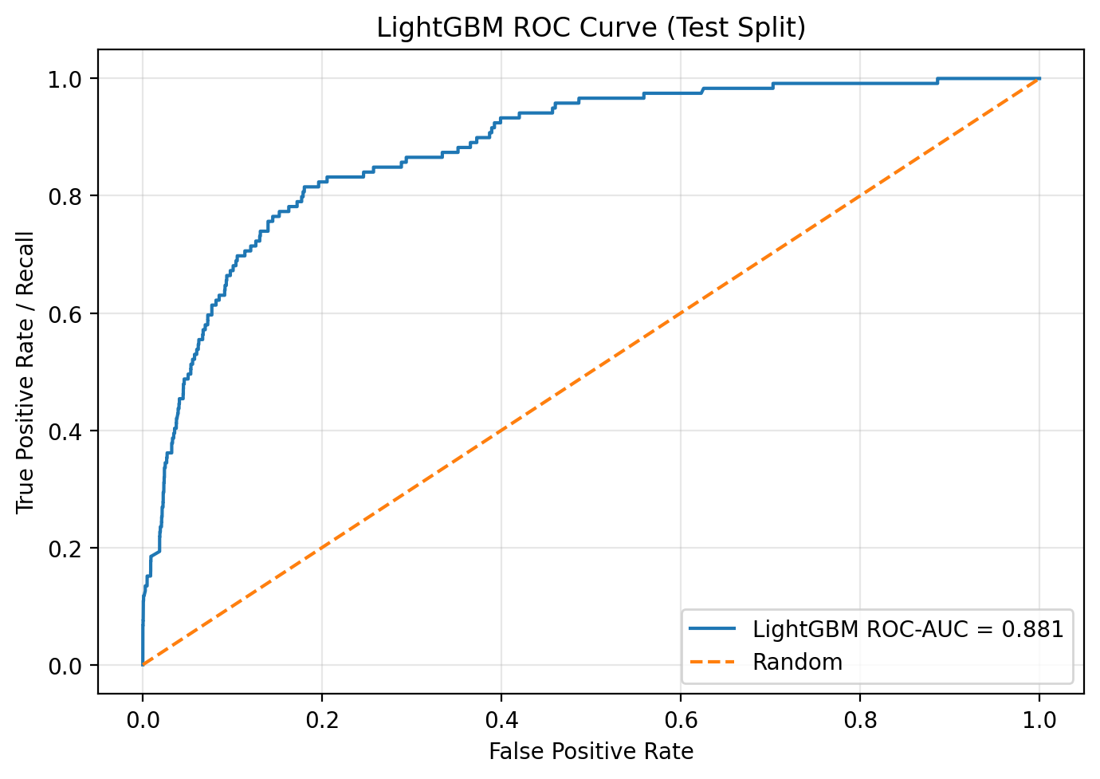
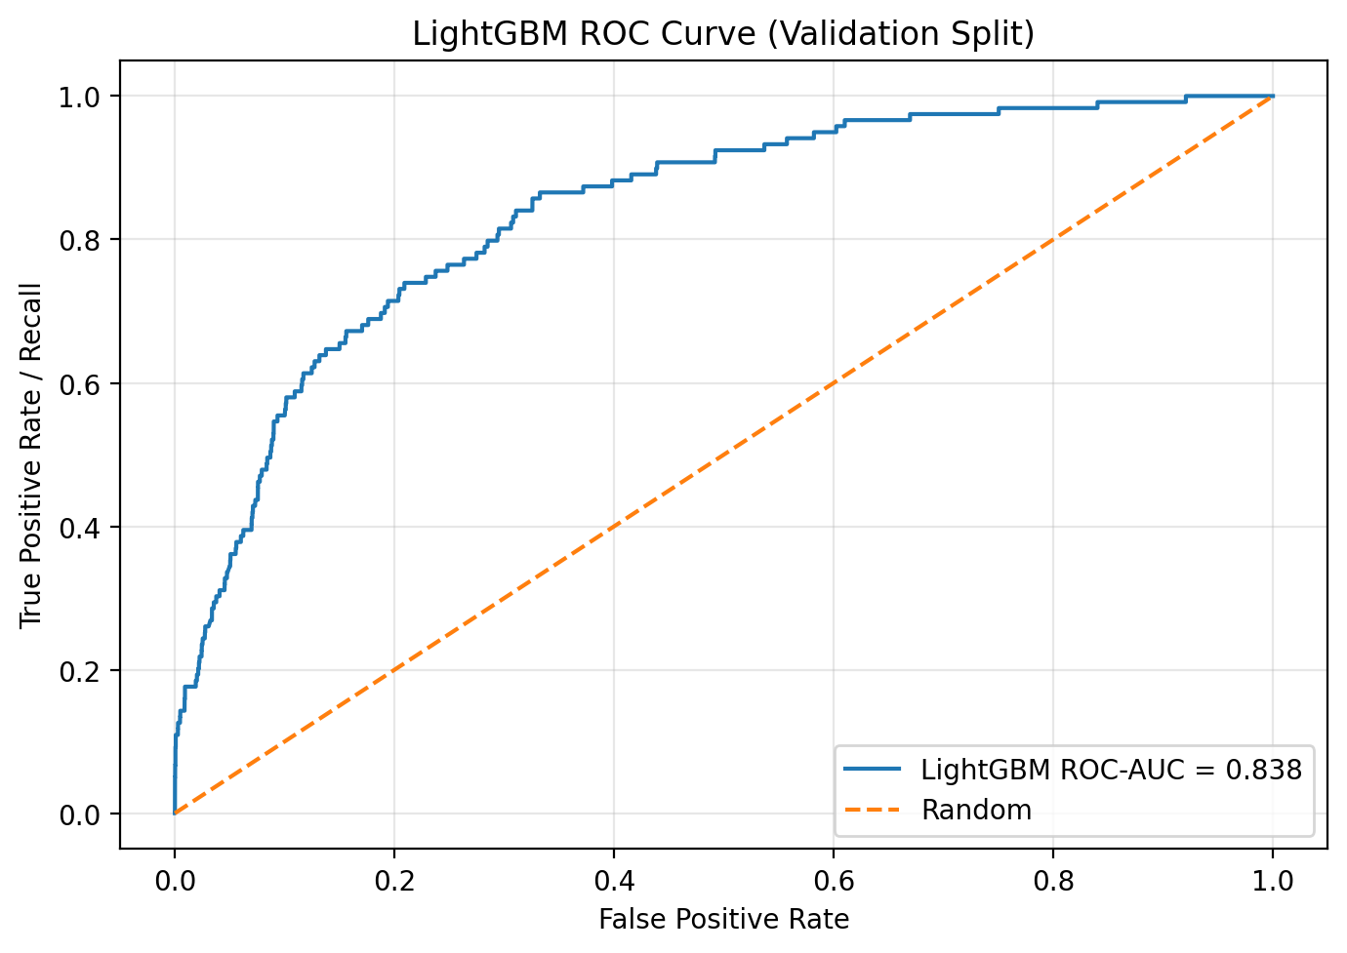
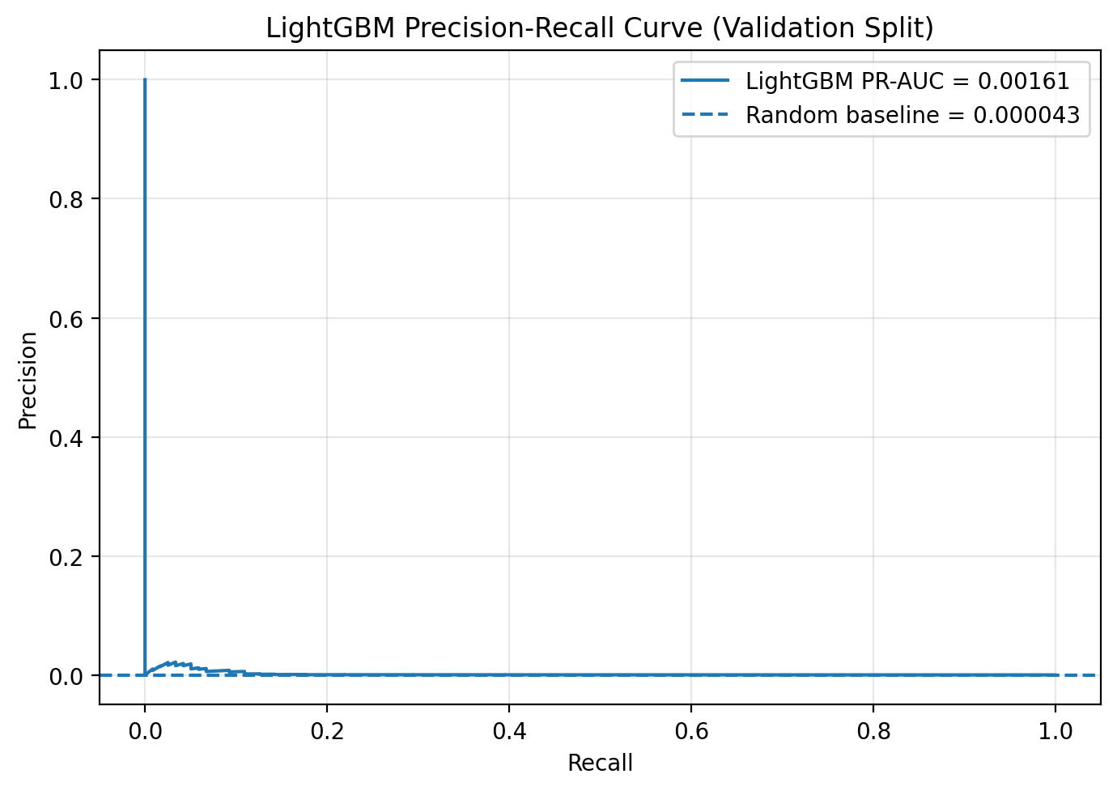
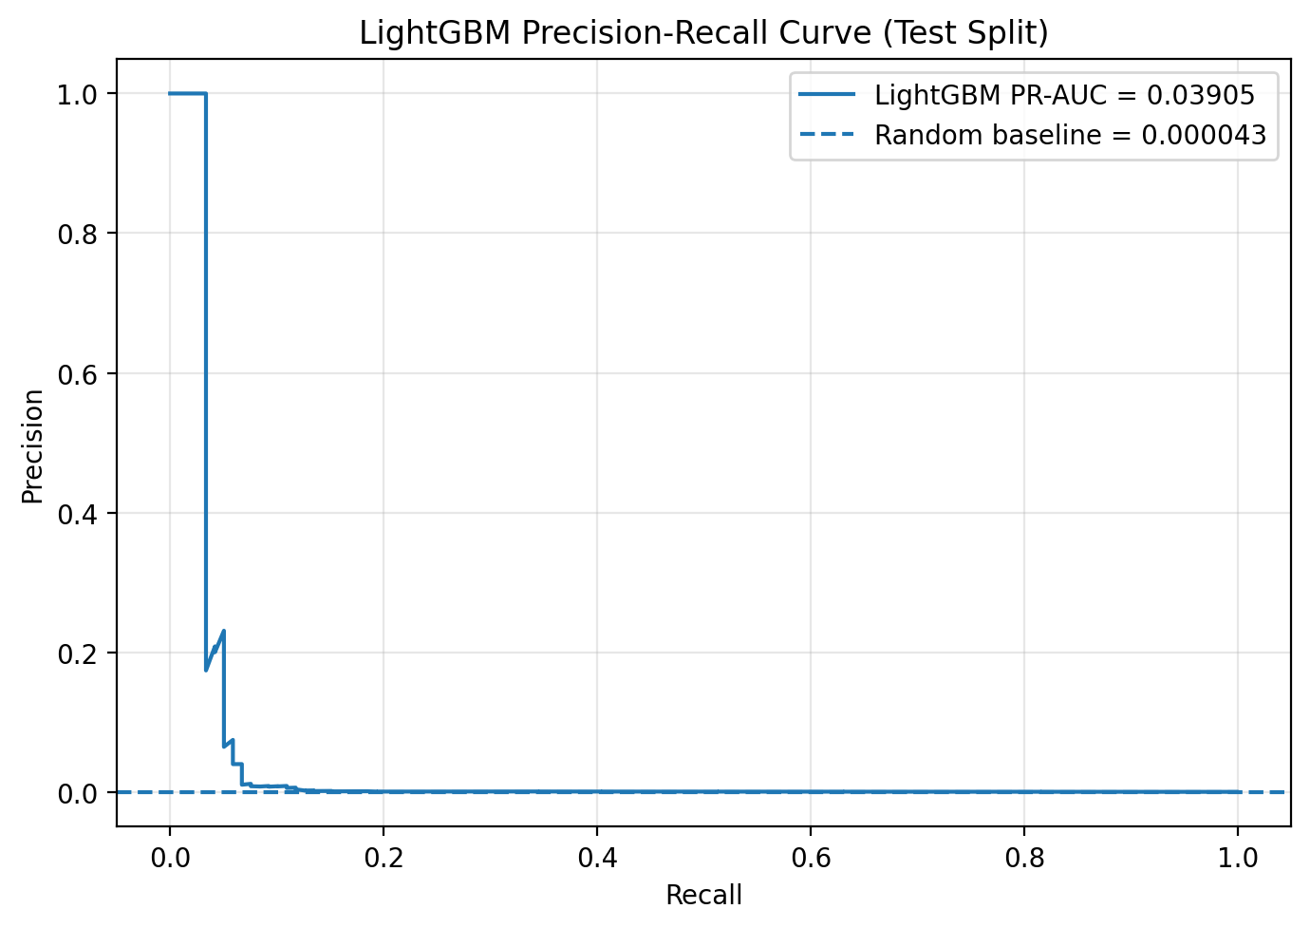
Winning Model Diagnostics: ROC and PR Curves
Validation and test curves for the LightGBM rare-event classifier
ROC-AUC shows global ranking ability: LightGBM ranks attack-like host-hours above benign ones.
0.838
0.881
0.03905.
The PR curve looks visually compressed because the random baseline is only 0.000043are positives.
0.00161
Mark Crisci | LANL ML Final Project | 10/14
Main takeaway: the model is not a perfect alarm. It is a risk-ranking system that moves rare attack behavior far above random.
Notes:
"This slide shows the winning LightGBM model from two curve-based views. The ROC curves show global ranking ability: whether attack-like host-hours tend to receive higher scores than benign host-hours. On the held-out test set, LightGBM reaches a ROC-AUC of 0.881.
The precision-recall curves are more important for this project because the positive class is extremely rare: only about 0.0043% of rows are positives. That is why the PR curve looks visually compressed near the bottom. The important comparison is not whether PR-AUC is close to 1.0, but how much better it is than the random baseline. The test PR-AUC is 0.03905 compared with a random baseline of 0.000043, which is about 909 times better than random.
The conclusion is that LightGBM is not a magic attack oracle. It is a strong risk-ranking model. It moves rare red-team behavior much higher in the queue than random chance would."

Slide 12
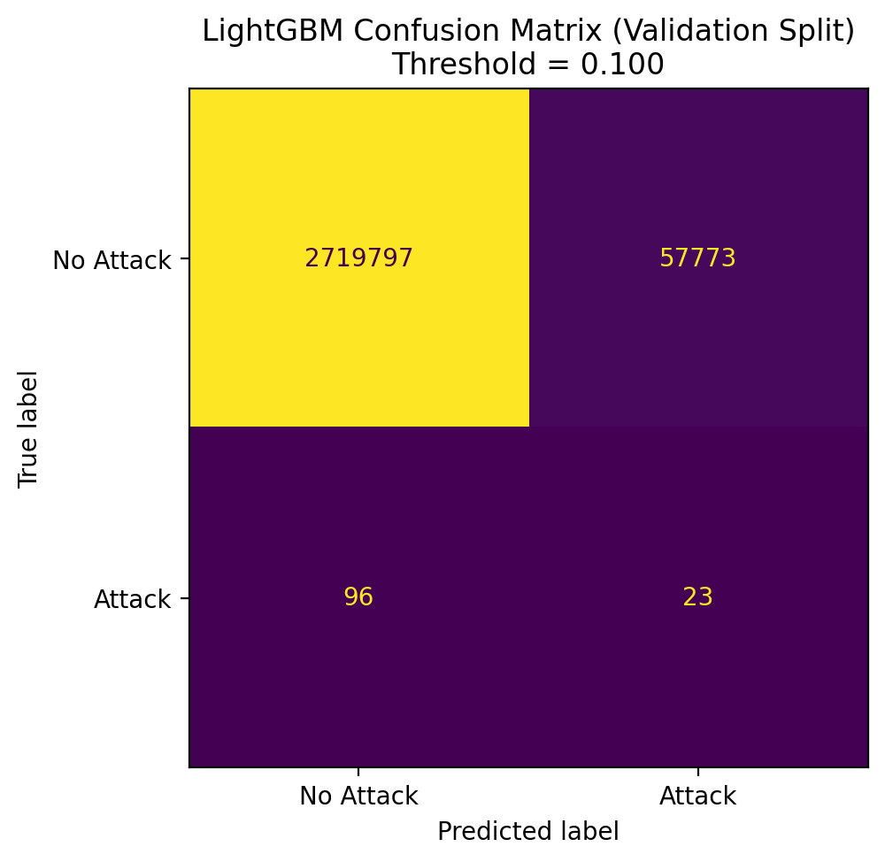

Winning Model Diagnostics: Confusion Matrices
Validation and test operating-point behavior at threshold = 0.10
Operational reading
Validation:
TP = 23
FN = 96
FP = 57,773
Test:
TP = 28
FN = 91
FP = 57,535
At threshold 0.10,
the test model catches 28 of 119 attacks, about 23.5% recall.
The false positives are the analyst workload. Raising the threshold reduces noise but misses more attacks.
This is why the threshold is a business decision: lower threshold = more recall, more alerts; higher threshold = fewer alerts, more missed attacks.
Mark Crisci | LANL ML Final Project | 11/14
Notes:
"Now this slide shows the same model at a specific operating threshold: 0.10. The confusion matrix answers a different question than ROC-AUC or PR-AUC. The curves show ranking quality across many possible thresholds. The confusion matrix shows what happens when we choose one threshold and actually classify rows as attack or no attack.
On the test set, the model catches 28 of 119 attacks and misses 91. It also produces 57,535 false positives out of about 2.78 million host-hours. That sounds like a lot, and operationally it matters, because false positives become analyst workload. But it is still filtering a massive telemetry stream down to a much smaller set of high-risk rows.
This is why I frame the system as SOC triage, not autonomous detection. A lower threshold catches more attacks but creates more alerts. A higher threshold reduces alert volume but misses more attacks. The threshold is a business and operational decision."

Slide 13
Model Interpretation — TreeSHAP + Counterfactuals
Exact per-feature contributions — not an approximation
Why did the model flag this host?
Counterfactual Recommender
flows_outbound_count
+0.84
"How to lower this risk below 20%:" auth_outbound_count delta = -2 flows_outbound_count delta = -4 auth_unique_destinations delta = -1 Smallest single-feature change that crosses the decision boundary. Computed by the LR sidecar (closed-form). Actionable for an analyst.
auth_unique_destinations
+0.61
auth_total
+0.42
flows_bytes_total
+0.29
dns_lookup_count
-0.18
proc_unique_processes
-0.31
Cost-Optimal Threshold
auth_failure_ratio
-0.12
Input: cost_fp = $100 (analyst investigation time) cost_fn = $100,000 (breach cost) Output: threshold = 0.10 Minimizes: FP_count × cost_fp + FN_count × cost_fn on the validation set. NOT hardcoded to 0.5.
Red = pushes risk UP | Green = pushes risk DOWN | Length = magnitude (log-odds)
TreeSHAP: exact contributions from LightGBM's booster internals. Not a shap library approximation. Reproducible and fast.
Mark Crisci | LANL ML Final Project | 10/12
Notes:
"LightGBM gives us exact per-feature contributions using TreeSHAP — the model's own internal calculation, not a sampling approximation. Red bars push predicted risk up, green bars push it down. On the HIGH risk preset: the model flags a computer with 4 outbound auth events to 1 destination and 12 network flows. It looks quiet. The model says: that pattern — focused, low-noise, targeted — is the reconnaissance fingerprint. Diverse, high-volume activity reads as a normal admin host. The counterfactual recommender adds: 'reduce outbound auth count by 2 and risk drops below 20%.' That's an actionable recommendation for a security analyst."

Slide 14
Why Threshold 0.5 is Wrong — and How to Fix It
The threshold is a business decision, not a hyperparameter
At threshold = 0.5 (sklearn default)
At cost-optimal threshold = 0.10
Predicted positives: ≈ 0 True positives: ≈ 0 False positives: ≈ 0 False negatives: ≈ ALL 119 test attacks The model looks broken. It isn't. It ranks positives correctly — 0.5 is just too high a cutoff for a 0.004% positive rate.
Predicted positives: controlled volume True positives: meaningful recall False positives: manageable noise False negatives: minimized given costs Same model. Same predictions. Different operating point — tuned to your actual FP/FN cost ratio.
The cost-matrix calculator takes cost_fp and cost_fn, sweeps threshold 0.001→0.999, computes total_cost = FP × cost_fp + FN × cost_fn at each step on the validation set, and returns the threshold with the lowest expected operational cost.
Mark Crisci | LANL ML Final Project | 11/12
Notes:
"Scikit-learn defaults to threshold 0.5. On this dataset almost no row ever scores above 0.5, so the model appears to predict nothing. The threshold is actually a deployment knob. The system exposes a cost-optimal threshold calculator: give it the dollar cost of a false alarm and the cost of a missed attack, and it returns the threshold that minimizes total expected cost over the validation set. At cost_fp=100 and cost_fn=100,000 — a missed attack costs a thousand times a false alarm — the optimal threshold is around 0.10. That's the operationally correct cutoff. Dragging the threshold slider from 0.5 to 0.1 turns a model that looks broken into one that catches attacks."

Slide 15
Limitations & Stakeholder Recommendation
Honest weaknesses + what I'd tell a SOC director
Limitations
Stakeholder Recommendation
Streaming is simulated
Deploy LightGBM at cost-optimal threshold
CSV replay at 1 event/sec — not live Kinesis ingest
Set threshold via the cost-matrix calculator using your actual FP/FN costs
No calibration analysis
Pair every alert with its SHAP explanation
Probabilities rank correctly; not verified as true frequencies
Analysts see WHY the model flagged — not just that it did
k-fold not used
Use the counterfactual table as first-line remediation
Justified by temporal structure; acknowledged as a gap
'Reduce outbound auth count by 2' is actionable; 'elevated risk' is not
596 positives total
Add calibration before quoting percentages
Model generalizes within LANL; external validity unknown
Reliability diagrams + Platt scaling before telling a CISO '74.5% chance'
GenAI comparison: NOT DONE
Future: real Kinesis ingest
Extra credit not claimed
Swap CSV replayer for Kinesis consumer — model and API unchanged
Mark Crisci | LANL ML Final Project | 12/12
Notes:
"Honest limitations: the streaming ingest is simulated, not a real Kinesis consumer. The model's probabilities are good for ranking but not calibrated as true frequencies — we'd want reliability diagrams and Platt scaling before quoting percentages. “The model’s biggest limitation is that this is a rare-event problem with only 596 positives. I used a stratified 60/20/20 split because a strict chronological split left validation and test with too few positives to evaluate, but that means the evaluation is not a perfect forward-in-time deployment simulation. LightGBM performs much better than random and much better than logistic regression, especially on PR-AUC, but the absolute PR-AUC is still low because the positive rate is only about 0.0043%. The confusion matrix also shows that at threshold 0.10, the model catches some attacks but misses many and still creates analyst workload. So I would not frame this as an autonomous attack detector. I would frame it as a SOC triage model that ranks risky host-hours for analyst review. Future work would include external validation, probability calibration, stronger temporal validation, sequence/graph features, and threshold tuning based on actual SOC capacity.”

