Slide 1

Introduction to Automation
Automation and Scripting, Mihail Croitor, MSU, 2026
Notes:
Welcome to the course "Automation and Scripting". This first lesson is an introduction to automation: what it is, where it is applied, why it matters, and the languages and tools we will use throughout the course.

Slide 2

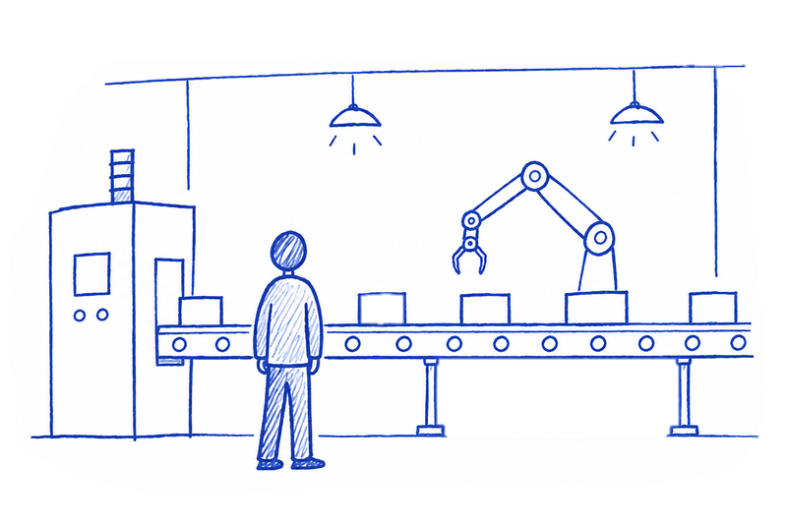
What is Automation?
Definition: technology performing tasks with minimal human intervention.
In practice: scripts and programs that run repetitive operations.
Goal: streamline workflows and improve efficiency.
Scope: any domain where routine or precision is required.
Notes:
Automation is the use of technology to perform tasks with minimal human intervention, in order to replace or augment human labor. In practice, this means writing scripts or programs that execute repetitive operations, streamline complex workflows, and improve overall efficiency. It is not limited to one domain — it is a foundational approach applicable wherever routine or precision is required.

Slide 3
A story
xxx: We had YYY (a build engineer) lured here. The guy lived strictly in the console and vim, drew diagrams with scripts in dot, wrote docs in wiki markdown, if something required more than 1.5 minutes he wrote a script. We're sitting here sorting out his legacy.
xxx: Some of the highlights
xxx: `smack-my-bitch-up.sh` - sends a text message "late at work" to his wife (apparently). Automatically picks reasons from an array of strings, randomly. Runs inside a cron-job. The job fires if there are active SSH-sessions on the server after 9pm with his login.
xxx: `kumar-asshole.sh` - scans the inbox for emails from "Kumar" (a DBA at our clients). Looks for keywords like "help", "trouble", "sorry" etc. If keywords are found - the script SSHes into the clients server and rolls back the staging database to the latest backup. Then sends a reply "no worries mate, be careful next time".
xxx: `hangover.sh` - another cron-job that is set to specific dates. Sends automated emails like "not feeling well/gonna work from home" etc. Adds a random "reason" from another predefined array of strings. Fires if there are no interactive sessions on the server at 8:45am.
xxx: (the first prize) `fuckingcoffee.sh` - this one waits exactly 17 seconds (!), then opens an SSH session to our coffee-machine (we had no frikin idea the coffee machine is on the network, runs linux and has SSHD up and running) and sends some weird gibberish to it. Looks binary. Turns out this thing starts brewing a mid-sized half-caf latte and waits another 24 (!) seconds before pouring it into a cup. The timing is exactly how long it takes to walk to the machine from the dudes desk.*

Slide 4

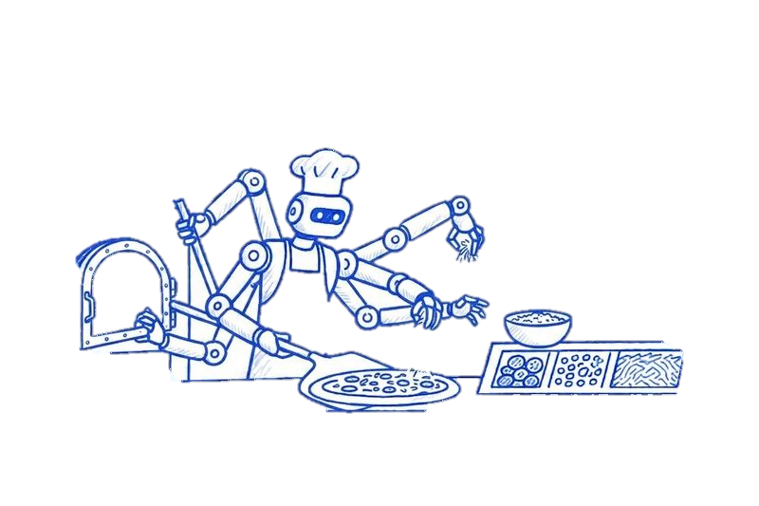
Where Automation Arises
The need appears when actions must be:
performed regularly
performed with accuracy
performed at scale
Examples:
making espresso, preparing a pizza
manufacturing bottles, launching a rocket
collecting data, building and deploying software
Notes:
The need for automation typically arises when a sequence of actions must be performed regularly, with accuracy, or at scale. You will find it in everyday and industrial contexts alike: making a cup of espresso, preparing a pizza, manufacturing plastic bottles, launching a space rocket, collecting data for analysis, and building, testing, and deploying software.

Slide 5

Automation in Practice
Most automation is implemented with:
automation scripts (small programs for specific tasks)
written in interpreted languages
Scripts can:
manage system resources
process files
interact with web services
Specialized tools add higher-level abstractions.
Notes:
In most cases, automation is implemented by writing automation scripts in interpreted languages. These are small programs designed to perform specific tasks such as managing system resources, processing files, or interacting with web services. Throughout this course, "automation script" and "script" are used interchangeably. Beyond scripts, specialized tools and frameworks provide higher-level abstractions for more complex, large-scale automation.

Slide 6

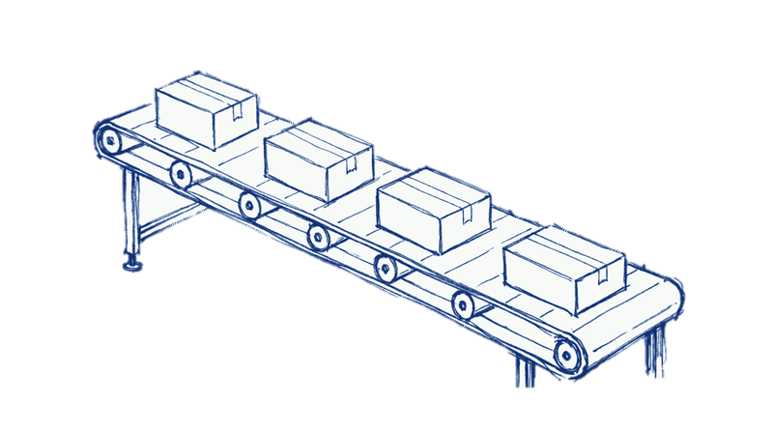
Areas of Automation Application
DevOps: deploy and maintain infrastructure
Testing: automate tests and ensure quality
Business processes: document flow, project management
Data analysis: automate collection and processing
System administration: routine tasks, user management
Notes:
Automation in IT spans a variety of domains, each with its own requirements and benefits. Key areas include DevOps for deploying and maintaining infrastructure, testing for automating tests and ensuring software quality, business processes for automating document flow and project management, data analysis for automating data collection and processing, and system administration for automating routine tasks and user management.

Slide 7

Advantages of Automation
Motivation: consistent, accurate, efficient execution.
Benefits:
increased efficiency and productivity
reduced human error
lower operational costs
improved consistency and quality
Result: a critical component of modern systems and workflows.
Notes:
The primary motivation for automation is to ensure that processes are executed consistently, accurately, and efficiently, especially for repetitive or large-scale tasks. By delegating such operations to automated systems, organizations and individuals achieve increased efficiency and productivity, reduced human error, lower operational costs, and improved consistency and quality. Consequently, automation becomes a critical component in developing and maintaining modern systems and workflows.

Slide 8

Overview of Scripting Languages
Designed for integration, flexibility, and ease of use.
CMD: command-line scripting for Windows
Bash: Unix shell and command language
PowerShell: Windows automation, .NET libraries, cmdlets
Python: high-level, known for readability
JavaScript: web development and cloud automation
Any interpreted language can be used for automation.
Notes:
Scripting languages are essential tools for implementing automation. They are designed for integration, flexibility, and ease of use. Commonly used languages include CMD for Windows command-line scripting, Bash as the Unix shell, PowerShell as a Windows automation framework that can use .NET libraries and cmdlets, Python for its readability, and JavaScript which is widely used in web development and increasingly in automation and cloud environments. While these are popular choices, any interpreted language can be used depending on the task.

Slide 9

Automation Tools
Provide interfaces, advanced features, and integration.
Ansible: IT automation using YAML
Jenkins: CI/CD for build, test, deploy
GitHub Actions: workflow automation in repositories
Terraform: infrastructure as code
Notes:
In addition to scripting languages, a variety of automation tools simplify and extend automation capabilities. Notable examples include Ansible, an IT automation tool that uses YAML to describe tasks; Jenkins, a continuous integration and delivery tool for automating the building, testing, and deployment of software; GitHub Actions, a workflow automation platform built into GitHub; and Terraform, an infrastructure-as-code tool for defining and provisioning infrastructure using configuration files.

Slide 10

What You Will Learn
A practical, real-world introduction to automation.
Bash and PowerShell for automation scripts
GitHub Actions for repository workflows
Jenkins for build and deployment automation
Primary OS for practical work: Linux (Ubuntu / Debian).
Notes:
This course provides a comprehensive introduction to automation, focusing on practical skills and real-world applications. You will learn to use Bash and PowerShell for writing automation scripts, GitHub Actions for automating workflows in repositories, and Jenkins for automating software build and deployment processes. By the end of the course, you will be equipped to design, implement, and manage automation solutions in a variety of IT contexts. The primary operating system for practical assignments will be Linux, specifically Ubuntu or Debian.

Slide 11

Thank You
Questions?
Notes:
That concludes our introduction to automation. Thank you for your attention — I would be happy to take any questions.

